Slide 1
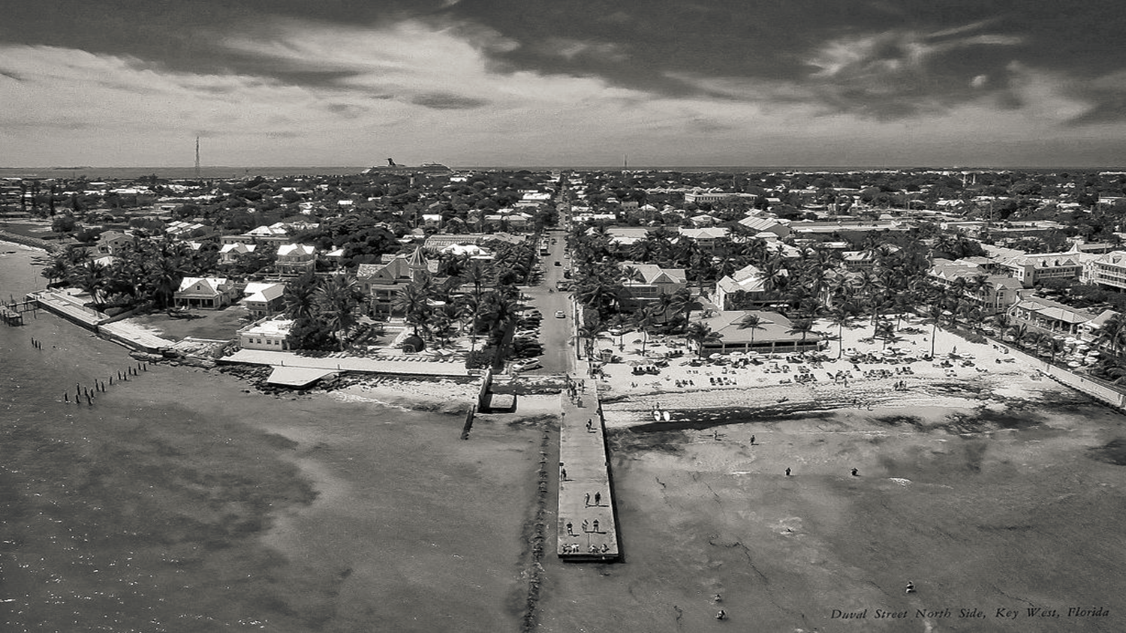
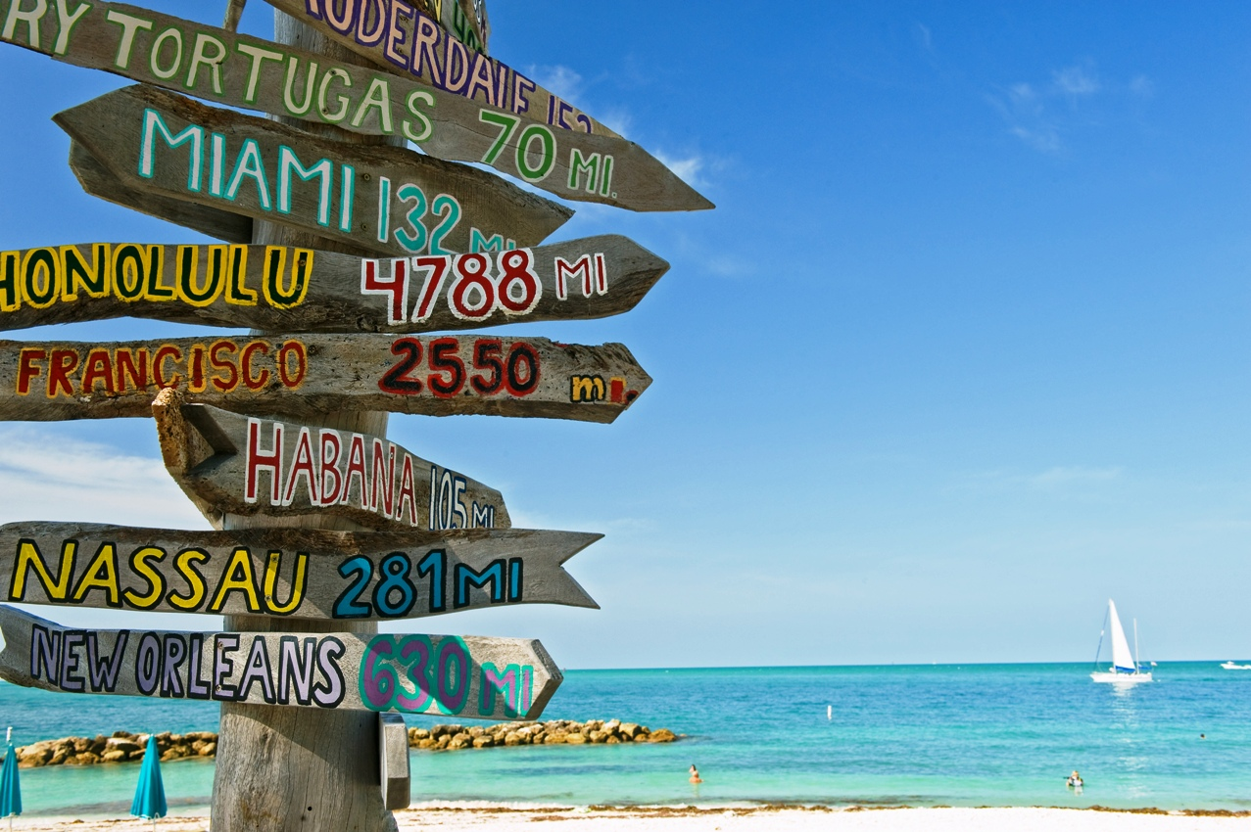
Key West
Key West
By: Amanda Chung, Albert Diaz, Beth Beals, Carlos Bejar, Morgan Brawner
Amanda Chung albert diaz beth Beals Carlos Bejar Morgan brawner

Slide 2
The Key West Comprehensive Plan
Focuses on Historic Preservation dating back to 1821, conserving the coastline and Florida’s natural ecosystems, promoting tourism and intergovernmental coordination for all transportation, land use, and development.

Slide 3
Future Land Use Element
Key West Land Use Objectives
Plan & Design for Residential Quality
Allocate sufficient land for commercial development
Ensure that needed public services, and facilities are developed concurrent with new development
Promote community appearance, national amenities and urban design principles
Implement water supply planning
Manage and coordinate future land use decisions
Protection of archaeological & historic resources
Protection of natural resources
Continuing land use programs
Continuing evaluation of land use element effectiveness

Slide 4
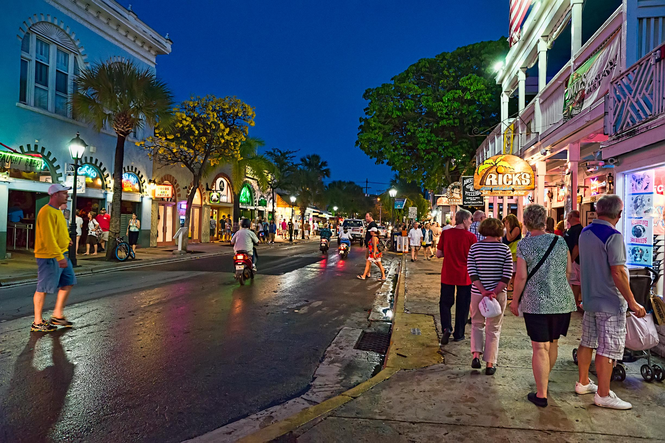
Managing building permit allocations (population growth)
Planned increases in evacuation capacities. Regulation in rate of growth also prevents further deterioration of public facilities.
Consider application of innovative land & water resource management, climate adaptation, and energy conservation concepts.
Adopting land development regulations that are unique to the city. (responsive to issues such as increased frequency of intense rainfall and sea level rise.)
Notes:
The city of Key west must continue to regulate population growth in order to maintain and improve hurricane evacuation clearance times.

Slide 5
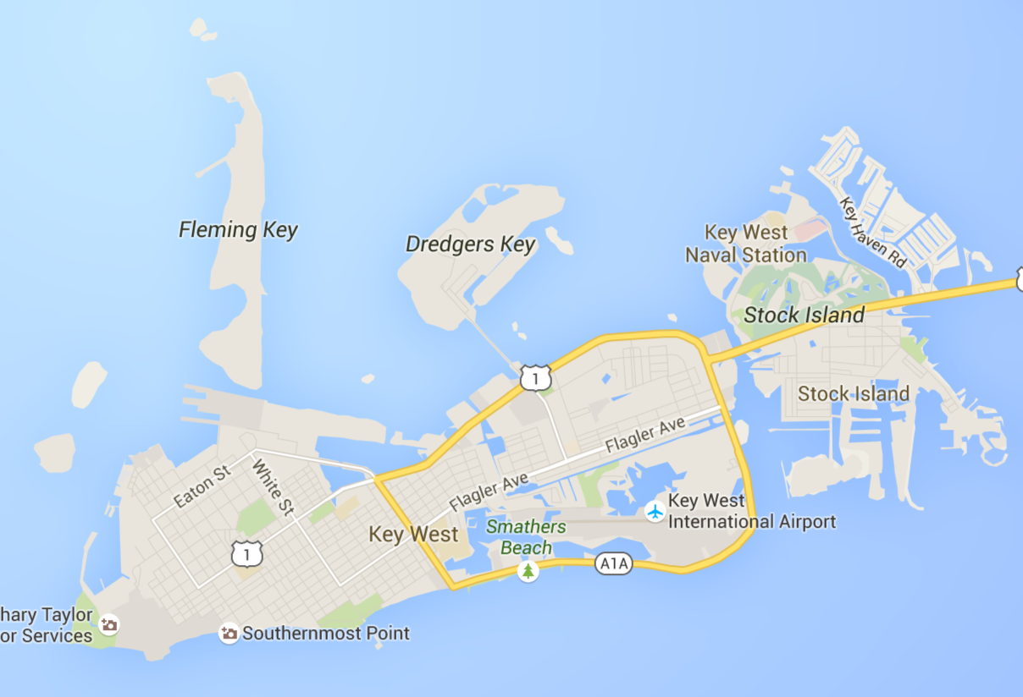
Integrate Former Military Sites
Providing: long term, sustained, economic growth.
Annexation Studies
To prevent Urban Sprawl, by 2017, the city of Key West will conduct an annexation study that analyzes the potential for incorporating Key Haven. By 2020 the city shall conduct another study for annexing South Stock Island.

Slide 6
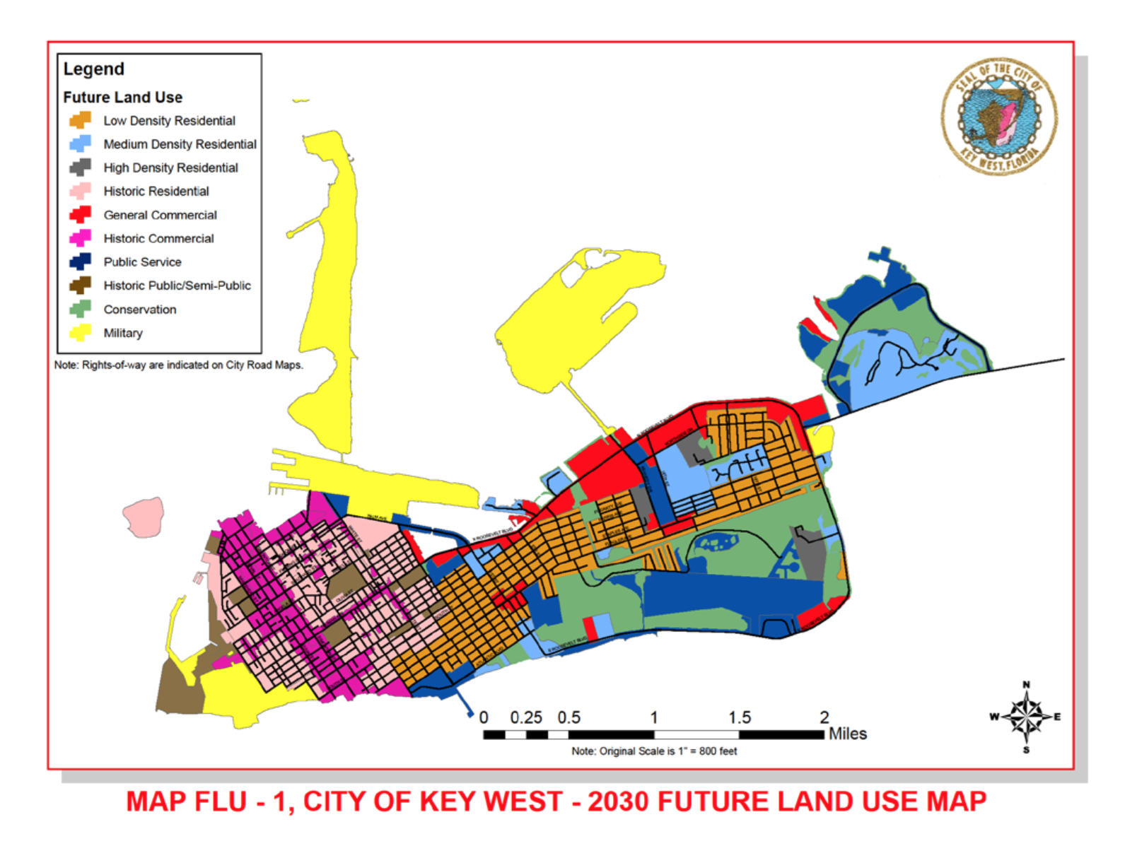

Slide 7
Transportation Element
Key West Objectives
Establish safe, convenient, and efficient motorized and non-motorized transportation systems.
Right of Way acquisition
Future roadway improvements
Reduction of the Urban heat island effect: The city will attempt to reduce this effect on roads, parking lots, bike lanes, and sidewalks by employing materials that are of lighter color and have higher reflectivity, and providing shade by enhanced landscaping.
Facilities for bicycle and pedestrian ways
Manage multimodal transportation and land use
Transportation and hurricane evacuation
The city shall direct transportation policies in accordance with the appropriate evacuation and emergency management plans.

Slide 8
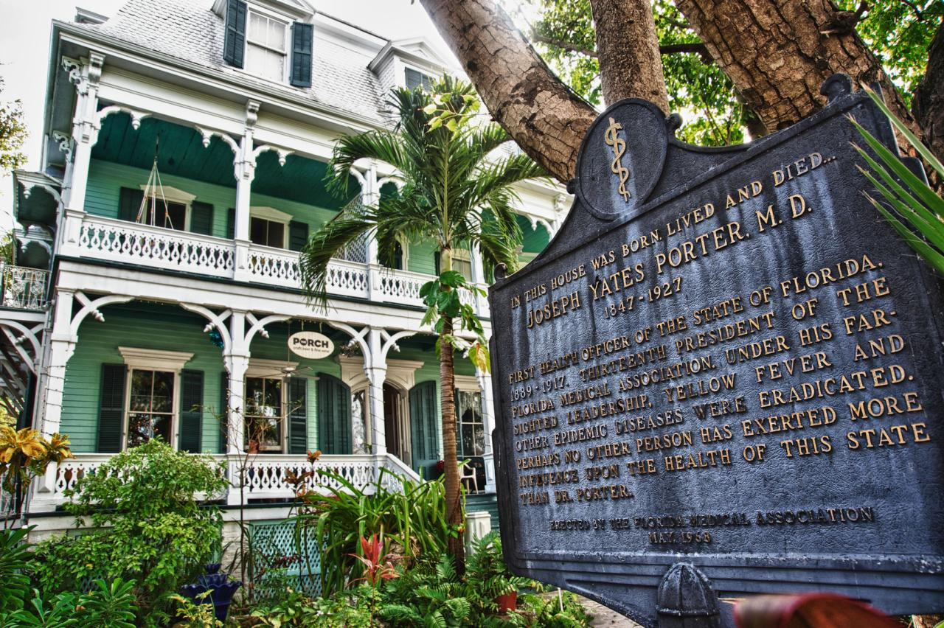
Historic Preservation

Slide 9
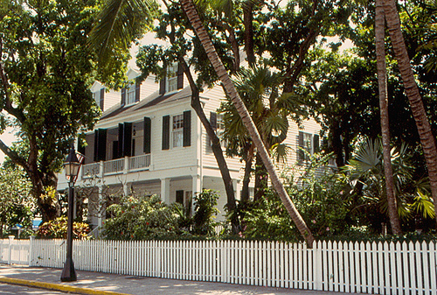
HARC
Historic Architectural Review Commission
Identify documents on the Master Site File
Evaluate historical, architectural and archeological
Place Historic and maritime resources on local and national register
Prepare HARC Reports

Slide 10
Highlights
Policy 1A-1.2.18: HARC Review of Military Base Reuse Plans
Objective 1A-2.1: Education and Awareness Program Initiatives
Policy 1A-5.1.4: Maintain Unique Architectural Heritage of Historically Significant Housing Resources
Policy 1A-2.1.9: Tourist Related Activities to Promote Preservation

Slide 11
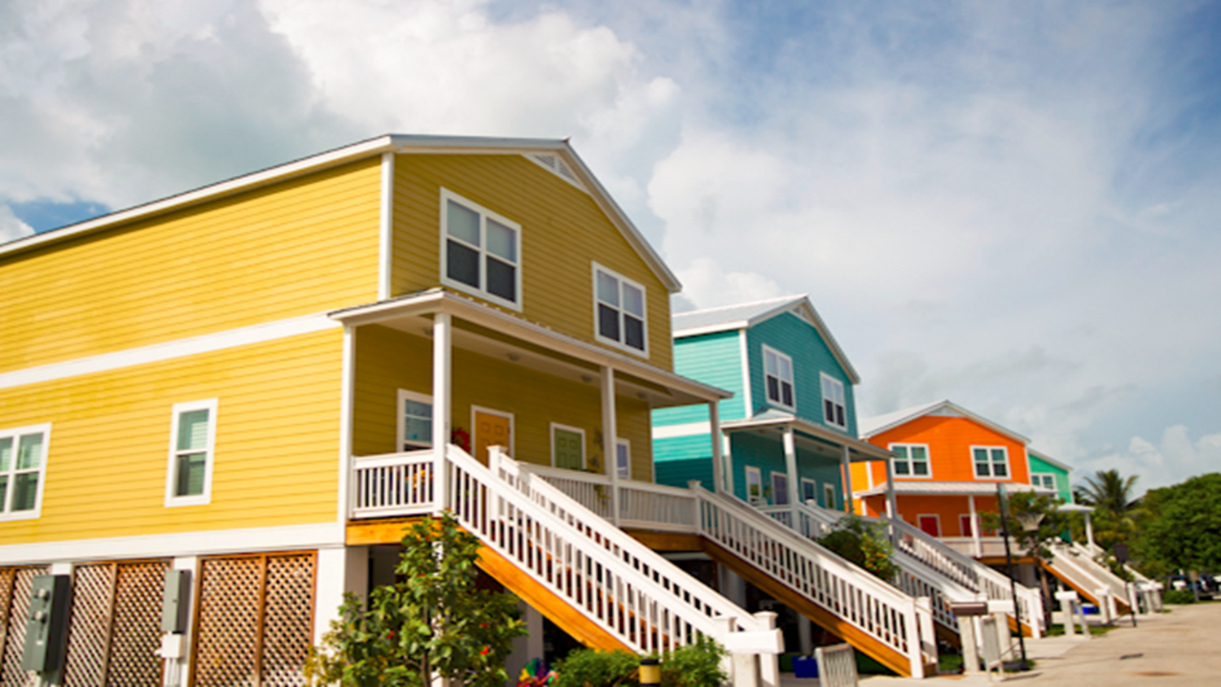
Housing Element
Housing

Slide 12
Key West Housing Authority
Provide technical assistance, information and referral services to the private sector
To maintain a housing production capacity sufficient to meet the projected housing
To advance fair housing and elimination of discrimination in housing
Promote best practices of land use planning, urban design, and landscaping

Slide 13
Highlights
Policy 3-1.1.10: Design Guidelines for Affordable Housing
Policy 3-1.5.4: Identification of Conservation, Rehabilitation or Demolition Activities, and Historically Significant Housing or Neighborhoods
Policy 3-1.7.7: Energy Saving Design and Construction Features
Policy 3-1.2.1: Elimination of Substandard Housing Conditions and Structural and Aesthetic Improvement of Housing

Slide 14
Public Facilities Element
Goal 4-1: Ensure Availability of Needed Public Facilities
Wastewater Treatment Standards:
The City’s Richard Heyman Environmental Protection Facility
dechlorination facilities
eutrophication of ocean waters by ocean outfall
Total Nitrogen Concentration: 6 mg/l
Total Phosphorus Concentration: 4 mg/l

Slide 15
Protect Natural Drainage Features
Ensure urban lands provide adequate drainage and protection from flooding and manage retention of ground and surface water levels
Promote aquifer recharge & enhance natural storage capacity
Requires all new development to integrate natural storage areas and drainage courses into their water management plans
Requires new development to provide buffer zones adjacent to natural drainage ways and retention areas
Optimize erosion control
Percolation and recharge of groundwater

Slide 16
Coastal Management Element
Goals:
Limit development activities that would potentially destroy coastal resources
Protect human life and spending in areas prone to natural disasters
Limit development in high-hazard areas
Increase pedestrian activities and waterfront access

Slide 17
Coastal Management Element
Objective 5-1.1:
Protect coastal resources, wetlands, estuarine salt pond environmental quality, living marine resources, and wildlife habitats by enforcing Land Development Regulations
Objective 5-1.3:
Land use controls and construction standards for protecting the natural shoreline and dune system
Objective 5-1.4 & 5-1.5 :
Limit and avoid public spending on development in coastal high-hazard areas
Decreasing large populations in high hazard areas, have a hurricane evacuation plan, post-disaster redevelopment, and intergovernmental coordination

Slide 18
Coastal Management Element
Land Development Regulations
Policy 5-1.1.1: Development Restrictions in Wetlands
Enforce a wetlands protection ordinance which restricts development in wetlands and transitional areas
This is supported by State and Federal Regulations
Policy 5-1.1.3: Protect, Stabilize, and Enhance the Coastal and Wetland Shorelines.
Enforce Land Development Regulations which stipulate that no native vegetation shall be removed from the coastal or wetland shoreline without a duly authorized permit.
Notes:
Impacts to be considered shall include: fish and wildlife habitat, Prevent degradation of water quality and estuaries, Manage surface water run-off, Protect living marine resources, including the near shore reef system; Reduce exposure to natural hazards
The reason it’s so important to conserve the wetlands is because they will protect key west against storm surges and erosion. Erosion=loss of land and they have what they have and that’s it. They have no more room for expansion

Slide 19
Coastal Management Element
Policy 5-1.2.2: Limit Impacts of Development and Redevelopment Upon Water Quality and Quantity, Wildlife Habitat and Living Marine Resources and Implement Policies for Shoreline Land Uses.
No development other than water dependent structures, native shoreline vegetation, elevated access ways, and other uses approved by the State
Notes:
Mangroves, Saw Grasses, and additional Rushes= coastal stabilization
For development the city of key west required shoreline set backs of 10-20 ft from highest tide. They encourages more natural shorelines versus concrete sea walls unless it was the last resort for stabilization on a property

Slide 20
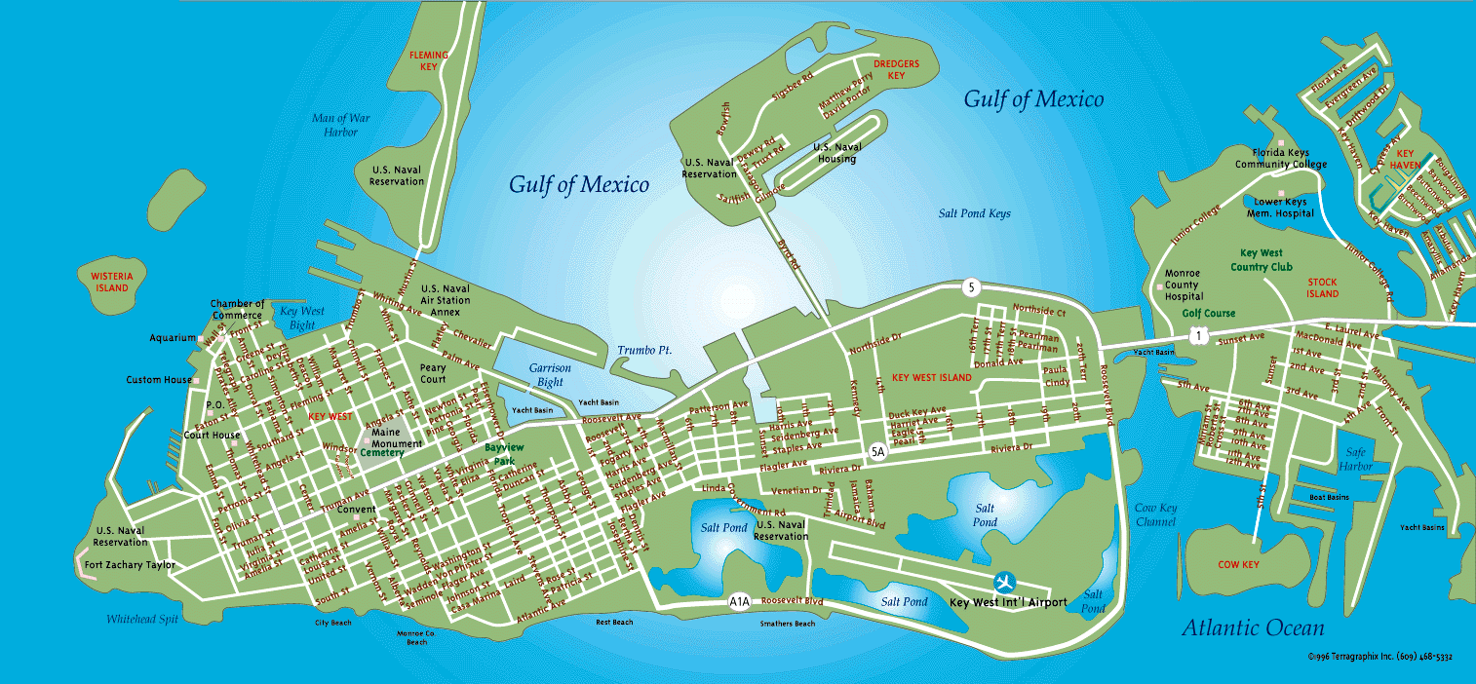
Coastal Management Element
Policy 5-1.3.2: Natural Shoreline and Beach/Dune Stabilization.
To protect natural rock outcrops which form most of the City's shoreline as well as the limited beach, shoreline development and access shall continue to be restricted in order to preserve the shoreline and the limited beach.

Slide 21
Coastal Management: Port Master Plan Element
Goal 5A-1: Port Facilities and Economic Development
Stimulate the local economy by providing port-of-call facilities to meet existing and future demand.
Goal 5A-3: Minimize Potential Adverse Land Use and Environmental Impact
Protect natural resources throughout expansion and existence of port
Notes:
This whole chapter was about budgeting for expansion and all the costs they would entail. It also covered the impacts of a larger port on the city keeping in mind the economy, traffic patterns, parking improvements

Slide 22
Coastal Management: Port Master Plan Element
Objective 5A-1.1: Maintain Port Contribution to Local Economy
Maintain port-of-call facilities to accommodate cruise ships
Generates an average of sixty dollars per passenger per day ($60.00/passenger/day) in retail sales to the City's economic base.
Evaluate economic impact (both positive and negative) on existing businesses and attractions in the City.

Slide 23
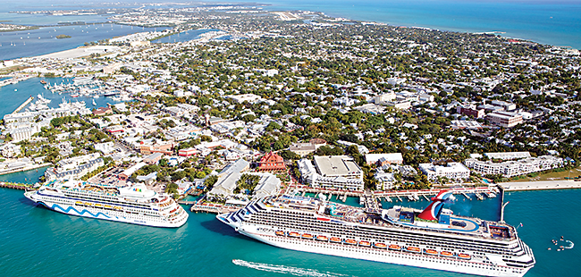
Key West Port
Port of Key West

Slide 24
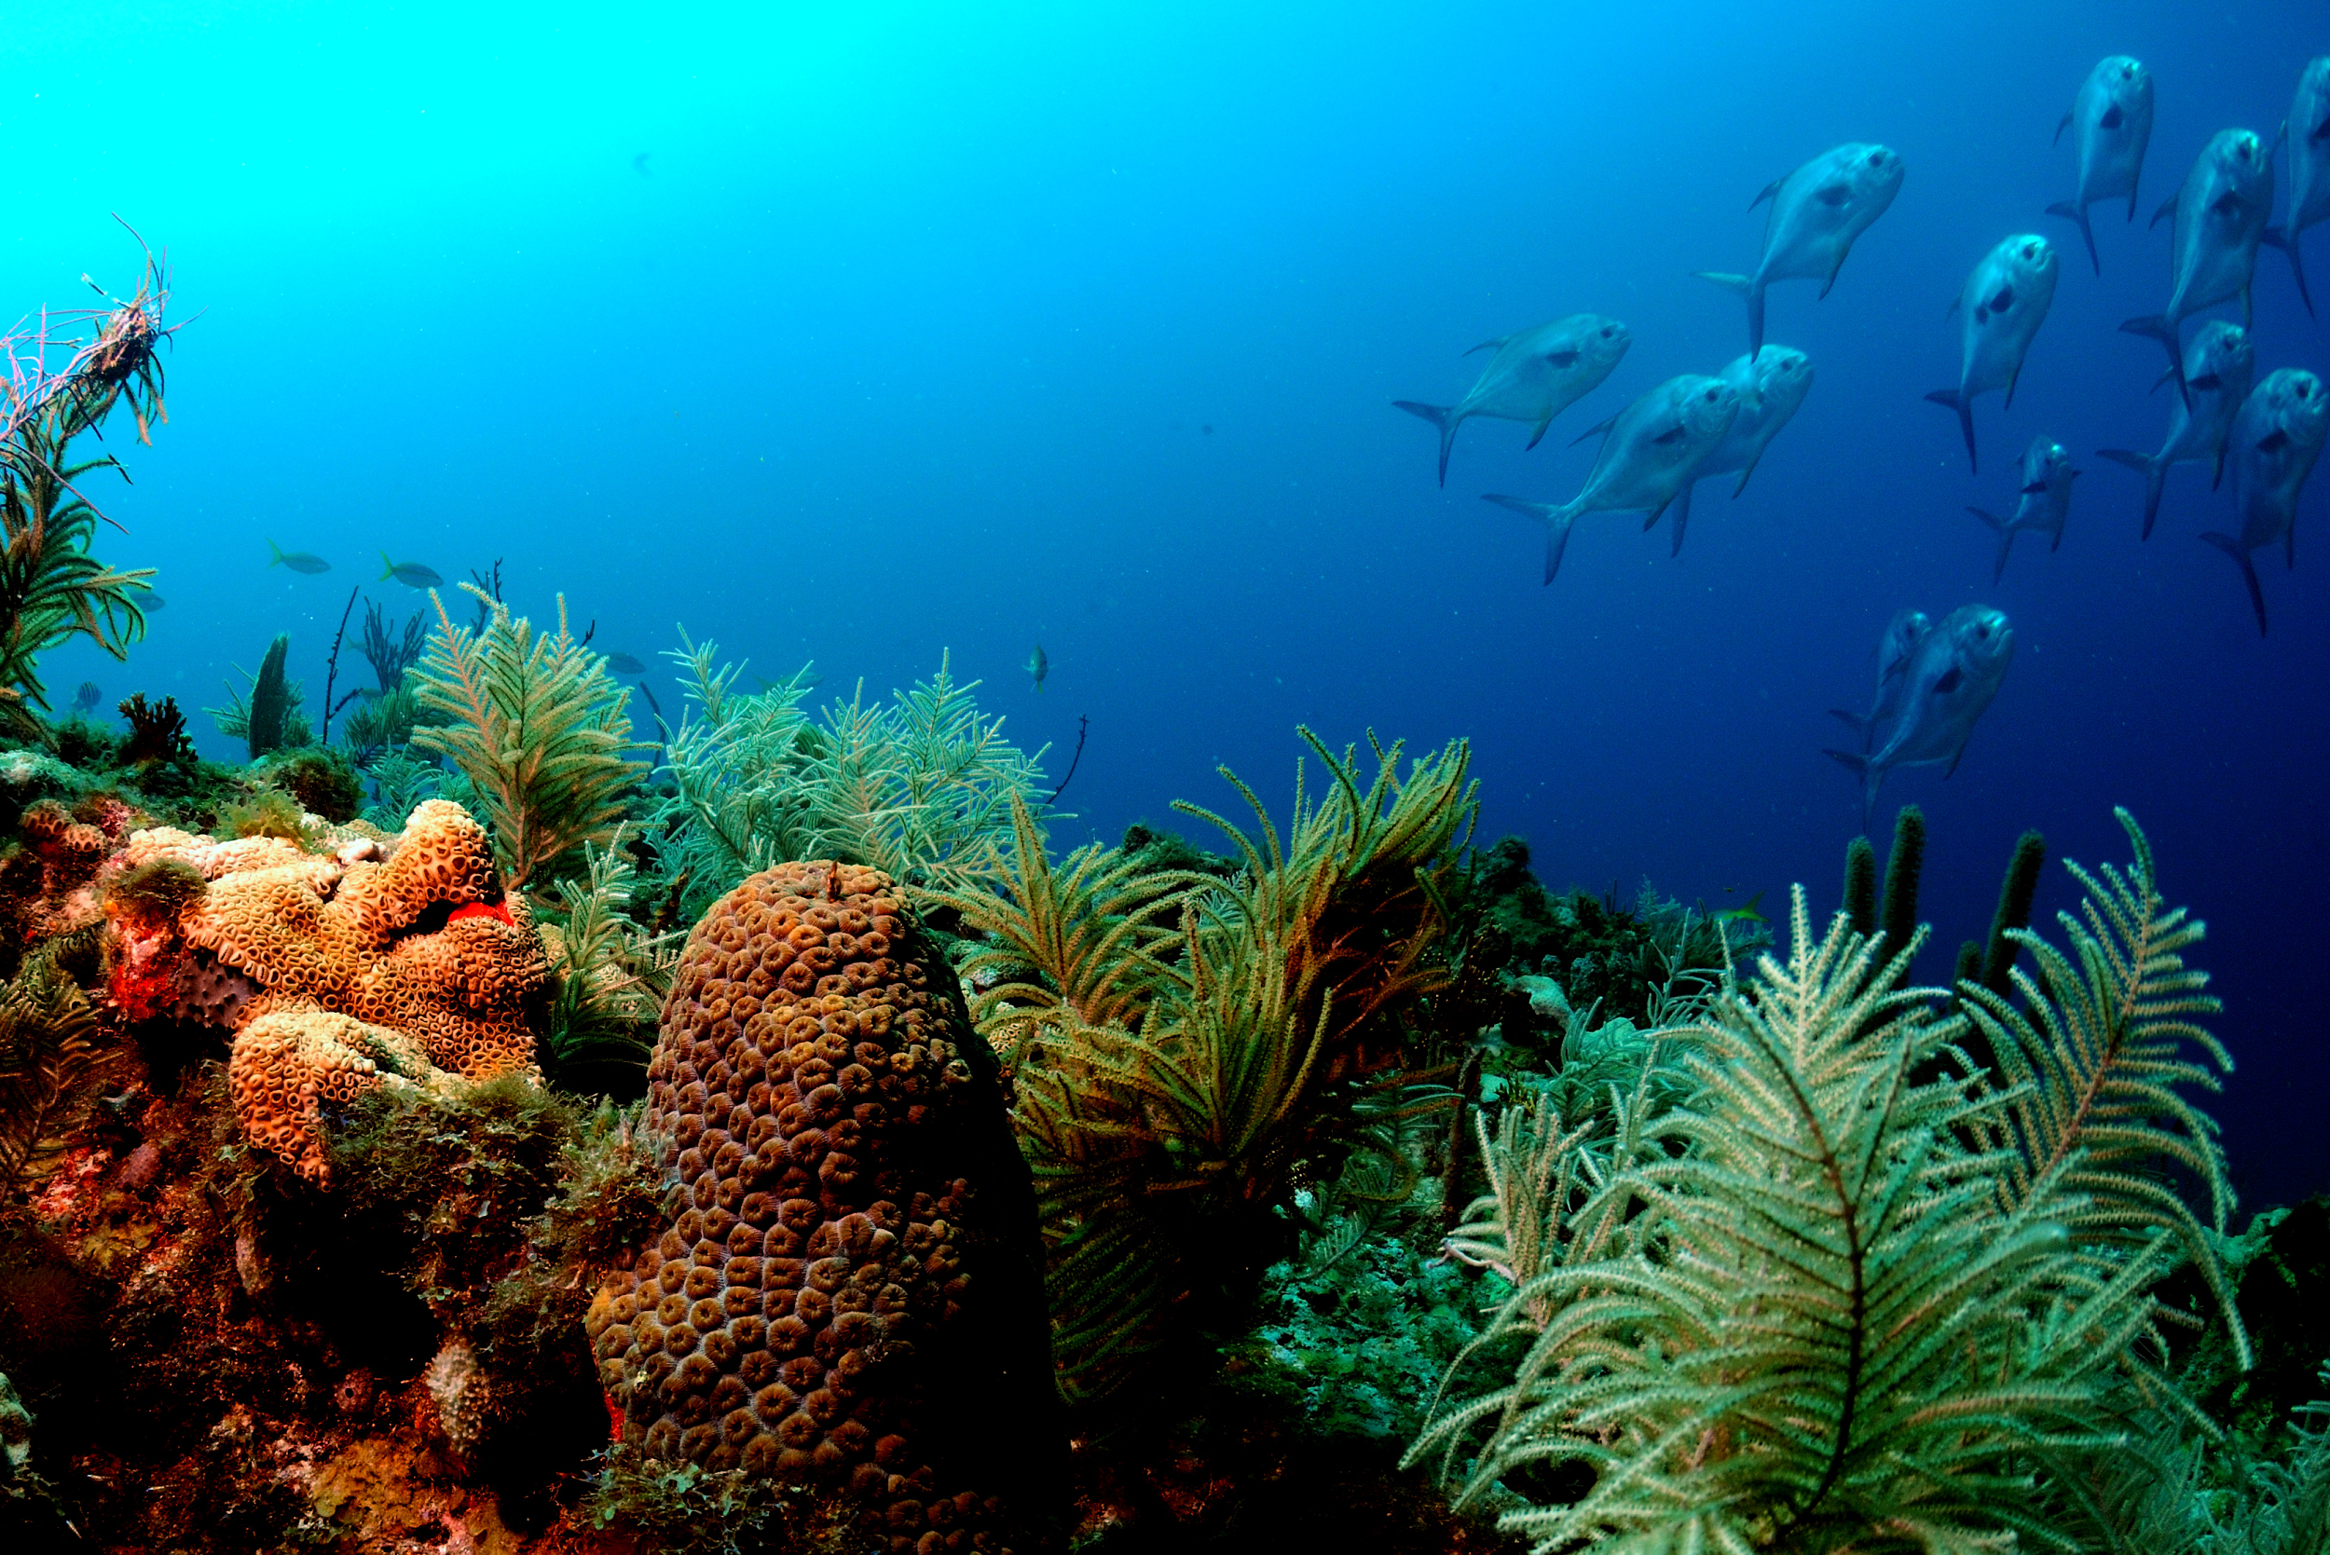
Conservation Element
Goal 6-1: Conservation “The coastal community of Key West shall conserve, protect, and appropriately manage the City’s natural coastal resources in order to enhance the quality of natural systems within the community.”
By 2015, reduce greenhouse gas emissions by 15% (City’s Climate Action Plan)
Maintain environmental health of Florida Keys Reef Tract
Preserve & enhance Atlantic Ocean, Gulf of Mexico and Canal Shorelines

Slide 25
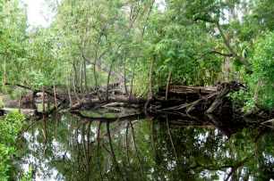
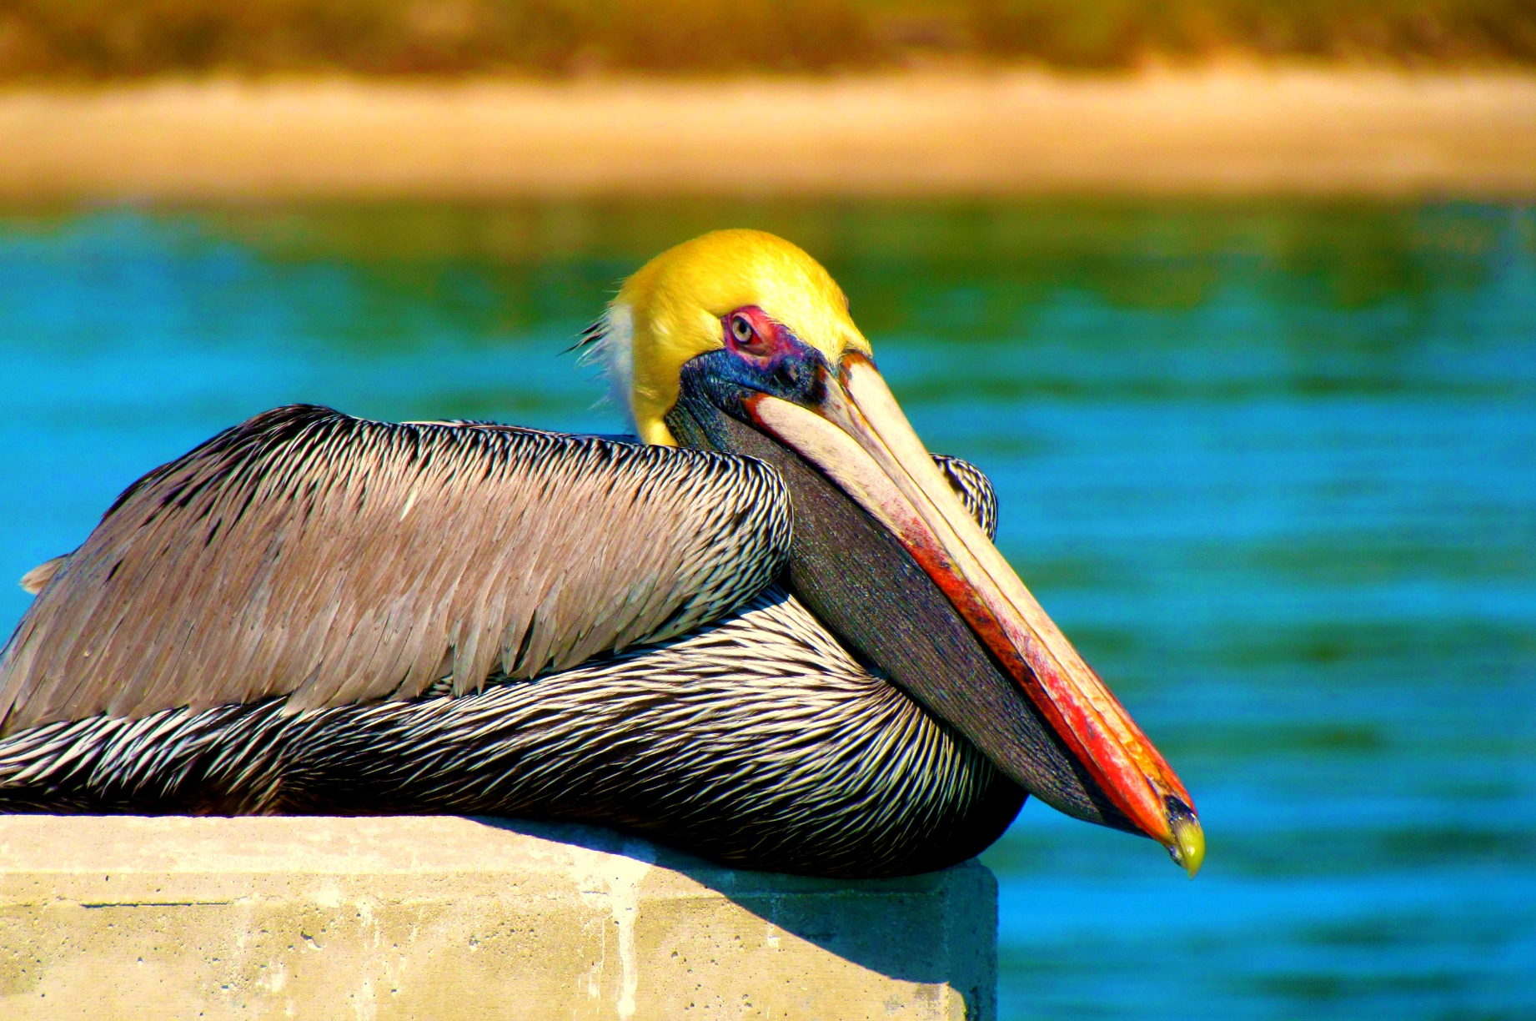
Preservation of Natural Key West
Policy 6.7.2: Preservation of Native Plant Communities
No development permitted on wetlands & at minimum must preserve 90% of hardwood hammocks
Policy 6-1.7.3: Removal of Undesirable Exotic Vegetation
Before the City will issue a certificate of occupancy for a new development, all nuisance and invasive exotic vegetation must be removed
Objective 6-1.8: Protecting Fisheries, Wildlife, and Wildlife Habitats
Prevent disturbance of seagrass beds, wetlands, mangroves, uplands, and other habitats of endangered or threatened species

Slide 26
Conservation of Water Supply
Policy 6-1.2.5: Protection and Conservation of Potable Water Supply Potable water cannot be used for irrigation if other sources are available
Encourage graywater and rainwater collection for irrigation
Require native plants and trees adapted to soil and climatic conditions existing on the subject site
Policy 6-1.2.11: Efficient Equipment and Appliances
Requires all new residential and commercial projects to use high efficiency toilets, showerheads, faucets, washers, dishwashers that are Energy Star Rated and WaterSense certified

Slide 27
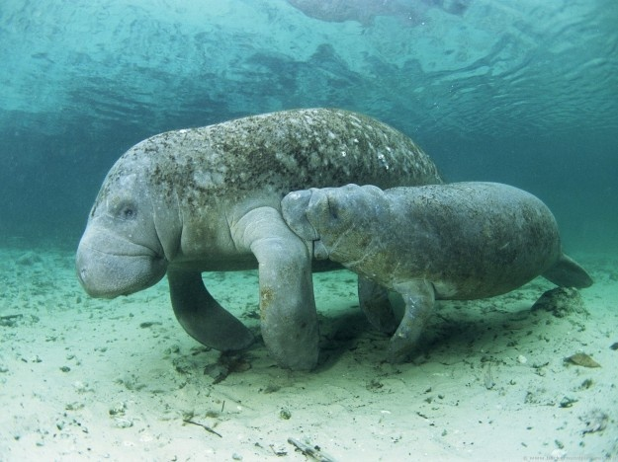
Protection of Manatees
Policy 6-1.7.4: Protection of Manatee Habitats
Area-specific manatee protection plan & marina sighting plan
Dock permits directed to locations with quick access to deep, open water outside of areas with high manatee concentration
Slow or idle speed zones
Aquatic plant management & manatee food requirements

Slide 28
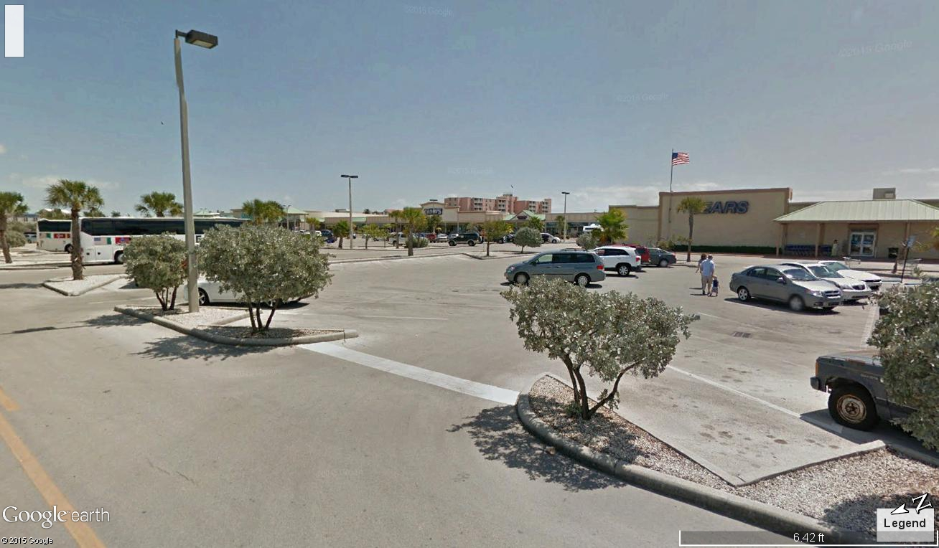

Slide 29
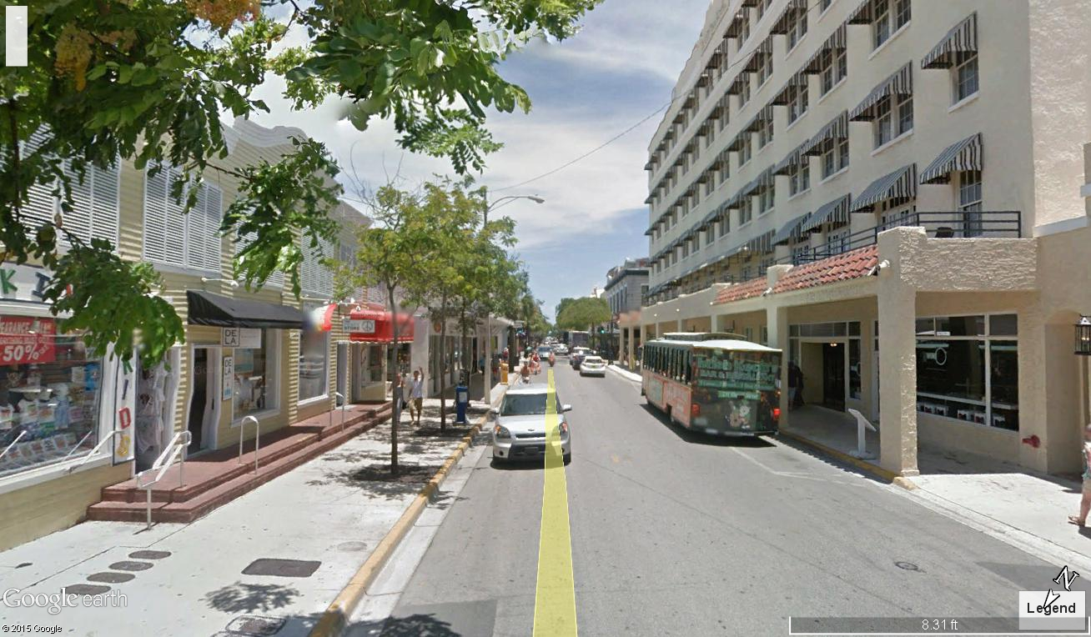

Slide 30
