Slide 1
Community Assessment and Windshield Survey for Daytona Beach, Florida
Group B: Monica Cavallero, Samantha Conley, Megan Cossart, Ashley Jenkins, Karolina Seaman and Darryl Wiseman

Slide 2
Part 1: The People

Slide 3
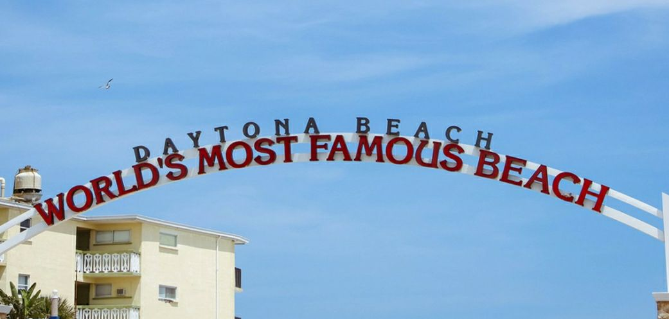
Daytona Beach
Daytona Beach is a spring break destination that offers 23 miles of sandy beaches with opportunities to swim, surf and some drive on beach locations.
Another attraction located on the beach is the scenic amphitheater. The amphitheater offers free live music and concerts which can accommodate up to 5,000 people who wish to overlook the Atlantic Ocean while listening to music.
Other experiences for which Daytona Beach is known for is for the Daytona-500. Daytona Beach is home to the Daytona International Speedway complex, also known as “The World Center of Racing”. The complex recently underwent a 400 million dollar renovation that included upgrades to luxury suites, larger seats and cool spots.

Slide 4
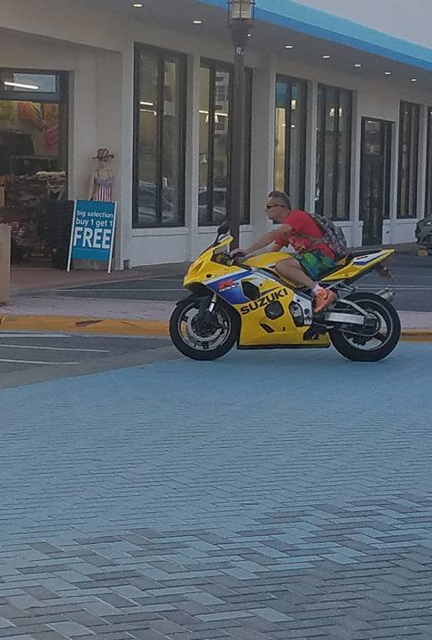
People in Daytona
The 2016 Daytona Beach, Florida, population is 64,736. There are 1,108 people per square mile (population density).
The median age is 40.6. The US median is 37.4. 32.44% of people in Daytona Beach, Florida, are married. 14.98% are divorced.
The average household size is 2.24 people. 12.79% of people are married, with children. 25.09% have children, but are single.
52.92% of people are white, 33.68% are black, 2.86% are Asian, 0.12% are Native American, and 0.67% claim 'Other'.
7.72% of the people in Daytona Beach, Florida, claim Hispanic ethnicity (meaning 92.28% are non-Hispanic).
(Sperlings, 2017)
Part of Daytona Beach's population

Slide 5
Population Characteristics of Daytona Beach
Total Population (2015): 62,726
Median Age (2015): 41
Population by Gender (2014): Males 49.2%, Females 50.8%
Median Household Income: $27,901(Daytona), $41,117(Daytona), $53,889 (USA)
Average Property Value (2015): $112,000
(Data USA, n.d.)

Slide 6
Population of Daytona Beach, Florida based on Race/Ethnicity
White: 33,255
African American: 21,873
Hispanic: 4,485
Asian: 1,403
Multiracial: 1,243
Other: 369
Native American: 99
Hawaiian: 19
(Data USA, n.d.)

Slide 7
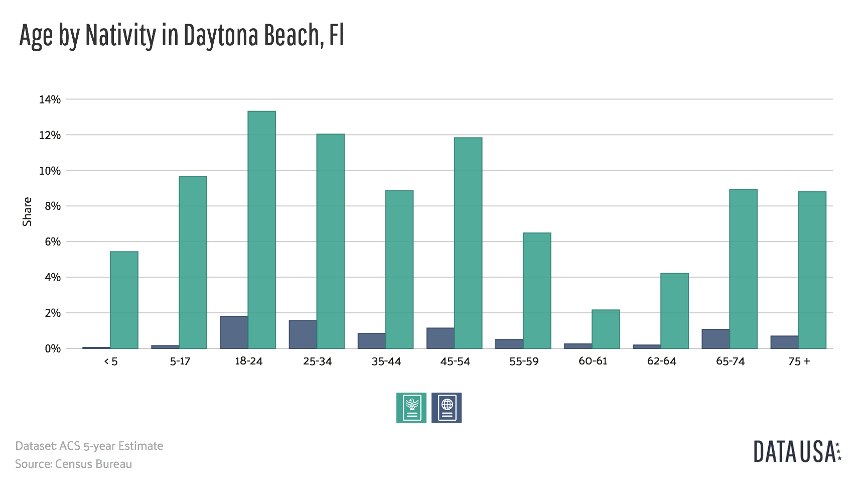
Population of Daytona Beach Based on Age
Green symbolizes native born, Blue symbolizes foreign born
(Data USA, n.d.)

Slide 8
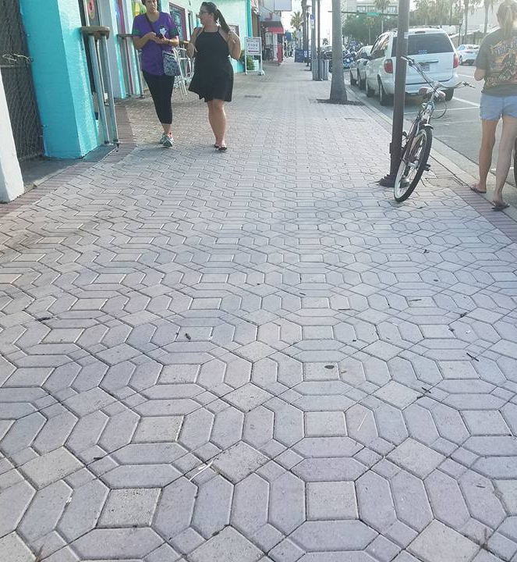
People on the street
During 2013 survey, there were 1,483 unsheltered homeless people living in Daytona Beach. This does not include 500 people living in emergency or transitional shelters.
22% of unsheltered population in Daytona are Veterans
19% of unsheltered homeless suffer from chronic substance abuse
42 children under the age of 18 were living unsheltered on the streets
71 included in the population count of unsheltered were severely mentally ill.
(Willis, 2014)
People walking down a street in Daytona Beach

Slide 9
Socioeconomical Data: Poverty
Poverty: 31.7% live in poverty in Daytona, FL.
Female ages 18-24 are the largest demographic living in poverty.
Poverty by race in Daytona, FL:
-African Americans: 9,165 people
-White: 7,753 people
-Hispanic: 1,770
(Data USA, n.d.)

Slide 10
Socioeconomical Data: Occupation
Highest paid jobs in Daytona, FL:
- Health practitioners ~61,937.80 yearly
-Management ~54,205.40 yearly
-Architecture ~ 53, 301.60 yearly
-Computer/ Mathematical ~48,593 yearly
Most common jobs held in Daytona, FL: administrative sales and food/ serving industry.
(Data USA, n.d.)
Lowest paid jobs in Daytona, FL:
-Cleaning/maintenance ~17,650.10 yearly
-Personal Care Services ~17,502.20 yearly
-Sales ~16,094,40 yearly
-Law Enforcement ~13,942.90 yearly
- Food and Serving ~13,382.58 yearly
People employed in 2014 in Daytona: 23,391
People employed in 2015 in Daytona: 24,258
(Data USA, n.d.)

Slide 11
Part 2: Community

Slide 12
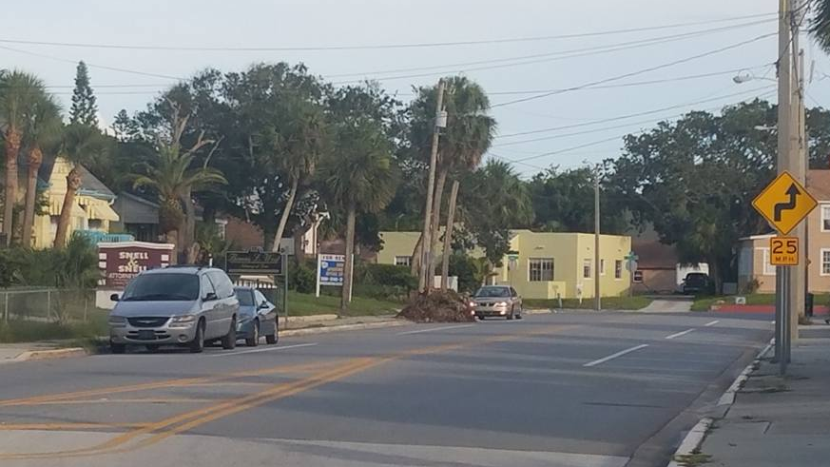
Community Boundaries
Daytona Beach is located within Volusia County.
The primary coordinates are latitude 29.1901 and longitude -81.0894.
The city of Daytona Beach encompasses a land area of 58.41 sq. miles and a water area of 5.36 sq. miles.
Neighboring cities/communities include Holly Hill, Daytona Beach Shores, Ormond Beach, Port Orange and Deland.
Daytona Beach is comprised of a mixture of residential and commercial zones.
(FL HometownLocator, 2016)
A typical street in Daytona Beach showing a mixture of residential and commercial properties

Slide 13
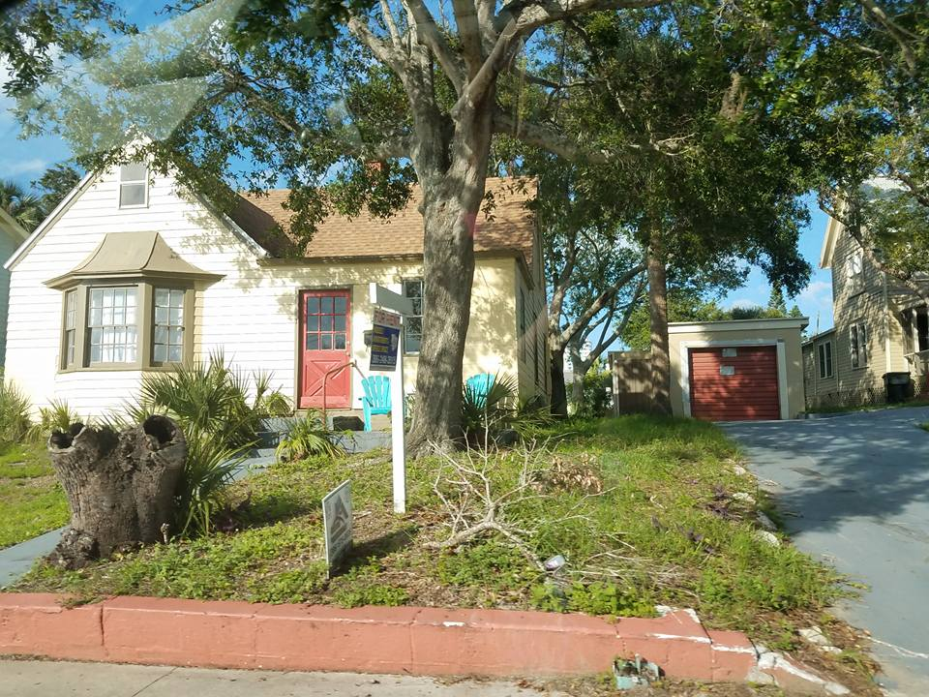
Housing/Signs of Decay and Growth
The average home in Daytona Beach is 37 years old.
The majority of the homes in Daytona Beach were built between 1970-1979 (20.1%) or between 1980-1989 (19.7%).
Only 0.7% of the homes are newer - built in or after 2010.
The average home value in Daytona Beach is $110,000.
Home appreciation is down -29.01% over the last 10 years.
Home ownership accounts for 33.91% vs. home rentals account for 38.54%.
27.55% of homes and apartments are vacant properties.
(Sperling, 2017a)
Home ”For Rent” in Daytona Beach (June 2017)

Slide 14
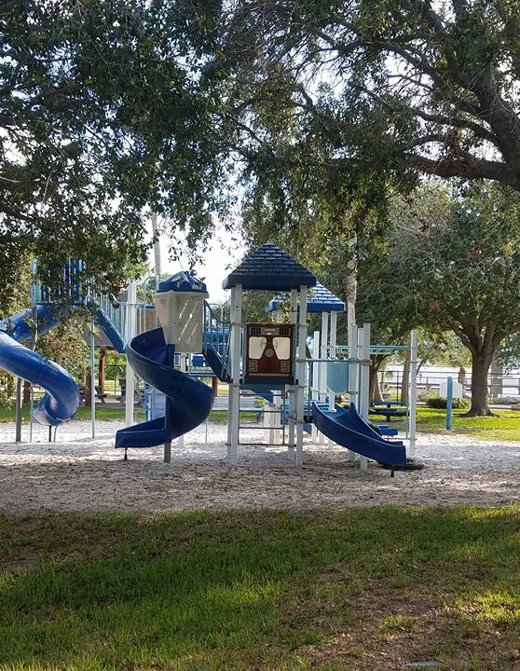
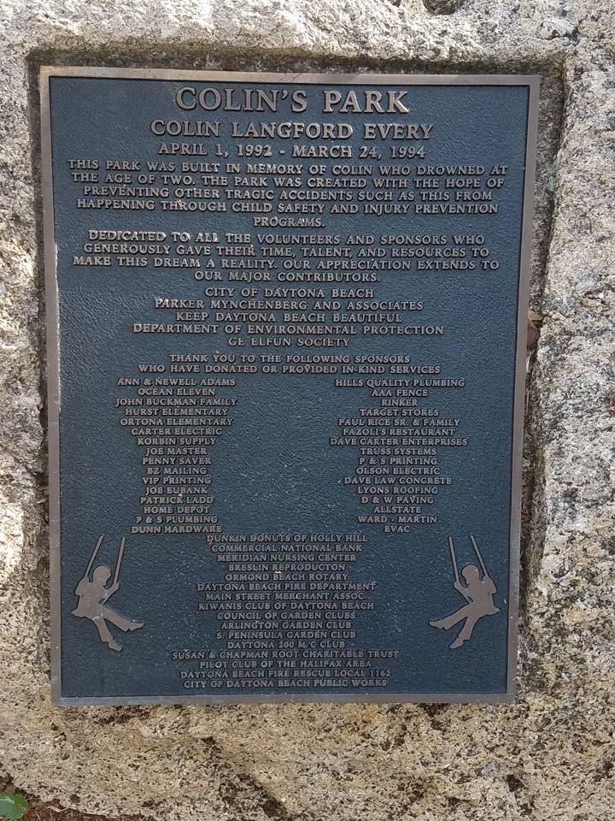
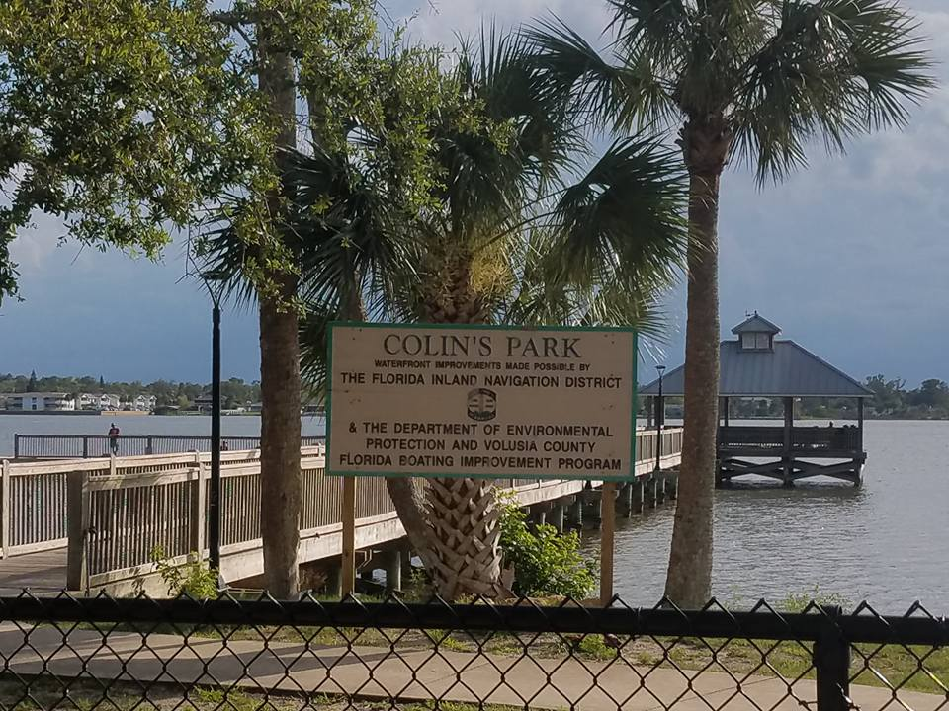
Parks/Recreations/Community Common Areas
Colin's Park, Daytona Beach
The most prominent open space in Daytona Beach is the public beach which stretches 23 miles across.
Daytona Beach is known as the "World's Most Famous Beach" and allows vehicles to be driven across its hard-packed sand in designated areas.
The Daytona Beach Pier has been the very center of the Daytona Beach since the beginning of this community.
Fishing off the pier is free and does not require a fishing license.
From Memorial Day until Labor Day, fireworks are launched off the pier every Saturday at 9:45pm for all to enjoy.
The pier is located on the Daytona Beach boardwalk which is a free public area home to an amusement park, arcades, several restaurants, shops and the Bandshell.
The Bandshell hosts free concerts every Saturday night prior to the fireworks show.
The city of Daytona Beach has a total of 51 public parks, recreation and community areas.
Colin's Park in Daytona Beach is located behind Fire Station # 3and it was built in honor and remembrance of Colin Every, the son of a local firefighter/paramedic. Colin tragically drowned in March 1994.
The park has a children's playground, a fishing dock and open space for group activities.
Several land and water safety programs are offered free of charge to the community by the firefighters and paramedics of Daytona Beach.
Colin's Park also has a strong focus on encouraging recycling. This theme is seen throughout Daytona Beach.
Boaters can enjoy miles of the Intercoastal Waterway and Halifax River with many free public docks located throughout the city.
(Volusia County Florida, n.d.; City of Daytona Beach, n.d.)

Slide 15
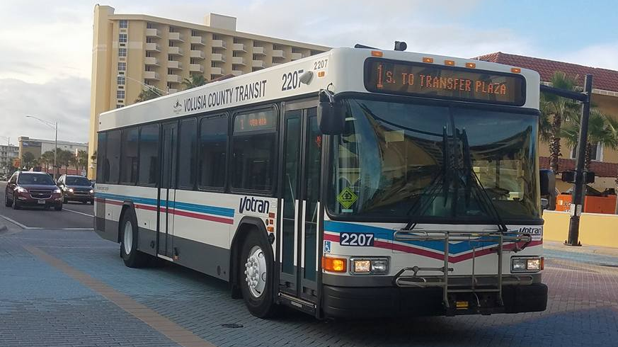
Transportation
Votran is consider the public transportation service of Daytona which allows access to shopping, employment, healthcare and entertainment in the Volusia County Area.
Bus fares:
$1.75 for adults
85 cents for senior citizens over 65 years-old/youth ages 7 to 18 years-old and people with disability
children under the age of 7 who is riding with an adult is free.
For bus passes the cost varies but for adults passes cost the following:
All day pass is $3.75
3-day pass $7.50
7-day pass $13.00
31-day pass $46.00
Reduce fare rates are available for senior citizens, children age 7 to 18 years-old and people with disabilities.
Passes can be bought throughout Volusia County, locations include:
Deltona Regional Public Library
Edgewater Public Library
New Smyrna Beach Regional Library
Ormond beach Regional Library
Thomas C. Kelly Administration Center
Volusia County Council on Aging
Votran administrative offices
Votran transfer plaza
Passes can also be purchased online at https://www.payment-express.net/pub/volusia/VOTRAN/pos/item_list
(Votran, 2013)
Votran Bus that runs through Daytona

Slide 16
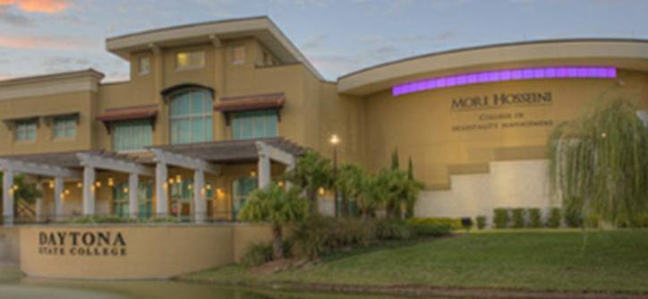
Education
Daytona is part of Volusia County's tenth largest school district in the state. There are over 40 schools in Daytona Beach, Florida. Daytona schools are part of Florida's Healthy School District recognition. This approach consists of Health education, physical education, health services, nutrition services and education, counseling and social services, healthy school environment, health promotion for staff, and parent and community involvement.
Top Rated Schools in Daytona:
David C Hinson Sr Middle school (public 6-8)
Seabreeze High school (public 9-12)
R.J. Longstreet Elementary school (public PK-5)
South Daytona Elementary school (public PK-5)
Colleges in Daytona:
Bethune Cookman College
Daytona State College
Embry Riddle Aeronautical University
Keiser University
(The Florida Department of Education, Volusia County School District, 2017)
Daytona State College

Slide 17
Education Continued
Most common degrees earned:
General Aeronautics & Aerospace Science and Technology: 1,160 degree awarded in 2015. (33.6%)
General Business Administration and Management: 453 degrees earned in 2015. (13.1%)
Business Administration, Management and Operations: 427 degrees earned in 2015. (12.4%)
Largest universities in Daytona, Florida
Daytona State College: 4,262 degrees awarded in 2015
Embry Riddle Aeronautical University: 3,384 degrees awarded in 2015
(Data USA, n.d.)

Slide 18
Protective Services and Crime Rates
Child Protective Investigation
Delta Security Protective Services
Allegiance Security Group
Community partnership for children
American Protective Systems
Area wide protective (AWP)
Children's Advocacy Center
Protective Solutions
(Florida Department of Children and Families, 2014)
Statistic | Reported | Daytona Beach/100k | Florida /100k | National/100k
Murder | 10 | 15.7 | 5.1 | 4.9
Rape | 52 | 81.9 | 37.3 | 38.6
Robbery | 147 | 231.5 | 104.3 | 101.9
Assault | 779 | 1,226.7 | 315.2 | 237.8
Burglary | 556 | 875.5 | 539.0 | 491.4
Theft | 3,226 | 5,079.9 | 2,073.6 | 1,775.4
Vehicle theft | 398 | 626.7 | 200.6 | 220.2
(FBI Crime Reports, 2015)

Slide 19
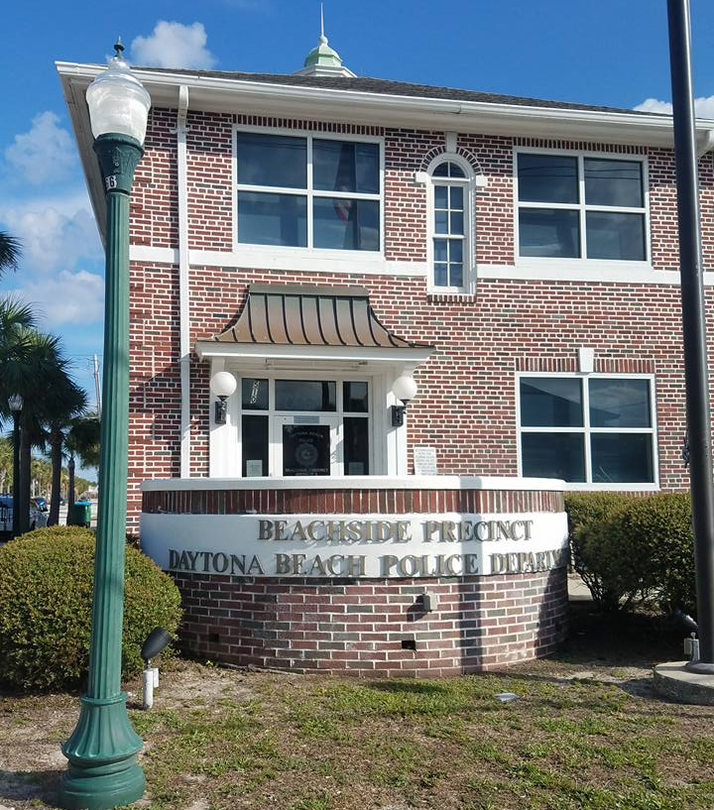
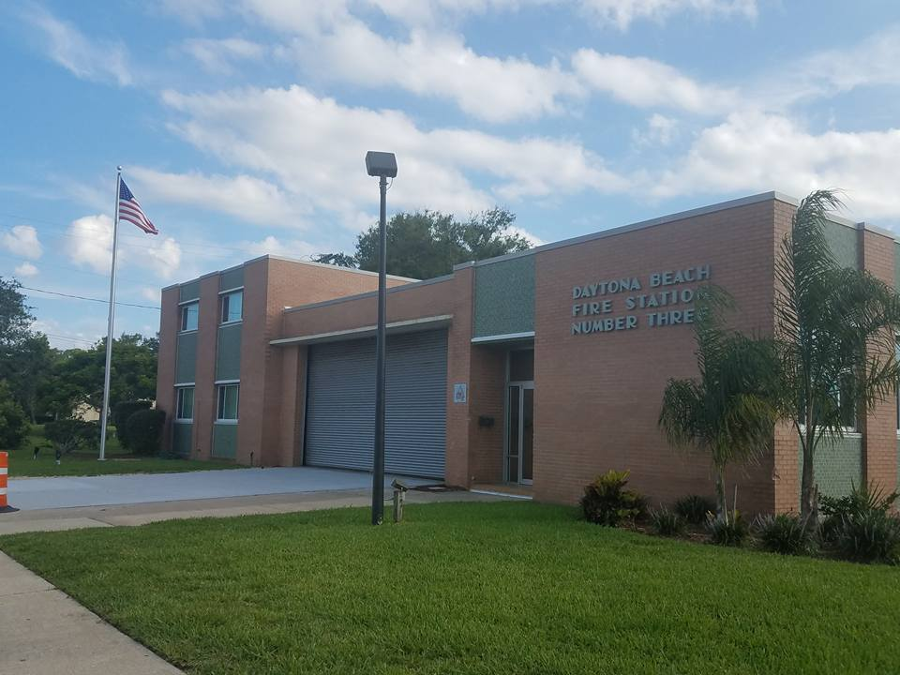
Protective Services and Crime Rates
Beachside Precinct Daytona Beach Police Department
Daytona Beach Fire Station Number Three

Slide 20
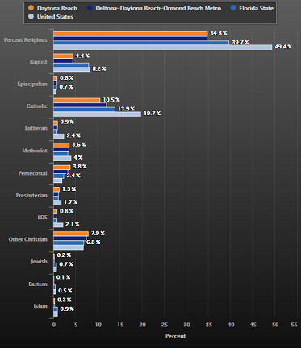
Religion
34.76% of people in Daytona Beach are affiliated with a religion.
Organized religion in Daytona Beach (%):
Baptist: 4.4
Episcopalian: 0.8
Catholic: 10.5
Lutheran: 0.9
Methodist: 3.6
Pentecostal: 3.8
Presbyterian: 1.3
LDS: 0.8
Other Christian: 7.9
Jewish: 0.2
Eastern: 0.1
Islam: 0.3
(Sperling, 2017b)

Slide 21
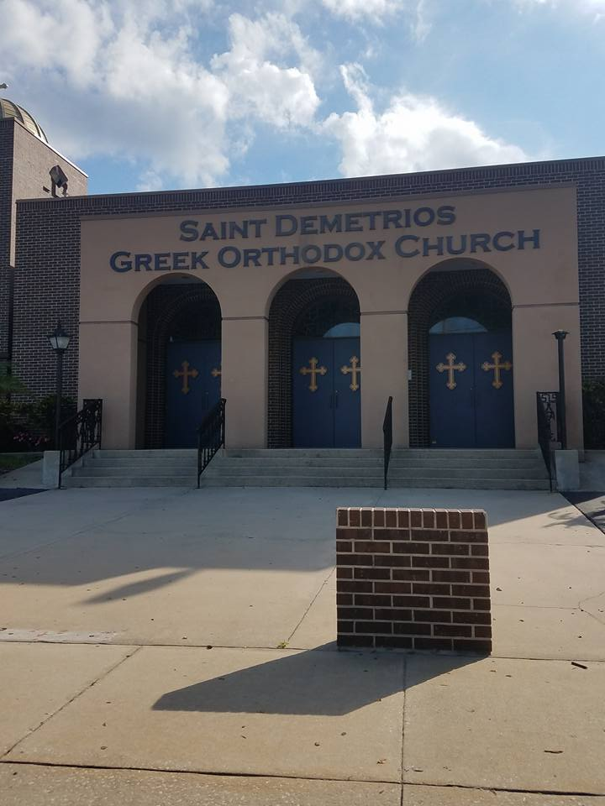
Religion
Local Catholic Church in Daytona Beach
Local Greek Orthodox Church in Daytona Beach

Slide 22
Politics
The Daytona Beach, Fl City Commission includes 7 elected officials- the mayor and 6 zone commissioners
-Each serves a four-year term
-Elections are staggered on even-numbered years
Members of the City Commission include:
-Derrick L. Henry, Mayor
-Ruth Trager, Commissioner, Zone 1
-Aaron Delgado, Commissioner, Zone 2
-Kelly White, Commissioner, Zone 3
-Robert A. Gilliland, Commissioner, Zone 4
-Dannette Henry, Commissioner, Zone 5
-Paula R. Reed, Commissioner, Zone 6
(City of Daytona Beach, n.d.)

Slide 23
Part 3: Healthcare

Slide 24
Healthcare Providers
Daytona offers two major hospital organizations, Florida Hospital and Halifax.
Florida Hospital Memorial Medical Center has a capacity of 293 beds, with more than 400 physicians holding privileges throughout the Florida Hospital organization and employing more than 1,700 team members at this location.
Specialties include cardiology, oncology, emergency care, surgical services, obstetrics, neurosurgery, stroke care, rehabilitation, weight-loss surgery, imaging, laboratory, home health, wound care, diabetes, hospice, physician practices and women’s services.
Halifax Health Medical Center has a variety of locations spread throughout Daytona. Halifax offers the area’s only level II trauma center, comprehensive stroke center, neonatal and pediatric intensive care units, pediatric emergency department, child and adolescent behavioral services, complete neurosurgical services and OB emergency department
(Florida Hospital, n.d.; Halifax Helath, 2017)

Slide 25
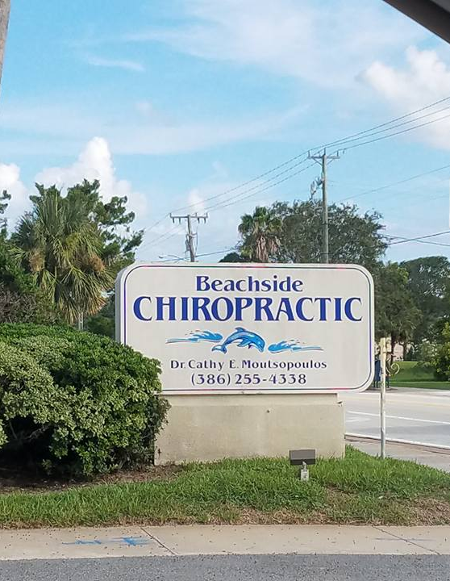
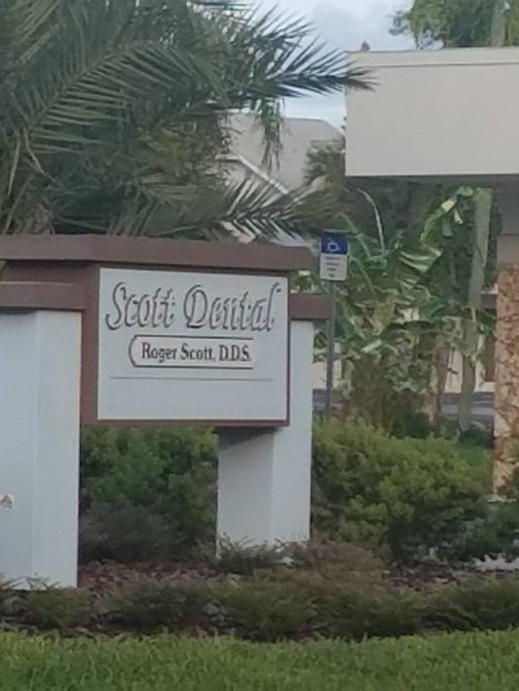
Healthcare Providers Continued
Local Chiropractic Office in Daytona Beach
As a community, a survey was completed with one of the following questions being asked: What health care services are difficult to obtain in your community? The response is ranked as most difficult to obtain to least.
Mental health/counseling, substance abuse services, alternative therapy, dental care, special care (i.e. cardiology), primary care, medical supplies, preventive care, vision care, family planning/birth control, rehab therapy, emergency care, prenatal, inpatient hospitals
(Florida Health, 2016)
Local Dental Provider in Daytona Beach

Slide 26
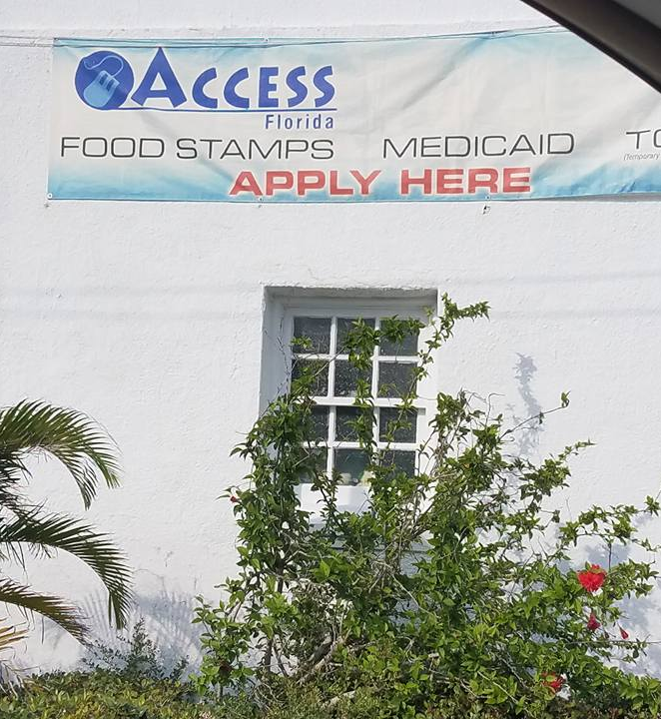
Service Centers
The Florida Department of Health for Volusia County offers clinical, dental and nutrition services, in addition to wellness programs, emergency preparedness and response, infectious disease services and community health planning. The goal of Volusia County’s health department is to allow individuals make informed decisions about personal health and health of loved ones. It is their mission to protect, promote and improve the health of people in Florida.
For Daytona, the department of health is located at
1845 Holsonback Dr,
Daytona Beach, Fl 32117
This location offers adult and children immunizations, birth control, child and adult health and dental
Children’s medical services is located at
421 S. Keech Street
Daytona Beach, Fl 32114
This location offers only children immunizations, dental and WIC
(Florida Health, n.d.)

Slide 27
Health Status: Morbidity and Mortality data
Indicator ​ | Year(s)​ | Measure​ | County: Volusia ​ | State: Florida​
Low birth weight births​ | 2013-15​ | percent​ | 8.7%​ | 86.%​
Infant death rate​ | 2013-15​ | Per 1000 live births​ | 5.8​ | 6.1​
Coronary heart disease age-adjusted death rate​ | 2013-15​ | Per 100,000 population​ | 110.5​ | 98.7​
Stroke age-adjusted death rate​ | 2013-15​ | Per 100,000 population​ | 40.8​ | 34.5​
Heart failure age-adjusted death rate​ | 2013-15​ | Per 100,000 population​ | 13.3​ | 11.3​
Lung cancer age-adjusted death rate​ | 2013-15​ | Per 100,000 population ​ | 49.8​ | 42.1​
Chronic lower respiratory diseases age-adjusted death rate​ | 2013-15​ | Per 100,000 population​ | 58.5​ | 39.9​
Diabetes age-adjusted death rate​ | 2013-15 ​ | Per 100,000 population​ | 27.4​ | 19.5​
(Florida Health, 2017)

Slide 28
Health of the residents
Volusia County is ranked 42 out of 67 counties in Florida in regards to overall health (Florida Department of Health, 2013).
In Daytona Beach, FL:
-50.7% have a healthy diet
-33.3% of residents are overweight
-The average BMI is 28.8
A Volusia County community health needs assessment found hypertension, diabetes, heart disease, and obesity to be the 4 major health concerns in 2013. The major barriers to health were access to healthcare and affordability of healthcare.
-25% of Daytona residents have high blood pressure
-10.7% of Daytona residents are diabetic
-3.7% of Daytona residents have coronary heart disease
-37.7% of Daytona residents are obese
Daytona Beach residents on average take two prescription medicines.
77% of Daytona Beach residents are covered by health insurance.
(City-data, 2017; Florida Health, 2013)

Slide 29
Health of residents: Obesity in Daytona Beach
According to the County Health Status Summary report in 2013: Volusia vs. Florida
-Adults who are obese make up 24.4% of Volusia County compared to 26.4% for the State of Florida.
Percent of Adults who are Overweight by Race, Ethnicity, and Gender 2010:
Volusia Total: 38.9
Florida Total: 37.8
Volusia Non-Hispanic White: 40.0
Volusia Non-Hispanic Black 36.2
Volusia Hispanic 29.0
Volusia Male 41.9
Volusia Female 36.
(Florida Health, 2016)

Slide 30
Leading Causes of Illness and Death in Volusia County in 2015
Heart Disease: ~23% of deaths
Cancer: ~22% of deaths (listed below are most
common in Volusia County)
- Breast cancer
- Cervical cancer
- Prostate cancer
- Colon cancer: most prevalent in Daytona, FL
-Lung cancer: most prevalent and most deadly
in Volusia County
(Florida Health, 2015)

Slide 31
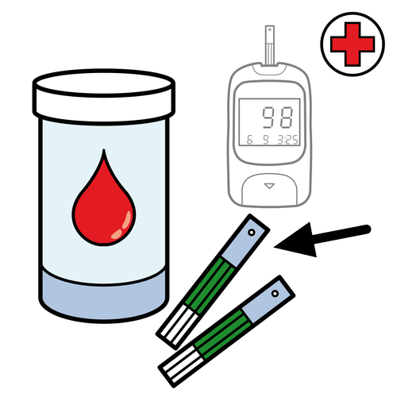
Leading Causes of Illness and Death in Volusia County in 2015 (continued)
Chronic lower respiratory disease: 8.1% of deaths
Stroke: 6.4% of deaths
Alzheimer's Disease:4.8% of deaths
Diabetes: 3.3% of deaths
Suicide: 1.8% of deaths
(Florida Health, 2015)

Slide 32
Health Risks
1. Violence (Ashley Jenkins)
2. Diabetes (Darrly Wisemen)
3. Colon Cancer (Monica Cavallero)
4. Obesity (Samantha Conley)
5. Sexually transmitted infections (Megan Cossart)
6. Tobacco use (Karolina Seaman)

Slide 33
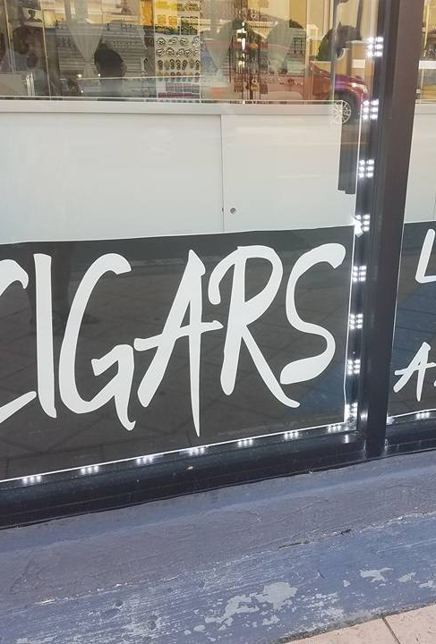
One health risk focus: Tobacco use
Primary Prevention for Tobacco-Related Illnesses:
Aims at reducing possibility of smoking or related illnesses from occurring
Lifestyle changes – form and maintain close, personal connections with other people to prevent a need for bonding with harmful (acetone, cyanide, ammonia, lead, phenol, pyridine, styrene, toluene, carbon monoxide, tar, nitric oxide, cadmium, etc.) and addictive substances (nicotine)
Reduce foods that elevate glycemic index and increase insulin resistance such as saturated fats and simple carbohydrates in order to prevent type II diabetes mellitus (increased prevalence in smokers)
Health education – increase knowledge about tobacco-related illnesses and methods to break free from addictions
Environmental modifications – avoid spending time around people while and after they smoke in order to prevent exposure to second-hand smoke
Get 7-8 hours of quality sleep per night and eat nutritious foods to help boost immune resistance to tobacco-related cancers
Perform at least 30 minutes of daily exercise to prevent depression and body image disturbances which lead to addictions and help to reduce insulin resistance which leads to diabetes
(American Lung Association, 2017)

Slide 34
Tobacco use continued
Secondary Prevention for Tobacco-Related Illnesses:
Minimizes damage from smoking before symptoms arise or become debilitating
Early pathophysiological changes may have started, but the diseases have yet to produce symptoms
Screening for diabetes, tobacco-related cancers (lung, stomach, pancreatic, cervical, liver, oral), asthma, COPD, heart disease, stroke, macular degeneration and pregnancy complications such as low-birth weight
Detect strokes as early as possible so they can be treated with anti-coagulants
Medications can aid in smoking cessation such as nicotine patches, Chantix and anxiety-reducing medications
(American Lung Association, 2017; Institute for Work and Health, 2006)

Slide 35
Tobacco use continued: Implications for nursing practice
Application of Primary and Secondary Prevention Strategies:
This information raises awareness of how public health nurses can education members of communities who are susceptible to tobacco use and other addictive behaviors
Public health screenings can be conducted in schools and workplaces to help identify which people can be diagnosed with and receive prompt, appropriate treatment for tobacco-related illnesses
Lifestyle changes made to reduce the impact of tobacco-related illnesses can be applied to general health promotion materials which can be disbursed through classrooms, internet website and social media
(Institute for Work and Health, 2006)

Slide 36
Part 4: Comparison & Contrast: Summary

Slide 37
Race/ Socioeconmical Status/ Occupation
Race
Looking through the windshield Daytona is a diverse community. Although the majority is white (53%), African Americans and Hispanics were seen and observed during the windshield survey. Diversity is what makes a healthy community function and with all of Daytona's attractions, it it obvious that it appeals to different cultures and ethnicities. Different races were also seen interacting with each other in conversation and in work.
Socioecominal Status
The windshield survey showed diversity in socioeconomic status due to the difference in visual characteristics of the people in the community. With income, education and occupation being factors in socioeconomic status, it was observed that some of the community is in poverty based on physical appearance, housing, and surroundings. 31.7% of people living in Daytona live in poverty and although it is hard to confirm if someone is living in poverty with just visual data, it was to be assumed based observable characteristics. Closer to the beach it was observed that the socioeconomic status was higher based on the observation of large maintained houses, businesses that have expensive product, and by the observations of newer maintained cars.
Occupation
Many businesses were observed during the survey, most commonly restaurants. The restaurants ranged from fast food to fine dining and appeared most commonly on busy roads such as International Speedway Blvd. The food and service industry is one of the most common jobs held in Daytona, yet is one of the lowest paid. Attractions such as the Daytona Speedway and Daytona Beach also employ a lot of its residents and is visually observed during the survey.

Slide 38
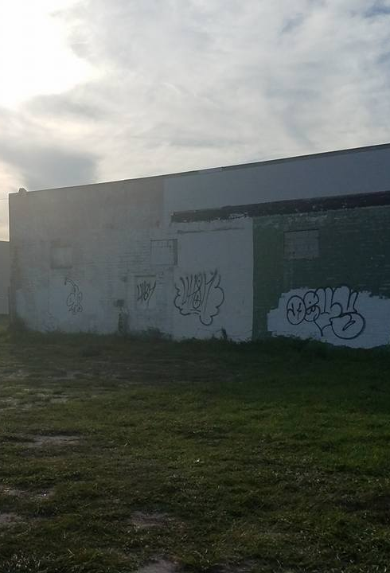
Community Boundaries/Housing/Signs of Decay & Growth
Community Boundaries
During the windshield survey, official neighborhood boundaries were not noted during the drive starting from the intersection of Harvey Ave. and A1A, then down to Halifax Ave, across to N. Oleander Ave., back up to A1A and ending at the intersection of Oakridge Blvd. and Halifax Ave. The neighborhoods did not have an official name either. Commercial streets such as A1A, Main Street and Seabreeze Blvd were seen mixed in with the residential streets. Residential streets had businesses sprinkled in between residential homes such as the Dr. offices that were seen on Oakridge Blvd. and Halifax Ave.
Housing/Signs of Decay and Growth
The majority of the homes seen in the area during the windshield survey were older single family homes or multi-family structures that appeared to be built between the 1920’s to 1970’s. The data analysis revealed that the average home in Daytona Beach is 37 years old. There were a few newer homes noted during the drive that were built in the early 2000’s sprinkled throughout the neighborhoods. Most of the homes seen were frame, stucco and concrete block homes with an occasional brick home noted along the way. Single family, multi-family homes or duplexes, apartments and condos were seen throughout the area. Both the single and multi-family homes were 1-2 stories with some of the apartments comprising of 3-5+ stories. As expected from the data analysis, more residential properties were seen with “For Rent” signs than “For Sale”.
All of the homes seen had a front and/or side lawn. None of the homes seen were on zero lot lines. The majority of the lawns were well-groomed with grass, trees and flower beds noted and the homes appeared to be in good condition. Cars were seen in the driveways and on the streets and the majority of the homes appeared to be occupied. Sidewalks were seen in most of the areas. The neighborhoods had streetlights, curbs, and gutters.
Grafitti was seen on some of the walls of the businesses but not on any of the homes. Several businesses were closed down, one had boarded up windows, and several still had signs of damage from the last hurricane.

Slide 39
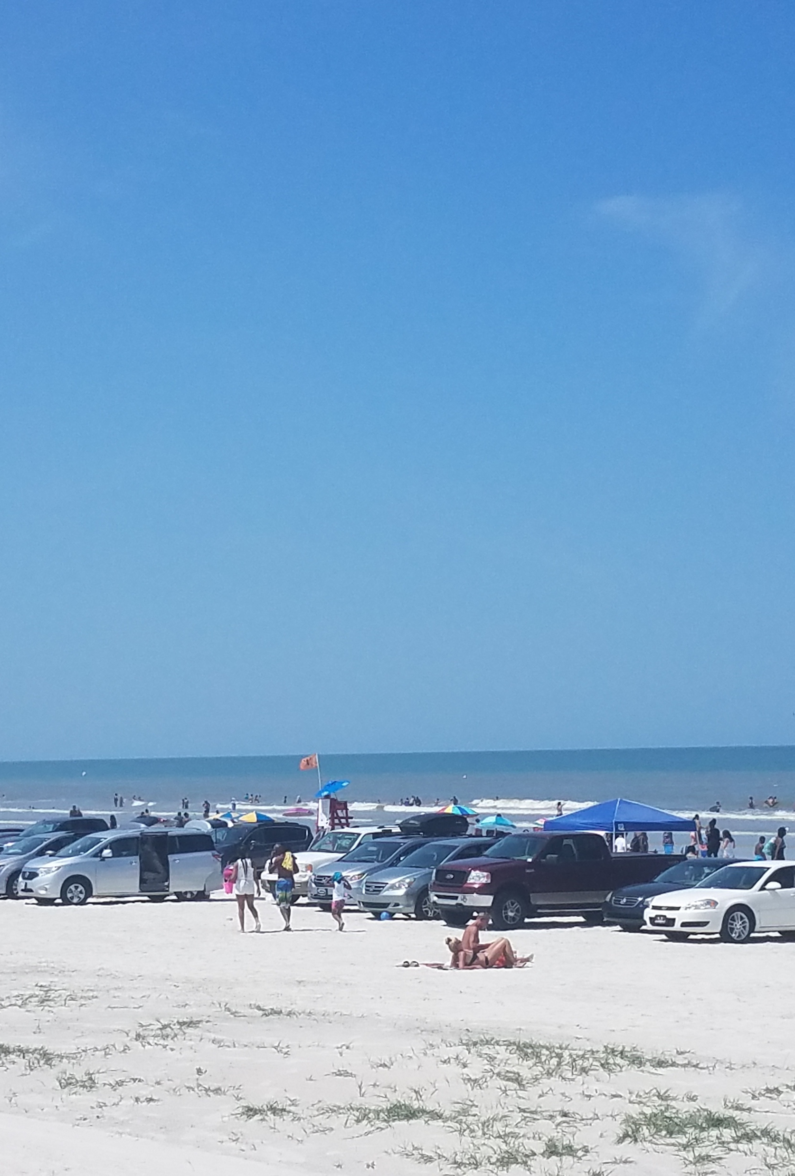
Parks/Recreations/Community Common Areas
Parks/Recreations/Community Common Areas
As expected from the data analysis, many people were observed gathered together on the beaches of Daytona Beach during the windshield survey. Colin’s Park, a public, well-lit and clean playground, had several men and children gathered together fishing off the dock. Several cars were also seen parked outside of the Daytona Bridge Club. The Peggy Schnebly Recreation Center had several adolescent boys and young men playing basketball outside. Several school playgrounds were seen; however, these were locked and closed to the public.
The open spaces were generally well-maintained and clean except for a few pieces of trash and cigarette butts that were seen on the ground.

Slide 40
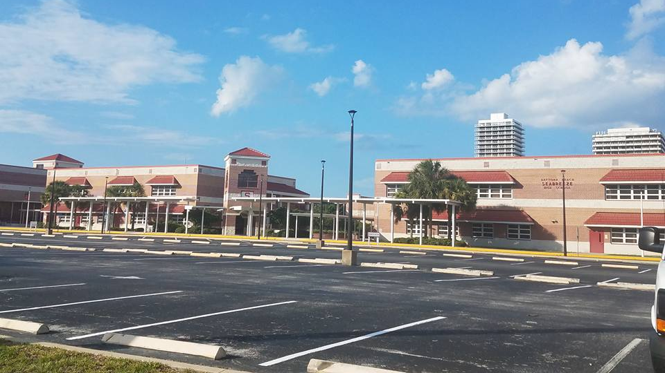
Education
Many schools of all different levels were observed during the survey, Daytona Beach has over 40 schools, mostly public schools. Upon observation most school were maintained nicely visually from the outside. General Aeronautics and Aerospace Science and Technology is the most common college degree earned in Daytona Beach. Embry Riddle College, located in Daytona Beach, is largely responsible for the number of Aeronautics degrees earned. Mainland High School and Daytona State College were also observed and found to portray a nice physical appearance and it was observed that both schools have a diversity of students regarding race/ethnicity and socioeconomic status.
Seabreeze High School

Slide 41
People on the Streets
As researched, 1483 people live on the street in Daytona Beach. You do not quite see many homeless on the streets while driving through the city during the windshield study. As compared to the windshield project there were several protective services that were in the community. Many of these services are spotted driving through town. As seen through the windshield, the schools are kept clean and there are several many of them. Daytona Beach has over 40 schools and a couple of them are colleges.
As seen in the windshield, are are many liquor and tobacco advertisements. I noticed that there are high mortality rates in coronary heart disease, stroke, heat failure, lung cancer, and lower respiratory diseases in this area. With this being said, having so many advertisements for liquor, beer, and tobacco can be compared with the high mortality rates in this area.

Slide 42
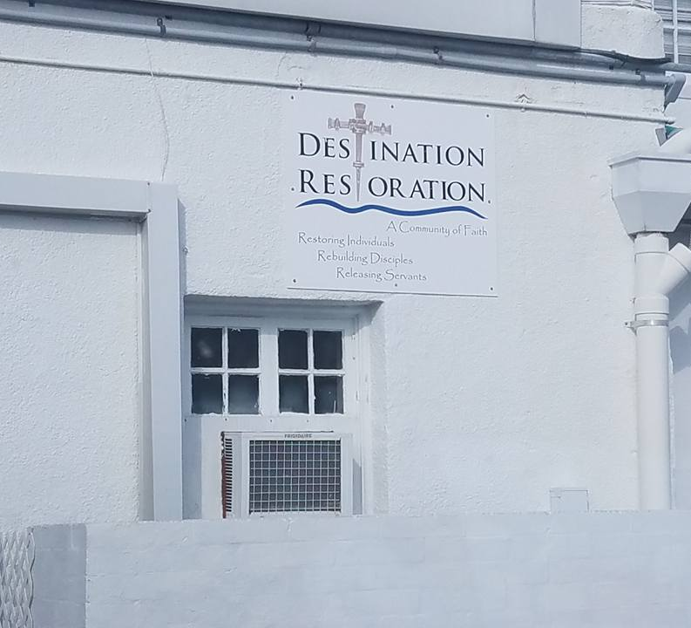
Religion and Politics
Religion
34.76% of the residents of Daytona Beach are affiliated with a religion. Several different churches are seen throughout the windshield survey which supports this finding. The majority of churches seen throughout the windshield survey were Christian which is also supported by the data with Catholics being the most common religion in Daytona Beach (10.5%).
Politics:
There is not anything seen throughout the windshield survey in regards to politics. There are no signs, buildings, etc. seen that are related to the politics of the city.

Slide 43
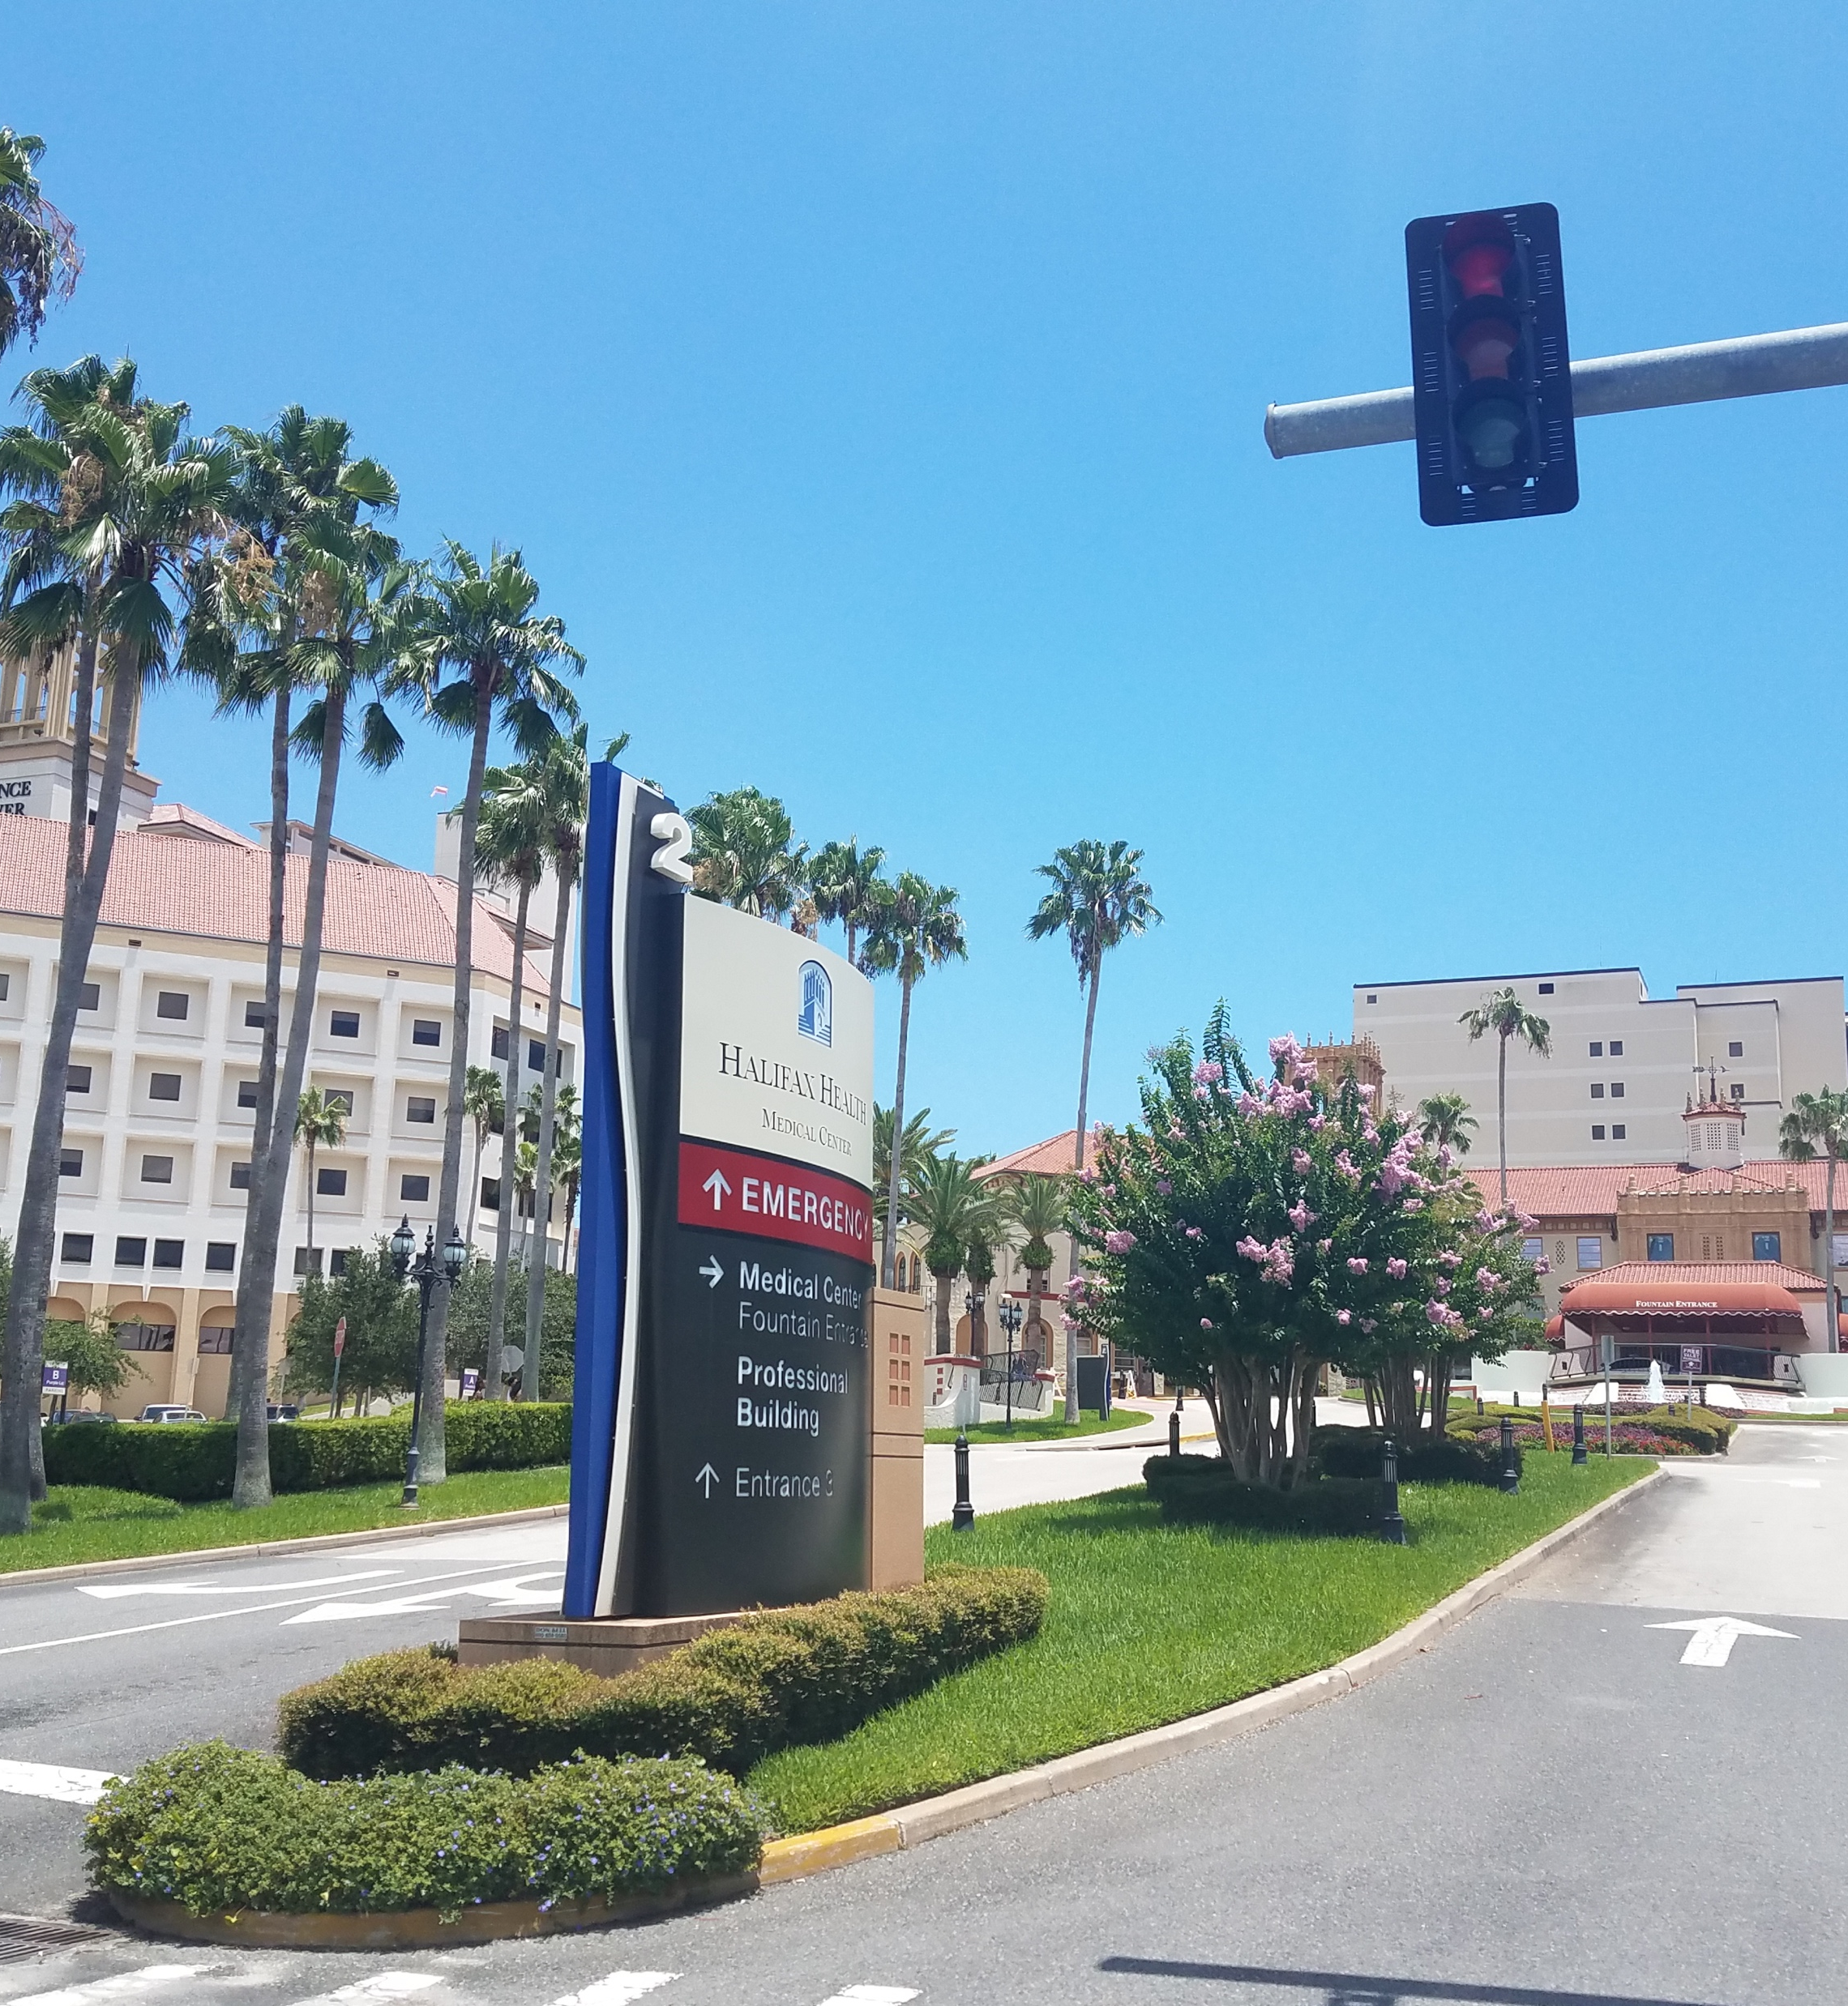
Healthcare Providers
As mentioned prior a survey was distributed to residents of Daytona Beach asking: What health care services are difficult to obtain in your community? The response is ranked as most difficult to obtain to least.
The reply was as follow: Mental health/counseling, substance abuse services, alternative therapy, dental care, special care (i.e. cardiology), primary care, medical supplies, preventive care, vision care, family planning/birth control, rehab therapy, emergency care, prenatal, inpatient hospitals
By the windshield survey it appears there is an abundant of different specialty offices for healthcare providers. Along the driving route several healthcare providers were located within the residential areas. During the assessment for Volusia County the estimated amount of medical physicians and osteopathic physicians is around 1,145 for the county. While the number of dentists is only 240 physicians in Volusia county. Dental care is high on the survey for difficult to obtain.
Inpatient hospitals ranged last last on the difficult to obtain list. However, in the Daytona Beach area, there are only two hospitals which Halifax and Florida Hospital Memorial Medical Center. While there are several hospitals in surrounding cities, they are not directly in Daytona Beach. The amount of hospitalizations for Volusia County was estimated at 54,412 during an eleven month period. Combined Halifax and Florida Hospital only offers 800 beds for a population of an estimated 63,000 people.
(Florida Health, 2013)

Slide 44
Health of Residents
33.3% of Daytona residents are overweight and 37.7% are obese. In contrast to this data, when reviewing the windshield survey, several of the residents of Daytona seem to be somewhat active rather than sedentary. There are several people seen walking dogs, playing basketball, fishing, and at the beach. One of the major barriers to health in Daytona is access to healthcare. There is one hospital found when completing the windshield survey, which is Halifax Hospital. The next closest hospital found was Florida Oceanside in Ormond Beach. The windshield survey shows that there are several Dr. offices and dentist offices in the residential areas of Daytona. It appears that there are several places in the community for residents to receive healthcare.

Slide 45
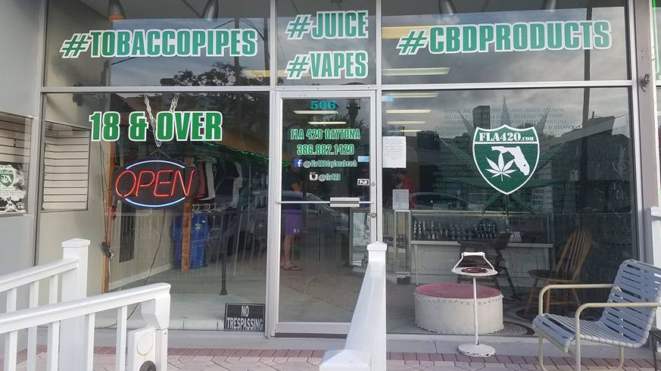
Health Risk: Tobacco
When reviewing the photographs taken during the windshield survey of Daytona, numerous advertisements stood out that promoted cigars, cigarettes, lighters and ashtrays. In addition, a smoking paraphernalia store that advertised smokeless tobacco and vaping also made an appearance. Upon closer inspection, the ground in several urban area was also littered with cigarette butts which indicate that smoking regularly takes place in these areas. When compared to the health and wellness data taken in the Daytona area in 2013, one finds clear correlations between the levels of publicly displayed tobacco advertisements and the smoking and tobacco-related illness data compiled in the survey. Specifically, the percentage of adults who smoke in Volusia county is 23.3% compared to the average Florida smoking rate of 17.1%. In addition, several chronic illnesses which stem from tobacco use have also been observed to occur at higher rates in Volusia county compared to the average rates in Florida. For instance, the death rate from chronic lower respiratory disease per year is 50.4 per 100,000 compared to the Florida average of 37.6. Similarly, the rate of death from cancers is 4 per year compared to 2.7 per 100,000 deaths for Florida. Furthermore, the death rates from asthma (9.0 vs 8.3) and stroke (31.9 vs 29.8) are also slightly higher than the state average per 100,000 deaths
(Florida Health, 2013).

Slide 46
References
American Lung Association. (2017). 10 of the Worst Diseases Smoking Causes. Retrieved July 4, 2017, from http://www.lung.org/our-initiatives/tobacco/reports-resources/sotc/by-the-numbers/10-worst-diseases-smoking-causes.html
American Lung Association. (2017). What’s in a cigarette? Retrieved July 4, 2017, from http://www.lung.org/stop-smoking/smoking-facts/whats-in-a-cigarette.html
City-data. (2017). Daytona Beach, Florida. Retrieved from http://www.city-data.com/city/Daytona-Beach-Florida.html
City of Daytona Beach. (n.d.). City commission. Retrieved from http://www.codb.us/index.aspx?NID=384
City of Daytona Beach. (n.d.) Daytona Beach pier. Retrieved from http://codb.us/index.aspx?nid=529
Data USA. (n.d.) Daytona Beach, FL. Retrieved from https://datausa.io/profile/geo/daytona-beach-fl/
FBI crime reports. (2015). Daytona Beach, FL Crime Rates & Statistics. Retrieved from http://www.areavibes.com/daytona+beach-fl/crime/
Florida Department of Children and Families. (2014). Adult Protective Services | Florida Department of Children and Families. Retrieved from http://www.myflfamilies.com/service-programs/adult-protective-services
Florida Department of Education. (2017). Office Of Healthy Schools. Retrieved from http://www.fldoe.org/schools/safe-healthy-schools/healthy-schools/
Florida Health. (n.d.). Programs and services. Retrieved from http://volusia.floridahealth.gov/programs-and-services/index.html
Florida Health. (2013). Community health assessment. Retrieved from http://www.floridahealth.gov/provider-and-partner-resources/community-partnerships/floridamapp/state-and-community-reports/volusia-county/_documents/volusia-cha.pdf
Florida Health. (2015) Leading Causes of Death-Volusia County-2015. Retrieved from http://www.flhealthcharts.com/ChartsReports/rdPage.aspx?rdReport=ChartsProfiles.LeadingCausesOfDeathProfile

Slide 47
References (continued)
Florida Health. (2016). Community health improvement plan. Retrieved from http://volusia.floridahealth.gov/programs-and-services/community-health-planning-and-statistics/community-planning/_documents/chip-2016-2019.pdf
Florida Health. (2017). County Health Status Summary Profile. Retrieved from http://www.flhealthcharts.com/ChartsReports/rdPage.aspx?rdReport=ChartsProfiles.CountyHealthSummary
FL HomeTown Locator. (n.d.). Daytona Beach CCD, FL. Retrieved from https://1drv.ms/p/s!AnkyJvbwLHYFmwftmN37PWeVGD_X
Florida Hospital. (n.d.). Florida Hospital Memorial Medical Center. Retrieved from https://www.floridahospital.com/memorial-medical-center
Halifax Health. (2017). Find a location. Retrieved from https://www.halifaxhealth.org/locations
Institute for Work and Health. (2006). What researchers mean by primary, secondary and tertiary prevention. Retrieved July 4, 2017, from http://www.iwh.on.ca/wrmb/primary-secondary-and-tertiary-prevention
Sperling, B. (2017a). Daytona Beach, Florida housing. Retrieved from http://www.bestplaces.net/housing/city/florida/daytona_beach
Sperling, B. (2017b). Religion. Retrieved from http://www.bestplaces.net/religion/city/florida/daytona_beach
Sperling, B. (2017c). Daytona Beach, Florida People. Retrieved from http://www.bestplaces.net/people/city/florida/daytona_beach
The School District of Volusia County. (2017). Home - Schools - Volusia County Schools. Retrieved from http://myvolusiaschools.org/schools/Pages/default.aspx
Volusia County Florida. (n.d.). Parks, recreation and culture. Retrieved from https://www.volusia.org/services/community-services/parks-recreation-and-culture/
Votran. (2013). Bus fares and passes. Retrieved from http://www.votran.org/take-a-trip/bus-fares-passes.stml
Willis, T. (2014). Five facts about homelessness in daytona beach. Retrieved from http://www.liberalamerica.org/2014/11/18/five-facts-about-homelessness-in-daytona-beach/

