Slide 1
Cash Management and Investments

Slide 2
Intro to Cash Management and Investing
Suppose you have $10,000 sitting in your checking account. Is this a good idea? No, the time value of money tells us that someone will be willing to pay for access to these funds today If you were to invest these funds (i.e., make them available to others) you would get a future return. How much? FV= PV(1+r)^{n}

Slide 3
Nonprofits Are Not Only Borrowers But Also Investors
In the short-term Nonprofits may have “idle” cash balances (like $10,000 in checking account) But nonprofits also have spending obligations So nonprofits want investments that are liquid In the long-term Nonprofits have assets they would like to invest (e.g., endowments) Here, nonprofits can afford to sacrifice some liquidity for a greater return or yield

Slide 4
Cash Budget
A cash budget includes information on beginning cash balance, cash receipts (cash flow of revenues) and cash disbursements (cash flow of expenses) Beginning cash balance + cash receipts Subtotal: Cash available - cash disbursements = Ending cash balance

Slide 5
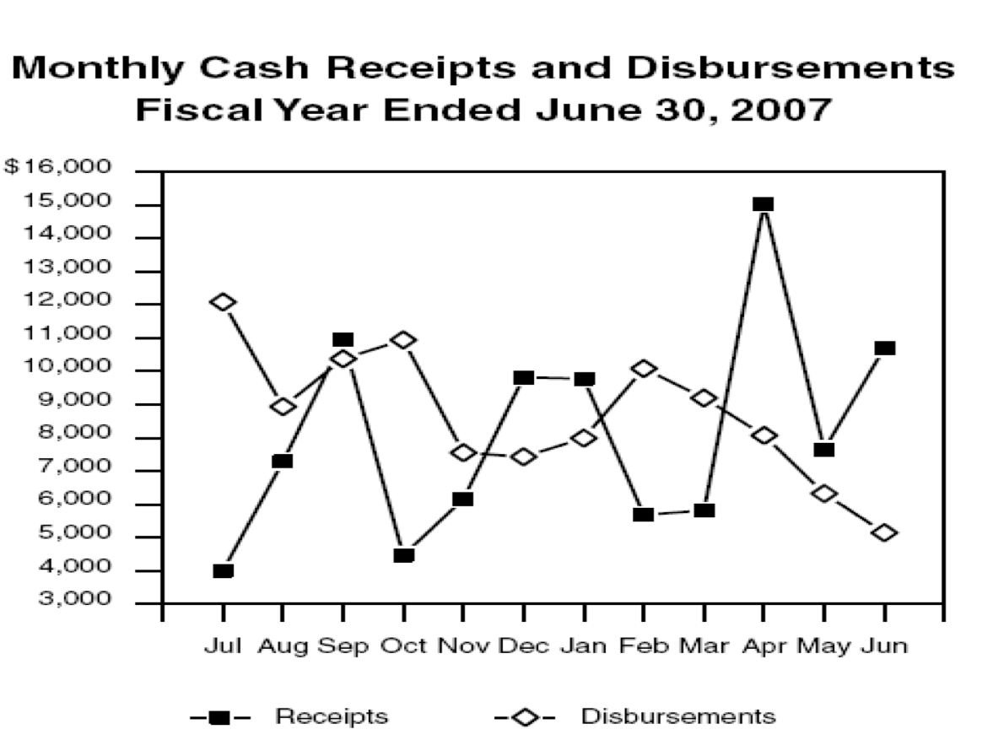
Cash Flow (State of California)
California General Fund ($ millions)
Note how cash and expenditures can fluctuate during the fiscal year. The cash flow manager must use the peak in revenues to cover shortfalls in other months

Slide 6
Cash Management
Cash mobilization: get the money owed as quickly as possible Prompt billing Rapid processing and immediate deposit Quick collection (e.g., credit card payments) Disbursement control: make payments as late as possible Time major payments to coincide with receipts Investment: do something productive with the balances in between

Slide 7
Short-Term Investments
General principles: Legality: not all investments are available to nonprofits due to legal or policy constraints Risk: no default risk (loss of principal) and no credit market risk (loss of market value of the interest) Yield: no artificially low rates of return (muni bonds) Liquidity: no illiquid assets (something you can’t sell immediately)  Do not invest short-term funds in long-term investments

Slide 8
Short-Term Investments
Where to invest?
Yield
Liquidity
Equities (stocks)
Commercial paper
Repo
CDs
Other federal- agency issues
T-Bills
Cash

Slide 9
Key Money-Market Instruments
Treasury bills (T-bills) Short-term (91 days to 1 year) federal securities sold in weekly auctions Other federal-agency issues Issued by federal agencies that make or guarantee loans Certificates of Deposit (CDs) Deposits with a bank for a contracted period of time and interest rate Commercial paper Corporate short-term, unsecured promissory notes with maturities up to 270 days Repurchase agreements (Repo) Investor purchases a security from bank or dealer with commitment that seller will repurchase at a set date and price

Slide 10
Long-Term Investments
Long-term focus means you can sacrifice liquidity in favor of higher yields (prudently managed) Average portfolio comprised of: U.S. corporate equities (stocks) 42% U.S. bonds 27% Non-U.S. equities (stocks) 17% Real estate 5% Private equity 4% Other 3% Non-U.S. bonds 0.9%

