Slide 1
Budget Cycle: Politics and Approval

Slide 2
The Players
Staff
Typically program managers
Chief Executive
Board

Slide 3
Decision-Making Models
Process of using judgments
Usually involves an evaluation of trade-offs
Useful in policy discussions, and therefore budgetary debate

Slide 4
Approaches to Decision-Making
Rational-comprehensive
Incremental
Policy process

Slide 5
Rational-Comprehensive
Defined by planning and goal-setting in a rational, information-driven budgetary arena
Once goals are set, organization aligns itself with them
Budgeting becomes a technical process driven by established goals
More typical of local government, nonprofits

Slide 6
Limits to Rationality
Imperfect or incomplete:
Information
Time
Resources
Constraints and Tradeoffs
Constraints impinge the decision maker
The Role of Intuition
Experience and judgment rather than logic
Nonprogrammed decisions

Slide 7
Incrementalism
Bounded rationality
Muddling through
Politics
More typical of federal, state governments

Slide 8
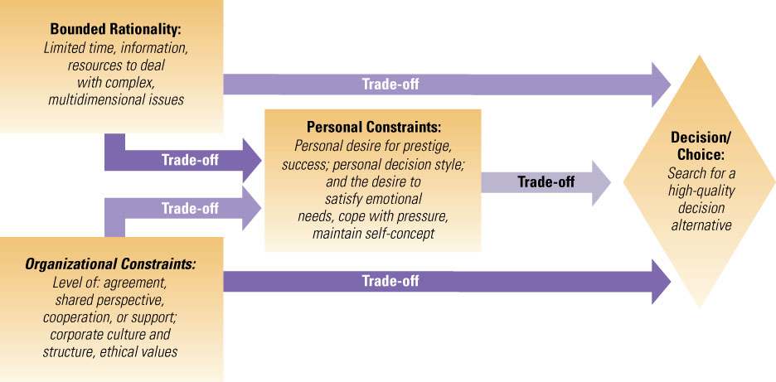
Bounded Rationality
Notes:
From Richard L. Daft Organization Theory and Design 10th Edition ©2010

Slide 9
Muddling Through
Charles Lindblom
Successive limited comparisons
Consider only those ways that the policy differs from the status quo
This method is used for most U.S. policy decisions

Slide 10
Limits to Incrementalism
Mandatory spending exempts a large and increasing portion of budget from incremental politics
Ignores prevalence of executive-driven budgetary processes
Chronic budget deficits have eliminated the increment available for distribution

Slide 11
Policy Process
Hybrid approach
Recognizes punctuated equilibrium
Typically, incrementalism governs
However, policy sometimes makes dramatic shifts when a policy window is capitalized upon
Policy shifts change rules of the game, political forces adjust accordingly

Slide 12
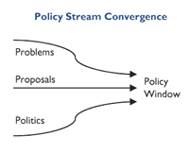
“Policy Windows”

Slide 13
Budgetary Politics
Attempts to influence distribution of resources
Types
Basic
Partisan
Policy
Institutional
Organizational
Personal

Slide 14
Budgetary Politics
In PA theory, legislators make policy and administrators implement policy
In reality, managers frequently involved with policy and organizational politics, try to stay out of others
Why is this the case?

Slide 15
Budgetary Politics: Interactions
Program managers
“True believers”
Spending advocates and resource maximizers
Compete with other managers
Role depends on perspective and context
Service provider
Policy analyst/proposer
Political entrepreneur
Link to organization for board, outsiders
Outside supporters seen as a potential resource; opponents as a threat

Slide 16
Budgetary Politics: Interactions
Policymakers
Chief executive and the board
Guardian of resources; targeted spending advocacy
Managers viewed as overly enthusiastic, self-interested resource seekers
Outsiders can be seen as legitimate participants or irrational meddlers; potential resource or threat

Slide 17
Budgetary Politics: Interactions
Outsiders
Volunteers, citizens, constituents, supporters seeking goods and services
Represent “the public”
Policymakers and public managers as means to end

Slide 18
Sources of Power for Nonprofit Managers
Proximity to an issue
Complexity of an issue
Alignment with organized private interests (coalitions)

