Slide 1
Differing Budgetary Approaches
This presentation illustrates how budgets can be presented in a number of formats
It is adapted from governmental budgeting and uses local government examples, but the principles apply the same for nonprofit organizations

Slide 2
Differing Budgetary Approaches
Budget formats have varying levels of strengths and weaknesses in terms of communication, understanding, emphasis, and transparency
Types
Line-Item
Program
Performance/Outcome

Slide 3
Line-Item Budgeting
Traditional form of budgeting
Communicated as organization by object of expenditure (a.k.a, a line item)
Does little to explain activities and performance of organization
Most common budgetary approach

Slide 4
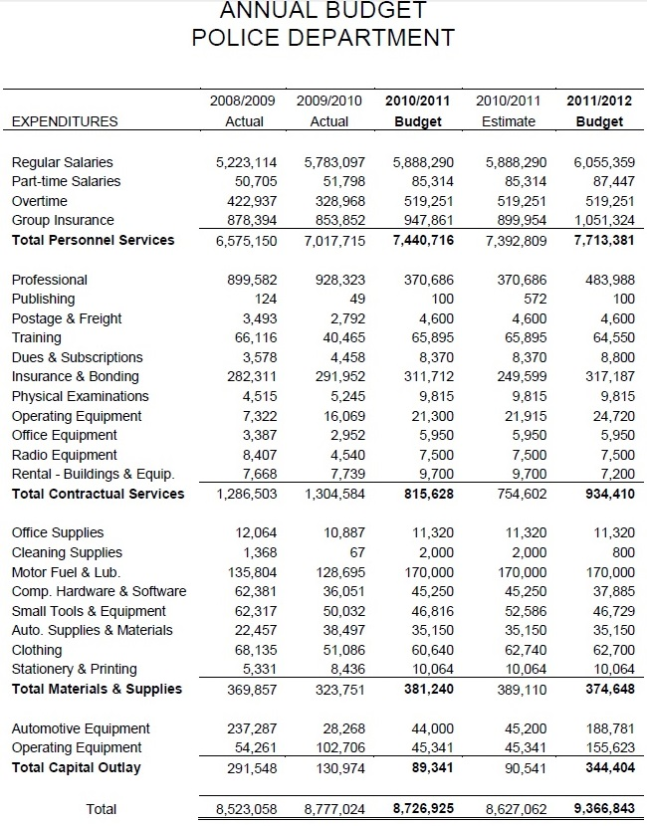
Line-Item Budgeting
Crystal Lake, IL Annual Budget
Entire budget for police department lumped together
Lack of separation makes it impossible to determine how much each police program
What results from police are citizens getting for the money?
Most funds spent on personnel—What types of positions? How many?
No real need for citizens to see how much is spent on every line item
No explanation of changes
A line item

Slide 5
Program Budgeting
Communicated as program by appropriation unit
More detailed in terms of activities
Less detailed in terms of specific expenditures
Use “Appropriation units” to group like expenditures, e.g.:
Personnel
Contracts
Supplies
Capital

Slide 6
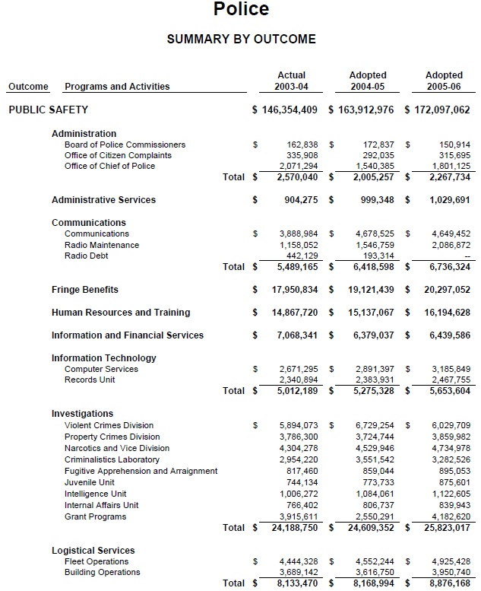
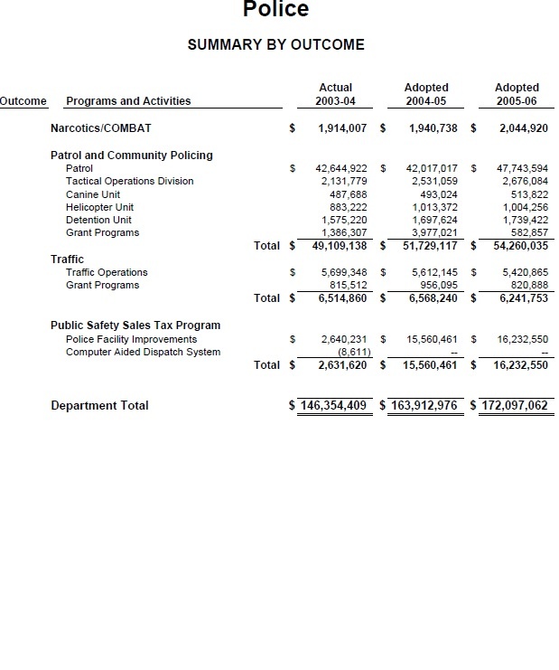
Program Budgeting
Kansas City, MO Annual Budget
Note division of costs into programs, use of summary totals
Allows reader to see cost of each activity in context of entire department

Slide 7
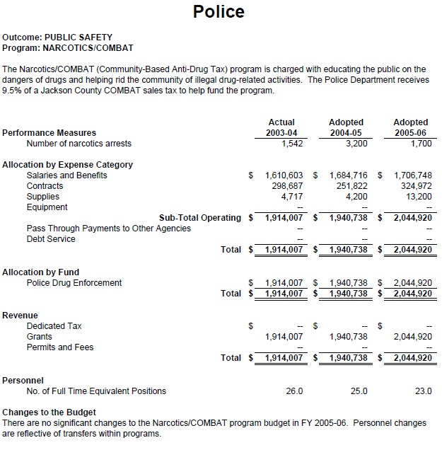
Program Budgeting
Kansas City, MO Annual Budget
Program detail provided on subsequent program page
This page tells us that Kansas City, MO spends $2m on narcotics enforcement, the Crystal Lake budget cannot do the same
Still not going to line-item detail, using appropriation-unit summaries to collapse them into like categories
Appropriation-unit

Slide 8
Performance/Outcomes Budgeting
New, innovative method of budgeting
Communicated as program’s contribution to planned organizational performance
Organization goals explained initially, then activities of organization tied to goals
Expenditures reported as price per unit

Slide 9
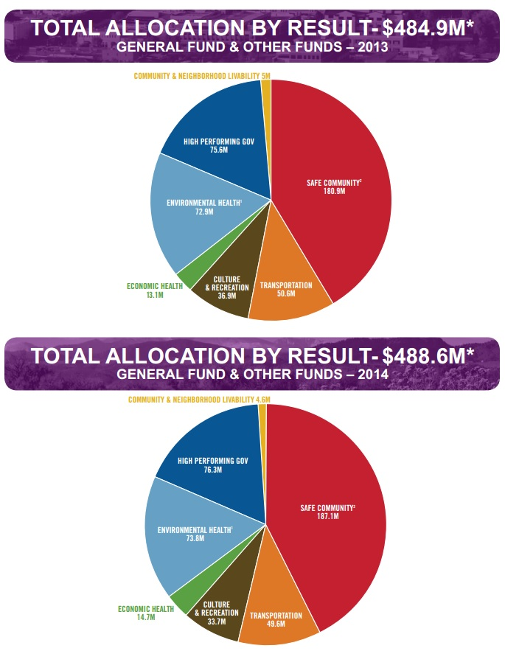
Performance/Outcomes Budgeting
Fort Collins, CO Annual Budget
Budgetary allocations decided at outcome (result) level
Each program submits proposal to try to achieve goals associated with each outcome
Those whose proposals are accepted get funded, those who are not accepted are first in line for budgetary cuts

Slide 10
Why do organizations use performance/outcomes budgeting?
Fiscal stress
Frustration with the existing budget process
Increased focus on priorities
Shifts discussion from finances to choices
Get the best deal for the money

Slide 11
Are there any drawbacks to performance/outcomes budgeting?
How do you determine appropriate priority allocations?
Inability to set specific goals
Employee insecurity
Programs gaming the system

Slide 12
What lessons have been learned from performance/outcomes budgeting?
Define priority at program level, don’t create new priority areas
Prioritization methods
Is the service mandated?
Can costs be recovered by fees/contributions, etc.?
What is the demand for the program?
How reliant is the community upon the program?
Treat employees with respect
Involve stakeholders

Slide 13
Does performance/outcomes budgeting work?
Strong anecdotal evidence
Too early to tell
Implementation has been a challenge
Beginning study

Slide 14
Recommendations to Managers re: performance/outcomes budgeting
Starting with fully costing existing programs
Adopt a prioritization scheme that has buy in
Invite collaborative and outside proposals
Respect your employees in this process

