Slide 1
EDG 2940
Experiential Learning Overview
College of Community Innovation & Education
School of Teacher Education
Angela Slaughter, Ed.D.

Slide 2
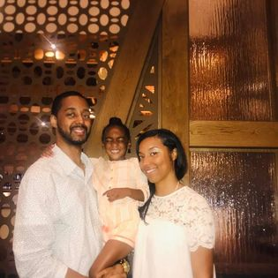
Display Your Name Tent
Educator
Mom & Wife
Dr. Slaughter
Taylar
Foodie
Travelista
Display Name Tents During Class
Helps us get to know each other!

Slide 3
Culturally Responsive Teaching

Slide 4
CULTURALLY RESPONSIVE TEACHING INTERVIEW

Slide 5
DEFINING CULTURALLY RESPONSIVE TEACHING
"Culturally responsive teaching is using the cultural knowledge, prior experiences, and performance styles of diverse students to make learning more appropriate and effective for them; it teaches to and through the strengths of students".
Gay, G. (2000). Preparing for Culturally Responsive Teaching. Journal of Teacher Education, Vol. 5, No. 2, March/April.

Slide 6
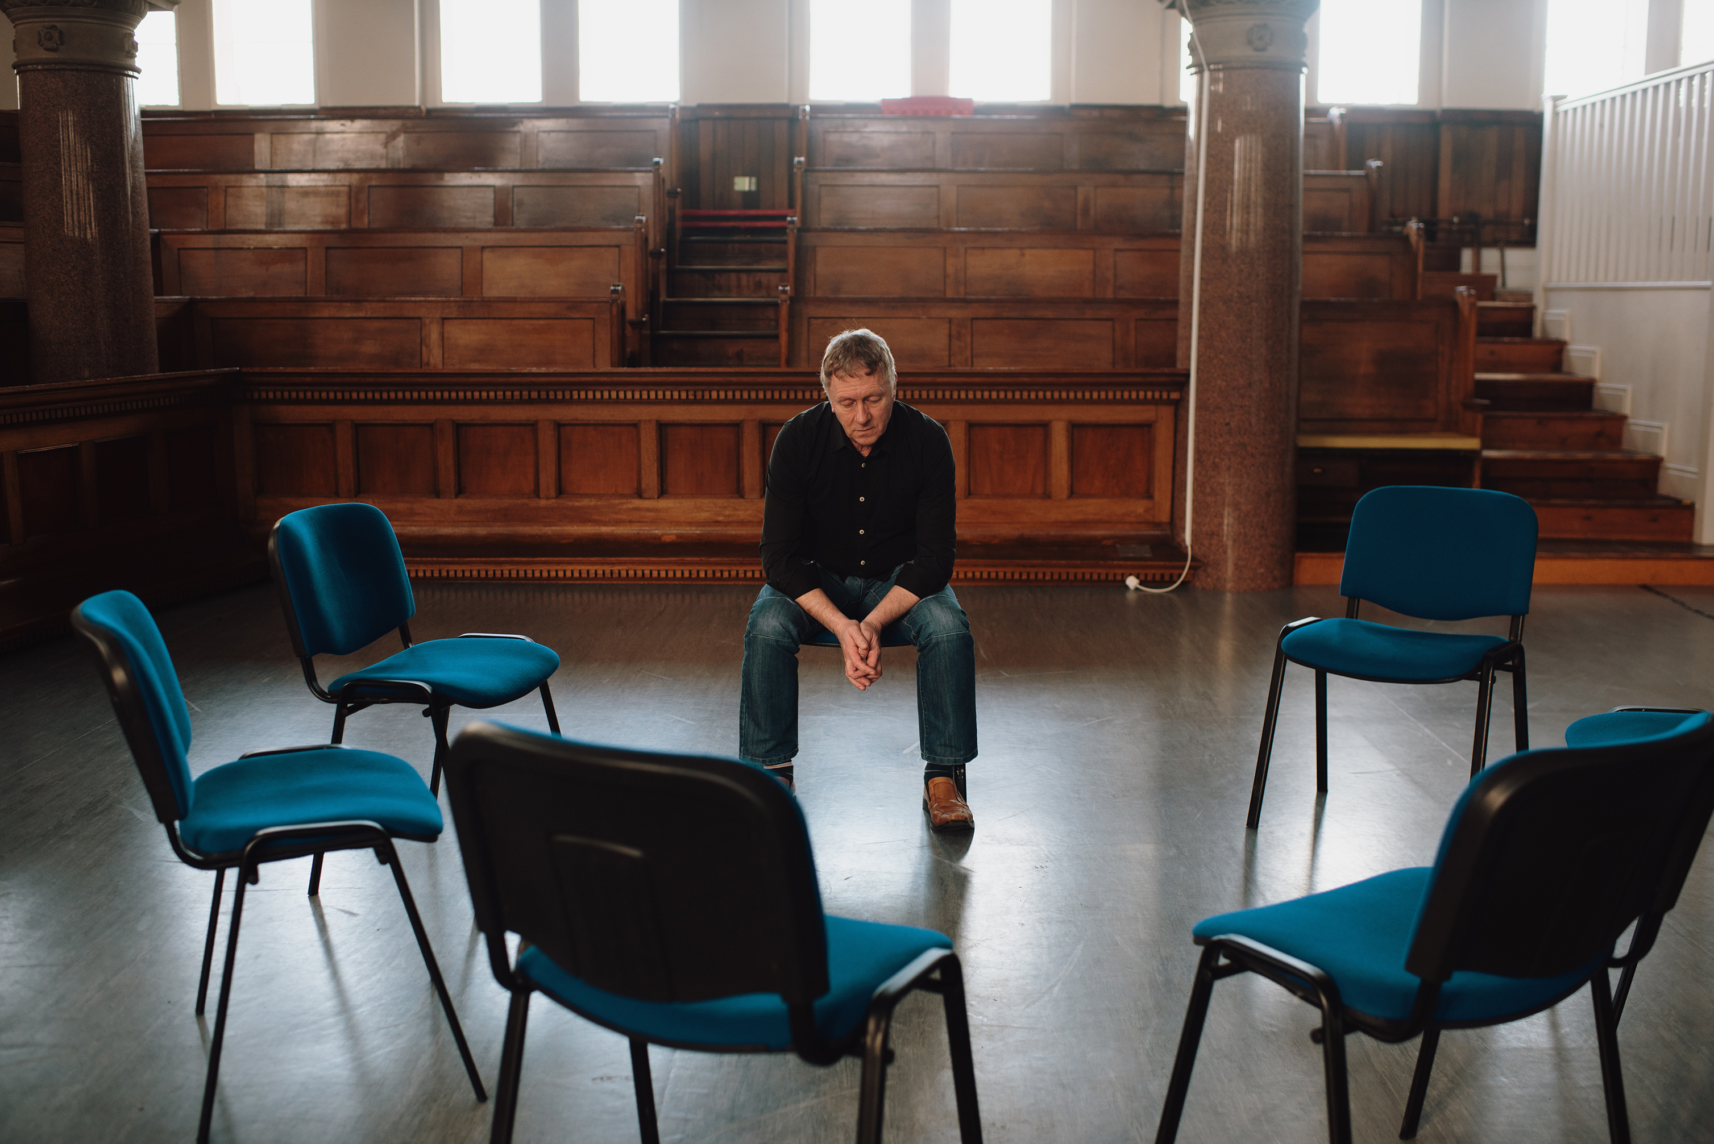
What factors may influence our capacity to be responsive?
“Implicit biases are discriminatory biases based on implicit attitudes or implicit stereotypes. Implicit biases are especially intriguing, and especially problematic, because they can produce behavior that diverges from a person’s avowed or endorsed beliefs or principles.”
Anthony G. Greenwald, Linda Hamilton Krieger, “Implicit Bias: Scientific Foundations.” California Law Review 94:4 (July 2006), p. 951.

Slide 7
Implicit Bias Reactions
What feelings or reactions did you have upon learning your IAT results?
How might your life experiences have shaped your biases, with or without your conscious awareness?
How might knowing your IAT results affect your future actions and decisions, both in your role at your workplace and in other aspects of your life?

Slide 8
Notebook Entry
Culture Tree and You
What is Culture?
Left
Right

Slide 9
What is culture?
Culture
Thoughts
Feelings
Attitudes
Beliefs
Values
Behavior Patterns
Shared by racial groups
Shared by ethnic groups
Shared by religious groups
Shared by social groups
Hammond, 2018

Slide 10
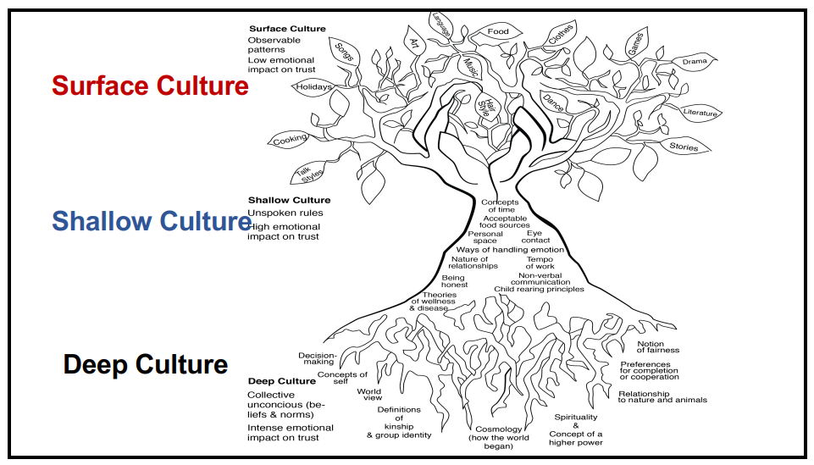
Culture Tree
Hammond, 2018

Slide 11
Culture Tree and You . . .
Describe your family’s favorite way to spend free-time/vacation time.
If your house was burning down, what 3 items would you try to save? Why?
What activities made you happiest as a child?
What experience(s) made you sad or angry?
Describe how members of your family deal with conflict.

Slide 12
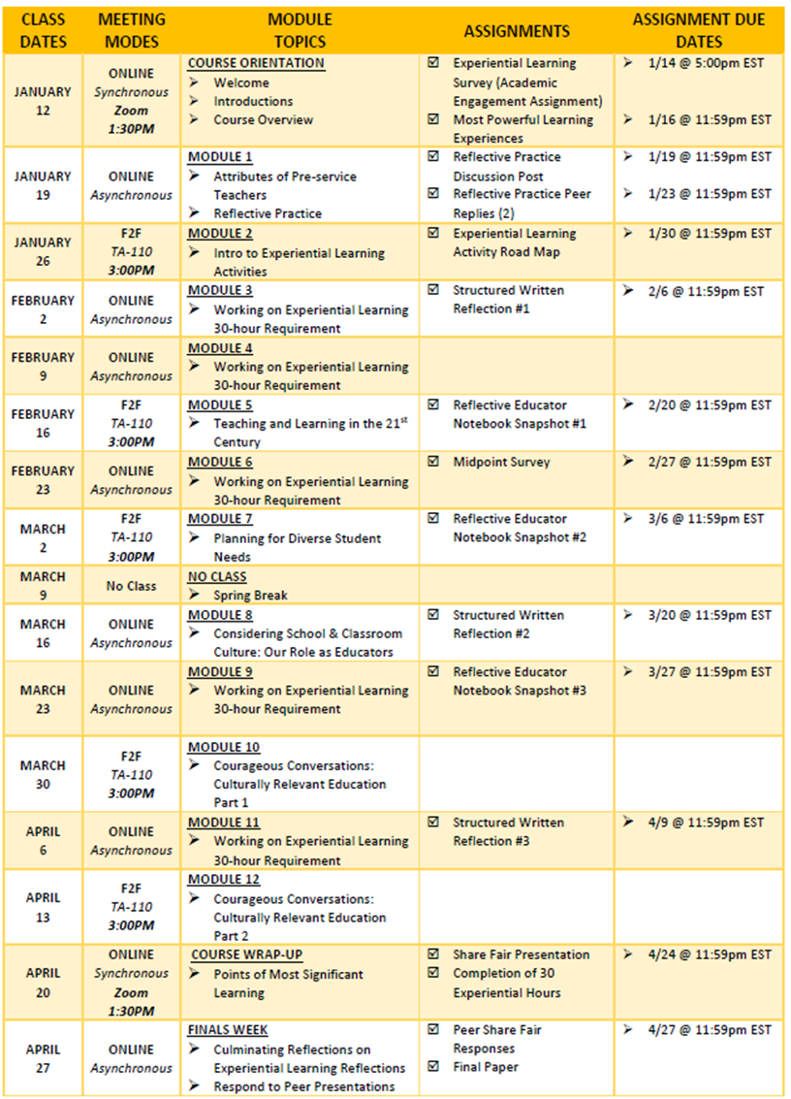
COURSE SCHEDULE SECTION 0M02

