Slide 1
EDG 2940
Experiential Learning Overview
College of Community Innovation & Education
School of Teacher Education
Angela Slaughter, Ed.D.

Slide 2
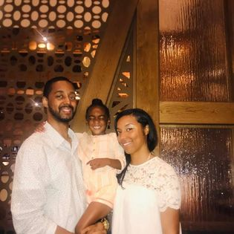
Name Tent
Educator
Mom & Wife
Dr. Slaughter
Taylar
Foodie
Travelista
Create a Name Tent
Display Name Tents During Class
Include name and pictures, words, and/or phrases that represent you!
Helps us get to know each other!

Slide 3
AGENDA
Final Assignment Overview
Final Assignment Self-Check
Implicit Bias Test

Slide 4
Notebook Entry
Final Assignment Overview
Left
Right

Slide 5
UPCOMING ASSIGNMENTS
DETAILED OVERVIEW

Slide 6
FIELD EXPERIENCES
IN-PERSON EXPERIENCE
ALTERNATIVE EXPERIENCE
Complete six of the mini learning activities
3 Group A Activities
3 Group B Activities
Must volunteer/observe for 30+ hours
Experience hours must be in at least two educational settings [Must include at least 15 hours in a Title I School]
Required Documentation:
Signed Evaluation Form
Time Log
Placement Agreement
See Experiential Learning Field Experience Resources Module in Webcourses

Slide 7
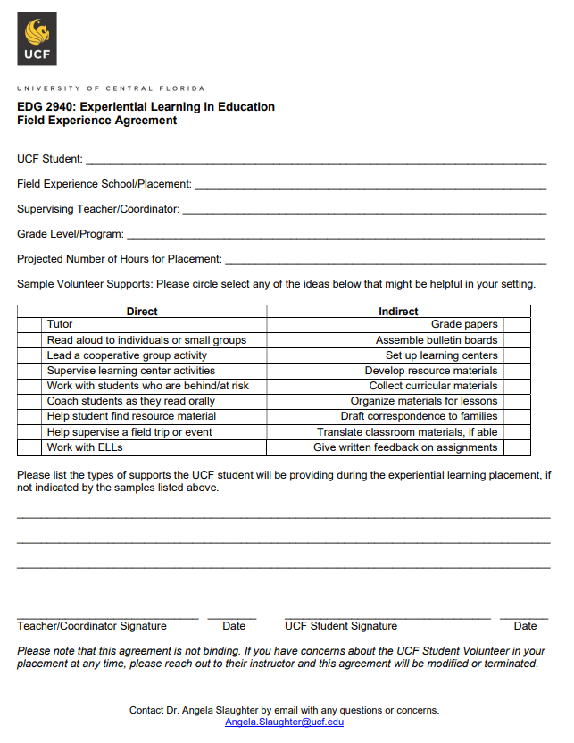
In Person Field Experience
Agreement
Due April 24

Slide 8
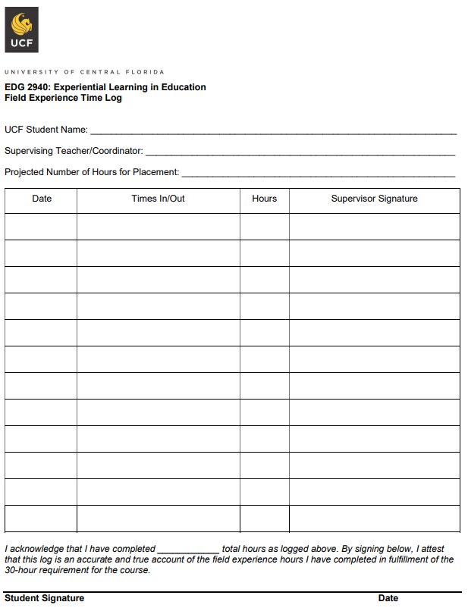
In Person Field Experience
Time Log
Due April 24

Slide 9
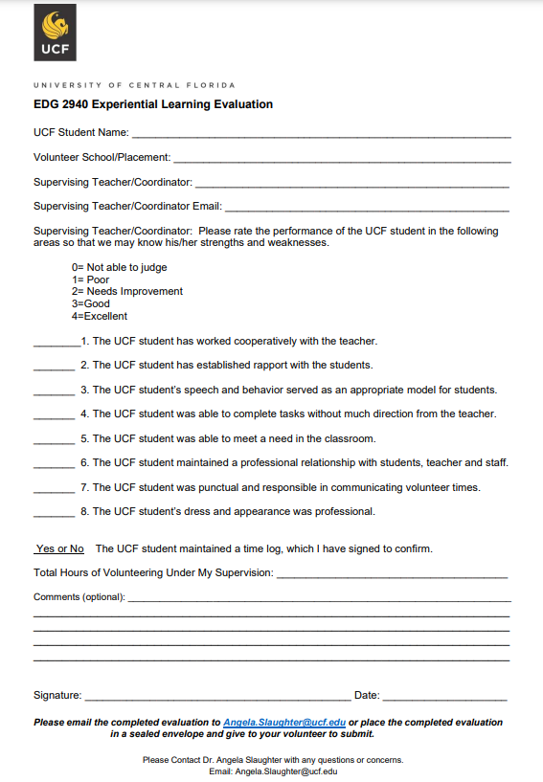
In Person Field Experience
Evaluation
Due April 24

Slide 10
Reflective Educator Notebook
Should be taking notebooks to field experiences.
Final snapshot should be based on your field experience (F2F and Alternative Placements)
REMINDERS
Record observation notes, wondering questions and thoughtful reflections.
Snapshot #3 Due Mar 27

Slide 11
Structured Written Reflections
Strong reflections will demonstrate your self-awareness and your ability to question your own biases, stereotypes, preconceptions, and/or assumptions.
REMINDERS
Assignments will be assessed holistically using the following criteria: Clarity, Relevance, Analysis, and Critical Self-Reflection (see rubric).
Writing should also be free of errors in grammar and conventions.
Structured Written Reflection #3 Due Apr 10
Respond to guiding questions and use rubric to guide writing

Slide 12
Share Fair Presentation
PRESENTATION
Each section/slide should reflect a detailed response to the prompts provided:
Title and name: Give your presentation a title based on your growth.
Placement Dilemma/Challenge/Takeaway: A rich description of a placement experience/scenario/dilemma/challenge/takeaway and how you overcame or plan to overcome it.
Placement Observation: Write about a meaningful encounter from your placement, or from the readings, or class sessions.
Questions: Note some questions/wonderings that you have about teaching and learning.
Your Growth: Write about your shift in learning to be a teacher.
Conclusion: Conclude with your next steps in your educational journey.
Be prepared to upload this PPT to the discussion board. Because you do not have the opportunity to present these in person, write more than you normally would on the PPT slides.
After you have posted, reply to at least TWO other presentation with at 3 sentences of meaningful feedback by Apr 27.
Prepare a multimedia presentation (PPT, Prezi, etc.) to share with class.
REQUIRED SECTIONS
UPLOAD PPT TO WEBCOURSES
RESPOND TO CLASSMATES
Due
Apr 24
Detailed Assignment Description and Rubric Posted in Webcourses

Slide 13
Structured Final Paper
Final Reflection: Your Growth as an Educator
Make a collage to represent your growth.
POSSIBLE GUIDING QUESTIONS
Explain your collage. What is it representing? Why?
What will you take from this class to use in your future classroom?
How has your thinking shifted over the semester?
What experiences did you want more of? Why?
What are your next steps in becoming a teacher?
What are you nervous about?
Use at least three pictures. Must be different from previous pictures and can be anything that you believe is representative of your growth.
IMPORTANT
Review rubric as you write
Reflection should be typed (Times New Roman font), double-spaced, and 3-4 pages (approximately 1000 words).
Assignments will be assessed holistically using the following criteria:
Clarity, Relevance, Analysis, and Critical Self-Reflection (see rubric).
Writing should also be free of errors in grammar and conventions.
Due
Apr 27
Detailed Assignment Description and Rubric Posted in Webcourses

Slide 14
Notebook Entry
Final Assignment Self-Check . . .
Final Assignment Clarifications
Are you on track with your field experience and assignments?
What is your next step to make sure you complete final assignments successfully?
Left
Right

Slide 15
Test Yourself Here
Complete Harvard’s Project Implicit Implicit Bias Test using the link provided.
Complete any test of your choosing.
Be prepared to share your experience and findings during the next class.

Slide 16
Coming Up . . .
Module 11 – No Class
Structured Written Reflection #3
April 10
Implicit Bias Test
Complete before
April 13
Notes:
0M03

Slide 17
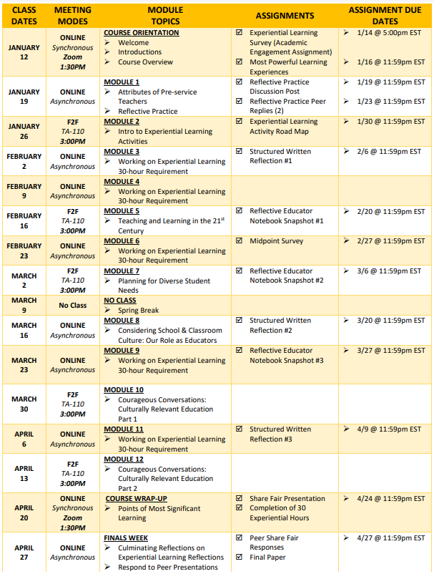
COURSE SCHEDULE SECTION 0M02

