Slide 1
EDG 2940
Experiential Learning Overview
College of Community Innovation & Education
School of Teacher Education
Angela Slaughter, Ed.D.

Slide 2
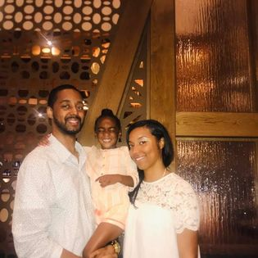
Display Your Name Tent
Educator
Mom & Wife
Dr. Slaughter
Taylar
Foodie
Travelista
Display Name Tents During Class
Helps us get to know each other!

Slide 3
AGENDA
Diverse Learning Needs
Universal Design for Learning
Coming Up . . .
UDL Bingo

Slide 4
Notebook Entry
Diverse Needs in Action
What’s happening in the classroom?
What key terms are evident?
What questions do you have about what’s happening in the classroom?
Left
Right

Slide 5
Diverse Needs in Action Video Observation

Slide 6
Notebook Entry
Diverse Needs
Video Observation
Diverse Needs in Action
What’s happening in the classroom?
What key terms are evident?
What questions do you have about what’s happening in the classroom?
How do Ms. DeBose and her co-teacher use data to inform their planning?
How are stations effective in meeting the needs of diverse learners?
How might you accomplish a similar lesson without a co-teacher or paraprofessional?
How does this video show diverse learning needs in action?
Left
Right

Slide 7
Notebook Entry
UDL Bingo
UDL Guidelines
Take Notes as Needed
You will also receive a graphic organizer that you can tape on this page as well.
Left
Right

Slide 8
UNIVERSAL DESIGN FOR LEARNING
Universal Design for Learning (UDL) is a framework to improve and optimize teaching and learning for all people based on scientific insights into how humans learn.

Slide 9
UDL GUIDELINES
The UDL Guidelines are a tool used in the implementation of Universal Design for Learning. These guidelines offer a set of concrete suggestions that can be applied to any discipline or domain to ensure that all learners can access and participate in meaningful, challenging learning opportunities.

Slide 10
PRINCIPLE
Provide multiple means of Engagement
Affect represents a crucial element to learning, and learners differ markedly in the ways in which they can be engaged or motivated to learn.
There are a variety of sources that can influence individual variation in affect including neurology, culture, personal relevance, subjectivity, and background knowledge, along with a variety of other factors.
Some learners are highly engaged by spontaneity and novelty while others are disengaged, even frightened, by those aspects, preferring strict routine. Some learners might like to work alone, while others prefer to work with their peers.
In reality, there is not one means of engagement that will be optimal for all learners in all contexts; providing multiple options for engagement is essential.

Slide 11
KEY QUESTIONS TO CONSIDER

Slide 12
PRINCIPLE
Provide multiple means of Representation
Learners differ in the ways that they perceive and comprehend information that is presented to them.
For example, those with sensory disabilities (e.g., blindness or deafness); learning disabilities (e.g., dyslexia); language or cultural differences, and so forth may all require different ways of approaching content.
Others may simply grasp information quicker or more efficiently through visual or auditory means rather than printed text.
Also learning, and transfer of learning, occurs when multiple representations are used, because they allow students to make connections within, as well as between, concepts.
In short, there is not one means of representation that will be optimal for all learners; providing options for representation is essential.

Slide 13
KEY QUESTIONS TO CONSIDER

Slide 14
PRINCIPLE
Provide multiple means of Action & Expression
Learners differ in the ways that they can navigate a learning environment and express what they know.
For example, individuals with significant movement impairments (e.g., cerebral palsy), those who struggle with strategic and organizational abilities (executive function disorders), those who have language barriers, and so forth approach learning tasks very differently.
Some may be able to express themselves well in written text but not speech, and vice versa. It should also be recognized that action and expression require a great deal of strategy, practice, and organization, and this is another area in which learners can differ.
In reality, there is not one means of action and expression that will be optimal for all learners; providing options for action and expression is essential.

Slide 15
KEY QUESTIONS TO CONSIDER

Slide 16
UDL BINGO

Slide 18
Coming Up . . .
Module 7
Mar 2
Reflective Educator Notebook Snapshot #2
Spring Break
No Class
Mar 9
Mar 6
Module 8
Mar 16 – No Class
Structured Written Reflection #2
Mar 20
Notes:
0M03

Slide 19
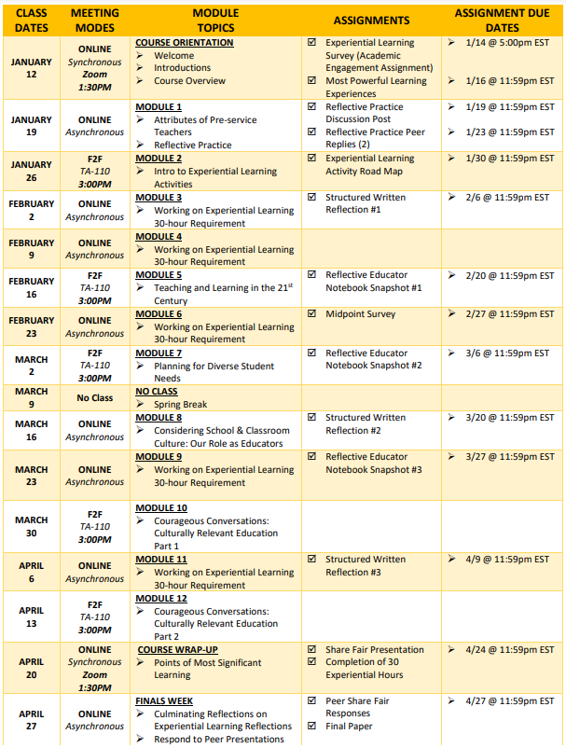
COURSE SCHEDULE SECTION 0M02

