Slide 1
EDG 2940
Experiential Learning Overview
College of Community Innovation & Education
School of Teacher Education
Angela Slaughter, Ed.D.

Slide 2
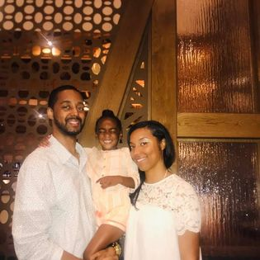
Display Your Name Tent
Educator
Mom & Wife
Dr. Slaughter
Taylar
Foodie
Travelista
Display Name Tents During Class
Helps us get to know each other!

Slide 3
My Classroom
On an empty right page right the words, “MY CLASSROOM”
On the adjacent left page, page in your notebook, draw a picture of your future classroom!

Slide 4
Notebook Entry
MY CLASSROOM
Draw a Picture of your Future Classroom
Left
Right

Slide 5
AGENDA
The 21st Century Learner
Teaching and Learning in the 21st Century Jigsaw
Coming Up . . .
Implications of the P21 Framework

Slide 6
Who is the 21st century learner?

Slide 7
JAMBOARD JIGSAW
P21 FRAMEWORK
https://tinyurl.com/P21-Jigsaw
Notes:
Students complete jigsaw activity for the P21 Framework Definitions - https://files.eric.ed.gov/fulltext/ED519462.pdf
Students report out on the JamBoard - https://jamboard.google.com/d/1RMzjaavCk3tuAp0nmt2DH464E05I3sHtYpqS9gCPxkg/viewer?f=0

Slide 9
Notebook Entry
My 21st Century Classroom
P21 Framework
P21
Framework
What changes would you make to your classroom to ensure it is prepared for 21st century learning?
Tape or glue handout on this page, any way you’d like
Left
Right

Slide 10
Coming Up . . .
Module 5
Feb 16
Reflective Educator Notebook Snapshot #1
February 20
Module 6
No Class Feb 23
Work on Observation Hours
Midpoint Survey
February 27
Notes:
0M03

Slide 11
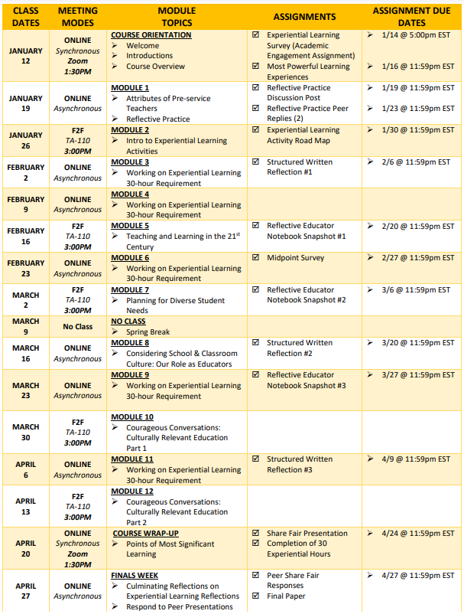
COURSE SCHEDULE SECTION 0M02

