Slide 1



EDG 2940
Experiential Learning Overview
College of Community Innovation & Education
School of Teacher Education
Angela Slaughter, Ed.D.

Slide 2





Name Tent
Educator
Mom & Wife
Dr. Slaughter
Taylar
Foodie
Travelista
Create a Name Tent
Display Name Tents During Class
Include name and pictures, words, and/or phrases that represent you!
Helps us get to know each other!

Slide 3

Let’s Talk About It
Think-Pair-Share
SHARE your reflections on the powerful learning experience
THINK about a powerful learning experience that you’ve had
PAIR Up with someone
A
B
Notes:
Block Party to Share
Discuss: How did this community building activity make you feel?
Why do you think we devoted such significant time to an experience like this?
Why are community building activities like this important?

Slide 4

Let’s Talk About It
Rally Robin
Think about the key qualities of your and your partner’s learning experiences
“The Chosen One” identifies a key quality of the shared learning experiences and calls it out to the table
The next table mate takes a turn identifying and calling out a key quality of the shared learning experiences
Repeat until time is called
Notes:
Block Party to Share
Discuss: How did this community building activity make you feel?
Why do you think we devoted such significant time to an experience like this?
Why are community building activities like this important?

Slide 5
Reflective Practices
When teachers carry out systematic inquiry into themselves, they will understand themselves, their practices and their learners. By constantly looking into their own actions and experiences, they can professionally grow in their own work places.
Laxman Gnawali (2008)

Slide 6

AGENDA
Reflective Educator Notebook Setup
Coming Up . . .
Field Experience Overview

Slide 7
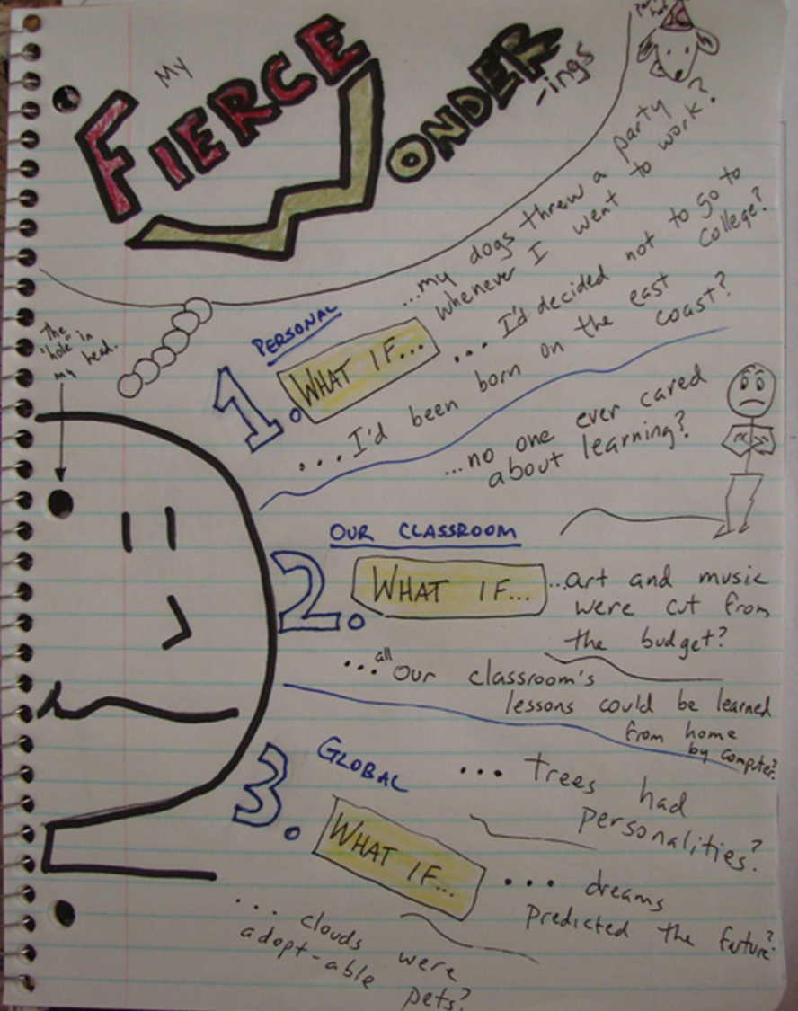
Reflective Educator Notebook
Purchase a notebook that “speaks” to you.
Use notebook to record wondering questions and thoughtful reflections.
OVERVIEW
Bring notebook to class and field experiences.
Students will submit 3 snapshots of notebook entries throughout the semester.
Notes:
Students will maintain a “Reflective Educator Notebook” throughout their experiences where they take the stance of “Teacher as Researcher” and identify wondering questions or thoughtful reflections about their work. Students are encouraged to personalize their notebooks and organize them in a way that proves to be useful for them; however, snapshots of the notebook and included wonderings will be submitted throughout the semester.

Slide 8

INTERACTIVE NOTEBOOK
SETUP

Slide 9
What is an Interactive Notebook?
Your own personalized diary of reflection & learning content
A portfolio of your work in ONE CONVENIENT SPOT
A great organizational tool that allows you to:
  Record & process info to improve understanding
  Learn new ideas using different writing and graphic techniques
  Opportunity to DO something with the ideas you learn

Slide 10
Why do we do this?
To develop stronger critical thinking skills needed for high school, college, and the workplace
To become a more creative and independent thinker
To have a deeper understanding of what you are learning
Writing down lecture notes does not mean that you have learned the information.
You must actively do something with the information before you really understand it.
Note-taking becomes an active process

Slide 11

LET’S GET STARTED
Every student needs a notebook!

Slide 12

Page 1
Table of Contents
Turn to the second page of your notebook
Title it : Table of Contents
Draw lines to create 2 equal columns
TABLE OF CONTENTS
1

Slide 13
Page 1
Table of Contents
Label the 2 columns:
  “Left Page ”
  “Right Page ”
TABLE OF CONTENTS
Left Page
Right Page
1

Slide 14
NUMBERING
Number the pages in the bottom, outside corner, starting with the Table of Contents
Number from Page 1 - 11
Left = Even Pages
Right = Odd Pages
2
3

Slide 15

What Should We Know Before Getting Started?
Left Side
Right Side
Output = YOUR side
Used for processing &
understanding information
Has daily learning activities
May include diagrams, reflections, drawings, summaries, poems, foldables, etc.
EVEN pages – 2, 4, 6, 8, etc.
Remember:
Left Side – It LEFT your brain
Input = TEACHER side
Information given by the teacher
Notes from observations, powerpoint, lecture, video, etc.
Instructions/Processes
Worksheets or Handouts
ODD pages – 1, 5, 7, 9, etc.
Remember:
Right Side – Reserved for teacher

Slide 16
You can cut & design handouts to fit on the page anyway you’d like.
Just make sure it goes on the CORRECT page number/side.
OBSERVATION TOOL
Observation Tool
Caution: Always use the MINIMUM amount of glue or tape that will get the job done!!!
Tape or glue handout on this page, any way you’d like
2
3

Slide 17
Author’s Page
Set up the first page of your notebook as the title page. It should have the following information:
Experiential Learning in Education
Course Title
Illustrations or other information
Illustrations or other information
Your Name
Joe Student

Slide 18
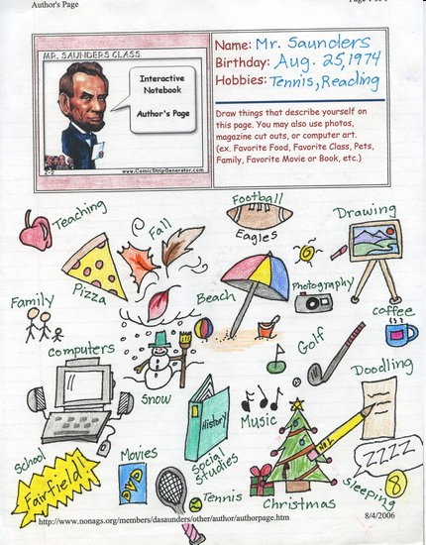
Sample
Author
P a g e

Slide 19
Author’s Page
Design your title page
The title page must contain the following:
  Course Title: Experiential Learning in Education
  Student Name: First and Last
  At least 2: Drawings, interests, hobbies, etc. that represent you!
  Minimum of four colors

Slide 20

FIELD EXPERIENCES
Volunteer/Observe for a minimum of 30 hours
Experience hours must be in at least two educational settings
Traditional Public School (including Charter Schools)
Private School, Alternative School, Virtual, or Other Educational Setting
See Experiential Learning Field Experience Resources Module in Webcourses
Consist of various article and video reflections
Must include at least 15 hours in a Title I School
IN-PERSON EXPERIENCE
ALTERNATIVE EXPERIENCE
Complete six of the mini learning activities
3 Group A Activities
3 Group B Activities
Must Maintain Reflective Educator Notebook
Activity Road Map Due January 30

Slide 21
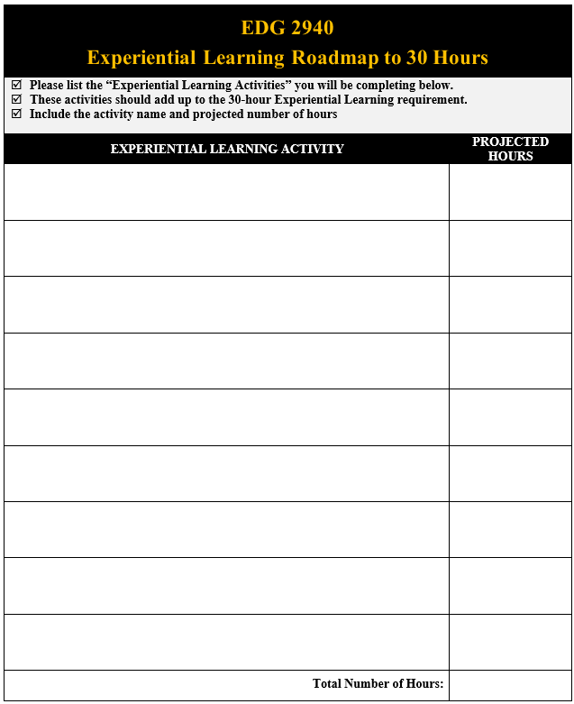
STEP 1
Experiential Learning Activity Roadmap
Due Jan 23

Slide 22
STEP 2
IN-PERSON:
Complete Field Experience Agreement
Send Placement Letters
ALTERNATIVE:
Preview Selected Activities
Finalize Selections
Purchase Nametag
Complete any Necessary Background Checks
Secure Placements

Slide 23
STEP 3
IN-PERSON:
Field Experience Time Log
Complete Selected Activities Online (Students will be excluded from non-selected activities)
Reflective Educator Notebook Entries
Field Experience Evaluation Form
ALTERNATIVE:
Reflective Educator Notebook Entries
Structured Reflections
Structured Reflections
Final Paper & Presentation
Final Paper & Presentation
Complete Field Experience

Slide 24
Coming Up . . .
Experiential Learning Activity Road Map
January 30
Module 3 – No Class
Structured Written Reflection
February 6
Notes:
0M03

Slide 25
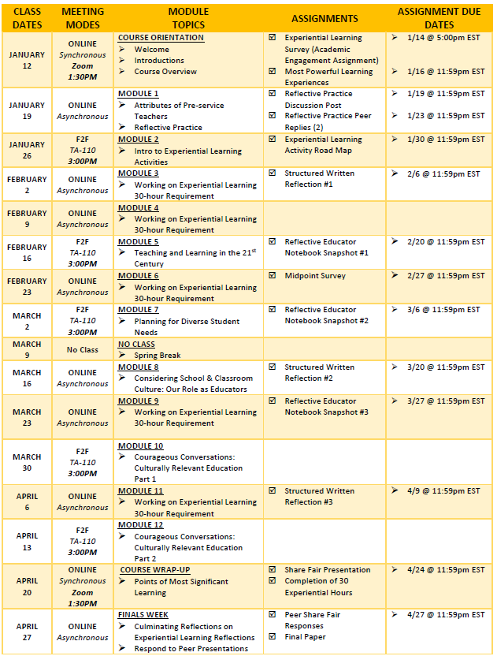
COURSE SCHEDULE SECTION 0M02

