Slide 1
Musculoskeletal Fitness-Week 11
PET4550C

Slide 2
Objectives
Become familiar with various methods of evaluating muscular strength and endurance
Differentiate between direct and indirect methods of determining muscular strength
Understand the proper methods for performing a 1RM bench press and leg press test
Introduce various prediction equations that are useful when attempting to estimate muscular strength

Slide 3
Important Definitions
1-Repetition Maximum (1RM)
Maximum amount of weight or load that can be lifted one time
Muscular Endurance
Ability to exert submaximal forces repetitively
**Muscular Fitness**
Combination of muscular endurance and maximal strength
Muscular Strength
Highest amount of force that can be generated by a muscle or group of muscles during a single contraction
Prediction Equation
Equation established to predict one variable from one or a series of other variables
Repetition Maximum (RM)
Maximum amount of weight that can be lifted for a prescribed repetition range
Alternated, Supinated & Pronated Grip

Slide 4
Why do we measure Musculoskeletal fitness levels?
Associates with numerous health benefits
↓ Risk of heart disease, osteoporosis, glucose intolerance, & musculoskeletal injuries
↑ Ability to complete ADL's
↑Quality of life
↑ Levels of MSK. Fitness are associated with a positive health status
↓ Levels of MSK. Fitness are associated with a lower health status
Muscular fitness is related to all-cause mortality
↓ In MSK. Fitness as indicated by reductions in muscle mass and strength are important risk factors as one ages

Slide 5
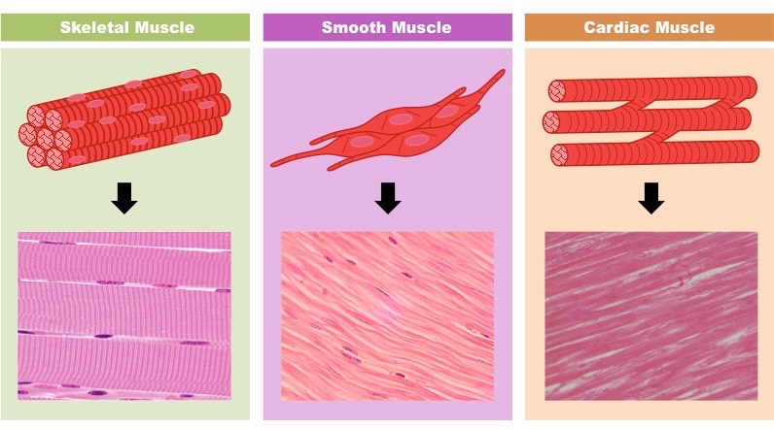
The Basics: Human Muscular System
3 Categories of Muscle
Striated, smooth, cardiac
Smooth Muscle: Involuntary control (Blood Vessels, Bladder)
Cardiac Muscle: Involuntary control (Heart)
Striated Muscle: Voluntary control (Skeletal Muscle)
Under the control of the SNS

Slide 6
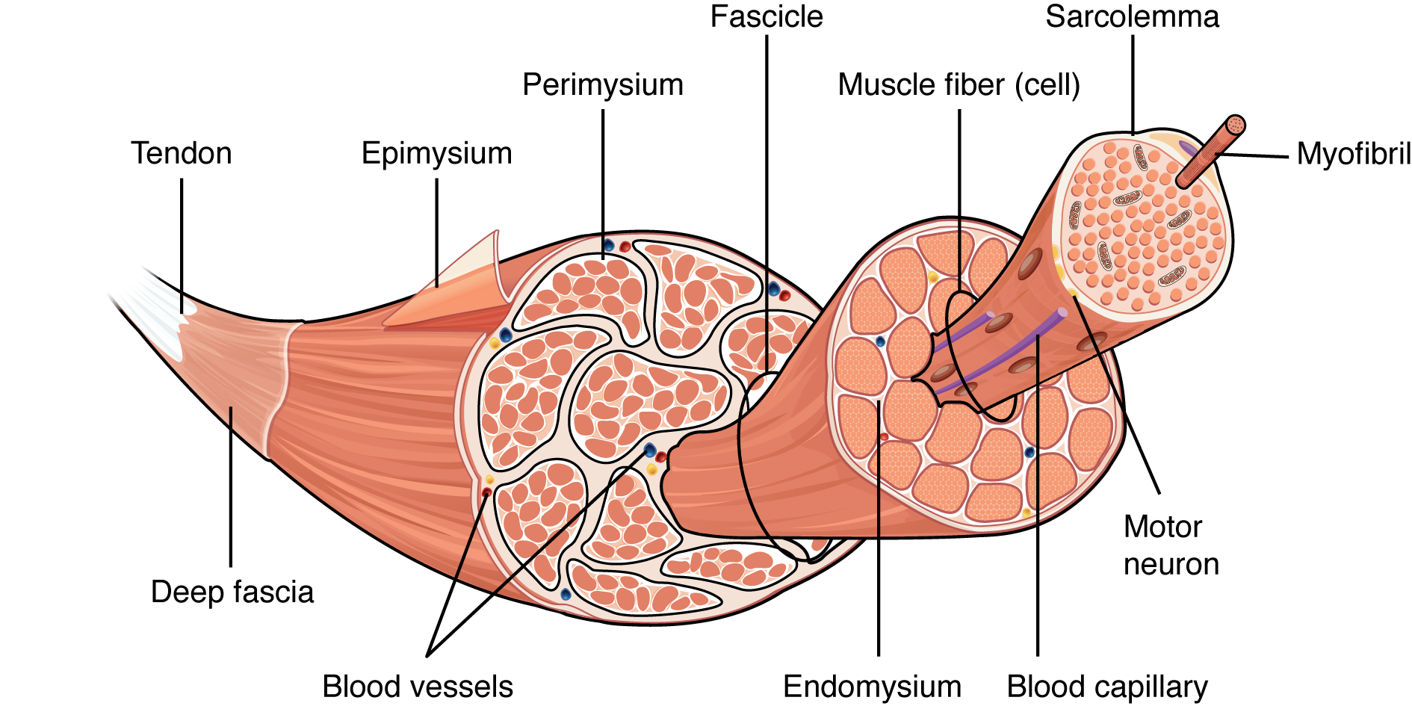
Striated (Skeletal) Muscle Anatomy
Hierarchical and highly ordered structure
Comprised of repeating, functional units
Contains connective tissue, blood vessels and nerves
3 layers of connective tissue
Epimysium
Perimysium
Endomysium
Provide structure and compartmentalize the muscle fibers within the muscle
Muscle fibers are grouped into fascicles

Slide 7
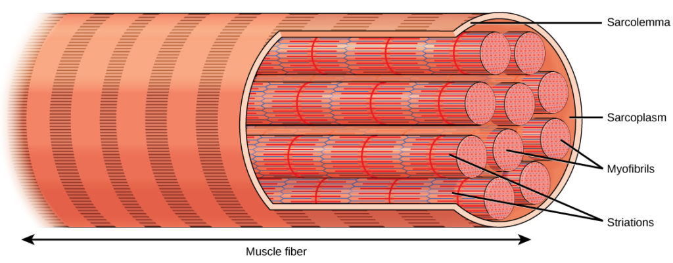
Muscle Fibers
Long, multinucleated cells
Produce large amounts of proteins and enzymes needed to maintain normal function in these large protein dense cells
Covered by a membrane called the sarcolemma
Sarcolemma=cytoplasm
Composed of myofibrils
Comprised of sarcomeres linked in a series
Hundreds to thousands inside 1 muscle fiber

Slide 8
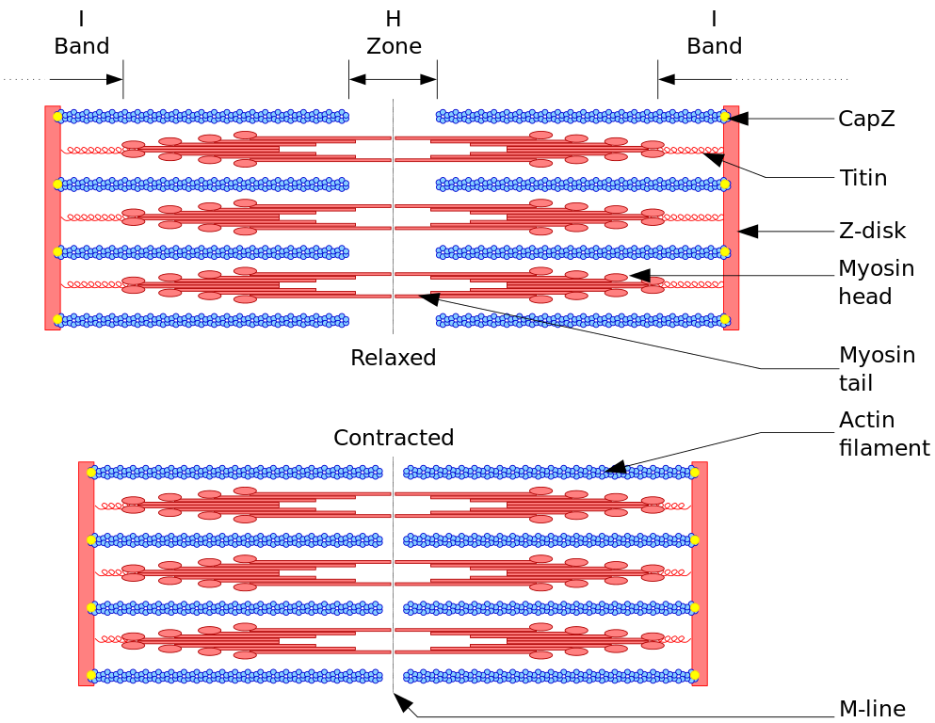
Sarcomeres
Smallest functional unit of a muscle fiber
Linked in a series
Striations of SM are created by the organization of myosin and actin filaments
Results in the banding pattern seen on myofibrils
Thick and thin myofilaments
The Sliding Filament Model of Muscle Contraction
Actin and Myosin filaments slide over each other
Causes shortening of sarcomeres and the cells to produce force

Slide 9
Muscle Fiber Types
Type 1 "Red Fibers"
Slow Twitch
↑ content of myoglobin
↑ mitochondria
↑capillary density
↑ blood flow
Depend on aerobic respiration and function mainly in sustained activity or for postural purposes
Type 2 "White Fibers"
Fast Twitch
Subtypes: 2A + 2B
Rich in glycogen
Smaller mitochondria population
More efficient under anaerobic respiration
Sudden or intermittent activity

Slide 10
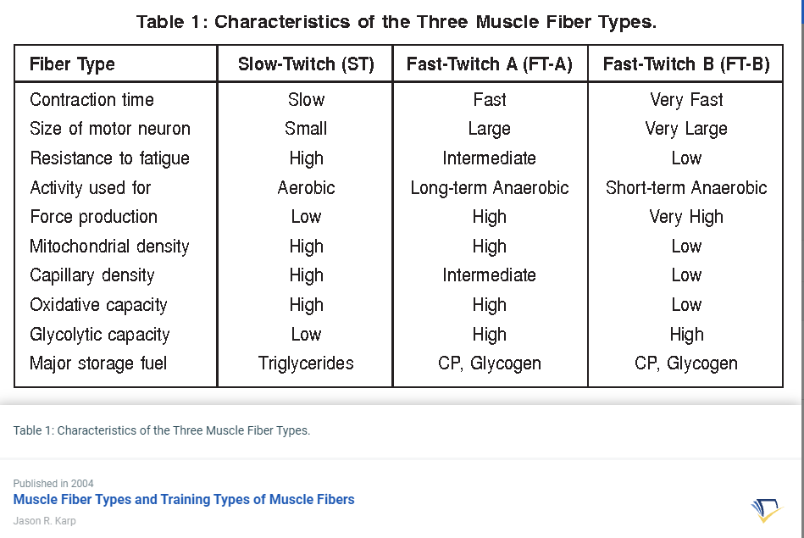

Slide 11
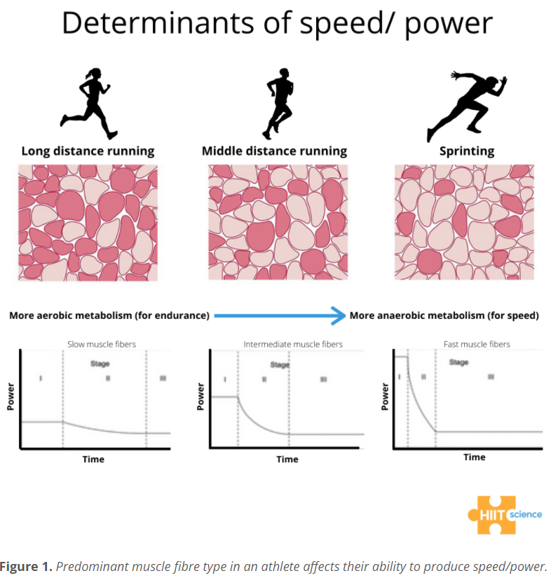

Slide 12
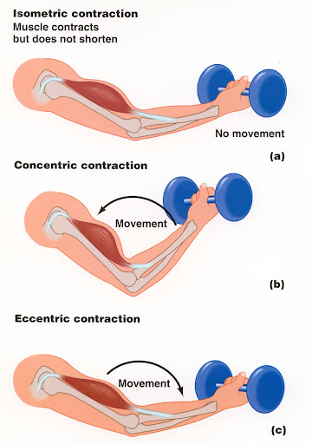
Types of Muscle Contractions
Concentric Contraction
Muscle contraction in which the muscle body is shortening
Upward phase of biceps curl for biceps – Upward phase of bench press for pecs
Eccentric Contraction
Muscle contraction in which the muscle is lengthening
Downward phase of squat for quads or downward phase of bench press for pecs
Isometric contraction
Muscle contraction in which there is no movement of the muscle
Wall sit, plank, med thigh pull with brace

Slide 13
Assessments of Muscular Strength
No single assessment that evaluates total-body strength or endurance
Specific to the muscle group tested, velocity of the movement, type of contraction, ROM and equipment used to perform the assessment
Perform under standardized conditions
Dynamic or static methods
Dynamic-moving an external load or body part
Static-exhibit no overt muscular or limb movement
2 Categories
1Rep Max
Static or Isometric Tests

Slide 14
ACSM Recommendations for Standardized Conditions for Strength and Endurance Tests

Slide 15
1RM Testing
Gold Standard for Dynamic strength
Exertion of Maximal force in a controlled manner
Proper technique, ROM
Difficult, inaccurate, unreliable for new or unfamiliar clients
Highly reliable for experienced and familiar clients

Slide 16
Indirect 1RM
Used when direct testing is not feasible or safe
The percentage of 1RM load ↓ by 2% to 2.5% per maximal repetition performed
1RM=100% load; 5RM would be 90% of 1RM load
2 Indirect Methods
Repetition Maximum Test
Prediction Equations

Slide 17
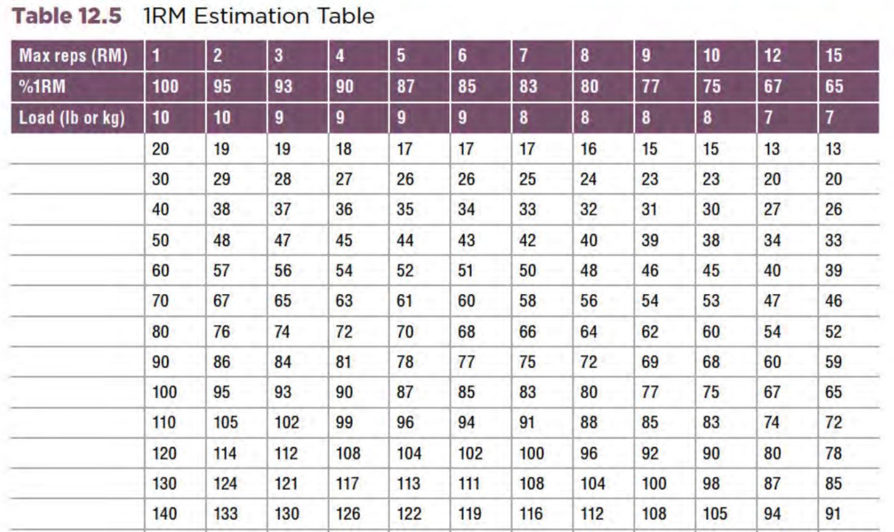
Repetition Maximum Test
Performed with a load that ranges between 5 & 10 repetitions
Heaviest load that allowed this with proper technique
Used in conjunction with a 1RM estimation table to predict maximal muscular strength for a specific exercise

Slide 18
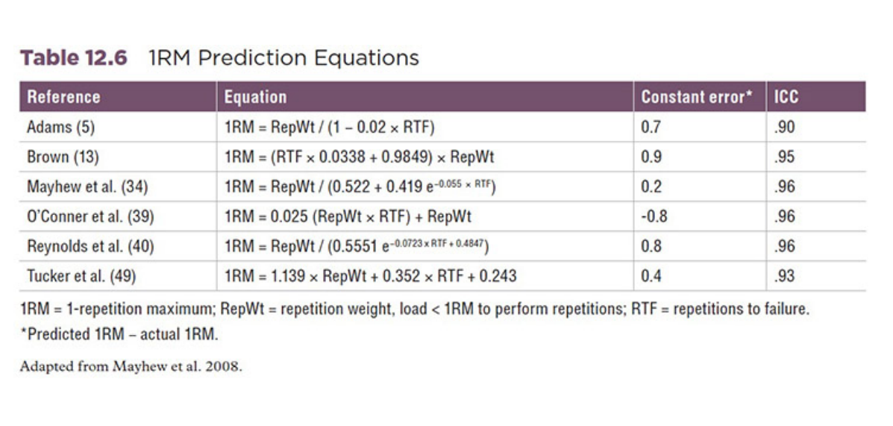
Prediction Equations
Allows the client to perform less than 10 repetitions
More accurate with heavier loads and fewer repetitions

Slide 19
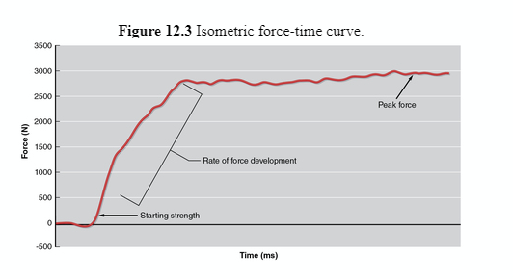
Isometric Strength Tests
No Visible movement; length of the muscle remains constant
Specific to muscle group and joint angle -> limited in describing total strength
Results affected by:
Joint angle (Must be standardized)
Protocol
Feedback
Participant motivation
Simple tests -> Peak Force and time to peak force
More complex tests -> Force-time curve

Slide 20
Assessments of Muscular Endurance
The ability of the neuromuscular system to perform one or two types of action
Perform under standardized conditions
Repeated contractions over a period until fatigue occurs with dynamic exercises
Maintenance of a specific percentage of an MVC for a period with static exercises
The total # of reps a person can perform with a percentage of 1RM

Slide 21
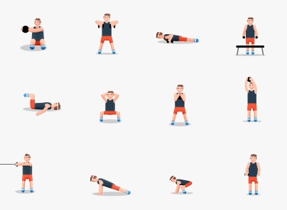
Lab 9: Assessments & Tables

Slide 22
Part 1 - Push-Up Test
Step 1: Set up the testing area and explain the basics of the test to the subject.
Step 2: Gather basic data (e.g., age, height, weight) for the individual data sheet as described in laboratory activity
1.1. Have the subject put his or her shoes back on and move to the test area.
Step 3: Lead the subject through a 10 min warm-up that includes both a general warm-up and a dynamic stretching routine targeting the musculature of the upper body.
Step 4: Instruct the subject to assume the proper starting position (for men, use the standard position; for women, use the modified position in the figure).
Step 5: Have the subject lower the body while maintaining a straight back until the chin touches the mat (figures 12.7b and 12.8b). The stomach should not touch the mat at any time during the assessment.
Step 6: Once the chin touches the mat, the subject should push up by extending the arms until achieving a straight-arm position. Record each successful push-up as it is performed.
Step 7: Without resting, the subject should repeat steps 5 and 6 until no longer able to maintain a straight-back position or complete any more push-ups.
Step 8: Record the total number of push-ups completed in the appropriate location on the individual and group data sheets. Compare the subject’s results with the data presented in table 12.9 and record the appropriate classification.

Slide 23
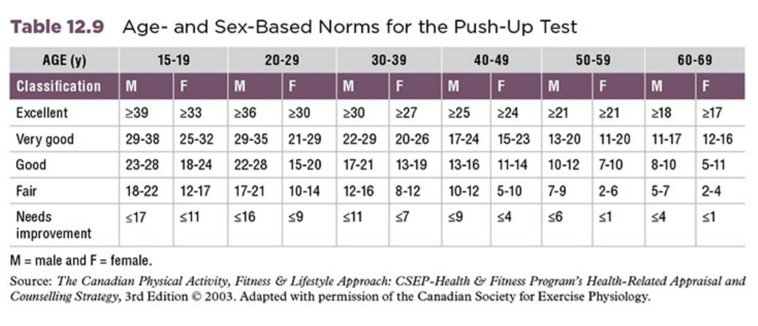

Slide 24
Part 2 - YMCA Bench Press Test
This test requires a station with a bench press, barbell (with appropriate weights), and metronome. Men use an 80 lb(36.3 kg) barbell, and women use a 35 lb(15.9 kg) barbell. During the test, a metronome counts 60 beats ∙ min⁻¹ to establish a rate of 30 reps ∙ min⁻¹. If the subject cannot maintain this rate, the test is ended.
Step 1: Set up the testing area with the appropriate weight, as well as a bench and a metronome.
Step 2: Set the metronome to 60 beats ∙ min⁻¹ to establish the necessary cadence (30 reps ∙ min⁻¹).
Step 3: Gather basic data (e.g., age, height, weight) for the individual data sheet as described in laboratory activity 1.
Step 4: Assume a spotting position while directing the subject to lie on his or her back on the bench. Explain that the subject must maintain all five points of contact (e.g., head, shoulders, buttocks, right and left feet) during the test.
Step 5: Once the subject is positioned on the bench, lift the bar off the rack using an alternated grip while the subject holds the bar using a pronated grip with the hands slightly farther than shoulder-width apart. Throughout the test, spot the subject with an alternated grip in order to assist when muscular failure is reached.
Step 6: Have the subject lower the bar to the starting position with the bar resting on the chest and the elbows in a flexed position.
Step 7: Instruct the subject to press the bar up to a position in which the arms are fully extended and then return bar to the chest at a cadence of 30 reps ∙ min⁻¹. The up-and-down movement will continue as long as the subject can maintain the prescribed cadence. During each repetition, ensure that a full range of motion (ROM) is performed. Count each successful repetition.
Step 8: When the subject can no longer maintain the 30 reps ∙ min⁻¹ cadence, help return the barbell to the rack.
Step 9: Record the total number of repetitions completed and determine the subject’s percent rank by comparing the results with the data presented in table 12.8. Record the results in the appropriate locations on the individual data sheet.
Step 10: Using the equations presented on page 262, estimate the subject’s 1RM bench press. Transfer this value to the individual and group data sheets.

Slide 25
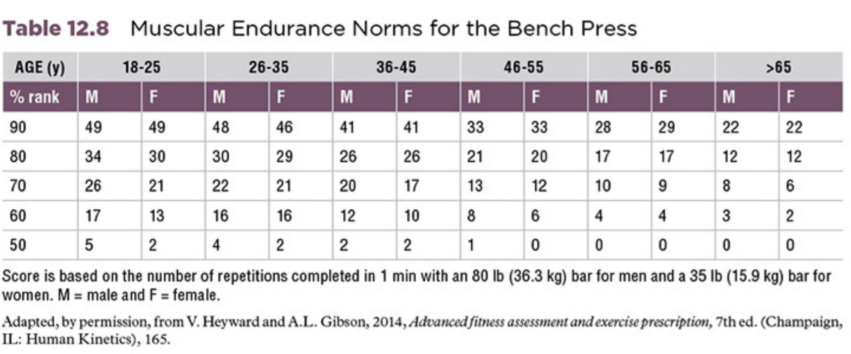

Slide 26
Part 3- 1RM Bench Press Test
Step 1: Set up the bench press area with all the equipment needed to conduct the test.
Step 2: Gather basic data (e.g., age, height, weight) for the individual data sheet as described in laboratory activity 1. Have the subject put on his or her shoes.
Step 3: Lead the subject through a 10 min warm-up that includes dynamic warm-up activities such as arms swings to prepare the upper body for the bench press test.
Step 4: Load the bar with the weight corresponding to the subject’s warm-up weight (40%-60% of perceived maximum). Move into an appropriate spotting position behind the bench press.
Step 5: Instruct the subject to lie on his or her back on the bench in a five-point-contact position. The subject’s body should be positioned on the bench such that the racked bar is directly above the eyes. All repetitions should begin in this position.
Step 6: Upon the subject’s command, lift the bar off the rack using an alternated grip. Guide the bar to a position over the subject’s chest, and then release the bar to the subject.
Step 7: Have the subject lower the bar in a controlled manner to touch the chest at approximately nipple height while maintaining the five points of contact and inhaling. During this movement, keep your hands in the alternated position near the bar but not touching the bar.
Step 8: The subject should push the bar upward until the elbows are fully extended while maintaining the five points of contact and exhaling. At the end of the prescribed number of repetitions (5-10)—or if maximum is achieved—grasp the bar with an alternated grip and place it back on the rack.
Step 9: After the subject completes 5 to 10 repetitions with the 40% to 60% load, quickly change the load to the predetermined second-set load. The subject should have only 1 min to rest during this change.

Slide 27
Part 3- 1RM Bench Press Test
Step 10: After the 1 min rest interval, conduct steps 5 through 8 and have the subject perform 3 to 5 repetitions with a load that is 60% to 80% of perceived maximum.
Step 11: After the completion of set 2, the subject rests for 3 min while you change the resistance to a load that is 90% of perceived maximum.
Step 12: After the 3 min rest, conduct steps 5 through 8 and have the subject perform 1 repetition with the 90% load.
Step 13: While the subject rests for 3 min, increase the load. If the attempt appeared relatively easy, increase the load by 5 to 10 kg. If, however, the attempt was more difficult, increase the load by 1 to 5 kg, depending on the weights available.
Step 14: Repeat steps 12 and 13, continuing to have the subject perform only 1 repetition until 1RM is achieved.
Step 15: If an attempt is unsuccessful, reduce the load by 1-10 kg, but keep it above the last successful attempt and have the subject rest for 3 min.
Step 16: After the 3 min rest, have the subject perform another attempt with the procedures outlined in steps 5 to 8.
Step 17: If the attempt is successful, increase the load by a small amount (1-5 kg) and repeat step 16. If the attempt is unsuccessful, the 1RM load is determined as the heaviest load successfully completed. Record the maximum weight lifted in the appropriate location on the individual and group data sheets.
Step 18: Divide the maximal weight lifted by the subject’s body mass and record the result in the appropriate location on the individual and group data sheets. This value should then be compared with the data in the norm table for the bench press (see table 12.2). Based on the results, note the subject’s strength classification and percent ranking on the individual data sheet.

Slide 28
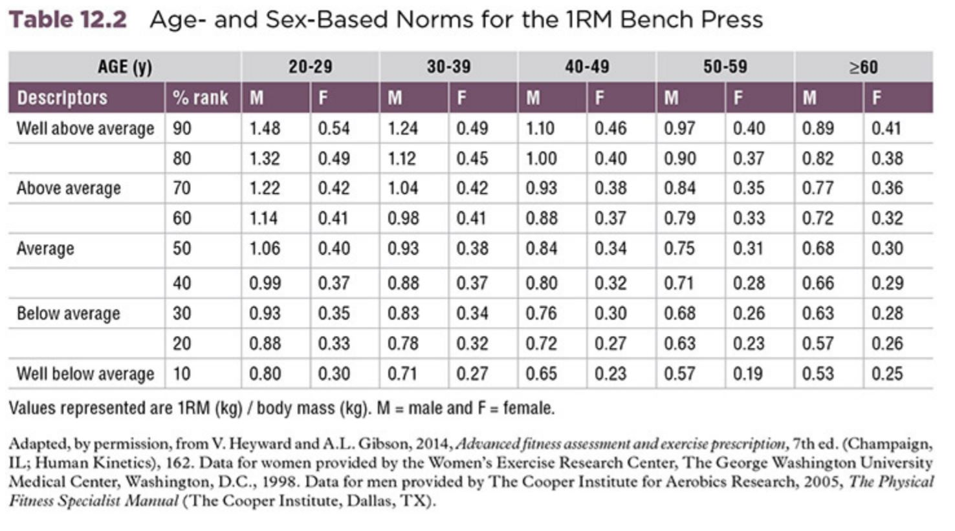

Slide 29
Part 4 - Bench Press 1RM Prediction Test
Step 1: Set up the bench press area with the appropriate weights.
Step 2: Gather basic data (e.g., age, height, weight) for the individual data sheet as described in laboratory activity 1.1. Instruct the subject to put on his or her shoes and move to the test area.
Step 3: Explain the test to the subject. Then begin a 10 min warm-up that contains a 5 min general warm-up (e.g., cycling, jogging, rope jumping) followed by 5 min of dynamic stretching activities targeting the upper body.
Step 4: Use the subject’s 1RM to determine the test set load. This will be considered the repetition weight (kg) used for the test (RepWt).
Step 5: Load the barbell with 50% of the calculated test set load using the estimation table.
Step 6: Instruct the subject to lie on the bench on his or her back with five points of contact (head, shoulders and upper back, buttocks, left foot, and right foot).
Step 7: Assume the spotting position.
Step 8: Instruct the subject to grasp the bar using a pronated grip with hands approximately shoulder-width apart.
Step 9: Lift the barbell off the rack with an alternated grip while the subject is grasping the bar. The subject should hold the barbell at arm’s length.
Step 10: Have the subject lower the barbell in a controlled fashion while inhaling until it touches the chest by moving the elbows down past the torso and slightly away from the body. Once the barbell touches the chest, instruct the subject to press the bar upward while exhaling until the arms are fully extended. This pattern should be completed six times. While the subject is performing each repetition, follow the bar with an alternated grip in order to assist the subject if needed.

Slide 30
Part 4 - Bench Press 1RM Prediction Test (cont.)
Step 11: Once the last repetition has been completed for the set, help the subject place the bar onto the rack.
Step 12: Adjust the weight to a load corresponding to 70% of the test weight previously calculated. During this time, the subject rests for 3 min.
Step 13: Repeat steps 6 through 11.
Step 14: While the subject rests for 3 min, change the weight to a load corresponding to 90% of the predetermined test weight.
Step 15: Repeat steps 6 through 11.
Step 17: If the subject completes fewer than 10 repetitions with the predetermined load, the test is complete. Record the total number of repetitions completed (RTF), as well as the load used (RepWt), in the appropriate location on the individual data sheet. Skip to step 21.
Step 18: If the subject performs more than 10 repetitions, increase the load by 2.5% to 5.0% while the subject rests for 3 min.
Step 19: Repeat steps 6 through 11, but have the subject perform as many repetitions as possible.
Step 20: After the subject completes step 19, the tester can then complete step 17. Continue this process until reaching a weight where the subject can lift fewer than 10 times.
Step 21: Using the Adams (5) equation, calculate the subject’s predicted 1RM bench press.

Slide 32
Part 5: Hand Grip Dynamometer
Set
Set HGR dynamometer to proper distance
Hold
Firmly hold HGR dynamometer
Hold
Hold arm at 90 degrees elbow flexion
Squeeze
Maximally squeeze handheld dynamometer for 3 seconds
Rest
Rest for 90 seconds
Repeat
Repeat squeeze trial

Slide 33
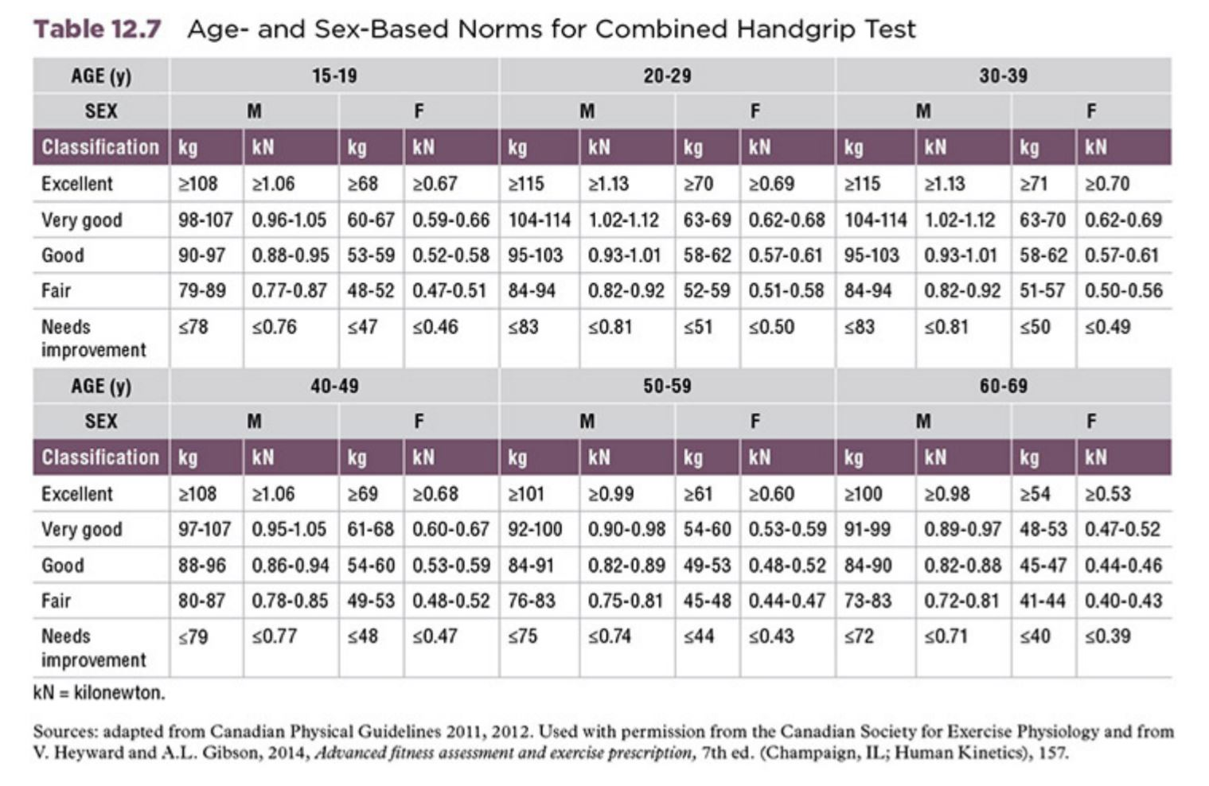

Slide 34
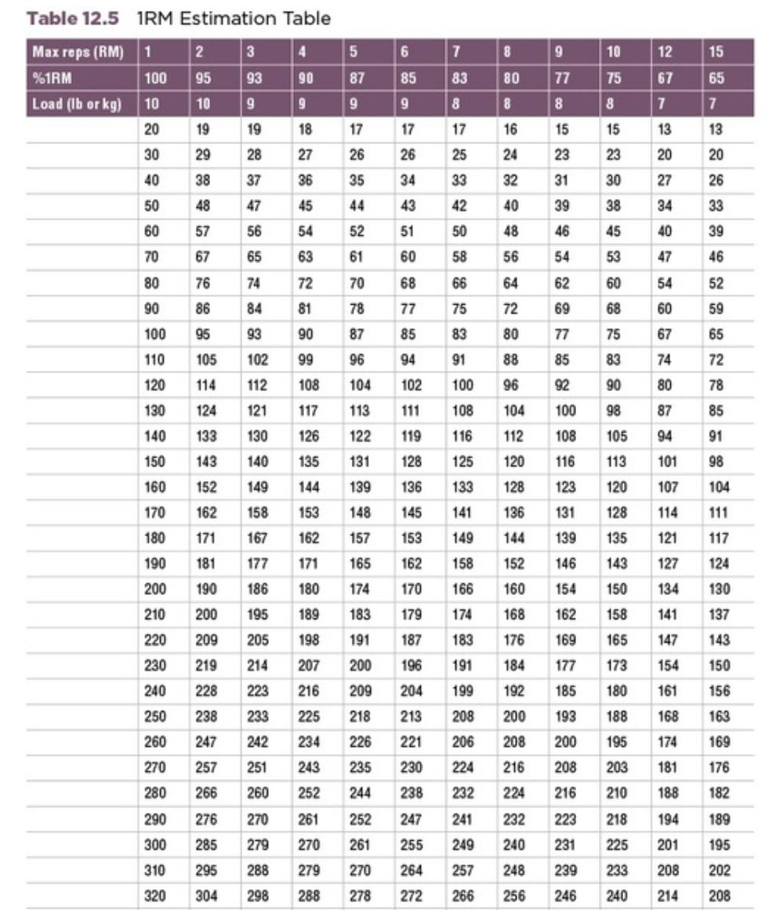
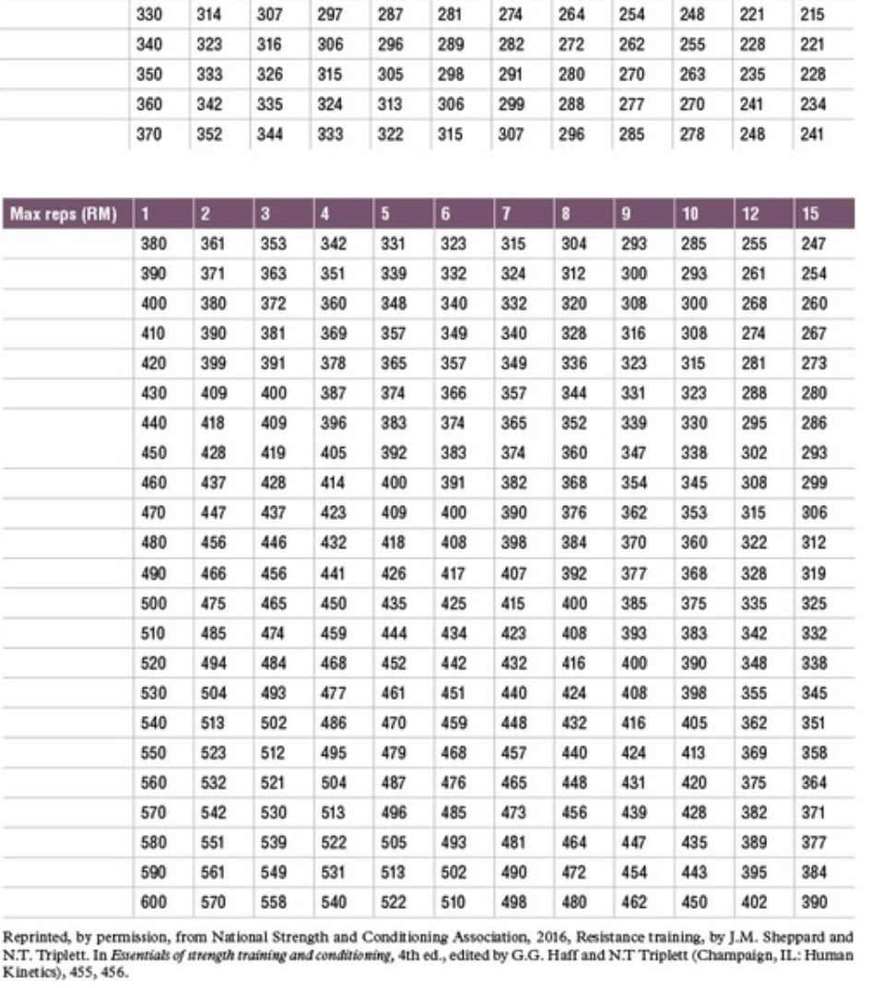

Slide 35
