Slide 1
Definitions
Submaximal Exercise Testing
Maximal Oxygen Consumption Testing
Science but Math
Trick or Treat
10
10
10
10
10
20
20
20
20
20
30
30
30
30
30
40
40
40
40
40
50
50
50
50
50

Slide 2
Category 1 questions follow

Slide 3
Category 1
Point where aerobic metabolism contributes 100% of the energy requirement at a given absolute intensity
10

Slide 4
Category 1
Steady State
10

Slide 5
Category 1
Maximal capacity for resynthesizing ATP with aerobic means; best determined with a GXT to exhaustion
20

Slide 6
Category 1
Aerobic Power
20

Slide 7
Category 1
Ergometer protocol for assessing maximal oxygen consumption; increases intensity every 1 to 3 min stage to exhaustion
30

Slide 8
Category 1
Graded Exercise Test (GXT)
30

Slide 9
Category 1
Point during increasing exercise intensity where ventilation begins to increase disproportionately as the body expires excess CO2
40

Slide 10
Category 1
Ventilatory Threshold
40

Slide 11
Category 1
Indicator of the reliability of a measure
50

Slide 12
Category 1
Intraclass correlation
50

Slide 13
Category 2 questions follow

Slide 14
Category 2
The exercise intensity below 85% of maximal effort, allowing steady state to be attained is called __________
10

Slide 15
Category 2
Submaximal
10

Slide 16
Define absolute work rate.
20

Slide 17
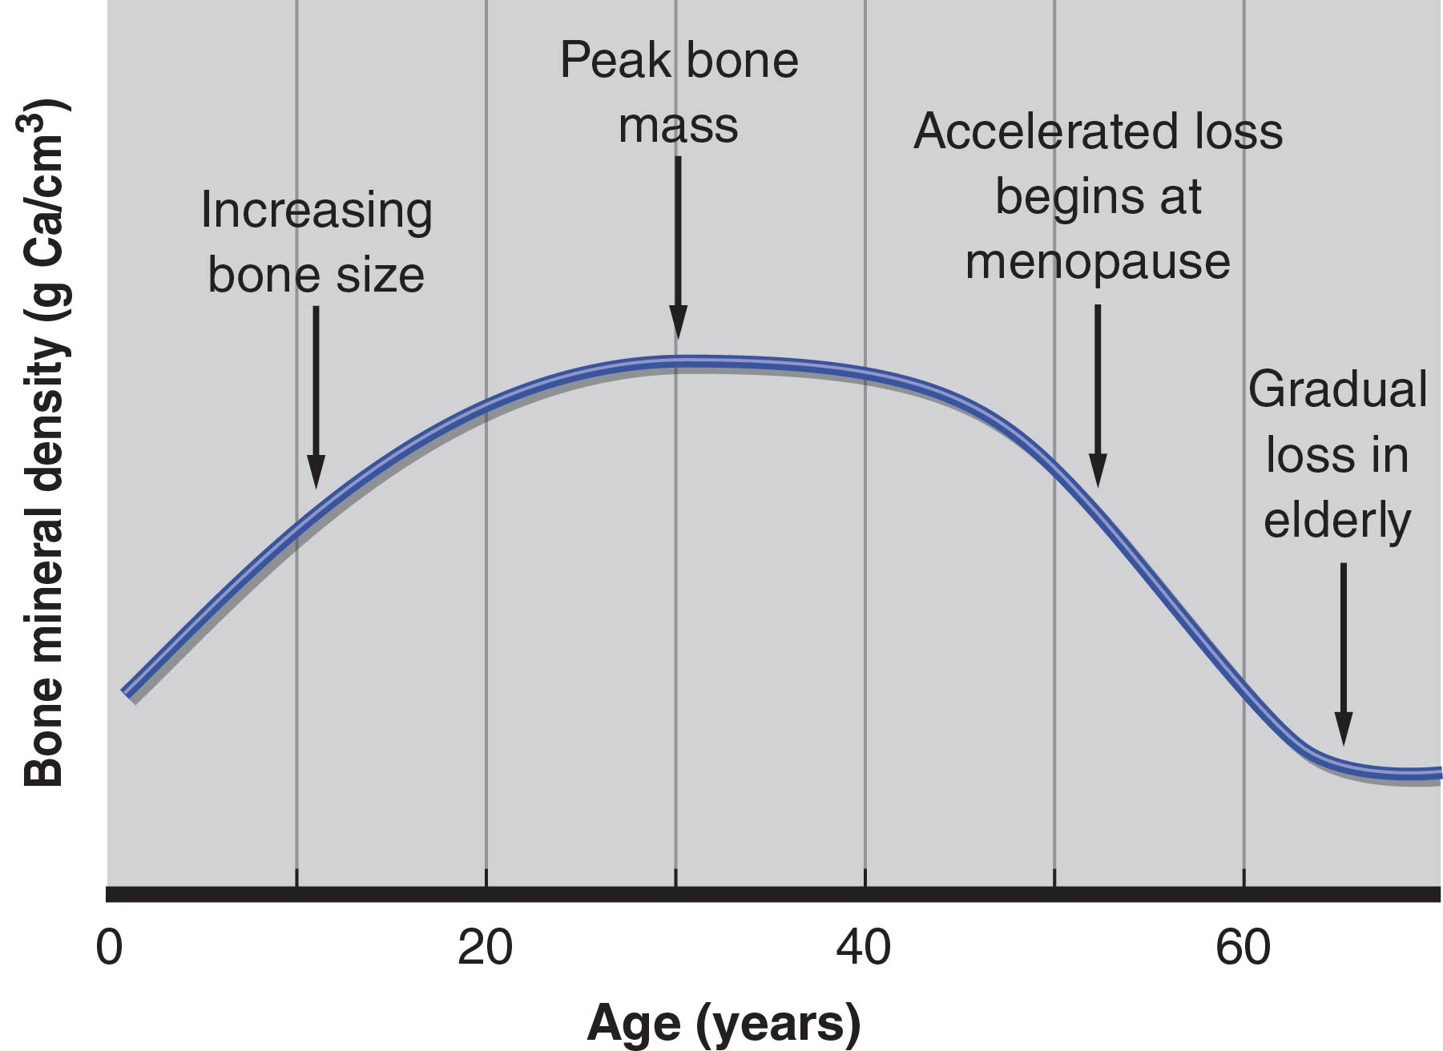
Category 2
Intensity of exercise measured on an ergometer by a unit of power; independent of fitness
20

Slide 18
Category 2
What are three advantages of submaximal testing?
30

Slide 19
Category 2
Practical
Do not require special equipment
Not population specific
Cost Effective
Can be performed quickly
Can do mass testing
Does not require subjects to exercise at maximal levels
Lower risk
30

Slide 20
Category 2
Name three factors that are monitored when performing submaximal testing:
40

Slide 21
Category 2
Heart Rate
Blood Pressure*
Patient Symptoms
Time
Work Rates
RPE
40

Slide 22
Category 2
What are the three submaximal tests described in our Submaximal exercise testing unit?
50

Slide 23
Category 2
Queens College step test
Ebbeling Submaximal Treadmill Test
Astrand Submaximal Cycle Test
50

Slide 24
Category 3 questions follow

Slide 25
Category 3
The Highest rate of oxygen consumption that a person can attain during exercise; commonly expressed in either the absolute units (L•min-1) or the relative units (ml•kg-1•min-1) is known as _________.
10

Slide 26
Category 3
Maximal Oxygen Consumption (VO2max)
10

Slide 27
Category 3
The point where aerobic metabolism contributes 100% of the energy requirement at a given absolute intensity is called _______
20

Slide 28
Category 3
Steady State
20

Slide 29
Category 3
Jenny is a 25-year-old triathlete who is serving as the subject for your class’s graded treadmill test. At the end of the test, her RER is 1.0, her RPE is 20, and the highest heart rate that she achieved was 165 beats ∙ min⁻¹.
Did she reach her V̇O₂max? Why or why not?
30

Slide 30
Category 3
Need to know plateau to determine. 2/4 criteria must be met to be considered a true test
30

Slide 31
Category 3
What are the criteria for distinguishing a VO2 peak test, from a VO2 max test? (4)
40

Slide 32
Category 3
VO2 Plateau
Predicted HR
RER greater than 1.1
RPE greater than 17 on the BORG scale
40

Slide 33
Category 3
VO2max is Influenced by (5 things):
50

Slide 34
Category 3
Hereditary (Genetics)
25% to 50% is considered genetic
Sex
Male values are 15% to 20% higher than female values for the same age group
Age
Gradual decline of about 8% per decade occurs from 30 years on
Can be attenuated with exercise training
Training Status
6% to 25% improvement in values may be seen with training
Mode of Exercise
Outcome is affected by choice of exercise; more muscle recruitment results in greater VO2 max values
50

Slide 35
Category 4 questions follow

Slide 36
Category 4
Which of the following is not an advantage of conducting field tests of aerobic power?
requires minimal equipment
largest amount of control possible in testing conditions
minimal medical supervision
large groups of people can be conducted at once
10

Slide 37
Category 4
largest amount of control possible in testing conditions
10

Slide 38
Category 4
You decided to estimate your client's VO2max using the Queens College Step Test.
These are the outcomes of the test:
Resting HR: 50 bpm
3:05 to 3:20 pulse count: 45
Use the following formula to calculate
111.33 - (0.42x HR) = VO2max
Enter an integer number (without decimals).
20

Slide 39
Category 4
36 ml/kg/min
20

Slide 40
Category 4
What is the relative VO2 max of the following athlete:
Athlete A
Soccer
Female
32
66kg | 145lbs
150cm | 59.1in
VO2max: 2.8 liters per minute
30

Slide 41
Category 4
42.4 ml/kg/min
30

Slide 42
Category 4
Cooper 1.5 Mile Run/Walk Test
Using the participant information below, what is the appropriate VO2 max:
Participant Name: John Weight: 91.1kg Age: 26 Sex: M = 1 / F = 0 Time: 12:15
Equation 1
VO2max (ml⋅kg−1⋅min−1) = 91.763−(0.1656 ∗ body mass(kg) )−(2.767 ∗ Time (min))
40

Slide 43
Category 4
42.3 ml/kg/min
40

Slide 44
Category 4
Draw a graph explaining ventilatory threshold and its relationship to VO2 max.
50

Slide 45
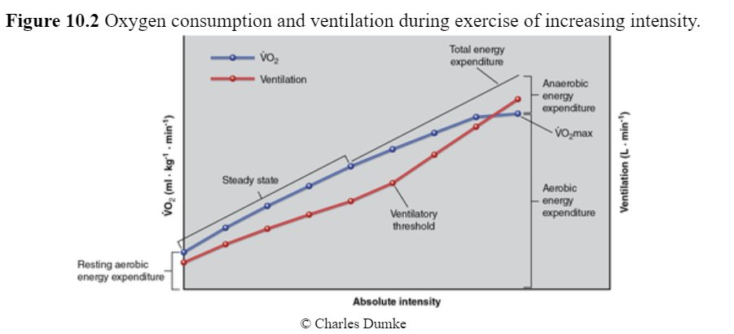
Category 4
50

Slide 46
Category 5 questions follow

Slide 47
Category 5
Who was the British physiologist, known for his research on respiratory physiology and the invention of the Douglas Bag.
10

Slide 48
Category 5
Claude Gordon Douglas
10

Slide 49
Category 5
Heavy breathing at maximum exercise is an attempt to _________
20

Slide 50
Category 5
Fun Fact: Many people believe that heavy breathing at maximum exercise is an attempt to consume more O2, in fact the increased ventilation is driven more by CO2 production
20

Slide 51
Category 5
Greater rate of VE (ventilation) above ventilatory threshold coincides with:
30

Slide 52
Category 5
An increase in blood lactate
Rise in VCO2
Increased RER above 1.0
30

Slide 53
Category 5
A lower HR response to a given absolute work rate, extrapolates to a higher intensity at the predicted HRmax and therefore a ______ predicted O2 uptake
40

Slide 54
Category 5
Higher
40

Slide 55
Category 5
Explain how RER during exercise can rise above 1.0 and the mechanisms contributing to this value.
50

Slide 56
Category 5
Greater rate of VE above ventilatory threshold coincides with:
An increase in blood lactate
Rise in VCO2
The increase in blood CO2 is the result of lactic acid dissociation into water and CO2, which stimulates an increase in ventilation
*Ventilatory Threshold is indicative of an abrupt increase in blood lactate and a subsequent decrease in Blood pH
This non-metabolic excess VO2 contributes to the VCO2 which is why RER can exceed 1.0 at high intensities
50

