Slide 1
Submaximal Exercise Testing- Week 8
PET4550C

Slide 2
Objectives
Reinforce terminology and techniques associated with measuring blood pressure at rest and during exercise
Learn the skills needed for administering three types of submaximal exercise tests
Reinforce the terminology and techniques associated with measuring hear rate at rest and during exercise
Estimate VO₂ max by measure of HR response to submaximal exercise

Slide 3
Important Definitions
Absolute Work Rate
Intensity of exercise measured on an ergometer by a unit of power; independent of fitness
Maximum Heart Rate
Maximum rate at which an individual's heart can beat per minute
Most popular formulas for measuring HR_{max} are:
[ 220 – Age ] – most common and widely used maximum heart rate formula
[ 208 – 0.7 x Age ] – more precise formula, adjusted for people over the age of 40
[ 211 – 0.64 x Age ] – slightly more precise formula, adjusted for generally active people
Relative Work Rate
Intensity of exercise measured relative to an individual's maximal abilities
Submaximal
Exercise intensity below 85% of maximal effort, allowing steady state to be attained
Rating of Perceived Exertion
Scale to assess the difficulty of exercise perceived by the subject

Slide 4
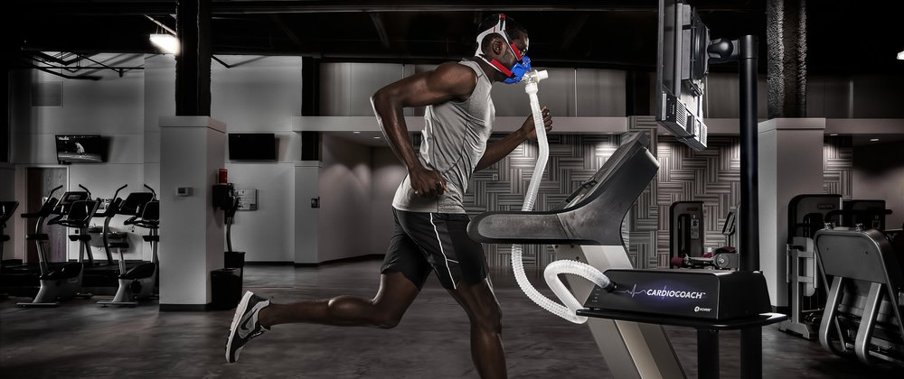
Cardiorespiratory Capacity (VO₂ Max)
Refers to the capacity of the circulatory and respiratory systems to supply oxygen to skeletal muscle mitochondria for energy production needed during physical activity.
Useful for exercise prescription or for diagnostic purposes
Tests for estimating VO₂ Max can be maximal or submaximal

Slide 5
Maximal vs Submaximal Testing
Maximal Testing Advantages
More accurate
Offers better sensitivity
Personalized Results
Submaximal Testing Advantages
Practical
Do not require special equipment
Not population specific
Cost Effective
Can be performed quickly
Can do mass testing
Does not require subjects to exercise at maximal levels
Lower risk

Slide 6
Maximal vs Submaximal Testing
Maximal Testing Disadvantages
Cost of Equipment
More time consuming
More risk involved
Requires individual to exercise until volitional fatigue
Submaximal Testing Disadvantages
VO₂ max is not directly measured
Error rate of 10-20%
No true measurement of maximal HR
Estimates of max HR using can vary by +/- 15% bpm for individuals of the same age

Slide 7
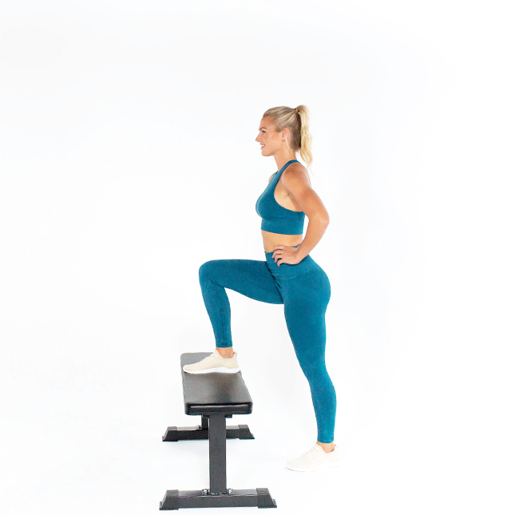
Submaximal Testing
In order to determine submaximal effort, you must quantify the work performed
Therefore, approaches that facilitate the quantification of work rate are used
Bench Stepping, treadmill, & cycle ergometer tests
Requires monitoring:
Heart Rate
Blood Pressure
Patient Symptoms
Time
Work Rates
RPE

Slide 8
Importance of Heart Rate
HR response to exercise (increasing work rate) is linear
Submaximal work rates can be extrapolated to HR
This is the most popular assessment for estimating VO₂ max
To predict cardiorespiratory fitness, you must examine the relationship between HR, age, and fitness level

Slide 9
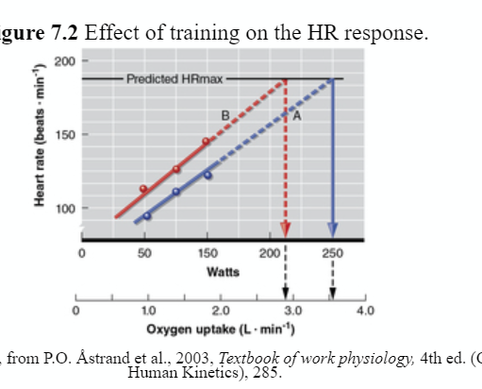
Effect of Training on the HR Response
The fitter someone is, the lower their HR at a given absolute submaximal workload
Hallmark of adaptation to training
Reduction in HR at submaximal intensities results from an increase in Stroke Volume
This allows a lower HR to accomplish the same CO and VO₂
Predicted oxygen uptake is estimated from HR response to submaximal intensities up to the predicted HR_{max}
Therefore, a lower HR response to a given absolute work rate, extrapolates to a higher intensity at the predicted HR_{max} and therefore a higher predicted O₂ uptake

Slide 10
Effect of Training on the HR Response Cont'd
2nd Cardiovascular adaptation to training is the recovery of HR following exercise
In trained individuals, HR returns to a normal resting value more quickly than in an untrained individual
Accurately times postexercise HR can be used as a predictor of fitness

Slide 11
Assumptions of Submaximal Testing
A subject attains steady state exercise at each submaximal work rate so that the outcome measures of BP and HR are at a steady state
Efficiency does not differ significantly between subjects
It is assumed all subjects expend the same amount of energy at a given absolute rate independent of fitness
Subjects can be at vastly different percentages of their individual maximal capacity, or relative work rates
HR_{max} is the same across a given age
Error can be significant in the estimation of HR_{max} according to the formula in which HR=220-age; SD is ± 12 bpm

Slide 12
Assessing Heart Rate
HR can be measured via:
Palpation
Auscultation
ECG
HR Monitors
HR can be palpated at several artery sites:
Radial
Brachial
Carotid
Temporal
Femoral
To check your pulse at your wrist, place two fingers between the bone and the tendon over your radial artery — which is located on the thumb side of your wrist.
When you feel your pulse, count the number of beats in 30 seconds. Multiply this number by 2 to calculate your beats per minute.

Slide 13
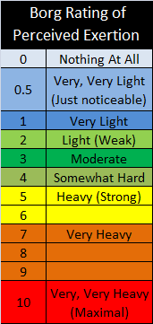
Rating of Perceived Exertion
Can be used to monitor progress toward maximal exertion
2 Scales have been developed
Developed by Gunnar Borg
1 ranges from 0-10
1 ranges from 6-20
The scales include instructions to read before the start of the test

Slide 14
The Tests
Submaximal Exercise Tests

Slide 15
Submax Bench Step Test
Queens College Step Test

Slide 16
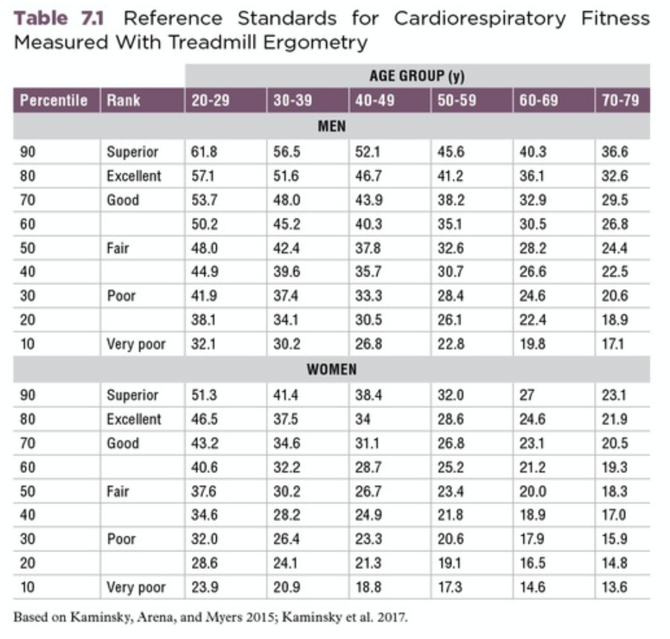
Steps: Queens College Step Test
Step 1: Because the accuracy of the test relies on the HR response, attempt to eliminate factors that might alter this outcome measure. Ideally, subjects will have avoided exercise for the previous 24 h, fasted for at least 2 h, and avoided the use of foods and drugs that alter HR (e.g., coffee, soda, energy drinks, diet pills, beta-blockers).
Step 2: Pair up with another student and find an appropriate space in which to conduct the test. Either you or your partner will start as the tester, and the other person will serve as the subject. You will then reverse these roles.
Step 3: Gather basic data (e.g., age, height, weight) for the individual data sheet as described in laboratory activity above. The subject then sits on the bench step, and rests for 3 min, after which the tester palpates the radial pulse for 15 s and records the resting HR. Record the simultaneous HR from the HR monitor on the individual data sheet.
Step 4: Set the metronome at 88 beats∙min⁻¹ to allow the subject to make contact with a foot on each beep in an up-up-down-down manner. This cadence results in the necessary 22 steps ∙ min⁻¹ for women. For men, set the metronome at 96 beats ∙ min⁻¹ and thus 24 steps ∙ min⁻¹. Allow a few steps for practice.
Step 5: When the subject is ready, begin the 3 min test and start the stopwatch.
Step 6: To avoid muscle fatigue, the subject should switch the leading leg at least once during the test.
Step 7: After exactly 3 min of stepping, the subject should stop. The tester should palpate for the radial pulse. Begin counting at exactly 3:05 and count for 15 s (i.e., to 3:20). Record the pulse count, recovery HR, and simultaneous HR from the HR monitor on the individual data sheet.
Step 8: Calculate the predicted VO2max by using the recovery HR in the following equations, where HR is beats ∙ min−1.
Men: VO2max = 111.33 − (0.42 × HR) Women: VO2max = 65.81 − (0.1847 × HR)
Step 9: Record your own data on the individual data sheet. Include your percentile rank from table 7.1

Slide 17
Submaximal Treadmill Test
Ebbeling Submaximal Treadmill Test

Slide 18
Steps: Ebbeling Submaximal Treadmill Test
Step 1: Because the accuracy of the test relies on the HR response, attempt to eliminate factors that might alter this outcome measure. Ideally, subjects will have avoided exercise for the previous 24 h, fasted for at least 2 h, and avoided the use of foods and drugs that alter HR (e.g., coffee, soda, energy drinks, diet pills, beta-blockers).
Step 2:Gather basic data (e.g., age, height, weight) for the individual data sheet as described in laboratory activity above.
Step 3: Determine the subject's age predicted HR max using the equation: 208-(0.7 * age).
Step 4: Take resting blood pressure and record.
Step 5: Select a walking speed between 2 and 4.5 mph based on the subjects age, sex, and anticipated fitness level.
Step 6: Have the subject warm up at the selected speed and 0% for grade for 4 minutes. At minutes 2 and 4, take palpated HR, BPE, and RPE. The warmup should elicit an HR of 50% to 70% of age-predicted maximum. If the HR response is too low or too high, adjyst the treadmill speed and repeat the warm-up.
Step 7: The 4-minute single-stage test begins by increasing the grade to 5% at the same speed established in the warmup. At minutes 2 and 4 of this stage, collect palpated HR, BP, and RPE and record.
Step 8: Have the subject cool down by lowering the grade to 0%. At minute 2 and 4 of the cool down, collect HR, BP, and RPE.
Step 9: Calculate VO2 max using the following equation:
VO2 max= 15.1 + (21.8 * speed in mph) - (0.327*HR) - 0.263 * (speed in mph * age) + 0.00504 * (HR *age) + 5.98 * (sex where 0=female and 1=male)

Slide 19
Submaximal Cycle Ergometer Test
The Astrand Bicycle Ergometer Test

Slide 20
Steps: Astrand Submaximal Cycle Test
Step 1: Because the accuracy of the test relies on the HR response, attempt to eliminate factors that might alter this outcome measure. Ideally, subjects will have avoided exercise for the previous 24 h, fasted for at least 2 h, and avoided the use of foods and drugs that alter HR (e.g., coffee, soda, energy drinks, diet pills, beta-blockers).
Step 2:Gather basic data (e.g., age, height, weight) for the individual data sheet as described in laboratory activity above.
Step 3: Determine the subject's age predicted HR max using the equation: 208-(0.7 * age).
Step 4: Set the cycle to the right height (seat at hip height);
Step 5: Start the warming up of approximately two or three minutes at low wattage;
Step 6: Once the test starts, the test person should keep the rotations between 50-60 RPM;
Step 7: Start at 50 watts and increase the resistance in steps of 25 watts (women) and 50 watts (men), so the heart rate increases to 130;
Step 8: The heart rate is then recorded every minute
Step 9: During the final two minutes, the heart rate is recorded every fifteen seconds;
Step 10: A steady state heart rate should occur in the final two minutes (i.e. no more than 5 sl/min difference between 140-145 sl/min);
If a steady state heart rate does not occur, use the average heart rate of the final two minutes.
Calculate VO₂ using the provided tool

Slide 21
Lab 7-Submaximal Exercise Testing
To complete this week's lab, you will need to watch the Virtual Lab-Step Test (Queens college Step Test) located in the Module
Record the participant information presented in the video
Record all other data in the video in the appropriate spot on the data sheet
Listen and record the HR data in the video
Use the appropriate equation for calculating VO₂ Max
Classify the participant based off the information calculated using tables 7.1 and 7.3
(Provided on the next slides)

Slide 23
