Slide 1
Blood Pressure- Week 3
PET4550C

Slide 2
Review
Pretest Screenings
What are the goals?
Identify those with medical contraindications for performing exercise (testing)
Identify those who should be medically supervised during testing
Identify those with other medical/health concerns

Slide 3
Minimum Components
1. Health History Questionnaire
2. Physical Activity Questionnaire for Everyone (PAR-Q+)
3. Medical or Health Exam

Slide 4
Seven-Step Comprehensive Screening Process
1. Informed Consent
2. PAR-Q+
3. Medical and Health History
4. Signs & Symptoms of Disease & Medical Clearance
5. Coronary Risk Factor Analysis
6. Lifestyle Evaluation
7. Disease Risk Classification

Slide 5
What is the base process?
ACSM- Two basic approaches to preparticipation in physical activity screening
1. Performed by the individual in a self-guided screening
PAR-Q+
EPARmed-X
2. Requires the involvement of a health professional (professionally supervised screening)
Health History Questionnaire
Medical Examination
Preparticipation Physical Activity screening

Slide 6
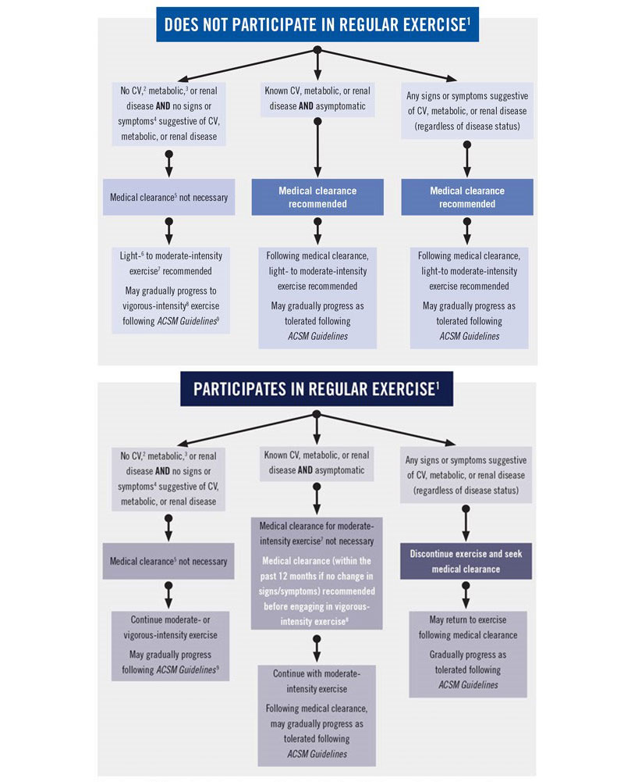
ACSM Exercise Preparticipation HS Algorithm

Slide 7
Contraindications
Absolute
Relative
Not allowed to participate in any form of physical activity program and/or exercise test
Requires Medical Supervision
Examples
Ongoing unstable angina
Acute myocardial infarction (MI), within 2 days
Uncontrolled cardiac arrhythmia with hemodynamic compromise
Active endocarditis
Symptomatic severe aortic stenosis
Decompensated heart failure
May be accepted or allowed into a physical activity assessment and/or program if it is deemed that the benefits for the individual outweigh the risks to the individual.
Examples
Known obstructive left main coronary artery stenosis
Moderate to severe aortic stenosis with uncertain relation to symptoms
Recent stroke or transient ischemic attack
Mental impairment with limited ability to cooperate
Resting hypertension with systolic or diastolic blood pressures >200/110 mm Hg

Slide 8
Questions?

Slide 9
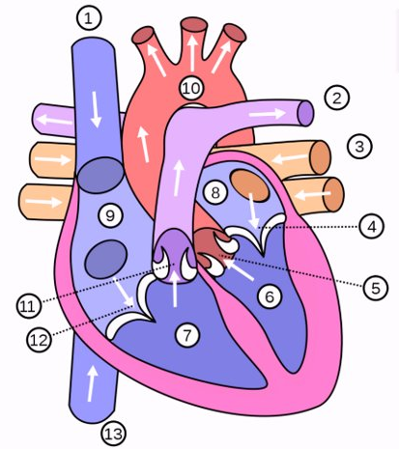
The Heart
1. Superior Vena Cava
2. Pulmonary Arteries
3. Pulmonary Veins
4. Mitral Valve
5. Aortic Semilunar Valve
6. Left Ventricle
7. Right Ventricle
8. Left Atrium
9. Right Atrium
10. Aorta
11. Pulmonary Semilunar Valve
12. Tricuspid Valve
13. Inferior Vena Cava

Slide 10
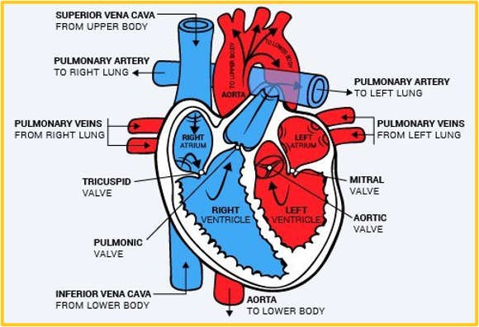
Blood Flow & The Heart
Arteries vs Veins
Most of the filling of the ventricles is due to passive filling
Atria contraction does little ventricular filling (20%)
Right side of the heart to pulmonary circuit
Left side of heart to systemic circuit
Left ventricle of heart is more muscular
Laminar Blood Flow
Flows without turbulence; no audible sound

Slide 11
Understanding Blood Pressure
Pressure exerted against the walls of the various vessels of the arterial side of the circulatory system by the heart as it pumps blood to the body.
Dependent on two factors:
the volume of blood delivered to a vessel
amount of resistance exerted against the blood being delivered (vascular resistance or total peripheral resistance).
Small changes in radius of vessels results in large increases in vascular resistance

Slide 12
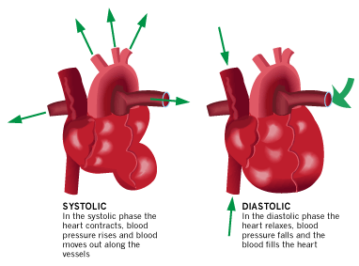
Systolic & Diastolic Pressure
Arterial systolic blood pressure (SBP) is the maximum pressure attained during peak ventricular ejection or systole during the cardiac cycle
Pressure exerted when blood is ejected into arteries
Diastolic blood pressure (DBP) is the minimum arterial pressure within the cardiac cycle during ventricular relaxation or diastole.
Pressure blood exerts within arteries in between beats

Slide 13
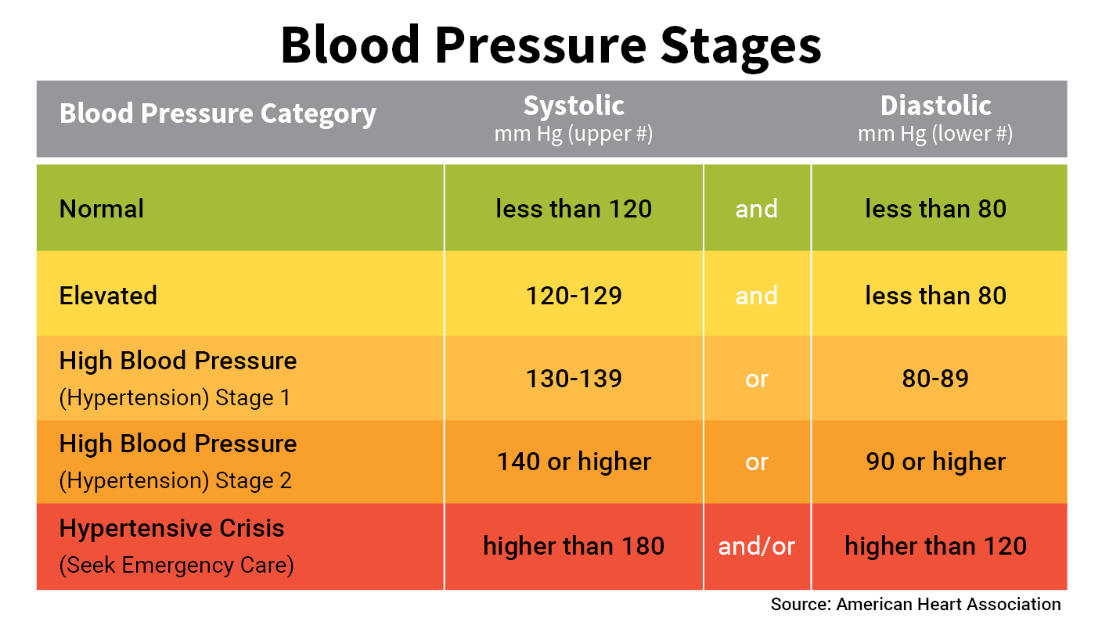
Ranges
High Blood Pressure:
too much resistance inside your arteries… can cause arterial damage and increases risk of stroke, heart attack, or failure

Slide 14
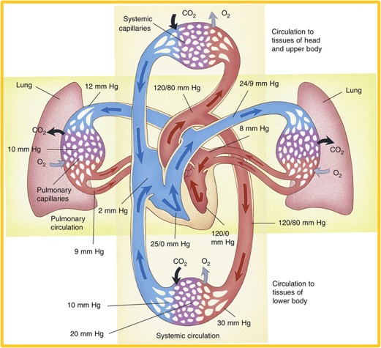
Pressure Gradients

Slide 15
Components of Cardiac Output (CO)
Definition:
The amount of blood ejected by the heart in 1 minute
2 factors used to calculate CO
Stroke volume x Heart rate
Volume of blood pumped by each ventricle with each heartbeat (mL/beat)
# of beats per minute (beats/min)
4 Determinants of Cardiac Output
1 Influence HR
3 Influence Stroke Volume

Slide 16
#1 Heart Rate
Heart Rate is influenced by 2 Factors called chronotropes!
Positive chronotropes ↑ HR
Sympathetic Stimulation: Epinephrine, adrenaline
Drugs: Atropine
Negative chronotropes ↓ HR
Parasympathetic Stimulation: Acetylcholine
Drugs: Adenosine, Metoprolol (Beta-Blockers)

Slide 17
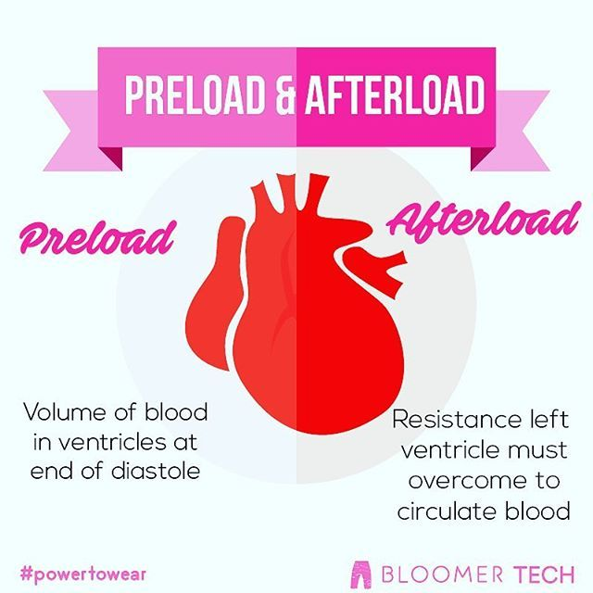
#2- Preload
Definition: The amount of blood entering the ventricles during diastole
Also referred to as end diastolic volume
Can be influenced by:
Venous Return
Fluid Volume
Atrial Contraction

Slide 18
#3 Afterload
Occurs during systole when your ventricles are contracting, ejecting blood out of the aorta.
Definition: The resistance ventricles must overcome to circulate blood
Factors increasing Afterload:
Hypertension
Atherosclerosis
Vasoconstriction
These factors increase resistance!

Slide 19
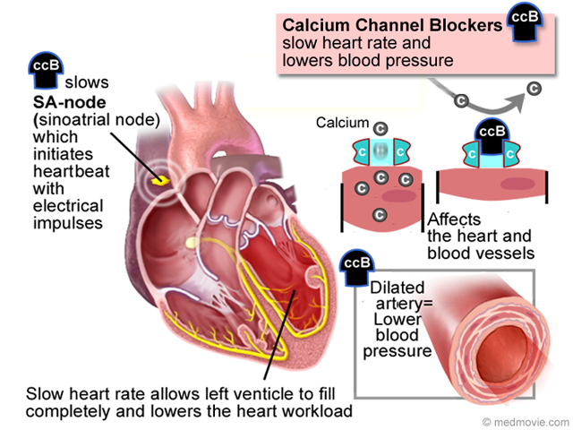
#4 Contractility
Definition: How hard the myocardium contracts for a given preload
Influenced by 2 factors called inotropes
Positive Inotropes ↑ Contractility
Sympathetic stimulation: noradrenaline/norepinephrine
Drugs: Dobutamine
Negative Inotropes ↓ Contractility
Parasympathetic Stimulation: acetylcholine
Drugs: B-Blockers, calcium channel blockers

Slide 20
Hemodynamics- Quick View
Blood Flow: the movement of blood through the vessels from arteries to the capillaries and into the veins.
Darcy's Law or Ohm's Law
Blood flow (F) through a blood vessel is determined by two main factors: (1) pressure difference (ΔP) between the two ends of the vessel and (2) the resistance (R) to blood flow through the vessel.
Poiseuille's Law
The volume flow rate is directly proportional to the pressure gradient and the radius^⁴.
Tells us that the volume flow rate is inversely proportional to the viscosity of that fluid.
Used to estimate the volume flow rate of blood through the blood vessels of our body.
If we ↓ the radius of the blood vessel, we will greatly decrease the volume flow rate. The heart will try to compensate for this decrease by increasing the pressure difference between the different ends of the vessel.
Can lead to complications and high blood pressure.

Slide 21
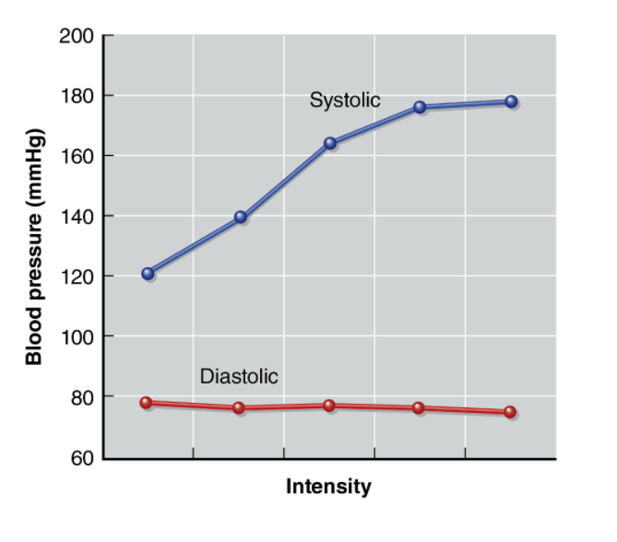
Blood Pressure Responses to Exercise
Systolic BP rises rapidly, then levels off after steady state exercise
Graded exercise tests usually produce progressively increasing systolic pressure
Can reach as high as 250mmHg
Rise in systolic is due to increased force from heart in order to increase Cardiac Output (CO)
Diastolic reflects no change due to redistribution of blood to capillaries in working muscles

Slide 22
Blood Pressure Responses to Exercise
After exercise
Systolic rapidly drops- due to pooling of blood that was in working muscles.
Pooling reduces venous return and decreases CO
Proper cool down is recommended- why?
Isometric Exercise
Occluding blood flow- increase resistance and decrease blood flow… therefore results in what changes for blood pressure?

Slide 24
Body Position and Blood Pressure
Changes in body position = Orthostatic Changes
Supine
Heart works less hard to deliver blood to the periphery
Gravity
Heart rate = lower due to increased venous return
Supine → Standing
Venous return decreases (gravity) ↓ Blood Pressure
Orthostatic Hypotension
→ Vasovagal syncope (Fainting)

Slide 25
When should an exercise test be stopped?
A drop in SBP ≥ 10 mmHg with an increase in intensity
SBP decreases below the value at rest in the same position
Increase of ≥ 250 mmHg in SBP or ≥ in DBP
Lack of increase in HR with increasing intensity
Poor signs of perfusion or dyspnea

Slide 26
QUESTIONS?

Slide 27
Lab 3: Taking Blood Pressure

Slide 28
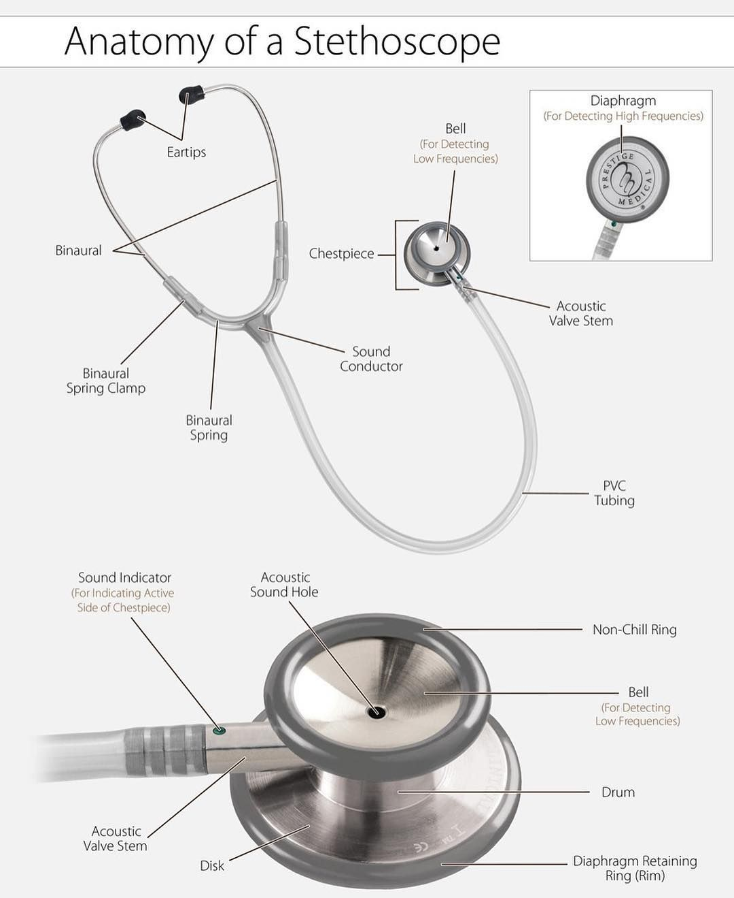
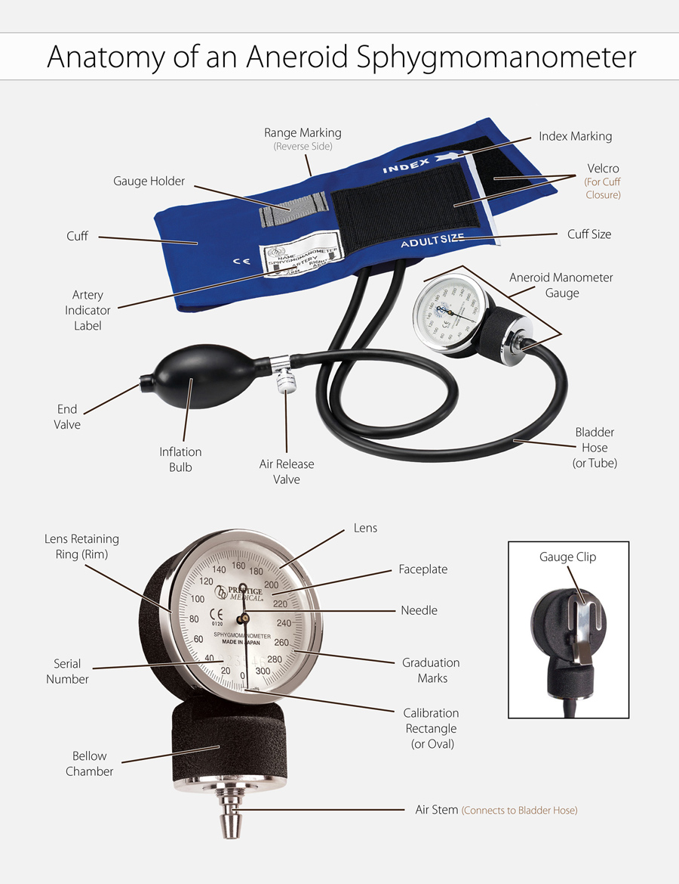

Slide 29
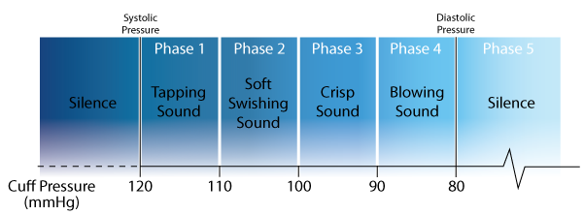
Korotkoff phases
Definition: "tapping" sounds heard with a stethoscope as the cuff is gradually deflated.
(Phase 1): The appearance of the clear "tapping" sounds as the cuff is gradually deflated. The first clear "tapping" sound is defined as the systolic pressure.
(Phase 2): The sounds in K-2 become softer and longer and are characterized by a swishing sound since the blood flow in the artery increases.
(Phase 3): The sounds become crisper and louder in K-3 which is similar to the sounds heard in K-1.
(Phase 4): As the blood flow starts to become less turbulent in the artery, the sounds in K-4 are muffled and softer. Some professionals record diastolic during Phase 4 and Phase 5
(Phase 5): In K-5, the sounds disappear completely since the blood flow through the artery has returned to normal. The last audible sound is defined as the diastolic pressure.

Slide 30
Taking Blood Pressure
Place the BP cuff on the subject’s arm.
Place the cuff with the lower margin about 1 in. (2.5 cm) above the antecubital space. Ensure the bladder covers the brachial artery. During the measurement, the arm should be supported at the level of the heart (figure 4.2a).
Palpate to find the brachial artery in the antecubital space and place the flat side of the stethoscope bell lightly over the brachial artery (figure 4.2c). Too much pressure on the bell can affect blood flow in the artery and cause sounds independent of the cuff pressure. Too little pressure can reduce the ability to hear Korotkoff phases. Be sure the bell is flat against the skin and you have the earpieces in correctly (pointed forward).

Slide 31
Taking Blood Pressure
Holding the stethoscope in place, close the air-release valve (clockwise) and inflate the BP cuff to 200 mmHg or more by pumping the air bulb. The pressure occludes the flow to the brachial artery, causing the pulse sound to stop. At rest, you may need only to inflate to 180 mmHg to be above SBP (figure 4.2c).
Release pressure slowly and smoothly at a rate of 2 or 3 mmHg ∙ s−1 by releasing the air-release screw (counterclockwise).
As pressure is released, the Korotkoff sounds become audible. The appearance of a faint tapping sound marks the SBP; at this point, note the mmHg reading. This sound will increase in intensity before fading.
When the subject is at rest, such as sitting or standing, the DBP is marked by the disappearance of sound in the brachial artery, which indicates laminar blood flow. During exercise, the DBP is marked by an abrupt muffling of the pulse sound. Note the mmHg at the appropriate Korotkoff phase.

Slide 32
Sitting, Supine and Standing (4 BP’s)
Sitting (1)
Subject is sitting in chair, feet flat on floor
Arm should be horizontal at heart level
Supine (2)
Lay down, maintain supine for ~3min with cuff attached
Arm should be flat, palm facing up, next to body
Record HR and BP laying down
Standing
Pump cuff to 200mg BEFORE subject stands
IMMEDIATELY take BP when they stand (3)
Wait ~2min, standing
Take BP again (4)

Slide 33
Common Mistakes
Improper Positioning
Slouching, unsupported back/feet, legs crossed, arm not heart level
Can add anywhere from 2-10 points
Improperly fitted cuff
Too short or narrow= erroneously high
Too Large= erroneously low
Can add anywhere from 2-10 points
Measurements taken over clothing
Can add 5-50 points to a reading
Talking during measurement
Can add up to 10 points
Using your thumb on the stethoscope
Pressing hard with stethoscope
Normality reading prejudice

Slide 34
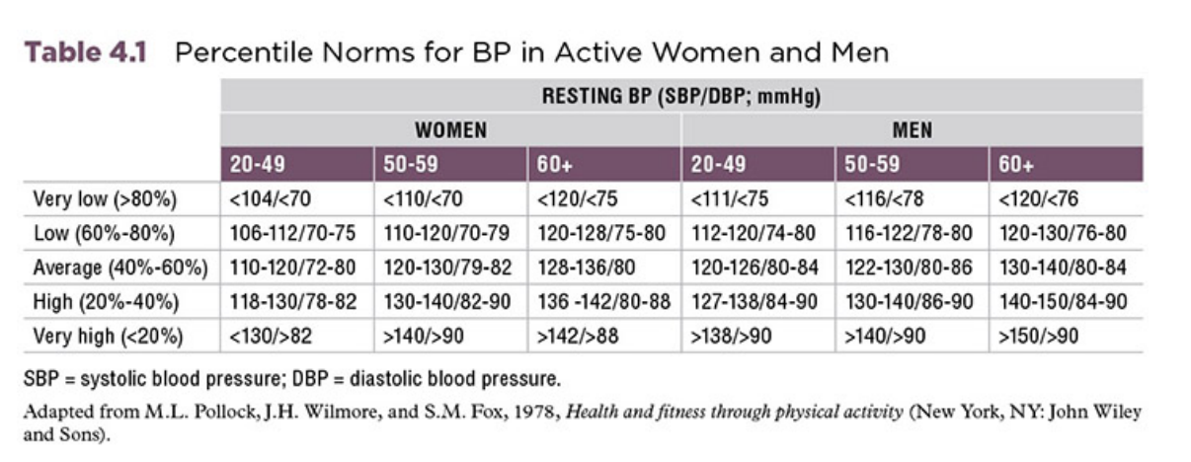
Tables.

