Slide 1
Assessment and Evaluation in Kinesiology
PET4550C

Slide 2
How do you feel today?

Slide 3
Introductions!
Name
1 Recent Win
1 Recent Loss

Slide 4
Today’s Lecture
Webcourses walk-thru
Assignments
Concept Checks
Labs
Chapter Quizzes
Discussions
Exams
Zoom
Attendance

Slide 5
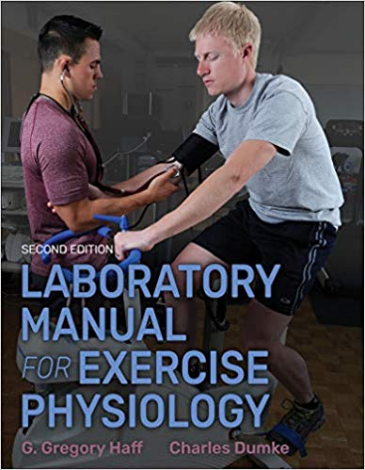
Course Expectations
Required Textbook:
Laboratory Manual for Exercise Physiology 2nd Edition. Human Kinetics. G. Gregory Haff & Chales Dumke
Arrive on time for each class
Participate in class discussions/activities
Show common courtesy and respect for instructor and classmates

Slide 6
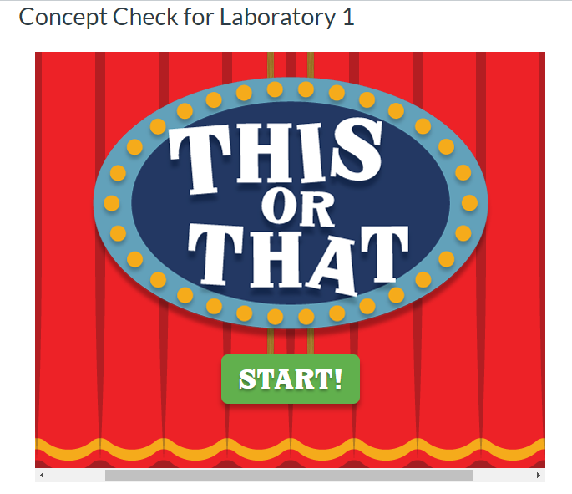
Assignments
DUE EVERY WEEK
Concept Checks: 3pts (x11)
Due the night before each class
Must get them all right for full credit
Discussions: 10 pts (x6)
Original post 6pts
Reply to classmate 4pts
Labs: 12pts (x10)
To be completed in class
Due the night before the next class
If you missed a lab: you must contact me to receive instructions for your makeup assignment
You are allowed to miss 1 lab assignment
Chapter Quizzes: 10pts (x10)
Due the night before each class
3 attempts (Highest taken as final score)

Slide 7
Exams
3 Exams: 35pts each
Proctor Hub
Open 24 hours
60 minutes to complete exam
What is on the Exams:
Any and all materials covered in class or in the required book

Slide 8
Housekeeping
Announcements:
Check your email and webcourses at least twice a week. Sometimes if I receive multiple emails regarding the same topic/issue, I will address it via Announcements.
If class is cancelled at last minute, this will also be conveyed via Announcements.
Emails:
All email/message policies must be followed, or the instructor will not respond
The body of the message should include an appropriate salutation (formal greeting), your class name and section, articulated words with respect, capitalization, punctuation, and a complimentary close (your name).
Please check webcourses, the syllabus and announcements before emailing me questions. Often, answers to questions can be found in webcourses.

Slide 9
Technology
In Class Lectures:
Phones should be silenced before class, if you need to take a phone call you may step out
Laptops are permitted for note taking purposes
Recording devices should be cleared with the instructor prior to use
Zoom:
Cameras MUST BE ON
Appropriate/professional behavior on Zoom is expected.
If you would like to have a virtual background instead of your location background, you can follow these steps: https://support.zoom.us/hc/en-us/articles/210707503-Virtual-Background

Slide 10
Week | Day | Topic | Laboratory Activity | Meeting | Online Discussion and Concept Check | Book Chapter
1 | Jan 13 | Intro, Syllabus, and Primary Data Collection | 1 | Face to Face | Yes | 1
2 | Jan 20 | Pretest Screening | 2 | Online | Yes | 2
3 | Jan 27 | Blood Pressure Measurements | 3 | Face to Face | Yes | 4
4 | Feb 3 | Flexibility Testing | 4 | Face to Face | No | 3
5 | Feb 10 | Resting Metabolic Rate | 5 | Face to Face | Yes | 5
6 | Feb 17 | Open Lab/Review | - | Face to Face | No | -
7 | Feb 24 | Exam 1 | - | Online | No | 1- 5
8 | March 3 | Aerobic Power Field Assessments | 6 | Face to Face | Yes | 8
9 | March 10 | SPRING BREAK- NO CLASS | - | - | - | -
10 | March 17 | Submaximal Exercise Testing | 7 | Online | Yes | 6
11 | March 24 | Maximal Oxygen Consumption | 8 | Face to Face | Yes | 10
12 | March 31 | Exam 2 | - | Online | No | 6,8,10
13 | April 7 | Musculoskeletal Fitness Measurements | 9 | Face to Face | Yes | 12
14 | April 14 | Body Composition Assessments | 10 | Face to Face | Yes | 15
15 | April 21 | Open Lab/Review | - | Face to Face | No | -
16 | April 28 | Exam 3 | - | Online | No | 12,15

Slide 11
QUESTIONS?

Slide 12
Primary Data Collection

Slide 13
Objectives
Define basic terminology associated with testing.
Learn metric conversions and the units recommended by the International System of Units (SI).
Learn the difference between field, field/laboratory, and laboratory tests.
Understand the concepts for evaluating temperature, barometric pressure, and relative humidity.
Learn the skills needed for administering height and weight, assessments.
Present basic statistical methods for evaluating test results
Describe types of graphics for presenting data

Slide 14
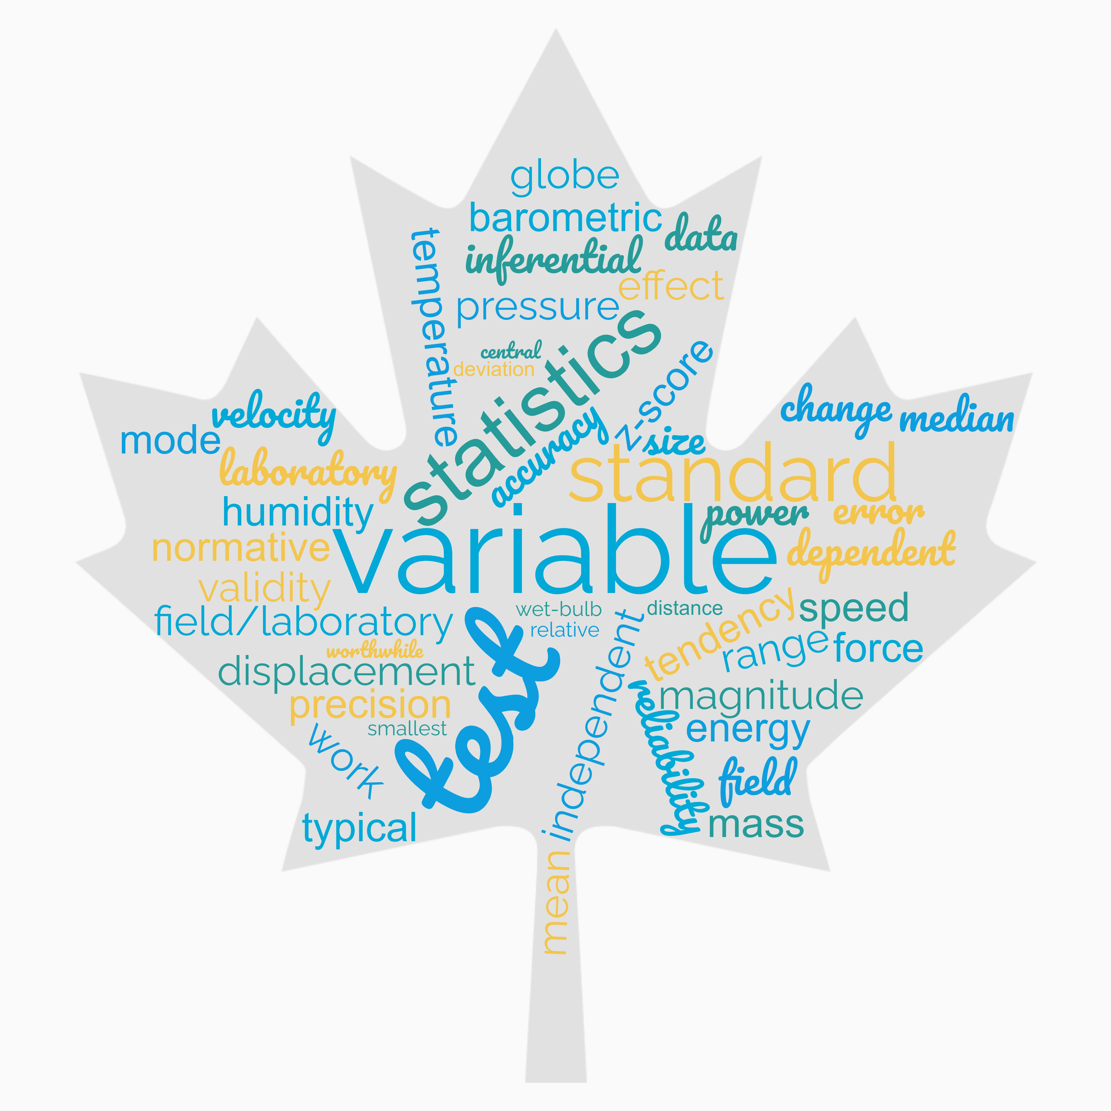
Important Words to Know!

Slide 15
Assessments
Why do we need them? Who does it benefit?
Field Tests
Field/Laboratory Tests
Laboratory Tests
Notes:
FT- Assess specific fitness and performance variables in real-world settings; Not typically used for research (useful for monitoring and screening) less expensive; high validity due to development methods (1.5 mile run test, Body mass index)
FT/L- can be conducted in field or lab settings; minimal equipment but tighter controls (ex. Step test; measured box vs bleachers; sit and reach, skinfolds, vert jumps etc)
LT- conducted with the highest level of control. Expensive equipment and performed on one person at a time; high degree of accuracy and precision (ex. DEXA, VO2 testing, RMR's)

Slide 16
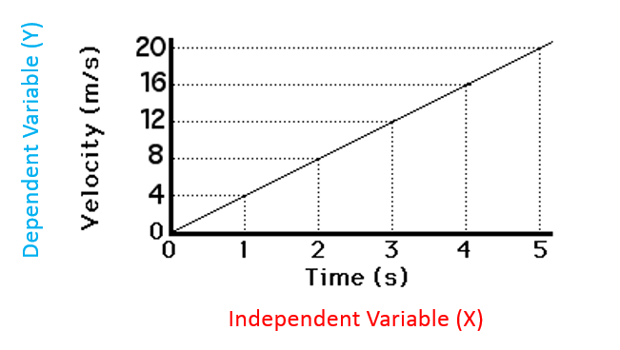
Test Variables
What is a Variable?
Characteristic
Examples?
Maximal Strength, Body Composition, Flexibility, etc.
Independent and Dependent Variables
IV: Controlled by the person administering the test, it is the variable that is manipulated
DV: Effect of, response to, or yield of the IV, it is the physiological or performance response to the IV
Example: Treadmill test:
IV= speed of the treadmill
DV= Heart Rate, Blood Pressure, Oxygen Consumption

Slide 17
Measurement Terminology
International System of Units (SI)
Why?
Simple, Precise, Accurate
Most Common
Mass: Body weight and mass used interchangeably in the US
More accurate to use Mass
SI Unit for Mass is the Kilogram or kg
Force = Newtons ( mass * acceleration)
Plays an important role in sport and ADL's
Strength is maximal force generated by a muscle (force-generating capacity)
Displacement and Distance: lengths
Cm or M (SI base unit)
Used to determine work, velocity of movements, expression of power

Slide 18
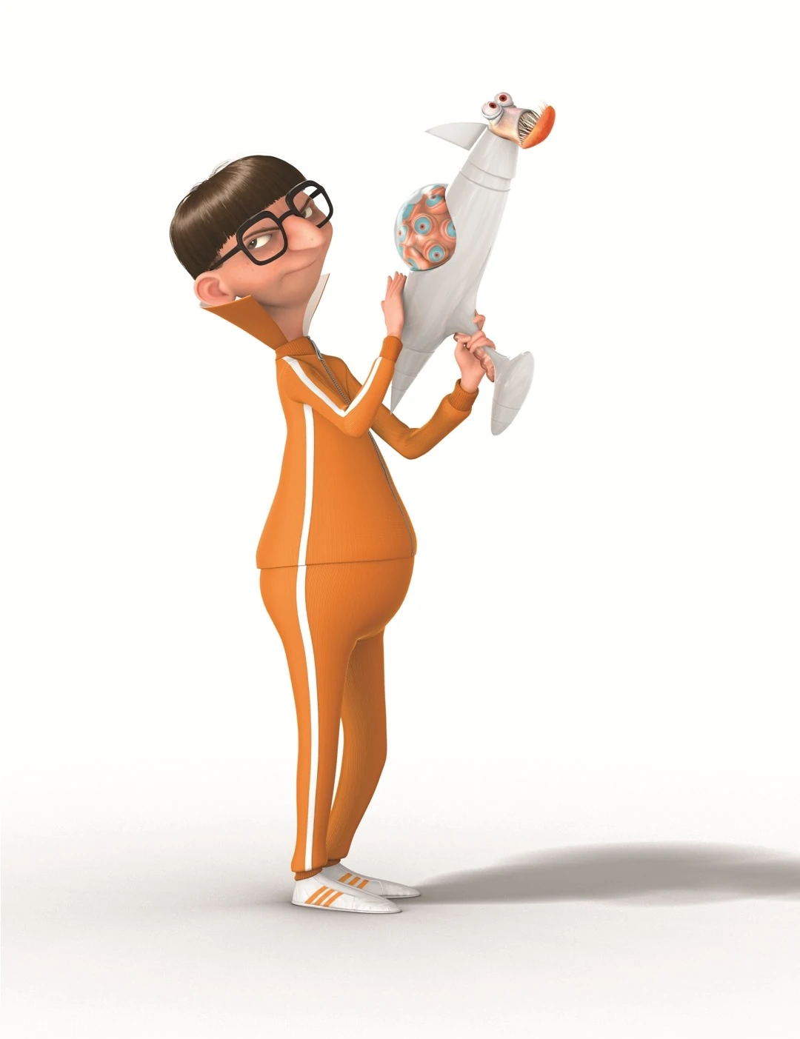
Measurement Terminology Cont.
Work: Directly related to energy expenditure
Work (J0= force (N) * distance (m)
Joule is SI Unit for Work
Speed: how fast a body is moving
Speed= distance/time
Velocity: Like speed but has a magnitude & direction
Velocity= Displacement/time
Power: rate at which work can be performed
One of the most important factors in SP
Power= work/time
= force * velocity
= force * (displacement/ time)
Proportional to energy used
↑PO → ↑WR → Faster EE
Energy: Capacity to do work
Metabolic Energy= Result of Work done & Heat Released
Joule is the SI unit
US: commonly uses kcal
FUN FACT
1L of O2 uptake corresponds to approximately 5kcal or 21kJ of EE

Slide 19
Conversions
Metric System: Preferred when conducting tests and research
3 main categories of conversion
Length
Weight
Volume
Length= Meter
Used when reporting height
To convert:
Multiply length in inches by 2.54 to reach cm (divide cm by 100 to reach m) or Multiply inches by 0.0254 to reach m directly
Weight= Kilogram
Used when reporting mass
To convert:
Divide mass in pounds by 2.2046 to reach mass in kilograms
Volume= Liter
Used when reporting lung volume, cardiac output, O2 consumption, sweat loss
To Convert:
Multiply volume in gallons by 3.785 to reach volume in Liters
** Length and weight measures can be converted to Volume**
Example: 1kg of body mass lost during exercise= 1L of sweat loss → 1L of water to restore balance

Slide 21
The Testing Process
Name or ID Number
Age and Sex
Date
Time
Tester's Initials
Meterological Information about Testing Environment

Slide 22
The Environment
Temperature
Barometric Pressure
Relative Humidity
ALL AFFECT THE RESULTS OF PHYSIOLOGICAL AND PERFORMANCE TESTS

Slide 23
Temperature
Represented in units of Fahrenheit, Celsius, or Kelvin
Fahrenheit
Americans commonly use Fahrenheit
32°F represents the melting point of ice
This is not recommended by the international system for research
°C = (°F -32) / 1.8
°C = 0.56 * (°F -32)
Celsius
Is more commonly found in scientific literature but is still not the recommended SI unit
0°C represents the freezing point of water; 100°C represents the boiling point
Kelvin
Is the SI unit
Contains no negative or below-zero temperatures
Coldest possible temperature is 0 K
HOW TO CONVERT
Fahrenheit to Celsius
°C = (°F -32) / 1.8
°C = 0.56 * (°F -32)
Celsius to Fahrenheit
°F = (°C × 9/5) + 32
°F = (°C × 0.56) + 32
Celsius to Kelvin
K = 273.15 + °C

Slide 24
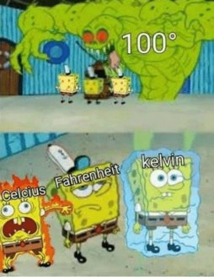
Why?
High temperatures can exert significant effects on test results
Heart rate increases by1 beat per minute for every 1°C above 24°C
Cold environments can increase respiratory rate → increased risk of dehydration

Slide 25
Barometric Pressure
Pressure of ambient air
Fluctuates with changes in altitude and weather patterns
Typically reported in mmHg, torr, hectopascal, or kilopascal
As BP changes → partial pressures of gases (O₂, CO₂ & N₂) also change
% of gases in ambient air remain constant
O₂ = 20.93%
N₂ = 79.04%
CO₂ = 0.03%
To determine PP of gas components, multiply the total BP by the % contribution of the gas
@ Sea Level BP= 760mmHg
PP of O2 = 159mmHg
760 * 0.2093= 159
Measured with an aneroid or mercury barometer in mmHg (millimeters of mercury)

Slide 26
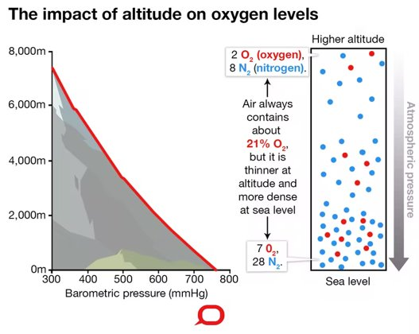
Why?
Changes in barometric pressure, and the associated changes in partial pressures of gases, particularly oxygen, can significantly affect one's ability to perform aerobic activity
Pulmonary and cardiovascular function are affected by changes in BP
Respiratory ventilation and metabolic volumes are corrected for these changes

Slide 27
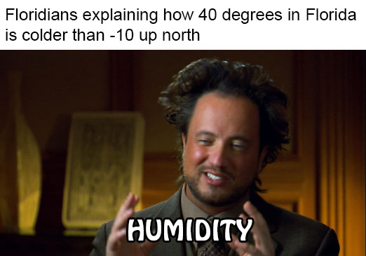
Relative Humidity
Amount of water or % saturation in ambient air
A hygrometer is used to measure this
Example: If ambient air is completely saturated with water vapor, the RH is represented as 100% at that temperature
The amount of water that can be contained in ambient air increases as temperature increases

Slide 28
Why?
Values between 20% and 60% do not affect exercise
High humidity limits the evaporative capacity of sweat
This can significantly decrease blood plasma volume and increase cardiovascular stress
High Humidity affects thermoregulation
Increases the effects of temperature on CV function
Heart rate increases by1 beat per minute for every 1°C above 24°C but with an increase in relative humidity changes can be 2 to 4 beats

Slide 29
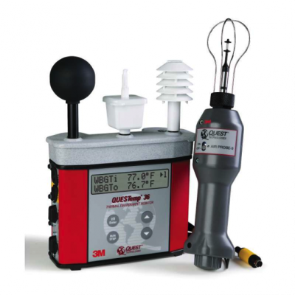
Wet-Bulb Globe Temperature
Used to estimate heat stress
Accounts for three thermometer readings and provides a single temperature reading to estimate the cooling capacity of the environment.
Dry-Bulb temperature: standard thermometer; evaluates actual air temperature
Wet-bulb temperature: wet-bulb thermometer; reflects the effect of sweat evaporating off skin
The difference between these two represents the environments capacity for cooling
3rd thermometer: placed in a Black Globe; has a higher temperature than indicated by the dry bulb (absorbs more heat); used to estimate radiant heat load of the environment
All combined to estimate coverall atmospheric challenge to the body
If the WBGT is > 28°C, then modifications to outdoor exercise should be considered

Slide 30
Descriptive Statistics

Slide 31
What are they?
Mathematical method for describing and analyzing numerical data
2 common statistics used in physiology labs
Central Tendency & Variability

Slide 32
Central Tendency
A score that best represents all the scores collected for a group
Most common statistics used to calculate this are:
Mean
Median
Mode

Slide 33
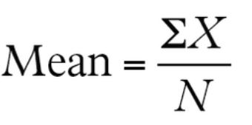
Calculating the Mean
Hand Calculation:
Step 1: Note the number of subjects for whom data were collected in the appropriate location on the individual data sheet for laboratory 2.
Step 2: Sum all scores recorded in mini-experiment and note the result as variable X on the individual data sheet.
Step 3: Calculate the mean for these scores and mark the result on the individual data sheet. <----- This formula should be used. N= the number of trials recorded.

Slide 34
Calculating the Median and the Mode
Calculating the Median &Mode
Hand Calculation:
Step 1: Place all the scores in order from lowest to highest for each group of data.
Step 2: Calculate the location of the median score for each group using the following formula:
Median = [(N + 1) / 2]thterm
Step 3: Determine the median score and record them in the appropriate locations on the individual and group sheets.
Step 4: Calculate the mode by determining which value occurs most frequently. Note the result on the individual data sheet.

Slide 35
Variability
Allows the spread of the data to be depicted
Most common statistics used to calculate this are:
Standard Deviation
Z-score
Range

Slide 36
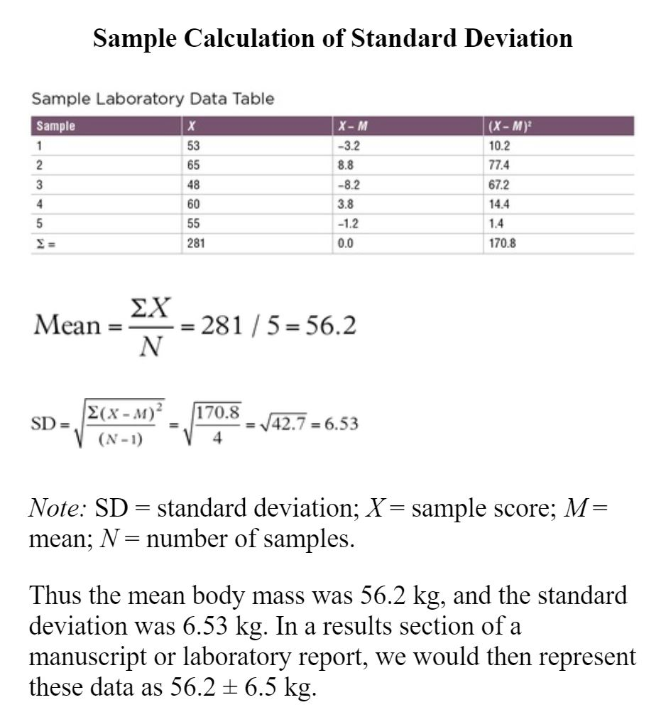
Calculating the Standard Deviation
Hand Calculation:
Step 1: Sum all the results for the variable being evaluated (X).
Step 2: Subtract the mean, calculated previously, from each variable collected (X − M). Hint: This must be done for each subject. If summed, the value should be 0.
Step 3: Square the value calculated in step 2 [(X − M)2] for each subject. Then sum all the values.
Step 4: Use the following equation to calculate the standard deviation:
Step 5: Record the results in the appropriate location on the individual and group data sheets.

Slide 37
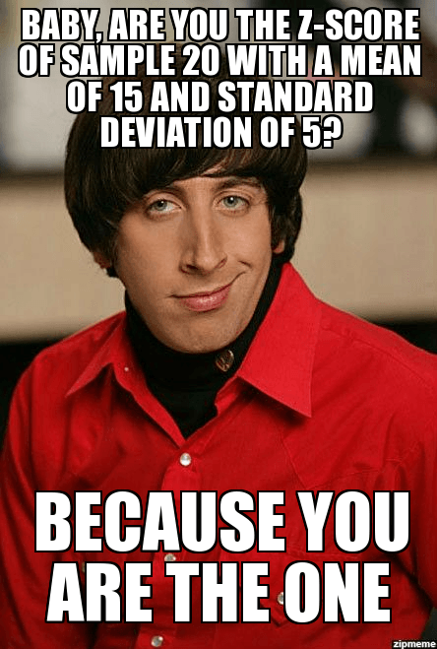
Calculating Z-Score
Expresses the distance of any individual score in standard units from the mean
Standard Deviation & mean are needed to calculate
Z= sample score – group mean
Group standard deviation
0 is average
Negative values = below average
Positive values = above average

Slide 38
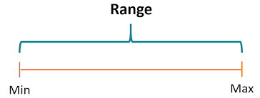
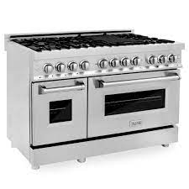
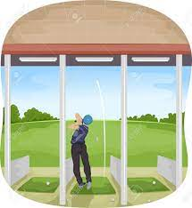
Calculating Range
The distance between the end points in a group of scores
Range = ( high score – low score) + 1
High score = maximum
Low score= minimum

Slide 39
Reliability
Highly reliable tests generate high ICC's and low coefficients of variation (CV) when repeated trials are compared
Acceptable ICCs range between 0 &1 or between 0 and –1
With performance-based measures, the general marker of reliability is:
ICC >0.90
CV (%) <10%
Why is it important?
Tests may produce false information!
The repeatability or consistency of a measure
Often affected by experimental or biological errors
Miscalibration: natural shifts in performance, fatigue, subjects' familiarity
Primary statistical method are the change in the mean between measurements, the standard error and the intraclass correlation coefficient (ICC)
Most common reliability measurement is the Typical Error of the measurement
Calculated by dividing the SD of the change scores between repeated measures divided by the square root of 2
The smaller the TE the more reliable the measure
Reliability ≠ Validity

Slide 40
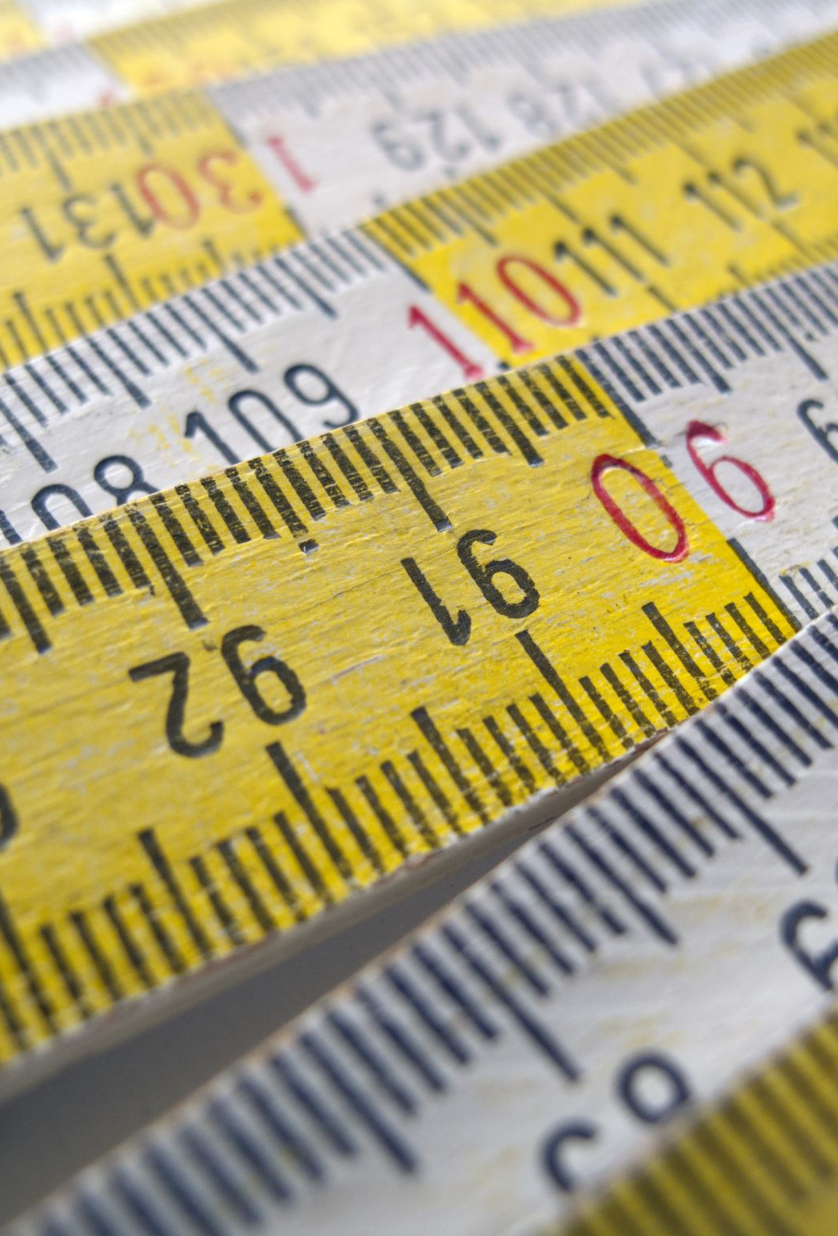
Validity
The degree to which a test or instrument measures what it is supposed to
Main form of validity in exercise physiology labs are criterion validity*
*The ability of a test to be related to a recognized standard or criterion measure
Example:
Underwater weighing is the gold standard for assessing body composition
When considering other ways of measuring body composition, for example Air Displacement Plethysmography, validity is determined by correlating the results from the ADP estimate to the body fat determined by underwater weighing
Only considered valid if it is both accurate and precise
Accuracy = the closer a measurement is to an accepted value
Precision = the reproducibility of the measurement
A measure can be accurate but not precise, highly precise but not accurate, highly accurate and highly precise, or neither highly precise nor highly accurate

Slide 41
Lab Activity 1

Slide 42
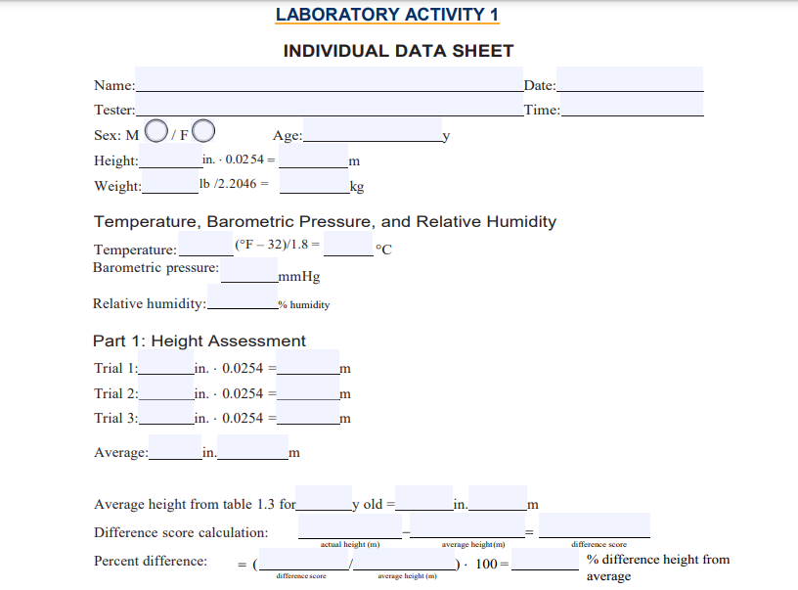
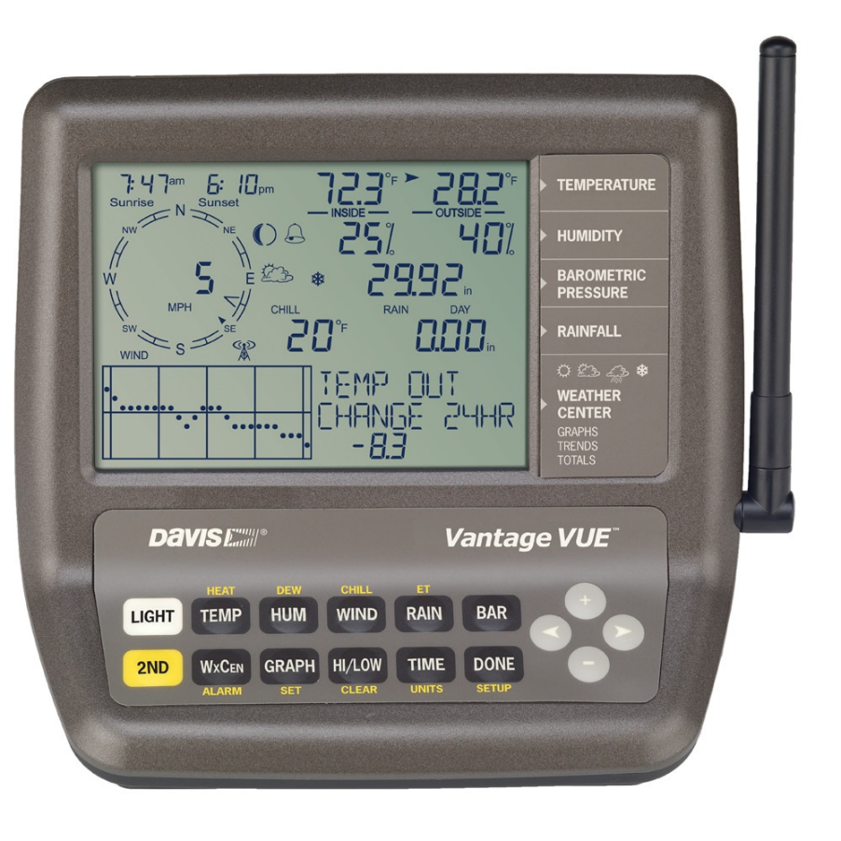
Participant X, Female Age 21
Height: 64inches
Weight: 145lbs
Temperature: 72.3F
Barometric Pressure: 29.92mmHg
Relative Humidity: 40%
EXAMPLE

Slide 43
Trial 1: 64.5 inches
Trial 2: 64 inches
Trial 3: 64 inches
Average: 64.16 inches
Average height from Table 1.3: 21yr old = 64.2 inches
EXAMPLE

Slide 44
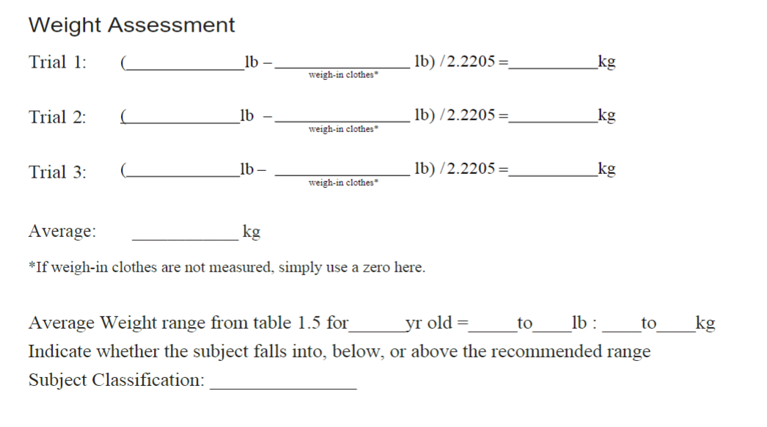
Trial 1: 145lb
Trial 2: 146lb
Trial 3: 144lb
Average: (145) lb / 2.2406 = _____kg
EXAMPLE

Slide 45
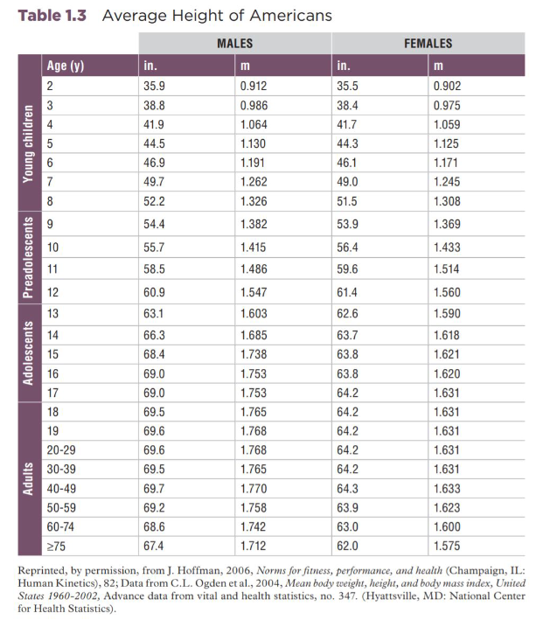

Slide 46
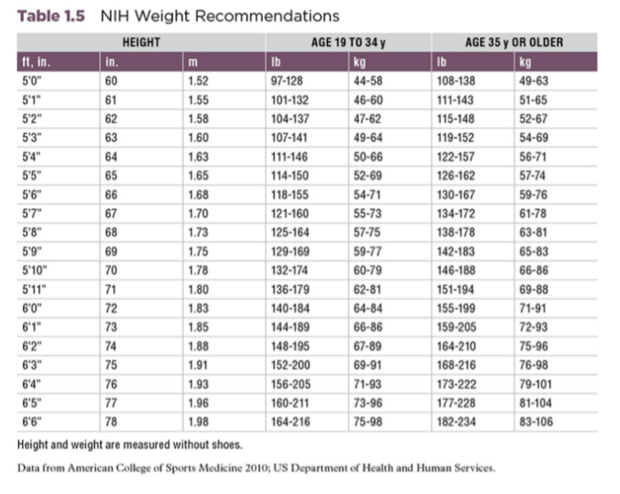

Slide 47
Final Step: Entering Your Data
Click Here

Slide 48
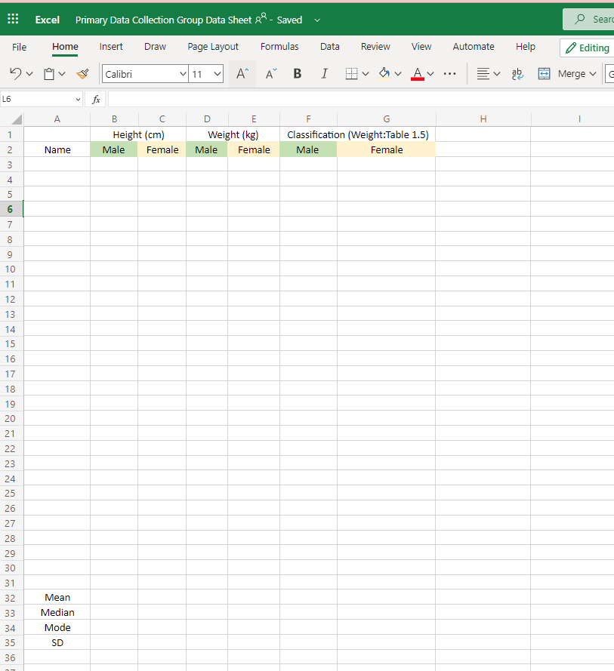
Fill in Your Data Here
Zach Smith
210
97.3
Within

Slide 49
Lab Report Guide

Slide 50
Start Here

Slide 51
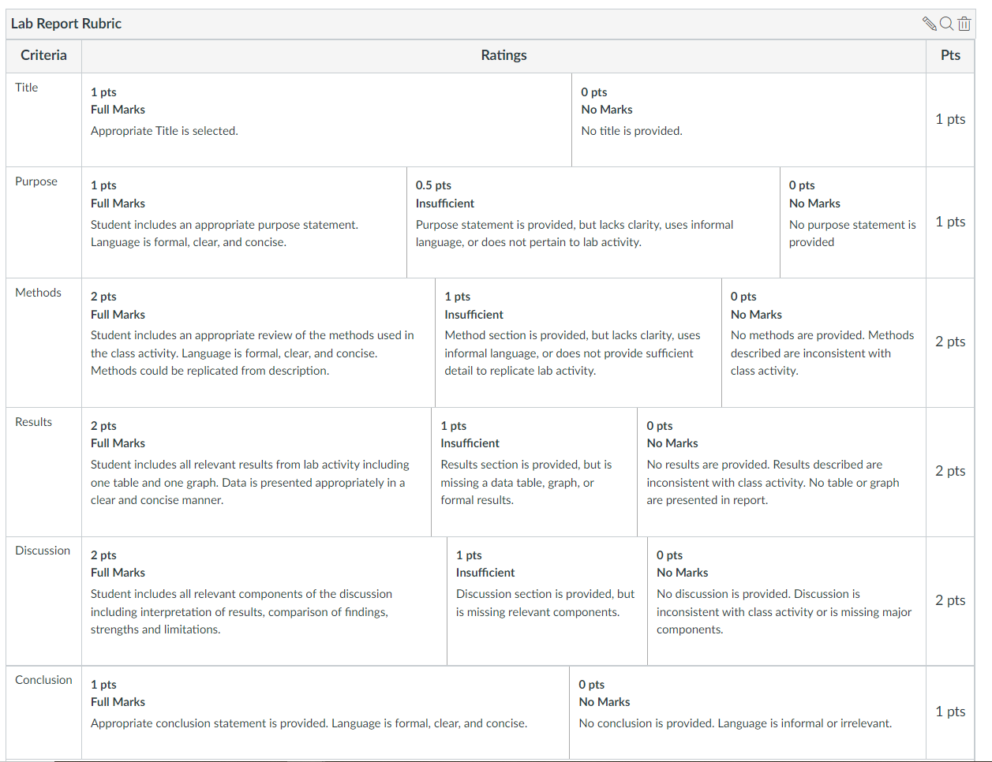
General Lab Report Grading

Slide 52
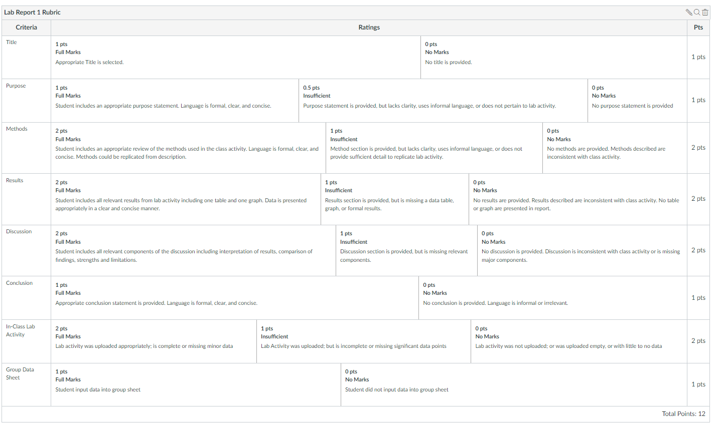
Lab Activity and Report Submissions

Slide 53
What’s Next?
Today
Complete Lab Activity 1
Schedule office hours if you need it!
Zoom or F2F
Due Before Next Class
Syllabus Quiz
Concept Check #1
Discussion Post
Chapter 1 Quiz
Baseline Assessment
Next Week
Online Class
Concept Check 2
Lab Activity 2
Chapter 2 Quiz

