Slide 1
Developing Your Research Proposal

Slide 2
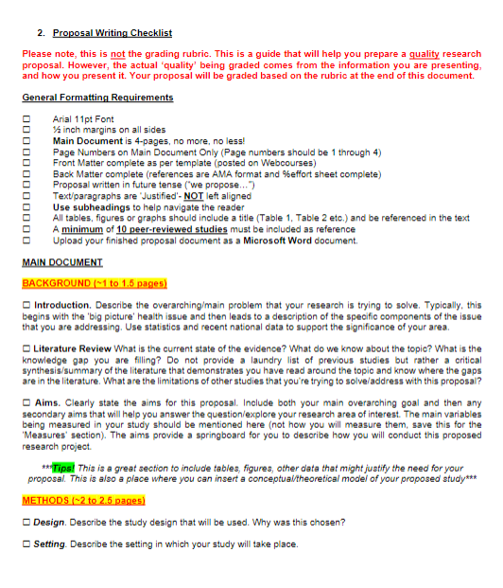
Main document
Proposal Outline:
Suggested section lengths
Background/Literature Review
~1 to 1.5 pages
Methods
~2 to 2.5 pages
Expected Results, Study Limitations, Ethical Principles, and Future Implications
~0.5 to 1 page
‘Proposal Guide’
on Webcourses

Slide 3
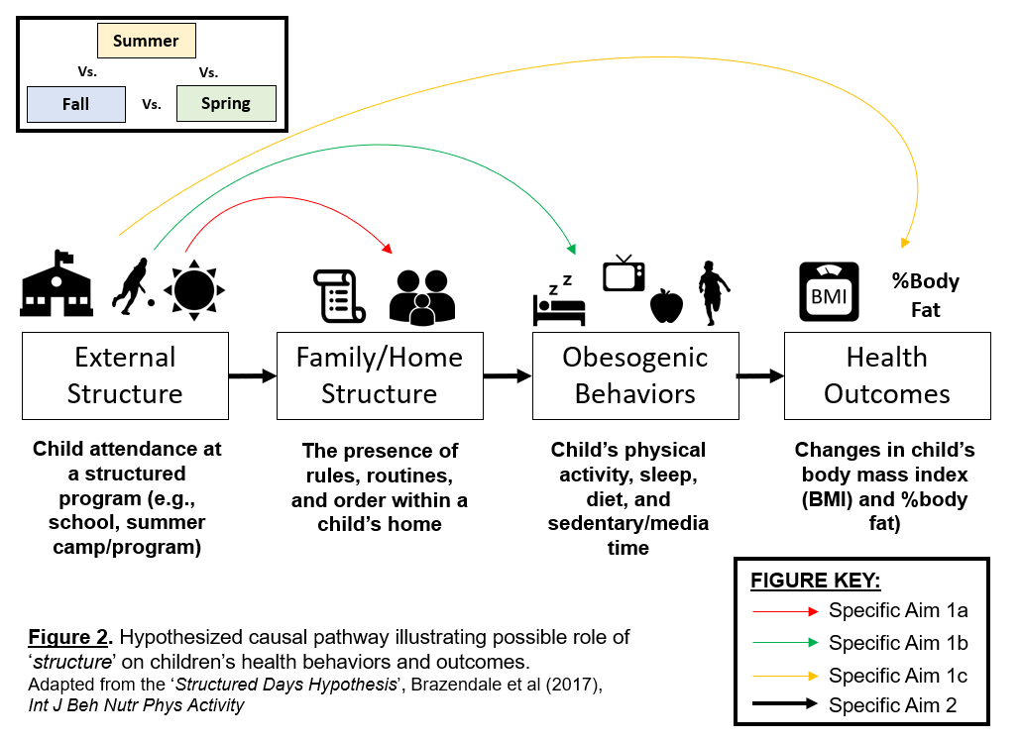
Conceptual or Theoretical models?
Children’s Physical Activity
Children’s Weight Status
Season:
Summer vs School Months

Slide 4
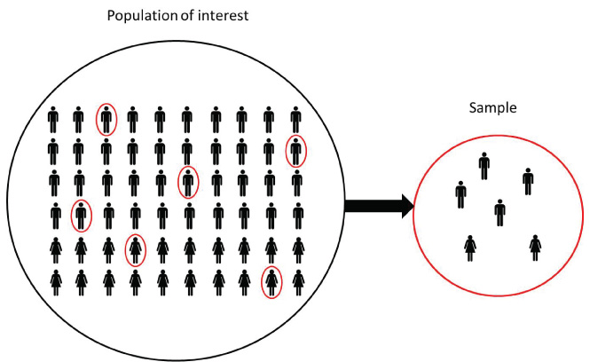
Methods
State study design chosen
Setting description (Will your study take place on campus, at a clinic, home, school?)
State sample population of study
Justification (why?)
Inclusion/Exclusion Criteria
Protocol to collect data (walk us through it!)
Experiment/intervention/RCT?
Define ‘conditions’ or ‘groups’
Use diagrams/timelines of when measurements will be taken

Slide 5
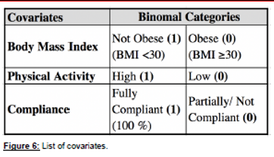
Questions to Consider (continued)
Data handling procedures
What outcome are you reporting?
(e.g., Minutes of activity or sleep?)
(e.g., Blood pressure (mm/Hg) change?)
(e.g., Depression score on a survey scale?)
Are you going to split your outcome or predictor variables ?
Participants who show ‘High’ or ‘Low’ outcomes?
In this example, this group proposed that they would split BMI into ‘Obese’ vs. ‘Not Obese’, ‘Physical Activity’ into ‘High’ vs. ‘Low’, and intervention compliance into ‘Fully Compliant’ and ‘Partially/Not Compliant’
Now they can explore Vitamin D supplementation and it’s impact on blood pressure by these other ‘covariates’

Slide 6
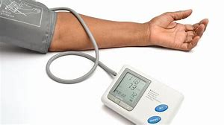
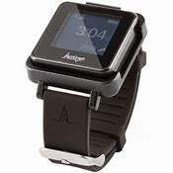
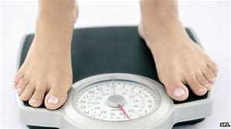
Measures (instruments)
Describe the ‘measures’ you will use to conduct the study
Objective measures
Subjective measures
Include all measures
Individual, environmental, demographic data etc.
When is this being collected? How often?
Why did you choose this ‘measure’?
Previous research?
Is it ‘valid’ and ‘reliable’ measure?

Slide 7
Data handling and analyses
How do you plan to ‘handle’ and ‘clean’ your data?
Main outcome of interest
What does that look like?
Variables
Dependent, independent, covariates/confounders?
Cleaning data
Reporting of descriptive statistics
Means, Standard Deviation (SD), range (min and max values)
Separate main results by covariates (Sex, Race, Age?)

Slide 8
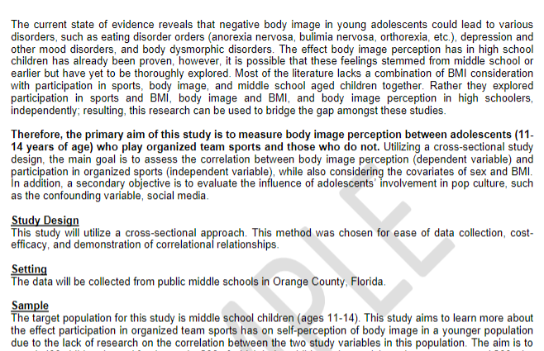
Make it visually appealing “grantsmanship”
Bold and underline key words, phrases and sentences

Slide 9
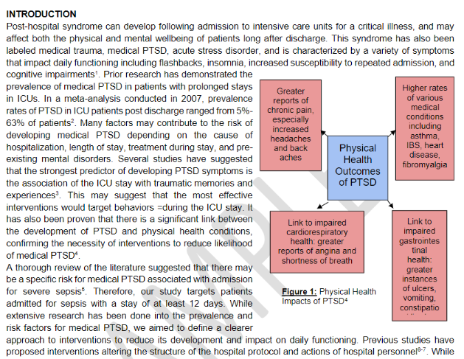
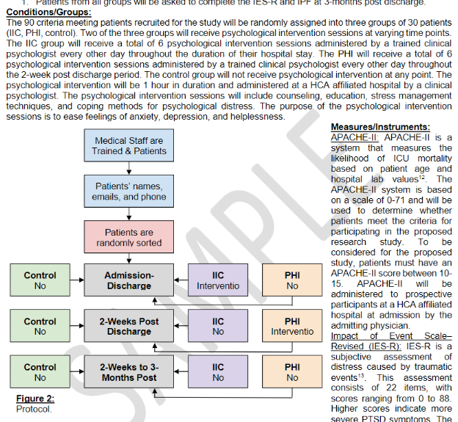
Incorporate figures and charts

Slide 10
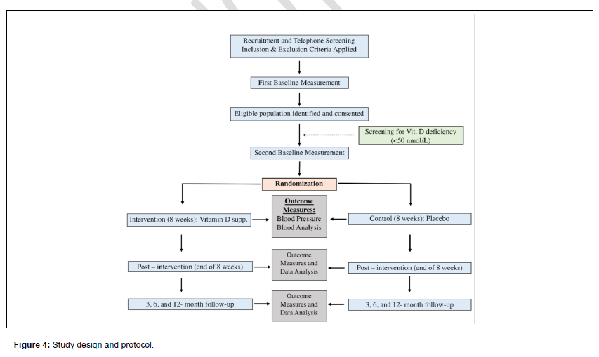

Slide 11
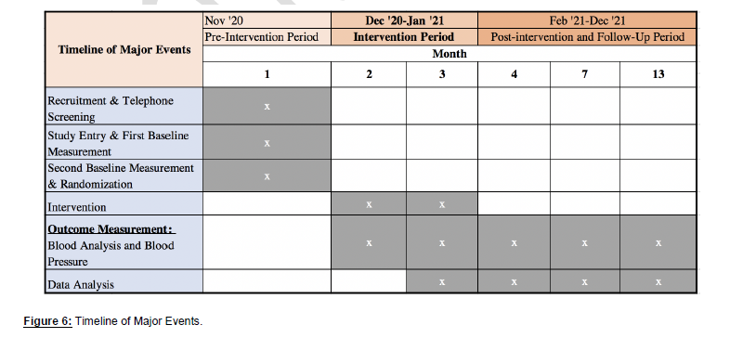

Slide 12
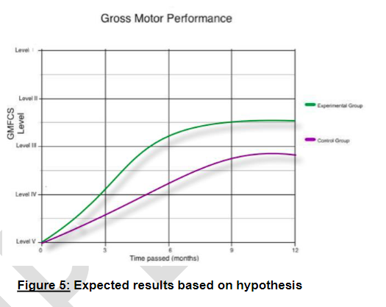

Slide 13
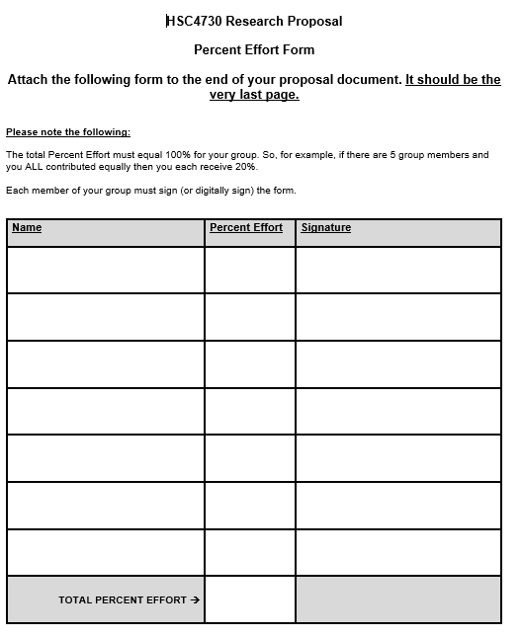
Back matter
Back matter should be presented in the following order:
References
Appendices (if any)
‘%Effort’
An Appendix (Appendices) is where you put any additional figures or graphs, surveys, pamphlets, educational handouts, etc. you want to share
Appendix (Appendices) OPTIONAL!
A 1-page ‘% effort’ sheet signed by each group member will be the LAST PAGE of your document.
Use 1-page template posted on Webcourses

Slide 14
