Slide 1
Research Proposal: An Introduction

Slide 2
A strong proposal provides enough detail that the study could be replicated by other research teams…

Slide 3
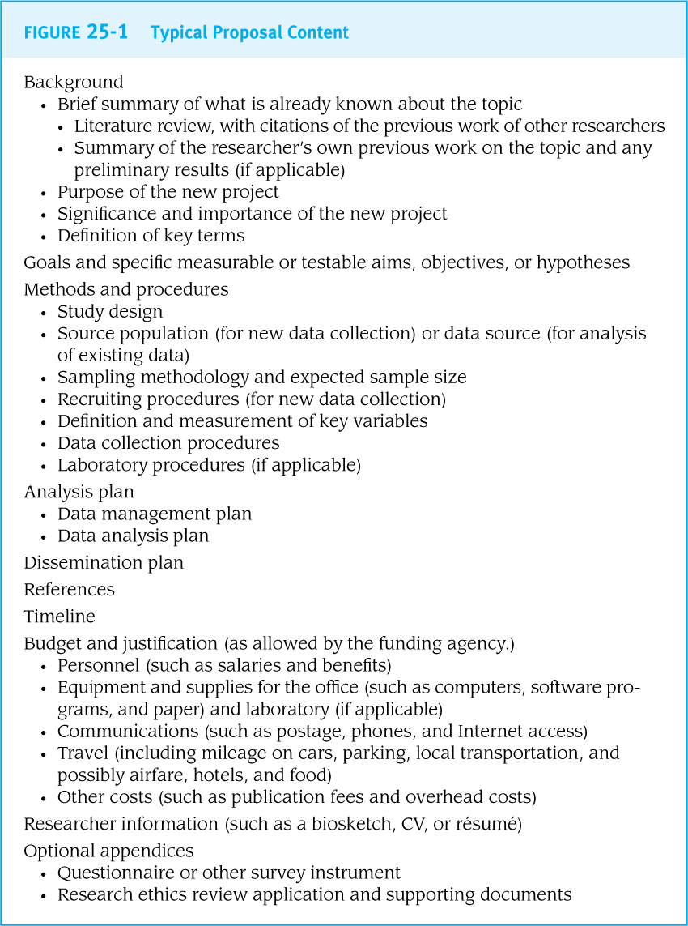
General Overview
A research proposal should describe the exact procedures that will be used for every step of the research process.
In the research world, research proposals are a time-intensive and multi-investigator project

Slide 4
Questions to Consider
Research Topic/Question?
Why do ‘we’ care?
What is the significance of your research?
What do we already know?
How does your research fill a ‘gap’ in the literature?
Limitations of other studies?
What makes your research question ‘original’?
Choice of study design?
Is it appropriate to answer your question?

Slide 5
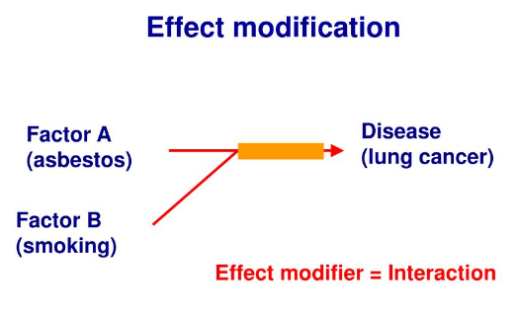
Questions to Consider (continued)
Sample Population?
Be specific!
Age, race/ethnicity, diseased/non-diseased?
Main ‘variables’ of interest?
What is your main exposure (predictor), disease (outcome)
Effect modifiers?
independent variable
= predictor/exposure;
and dependent variable
= outcome/disease
Does smoking influence the relationship between asbestos and lung cancer?

Slide 6
Questions to Consider (continued)
Hypothesis (Expected Results)
What do you think or expect to find?
Any secondary hypotheses?
How will you measure each variable?
Surveys, devices, clinical measures?
How many measurement timepoints?
If you choose an experimental design?
The treatment or intervention needs detail…What? When? How? How many? How long? Who by?

Slide 7
Questions to Consider (continued)
Study Limitations
What are some of the weaknesses of your study?
Implications
What is the take away message from this study that we could use to inform public health?
Future Directions
What would be the next step after this study was completed?
Future research should explore…?

Slide 8
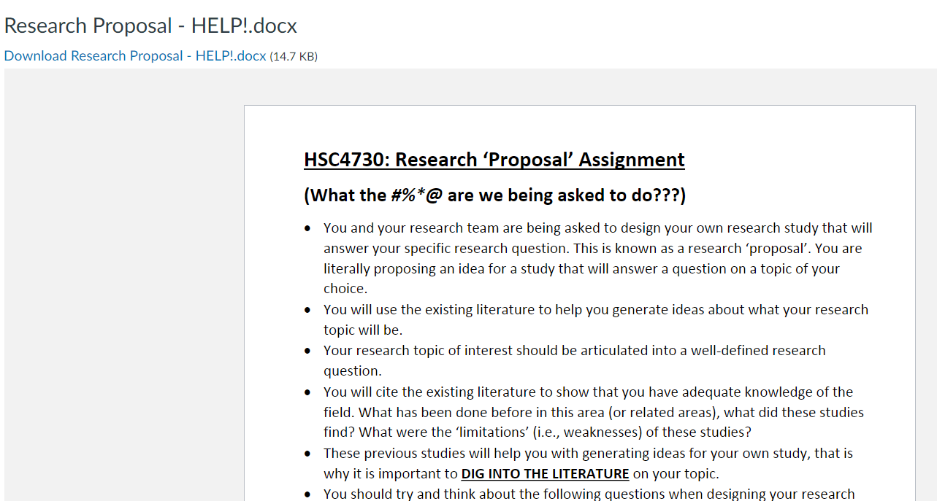
Guidelines
A 4-page research proposal
Single-spaced
0.5-inch Margins
11-point Arial font (everything)
3 main components of document
‘Front matter’
‘Main document’
‘Back matter’
‘Proposal Guide’
on Webcourses

Slide 9
Guidelines
A 4-page research proposal
Single-spaced
0.5-inch Margins
11-point Arial font (everything)
3 main components of document
‘Front matter’
‘Main document’
‘Back matter’
‘Proposal Guide’
on Webcourses

Slide 10
Front matter
Title page
Running Header
Title
First/Last Name of group members
Class Section
Class Semester
Group Number
TEMPLATE ON WEBCOURSES

Slide 11
Front matter (cont’d)
Abstract/Project Narrative page
250 words (max), Structured
Introduction/Background
Purpose statement
Methods
Hypothesis/Hypotheses
Future Implications
5 key words immediately below your abstract

Slide 12
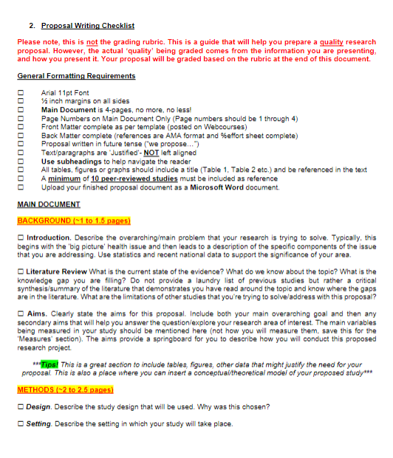
Main document
Proposal Outline:
Suggested section lengths
Background/Literature Review
~1 to 1.5 pages
Methods
~2 to 2.5 pages
Expected Results, Study Limitations, Ethical Principles, and Future Implications
~0.5 to 1 page
‘Proposal Guide’
on Webcourses

Slide 13
Writing a quality background supported by the literature
Start ‘big picture’ and narrow focus to end with your research question(s)
In between…
Why do ‘we’ care?
What do we know about this topic?
What is missing (limitations of other studies)?
What will your study add?
Use figures, data tables
Use boxes, bold important points, underline

Slide 14
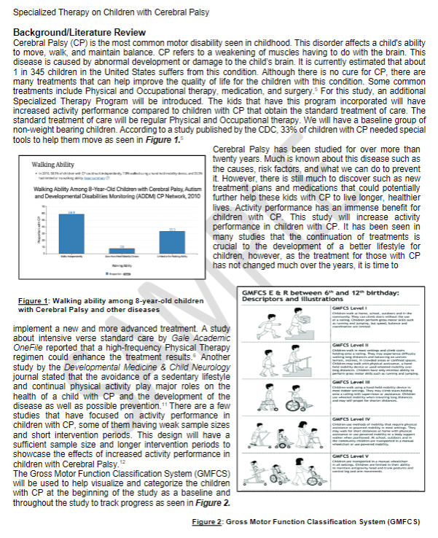
Review proposal examples on Webcourses

