Slide 1
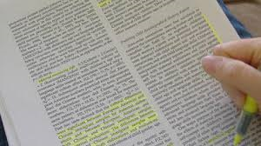
Reviewing the Literature
Notes:
Chapter 7 to 14, 22

Slide 2
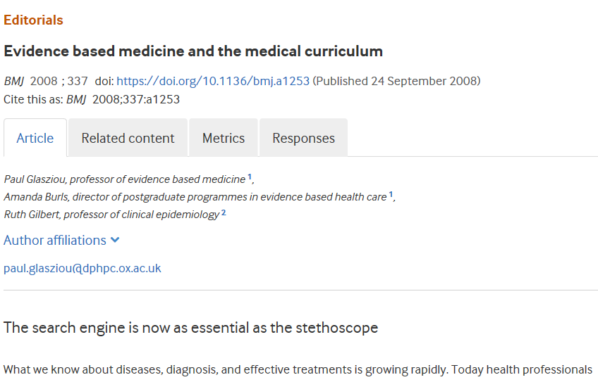
"…a 21st century clinician who cannot critically read a study is as unprepared as one who cannot take a blood pressure or examine the cardiovascular system.”

Slide 3
Abstract Search
Useful
Not Useful
Still Not Useful!
Revise Search ‘Terms’
MeSH Terms
Refine date range

Slide 4
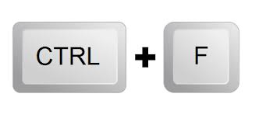
Abstract Search
Useful
Full text
Review
Information Extraction

Slide 5
Abstract Search
Useful
Not Useful
Still Not Useful!
Full text
Revise Search ‘Terms’
Review
Information Extraction
MeSH Terms
Refine date

Slide 6
Full Text Review (post abstract review)
Abstract (again!)
First few sentences of introduction
Why do we care?
Last few sentences of introduction
‘Purpose’ Statement/Study Aim
Straight to Results, Tables, Figures
Demographics, sample size, findings
Back to methods
Measures used
Study Conclusions
Accurate reporting?
Limitations?
Future Directions?

Slide 7
Example

Slide 8
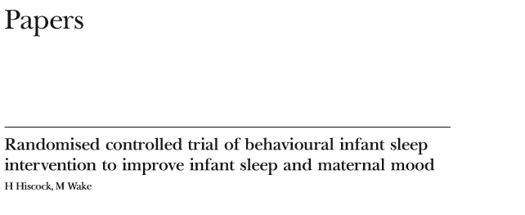
Task 1
Open PDF from webcourses in ‘Class Readings’ folder
Study design?
Purpose of the study?
What was the sample size for intervention and control groups after randomization?
Were any participants lost to follow-up at 2 or 4-months? (Hint: Check flow diagram)
Measurement used to determine infant sleep?
For the whole sample, was the intervention effective at improving depression scores at 2 or 4 month follow-ups? (Hint: Table 4)
State one limitation of the study?

Slide 9
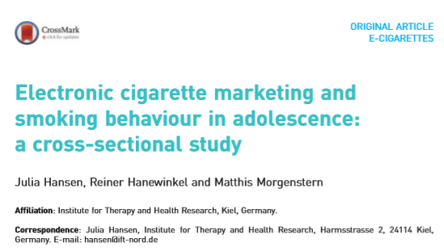
Task 2
Open PDF from webcourses
in ‘Class Readings’ folder
In the introduction, how many German adolescents aged 14-17 years have ever used an e-cigarette?
What was the study-design and the aim of the study?
What proportion (%) of the sample was considered high socioeconomic status (SES)? (Hint: Table 1)
What was the main measure used to assess ‘smoking behavior’?
Table 2, if a person reported “at least one friend vaping e-cigarettes”, how likely were they to be an e-cigarette user? Was this statistically significant?
State one limitation of the study and the study design the authors suggest for a future study to address?

Slide 10
Abstract Search
Full Text - Information Extraction
Useful
Full text
Review
Information Extraction

Slide 11
- END -

