Slide 1




Data Analysis
Notes:
Chapter 26 to 29

Slide 2

Overview – Part 1
Data management
Descriptive Statistics

Slide 3

Data Management
Codebooks
Data entry
Data cleaning
Data recoding
Data security
“refers to the entire process of record keeping”

Slide 4
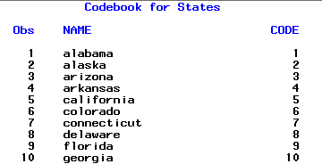
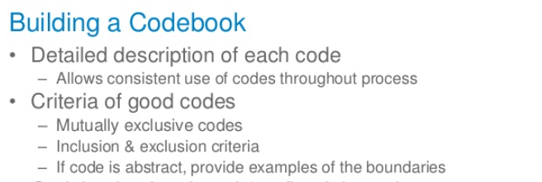
Codebooks
A codebook describes each variable and specifies how the collected information will be entered into a computer database.
A codebook also documents how data problems like illegible handwriting and missing responses are handled.

Slide 5
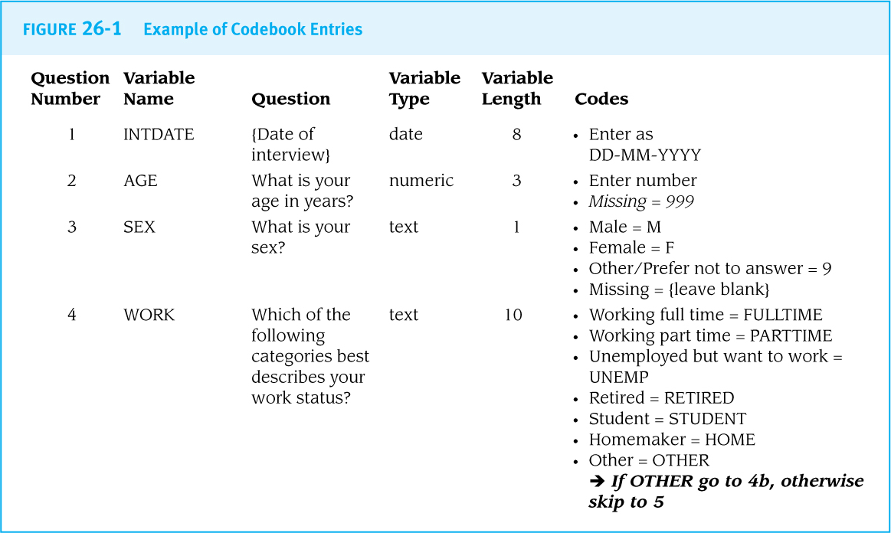

Slide 6
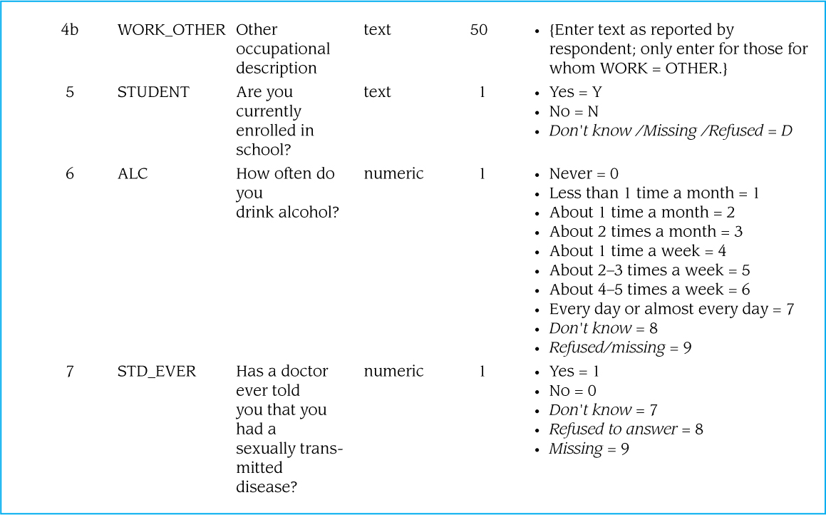

Slide 7
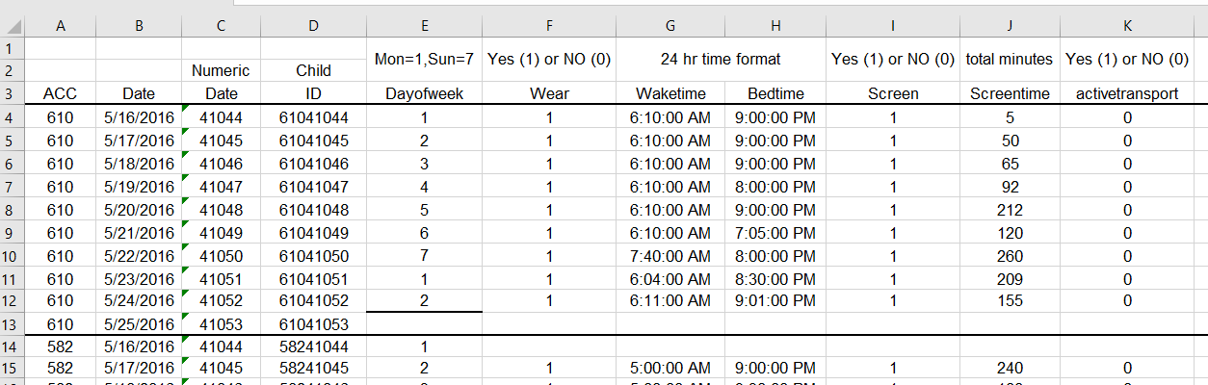
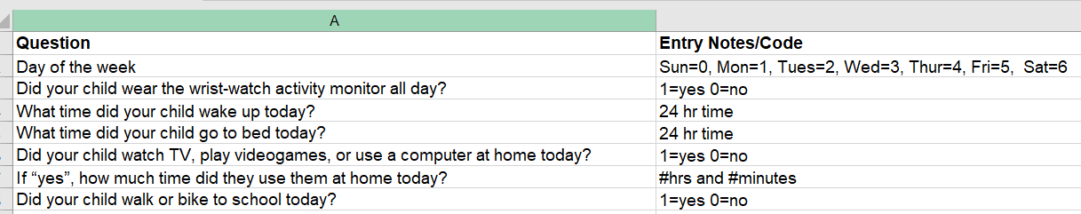

Slide 8

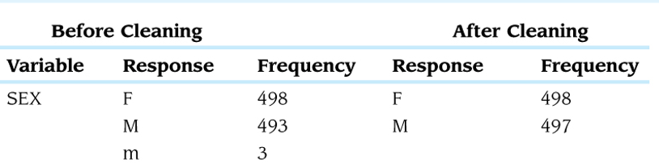
Data Entry
Data Cleaning
Data are usually entered into a database program (like Microsoft Access) or a spreadsheet program (like Microsoft Excel).
Double entry of at least some of the completed survey forms can confirm the accuracy of data entry.
Data cleaning is the process of correcting any typographical or other errors in data files
496

Slide 9


Data Recoding
Database and statistical programs typically create derived variables using calculations or assigned categorizations (0 or 1).
Never do any recoding until an original version of the cleaned data file is safely backed up elsewhere.
Never recode into the same variable (i.e., do not replace the original values with the new recoded values); always recode into a different (new) variable.
gen new_variable = old_variable
recode age (5/11 = 1) (else=0), gen (elementary_age)
Stata code: Examples

Slide 10


Data Security
Safely store paper records, including signed informed consent statements, in a locked and secure room.
Access to all computer files containing sensitive information should be password-protected, and access to them should be limited to essential research personnel.

Slide 11

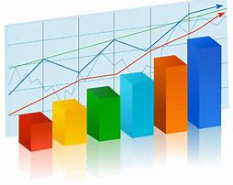
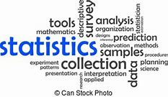
Descriptive Statistics
Analytical Plan
Types of Variables
‘Central Tendency’
Reporting Descriptive Statistics
“provide the basic characteristics of quantitative data”

Slide 12


Plan by Study Approach
Studies with no comparison group, like case series and cross-sectional surveys, may find that simple statistics like counts (frequencies), proportions, and averages are sufficient enough. This is known as “Univariate Analysis”.
For studies that compare two or more populations—including case-control, cohort, and experimental studies—the description of the study populations must be completed before moving on to comparative statistics (aka “bivariate analysis”).
“Multivariate analysis” examines three or more characteristics of participants at one time but is rarely required at this stage.

Slide 13
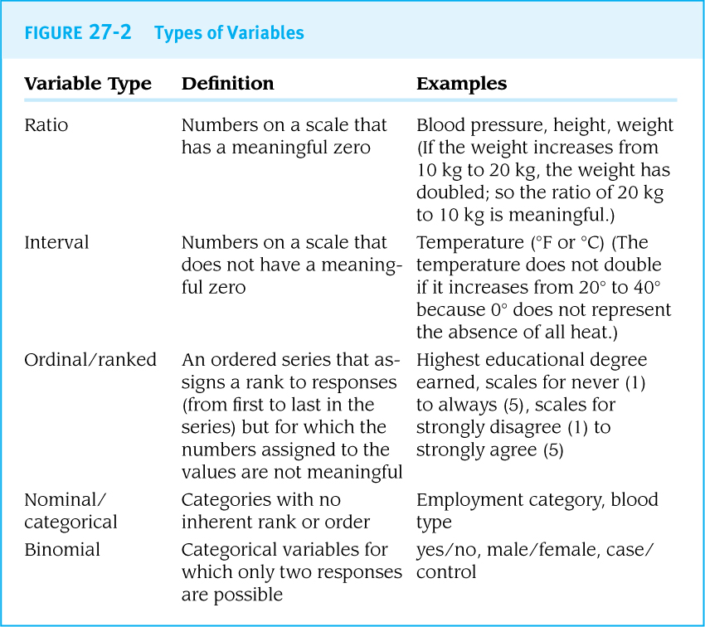
Types of variables
A variable is a characteristic that can be assigned more than one value.
Classifications:
  Ratio variables
  Interval variables
  Ordinal variables (ranked variables)
  Nominal variables
  (categorical variables)
  Binomial variables
  (dichotomous variables)
Recoding into dichotomous variables is common practice

Slide 14
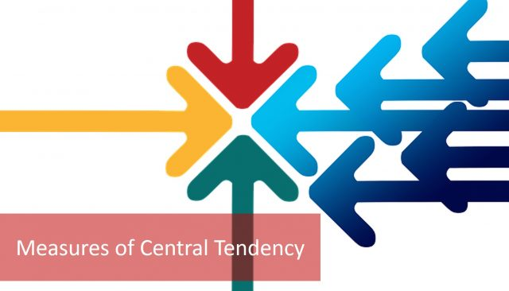
Measures of ‘Central Tendency’
Descriptive statistics are often used to describe the “average” value of a variable in a population.
For numeric variables, the average is often referred to as the central tendency:
  Mean 17
  Median 16.5
  Mode 16
“a central or typical value for a probability distribution”
Distribution

Slide 15
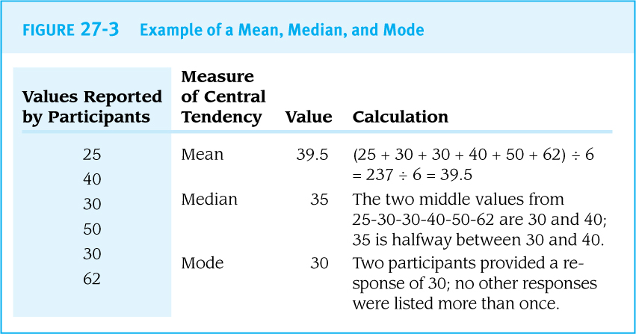

Slide 16
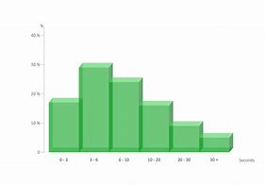
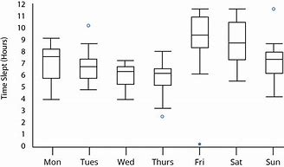
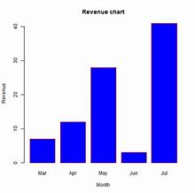
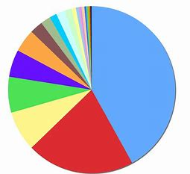
Range and Quartiles
Measures of spread (dispersion) are used to describe the variability and distribution of responses:
  Minimum
  Maximum
  Range
  Quartiles
  Deciles
  ‘IQR’ (interquartile range)
Displaying Distributions
Histogram Boxplot Bar chart Pie chart

Slide 17
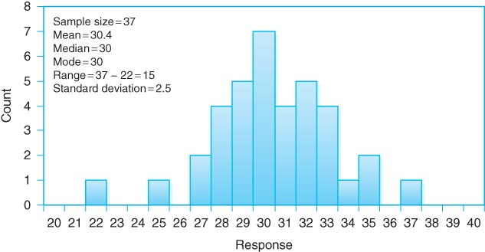
Histogram

Slide 18
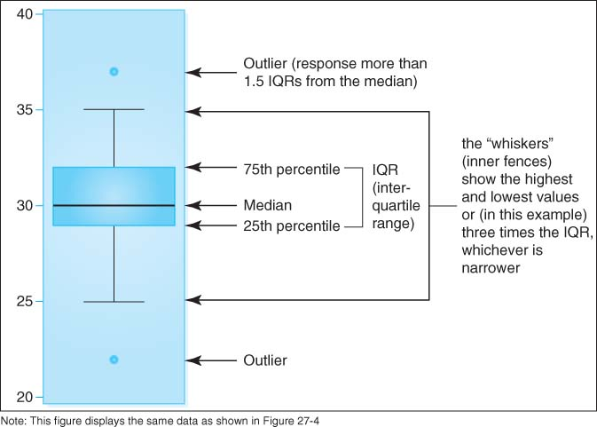
Boxplot

Slide 19
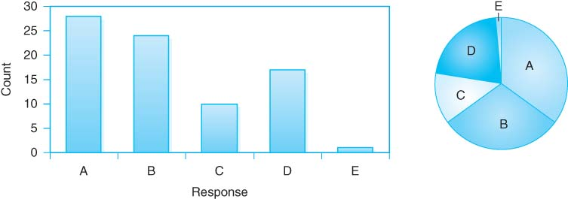
Bar and Pie Charts

Slide 20
- End -

