Slide 1
Research Overview: getting started…

Slide 2
The ‘process’…

Slide 3
Research is the process of systematically and carefully investigating a subject in order to discover new insights about the world.
Five steps
Identify a study question.
Select a general study approach.
Design the study and collect data.
Analyze data.
Write and share a report about the findings.

Slide 4
Health research examines a broad spectrum of biological, socioeconomic, environmental, and other factors that contribute to the presence or absence of physical, mental, and social health and well-being.
Population health research involves humans as the unit of investigation.
Health Research

Slide 5
Needs assessment
community health profiles
Risk assessment
risk factors for disease
Applied practice
clinical effectiveness
Outcomes evaluation
impact of interventions
Health Research Purposes

Slide 6
Selecting a topic…
Questions derived from clinical practice, community observations, and personal experience often point toward an unmet demand for needs assessments, program evaluations, and clinical effectiveness studies.
“A good research question ends in a question mark and is testable”

Slide 7
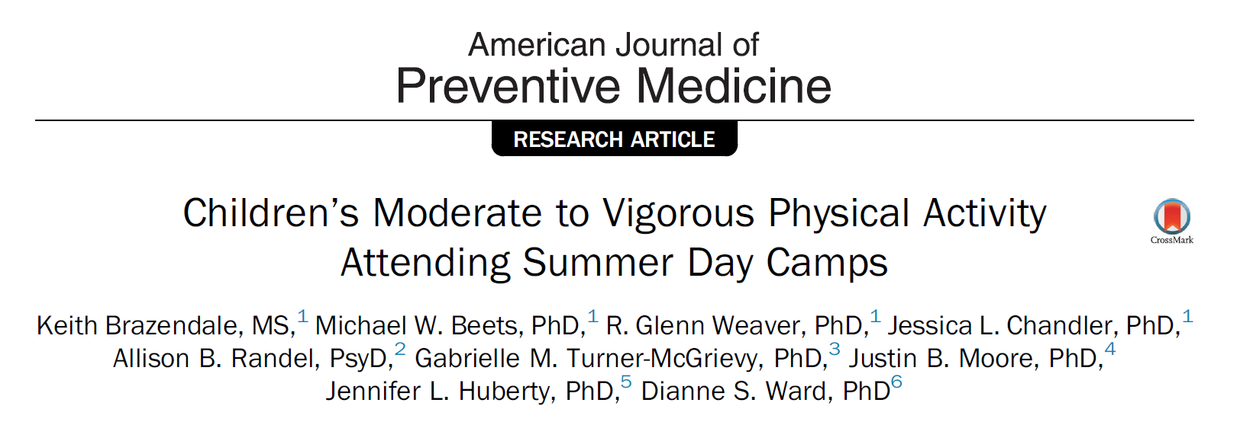
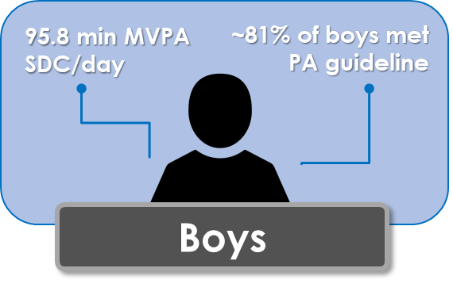
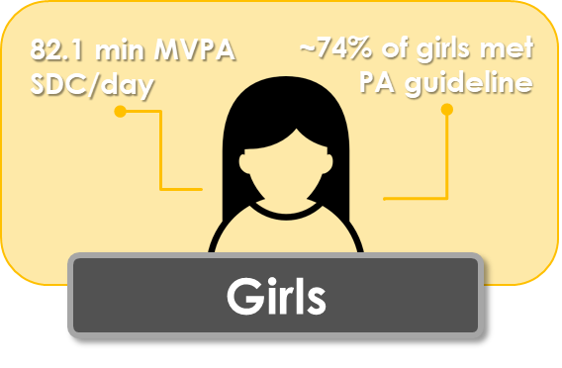
Selecting a topic…example
Childhood Obesity → Energy balance → Physical Activity Levels → Child-related contexts → Summer Day Camps…

Slide 8
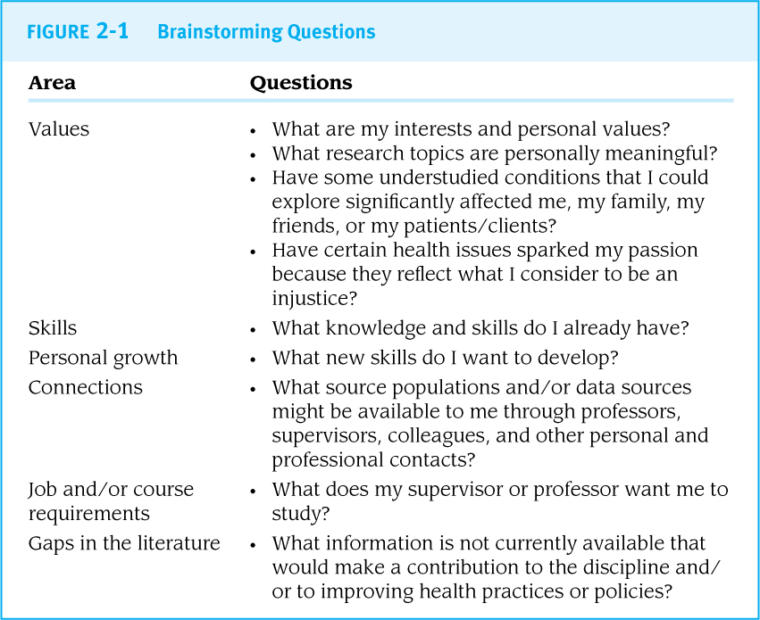
Brainstorming and Concept Mapping
Use brainstorming to create a long list of possible research topics.
or concept mapping to identify central themes that might be worth exploring.

Slide 9
Choosing the topic…

Slide 10
Exposure, Disease, Population
The “EDPs” form the basis for many research questions: “Is [exposure] related to [disease/outcome] in [population]?”

Slide 11
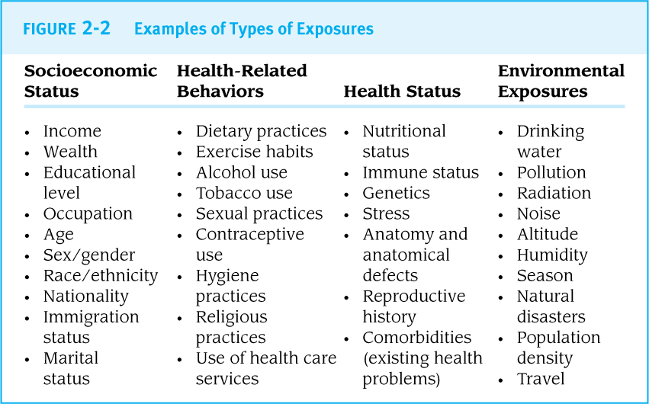

Slide 14
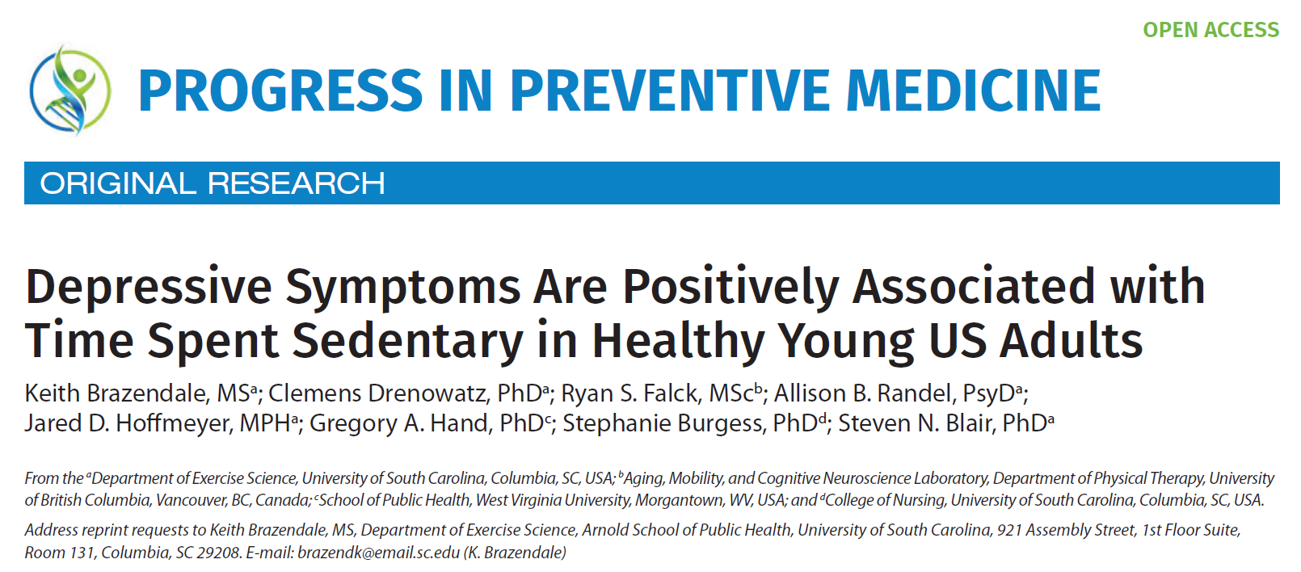
Example
Disease
Population
Exposure

Slide 15
“PICOT” is often used for clinical research
Patient/Population
Intervention
Comparison
Outcome
Timeframe

Slide 16
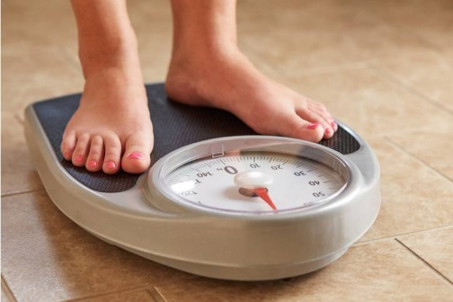
Example
“Evaluation of a pediatric weight management referral program for overweight or obese children from low-income households”
Proposed pilot clinical trial
Randomize 160 overweight or obese children attending a clinic
Treatment vs. Control Group
Evaluate summer weight gain
PICOT?
Change

Slide 17
- END PART 1 -

Slide 18
Reviewing current evidence…

Slide 19
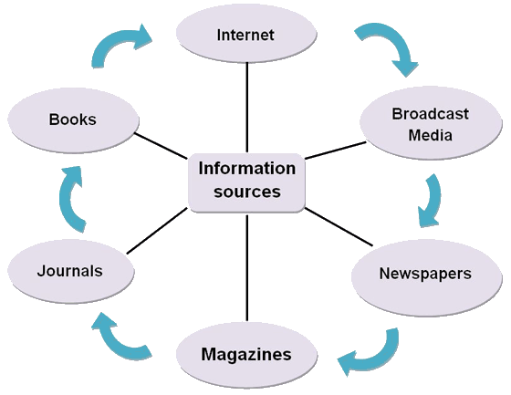
Sources
Informal sources
Statistical Reports
Abstract Databases
Full-Text Articles

Slide 20
Informal Sources
Nontechnical information from trusted sources (like the CDC and WHO) can provide helpful background on a topic.
Factsheets and other informal information are not part of the formal peer-reviewed scientific literature.

Slide 21
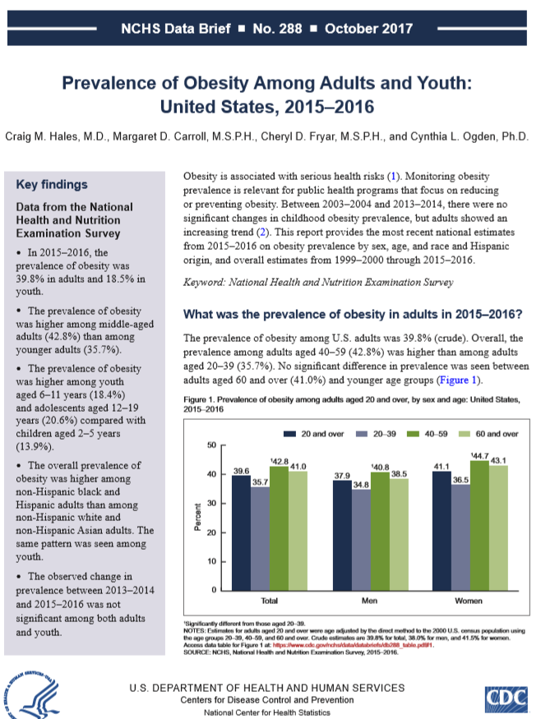
Statistical Reports
World Bank world development indicators
UN agency reports (World Health Statistics, Human Development Report, State of the World’s Children)
Annual reports from groups
E.g., American Cancer Society. CDC, Population Reference Bureau
Information from state and local health departments
cite

Slide 22
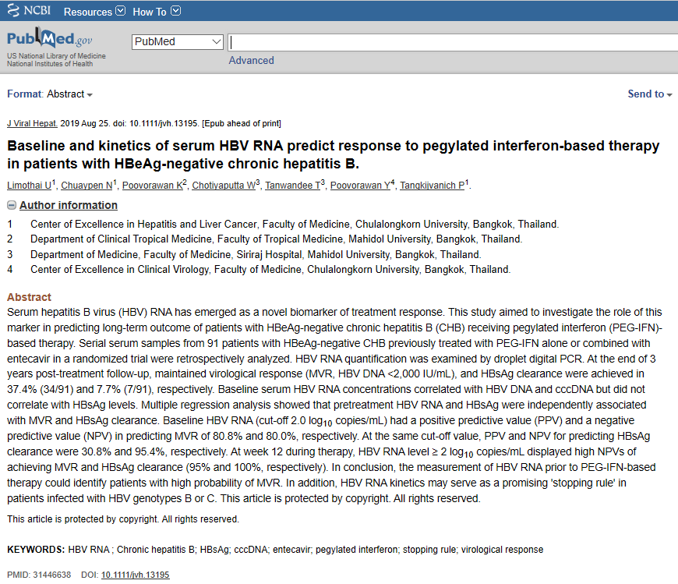
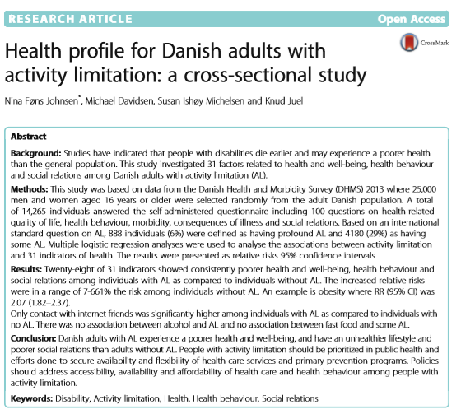
Abstracts
An abstract is a paragraph-length summary of an article, chapter, or book.
Unstructured (paragraph form) vs. Structured (headings)
~250-350 word limit
Journal-specific criteria
Background
Aim
Methods
Results
Conclusions

Slide 23
Full-text Articles
Where to find free full-text PDFs:
Google Scholar and other search engines
PubMed Central and other open access repositories
Journal websites (if the article is open access)
Library subscriptions (e-journals) or interlibrary loans when a journal is not in a library’s collection
Or……E-mail the author to politely request a copy!

Slide 24
Reviewing sources: considerations
Internal validity:
How well was the study designed, conducted, interpreted, and reported?
Study Conclusion = Study Results?
External validity (generalizability):
How likely is it that the results of this study apply to other populations?
Results from a study on Canadian men aged 30-49 yrs. old
Canadian women aged 30-49 yrs. old
Mexican men aged 30-49 yrs. Old

Slide 25
Reviewing sources: considerations
What Makes Research Original?
For a research project to be considered original, it needs to have only one substantive difference from previous work:
…a new exposure,
…a new disease/outcome,
…a new population,
…a new perspective.

Slide 26
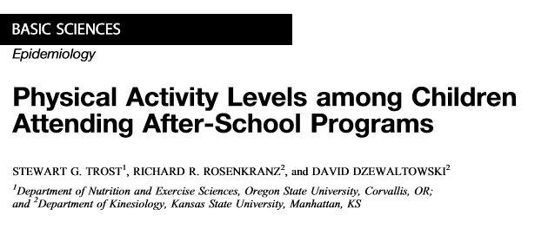
Originality: Example

Slide 27
Focusing the research question…

Slide 28
Study Approach
Primary study: collects new data from individuals
Secondary study: analyzes existing data
Tertiary study: reviews the existing literature

Slide 30
Conceptual and Theoretical Frameworks
A conceptual framework illustrates the key relationships between EDPs that will be evaluated during the study.
Idea-based
A theoretical framework draws on existing models in the literature to explain key relationships
Evidence-based
conceptual framework
theoretical framework

Slide 31
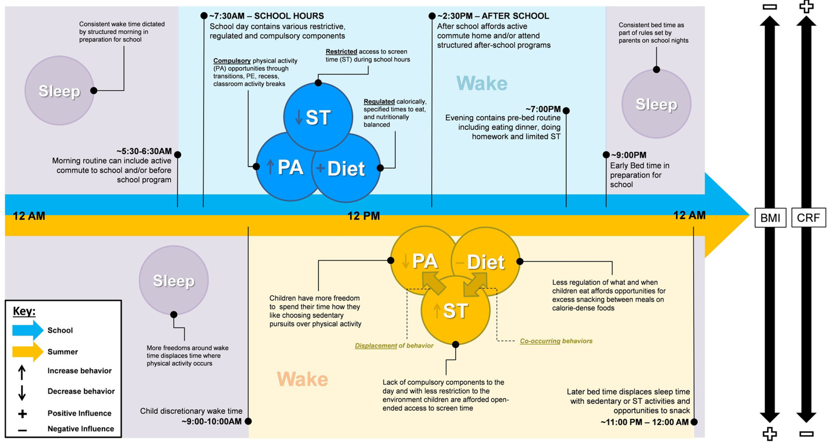
Conceptual Framework: Example

Slide 32
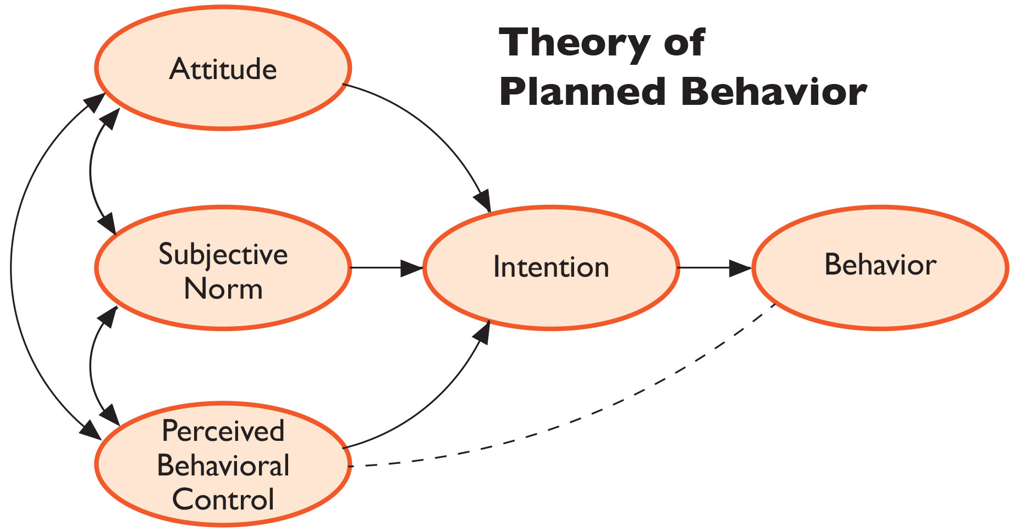
Theoretical Framework: Example

Slide 33
Study Goal and Specific Objectives
First identify one clear overall study goal or study question.
Then identify 2 or more aims or objectives that represent steps toward answering the main study question.

Slide 34
Specific Goals and Objectives: Example
Main study goal: Evaluate a pediatric weight management program as a treatment for overweight or obesity in low-income households
HOW?
Aim 1: examine the feasibility and acceptability of the referral program by parents, children and pediatricians.
Aim 2: examine preliminary effectiveness of program on weight-status of children who attend summer day camp compared to standard care.
Aim 3: explore moderating influence of obesogenic behaviors (physical activity, sleep, and diet) on changes in zBMI across two groups.

Slide 35
‘Good’ research projects are described by the acronym “FINER”:
F easible
I nteresting
N ovel
E thical
R elevant

Slide 36
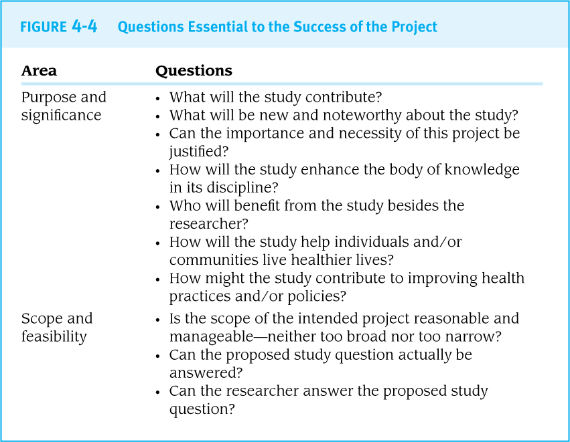

Slide 37
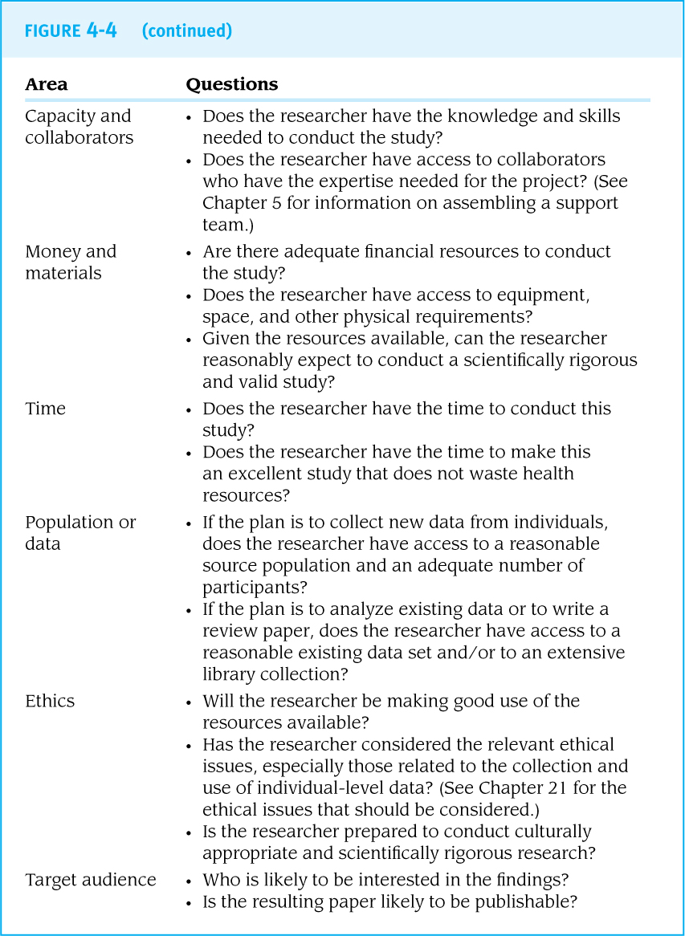

Slide 38
- END -

