Slide 1






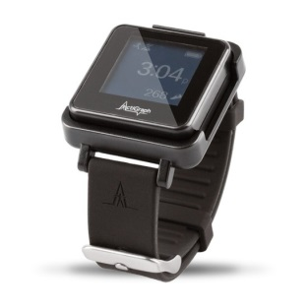
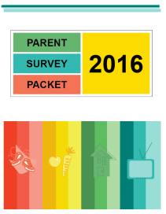
Instrumentation
Notes:
Chapter 18 - 21

Slide 2
….how we measure

Slide 3
….but first, what is measurement, and why do we measure?

Slide 4


What is ‘Measurement’?
Why measure?
The Process of assigning numbers to properties of objects, organisms, or events, according to some rule
Meaningful interpretations on comparisons of the magnitude of any two or more scores on the attribute
To accurately and precisely measure the underlying attribute of interest
  Study findings are worthless without accurate measures!
Decision making
  Evaluations can help inform decisions

Slide 5

Measurement Considerations
Goal/Questions
Purpose of assessment
Age of participants
Sample size
Tolerance limits of response burden
Resources – generally, cost of assessment is related to its accuracy (lower cost = lower accuracy)
Type of information sought
Context

Slide 6
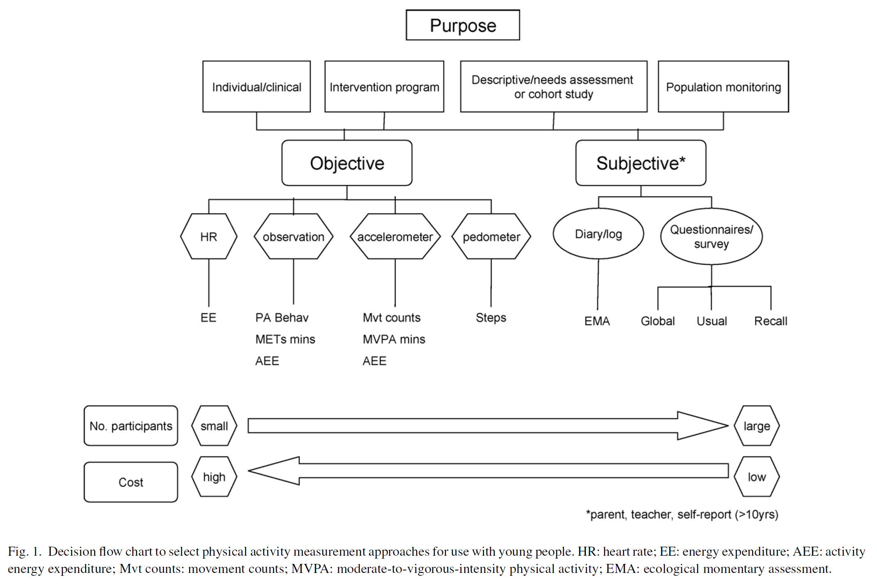
Measuring Physical
Activity Example

Slide 7
Ways to measure

Slide 8


Questionnaires
A questionnaire (or survey instrument) is a tool for systematically gathering information from study participants.
Start by compiling a list of the topics the survey instrument must cover.
Include questions that confirm eligibility to participate.
Question Areas

Slide 9
Types of Questions
Closed-ended questions (close-ended questions) allow a limited number of possible answers:
  Date/time
  Numeric
  Categorical: ordinal (ranked) or nominal (unordered)
Open-ended, or free response, questions allow participants to explain their answers at length.
When anonymity is important, avoid asking questions that could allow the participant’s identity to be determined based on his/her responses.
Anonymity

Slide 10
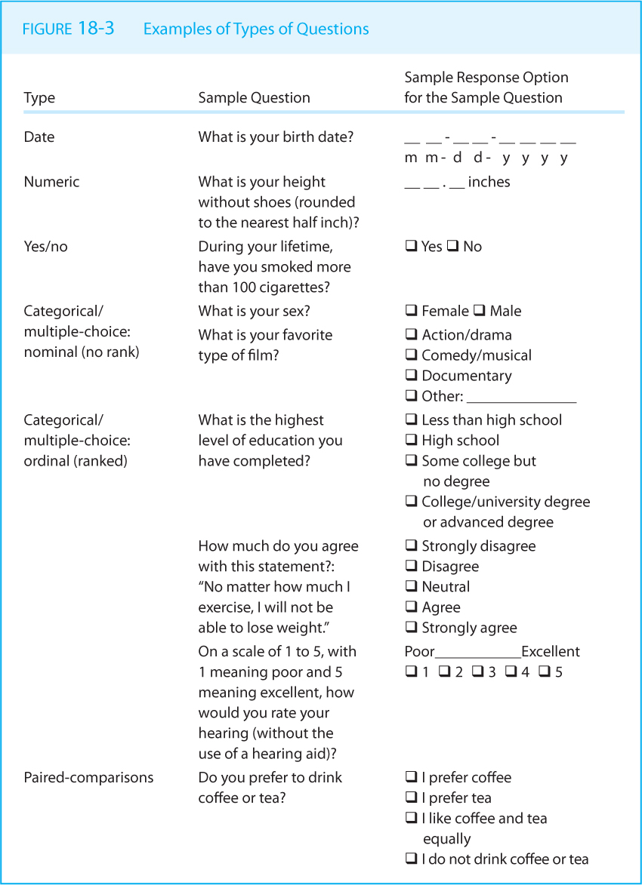
Types of Questions

Slide 11
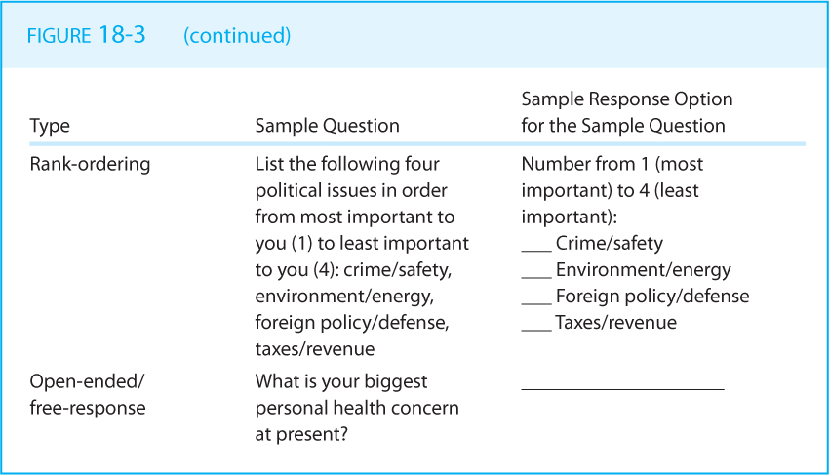
Types of Questions

Slide 12
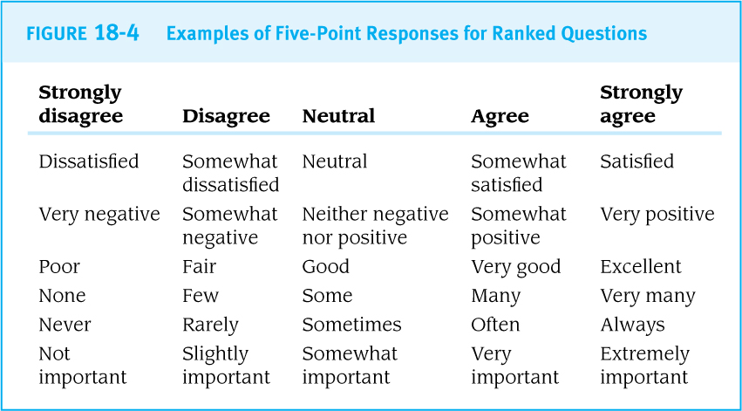
Ranked Response Examples

Slide 13

Wording of Questions
Check each question and all the response items for clarity.
Avoid using
  Jargon
  ‘Big’ words
  Abbreviations
  Vagueness
  Double Negatives
  Faulty Assumptions
  Hypotheticals
  Too much detail
  2-in-1
  ‘Leading’

Slide 14
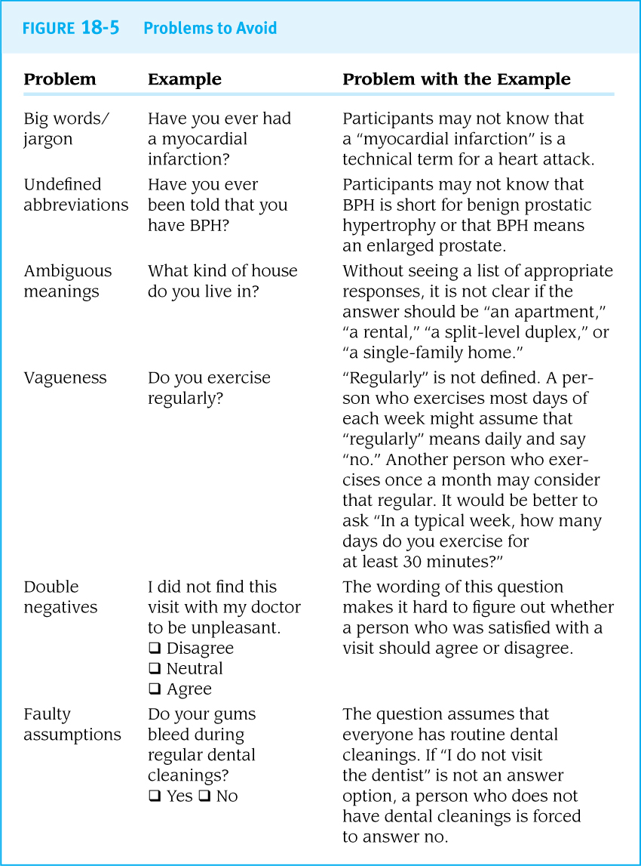
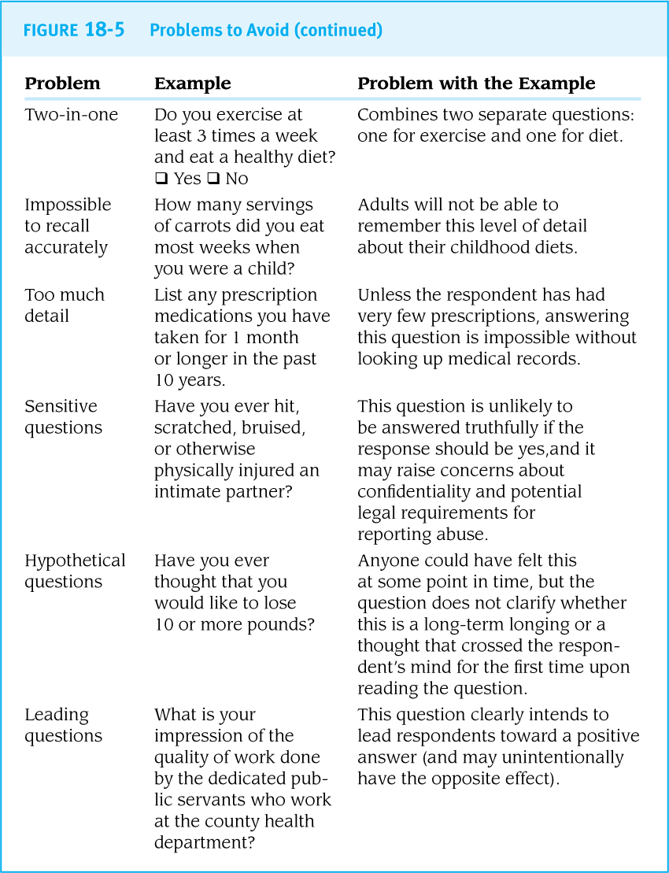

Slide 15
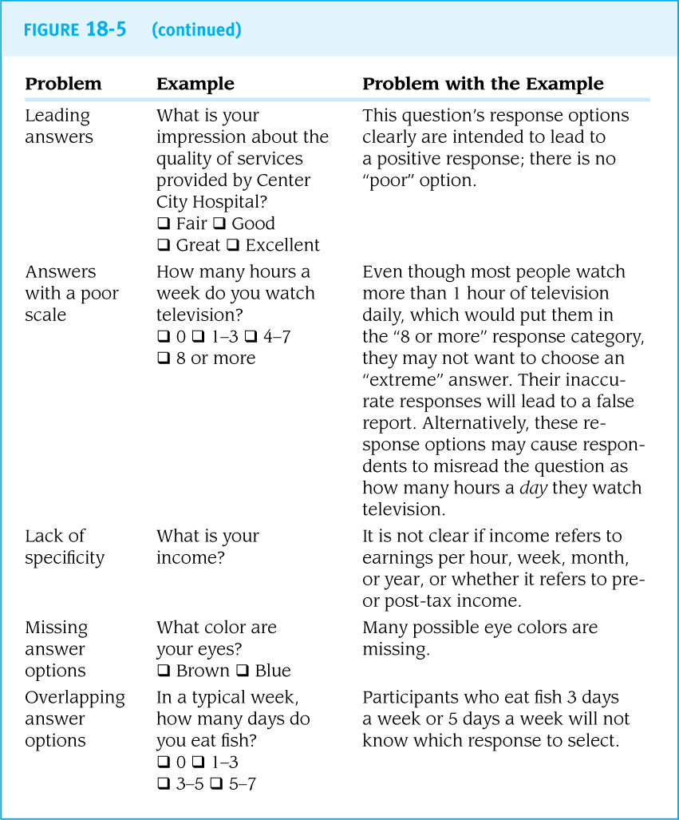

Slide 16

Order of Questions
Start with easy questions before moving to more difficult or sensitive questions.
Avoid habituation.
“a decrease in response to a stimulus after being repeatedly exposed to it”

Slide 17
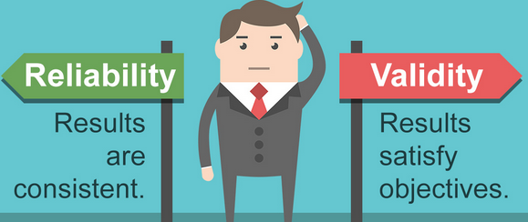
Reliability and Validity
Reliability (precision): consistent answers are given to similar questions
Validity (accuracy): the responses or measurements are correct
Content validity: Subject matter experts agree that the questionnaire captures the most relevant details about the study domain.
Construct validity: The test measures the theoretical construct it intended to assess (e.g., intelligence, motivation)
Criterion validity: A new test yields results similar to a standard test for a similar theoretical construct.
Content
“adequate coverage”
“a simple addition does not test the whole of mathematical ability”
Construct
“You cannot directly observe fear or motivation…”

Slide 18
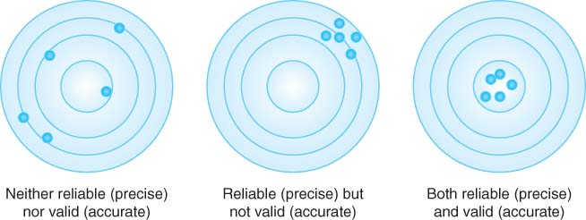

Slide 19


Pilot Testing
A pilot test allows the researcher to correct problems with the survey instrument prior to data collection from participants.
Examples:
  A question needs ‘rewording’
  An answer doesn’t make ‘sense’
  A device was ‘uncomfortable’
  A measure/instrument/assessment took ‘too long’

Slide 20
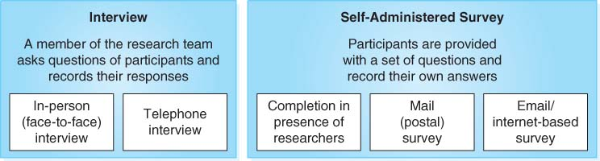
Interviews versus Self-Administered Surveys
Interviews may promote accuracy and completeness but may be expensive because of personnel costs.
Self-administered surveys may yield a higher sample size, be more cost-effective, and be preferable for sensitive questions.

Slide 21
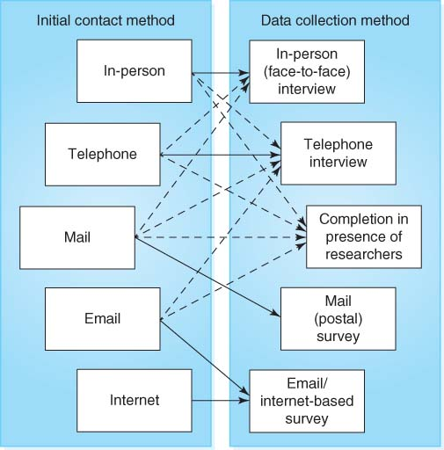
Recruiting Methods
The goal is to maximize the participation rate among sampled individuals.
The recruitment methods are often paired with the data collection method
  Using online methods to recruit for an Internet-based survey.
Provide multiple opportunities to participate
  Follow-up mailings, visits
Consider appropriate incentives.

Slide 22
- END PART 1-

Slide 23

Data Recording Methods
Paper-based surveys must later be scanned or typed into computers; this can be expensive and time-consuming, but they also allow a large number of people to take the survey at one time and place.
Computer-assisted surveys input survey responses directly into a computer and can have built-in checks and “skips,” but not all populations are comfortable with computers.

Slide 24
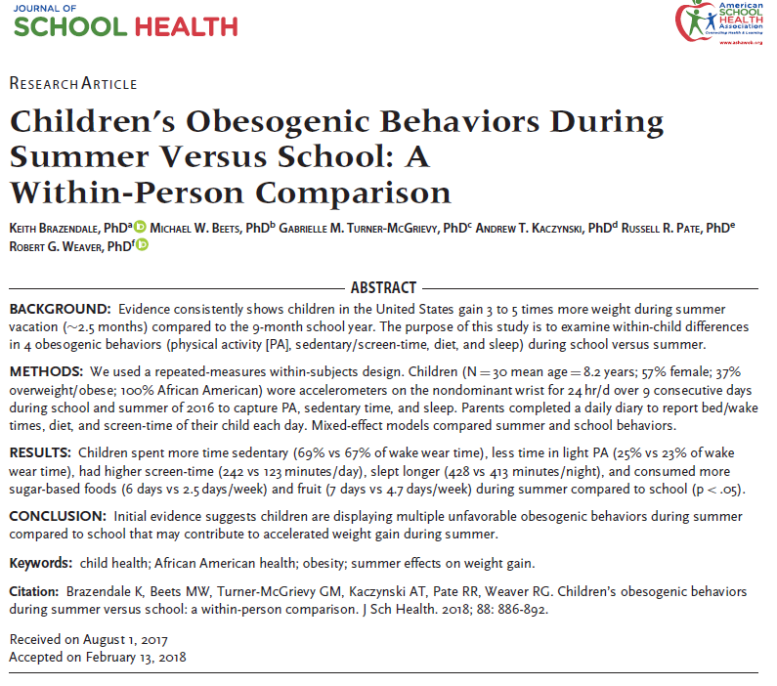
Paper-based Survey

Slide 25
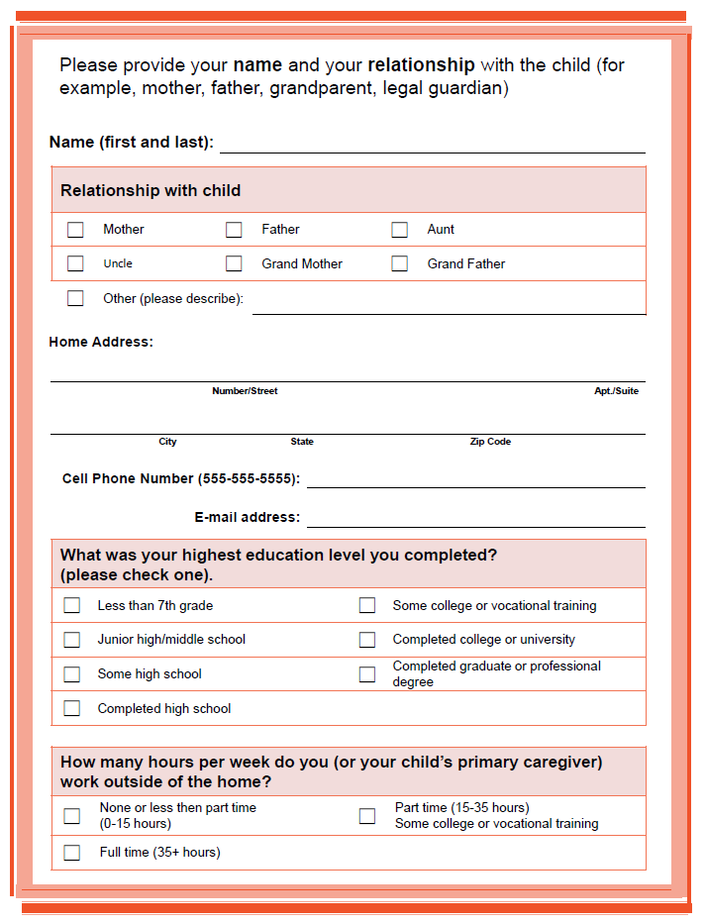

Slide 26
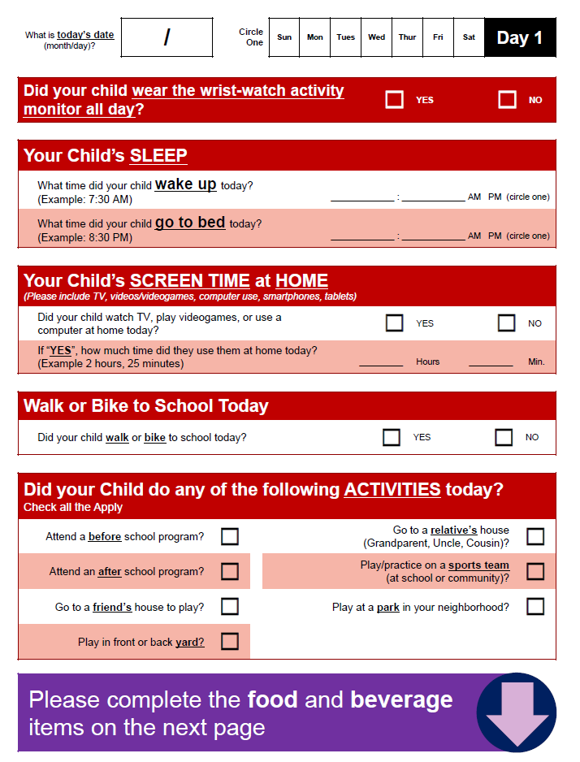

Slide 27
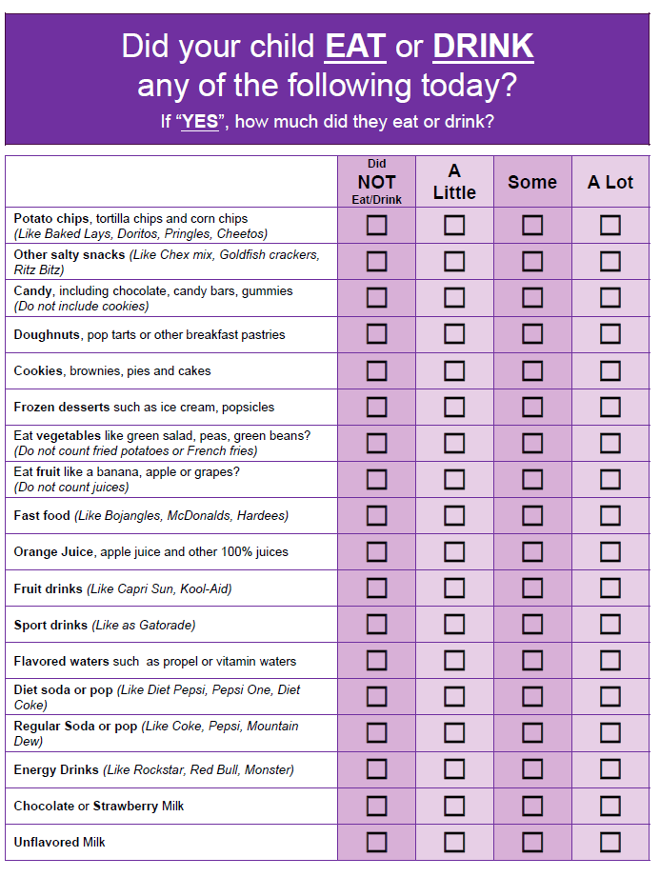

Slide 28
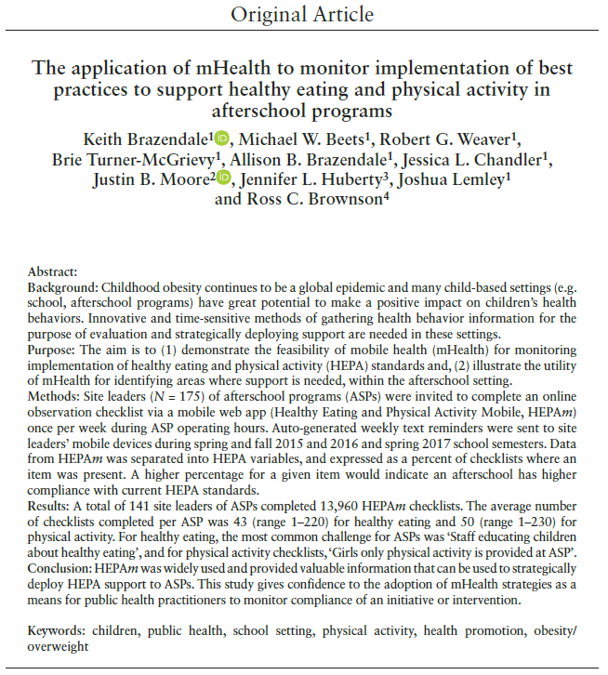
Computer-based Survey

Slide 29
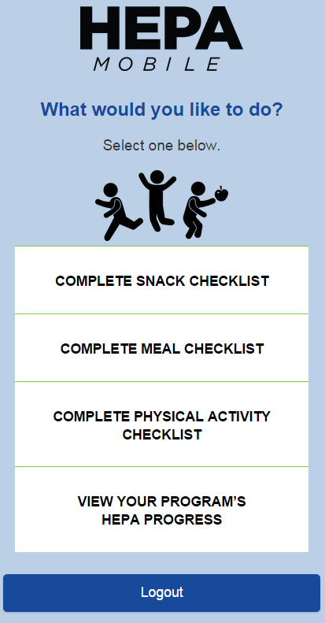
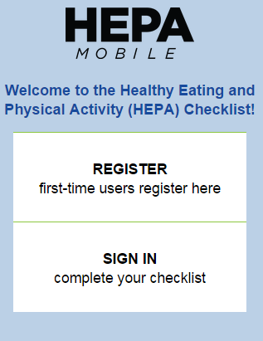
Computer-based Survey

Slide 30

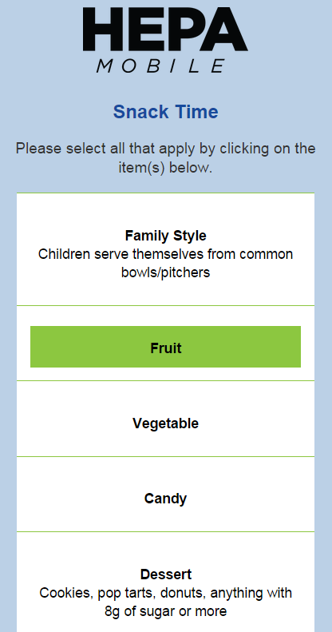
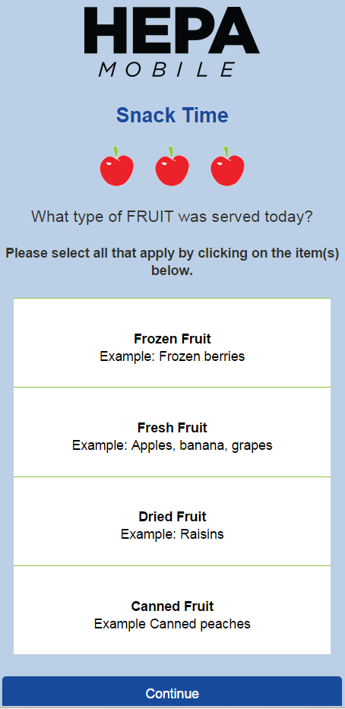
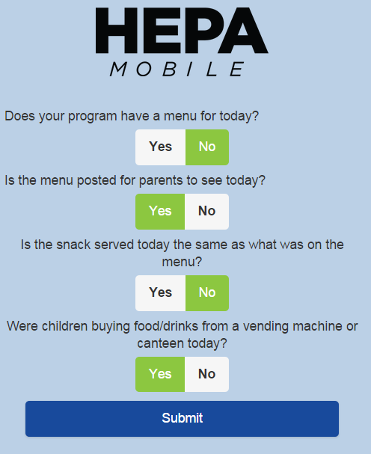
Computer-based Survey

Slide 31
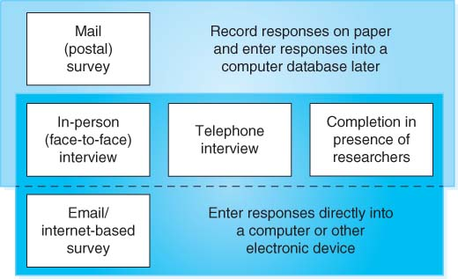
Summary

Slide 32
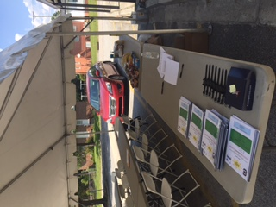
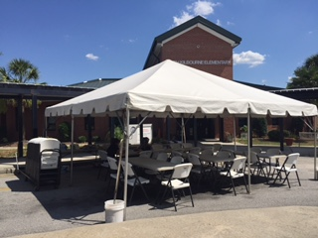

Training Data Collectors
Uniformity in data collection procedures is important.
Research personnel need access to comprehensive handbooks and training sessions to practice their skills before collecting data.
Essentials: Teamwork, communication, organization, professionalism, and energy!

Slide 33
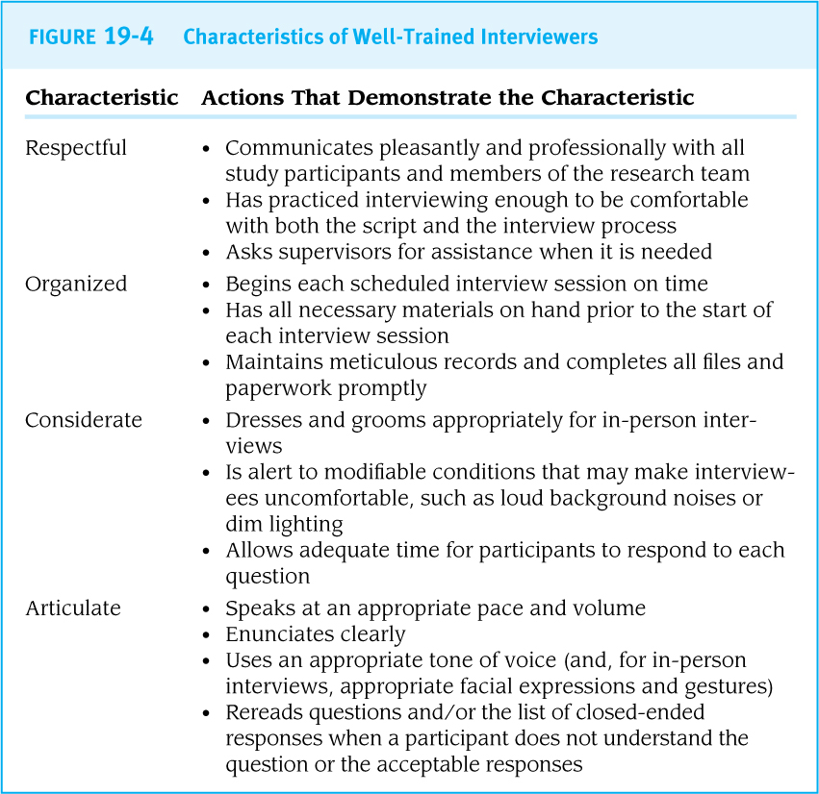
Characteristics of Interviewers

Slide 34
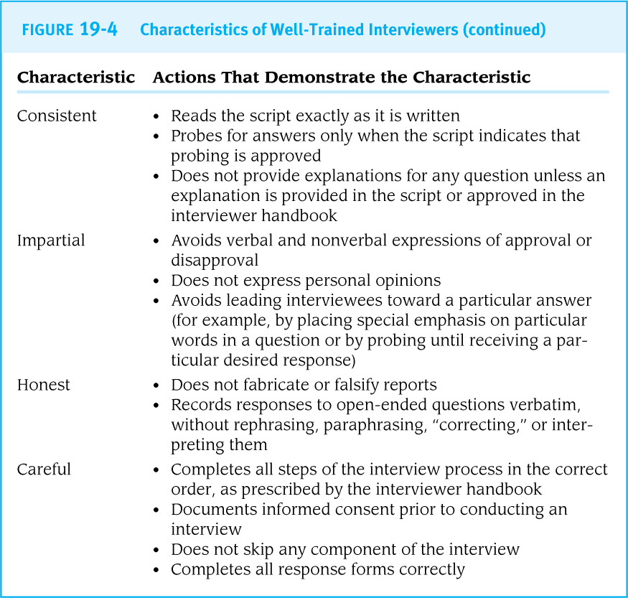
Characteristics of Interviewers

Slide 35

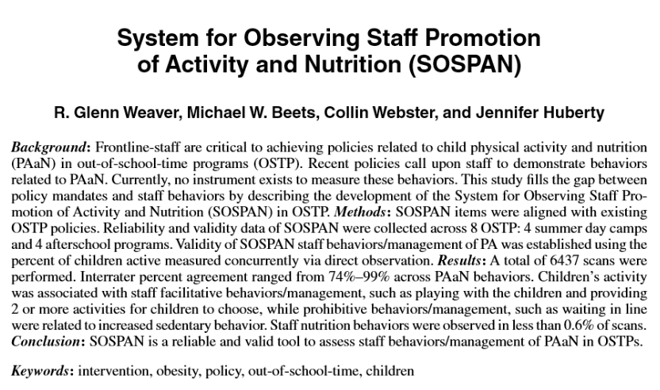
Inter-Rater Reliability
the degree of agreement among raters/assessors/data collectors
the kappa statistic demonstrates that two assessors are making consistently valid measurements
“Are we seeing, and agreeing that we are seeing, the same thing”

Slide 36
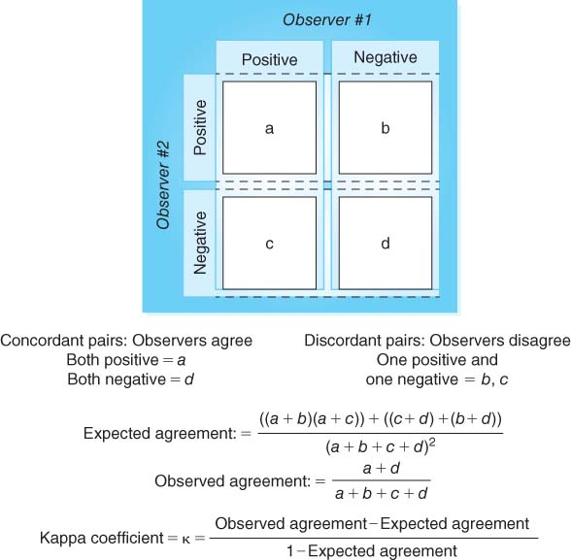
The Kappa Statistic: Assessing Agreement

Slide 37
- END PART 2 -

Slide 38
What to measure…

Slide 39
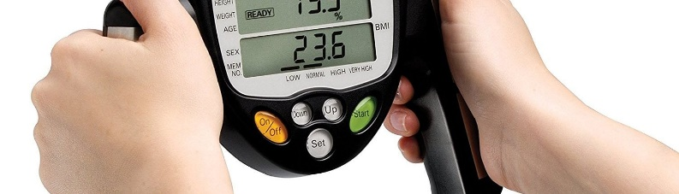
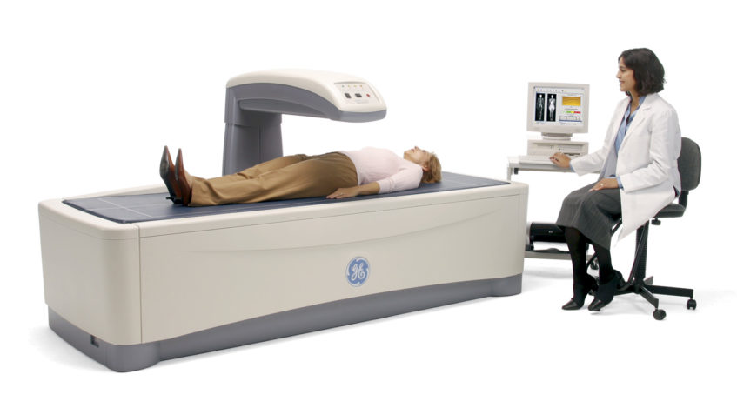

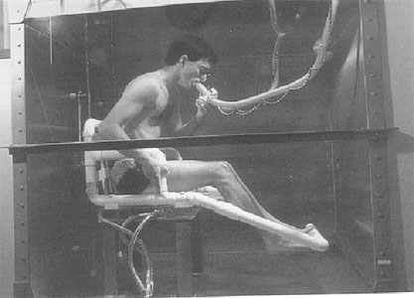
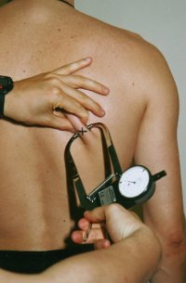
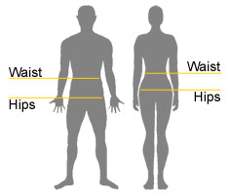
Anthropometry
Anthropometry is the measurement of the human body.
  Body Mass Index (BMI)
    Weight/Height²
  Waist-to-Hip Ratio
  Skinfold Calipers
  Bioelectrical Impedance (BIA)
  Dual-Energy X-Ray Absorptiometry (DEXA)
  Hydrostatic Weighing (Underwater)
  Air Displacement Plethysmography
Ensure privacy for participants is being measured.

Slide 40
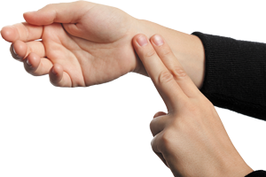
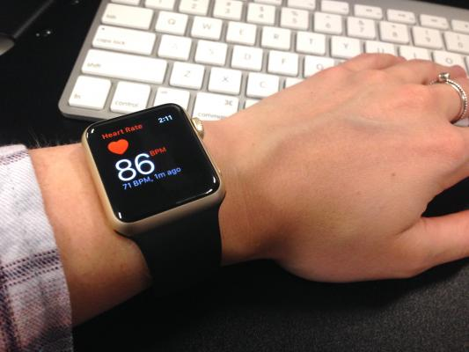


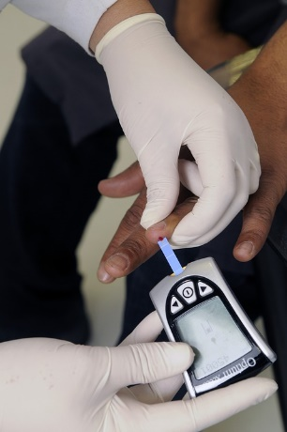

Vital Signs
Clinical Examination
Examples include body temperature, blood pressure, and pulse (heart rate).
The research protocol should state exactly how each measurement should be taken.
Examples include breathing sounds, range of motion, and oral health status.
An assessment form can guide the procedures that will be used for all participants.

Slide 41
Tests of Physiological Function
Examples include spirometry for lung function, EEG for brain function, and audiometry for hearing acuity.
Consider the costs of these tests.
Spirometry Example
  Measurement of pulmonary volumes and rate of expired airflow
  Vital capacity (VC)
    Maximal volume of air that can be expired after maximal inspiration
  Forced expiratory volume (FEV1)
    Volume of air expired during 1 second during maximal expiration
  FEV1/VC ratio
    ≥80% is normal for healthy individuals

Slide 42


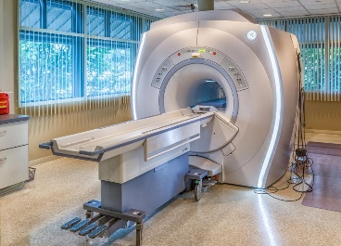
Laboratory Analysis of Biological Specimens
Examples include immunologic, genetic, and other tests of blood, urine, saliva, and other body fluids.
Decide ahead of time whether results will be shared with participants.
ELISAs
  ‘enzyme-linked immunosorbent assay’
Examples include X-rays, CT scans, MRIs, and ultrasound.
Medical Imaging

Slide 43
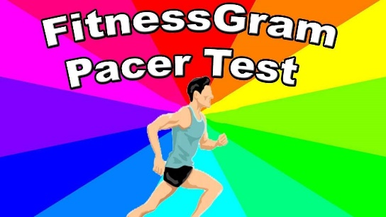
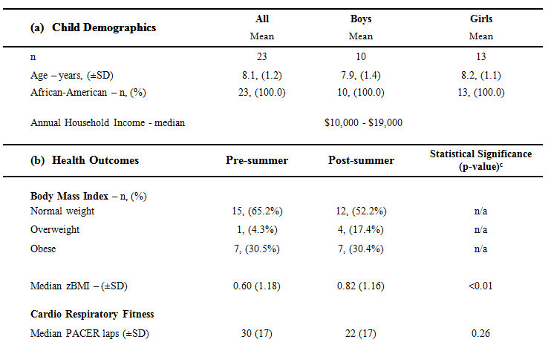

Tests of Physical Fitness
Examples include tests of strength, endurance, and flexibility.
Safety must be the top priority.
Cardiorespiratory Fitness (CRF)
  “Progressive Aerobic Cardiovascular Endurance Run ‘PACER’
“multistage aerobic capacity test that progressively gets more difficult as it continues”

Slide 44
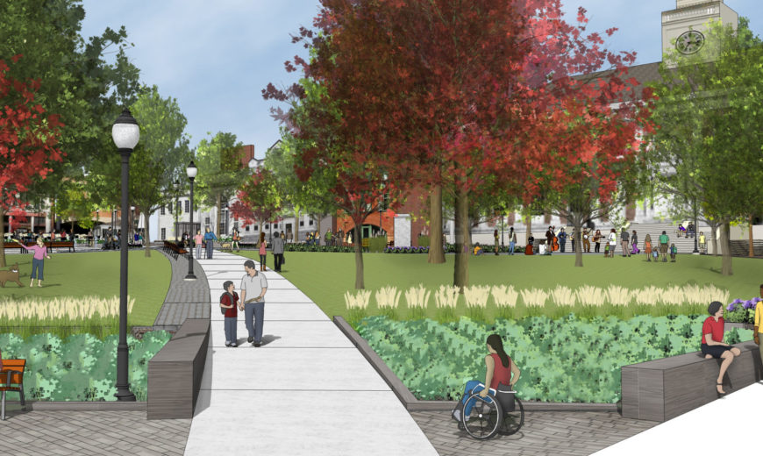
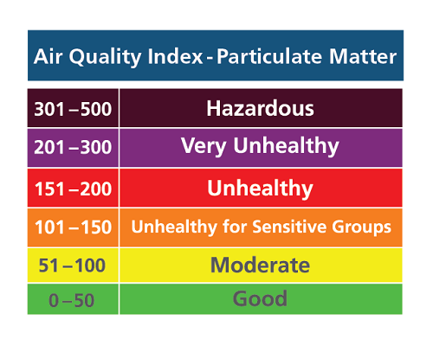
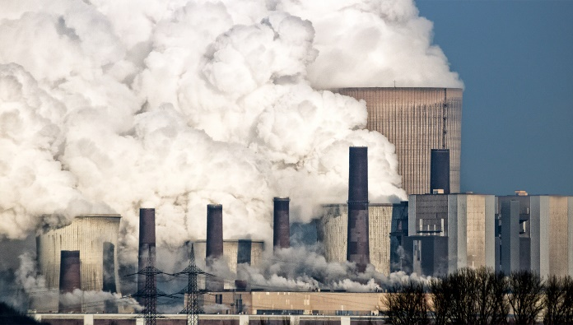
Environmental Assessment
Environmental risks to human health can be assessed by trained observers with checklists and by laboratory tests (such as tests for lead in the water).
Park Audits
Air Quality Index
“…the air quality index in Sacramento was at 316. That’s hazardous. Breathing in that air for a day is roughly equivalent to smoking 14 cigarettes.”

Slide 45

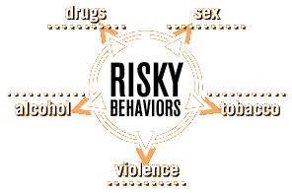

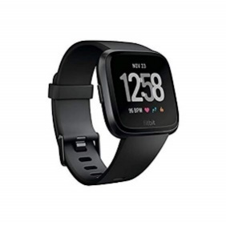
Behavioral Assessments
Lifestyle behaviors, risky behaviors…
  Activity (Sedentary, MVPA, TPA)
  Sleep (duration, quality, timing)
  Diet (quantity, quality)
  Technology use (duration, types)
  Substance/Drug use (recreational, clinical)
Consider objective and/or subjective measures

Slide 46

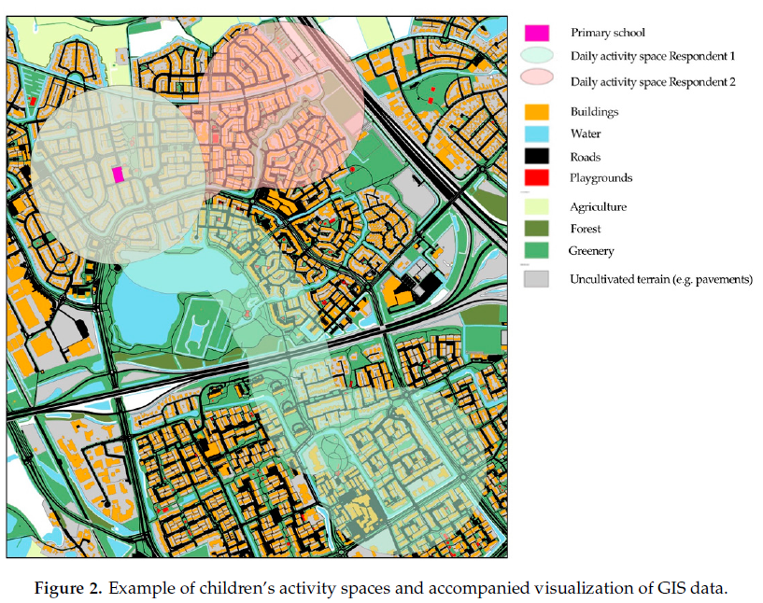
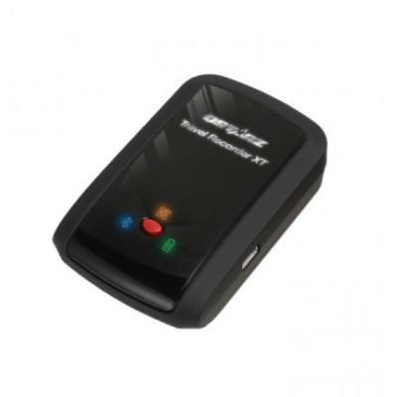
GIS (Geographic Information Systems)
Use a GPS (global positioning system) to gather the latitude and longitude for key places, so that they can be mapped and incorporated into a ‘spatial analysis’.

Slide 47

Using data collected by someone else aka…
Secondary Analysis
In a secondary analysis, the researcher conducting the statistical analysis has not had (and does not have) any contact with the individuals whose data are being examined.

Slide 48


Publicly Available Data Sets
Many datasets are available online, such as a diversity of cross-sectional studies from the CDC:
  National Health and Nutrition Examination Survey (NHANES)
  National Health Interview Survey (NHIS)
  Behavioral Risk Factor Surveillance System (BRFSS)
The data may be downloadable to all, or there may be an application process for acquiring the relevant data.
Read all relevant supporting documentation, and be aware of possible costs and authorship issues.

Slide 49

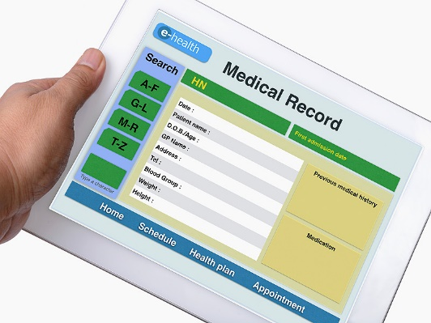
Private Data Sets
Clinical Records
Professors (and others) may make not-yet-analyzed data files available to students and other investigators.
Ethical approval, careful review of the data collection methods, and frank conversations about authorship are required.
Ethical review of a research protocol is required before data are accessed.
Some data are electronic; others may be on paper and require data entry.
Records are often incomplete; absence of information in a file cannot be assumed to mean that the symptom or sign was not present in the patient.

Slide 50
- END -

