Slide 1
Assessments
PET4550C

Slide 2
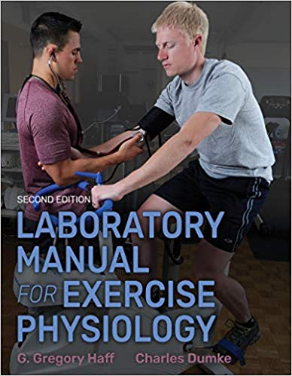
Course Expectations
Required Textbook:
Laboratory Manual for Exercise Physiology 2nd Edition. Human Kinetics. G. Gregory Haff & Chales Dumke
Arrive on time for each class
Participate in class discussions/activities
Show common courtesy and respect for instructor and classmates

Slide 3
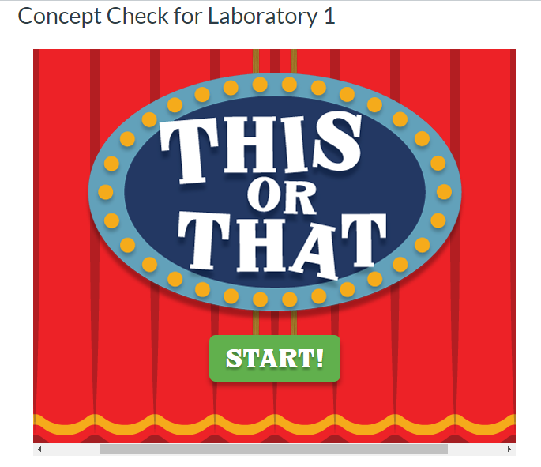
Assignments
DUE EVERY WEEK
Concept Checks: 3pts (x11)
Due the night before each class
Must get them all right for full credit
Discussions: 5pts (x11)
Original post 3pts
Reply to classmate 2pts
Labs: 10pts (x11)
To be completed in class (virtual labs)
If you missed a lab: there is a make-up lab and this must be completed in place of the in-class lab
You are only allowed TWO make-up labs

Slide 4
Exams
3 Exams: 35pts each
Proctor Hub
Open 24 hours
1.5 hours to complete exam
What is on the Exams:
Any and all materials covered in the required book

Slide 5
Housekeeping
Announcements:
Check your email and webcourses at least twice a week. Sometimes if I receive multiple emails regarding the same topic/issue, I will address it via Announcements.
If class is cancelled at last minute, this will also be conveyed via Announcements.
Emails:
All email/message policies must be followed, or the instructor will not respond
The body of the message should include an appropriate salutation (formal greeting), your class name and section, articulated words with respect, capitalization, punctuation, and a complimentary close (your name).
Please check webcourses, the syllabus and announcements before emailing me questions. Often, answers to questions can be found in webcourses.

Slide 6
Technology
In Class Labs:
Phones should be silenced before class, if you need to take a phone call you may step out
Laptops are permitted for note taking purposes
Recording devices should be cleared with the instructor prior to use

Slide 7
QUESTIONS?

Slide 8
Primary Data Collection

Slide 9
Objectives
Define basic terminology associated with testing.
Learn the difference between field, field/laboratory, and laboratory tests.
Learn metric conversions and the units recommended by the International System of Units (SI).
Understand the concepts for evaluating temperature, barometric pressure, and relative humidity.
Learn the skills needed for administering height, weight, and body frame assessments.

Slide 10
Assessments
Why do we need them? Why do we need this class?
Who does it benefit?
Field Tests
Field/Laboratory Tests
Laboratory Tests

Slide 11
Units of Measurement
International System of Units (SI)
Why?
Weight: kilograms (kg)
Height: meters (m)

Slide 12
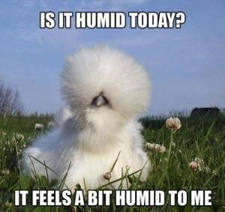
The Weather?!
Why do we need to take in account the temperature, pressure and humidity?

Slide 13
Lab Activity 1: Due January 26th

Slide 14
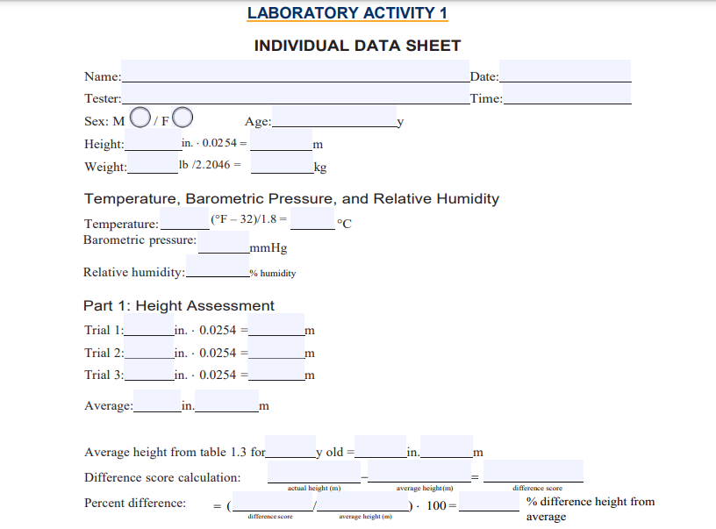
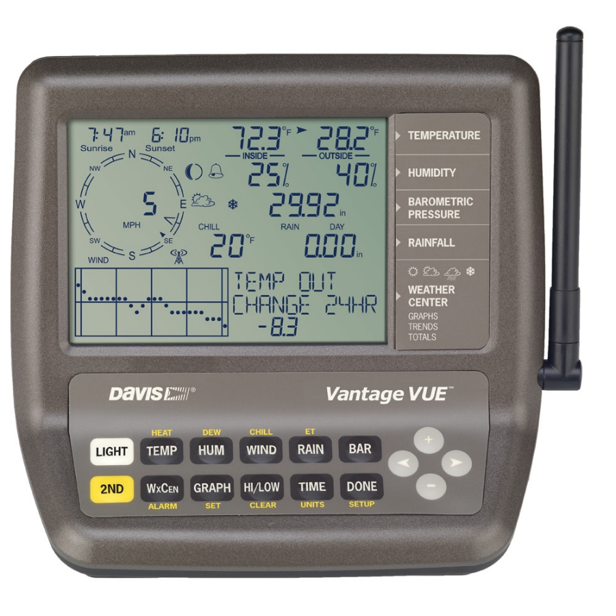
Participant X, Female Age 21
Height: 64inches
Weight: 145lbs
Temperature: 72.3F
Barometric Pressure: 29.92mmHg
Relative Humidity: 40%

Slide 15
Trial 1: 64.5 inches
Trial 2: 64 inches
Trial 3: 64 inches
Average: 64.16 inches
Average height from Table 1.3: 21yr old = 64.2 inches

Slide 16
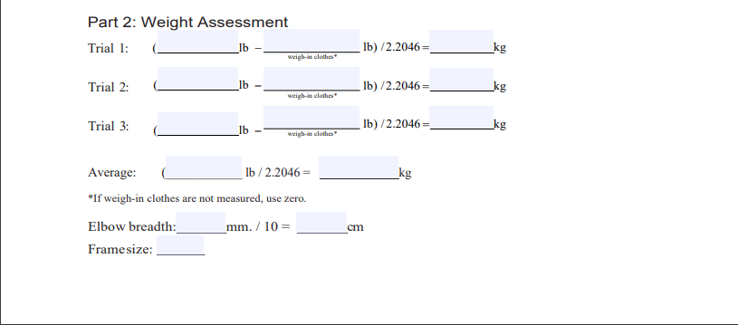
Trial 1: 145lb
Trial 2: 146lb
Trial 3: 144lb
Average: (145) lb / 2.2406 = ______kg

Slide 17
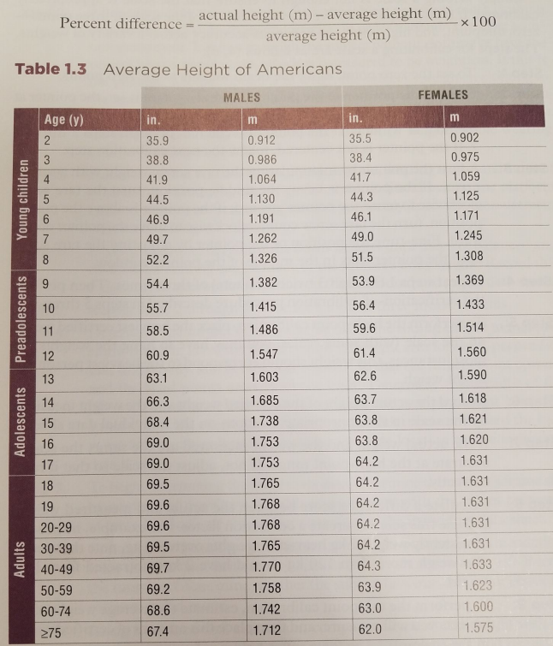

Slide 18
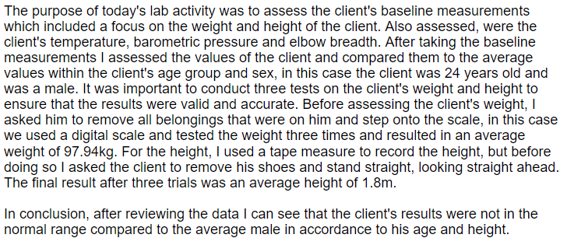
Abstract- EXAMPLE
Write an abstract (150- to 250-word paragraph) that provides a quick overview of today's laboratory activity. Explain the purpose (e.g., The purpose of today's lab activity was to...), the methodology (i.e., participant(s)' descriptive statistics such as age and sex and testing protocol(s) including variable(s) tested and equipment used), the results (i.e., result(s) for test(s) and classification(s)), and the conclusion drawn from this lab activity based on the data acquired.
Purpose
Methods
Descriptive Stats
and
Results
Conclusion

Slide 19
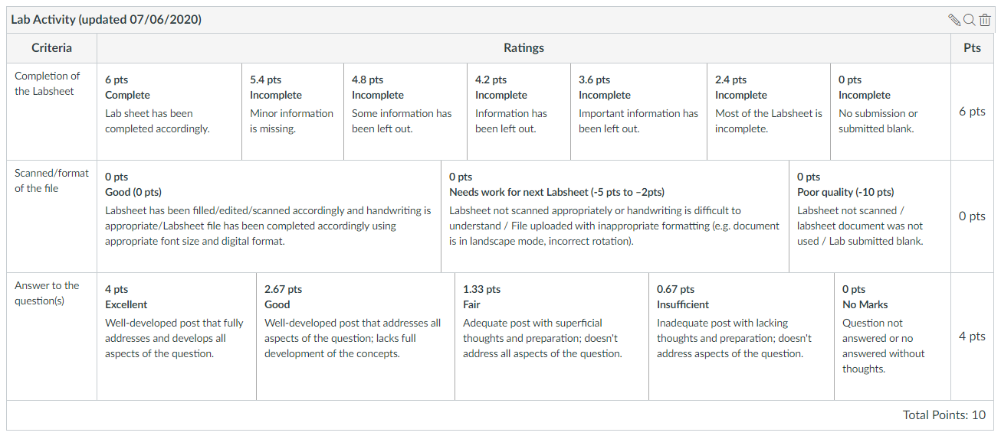

Slide 21
What’s Next?
Today
Complete Lab Activity 1
Due This Week
Syllabus Quiz
Concept Check
Discussion Post
Next Week
Concept Check 2
Lab Activity 1

