Slide 1
Review

Slide 2
VO_{2max} vs. VO_{2peak}
The highest VO₂ value measured during the test is taken as VO_{2max} if two of the following four criteria have been met. If not, Results are considered VO_{2peak}
$$\frac{\text{VCO}\text{2 }}{\text{VO}\text{2 }}$$
VO₂ Plateau
Predicted HR
RER
RPE
VO₂ plateaus (i.e., increases ≤150 ml ∙ min⁻¹) despite an increase in work rate
Heart rate (HR) during the last stage is no more than 10 beats/min below the subject’s age-predicted maximal heart rate (HRmax).
Respiratory exchange ratio (RER) is greater than 1.10 in the final work stage.
Rating of perceived exertion (RPE) is greater than 17 using the original Borg scale.

Slide 3
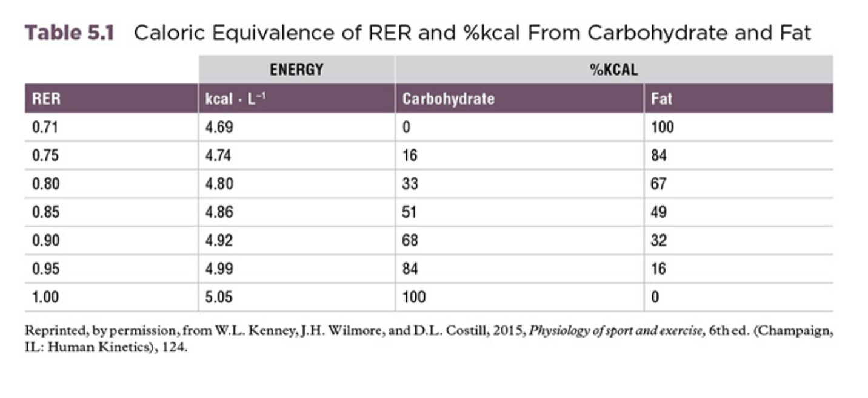
RER = VCO₂/VO₂

Slide 4
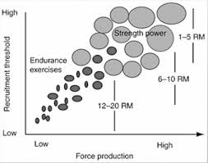
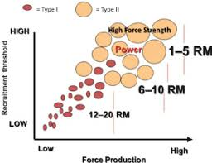
Motor Unit Recruitment

Slide 5
Anthropometric Assessments
PET 4550C
Assessments and Evaluation in Kinesiology

Slide 6
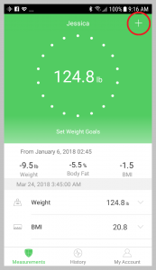
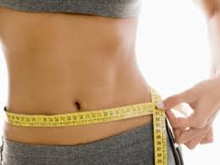
Why measure Body Composition?
The components that make up your body
Our bodies are made up of fat, muscle, bone, tissues, water, blood, and vital organs

Slide 7
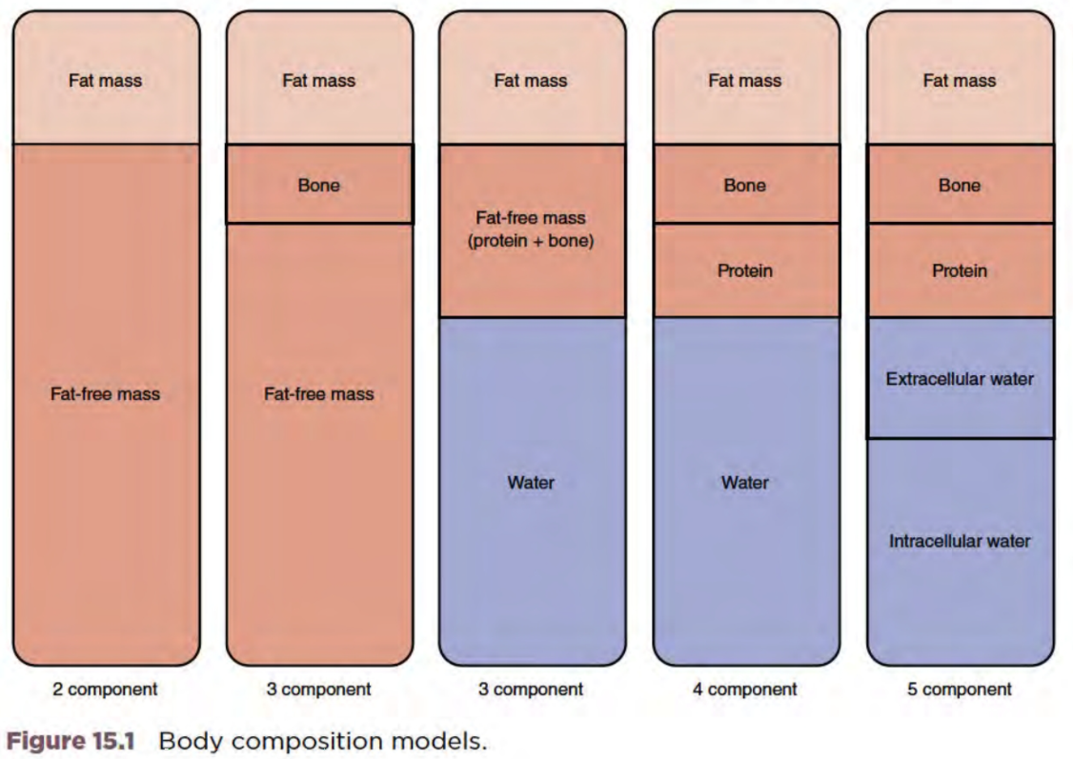
Methods of Estimating Body Composition
The body 24-Hour energy expenditure can be broken down into three components:
Anthropometry (2)
Body Mass Index (0)
Bioelectrical Impedance Analysis (2)
Skinfold Thickness (2)
Underwater weighing (2)
DEXA (3)
MRI (3)
Air Displacement Plethysmography
or BOD POD (2)
ENERGY OF PHYSICAL ACTIVITY

Slide 8
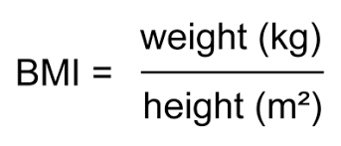
BMI
Body Mass Index
Is BMI a measure of Body Composition?
Remember, Body Composition tells us:
Fat mass
Body Water
Fat Free Mass
Bone Density
Protein
Extracellular Fluid
Intracellular Fluid
≠

Slide 9
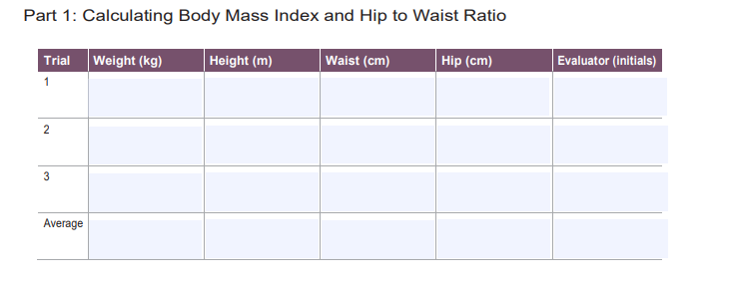
PERFORM
AT HOME
Laboratory Activity 10
Part 1 - BMI Calculation
Step 1: Each subject should be prepared in the appropriate attire (light, nonbulkyclothing to avoid mismeasurement of weight and girth).
Step 2: You will record your own data or that of a friend/roommate. Gather basic data (e.g., age, height, weight) for the individual data sheet as described in the first laboratory activity.
Step 3: Remove your shoes, jewelry, wallet, keys, and any excess clothing prior to weighing yourself on the scale. Record your weight in kg to the preciseness allowed by your equipment.
Step 4: Measure the subject’s height using a stadiometer or a measuring tape attached to a wall (or record the height you are sure of). Have the subject stand with his or her back to the stadiometer or wall with the heels on the floor. Use a lever arm or similar device placed on the top of the head at the highest point. Be sure that the arm or similar device is parallel to the ground before recording the height in centimeters to the nearest millimeter.
Step 5: To demonstrate the reliability of this measure, repeat for a total of three trials.
Step 6: Record your data on the individual data sheet.

Slide 10
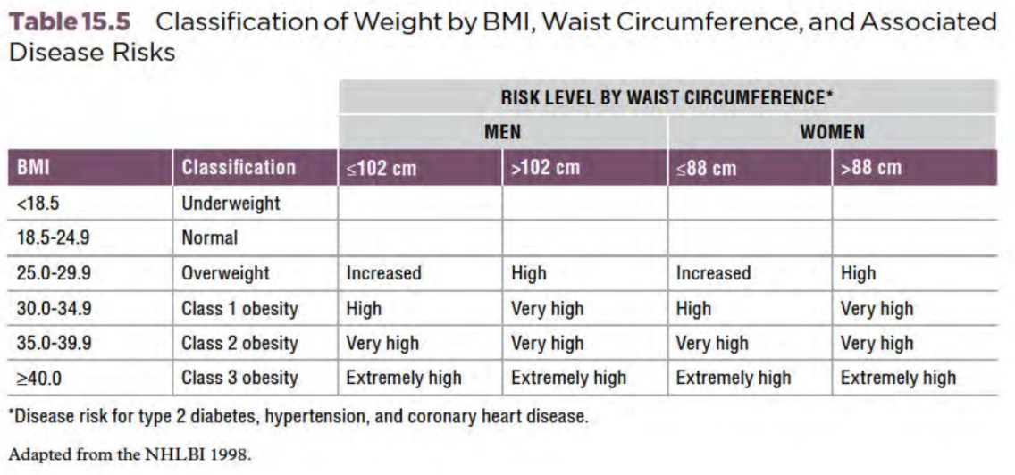
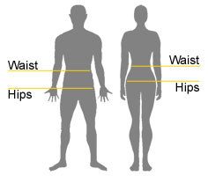
Waist to Hip Ratio
Step 1: To measure the circumference of the waist, wrap the tape measure around the subject from the anterior side. Place the tape at the narrowest circumference between the umbilicus and the lowest rib. Resolve any twists in the tape. Cross the tape and switch hands to avoid having your arms cross each other. Confirm that the tape is parallel to the ground all the way around the subject. (Doing this measure in front of a mirror can be helpful.) Have the subject relax the abdominal muscles. If you have a spring-loaded tape, pull the tape to the calibrated tension. Record the measurement in centimeters to the nearest millimeter at the end of a normal expiration
Step 2: To measure the circumference of the hips, wrap the tape measure around the subject from the lateral side. Place the tape at the largest circumference of the buttocks. Resolve any twists in the tape. Cross the tape and switch hands to avoid having your arms cross each other. (Doing this measure in front of a mirror can be helpful.) Confirm that the tape is parallel to the ground all the way around the subject. If you have a spring-loaded tape, pull the tape to the calibrated tension. Record the measurement in centimeters to the nearest millimeter.
Step 3: Repeat steps 1 and 2 two more times to complete the individual datasheet.
Step 4: Fill out the body composition data sheet the calculating the averages, BMI, and W/H ratio using the individual data sheet.

Slide 11
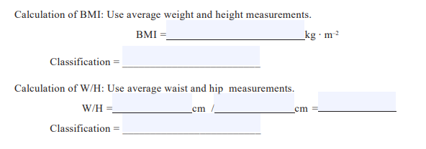

Slide 12
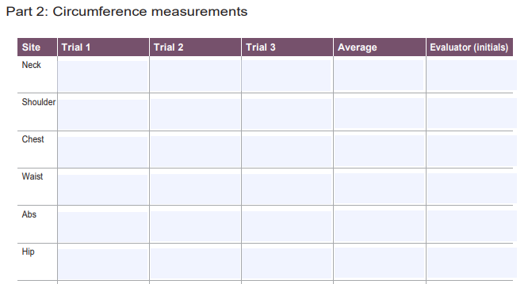
Follow the guidelines on the next slide for how to correctly take these measurements
*There are more sites other than those on these screenshot. Make sure to completely fill out your lab activity sheet

Slide 13
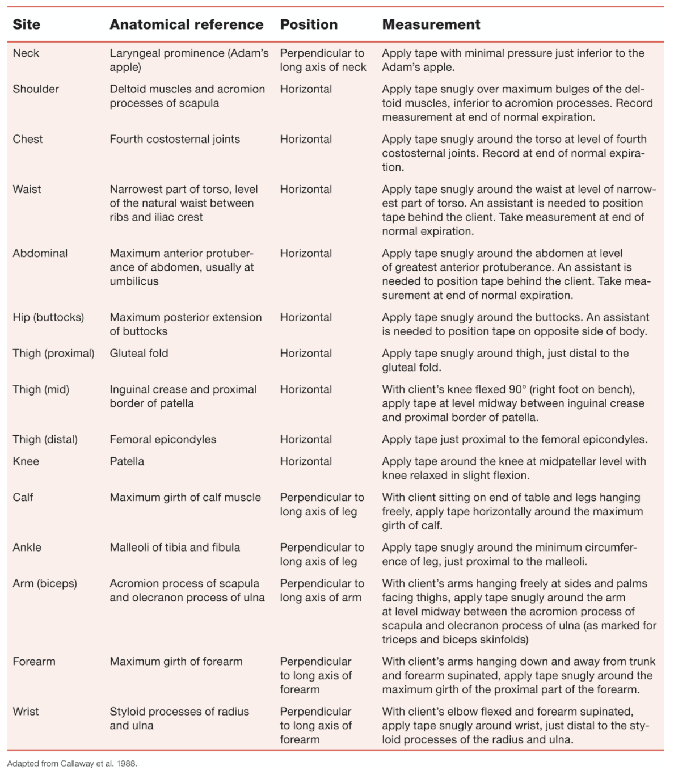

Slide 15
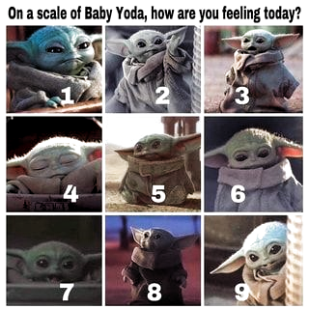
Poll

