Slide 1
Resting Metabolic Rate
PET 4550C
Assessments and Evaluation in Kinesiology

Slide 2
Why measure your resting metabolic rate?
22%
The practical application of understanding your energy expenditure
Energy expenditure should be predicted to prevent insufficient caloric intake as well as overfeeding.
email
password
myfitnesspal.com
SIGN IN

Slide 3
Components of Total Energy Expenditure
The body 24-Hour energy expenditure can be broken down into three components:
The amount of energy expended to sustain the basic body functions is called the resting metabolic rate (RMR) and is generally expressed as kilocalories (kcal).
60–75%
THERMAL EFFEECT OF FOOD
RESTING METABOLIC RATE
ENERGY OF PHYSICAL ACTIVITY
5–10%
The thermal effect of food (TEF) is defined as the amount of energy required to digest, absorb, and further process the energy-yielding nutrients in food (i.e., fat, protein, carbohydrate).
10–35%
Even though skeletal muscle contributes less than 20% to the RMR, skeletal muscle can cause the most dramatic increase in metabolic rate. During strenuous exercise, the total energy expenditure of the body may increase to over 20 times the resting levels.
Notes:
From a practical or intervention standpoint, the TEF is rather insignificant—individual variance in the TEF does not seem to make a difference in body composition among people; and changes in diet composition do not alter the TEF appreciably (Miller 2006).
Factors that influence variance RMR withing and among people: body composition, gender, dieting, race, and exercise.
Among the the tissues that compose lean body mass, brain, heart, kidney, liver, and skeletal muscles are the ones that affect RMR the most. People with larger amounts of muscle mass have higher RMR.
Why obese have higher RMR?
However, large differences in lean body mass differences do not promote that much of a difference…
30 minutes of exercise may account to 10% or more of daily expenditure
But this increased metabolic effect remains elevated for some time after exercise. This phenomenon has been termed excess postexercise oxygen consumption (EPOC). The magnitude of the EPOC is related to the duration and intensity of the workout. Can go from 20 minutes to 10 hours depending on the exercise.
National Strength and Conditioning Association. NSCA's Guide to Tests and Assessments (Science of Strength and Conditioning). Human Kinetics.

Slide 4
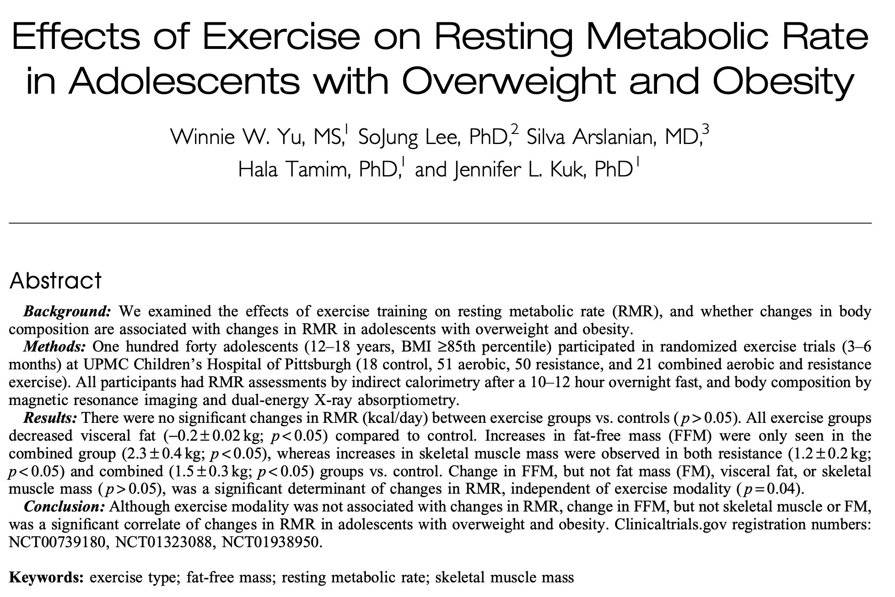
THERMAL EFFEECT OF FOOD
RESTING METABOLIC RATE
ENERGY OF PHYSICAL ACTIVITY
Notes:
From a practical or intervention standpoint, the TEF is rather insignificant—individual variance in the TEF does not seem to make a difference in body composition among people; and changes in diet composition do not alter the TEF appreciably (Miller 2006).
Factors that influence variance RMR withing and among people: body composition, gender, dieting, race, and exercise.
Among the the tissues that compose lean body mass, brain, heart, kidney, liver, and skeletal muscles are the ones that affect RMR the most. People with larger amounts of muscle mass have higher RMR.
Why obese have higher RMR?
However, large differences in lean body mass differences do not promote that much of a difference…
30 minutes of exercise may account to 10% or more of daily expenditure
But this increased metabolic effect remains elevated for some time after exercise. This phenomenon has been termed excess postexercise oxygen consumption (EPOC). The magnitude of the EPOC is related to the duration and intensity of the workout. Can go from 20 minutes to 10 hours depending on the exercise.
National Strength and Conditioning Association. NSCA's Guide to Tests and Assessments (Science of Strength and Conditioning). Human Kinetics.

Slide 5
Estimation of 24-Hour and Physical Activity Energy Expenditure
Activity Monitors
PEDOMETERS
Measure the number of steps taken into a day
ACCELEROMETERS
Accelerometers contain tiny force transducers that continuously measure the intensity, frequency, and duration of movement for extended periods of time.
The most plausible tools for measuring either 24-hour energy expenditure or physical activity energy expenditure in the field are pedometers, accelerometers, and heart rate monitors. Pedometers are more suited for monitoring physical activity than 24-hour energy expenditure, whereas accelerometers and heart rate monitors are well suited for both.
HEART RATE MONITORS
Heart rate monitors are similar to accelerometers in that they can accumulate data from short or long bouts of activity throughout the day. Regression equations are used to convert heart rate measures to energy expenditure.
Notes:
The most plausible tools for measuring either 24-Hour energy expenditure or physical activity energy in the field are…

Slide 6
Welcome to PET 4550C
Assessments and Evaluation in Kinesiology
Measuring
Energy Expenditure (EE)
Assessment of EE in humans originally focused on quantifying heat production via direct calorimetry
Metabolism
The chemical processes that occur within a living organism in order to maintain life.
Notes:
1st law of thermodynamics: all energy spent in physiological processes is dissipated as heat under conditions of thermal stability & negligible energy storage
The first explicit statement of the first law of thermodynamics, by Rudolf Clausius in 1850, referred to cyclic thermodynamic processes.
In all cases in which work is produced by the agency of heat, a quantity of heat is consumed which is proportional to the work done; and conversely, by the expenditure of an equal quantity of work an equal quantity of heat is produced.^{[7]}

Slide 7
Measurement of Energy Expenditure
Laboratory Methods
01
DIRECT CALORIMETRY
02
INDIRECT CALORIMETRY
03
DOUBLY LABELED WATER
Direct calorimetry can be used to measure the heat emission from a person enclosed in an insulated chamber.
The heat liberated from the body is the result of the metabolism of food. The metabolism of food can be simplified into the biochemical equation: food + O2 → usable energy + heat + CO2 + H2O
An oral dose of the stable is taken. The disappearance rates of the two isotopes measure the turnover of water and the turnover of water plus CO2. The CO2 production is calculated by the difference.
1524K
Notes:
Heat is released as a by-product in cellular metabolism. Because the rate of heat release is directly proportional to the rate of metabolism, metabolic rate can be determined by measuring heat release. The process of measuring this metabolic heat release is termed direct calorimetry.

Slide 8
Measurement of Energy Expenditure
This is how you really do it
01
DIRECT CALORIMETRY
02
INDIRECT CALORIMETRY
03
DOUBLY LABELED WATER
Direct calorimetry can be used to measure the heat emission from a person enclosed in an insulated chamber.
The heat liberated from the body is the result of the metabolism of food. The metabolism of food can be simplified into the biochemical equation: food + O2 → usable energy + heat + CO2 + H2O
An oral dose of the stable is taken. The disappearance rates of the two isotopes measure the turnover of water and the turnover of water plus CO2. The CO2 production is calculated by the difference.
1524K
Notes:
Heat is released as a by-product in cellular metabolism. Because the rate of heat release is directly proportional to the rate of metabolism, metabolic rate can be determined by measuring heat release. The process of measuring this metabolic heat release is termed direct calorimetry.

Slide 9
Measurement of Energy Expenditure
Laboratory Methods
01
DIRECT CALORIMETRY
02
INDIRECT CALORIMETRY
03
DOUBLY LABELED WATER
Direct calorimetry can be used to measure the heat emission from a person enclosed in an insulated chamber.
The heat liberated from the body is the result of the metabolism of food. The metabolism of food can be simplified into the biochemical equation: food + O2 → usable energy + heat + CO2 + H2O
An oral dose of the stable is taken. The disappearance rates of the two isotopes measure the turnover of water and the turnover of water plus CO2. The CO2 production is calculated by the difference.
1524K
Notes:
Heat is released as a by-product in cellular metabolism. Because the rate of heat release is directly proportional to the rate of metabolism, metabolic rate can be determined by measuring heat release. The process of measuring this metabolic heat release is termed direct calorimetry.

Slide 10
Welcome to PET 4550C
Assessments and Evaluation in Kinesiology
Indirect calorimetry measures
O₂ consumption & CO₂ production, which correspond to cellular respiration & heat production
Food + O₂ → CO₂ + H₂O + ATP + heat

Slide 11
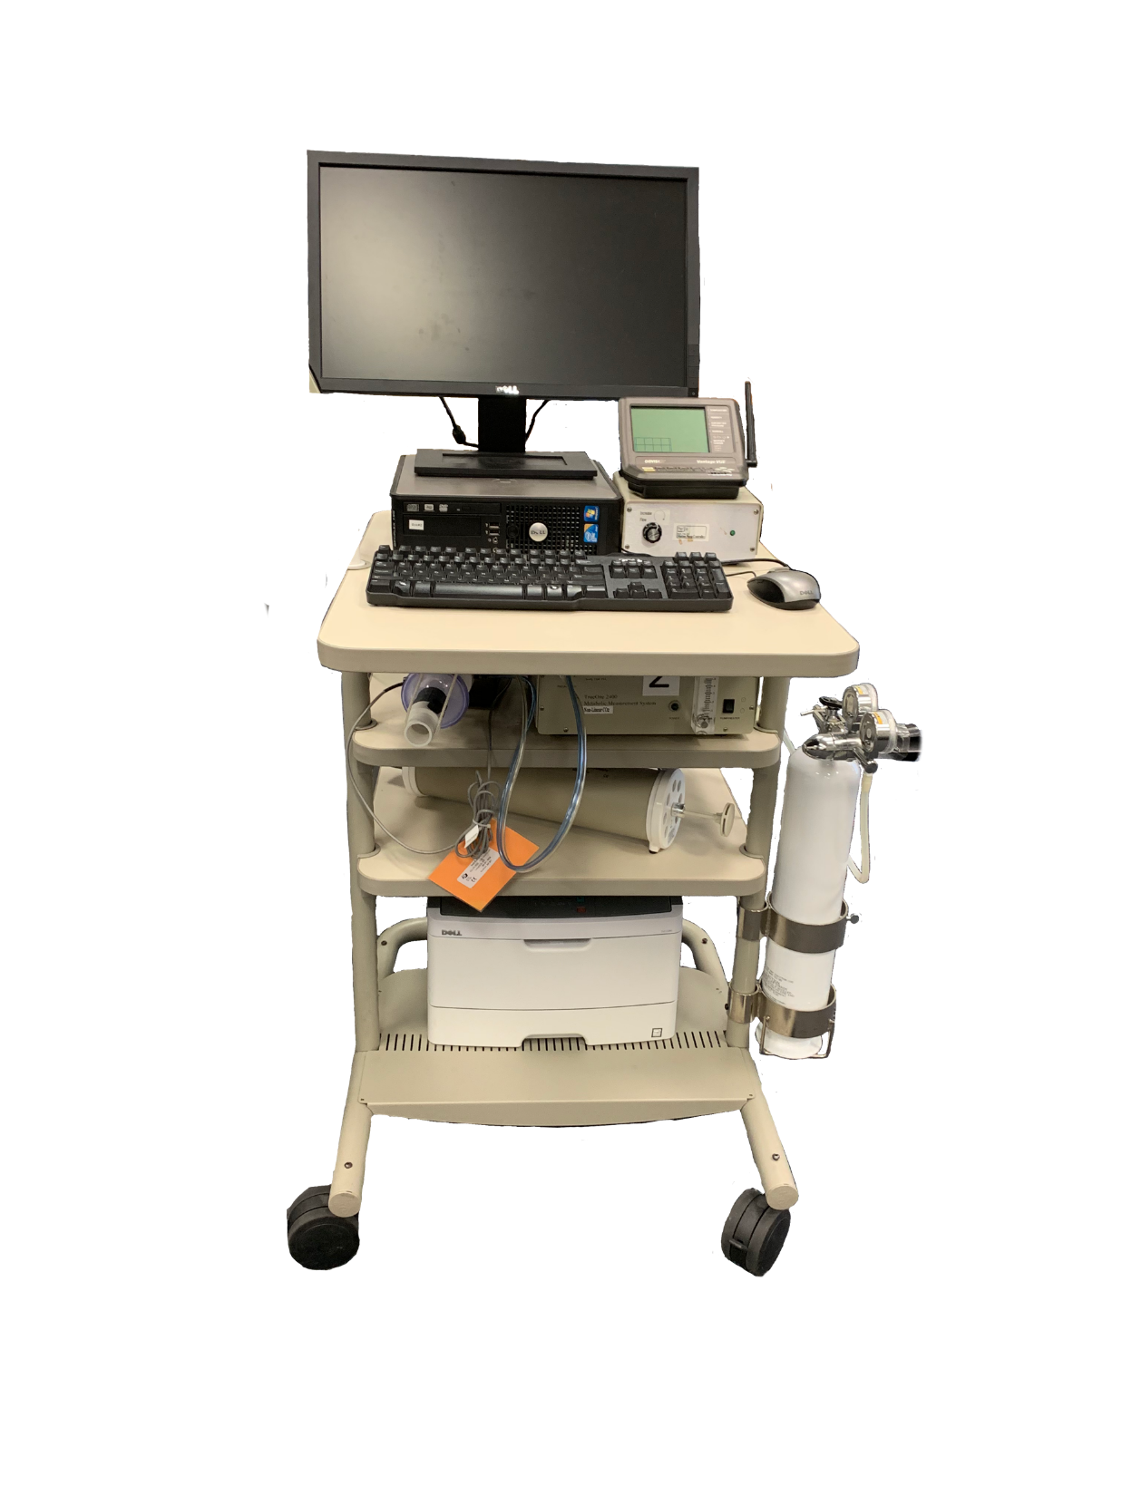
Indirect Calorimetry
Using a Metabolic Cart
Metabolic Cart
Gas Analyzer
Flow Analyzer
Mixing Chamber
Dilution Pump
Weather Station
Calibration Gas
Calibration Syringe
1
Brand: Parvo Medics

Slide 12
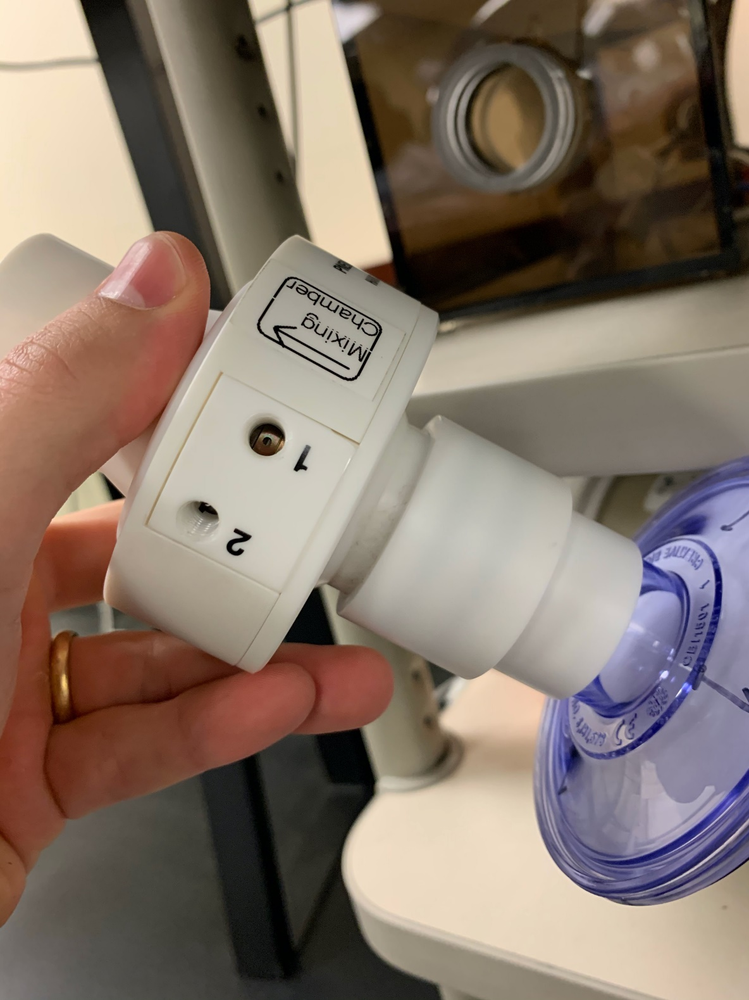
Indirect Calorimetry
Using a Metabolic Cart
Metabolic Cart
Gas Analyzer
Flow Analyzer
Mixing Chamber
Dilution Pump
Weather Station
Calibration Gas
Calibration Syringe
3
2
1
Brand: Parvo Medics
Notes:
The Pneumotach is an airflow transducer (white piece)

Slide 13
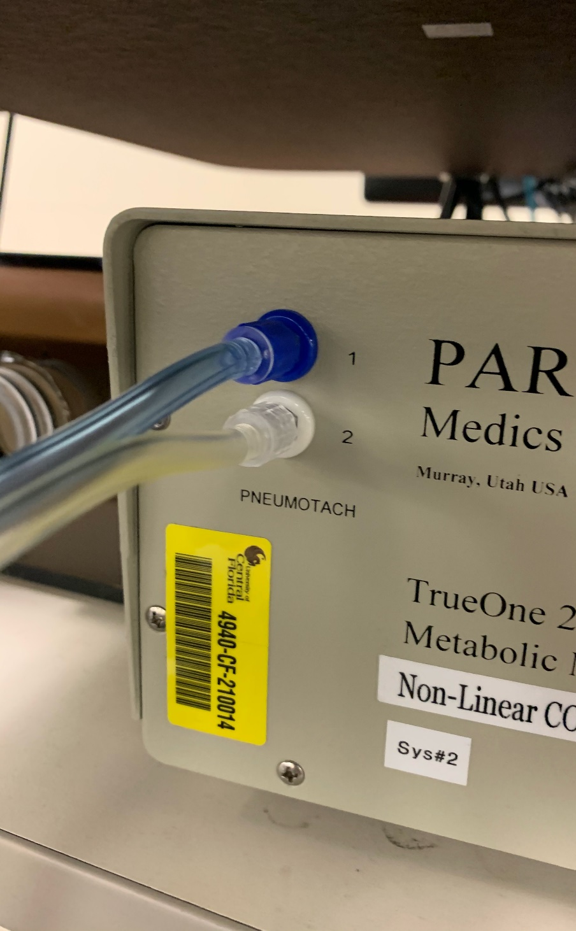
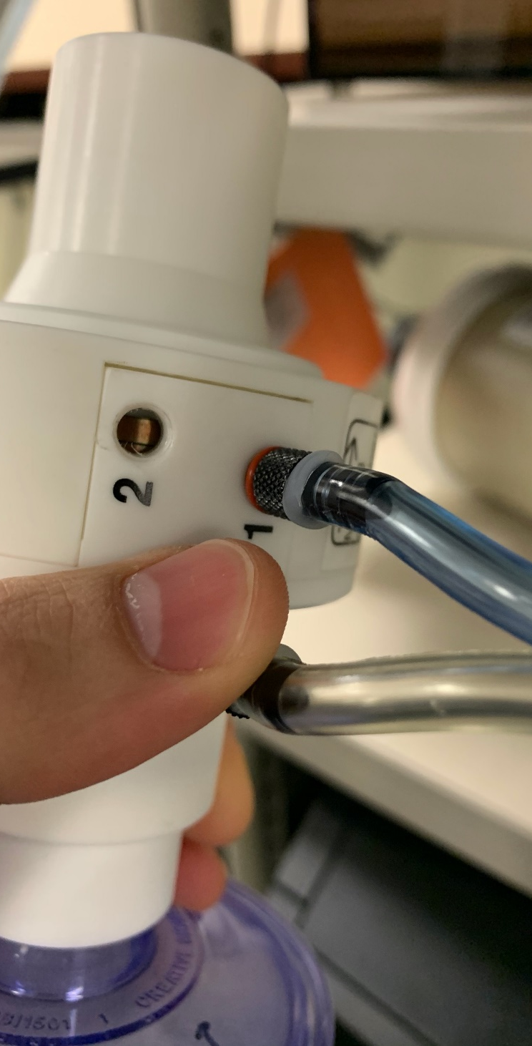
Indirect Calorimetry
Using a Metabolic Cart
Metabolic Cart
Gas Analyzer
Flow Analyzer
Mixing Chamber
Dilution Pump
Weather Station
Calibration Gas
Calibration Syringe
3
2
1
Brand: Parvo Medics
Notes:
Mixing chamber (behind figure 1 from left to right). Mixed expired gas concentrations for use in gas exchange measurements can also be estimated with a gas-mixing chamber. Automated systems featuring a mixing chamber have computer interfaces that allow continuous measurement of Vo2 and Vco2. The subject breathes through a two-way valve and expired air is directed through a baffled chamber (usually 5- to 15-L capacity) in which the baffles facilitate mixing of the entering gas. The concentrations of CO2 and O2 are measured continuously at the distal end of the mixing chamber and averaged every 15–20 seconds. Expired volume is also measured continuously with the pneumotachometer and also usually averaged every 15–20 seconds. The averaged concentrations of expired gas and the corresponding expired volume data are then used to calculate Vo2 and Vco2. For the final report, the data should be averaged over 30–60 seconds.

Slide 14
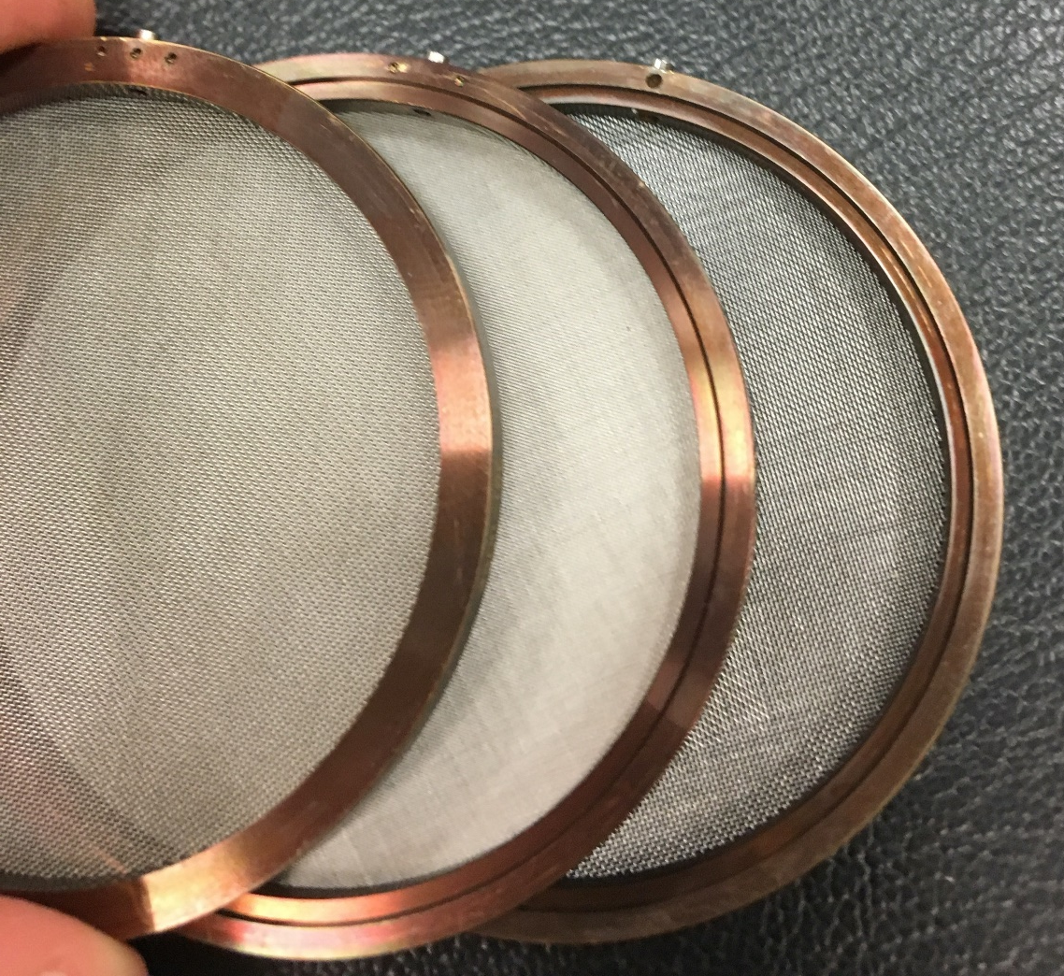
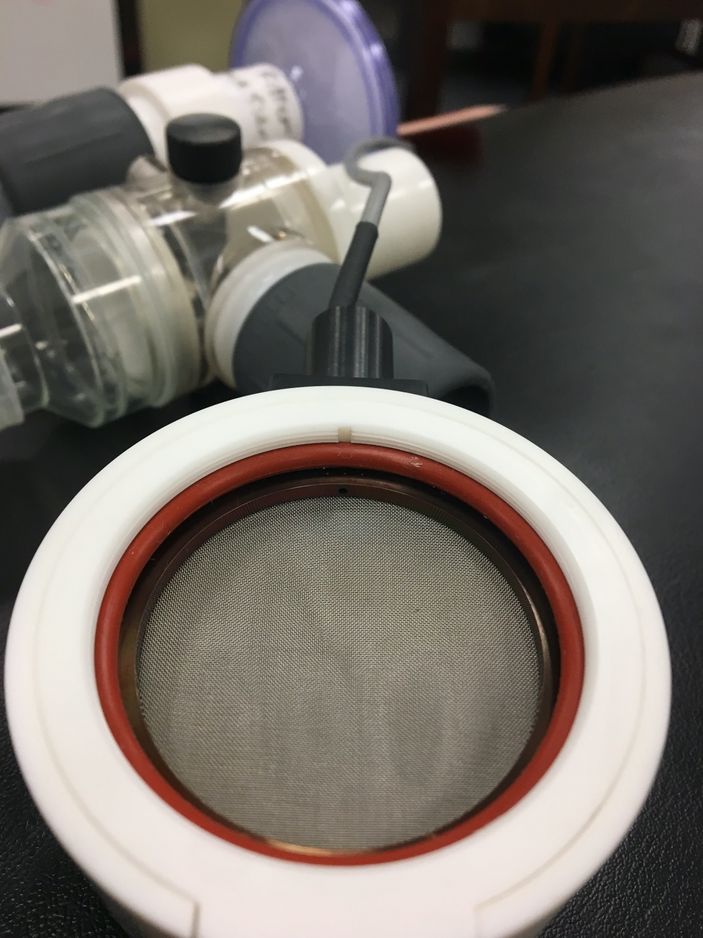
Indirect Calorimetry
Using a Metabolic Cart
Metabolic Cart
Gas Analyzer
Flow Analyzer
Mixing Chamber
Dilution Pump
Weather Station
Calibration Gas
Calibration Syringe
3
2
1
Brand: Parvo Medics
Notes:
Inside the pneumotachograph. This flow transducer measures the pressure drop across a low-resistance screen (189, 205–207). Because laminar flow is required and sputum impaction on the transducer screen can degrade performance, pneumotacho- graphs have generally been positioned well downstream from the mouth. They are often heated to prevent condensation of water vapor within the screen.

Slide 15
Indirect Calorimetry
Using a Metabolic Cart
Metabolic Cart
Gas Analyzer
Flow Analyzer
Mixing Chamber
Dilution Pump
Weather Station
Calibration Gas
Calibration Syringe
4
3
2
1
Brand: Parvo Medics

Slide 16
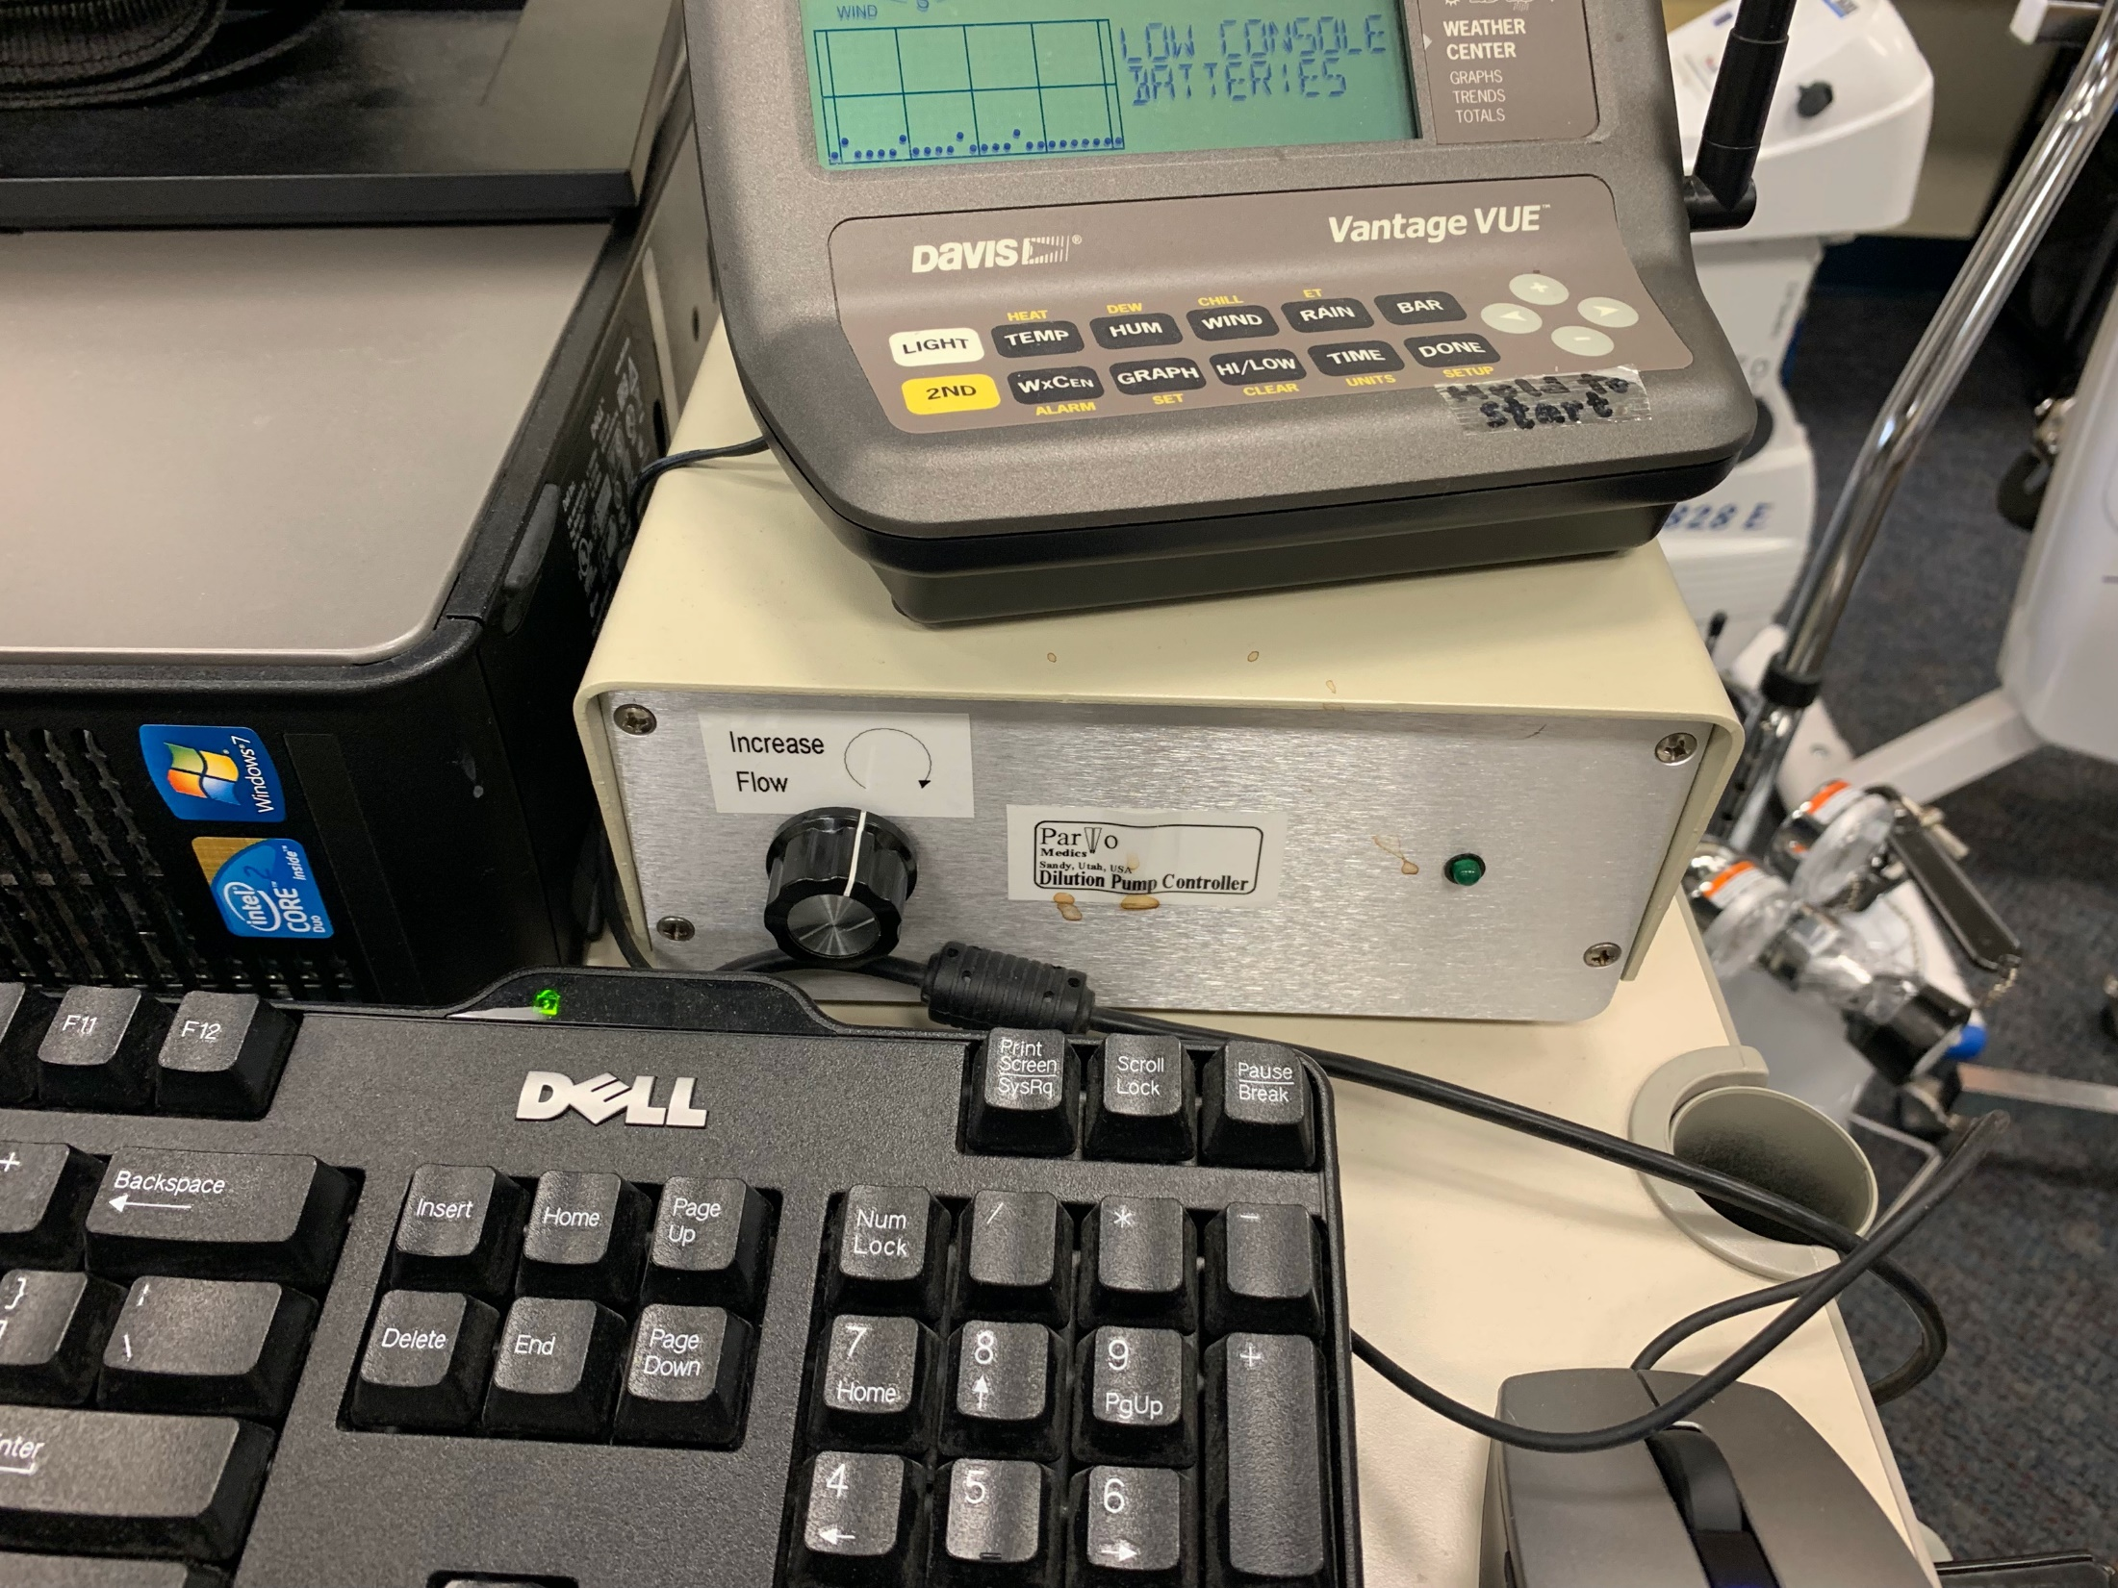
Indirect Calorimetry
Using a Metabolic Cart
Metabolic Cart
Gas Analyzer
Flow Analyzer
Mixing Chamber
Dilution Pump
Weather Station
Calibration Gas
Calibration Syringe
4
3
2
1
Brand: Parvo Medics

Slide 17
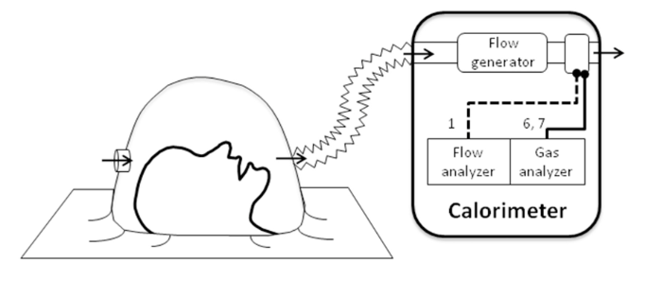
Indirect Calorimetry
Using a Metabolic Cart
Metabolic Cart
Gas Analyzer
Flow Analyzer
Mixing Chamber
Dilution Pump
Weather Station
Calibration Gas
Calibration Syringe
4
3
2
1
Brand: Parvo Medics

Slide 18
Indirect Calorimetry
Using a Metabolic Cart
Metabolic Cart
5
Gas Analyzer
Flow Analyzer
Mixing Chamber
Dilution Pump
Weather Station
Calibration Gas
Calibration Syringe
4
3
2
1
Brand: Parvo Medics

Slide 19
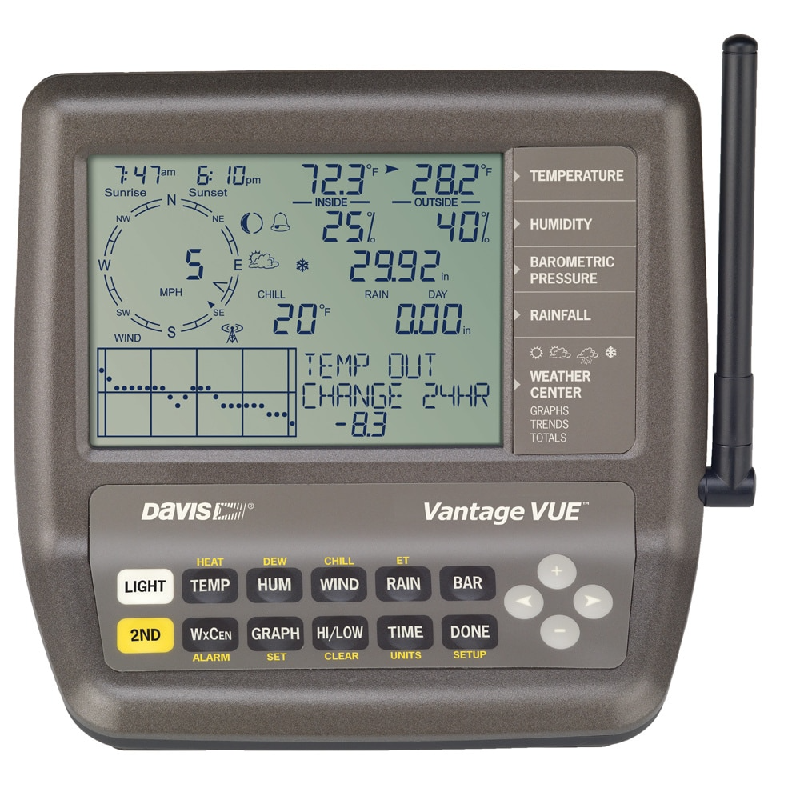
Indirect Calorimetry
Using a Metabolic Cart
Metabolic Cart
5
Gas Analyzer
Flow Analyzer
Mixing Chamber
Dilution Pump
Weather Station
Calibration Gas
Calibration Syringe
4
3
2
1
Brand: Parvo Medics

Slide 20
Indirect Calorimetry
Using a Metabolic Cart
Metabolic Cart
5
Gas Analyzer
Flow Analyzer
Mixing Chamber
Dilution Pump
Weather Station
Calibration Gas
Calibration Syringe
4
3
2
1
7
6
Brand: Parvo Medics

Slide 21
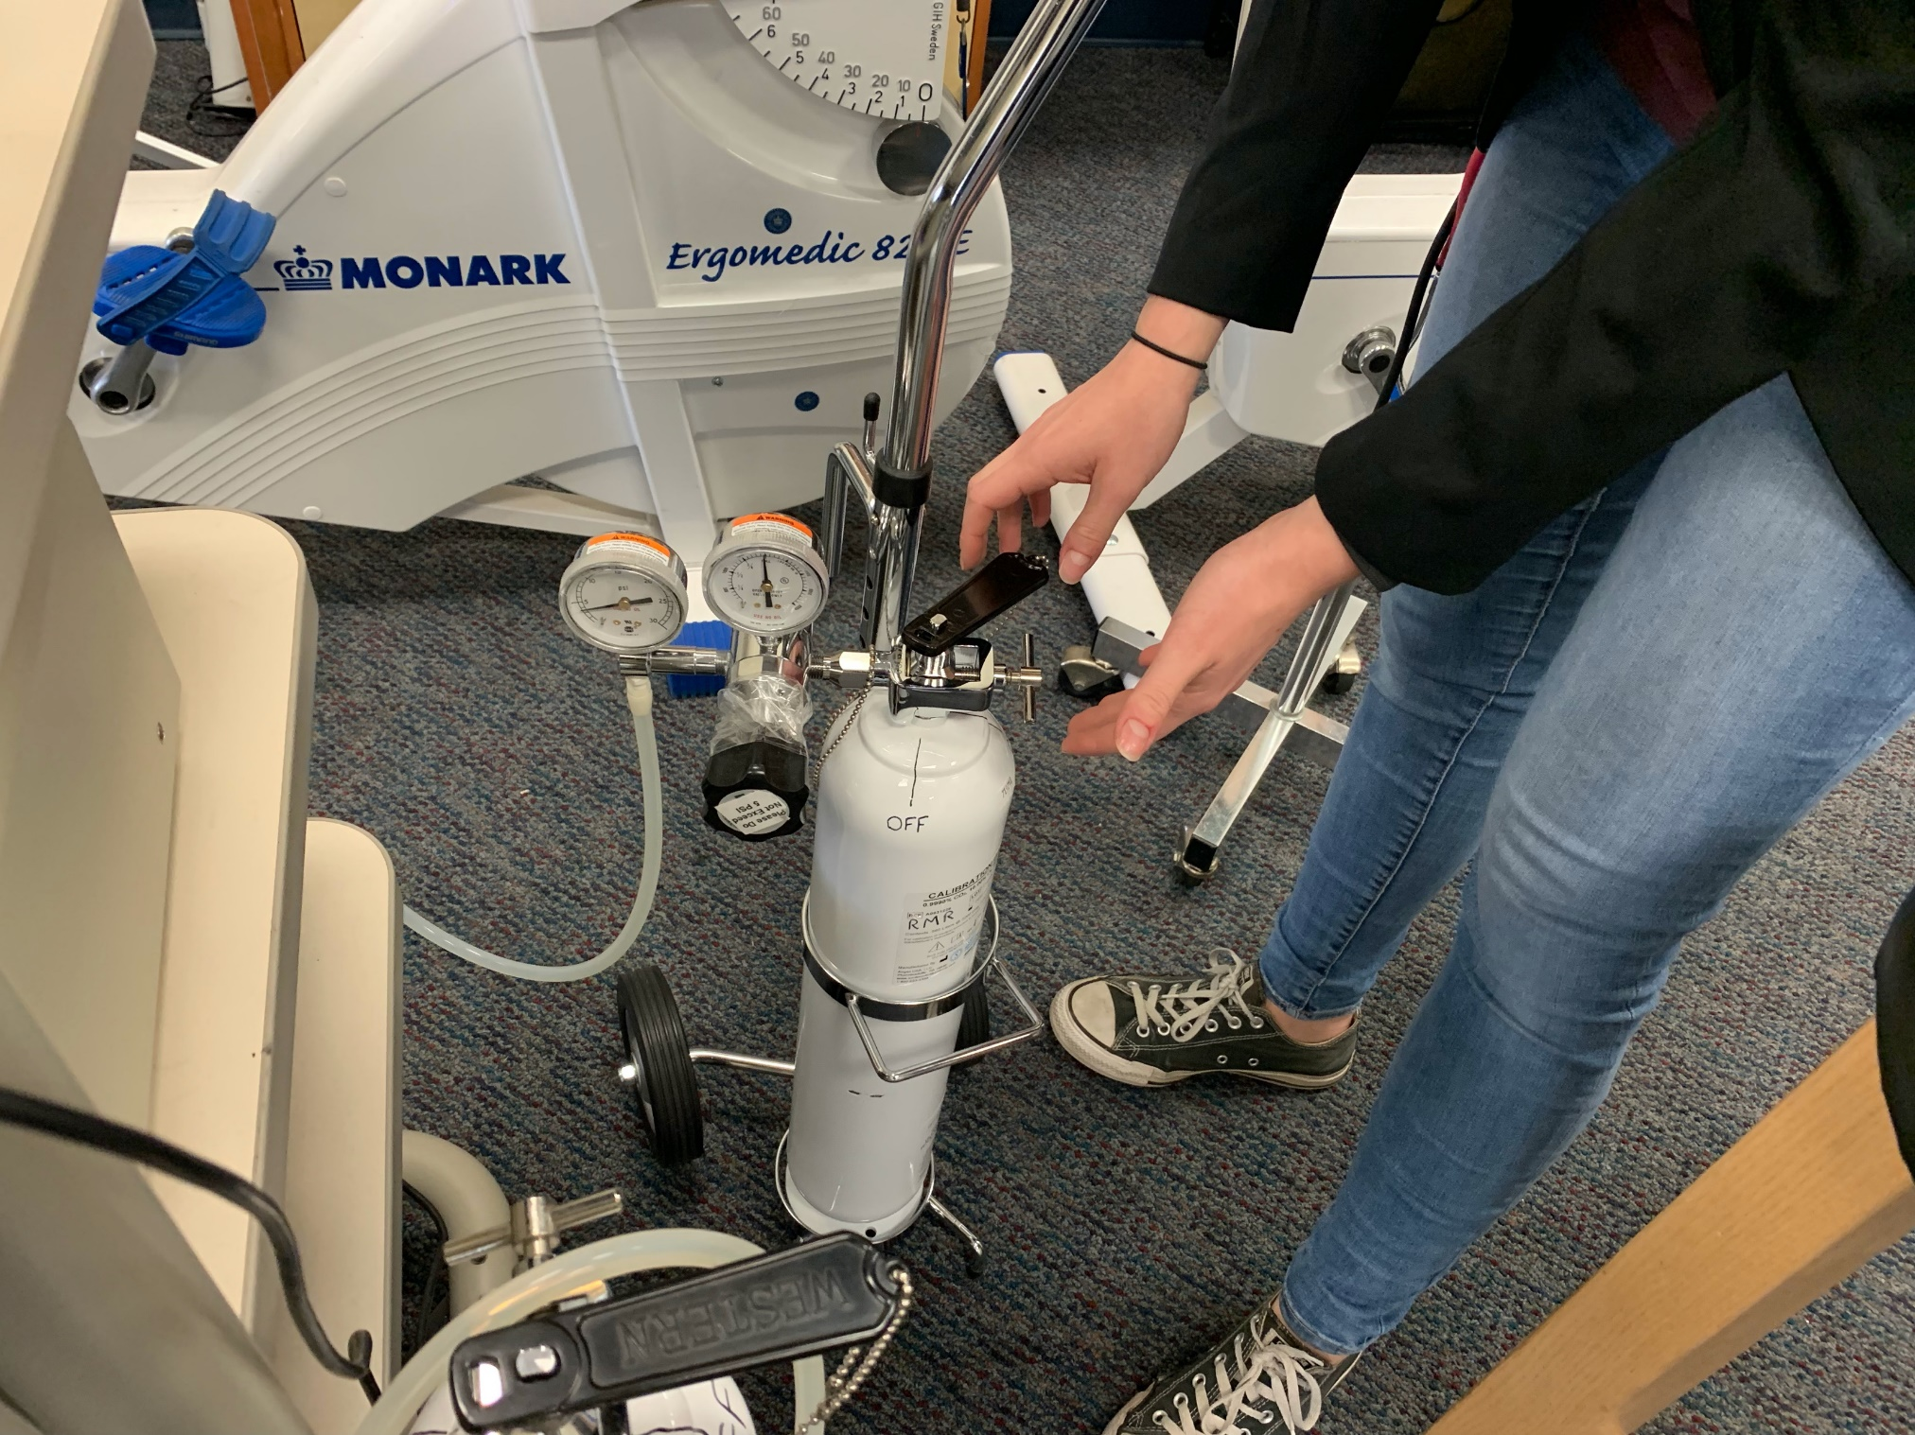
Indirect Calorimetry
Using a Metabolic Cart
Metabolic Cart
5
Gas Analyzer
Flow Analyzer
Mixing Chamber
Dilution Pump
Weather Station
Calibration Gas
Calibration Syringe
4
3
2
1
7
6
Brand: Parvo Medics

Slide 22
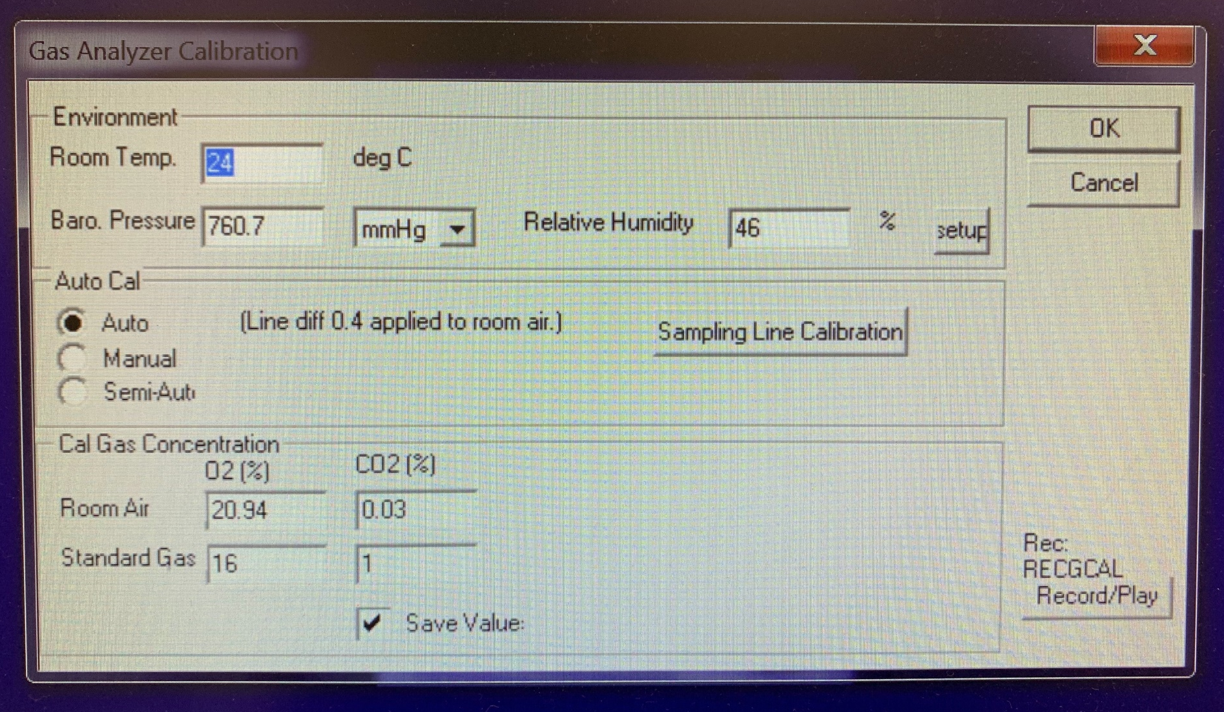
Indirect Calorimetry
Using a Metabolic Cart
Metabolic Cart
5
Gas Analyzer
Flow Analyzer
Mixing Chamber
Dilution Pump
Weather Station
Calibration Gas
Calibration Syringe
4
3
2
1
7
6
Brand: Parvo Medics

Slide 23
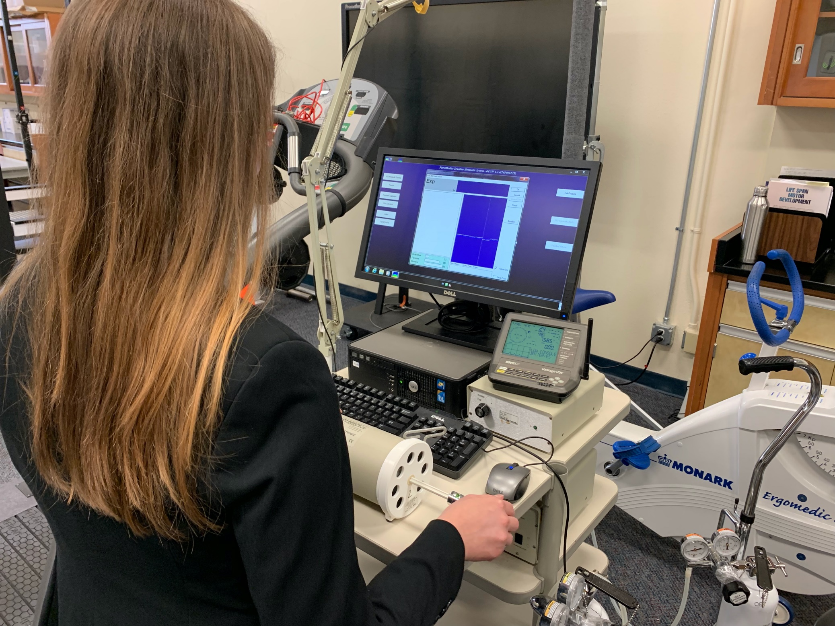
Indirect Calorimetry
Using a Metabolic Cart
Metabolic Cart
5
Gas Analyzer
Flow Analyzer
Mixing Chamber
Dilution Pump
Weather Station
Calibration Gas
Calibration Syringe
4
3
2
1
7
6
Brand: Parvo Medics

Slide 24
Indirect Calorimetry
Using a Metabolic Cart
Metabolic Cart
5
Gas Analyzer
Flow Analyzer
Mixing Chamber
Dilution Pump
Weather Station
Calibration Gas
Calibration Syringe
4
3
2
1
7
6
Brand: Parvo Medics

Slide 25
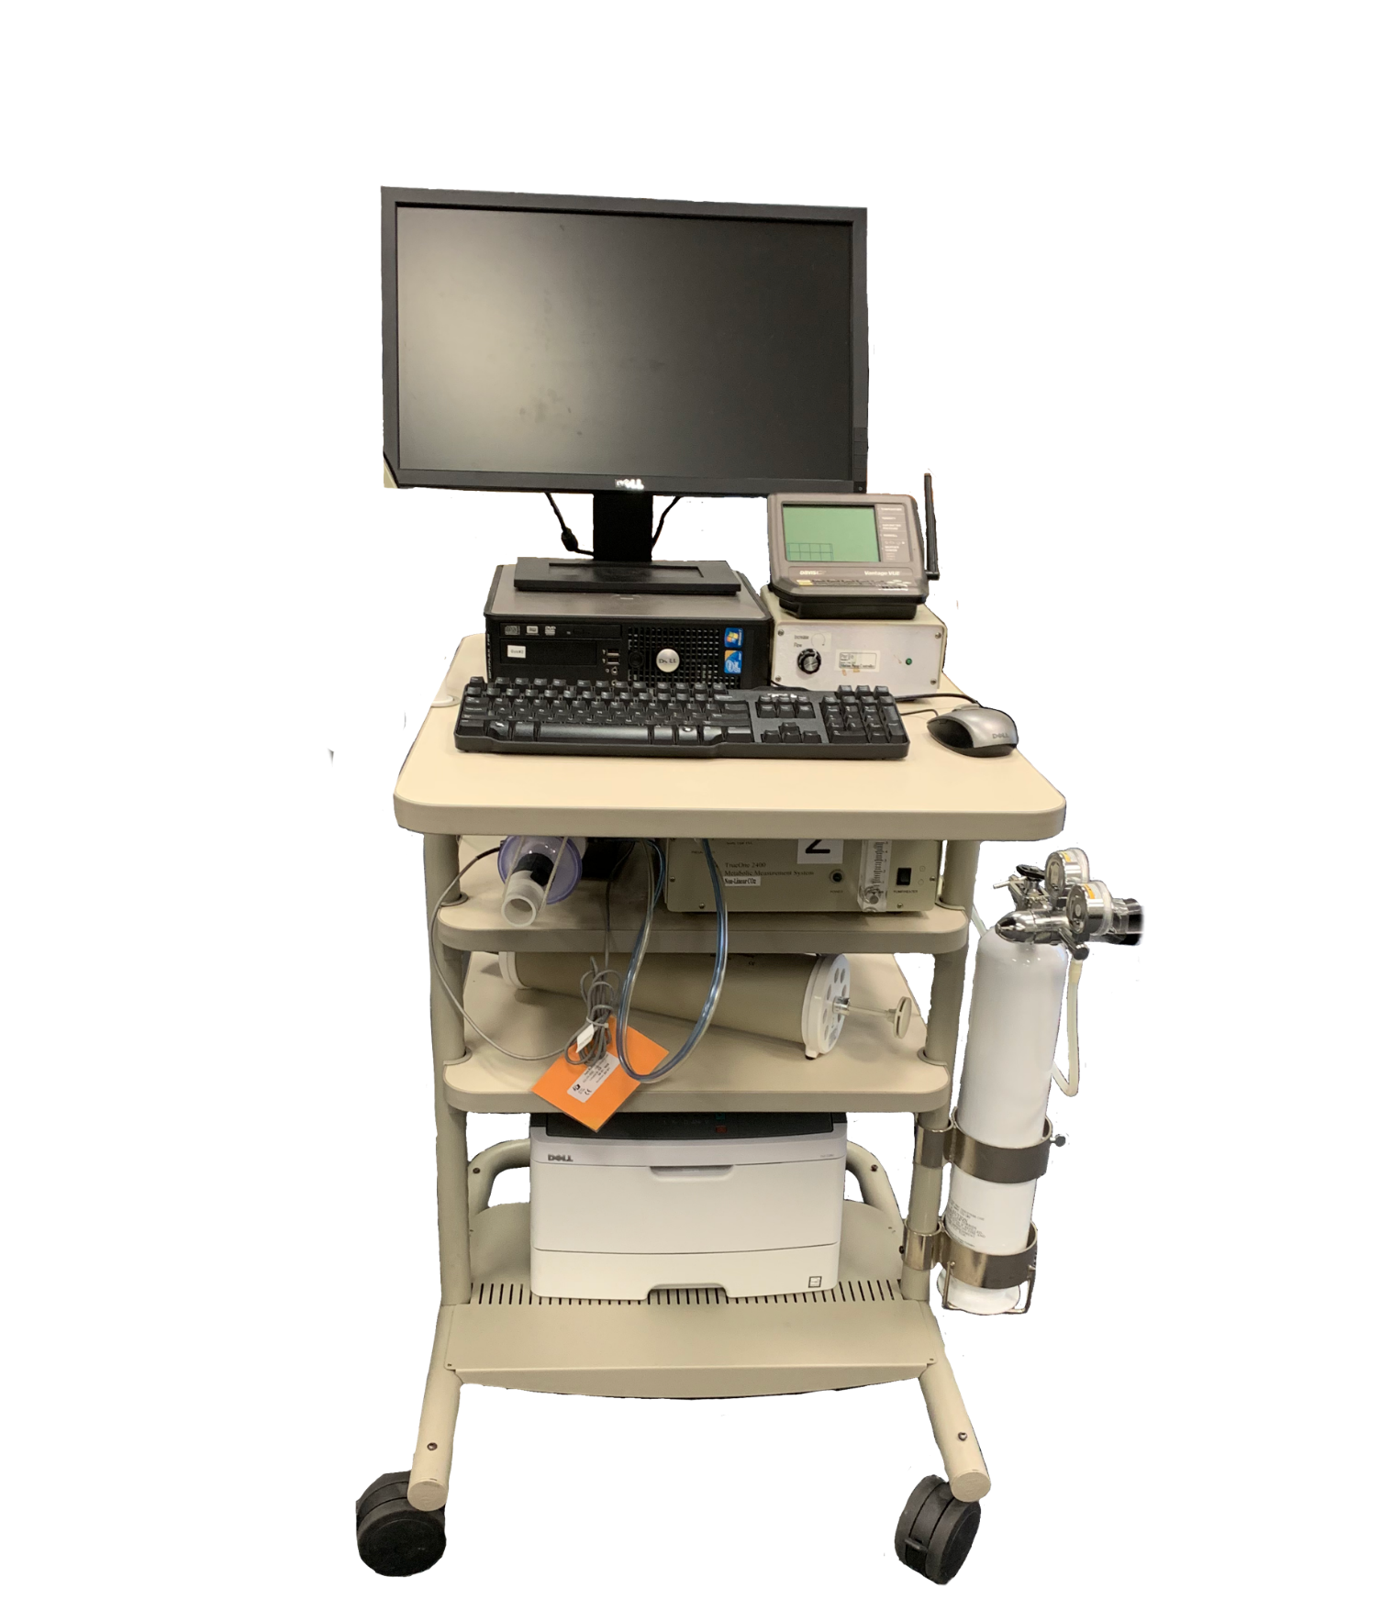
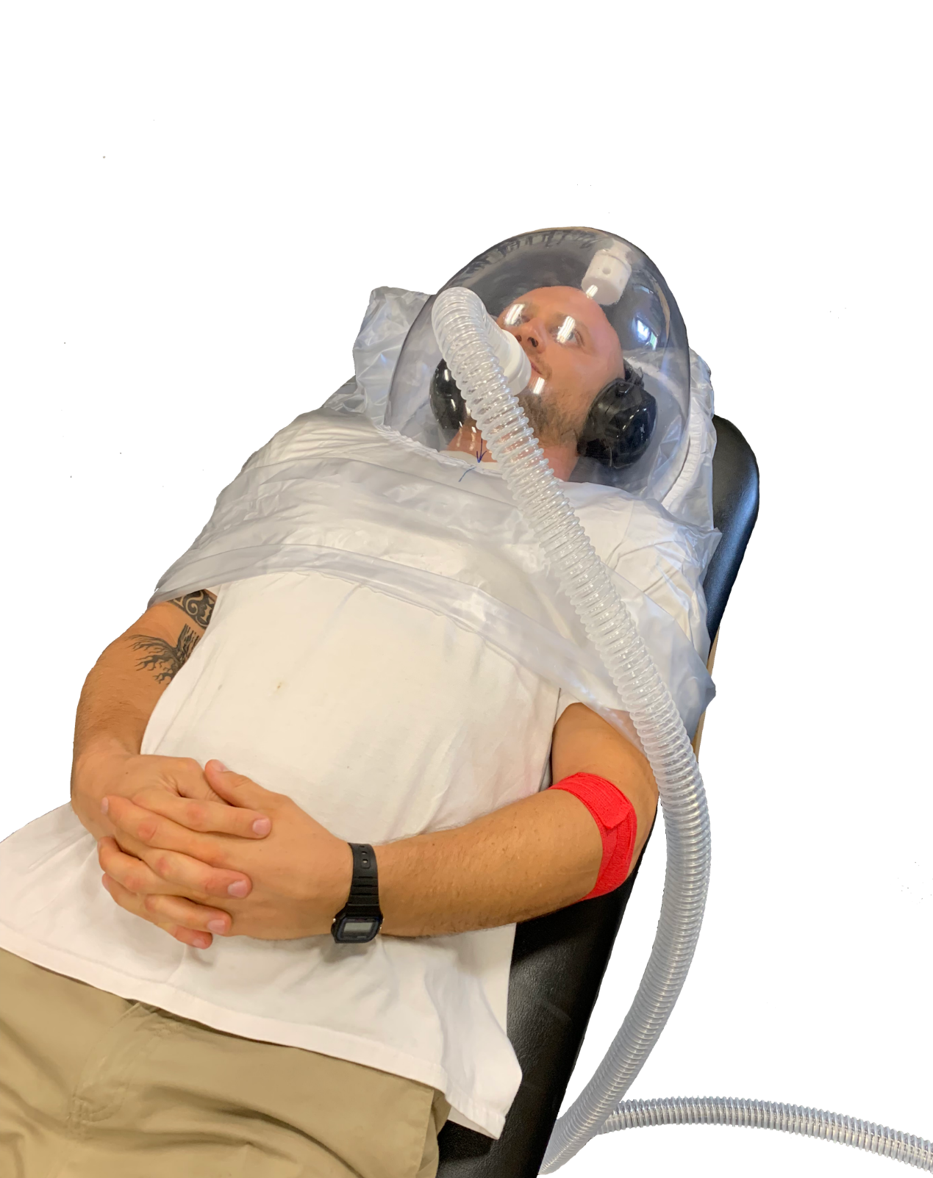
Indirect Calorimetry
Using a Metabolic Cart
Notes:
RMR still requires resting and fasting, but it does not necessitate staying overnight in the lab.
The subject should abstain from strenuous exercise for at least 48 h prior to measurement,
abstain from eating for 12 to 14 h prior to measurement,
lie or recline quietly in a dark, quiet environment (while awake) for 30 min prior to the measurement and during the O2 sampling,
and have a normal body temperature (absence of a fever).

Slide 26
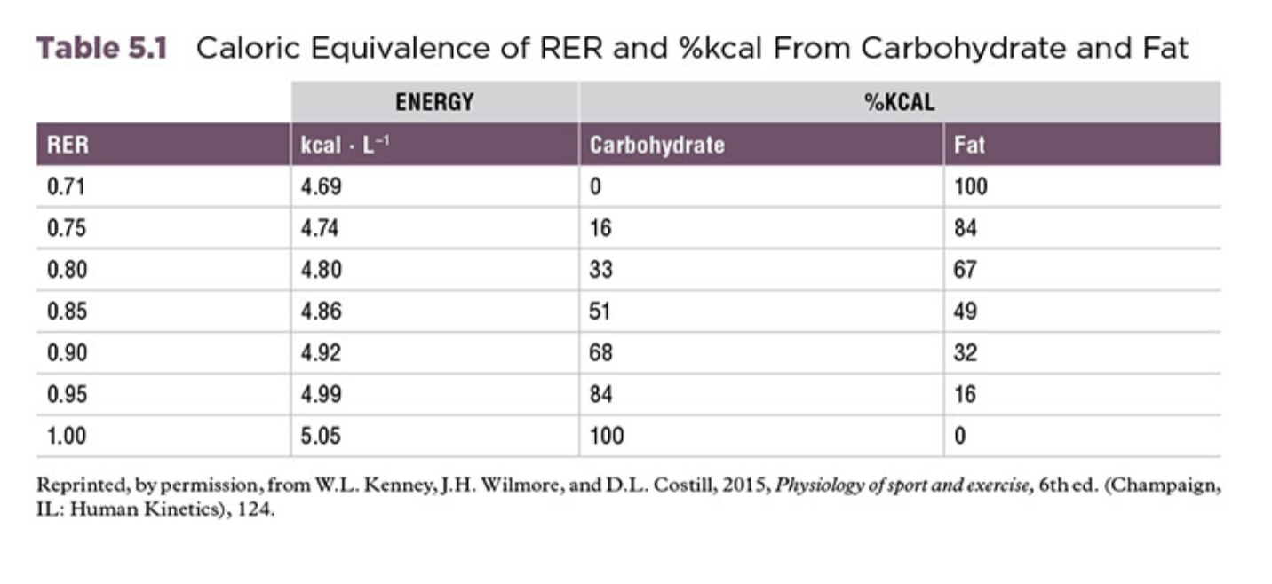
Indirect Calorimetry
Using a Metabolic Cart
RQ = Respiratory Quotient (at the cellular level/steady state conditions)
RER = Respiratory Exchange Ratio (measured in expired gases/ unsteady state conditions)
RQ = RER
Notes:
One important measurement that can be accomplished with knowledge of VO2 and VCO2 is the type of fuel being used. On this point, the respiratory quotient (RQ) or respiratory exchange ratio (RER) provides information regarding the macronutrient being oxidized at any given time during steady state. Because of inherent differences in the chemical composition of carbohydrate, fat, and protein, each requires a different amount of oxygen to completely oxidize the molecules to the end products of bioenergetics—ATP, CO2, and H2O. The RER can oscillate anywhere from 0.7 to 1.0 where 1.0 is 100% of carbohydrate being oxidized and 0.70 is for 100% of fat. 0.85 would be considered 50-50% of fat and carbs being oxidized.

Slide 27
Laboratory Activity 6
Predicting RMR and Measuring RMR
Part 1: RMR Prediction Equations
Using table 5.3
Part 2: Measuring RMR Using Indirect Calorimetry: Class Demonstration
Data will be provided during the lab meeting.
https://webcourses.ucf.edu
Questions: Webcourses Inbox

Slide 28
Laboratory Activity 6
Part 1: RMR Prediction Equations
RMR Calculation
Step 1: Gather basic data (e.g., age, height, weight) for the individual data sheet as described in laboratory activity 1.1.
Step 2: Determine your own RMR by using the prediction equations using table 5.3.
Step 3: Express RMR in kcal per day first, per hour by dividing day results by 24, and per minute by dividing hour results by 60.. Complete your own individual data sheet for each equation.
Notes:
Basically Free

Slide 29
Laboratory Activity 6
Part 1: RMR Prediction Equations
RMR Calculation
Step 1: Gather basic data (e.g., age, height, weight) for the individual data sheet as described in laboratory activity 1.1.
Step 2: Determine your own RMR by using the prediction equations using table 5.3.
Step 3: Express RMR in kcal per day first, per hour by dividing day results by 24, and per minute by dividing hour results by 60.. Complete your own individual data sheet for each equation.
Calculation for Equation 1
If I am…
89 kilos weight
1.83 meters height
33 years old
66.473 + 13.7516 (89) + 5.0033 (183) - 6.755 (33) =
= 66.473 + 1223.8924 + 915.6039 – 222.915
= 1,983 Kcal/day

Slide 30
PAL
PAC
The Institute of Medicine (IOM), the health arm of the National Academy of Sciences, developed four PALs as a means of predicting the PA component of TEE (1). PAL is the ratio of TEE divided by RMR.
Example:
If the PAL is 1.0, then the subject’s TEE is essentially the same as the RMR. Conversely, for a very active female with a PAL of 1.95, TEE is 1.95 times RMR. Thus, if her RMR is estimated to be 1,650 kcal, then her TEE would be 1.95 × 1,650 = 3,218 kcal∙d⁻¹
Another option for predicting the PA component of TEE is to use the category descriptor (male or female) to determine the PAC (physical activity coefficient; see table 5.2) in the following equations for estimating TEE, with the results expressed in kcal∙d⁻¹.
Males: TEE = 662 − 9.53 × age in y + [PAC × (15.91 × BW in kg + 539.6 × HT in m)]
Females 19+ Years Old: TEE = 354 − 6.91 × age in y + [PAC × (9.361 × BW in kg + 726 × HT in m)]
Notes:
Because RMR is only one of two main components of TEE, TEE often needs to be estimated from predicted physical activity levels (PALs).

Slide 31
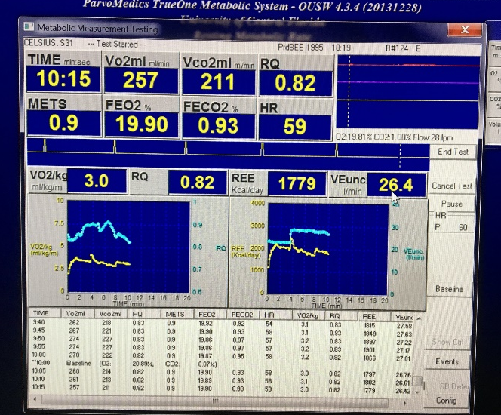
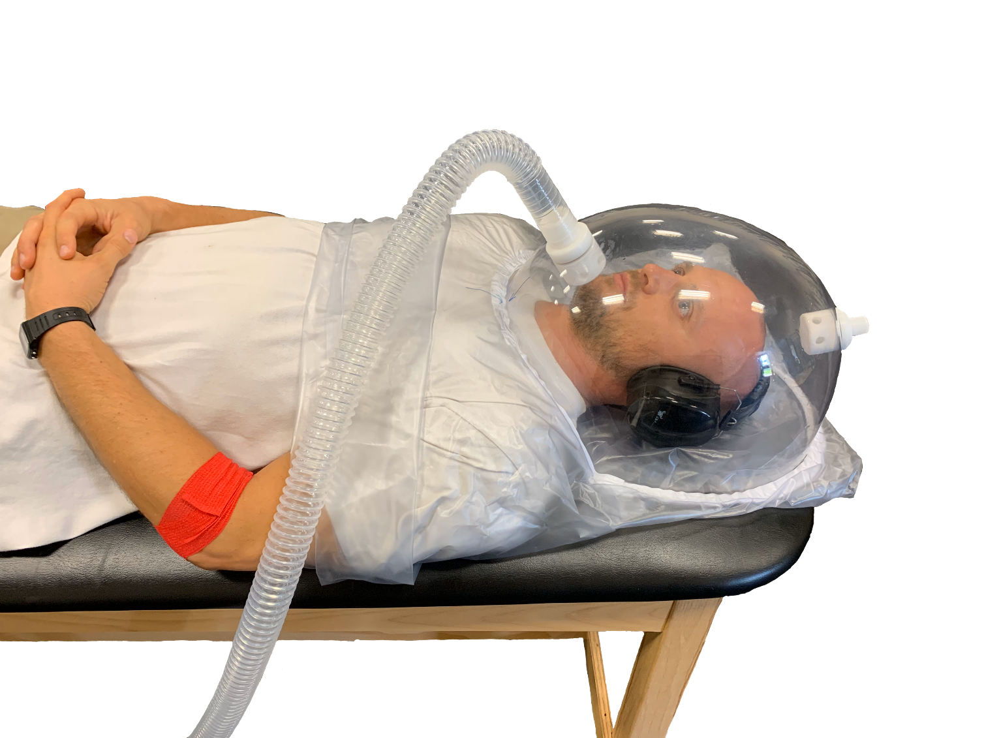
Measuring RMR Using Indirect Calorimetry: Class Demonstration
Part 2 of the Laboratory sheet activity

Slide 32
1:00
262
218
0.83
VO₂ (L/min)
0.9
19.9
0.9
RER/RQ
54
The software output is in mililiters. You will need to divide the result by 1000.
_______________________________
VO2 (L/min) = VO2ml (ml/min) / 1000
Resting Energy Expenditure (RER) or Respiratory Quotient (RQ).
3.1
0.83
1815
27.5
Kcal/day
% Carbohydrate & % Fat
%
Resting energy expenditure (REE) is the estimated value for the number of calories expend while at rest.
Percent of metabolized fats and carbs may be calculated with the following formula:
% fat burned = 1–RER |%Carbs = 100 – %fat
1– 0.7 |

Slide 33
1:00
262
218
0.83
VO₂ (L/min)
0.9
19.9
0.9
RER/RQ
54
The software output is in mililiters. You will need to divide the result by 1000.
_______________________________
VO2 (L/min) = VO2ml (ml/min) / 1000
Resting Energy Expenditure (RER) or Respiratory Quotient (RQ).
3.1
0.83
1815
27.5
Kcal/day
% Carbohydrate & % Fat
%
Resting energy expenditure (REE) is the estimated value for the number of calories expend while at rest.
Percent of metabolized fats and carbs may be calculated with the following formula:
% fat burned = 1–RER |%Carbs = 100 – %fat
1– 0.7 |

Slide 34
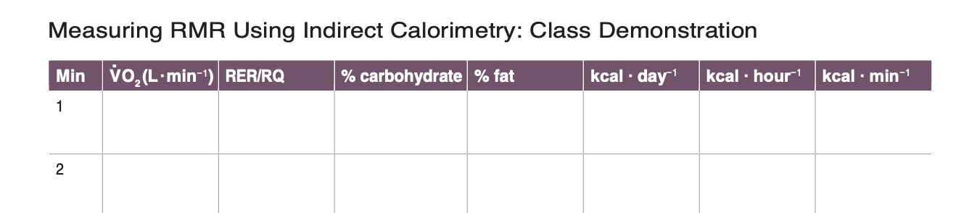
1:00
262
218
0.83
VO₂ (L/min)
0.9
19.9
0.9
RER/RQ
54
The software output is in mililiters. You will need to divide the result by 1000.
_______________________________
VO2 (L/min) = VO2ml (ml/min) / 1000
Resting Energy Expenditure (RER) or Respiratory Quotient (RQ).
3.1
0.83
1815
27.5
Kcal/day
% Carbohydrate & % Fat
%
Resting energy expenditure (REE) is the estimated value for the number of calories expend while at rest.
Percent of metabolized fats and carbs may be calculated with the following formula:
% fat burned = 1–RER |%Carbs = 100 – %fat
1– 0.7 |
0.262
0.83
43
57
1815
75.6
1.26

Slide 35
1:00
262
218
0.83
VO₂ (L/min)
0.9
19.9
0.9
RER/RQ
54
The software output is in mililiters. You will need to divide the result by 1000.
_______________________________
VO2 (L/min) = VO2ml (ml/min) / 1000
Resting Energy Expenditure (RER) or Respiratory Quotient (RQ).
3.1
0.83
1815
27.5
Kcal/day
% Carbohydrate & % Fat
%
Resting energy expenditure (REE) is the estimated value for the number of calories expend while at rest.
Percent of metabolized fats and carbs may be calculated with the following formula:
% fat burned = 1–RER |%Carbs = 100 – %fat
1– 0.7 |
0.262
0.83
43
57
1815
75.6
1.26

Slide 36
1:00
262
218
0.83
VO₂ (L/min)
0.9
19.9
0.9
RER/RQ
54
The software output is in mililiters. You will need to divide the result by 1000.
_______________________________
VO2 (L/min) = VO2ml (ml/min) / 1000
Resting Energy Expenditure (RER) or Respiratory Quotient (RQ).
3.1
0.83
1815
27.5
Kcal/day
% Carbohydrate & % Fat
%
Resting energy expenditure (REE) is the estimated value for the number of calories expend while at rest.
Percent of metabolized fats and carbs may be calculated with the following formula:
% fat burned = 1–RER |%Carbs = 100 – %fat
1– 0.7 |
0.262
0.83
43
57
1815
75.6
1.26

Slide 37
1:00
262
218
0.83
VO₂ (L/min)
0.9
19.9
0.9
RER/RQ
54
The software output is in mililiters. You will need to divide the result by 1000.
_______________________________
VO2 (L/min) = VO2ml (ml/min) / 1000
Resting Energy Expenditure (RER) or Respiratory Quotient (RQ).
3.1
0.83
1815
27.5
Kcal/day
% Carbohydrate & % Fat
%
Resting energy expenditure (REE) is the estimated value for the number of calories expend while at rest.
Percent of metabolized fats and carbs may be calculated with the following formula:
% fat burned = 1–RER |%Carbs = 100 – %fat
1– 0.7 |
0.262
0.83
43
57
1815
75.6
1.26

Slide 38
2:00
278
221
0.79
VO₂ (L/min)
1.3
20.1
0.7
RER/RQ
58
The software output is in mililiters. You will need to divide the result by 1000.
_______________________________
VO2 (L/min) = VO2ml (ml/min) / 1000
Resting Energy Expenditure (RER) or Respiratory Quotient (RQ).
4.4
0.79
2168
34.9
Kcal/day
% Carbohydrate & % Fat
%
Resting energy expenditure (REE) is the estimated value for the number of calories expend while at rest.
Percent of metabolized fats and carbs may be calculated with the following formula:
% fat burned = 1–RER |%Carbs = 100 – %fat
1– 0.7 |
0.262
0.83
43
57
1815
75.6
1.26
0.278
0.79
30
70
2168
90.3
1.51

Slide 39
3:00
274
242
0.88
VO₂ (L/min)
1.2
19.8
1.1
RER/RQ
60
The software output is in mililiters. You will need to divide the result by 1000.
_______________________________
VO2 (L/min) = VO2ml (ml/min) / 1000
Resting Energy Expenditure (RER) or Respiratory Quotient (RQ).
4.3
0.88
1726
24.9
Kcal/day
% Carbohydrate & % Fat
%
Resting energy expenditure (REE) is the estimated value for the number of calories expend while at rest.
Percent of metabolized fats and carbs may be calculated with the following formula:
% fat burned = 1–RER |%Carbs = 100 – %fat
1– 0.7 |
3
4

Slide 40
4:00
307
291
0.95
VO₂ (L/min)
1.4
19.9
0.9
RER/RQ
53
The software output is in mililiters. You will need to divide the result by 1000.
_______________________________
VO2 (L/min) = VO2ml (ml/min) / 1000
Resting Energy Expenditure (RER) or Respiratory Quotient (RQ).
4.9
0.95
1644
33.2
Kcal/day
% Carbohydrate & % Fat
%
Resting energy expenditure (REE) is the estimated value for the number of calories expend while at rest.
Percent of metabolized fats and carbs may be calculated with the following formula:
% fat burned = 1–RER |%Carbs = 100 – %fat
1– 0.7 |
3
4

Slide 41
5:00
240
240
0.99
VO₂ (L/min)
1.1
20.1
0.9
RER/RQ
50
The software output is in mililiters. You will need to divide the result by 1000.
_______________________________
VO2 (L/min) = VO2ml (ml/min) / 1000
Resting Energy Expenditure (RER) or Respiratory Quotient (RQ).
3.8
0.99
1651
31.7
Kcal/day
% Carbohydrate & % Fat
%
Resting energy expenditure (REE) is the estimated value for the number of calories expend while at rest.
Percent of metabolized fats and carbs may be calculated with the following formula:
% fat burned = 1–RER |%Carbs = 100 – %fat
1– 0.7 |
5
6

Slide 42
6:00
227
232
1.00
VO₂ (L/min)
1.0
20.1
0.9
RER/RQ
58
The software output is in mililiters. You will need to divide the result by 1000.
_______________________________
VO2 (L/min) = VO2ml (ml/min) / 1000
Resting Energy Expenditure (RER) or Respiratory Quotient (RQ).
3.6
1.00
1668
29.5
Kcal/day
% Carbohydrate & % Fat
%
Resting energy expenditure (REE) is the estimated value for the number of calories expend while at rest.
Percent of metabolized fats and carbs may be calculated with the following formula:
% fat burned = 1–RER |%Carbs = 100 – %fat
1– 0.7 |
5
6

Slide 43
7:00
230
227
0.98
VO₂ (L/min)
1.0
20.1
0.9
RER/RQ
55
The software output is in mililiters. You will need to divide the result by 1000.
_______________________________
VO2 (L/min) = VO2ml (ml/min) / 1000
Resting Energy Expenditure (RER) or Respiratory Quotient (RQ).
3.7
0.98
1639
28.8
Kcal/day
% Carbohydrate & % Fat
%
Resting energy expenditure (REE) is the estimated value for the number of calories expend while at rest.
Percent of metabolized fats and carbs may be calculated with the following formula:
% fat burned = 1–RER |%Carbs = 100 – %fat
1– 0.7 |
7
8

Slide 44
8:00
233
229
0.99
VO₂ (L/min)
1.1
20.1
0.9
RER/RQ
50
The software output is in mililiters. You will need to divide the result by 1000.
_______________________________
VO2 (L/min) = VO2ml (ml/min) / 1000
Resting Energy Expenditure (RER) or Respiratory Quotient (RQ).
3.7
0.99
1615
28.9
Kcal/day
% Carbohydrate & % Fat
%
Resting energy expenditure (REE) is the estimated value for the number of calories expend while at rest.
Percent of metabolized fats and carbs may be calculated with the following formula:
% fat burned = 1–RER |%Carbs = 100 – %fat
1– 0.7 |
7
8

Slide 45
9:00
228
160
0.70
VO₂ (L/min)
1.0
20.1
0.9
RER/RQ
52
The software output is in mililiters. You will need to divide the result by 1000.
_______________________________
VO2 (L/min) = VO2ml (ml/min) / 1000
Resting Energy Expenditure (RER) or Respiratory Quotient (RQ).
3.6
0.70
1615
28.7
Kcal/day
% Carbohydrate & % Fat
%
Resting energy expenditure (REE) is the estimated value for the number of calories expend while at rest.
Percent of metabolized fats and carbs may be calculated with the following formula:
% fat burned = 1–RER |%Carbs = 100 – %fat
1– 0.7 |
9
10

Slide 46
10:00
229
219
0.92
VO₂ (L/min)
1.0
20.1
0.9
RER/RQ
54
The software output is in mililiters. You will need to divide the result by 1000.
_______________________________
VO2 (L/min) = VO2ml (ml/min) / 1000
Resting Energy Expenditure (RER) or Respiratory Quotient (RQ).
3.4
0.83
1815
28.5
Kcal/day
% Carbohydrate & % Fat
%
Resting energy expenditure (REE) is the estimated value for the number of calories expend while at rest.
Percent of metabolized fats and carbs may be calculated with the following formula:
% fat burned = 1–RER |%Carbs = 100 – %fat
1– 0.7 |
9
10

