Slide 1
Module 1
The Healthcare Environment

Slide 2
Learning Objectives
Articulate the characteristics and services of different types of healthcare organizations (e.g., hospitals, clinics and ambulatory centers, community health organizations, healthcare payers, regulators, research, and academic).
Recognize the various types of interrelationship models of care within and across healthcare organizations (e.g., health information exchange [HIE], population health, reimbursement, and continuity of care).
Differentiate the roles and responsibilities of healthcare information and management systems professionals within organizational structures in which they work.
Describe the roles of governmental, regulatory, professional, and accreditation agencies play related to healthcare and their impact on clinical outcomes and financial performance.

Slide 3
CPHIMS Competency Areas
CPHIMS Examination Content Outline (effective March 01, 2013) | Cognitive Level |  |  |  |  |  | Total
 | Recall |  | Application |  | Analysis
1. General | 22 | 22% | 6 | 6% | 0 | 0% | 28 | 28%
A. Healthcare Environment | 10 | 10% | 4 | 4% | 0 | 0% | 14 | 14%
B. Technology Environment | 12 | 12% | 2 | 2% | 0 | 0% | 14 | 14%
2. Systems | 3 | 3% | 22 | 22% | 15 | 15% | 40 | 40%
A. Analysis | 2 | 2% | 10 | 10% | 4 | 4% | 16 | 16%
B. Design | 0 | 0% | 3 | 3% | 3 | 3% | 6 | 6%
C. Selection, Implementation, Support, and Maintenance | 0 | 0% | 4 | 4% | 3 | 3% | 7 | 7%
D. Testing and Evaluation | 0 | 0% | 2 | 2% | 3 | 3% | 5 | 5%
E. Privacy and Security | 1 | 1% | 3 | 3% | 2 | 2% | 6 | 6%
3. Administration | 5 | 5% | 18 | 18% | 9 | 9% | 32 | 32%
A. Leadership | 3 | 3% | 10 | 10% | 9 | 9% | 22 | 22%
B. Management | 2 | 2% | 8 | 8% | 0 | 0% | 10 | 10%
Total | 30 | 30% | 46 | 46% | 24 | 24% | 100 | 100%

Slide 4
What is Health?
The World Health Organization (WHO) defines health as:
  “a state of complete physical, mental and social well-being and not merely the absence of disease or infirmity.”

Slide 5
What is Health Information Technology?
Health Information Technology, or Health IT, is defined by the HHS Office of the National Coordinator for Health IT (ONC) as, “the application of information processing involving both computer hardware and software that deals with the storage, retrieval, sharing, and use of health care information, data, and knowledge for communication and decision making” in healthcare.

Slide 6
What is Health Informatics
As defined by the U.S. National Library of Medicine, health informatics is, “the interdisciplinary study of the design, development, adoption, and application of IT-based innovations in healthcare services delivery, management, and planning.”

Slide 7
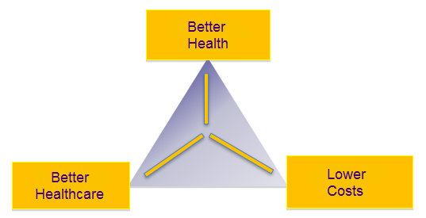
Health Information and Technology Characteristics
Fast-paced
Dynamic
Ever-changing
Focused on achieving the meaningful use of health IT and on regulatory initiatives to improve patient care

Slide 8
Key Issues in Healthcare
High, rapidly rising costs
Highly variable clinical quality
Patient safety issues
Need for evidence-based decision making
Complex administrative processes
Increasing consumerism and heightened expectations
Advances in research and technology

Slide 9
The 12 Healthcare Issues of 2018
Rise of artificial intelligence (AI)
Healthcare reform
Medicare advantage
Greater transparency and models based on outcomes
Opioid crisis
Internet of Things (IoT)
Cyber breaches
Balancing patient satisfaction and employee job satisfaction
Price transparency and control at the state level
Social determinants
Data sharing and infrastructure to support it
Disaster preparedness
Keeping financial reporting systems updated as new tax provisions go into effect
www.healthcareitnews.com/news/here-are-12-healthcare-issues-will-define-2018-according-pwc

Slide 10
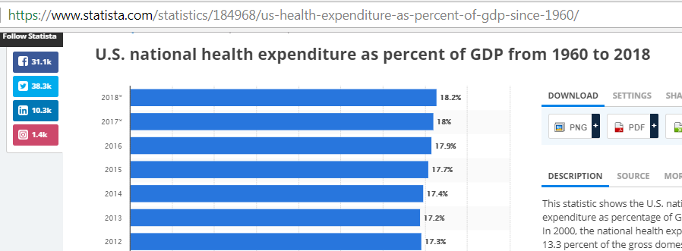
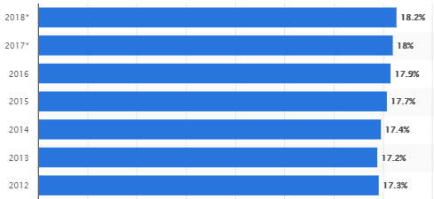
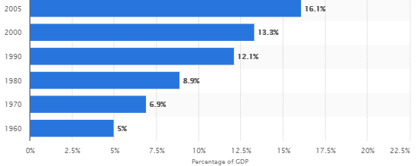
Healthcare Spending
www.statista.com/statistics/184968/us-health-expenditure-as-percent-of-gdp-since-1960/

Slide 11

Healthcare Spending
Source http://money.cnn.com/

Slide 12
Challenges - Safety
Preventable medical errors
  Claim over 250,000 people each year in US hospitals (about 700 per day)
  Number 3 Killer
  Third only to heart disease and cancer
http://www.npr.org/sections/health-shots/2016/05/03/476636183/death-certificates-undercount-toll-of-medical-errors

Slide 13
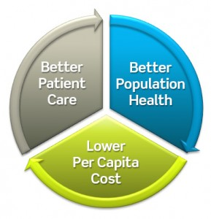
Triple Aim
Examples
  Reduce spending on Chronic Disease
    Opportunity: $262 Billion*
  Reduce preventable deaths from Heart Disease, Cancer, Stroke, Respiratory Disease
    Opportunity: 258,000**
  Reduce premature deaths attributable to preventable hospital error
    Opportunity: 200,000 – 440,000***
* National Council On Aging
** CDC
*** Journal of Patient Safety

Slide 14
Health IT as a Critical Enabler for Health Care Transformation
Technology Adoption and Use
Transformational Change in Health Care Delivery and Population Health -
TIME

Slide 15
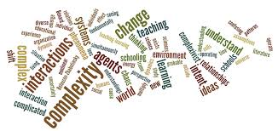
Complex Healthcare Environment
Many organizations
  Governmental and accrediting agencies
  Payers
  Providers of care
  Consumers
  Suppliers
Diverse workforce
Highly regulated
In a state of profound transition

Slide 16
Healthcare Organizations – Hospitals (2017)
AHA Hospital Statistics, 2017 edition

Slide 17

Healthcare Organizations - Hospitals
Hospitals (inpatient/acute care facilities) may be classified by:
Ownership
  Public (government-managed)
  Private
    Private hospitals may be further classified by
      Non-profit
      For-profit (Investor-owned)

Slide 18

Healthcare Organizations – Hospitals Continued
Hospitals (inpatient care facilities) may be classified by:
  Type of services provided
    General hospitals
    Psychiatric hospitals
    Rehabilitation hospitals
    Children’s hospitals
    Long-term acute
  Teaching status
    Academic medical centers or university hospitals
  Geographic location
    Rural hospitals/Critical Access
    Urban hospitals
  Others

Slide 19



Healthcare Organizations -
Outpatient or Ambulatory Care
Physicians’ Offices
Ambulatory Surgery Centers (ASC)
Emergency Department (ED)
Urgent Care
Outpatient Specialty Medicine
Prison Systems
Retail Clinics
Diagnostic Services
  Diagnostic Imaging Facilities
  Medical Laboratories
  Specialized Medical Laboratories

Slide 20
Long-Term Care Providers
Assisted Care
Nursing Home – skilled nursing and intermediate care facilities
Rehabilitation
Mental/Behavioral Health
Home Healthcare Agencies

Slide 21
Integrated Delivery Network (IDN)
A healthcare organization with a variety of providers offering services across the continuum of care and integrated in administration and information sharing
Formed through
  Merger and acquisition
  Joint venture
  Alliance
  Network

Slide 22
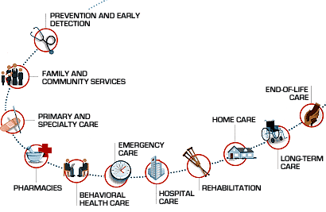
Continuum Of Care
A complete range of health care services and programs
  Primary Level
  Secondary Level
  Tertiary Level

Slide 23
Goals
Coordinated care across the continuum
  Better care
  Safer care
  Less costly care
HIT Enablers
  EMR
  Patient portals
  Health information exchanges
  Interoperability and data sharing
  Data analytics

Slide 24
The Roles of Government
Provider of Care
  Public ownership of hospitals and clinics
    US: Department of Veteran Affairs
    UK: National Health Service
Payer
  National Health Insurance
    US: Centers for Medicare and Medicaid Services
    Canada: Provincially-funded health insurance
Regulator
  Laws
  Regulations
An interesting compilation of information regarding health care systems worldwide can be found here; https://en.wikipedia.org/wiki/Health_systems_by_country

Slide 25
Payers: Financing and Reimbursement
Financing
  Private financing
    Commercial private insurance
    Self-Pay
  Public financing
    National health insurance
    National health system
Reimbursement models
    Fee for service (FFS)
    Prospective payment (DRGs-Diagnosis Related Groups)
    Pay for Performance and Value-Based
    Patient Centered Medical Home
    Accountable Care Organization (ACO)

Slide 26

Payers: Publically Financed
Government-financed and managed programs
  National Health Service (United Kingdom)
  National Health Insurance (Canada)
  United States
    Medicare, Medicaid, SCHIP (State Children’s Health Insurance Program), TRICARE, VHA (Veterans Health Administration), IHS (Indian Health Service)
      Medicare includes Part A, B, D, C (Medicare Advantage)

Slide 27

Payers: Privately Financed
Commercial insurance programs administered by private entities, generally funded by
  Employers
  Citizens
  Combination of both

Slide 28
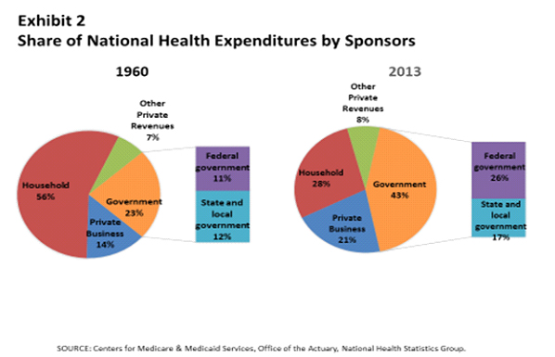
Healthcare Spending By Payer

Slide 29
Interrelationships of Healthcare Organizations
Support such purposes as
  Enabling access to comprehensive care services
  Assuring effective transfers of care
  Ensuring the general portability of care
  Reporting public and population health information
  Obtaining appropriate reimbursement for quality care
  Supporting particular organization models of care

Slide 30
Healthcare Workforce
Physicians / Providers
  Primary Care
  Specialists
  Hospitalists
  Physician Assistants
  Nurse Practitioners
  Residents and Interns
Nursing
Pharmacists
Therapists
Dietitians
Technicians
Clinical Departmental Support (Infection Control, UR, Social Services, etc.)
Clinical Support Staff (Unit Coordinators)
Clerical
Materials/Inventory
Administrative
IT / HIT

Slide 31
Example Senior Level Roles of Health IT/HIT/HIM Professionals
Senior IT roles
  Chief Information Officer: CIO
  Chief Technology Officer: CTO
  Chief Security Officer: CSO
  Privacy Officer
Senior Clinical Information Management Roles
  Chief Medical Information/Informatics Officer: CMIO
  Chief Nursing Information/Informatics Officer: CNIO

Slide 32
IT Department Responsibilities
Operations and technical support
Application management, development, and support
Information security
Network/Data Center operations
Database administration
Website development
Telecommunications
Desktop support

Slide 33
Common IT Positions in Larger Healthcare Organizations
Desktop Support Specialist
Database Administrator
Network Engineer/Analyst
Project Manager
Programmer/Application Developer
Systems Analyst/Administrator
Security Analyst
Web Developer
Telecommunications Specialist
Portal Administrators

Slide 34

Healthcare Providers
Are subject to
  Regulation
  Licensure
  Accreditation
  Certification

Slide 35
Regulation
An interpretation of a law that is written by the responsible regulatory agency
Federal and state laws are passed by legislative bodies and then are implemented as regulations
Required, NOT voluntary

Slide 36
Regulatory Agencies
Implement and Administer Healthcare Law
  Licensure
  Health Insurance Portability and Accountability Act (HIPAA)
  Emergency Medical Treatment and Labor Act (EMTALA)
  UK Data Protection Act of 1998
  European Union General Data Protection Regulation (EUGDPR)

Slide 37


Licensure
Legal authority granted to a person or facility to perform specific acts or provide specific services
Granted by governmental agencies – most often at the state level
  Example-physicians and nurses must hold licenses
Approval requirements and guidelines typically vary

Slide 38
Credentialing and Privileges
Credentialing is the process of verifying qualifications to ensure current competence to grant privileges. The term credentialing involves verification of education, training, experience, and licensure to provide services.
Privileging is the process of authorizing a specific scope of practice for patient care based on credentials and performance.

Slide 39

Accreditation
Process of granting recognition to an institution after it has met predetermined standards and qualifications
Accrediting organizations perform a semi-regulatory role
Voluntary process, yet highly recommended
  Example-The Joint Commission

Slide 40


Certification
Recognizes that health care facilities or individuals have met predetermined standards
Extends to educational programs as well as to individuals
Process is voluntary
Participate to receive certain benefits and/or privileges

Slide 41
Themes
Complexity
Reimbursement and Regulatory Compliance
Need for collaboration/cooperation/interoperability
Need for stakeholder involvement
Technology will adapt and emerge to support reform and market transformation

Slide 42
Practice Questions
Module 1

Slide 43
Practice Question 1
Among the multiple types of hospital ownership, which is not a common model?
  A. Public (government) owned and managed
  B. Private, not-for-profit
  C. Physician owned
  D. Private, for-profit

Slide 44
Practice Question 1
Among the multiple types of hospital ownership, which is not a common model?
  A. Public (government) owned and managed
  B. Private, not-for-profit
  C. Physician owned
  D. Private, for-profit

Slide 45
Practice Question 2
Hospitals may be classified many different ways. Which of the following statements is true regarding hospital classifications?
  Private hospitals are always for-profit organizations
  Urban, rural and children’s hospitals are classified by their geographic location
  Rural hospitals are most frequently classified as teaching hospitals
  Hospitals may be classified in more than one way, such as an urban hospital might also be classified as a government-owned hospital or as a general hospital

Slide 46
Practice Question 2
Hospitals may be classified many different ways. Which of the following statements is true regarding hospital classifications?
  Private hospitals are always for-profit organizations
  Urban, rural and children’s hospitals are classified by their geographic location
  Rural hospitals are most frequently classified as teaching hospitals
  Hospitals may be classified in more than one way, such as an urban hospital might also be classified as a government-owned hospital or as a general hospital

Slide 47
Practice Question 3
An ambulatory surgery center would be best classified as
  A. A teaching hospital
  B. An outpatient care setting
  C. A general hospital
  D. A rehabilitation hospital

Slide 48
Practice Question 3
An ambulatory surgery center would be best classified as
  A. A teaching hospital
  B. An outpatient care setting
  C. A general hospital
  D. A rehabilitation hospital

Slide 49
Practice Question 4
From the perspective of the healthcare delivery organization, payments generally come from three types of entities:
  Employers, employees, and government entities
  Government-financed and managed programs, insurance programs managed by private entities, and patients’ personal funds
  National health systems, national insurance systems, and multi-payer systems
  Uninsured, underinsured, and insured

Slide 50
Practice Question 4
From the perspective of the healthcare delivery organization, payments generally come from three types of entities:
  Employers, employees, and government entities
  Government-financed and managed programs, insurance programs managed by private entities, and patients’ personal funds
  National health systems, national insurance systems, and multi-payer systems
  Uninsured, underinsured, and insured

Slide 51
Practice Question 5
In considering the purpose for interrelationships among healthcare organizations, identify the purpose below that is correct:
  Enable access to comprehensive care services from only one healthcare organization
  Ensure effective transfers of care facilitated by the provision of essential health information
  Facilitate obtaining appropriate rewards for care referrals
  Facilitate marketing of healthcare services regardless of patients’ consent

Slide 52
Practice Question 5
In considering the purpose for interrelationships among healthcare organizations, identify the purpose below that is correct:
  Enable access to comprehensive care services from only one healthcare organization
  Ensure effective transfers of care facilitated by the provision of essential health information
  Facilitate obtaining appropriate rewards for care referrals
  Facilitate marketing of healthcare services regardless of patients’ consent

Slide 53
Practice Question 6
Ensuring the general portability of healthcare is facilitated by
  Health information exchanges (HIEs) such as Canada’s Health Infoway and the U.S. HIE programs, including the Nationwide Health Information Network (NHIN)
  The Organisation for Economic Cooperation and Development (OECD)
  Insurance programs administered by private entities
  The secondary use of healthcare information

Slide 54
Practice Question 6
Ensuring the general portability of healthcare is facilitated by
  Health information exchanges (HIEs) such as Canada’s Health Infoway and the U.S. HIE programs, including the Nationwide Health Information Network (NHIN)
  The Organisation for Economic Cooperation and Development (OECD)
  Insurance programs administered by private entities
  The secondary use of healthcare information

Slide 55
Practice Question 7
An example of the secondary use of a patient’s health information would be when the information is shared:
  To support transfer of the patient’s care between two providers
  Through an authorized health information exchange to support the portability of care
  In support of a diagnostic test required to further the treatment of a patient
  With public health officials for statistical reporting or in support of clinical research

Slide 56
Practice Question 7
An example of the secondary use of a patient’s health information would be when the information is shared:
  To support transfer of the patient’s care between two providers
  Through an authorized health information exchange to support the portability of care
  In support of a diagnostic test required to further the treatment of a patient
  With public health officials for statistical reporting or in support of clinical research

Slide 57
Practice Question 8
In the financial reimbursement area, the interrelationships between healthcare organizations:
  Are unrelated to the efficiency of healthcare claims processing
  May assure government payers that quality healthcare services have been delivered
  Does not support private insurance organizations in their assessment of the quality of delivered healthcare services
  Are designed to maximize reimbursement for covered healthcare services

Slide 58
Practice Question 8
In the financial reimbursement area, the interrelationships between healthcare organizations:
  Are unrelated to the efficiency of healthcare claims processing
  May assure government payers that quality healthcare services have been delivered
  Does not support private insurance organizations in their assessment of the quality of delivered healthcare services
  Are designed to maximize reimbursement for covered healthcare services

Slide 59
Practice Question 9
Key information technology and information management professionals in healthcare organizations include
  Chief information officer (CIO), chief executive officer (CEO), and chief medical information officer (CMIO)
  Chief information officer (CIO), chief security officer (CSO), and chief medical information officer (CMIO)
  Chief information officer (CIO), chief financial officer (CFO), and chief technology officer (CTO)
  Chief information officer (CIO), chief executive officer (CEO), and chief nursing informatics officer (CNIO)

Slide 60
Practice Question 9
Key information technology and information management professionals in healthcare organizations include
  Chief information officer (CIO), chief executive officer (CEO), and chief medical information officer (CMIO)
  Chief information officer (CIO), chief security officer (CSO), and chief medical information officer (CMIO)
  Chief information officer (CIO), chief financial officer (CFO), and chief technology officer (CTO)
  Chief information officer (CIO), chief executive officer (CEO), and chief nursing informatics officer (CNIO)

Slide 61
Practice Question 10
Non-government professional associations may perform regulatory roles for their profession. Which of the following is NOT a typical role for a professional association?
  Determining qualifications for a profession by defining professional examination criteria
  Making laws and regulations regarding reimbursements for their profession
  Issuing a code of conduct to guide professional behavior
  Implementing disciplinary procedures for those in their profession

Slide 62
Practice Question 10
Non-government professional associations may perform regulatory roles for their profession. Which of the following is NOT a typical role for a professional association?
  Determining qualifications for a profession by defining professional examination criteria
  Making laws and regulations regarding reimbursements for their profession
  Issuing a code of conduct to guide professional behavior
  Implementing disciplinary procedures for those in their profession

Slide 63
Practice Question 11
A clinical informatics professional within an acute care setting typically does NOT need to possess skills and/or experience in the following areas?
  A. Clinical medicine
  B. Computer science
  C. Quantitative statistics
  D. Population health

Slide 64
Practice Question 11
A clinical informatics professional within an acute care setting typically does NOT need to possess skills and/or experience in the following areas?
  A. Clinical medicine
  B. Computer science
  C. Quantitative statistics
  D. Population health

