Slide 1
Module 8 Administration Leadership

Slide 2
Learning Objectives
Participate in organizational strategic planning (e.g. measure performance against organizational goals)
Assess the organizational environment (e.g., corporate culture, values, and drivers)
Forecast technical and information needs of an organization by linking resources to business needs
Develop an information technology (IT) strategic plan and departmental objectives that align and support organizational strategies and goals

Slide 3
Learning Objectives
Evaluate performance (e.g., goal/performance indicators, system effectiveness)
Evaluate effectiveness and user satisfaction of systems and services being provided
Promote stakeholder understanding of information technology opportunities and constraints (e.g., business and IT resources, budget, project prioritization)
Develop policies and procedures for information and systems management
Comply with legal and regulatory standards

Slide 4
Learning Objectives
Adhere to ethical business principles
Employ comparative analysis strategies (e.g., indicators, benchmarks)
Prepare and deliver business communications (e.g., presentations, reports, project plans)
Facilitate group discussions and meetings (e.g., consensus building, conflict resolution)
Provide consultative services to the organization on IT matters

Slide 5
Learning Objectives
Develop educational strategies regarding the information and management systems function
Maintain organizational competencies on current IT technologies and trends
Assure that risk management is embedded in internal and external management processes, and consistently applied (e.g., risk assessment, risk mitigation)
Ensure quality standards and practices are followed by monitoring internal and external performance

Slide 6
CPHIMS Competency Areas
CPHIMS Examination Content Outline (effective May, 2015) | Cognitive Level |  |  |  |  |  | Total
 | Recall |  | Application |  | Analysis
1. General | 22 | 22% | 6 | 6% | 0 | 0% | 28 | 28%
A. Healthcare Environment | 10 | 10% | 4 | 4% | 0 | 0% | 14 | 14%
B. Technology Environment | 12 | 12% | 2 | 2% | 0 | 0% | 14 | 14%
2. Systems | 3 | 3% | 22 | 22% | 15 | 15% | 40 | 40%
A. Analysis | 2 | 2% | 10 | 10% | 4 | 4% | 16 | 16%
B. Design | 0 | 0% | 3 | 3% | 3 | 3% | 6 | 6%
C. Selection, Implementation, Support, and Maintenance | 0 | 0% | 4 | 4% | 3 | 3% | 7 | 7%
D. Testing and Evaluation | 0 | 0% | 2 | 2% | 3 | 3% | 5 | 5%
E. Privacy and Security | 1 | 1% | 3 | 3% | 2 | 2% | 6 | 6%
3. Administration | 5 | 5% | 18 | 18% | 9 | 9% | 32 | 32%
A. Leadership | 3 | 3% | 10 | 10% | 9 | 9% | 22 | 22%
B. Management | 2 | 2% | 8 | 8% | 0 | 0% | 10 | 10%
Total | 30 | 30% | 46 | 46% | 24 | 24% | 100 | 100%

Slide 7
Administration Leadership
Leadership is a skill every member of the organization is responsible for understanding and, when appropriate, undertaking

Slide 8
Participating in Organizational Strategic Planning
Mission
Statement of why an organization exists
Values
Measures to support vision accomplishment
SMART (specific, measurable, attainable, relevant and time bound)
Vision
Purpose Statement
Simple, concise, easily understood, remembered
Set by CEO and BOD
Does not change with any regularity unless the business is changing
Company statement that defines where it wants to go or what it wants to be
CEO and BOD typically set the vision
Depending on the reach, it may be altered with more regularity than the mission
Goals
Recent addition
List of values helps individuals to understand what the company supports and appreciate most
Can compare against personal values, activities one undertakes at work, guide for decision making/ actions
Clearly articulated goals support mission, vision and serve as guide against which to measure work

Slide 9
Participating in Organizational Strategic Planning
Leader responsibility
Strategy = formal or informal plan of action to achieve a goal
Strategic focus → points toward future
For the benefit of employees and customers, series of statements are created to outline and explain an organization's strategies

Slide 10
Developing a Strategic Plan
IT Strategic Plan
- Visual
- Scorecard
Organizational Strategic Plan
Current State of Systems and Processes (Assess effectiveness)
Current IT Plan
Validation of strategies and tactics
Build (internal/ external) or Buy Considerations
Gap Analysis
Desired State
A well-developed plan will map the organizational strategies and supporting applications and processes for each strategy
.

Slide 11
IT Strategic Plan
May vary dependent on size of the organization
Large organization-may serve as a reference tool for prioritizing the work that is to be done through the organization
Small/less complex-may be included as a section or addendum to the organizational strategic plan
Should align with the organizational priorities
Well-developed plan will map the organizational strategies and the supporting application processes for each strategy
Will provide a visual representation of the current systems’ status, an indicator of the expected useful lifeline of the systems or the gap that exists between the strategy and the needed technology

Slide 12
IT Strategic Plan
Focus on the gaps
Outline current state and desired future state
Perform a SWOT analysis
Focus on the first couple of plan steps and provide a higher-level analysis for the remaining steps
Outline more of the purely IT initiatives and personnel needs
Needed infrastructure changes
Advanced technologies
System refresh strategies
Transition and succession plans for staff and leaders

Slide 13
Forecasting Technical and Information Needs
Methodology that support organizational ability to measure activities against stated goals and objectives
Internal benchmarks
External benchmarks – local, national, contract may be required to use them
Ensure benchmarks are comparable to data your organization is capable of supplying

Slide 14
Forecasting Technical and Information Needs
Includes new ideas
Variety of sources and vary in level of development
Provide support in determining project scope, definition and objectives, and in some cases, for vendor relationship
Have a program evaluation staff
Serve as organization’s conscience
Within scope, scope creep, redirection, occasional time-limited expansion of scope
Resource availability
Personnel
Within scope of responsibility and expertise

Slide 15
Forecasting Technical and Information Needs
Provide assistance and direction in support of the goals and initiatives of the company
Operational goals direct information technology
Unclear leadership responsibilities outside IT can put organizational project at risk
Be ready
To actively recommend appropriate systems and technologies in support of organizational goals
To challenge requests to deviate from organizational goals and when goal deviation occurs – gather support materials
Avoid creating a service gap

Slide 16
Implementing the IT Strategic Plan
Should be a living object, regularly maintained
Should be a part of the organization strategic plan and updated accordingly with any changes to its companion
Make sure key objectives are visible to the entire department
Tie individual performance objectives back to the plan
Run report to measure, maintain a scorecard of goal progress that all can see

Slide 17
Evaluating Plan Performance
Need measures that monitor the ongoing effectiveness and progress
Two types:
Project tracking (Gantt Chart)
Service level (Dashboard)
Need measures that monitor effectiveness and user satisfaction
Regular departmental and systems assessment
Baseline analysis is necessary to understand benchmarks
Both objective and subjective assessment of quality metrics
Baseline assessment can be accomplished via face-to-face interviews, observation, focus group, town hall meetings, virtual and physical meetings
Commitment to on-going process for follow-up analyses with
Regular communication
Effectiveness reassessed with customers

Slide 18
Promoting Stakeholder Understanding
Responsibility to discuss opportunities and system limitations
Project initiation process is critical
Method: SBARC = Situation, Background, Assessment, Recommendation and Communication
Simplicity: completion and communication of concise summary for leaders prior to committing to full project proposal or pro forma financial plan
Disciplined approach to framing and initiating projects ensures stakeholder and project team members are operating from an identical framework
Written plan – signed off by all stakeholders will help “manage” opportunity for “scope creep”

Slide 19
Policies and Procedures Development
Policies and Procedures
Facilitate standardization of actions and operations
Answer the following questions
Is the policy really needed?
If so, at what level of the organization must that policy be implemented?
Ensure that you can audit and report on the effectiveness of the policy
Be prepared to act on the results from the audit

Slide 20
Complying with Legal and Regulatory Standards
Comply with Legal and Regulatory Standards
Need to know sources of standards for own country
For example, for US: Meaningful Use, e-prescribing, HIPAA, etc.
Organizational roles that need to know nuances: Compliance Officer or equivalent, Legal Counsel, lead Joint Commission liaison, among others
Two most influential sources of standards for healthcare organizations in US are CMS and The Joint Commission
Example from the UK; Care Quality Commission (CQC)

Slide 21
Ethical Business Principles
Ethical Business Principles
Adhere to an identifiable code of business or corporate ethics

Slide 22
Employing Comparative Analysis Strategies
Comparative Analysis Strategies
Budgets, financial and non-financial indicators, benchmarks, quality indicators

Slide 23
Budgets
To understand how an organization is performing financially, need to be able to read and understand a budget spreadsheet
Budget spreadsheet
Annual budgets by line item
Projected budget and expenditures to date
Variances
Comparison to history

Slide 24
Budgets Continued
Revenue and expenses
Some expenses spread evenly over the year
Other expenses have unique timing
Well-constructed report explains timing of events
Types of expenses
Capital-Treated as assets and have enduring value to the organization. Each asset is depreciated over a period of time.
Operating-Salaries, benefits, maintenance, travel, utilities, supplies

Slide 25
Benchmarks and Quality Indicators
Benchmarks-Compare one organization to another, national averages or internal goals (e.g., number of days in A/R, days cash on hand, quality safety, regulatory or accreditation measures)
Quality Indicators-Fixed measures set by federal government agencies or payers to the organization
May be voluntary or required
May serve as goals
External services will aggregate this data

Slide 26
Preparing and Delivering Business Communications
Written and verbal
Presentation and communication skills
Project communication plans
Status documents
Organized meeting preparation approaches
Outline and define time on each item
Develop a department template

Slide 27
Facilitate Group Discussions and Meetings
Meeting management skills
Be familiar with Robert’s Rules of Order (www.robertsrules.org) for more complex decisions and controversial topics

Slide 28
Providing In-House Consulting Services
Often purchased outside when internal personnel resources are in short supply or a specific skill is needed
Can also be provided as a means of managing, staffing, or advising on any manner of need
PMO (project management office) is an example

Slide 29
Developing Educational Strategies for IT Staff
Education must be valued
Commit to the time it will take for staff to complete further education
Commit to supporting the cost of education
Encourage staff to broaden skills
If considering cutting education in the budget, consider how much it will cost to recruit new staff with needed skills
Opportunities
Create low-cost educational opportunities
Professional societies
Vendor user groups

Slide 30
Staying Current on IT Technologies and Trends
Stay connected to a variety of disciplines related to specific sphere of expertise
Resources
Colleagues
The Guardian, WSJ, Healthcare IT News, etc.

Slide 31
Managing Risk
Key piece of the IT planning process
Issues of risk addressed along two dimensions
Develop a risk matrix
Magnitude of risk-how big of an impact would it have if it happened
Likelihood
Develop contingency plans

Slide 32
Quality Standards and Practices
Manage quality control standards
Begins at initial configuration and implementation
Perform comprehensive and regular review to ensure safe and high-quality performance
Set clear expectations
Measure and report
Modify to continually improve the products delivered

Slide 33
Create a Quality Toolkit
Uses in health information and technology
Planning
Process Redesign
Process Improvement
Root Cause Analysis and Failure Mode Effects Analysis
Rapid Cycle Improvement

Slide 34
Metric-Driven Transformation
Types of Measures
Clinical Outcomes or Intermediate Clinical Outcome
Mortality, absence of complications, UTI rate
Process
Administration of antibiotic prior to surgery
Structure
Staffing, availability of education/training
Composite
Combination of two or more measures used to generate a single score (sum, average, weighted average, etc.)

Slide 35
Metric-Driven Transformation
Types of Measures Continued
Resource use and cost
RNs per patient day, FTEs per patient day, cost per DRG
Efficiency – combination of quality and resource use
Relationship between nurse staffing and rate of UTIs
Balancing
Readmission rate as a balancing measure for effort to reduce length of stay.

Slide 36
Statistics
Mean
Average of a data set
Median
Found by ordering the set from lowest to highest and finding the exact middle
Standard deviation
Used to quantify the amount of variation or dispersion of a set of data values
P Value
Level of marginal significance within a statistical hypothesis test representing the probability of the occurrence of a given event
Used as an alternative to rejection points to provide the smallest level of significance at which the null hypothesis would be rejected

Slide 37
Tools to Facilitate Planning
Group techniques for participation and idea generation:
Delphi Approach
Each member of group writes ideas anonymously
Ideas listed and prioritized by group
Ideas voted upon to determine final selection
Nominal Group Technique
Divide into small groups
Write down ideas
List ideas by members in success
Discuss and rank ideas
Brainstorming

Slide 38
Performance Measurement Tools
• Graphing and charting tools
Histogram
Specialized type of bar chart
Shows how frequently data in each class occurs in the data
Graphs frequency and response variable range
High bars indicate more points in a class
Low bars indicate less points

Slide 39
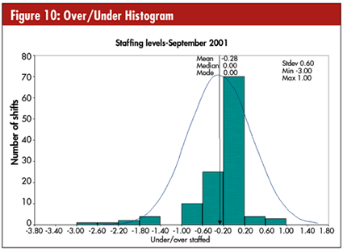
Performance Measurement Tools
Example: Histogram

Slide 40
Performance Measurement Tools
Bar Chart
Useful for comparing classes or groups of data
Graphically summarizes and displays differences between groups of data
Bar heights represent observed frequencies
Look for
Tallest bar
Shortest bar
Growth or shrinking of the bars over time
One bar relative to another
Change in bars representing the same category in different classes

Slide 41
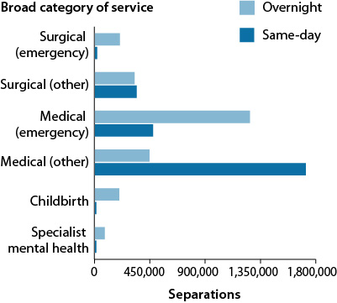
Performance Measurement Tools
Example: Bar Chart

Slide 42
Performance Measurement Tools
• Pareto Chart
The Pareto Principle: 80% of problems usually stem from 20% of the causes
Pareto charts display the Pareto principle in action
Arrange data to reveal the few factors that cause most of the problems
Values are arranged in ascending order
Summarizes and displays relative importance of differences between groups of data

Slide 43
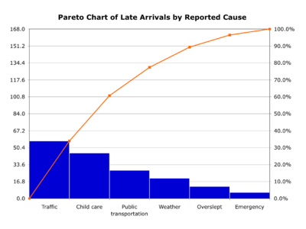
Performance Measurement Tools
Example: Pareto Chart

Slide 44
Performance Measurement Tools
Scatter Plot
Similar to line graphs in that they use horizontal and vertical axes to plot data points
Have a very specific purpose to show how much one variable is affected by another
The relationship between two variables is called their correlation

Slide 45
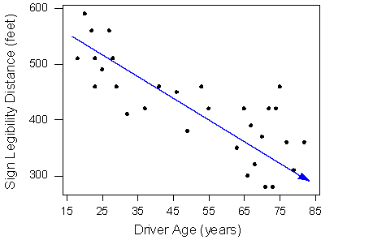
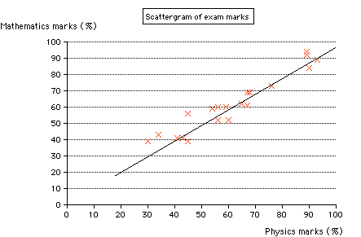
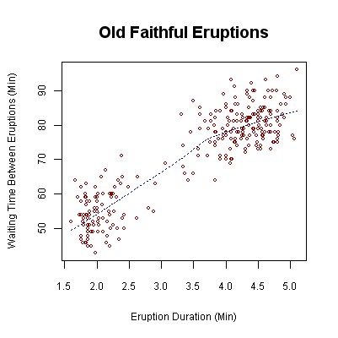
Performance Measurement Tools
Example: Scatter Plot

Slide 46
Performance Measurement Tools
Control Chart
Use to measure variance in
performance
quality
Utilizes upper and lower control limits based on standard deviation
Vertical axis identifies measurements
Horizontal axis reflects sequential measurement points over time
Process mean charted through center of chart

Slide 47
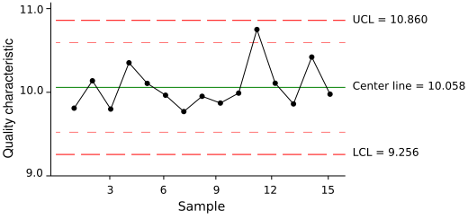
Performance Measurement Tools
Example: Control Chart

Slide 48
Performance Measurement Tools
• Fishbone Diagram
Cause and effect diagram
Used to explore all the potential or real causes of a problem
Causes arranged according to their level of importance or detail
Depicts relationships and hierarchy of events
Used for root-cause analysis or to identify requirements

Slide 49
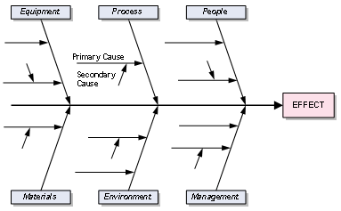
Performance Measurement Tools
Example: Fishbone Diagram

Slide 50
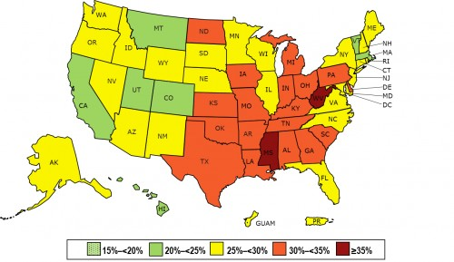
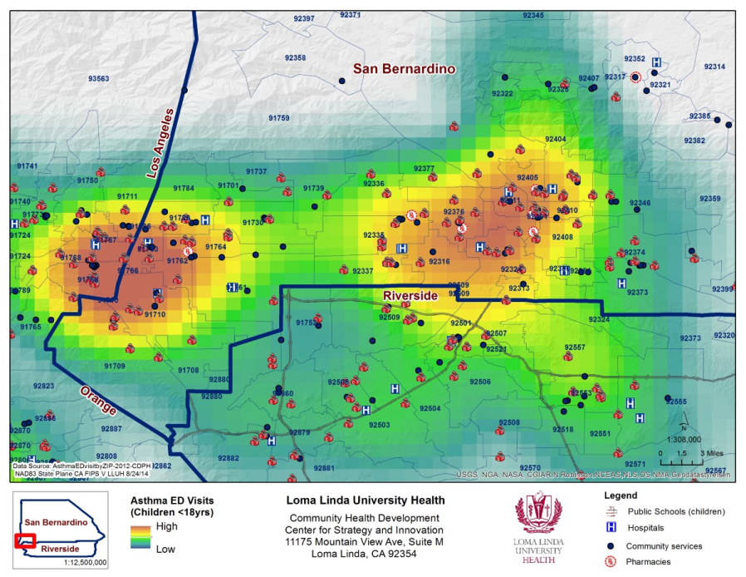
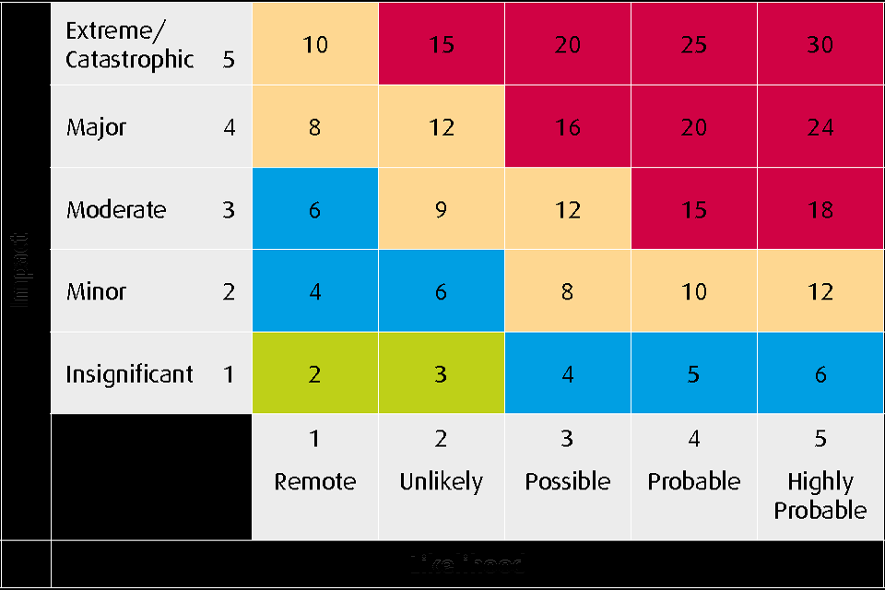
Performance Measurement Tools
Example: Heat Maps
CDC Obesity by State
Asthma ED Visits
Risk Assessment

Slide 51
Practice Questions Module 8

Slide 52
Practice Question 1
The company’s statement that defines where it wants to go or what it wants to be is known as the:
Mission Statement
Vision Statement
Statement of Values
Statement of Goals

Slide 53
Practice Question 1
The company’s statement that defines where it wants to go or what it wants to be is known as the:
Mission Statement
Vision Statement
Statement of Values
Statement of Goals

Slide 54
Practice Question 2
A control chart typically contains each of the following EXCEPT the:
Stretch goal
Upper control limit
Mean
Lower control limit

Slide 55
Practice Question 2
A control chart typically contains each of the following EXCEPT the:
Stretch goal
Upper control limit
Mean
Lower control limit

Slide 56
Practice Question 3
An SBARC includes each of the following EXCEPT the
Situation
Background
Assessment
Constitution

Slide 57
Practice Question 3
An SBARC includes each of the following EXCEPT the
Situation
Background
Assessment
Constitution

Slide 58
Practice Question 4
Each of the following is a recommended initial assessment tool EXCEPT:
Face-to-face interviews
Web surveys
Unit or department meetings
Focus group meetings

Slide 59
Practice Question 4
Each of the following is a recommended initial assessment tool EXCEPT:
Face-to-face interviews
Web surveys
Unit or department meetings
Focus group meetings

Slide 60
Practice Question 5
The international organization that serves as a voluntary accrediting, quality and safety organization is:
Project Management Institute (PMI)
Centers for Medicare & Medicaid Services (CMS)
Joint Commission International (JCI)
International Federation of Health Information Management Associations (IFHIMA)

Slide 61
Practice Question 5
The international organization that serves as a voluntary accrediting, quality and safety organization is:
Project Management Institute (PMI)
Centers for Medicare & Medicaid Services (CMS)
Joint Commission International (JCI)
International Federation of Health Information Management Associations (IFHIMA)

Slide 62
Practice Question 6
The actions of doing good, being honest and acting fairly are all components of a sound:
Business impact analysis
Systems design
Corporate mission
Business ethics position

Slide 63
Practice Question 6
The actions of doing good, being honest and acting fairly are all components of a sound:
Business impact analysis
Systems design
Corporate mission
Business ethics position

Slide 64
Practice Question 7
Successful conflict resolution is achieved through a mutual focus on
Eliminating the differences of opinion or positions
The common ground of the parties in conflict
Understanding the personality types of the parties in conflict
A proposed solution provided by the mediator

Slide 65
Practice Question 7
Successful conflict resolution is achieved through a mutual focus on
Eliminating the differences of opinion or positions
The common ground of the parties in conflict
Understanding the personality types of the parties in conflict
A proposed solution provided by the mediator

Slide 66
Practice Question 8
Which of the following items is NOT typically a part of the IT strategic plan:
Current systems state
Desired future systems state
A summary of IT initiatives supporting organizational goals
The IT project sponsors for each initiative

Slide 67
Practice Question 8
Which of the following items is NOT typically a part of the IT strategic plan:
Current systems state
Desired future systems state
A summary of IT initiatives supporting organizational goals
The IT project sponsors for each initiative

Slide 68
Practice Question 9
An organization has several pending IT projects. The organization is struggling financially. Which of the following will BEST determine project priorities?
Existing environment
Regulatory requirements
Mission of organization
Return on investment
1, 2, and 3 only
1, 2, and 4 only
1, 3, and 4 only
2, 3, and 4 only

Slide 69
Practice Question 9
An organization has several pending IT projects. The organization is struggling financially. Which of the following will BEST determine project priorities?
Existing environment
Regulatory requirements
Mission of organization
Return on investment
1, 2, and 3 only
1, 2, and 4 only
1, 3, and 4 only
2, 3, and 4 only

Slide 70
Practice Question 10
The recent addition of two rural-based community health centers to a healthcare network has increased the demand for IT support services. Which of the following line items will need to be increased in the IT budget for the next fiscal year?
Travel, supplies, salaries and benefits
Training, hardware, depreciation
Salaries and benefits, depreciation, training
Supplies, hardware, travel

Slide 71
Practice Question 10
The recent addition of two rural-based community health centers to a healthcare network has increased the demand for IT support services. Which of the following line items will need to be increased in the IT budget for the next fiscal year?
Travel, supplies, salaries and benefits
Training, hardware, depreciation
Salaries and benefits, depreciation, training
Supplies, hardware, travel

Slide 72
Practice Question 11
A director is preparing the IT department budget for the upcoming fiscal year. A patient care system maintenance contract will automatically renew at the end of the 2nd quarter next year. The contract term calls for a 10% increase from the current contract rate of $12,000 per annum. What amount should be budgeted?
$12,060
$12,120
$12,600
$13,200

Slide 73
Practice Question 11
A director is preparing the IT department budget for the upcoming fiscal year. A patient care system maintenance contract will automatically renew at the end of the 2nd quarter next year. The contract term calls for a 10% increase from the current contract rate of $12,000 per annum. What amount should be budgeted?
$12,060
$12,120
$12,600
$13,200

Slide 74
Practice Question 12
An IT department is trying to improve its customer service scorecard. The scorecard measures performance on service level agreements (SLAs), service problem management, and business continuity readiness. On which of the following should the IT manager focus improvement efforts?
Negotiating more achievable SLA goals
Including one more business continuity drill in next year’s budget
Requesting an analysis of the mean time to resolve a problems
Evaluating the utilization of the service request tracking system

Slide 75
Practice Question 12
An IT department is trying to improve its customer service scorecard. The scorecard measures performance on service level agreements (SLAs), service problem management, and business continuity readiness. On which of the following should the IT manager focus improvement efforts?
Negotiating more achievable SLA goals
Including one more business continuity drill in next year’s budget
Requesting an analysis of the mean time to resolve a problems
Evaluating the utilization of the service request tracking system

Slide 76
Practice Question 13
Which of the following is NOT a quality improvement aim?
A. Efficiency
B. Patient centeredness
C. Effectiveness
D. Innovation

Slide 77
Practice Question 13
Which of the following is NOT a quality improvement aim?
A. Efficiency
B. Patient centeredness
C. Effectiveness
D. Innovation

