Slide 1
Module 3 Systems Analysis

Slide 2
Learning Objectives
Describe the major components of the systems analysis process with regard to IT implementation in healthcare
Articulate the problem that can be resolved through proper policies based on IT
Explain the current and developing trends in IT systems analysis
Perform a cost–benefit analysis of a proposed initiative
Identify the project management stages that are most important to the systems analysis phase

Slide 3
CPHIMS Competency Areas
CPHIMS Examination Content Outline (effective February, 2014) | Cognitive Level |  |  |  |  |  | Total
 | Recall |  | Application |  | Analysis
1. General | 22 | 22% | 6 | 6% | 0 | 0% | 28 | 28%
A. Healthcare Environment | 10 | 10% | 4 | 4% | 0 | 0% | 14 | 14%
B. Technology Environment | 12 | 12% | 2 | 2% | 0 | 0% | 14 | 14%
2. Systems | 3 | 3% | 22 | 22% | 15 | 15% | 40 | 40%
A. Analysis | 2 | 2% | 10 | 10% | 4 | 4% | 16 | 16%
B. Design | 0 | 0% | 3 | 3% | 3 | 3% | 6 | 6%
C. Selection, Implementation, Support, and Maintenance | 0 | 0% | 4 | 4% | 3 | 3% | 7 | 7%
D. Testing and Evaluation | 0 | 0% | 2 | 2% | 3 | 3% | 5 | 5%
E. Privacy and Security | 1 | 1% | 3 | 3% | 2 | 2% | 6 | 6%
3. Administration | 5 | 5% | 18 | 18% | 9 | 9% | 32 | 32%
A. Leadership | 3 | 3% | 10 | 10% | 9 | 9% | 22 | 22%
B. Management | 2 | 2% | 8 | 8% | 0 | 0% | 10 | 10%
Total | 30 | 30% | 46 | 46% | 24 | 24% | 100 | 100%

Slide 4
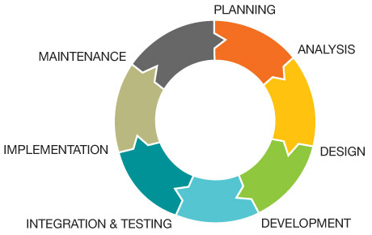
System Development Life Cycle (SDLC)
Conceptual model used in project management that describes the stages involved in an information system development project

Slide 5
Systems Analysis
First step in the system development life cycle (SDLC)
Problem Definition
Needs Analysis
Cost Benefit Analysis
Determine the “why”
Establishes scope and value
Lays the foundation
Determines what the desired system is to do

Slide 6
Problem Definition
Describe the problem: What type of failure is occurring?
This printed patient scheduled report is not showing all of the patients that are visible to the front desk clerk online.
Identify where the problem is occurring: Everywhere? Only specific time and location for specific users?
In the morning reports for the pediatrics practice.
Describe the size of the problem in measurable terms.
Over the past 3 days, an average of 3 out of 82 patients per day were missing from the report.
Describe the impact of the problem to help determine the priority.
Backup=Low priority
Reconciliation=High priority

Slide 7
Examples of Healthcare Problems and Opportunities for IT Implementation
Clinical Functions
Use of physical patient files, lack of computerized order information, lack of electronic health records
Administrative and Financial functions
General ledger operations, billing, cost accounting, payroll, personnel management, integrated HR functions, patient registration, electronic management of materials
Infrastructure
Security, network development

Slide 8
Needs Analysis
Identify main challenges in the sector and specifically those needs that can be sufficiently met by the implementation of sustainable, secure, and cost-efficient IT practices
Needs are categorized as
Operational
Administrative
Industry related
Tools used in a needs analysis
Interviews, review of documentation, observation, surveys, data analysis

Slide 9
Needs Prioritization
Drives the likelihood of project acceptance
Examples
Patient safety
Profitability
Ease of processes
Industry standardization

Slide 10
Problem Analysis vs. Needs Analysis

Slide 11
Determine the Requirements
The documented record of what the system actually does
Critical for alignment to project scope
Essential for testing – test cases should validate that the system meets requirements
Describes the “future state”
Primary input for estimating resources, cost and time needed for project

Slide 12
Requirements Analysis
Describe – Validate – Prioritize - Signoff
Requirements document
High level description/use cases
Detailed description of each requirement
Graphical depiction
Prioritize
Needs are must-haves, which are critical to benefits realization
Wants are desirables
Use scoring methodology and/or force ranking

Slide 13
Categorization of Requirements
Functional and workflow
Reporting/analysis capabilities
Regulatory requirements
Data/database
Security
System performance and response time
Disaster recovery
Platform compatibility
Interfaces and Interoperability
Physical plant considerations
Client devices
Network

Slide 14
Modeling Current and Future State
Used to document workflow, process steps, data flow
Common tools
Activity Diagram
Flowchart
Data Flow Diagram
Entity Relationship Diagram

Slide 15
Flowcharts and Process Diagrams
Visual representation that shows
Boundaries of the process
Steps
Sequence
Utilizes standard symbols
Different approaches use different symbol sets
Standards and Tools
ISO 5807
UML (Unified Modeling Language)

Slide 16
Sample Activity Diagram – High Level Flow of Practice Visit
Patient
Appears at
Front Desk
History
Form
Completed
Schedules
Follow-up
Visit
Receptionist
Documents
Complaint
Educates
Patient
NO
Nurse
Takes Ht.,
Wt., Vitals
YES
Reviews
Chart
Education
Ordered?
Physician
Examines
Patient
Writes
Orders

Slide 17
Sample Flowchart

Slide 18
Sample Dataflow Diagram

Slide 19
Sample Entity Relationship Diagram

Slide 20
Requirements Signoff
Establishes basis of commitment for stakeholders and project team
Reflects what the stakeholder team has prioritized
Creates baseline for scope of work
Clearly states what requirements will be addressed and what requirements will not be addressed
Provides basis for initial estimates in cost-benefit analysis

Slide 21
Approval
Decision point at which the team is asking for resources:
to do detailed design, build and implementation
to engage in a vendor selection process based on requirements analysis
Clear processes
Governance
Documents/Artifacts
Signoff Requirements

Slide 22
Work Plan/Proposal Development
Step-by-step plan for implementing the project
Materials and equipment layout
Intended workflow processes
Managing the time
Analysis of the processes
Evaluation of the outcomes
Needed for IT acceptance by healthcare facilities

Slide 23
Elements of a Work Plan/Proposal
Executive Summary
Introduction and Background
Goals and Objectives
Resources and Constraints
Alternatives Considered
Strategies and Actions
Work Plan Accountability
Cost Benefit Analysis

Slide 24
Executive Summary
What is the project aimed at?
What is being assessed?
What is the purpose of the project?
What will the plan provide?

Slide 25
Introduction and Background
What is the issue that needs to be addressed and why is it a problem?

Slide 26
Goals and Objectives
What is the goal and what are the specific objectives that must be met to accomplish the goal
Includes evaluation of the current situation
Identify the major problems and processes
Identify alternative solutions
Do comparative analysis between original and alternative
Evaluate alternatives against plan objectives
Evaluate ethical, legal, social, economic implications through cost-benefit analysis
Develop a proposal for implementation of recommendations and follow up

Slide 27
High Level Objectives
Patient satisfaction | Efficient processes - reduce delay time - enhance customer experience - offer good follow-up on patient issues
Revenue generation | Reduced staff time spent per patient - leads to increase in daily patient volumes
Efficient processes (cut costs/increase profit) | Reduced work duplication and improved service quality - increase revenue generation through cost cutting
Conform to industry standards | Establishment of a platform for global standardization of healthcare IT processes

Slide 28
Resources and Constraints
Resources
Personnel – software support, simulation, project evaluation, engineers, technical, others
Partners – government, government-sponsored partners, non-governmental organizations, private investment agencies
Equipment – facilities, computers, software, other
Legal and regulatory infrastructure
Constraints
What are the expected barriers?

Slide 29
Alternatives Considered
Use requirements in analysis of alternatives
Do nothing
Enhance existing system
Partially implement the proposed solution
Understand the pros and cons of each

Slide 30
Strategies and Actions
How will the work be done?
What are the responsibilities?
What will people be looking at?
What information will they be gathering, analyzing, organizing?
How will simulations/tests be conducted?
How will the actual implementation be managed?

Slide 31
Work Plan Accountability
How will the work and the people be governed?
Who will be held accountable?

Slide 32
Cost Benefit Analysis (CBA)
Validation that benefits in recommended solution are equal to or greater than costs
Common yardstick for comparison of alternatives
Basis for holding stakeholders accountable for realizing benefits
High level benefits given a financial value
Improved efficiency in Medical Records handling = total time eliminated in paper record pulls and paper record filing based on assumptions about total hours needed per year and cost per hour of existing FTEs
Costs based on preliminary project plan outlining resources and time as well as assumptions about costs of hardware, network, recurring fees, etc.

Slide 33
Cost Benefit Analysis
Involves project team, stakeholders, Finance or Accounting
Often complicated calculations
Process ensures credibility
Will often include a preliminary work plan with assumptions about costs, resources, time
Can include tangible and intangible benefits
Common metrics
Return on Investment
Dollar amount or percent
Payback Period

Slide 34
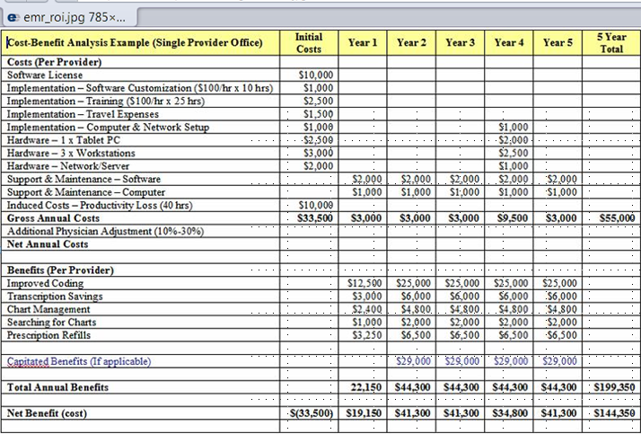
Sample Cost Benefit Analysis

Slide 35
Practice Questions Module 3

Slide 36
Practice Question 1
What system will give informative guidelines to practitioners regarding medication and procedures, including warning systems relating to high-risk medications and processes?
Clinical decision support system (CDSS)
Computerized practitioner order entry (CPOE)
Picture archiving and communications system (PACS)
Electronic health record (EHR)

Slide 37
Practice Question 1
What system will give informative guidelines to practitioners regarding medication and procedures, including warning systems relating to high-risk medications and processes?
Clinical decision support system (CDSS)
Computerized practitioner order entry (CPOE)
Picture archiving and communications system (PACS)
Electronic health record (EHR)

Slide 38
Practice Question 2
When defining problems and opportunities, major areas of change can occur in the following areas:
Analytical, supervisory, financial, administrative
Clinical, administrative, financial, application
Supervisory, administrative, financial, clinical
Application, analytical, administrative, financial

Slide 39
Practice Question 2
When defining problems and opportunities, major areas of change can occur in the following areas
Analytical, supervisory, financial, administrative
Clinical, administrative, financial, application
Supervisory, administrative, financial, clinical
Application, analytical, administrative, financial

Slide 40
Practice Question 3
When defining requirements, what is the key to implementing safe, sustainable and cost-effective IT practices?
Quality tools
Sustainment plan
Control plan
Project plan

Slide 41
Practice Question 3
When defining requirements, what is the key to implementing safe, sustainable and cost-effective IT practices?
Quality tools
Sustainment plan
Control plan
Project plan

Slide 42
Practice Question 4
Sustainable controls for IT implementation can result in
Uncontrolled security
Serving minimum purpose possible
Determining what is practical for local area implementation and testing
Satisfying integration with policy regulations

Slide 43
Practice Question 4
Sustainable controls for IT implementation can result in
Uncontrolled security
Serving minimum purpose possible
Determining what is practical for local area implementation and testing
Satisfying integration with policy regulations

Slide 44
Practice Question 5
When performing cost-benefit analysis, important variables to be considered include:
Sustainability versus total costs per month
Time and cost of implementation
Impact on internal parties
Process mapping

Slide 45
Practice Question 5
When performing cost-benefit analysis, important variables to be considered include:
Sustainability versus total costs per month
Time and cost of implementation
Impact on internal parties
Process mapping

Slide 46
Practice Question 6
The benefits of developing proposals in support of integrating healthcare practices can include
Secure information sharing
Minimal communication between various localized care providers
Stand-alone architectures for various equipment and software applications
Enhanced efficiency in the communications flow

Slide 47
Practice Question 6
The benefits of developing proposals in support of integrating healthcare practices can include
Secure information sharing
Minimal communication between various localized care providers
Stand-alone architectures for various equipment and software applications
Enhanced efficiency in the communications flow

Slide 48
Practice Question 7
When presenting your analysis to your executive leadership, key elements may include
Possible changes in the project implementation that can be driven by changes in technology standards
Requirements that may change, affecting the strategic capability of the proposal
Sensitivity to challenges or changes in the internal environment that may rely on the establishment of a support team within the organization
Expectations that the implementation of analysis and subsequent proposals will rely on the presence of standard operational processes in the internal environment

Slide 49
Practice Question 7
When presenting your analysis to your executive leadership, key elements may include
Possible changes in the project implementation that can be driven by changes in technology standards
Requirements that may change, affecting the strategic capability of the proposal
Sensitivity to challenges or changes in the internal environment that may rely on the establishment of a support team within the organization
Expectations that the implementation of analysis and subsequent proposals will rely on the presence of standard operational processes in the internal environment

Slide 50
Practice Question 8
When managing projects and resources it is important to have a work plan that:
Is aimed at establishing a generic implementation setup for a project
Includes equipment costs
Plans the intended workflow processes by managing personnel
Analyzes processes and evaluates outcomes.

Slide 51
Practice Question 8
When managing projects and resources it is important to have a work plan that:
Is aimed at establishing a generic implementation setup for a project
Includes equipment costs
Plans the intended workflow processes by managing personnel
Analyzes processes and evaluates outcomes.

Slide 52
Practice Question 9
Promotion and application of system analysis can include:
Evaluating past operational situations in an average healthcare facility
Identifying the minor problems in processes with respect to optimization of IT use
Identification of primary solutions to problems through the implementation of IT policies
Evaluation of alternative solutions’ with the specific objectives set out in the plan.

Slide 53
Practice Question 9
Promotion and application of system analysis can include:
Evaluating past operational situations in an average healthcare facility
Identifying the minor problems in processes with respect to optimization of IT use
Identification of primary solutions to problems through the implementation of IT policies
Evaluation of alternative solutions’ with the specific objectives set out in the plan.

Slide 54
Practice Question 10
What are possible characteristics that you may encounter when analyzing future healthcare IT trends?
Integration of possible entities within an organization in preparation for standardization
Alignment with emerging trends on the local IT platform
Loss of a low volume of business due to nonalignment of health-sector players
Importance of implementing an operational work plan to align the healthcare sector with current IT trends

Slide 55
Practice Question 10
What are possible characteristics that you may encounter when analyzing future healthcare IT trends?
Integration of possible entities within an organization in preparation for standardization
Alignment with emerging trends on the local IT platform
Loss of a low volume of business due to nonalignment of health-sector players
Importance of implementing an operational work plan to align the healthcare sector with current IT trends

Slide 56
Questions?

