Slide 1
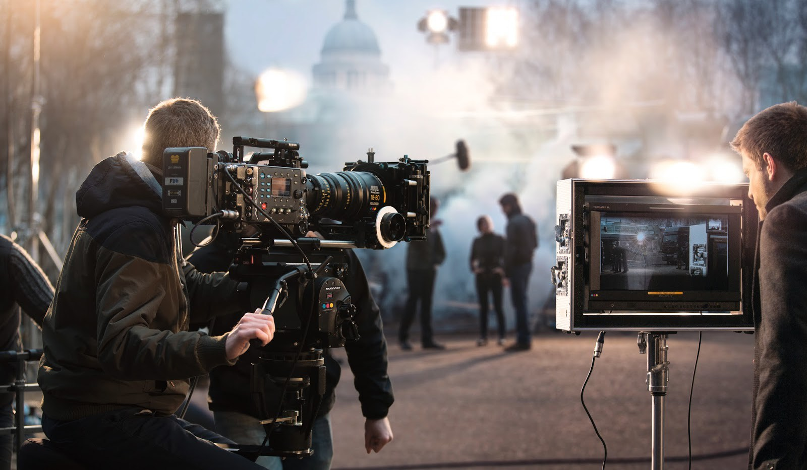
3 Production Stages
Pre-production
Acquisition
Postproduction

Slide 2
Pre-production Objectives
conceptualize
pitch/fund
script
crew
schedule

Slide 3
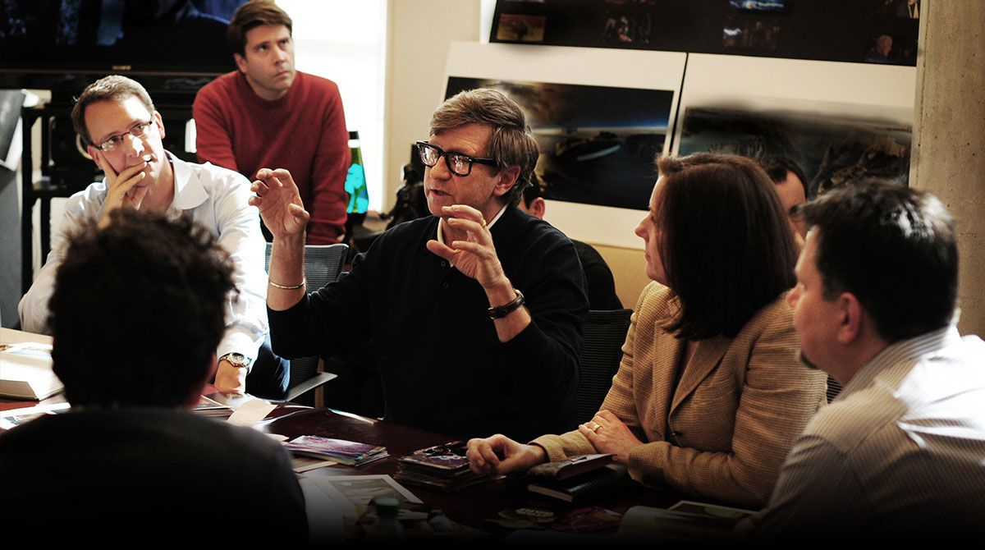
Pre-production Objectives
Pre-production meeting
conceptualization
audience
venue of exhibition

Slide 5
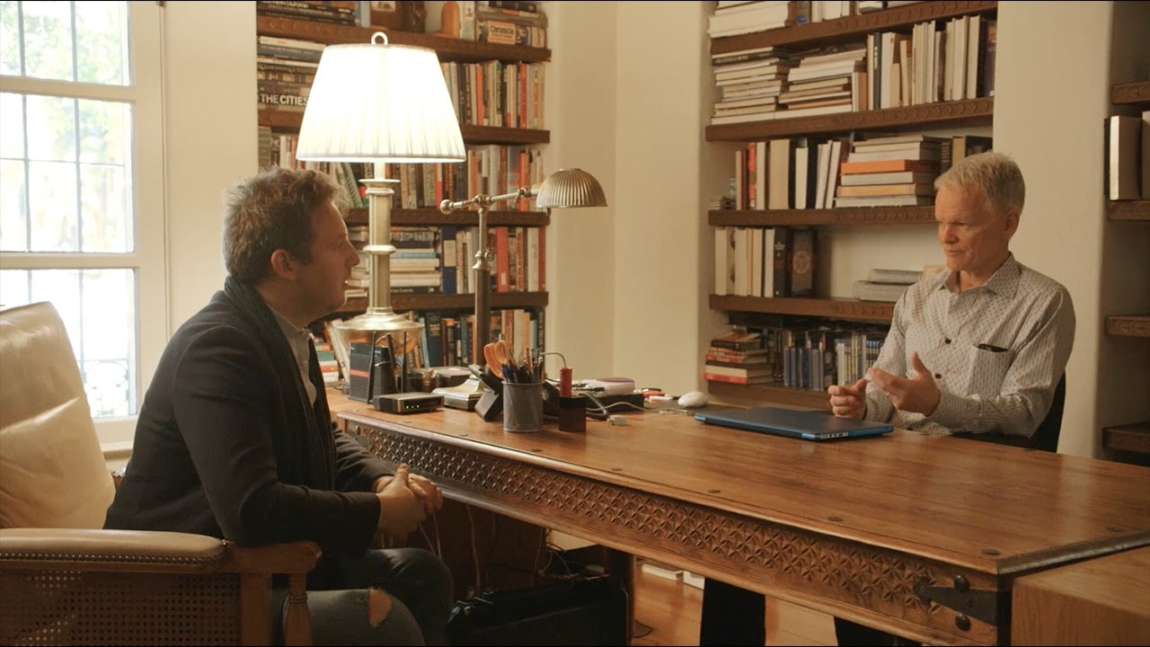
Pre-production Objectives
Pre-production meeting
conceptualization
audience
venue of exhibition
length (TRT)
pitch
treatment

Slide 6
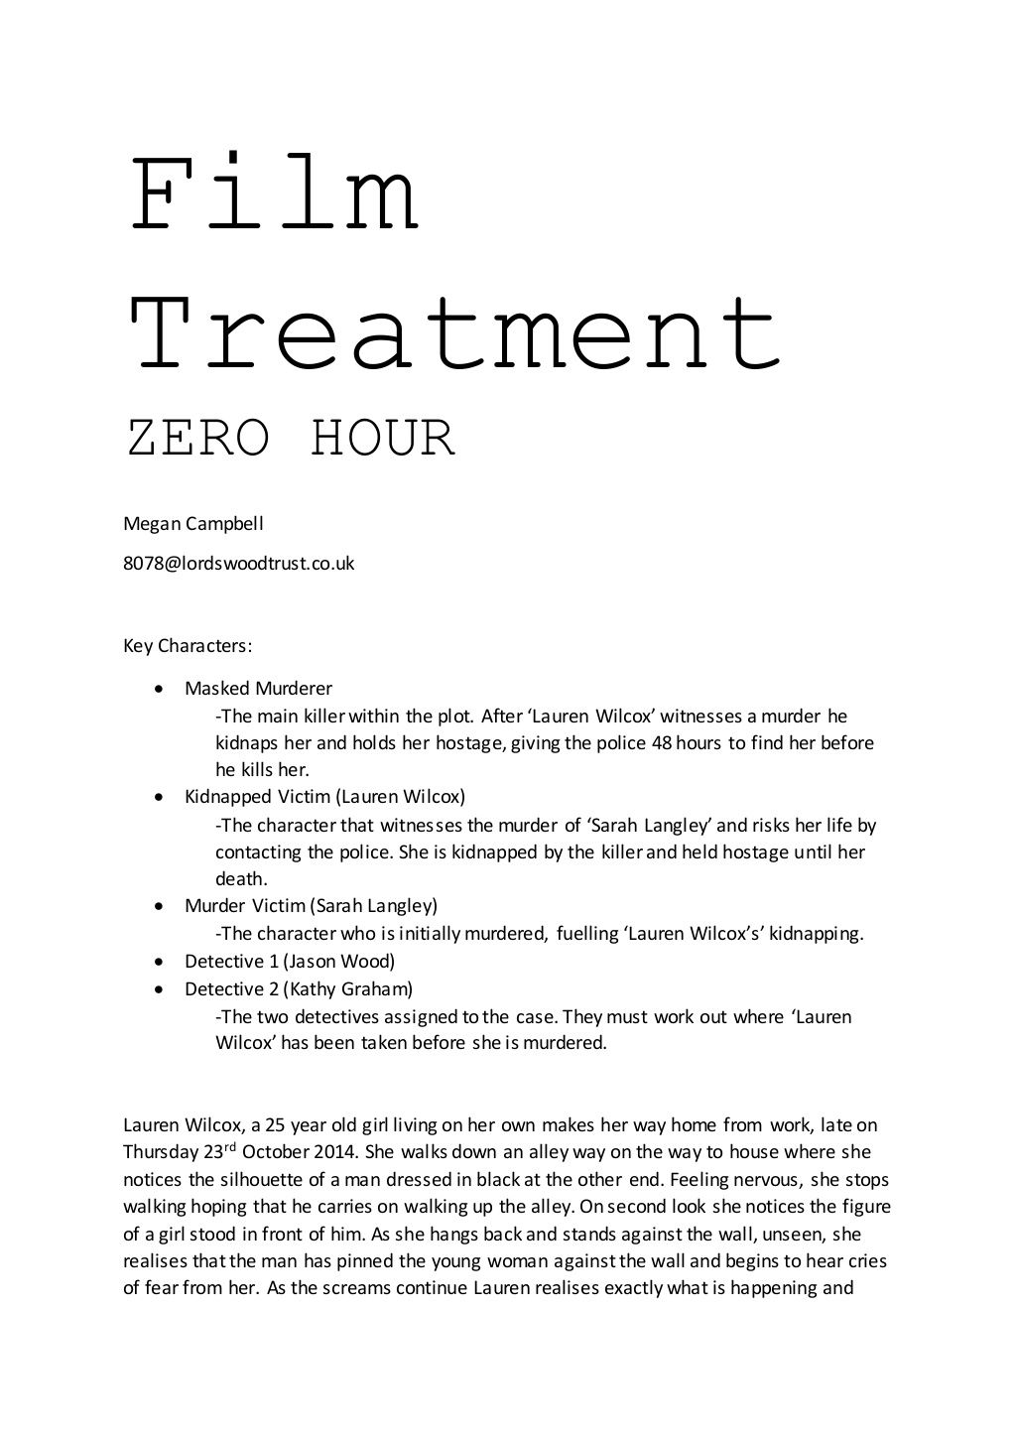

Slide 7
Pre-production Objectives
conceptualization
pitch
budget
production team/crew
gear
permits
locations/facilities

Slide 8
Sample Location Fees
Altamonte Springs - $50 per permit processed
Belle Isle - $1,000 per permit processed
Casselberry - $50 per permit processed
Celebration - $500 per day to film
Maitland - $75 per day to film
Seminole County - $75 per permit processed
St. Cloud - $25 per permit processed
Windermere - $100 per permit processed
Winter Park - $100 per permit processed/
$500 per day to film
Winter Springs - $25 per permit processed

Slide 9
Pre-production Objectives
conceptualization
pitch
budget
production team/crew
gear
permits
locations/facilities
props?

Slide 10
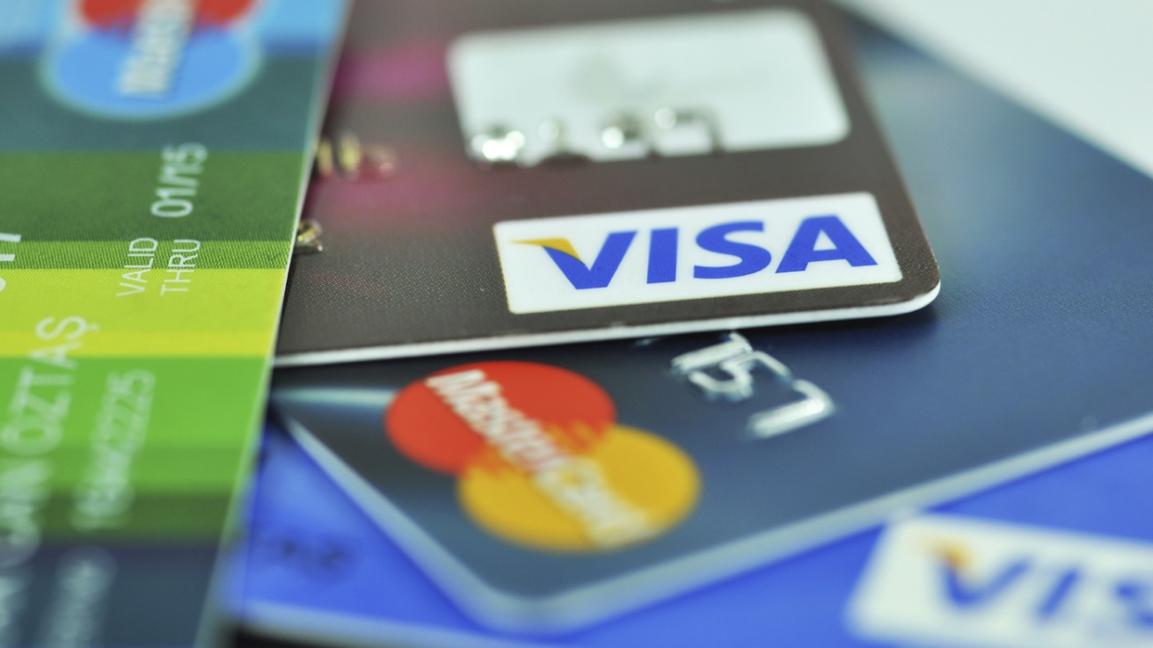
Pre-production Objectives
concept
pitch
budget
funding
client
investors
independent money
grants
grants.gov
florida.grantwatch.com
Google search

Slide 11
Pre-production Objectives
conceptualization
pitch
budget
funding
script

Slide 12
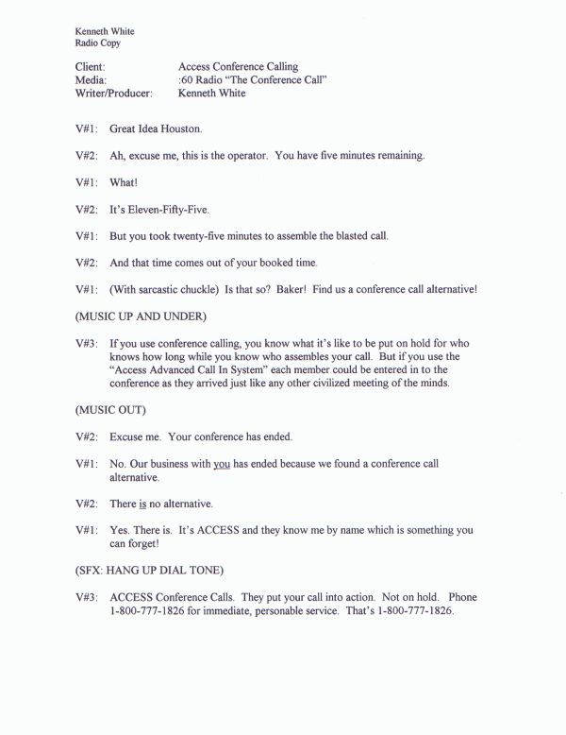
Script Types
Audio
Script

Slide 13
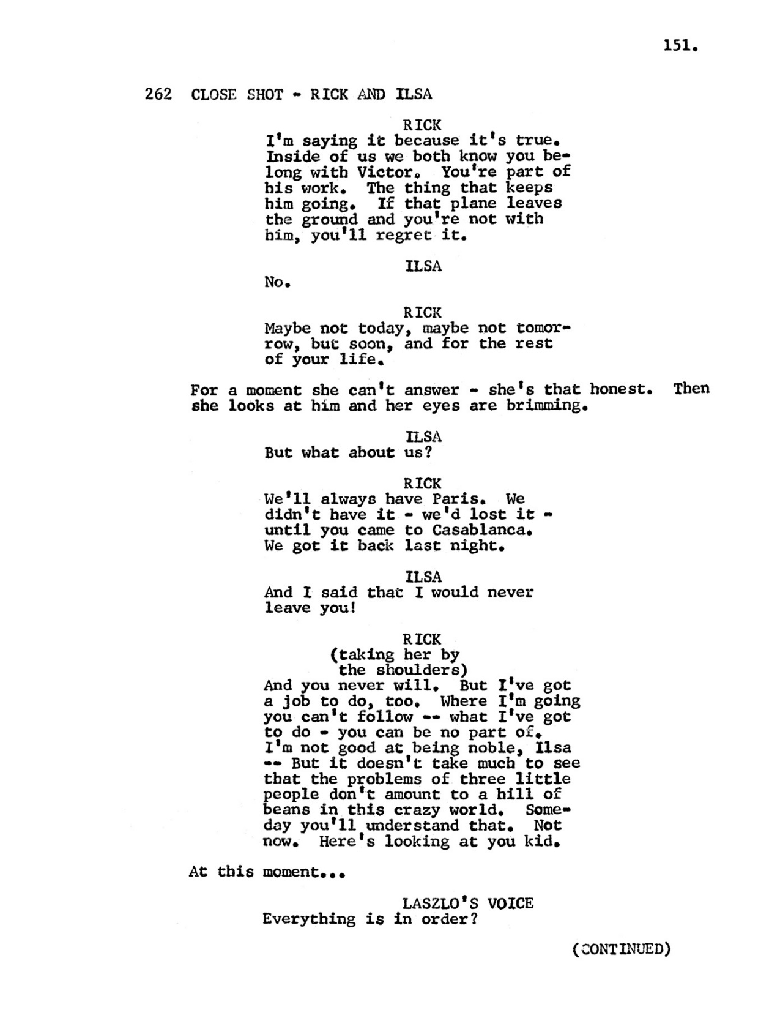
Script Types
Narrative
(film)
Script
(screenplay)

Slide 14
Script Types
CLIENT: Playland Hamburger Restaurants
PRODUCTION TYPE: Commercial Spot
PROD./DIR.: Bill Smith
TRT: 60ss
VIDEO
FADE FROM BLACK
CAM 1 - MCU-M budget OTHER
TAKE - CAM 2
CU-MOTHER
TAKE - CAM 3
MCU-NARRATOR
TAKE CAM 1 (W/KEY)
2-SHOT: NARR/MOTHER
TAKE - CAM 2
MCU MOTHER
MIX-FS/CG
FADE TO BLACK
AUDIO
(fade to BG SFX -fussing children)
MOTHER: (disheveled; sitting in chair)
“When you have three screaming children at your feet, you only want some escape.”
“I don't care about proper nutrition at times like these; just get me to Playland where I can turn the kids loose in the playpen.”
(crossfade SFX to music under)
NARRATOR: (kindly, patronizingly)
“Playland is dedicated to the parent. We know that your day can be a little hectic.”
“So bring the kids on down here for dinner. We'll babysit for a while so you can relax with a nice big Playland shake.”
MOTHER: (Relieved)
“Thanks, Playland!”
NARRATOR & MOTHER (together):
“Playland. It's your kind of place.”
(music out)
2-Column
Script

Slide 15
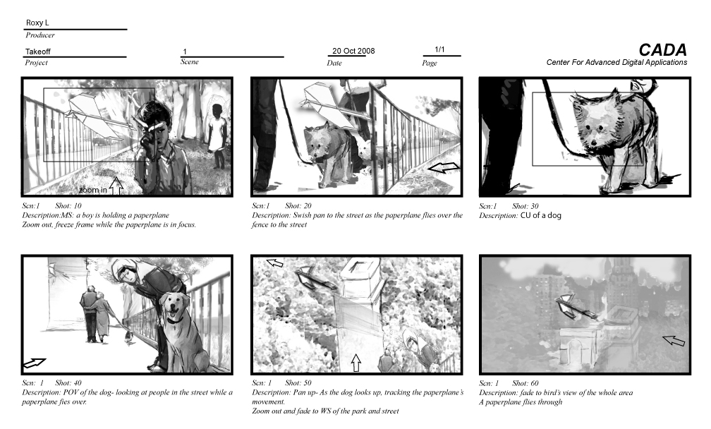
Script Types
Storyboard

Slide 16
Script Types
Animated Storyboard
(animatic)

Slide 17
Script Types
Project Title: Sprint Commercial Spot
Producer: Bob Smith
Client: Sprint
Projected Run Time: 30ss
Page #: 1
VIDEO
Fade up: Limo pulls up to red carpet
Limo doors open; crowd starts cheering
Tight Shot: shoes stepping from limo to red carpet.
AUDIO
NAT SOUND (red carpet buzz): up and under
REPORTER (off-camera): “This is the most exciting event we’ve ever covered at WZZZ.”
REPORTER (off-camera): “It’s the arrival of All-Star power forward, Daryll Smithfield...”
SFX (building applause): under
REPORTER (off-camera): “...for tonight’s playoff game with the Boise Moons.”
SFX (applause): up full
REPORTER (off-camera): “If only all you fans could be here to witness this momentous event. And...wait a minute. I think...yes, here he comes now. I can see his shoes just stepping onto the carpet.”
Storyboard
Script

Slide 18
Pre-production Objectives
conceptualization
pitch
funding
budget
script
location scouting
camera
lights
sound

Slide 19
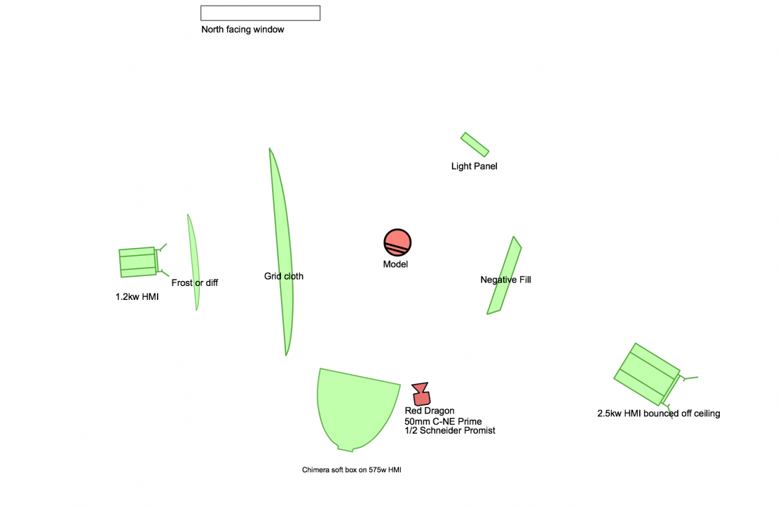

Slide 20
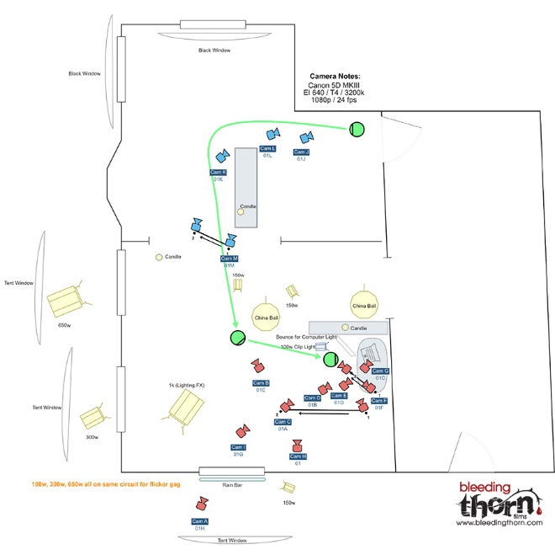

Slide 21
Pre-production Objectives
conceptualization
pitch
budget
funding
script
location scouting
crew hires
scheduling
contracts/releases

Slide 22
Contracts/Releases
Contracts
Talent
Extras (paid)
Releases
Extras (unpaid)
2. Minors
Copyrighted Material
Locations
Notes:
22

Slide 23
ACQUISITION

Slide 24
Post-Production
Editing
Film vs. Video

Slide 25
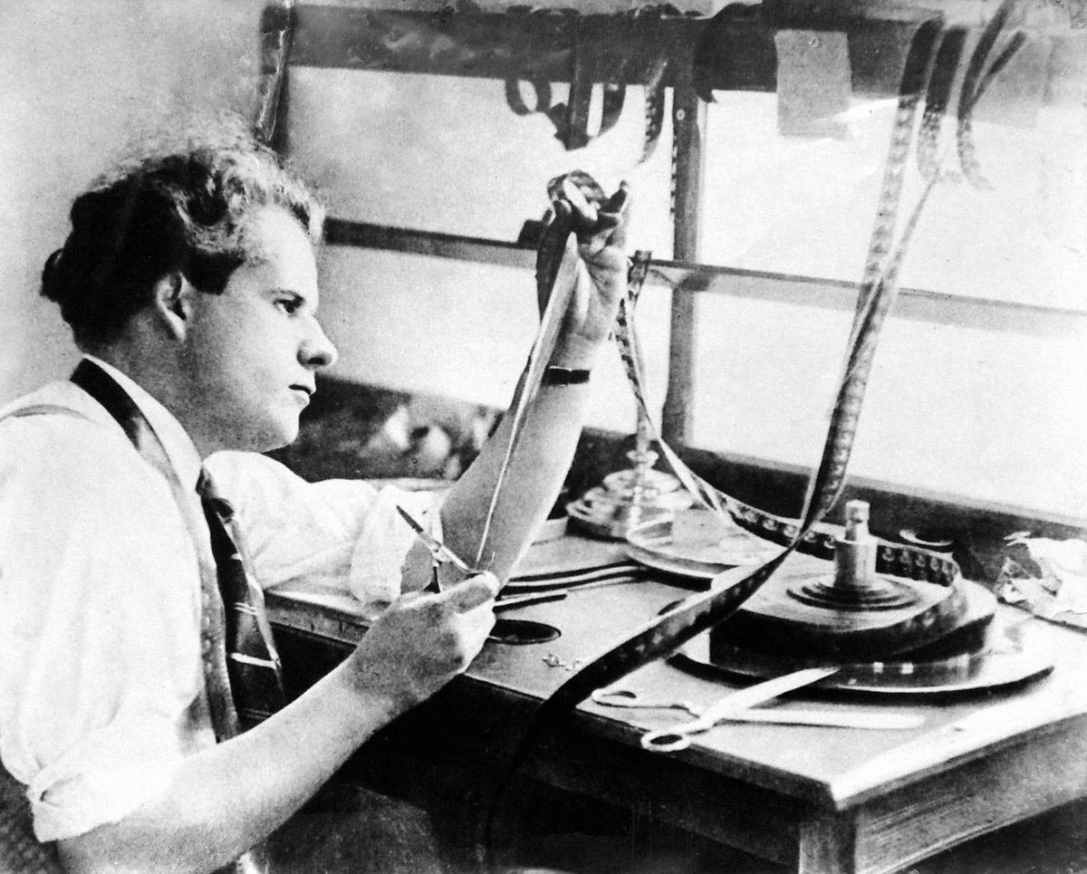
Post-Production
Film
(cut and paste)

Slide 26
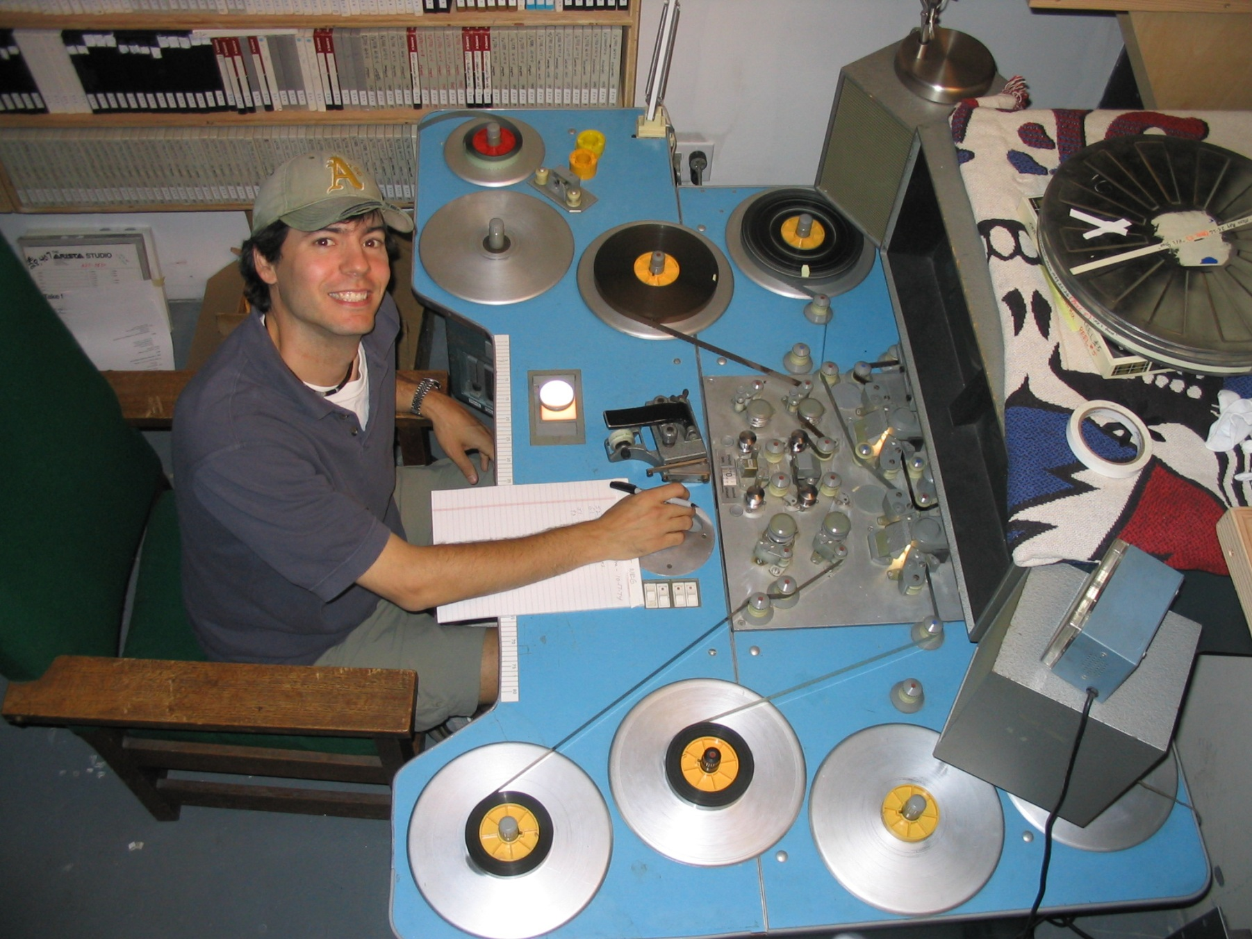
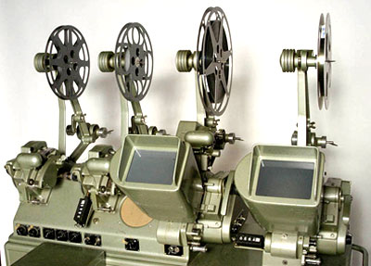
Film Method
Flatbed Editor
Movieola

Slide 27
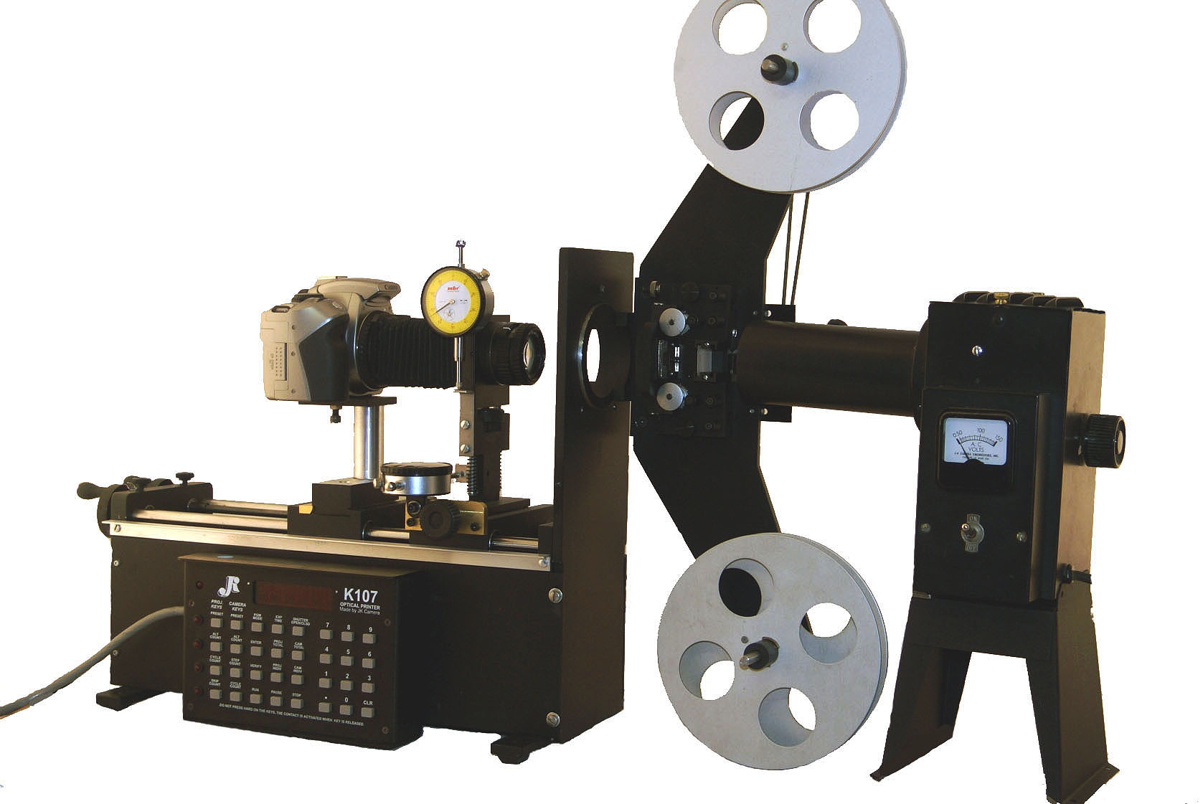
Film Method
Digital Intermediate
(DI)
-Film Chain-

Slide 28
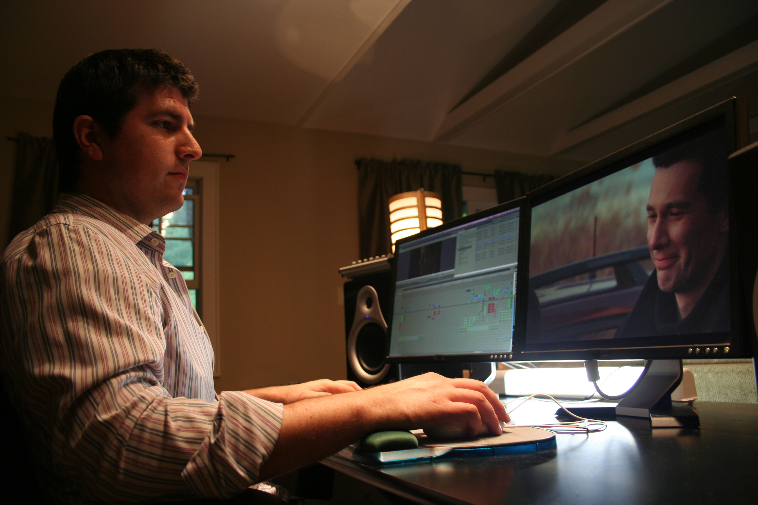

Slide 29
Post-Production
Video
(electronic editing)

Slide 30
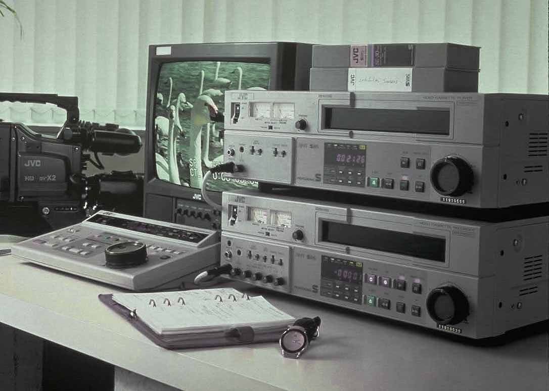
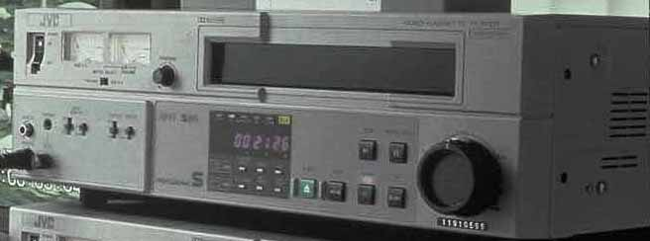
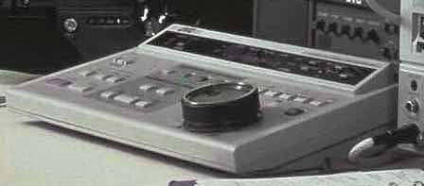
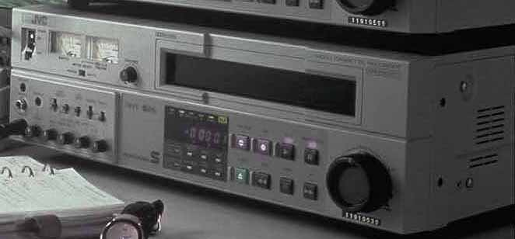
Electronic Editing
Linear (tape-to-tape)
Edit Controller

Slide 31
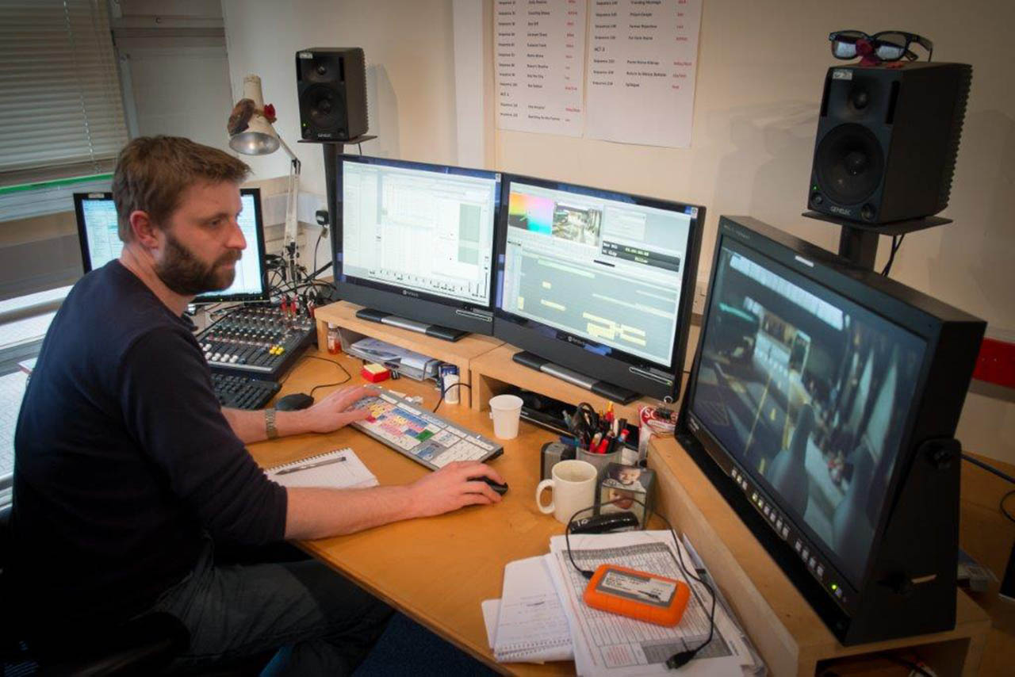
Post-Production Editing
Non-Linear
(computers)

Slide 32
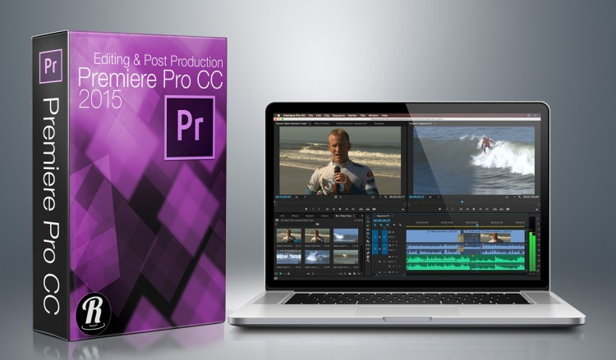
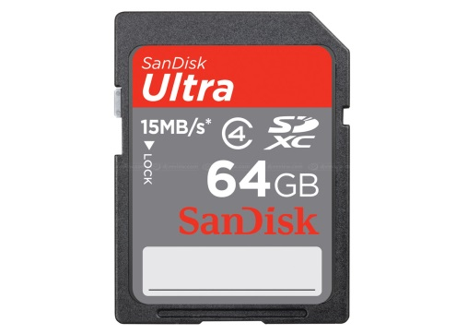
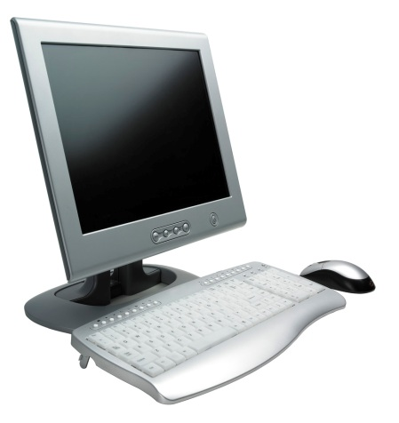
NLE
Acquisition Content
Computer
“digitize”
or
“capture”

Slide 33
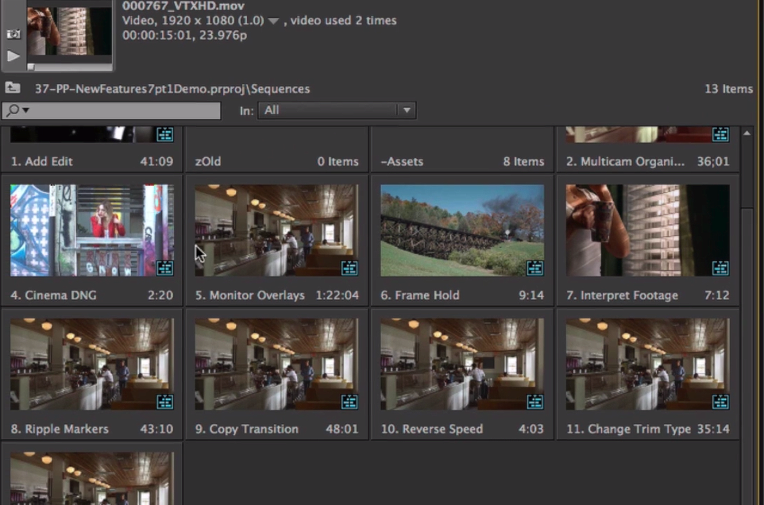

Slide 34
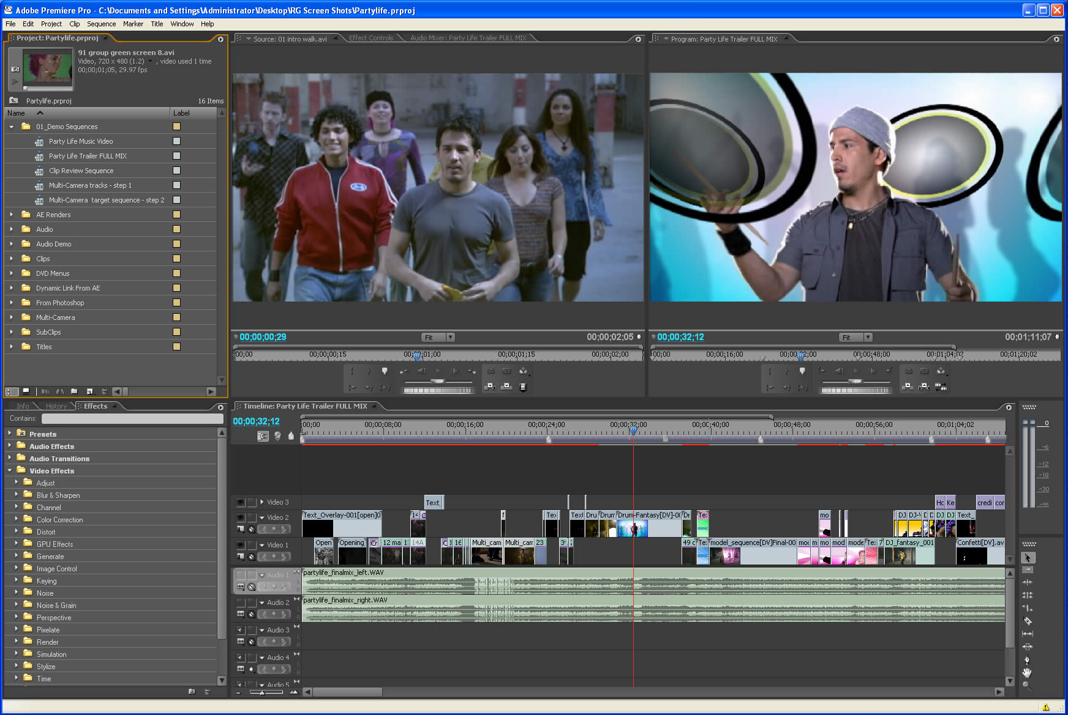
timeline or sequence

Slide 35
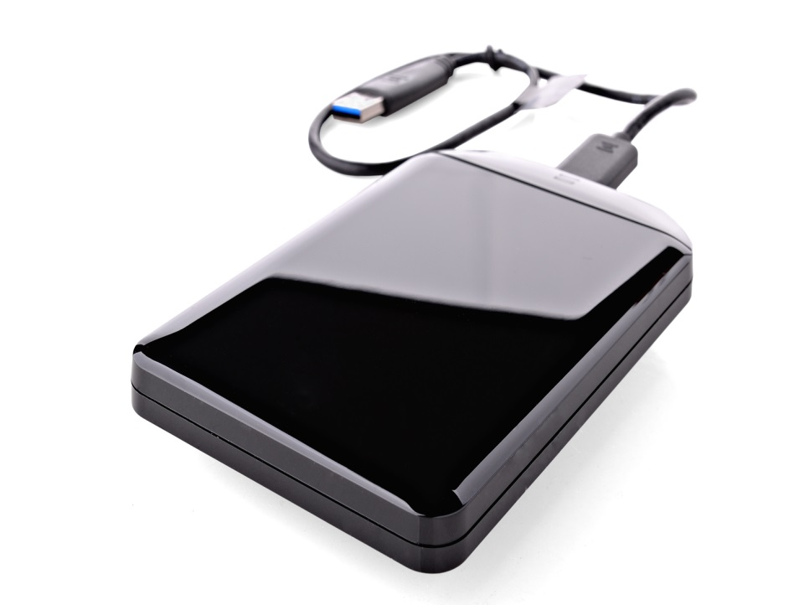
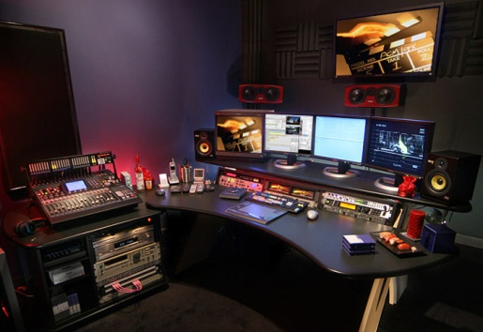
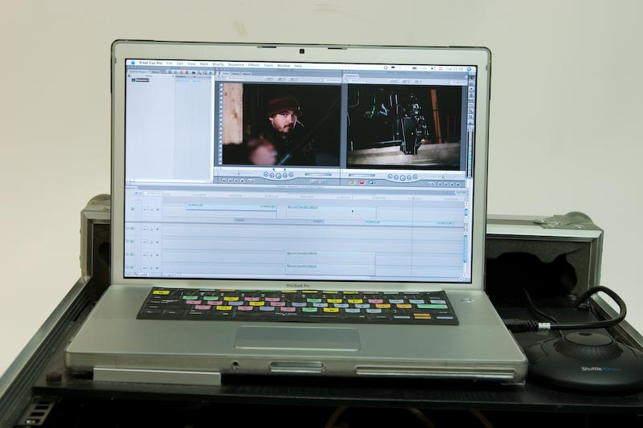
NLE Suite

Slide 36
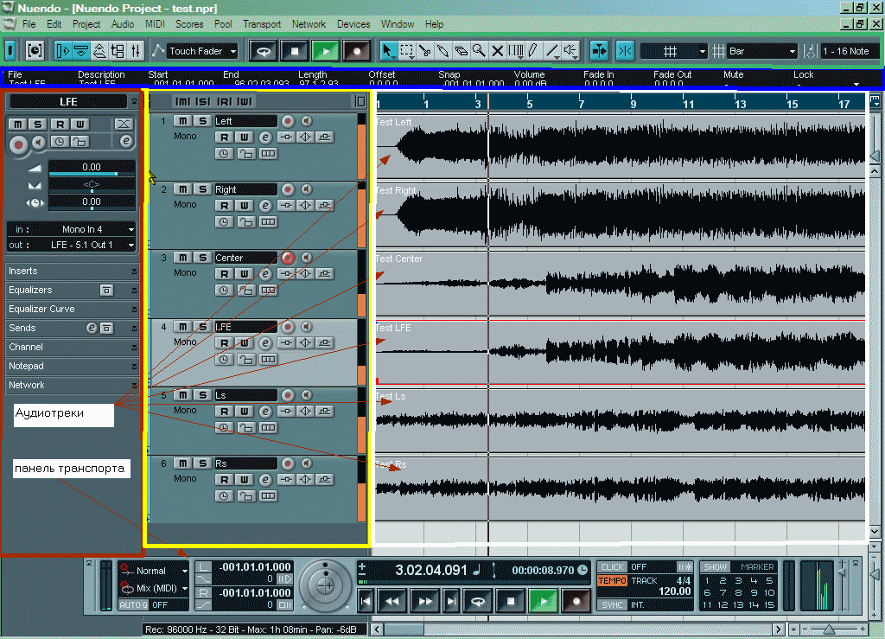
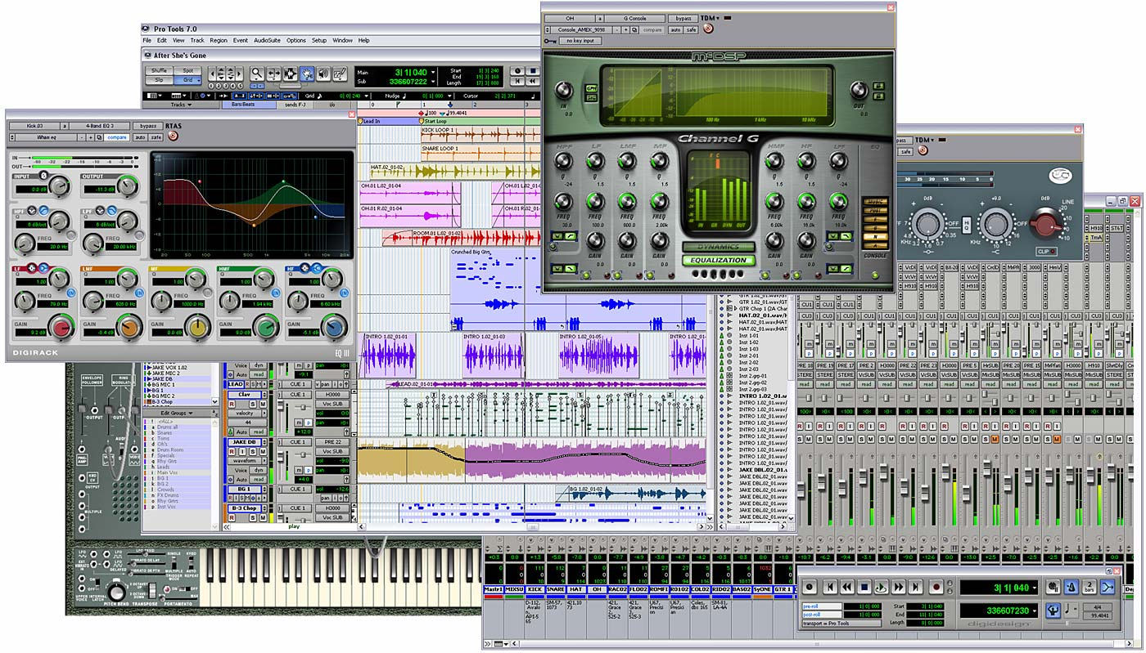
Audio
Non-linear Editing

Slide 37
Post-Production
GFX/Titles
SFX
Buzz Tracks

Slide 38
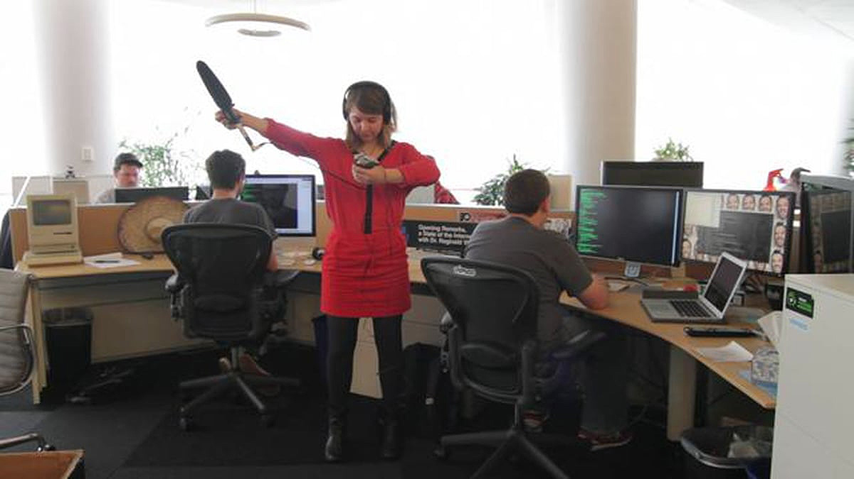
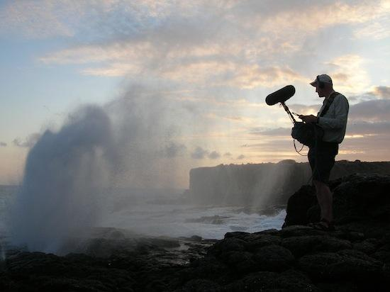
Post-Production

Slide 39
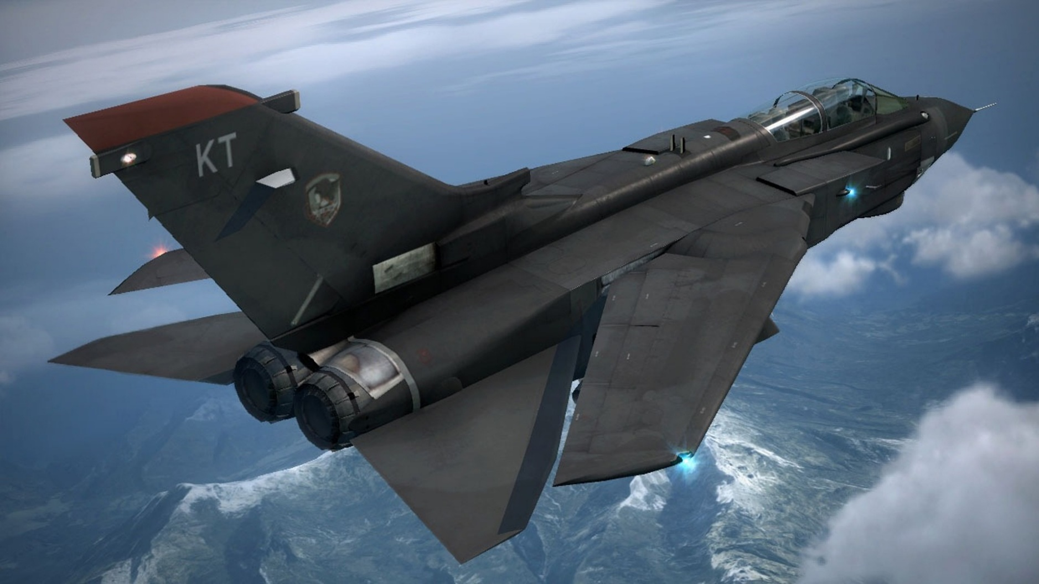
Post-Production
CGI

Slide 40
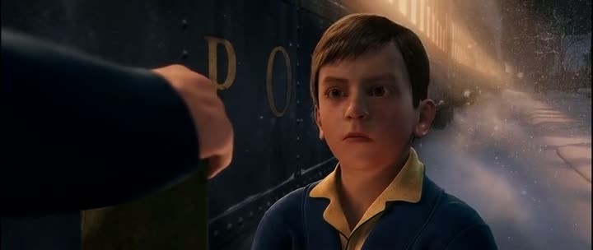

Slide 41
Post-Production
Organization
Content Log

Slide 42
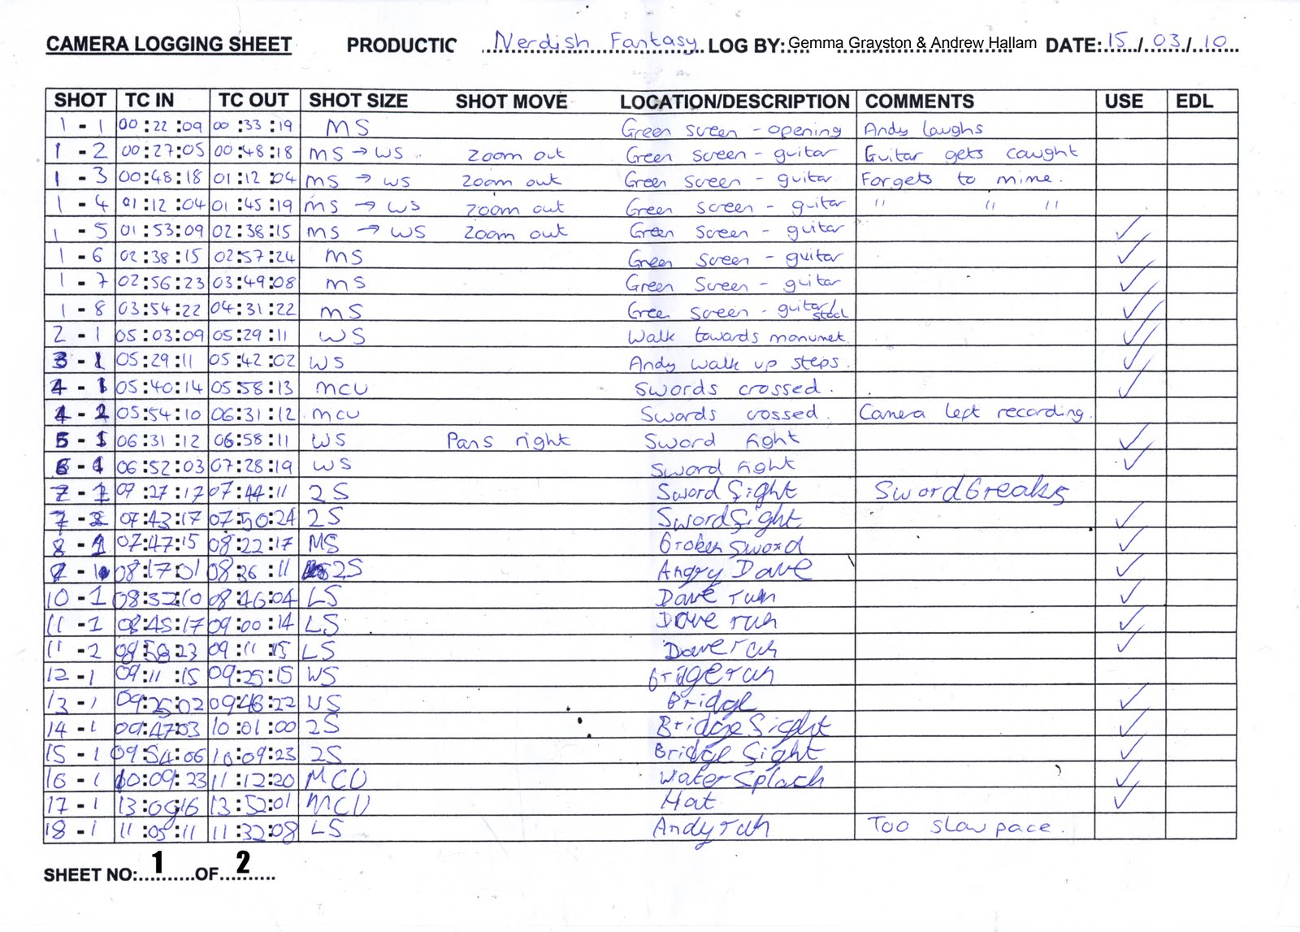

Slide 43
Post-Production
Organization
Content Log
Edit Decision List

Slide 44
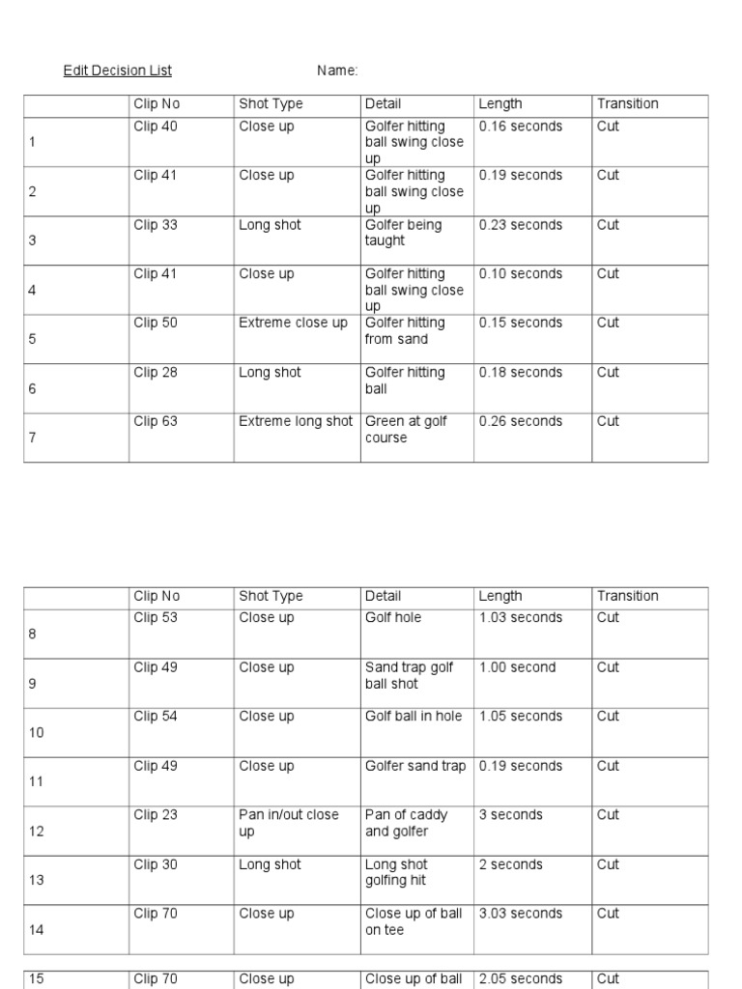

Slide 45
Off-line
&
Online
Edits

Slide 47
News
story conference
story research
ENG (field acquisition)
scripting
composition
script review
video editing
show playout

Slide 48
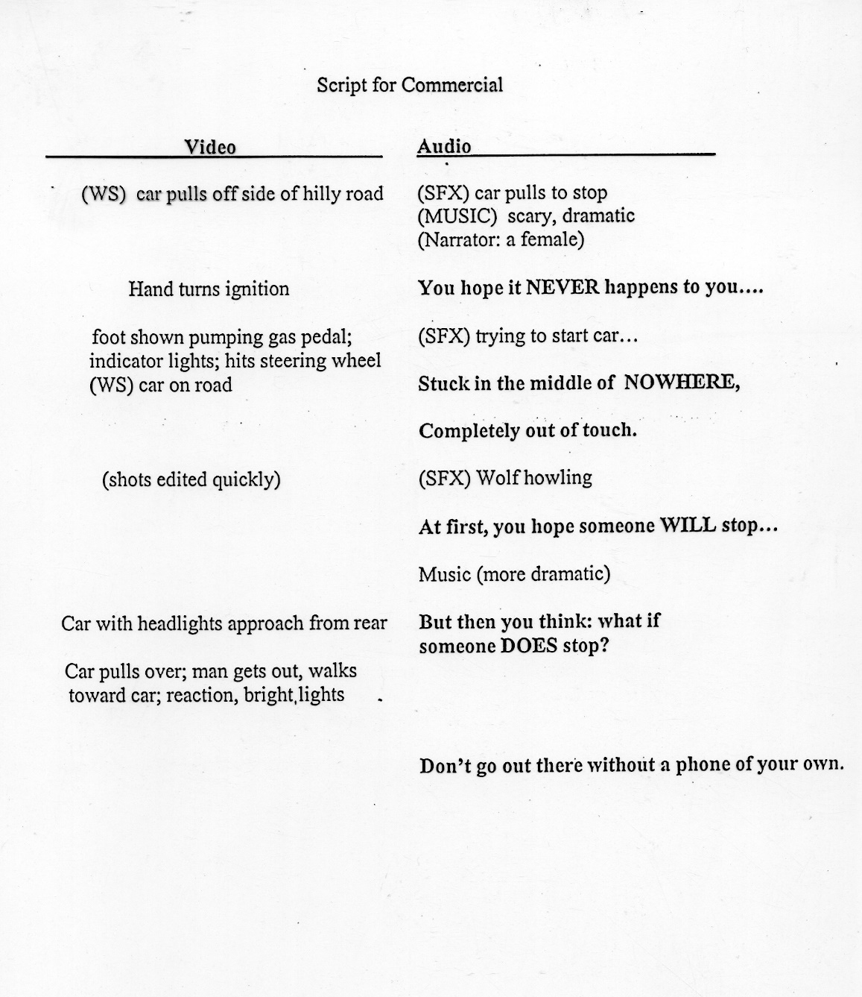
Script Types
2-Column
Script

Slide 49
Linear Editing
cuts-only
cuts
A/B Roll (matched frame)
cuts
dissolves
wipes
DVE
Notes:
49

Slide 50
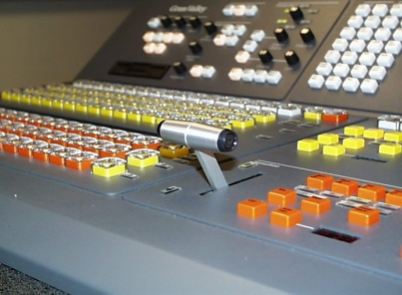
A/B Roll Editing
Playback A
Playback B
Switcher
Record Deck

Slide 51
A/B Roll Editing
Playback A
Playback B
Record Deck

Slide 52
