Slide 1
Welcome to Production fundamentals & aesthetics
TV PRODUCTION PROCESSES, PRE-PRODUCTION, PRODUCING & DIRECTING

Slide 2
THREE STAGES OF PRODUCTION
PRE-PRODUCTION – Most important stage because if this is not done correctly nothing goes right in the other stages
PRODUCTION – The actual acquisition of media, videography, photography, image creation, graphics, content
POST PRODUCTION – Different depending on whether you are in the studio or in the field.

Slide 3
What is pre-production?
STAGE ONE – Idea creation, concepts, scripting, process message, medium requirements
STAGE TWO – locations, crew, equipment, scheduling, contracts (talent and client), booking, budgeting

Slide 4
Production people

Slide 5
Above the line personnel
Considered “non-technical”:
They are: Producers, Directors, Actors, Writers, Musicians, Art Directors
These individual’s rates are negotiated (in smaller productions they may work for scale or close to that in non union areas, but usually they work for their asked rate which would be negotiated above scale)

Slide 6
Below the line personnel
Considered “technical”
They are: Camera Operators, Audio Engineers, Lighting, Graphics, Technical directors, Editors, Production Assistants.
These individuals rates are usually fixed (based on scale or the going rate in that market). Generally, scale for production people is around $500.00 a day based on a 10 hr day. In a non-union production the rate could be the same or a bit lower.

Slide 7
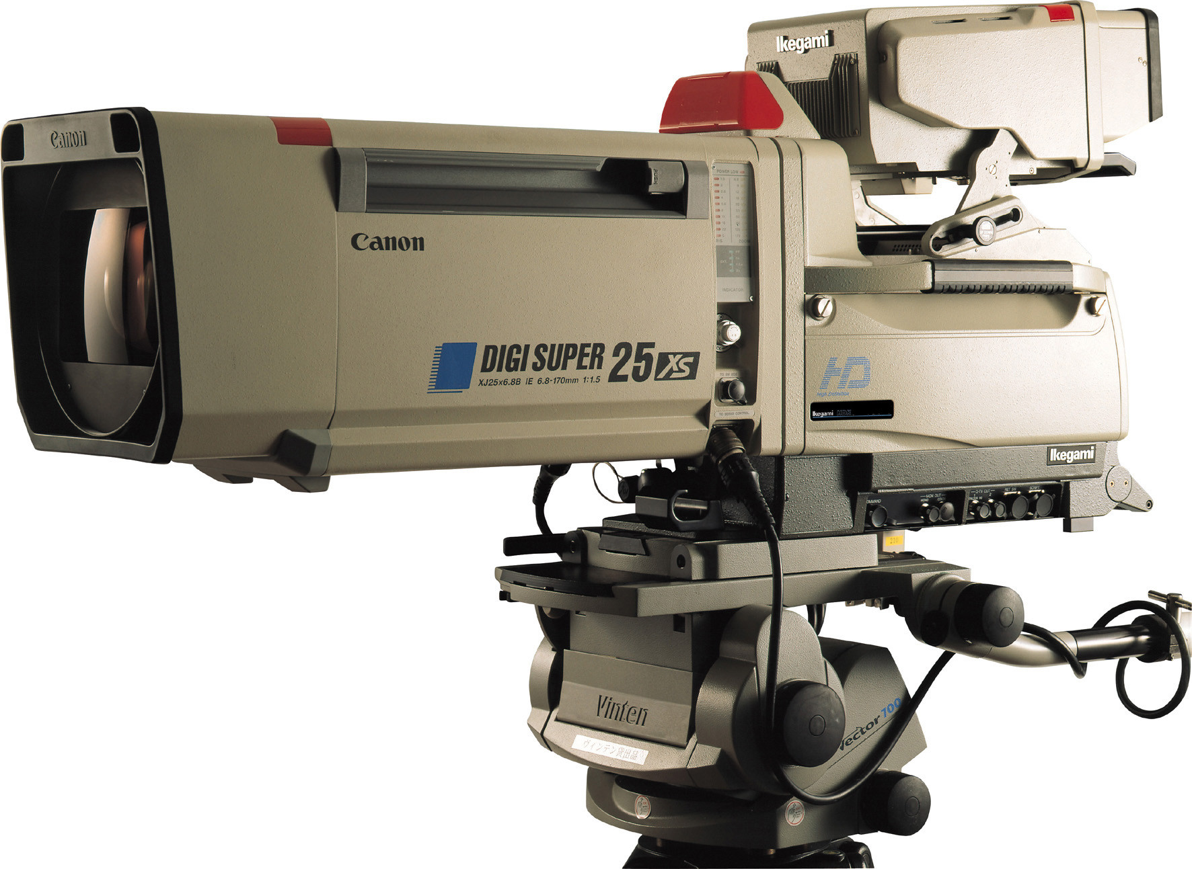
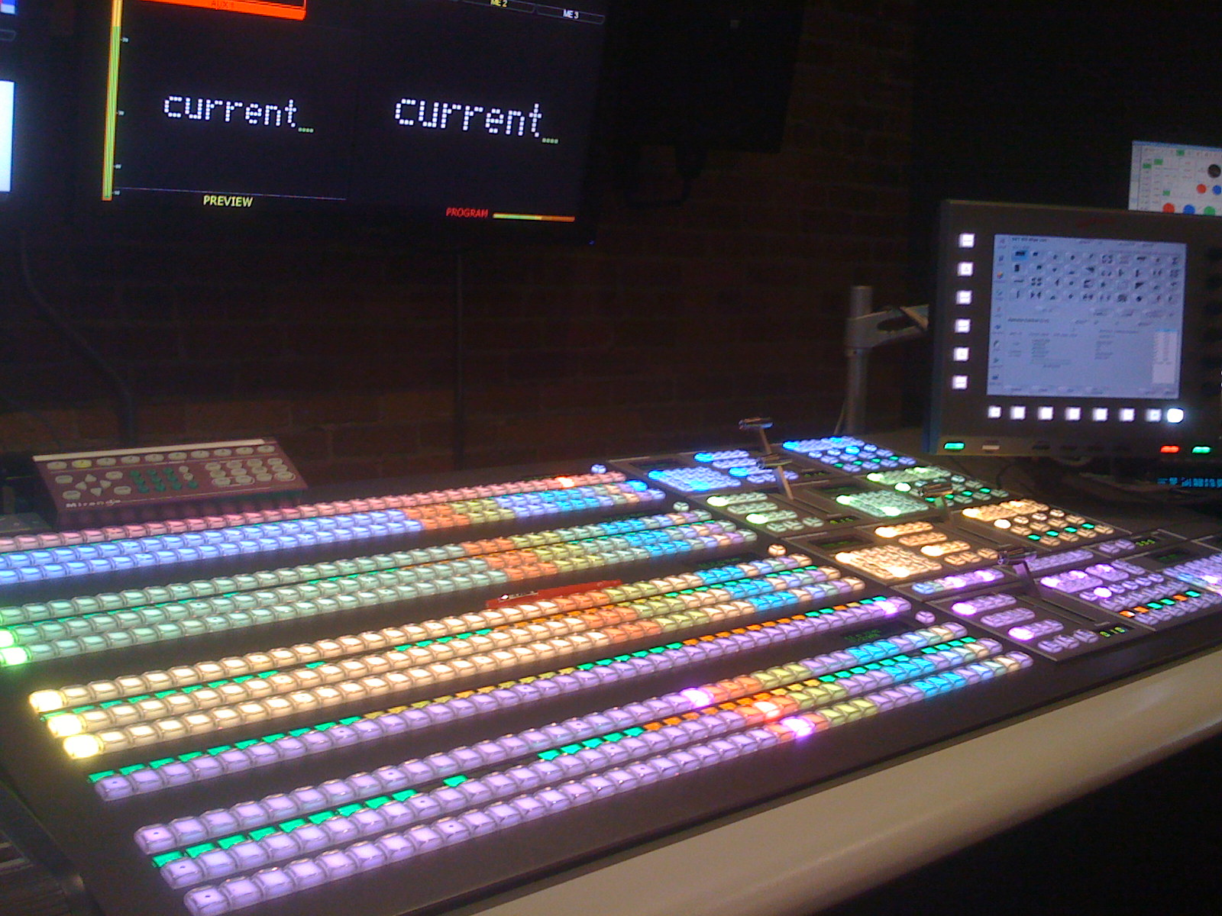
Studio PRODUCTION SYSTEM
Studio – Multi-camera system – multiple cameras, editing done instantaneously with the switcher (ready camera 1, take 1, etc.)

Slide 8
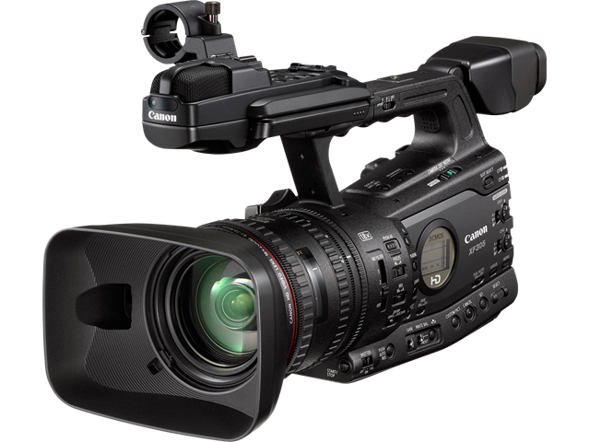
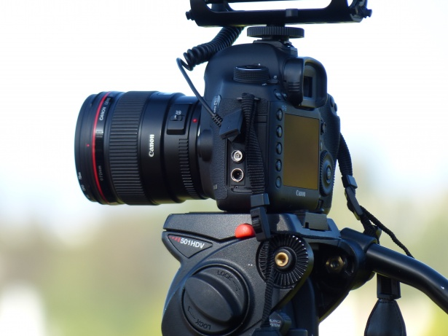
Field production systems
ENG – Electronic News Gathering – News happens, we cover it with one camera, no staging, minimal editing
EFP – Electronic Field Production – Sometimes referred to as “film style” production because it is usually one camera with multiple set ups, multiple takes, staging, and editing.

Slide 9
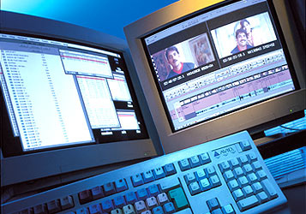
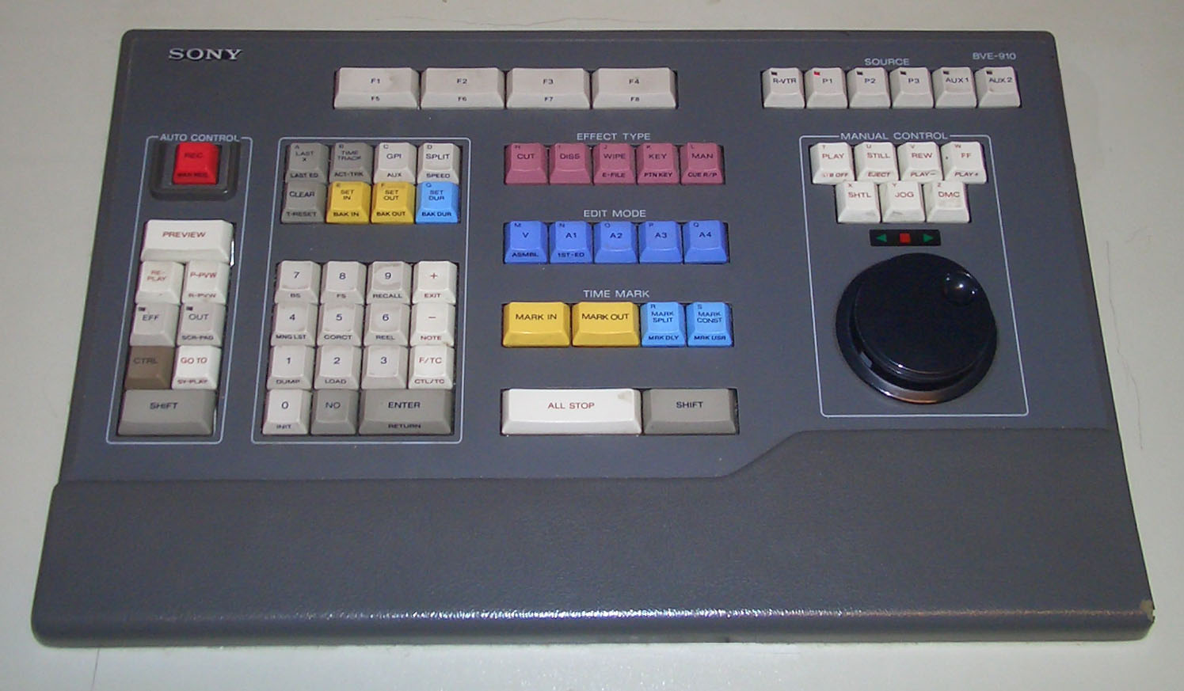
Post production
If a studio production, post could be coiling the cables, putting cams, set pieces, and props away, turning off lights, etc.
If a field production, post is putting gear away, but it also includes editing project into coherent story based on script.

Slide 10
PRODUCING
The person in charge of the overall organization of the project.
May be idea creator and then hire writer or act as writer too (and produce a treatment and script).
Wears many hats, delegates to associates, but still responsible for the outcome.
Hires above the line people and Director.
In charge of budget (or may delegate to Production Manager once budget is established).
Permits, promotion, & publicity
In charge of idea evaluation (once show has aired, did it hit your demographic or not or did you find out something else from your viewers that you can use to refine your next show or project)?

Slide 11
DIRECTING
The person responsible for the creative “look and feel” of a show or program.
Responsible for taking script to screen through visualization (of script) and sequencing of shots.
Usually hires their technical crew (below the line personnel).
Figures out locations (with help of location scout for large productions) if not in studio.
Directs cameras and their shots (after marking script).
Directs actors as they navigate emotions for scenes.
Responsible for adhering to production schedule as not to go over budget.
Usually present in editing.

