Slide 1
It’s All
About Light

Slide 2
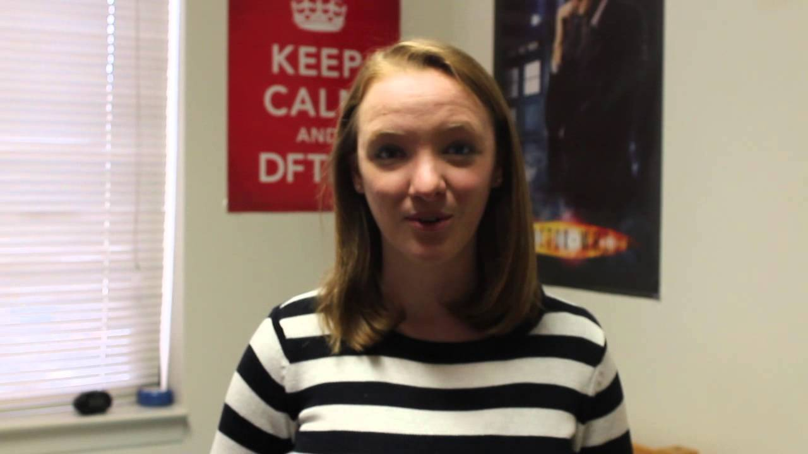

Slide 4
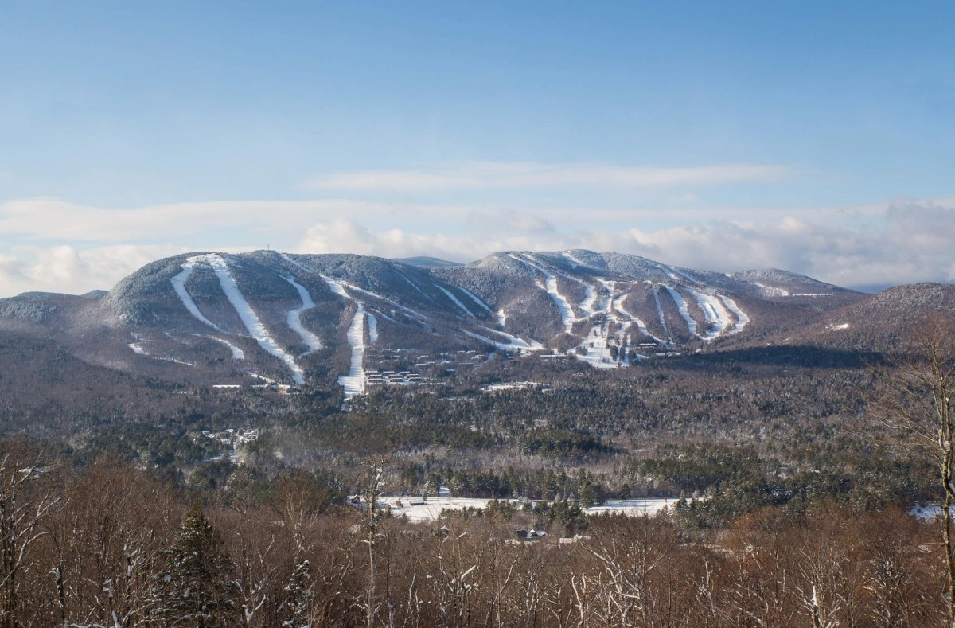

Slide 5
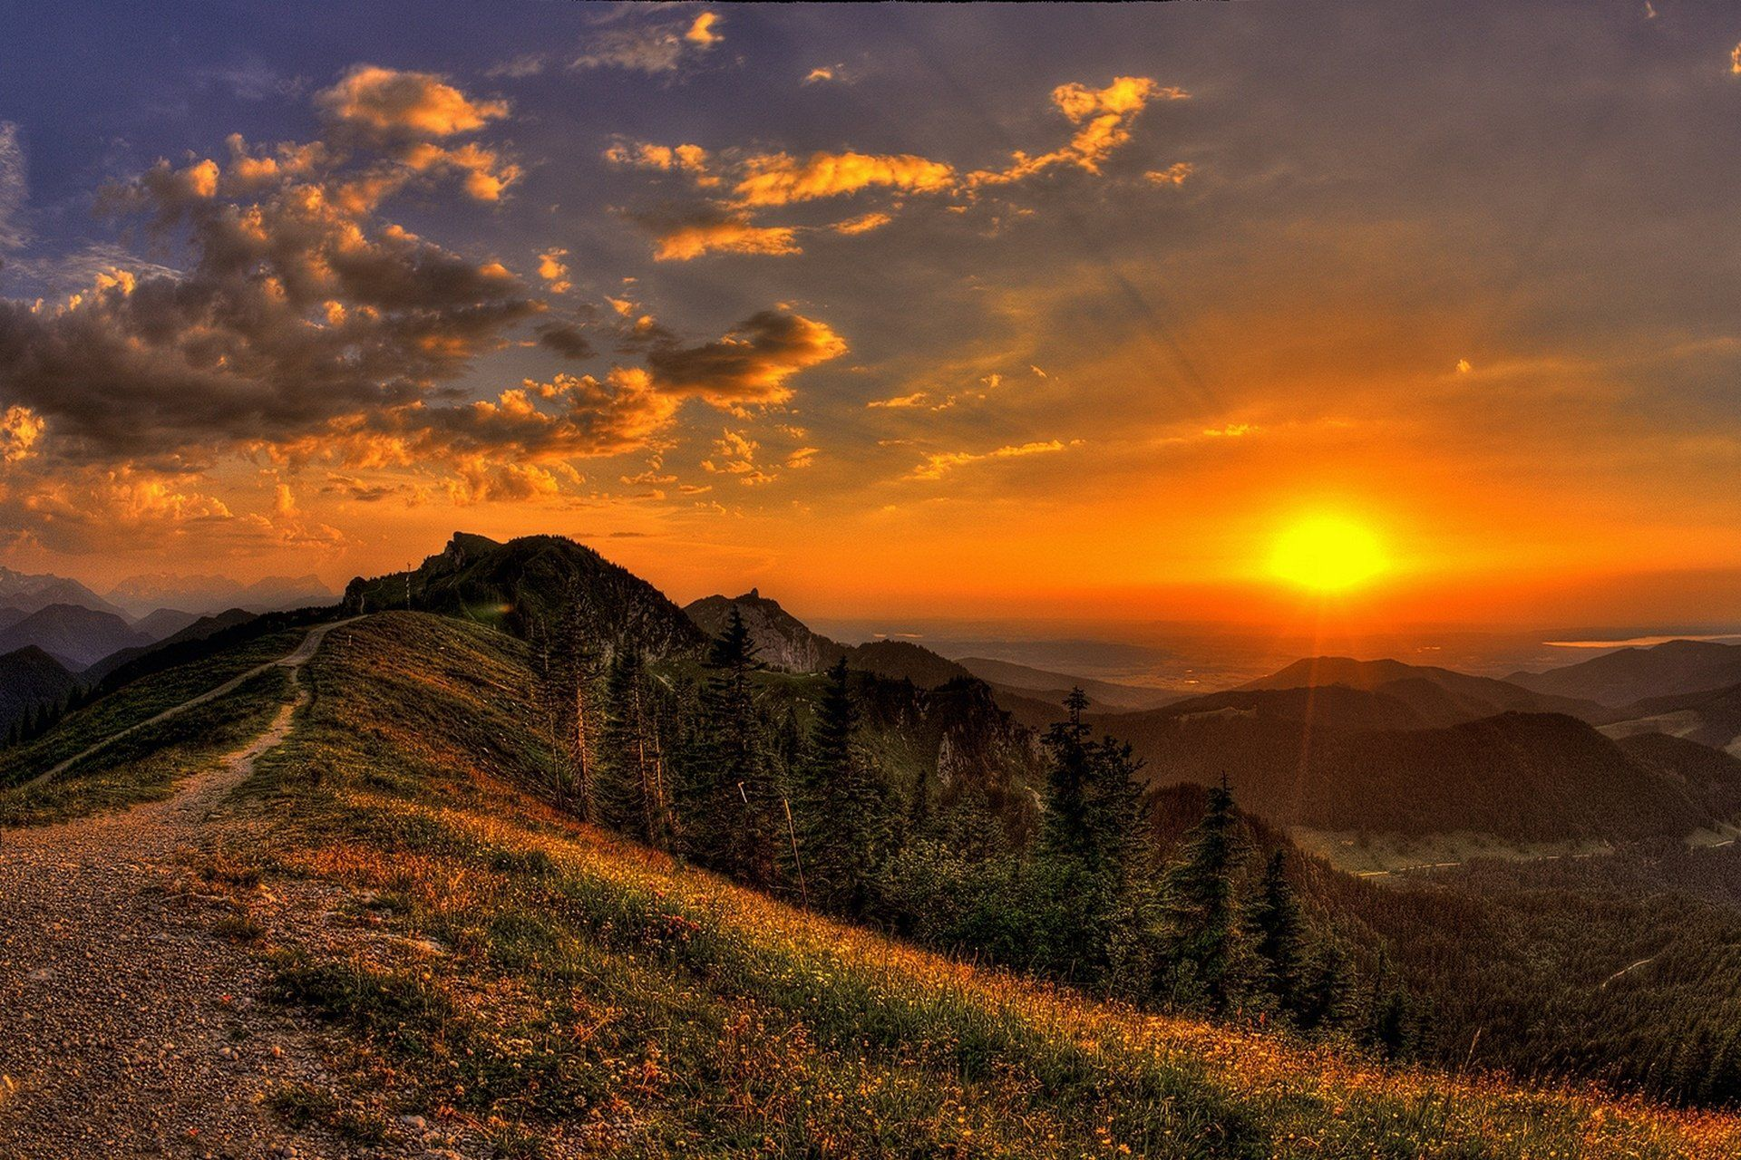

Slide 6
Obstacles
Technical Property/Mechanical Process
Fast Image Sensors

Slide 7
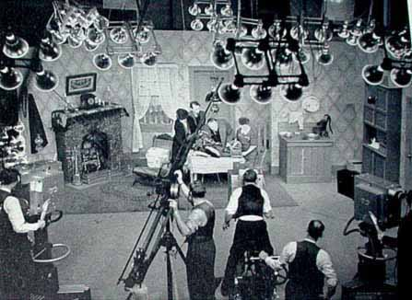
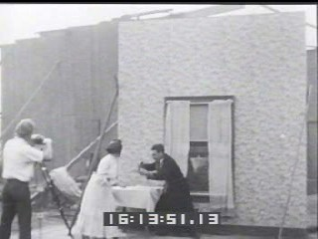

Slide 8
Lighting Obstacles
Technical Property/Mechanical Process
Fast Image Sensors
Time and Patience

Slide 9
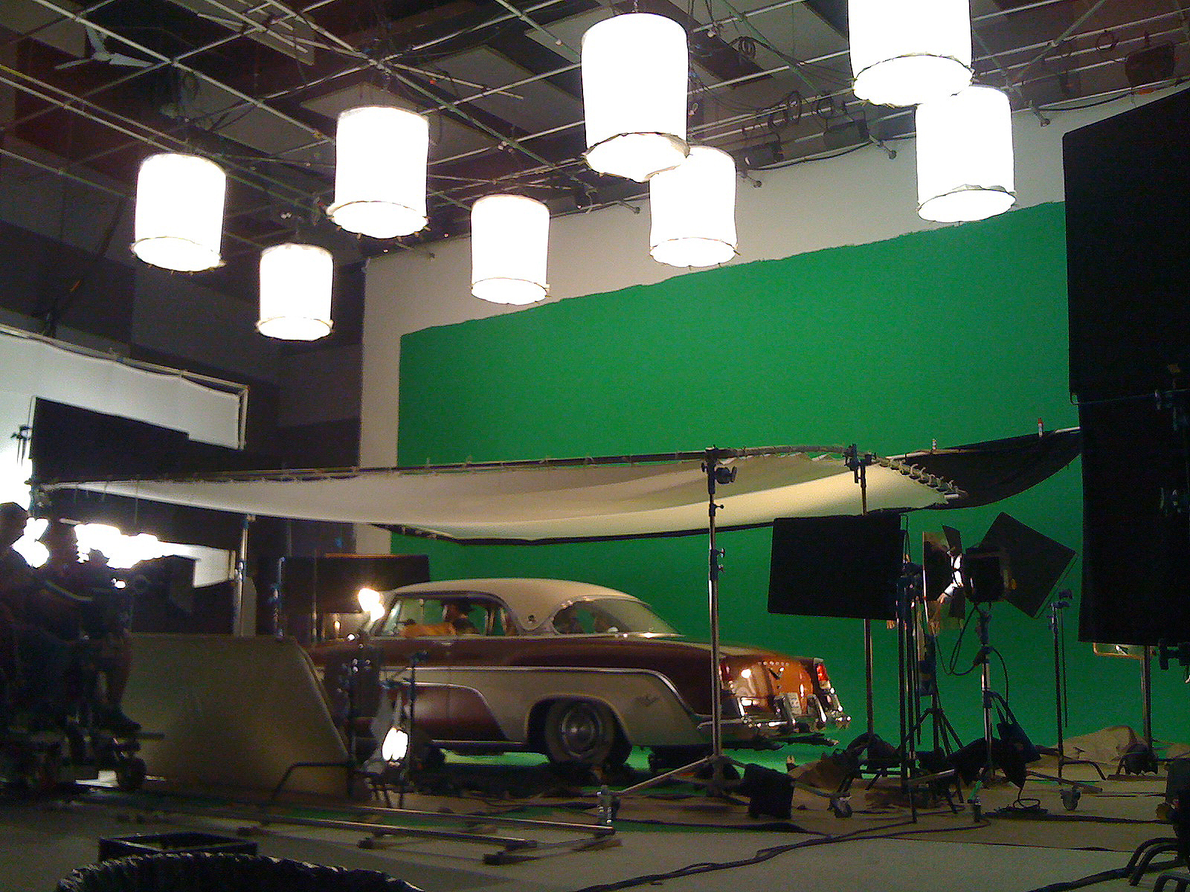
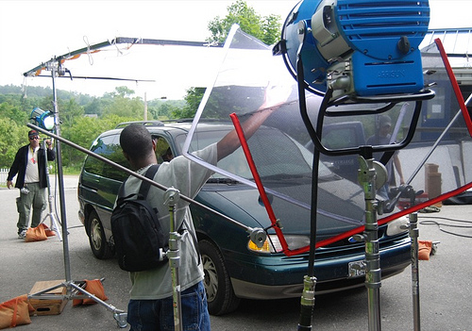

Slide 10
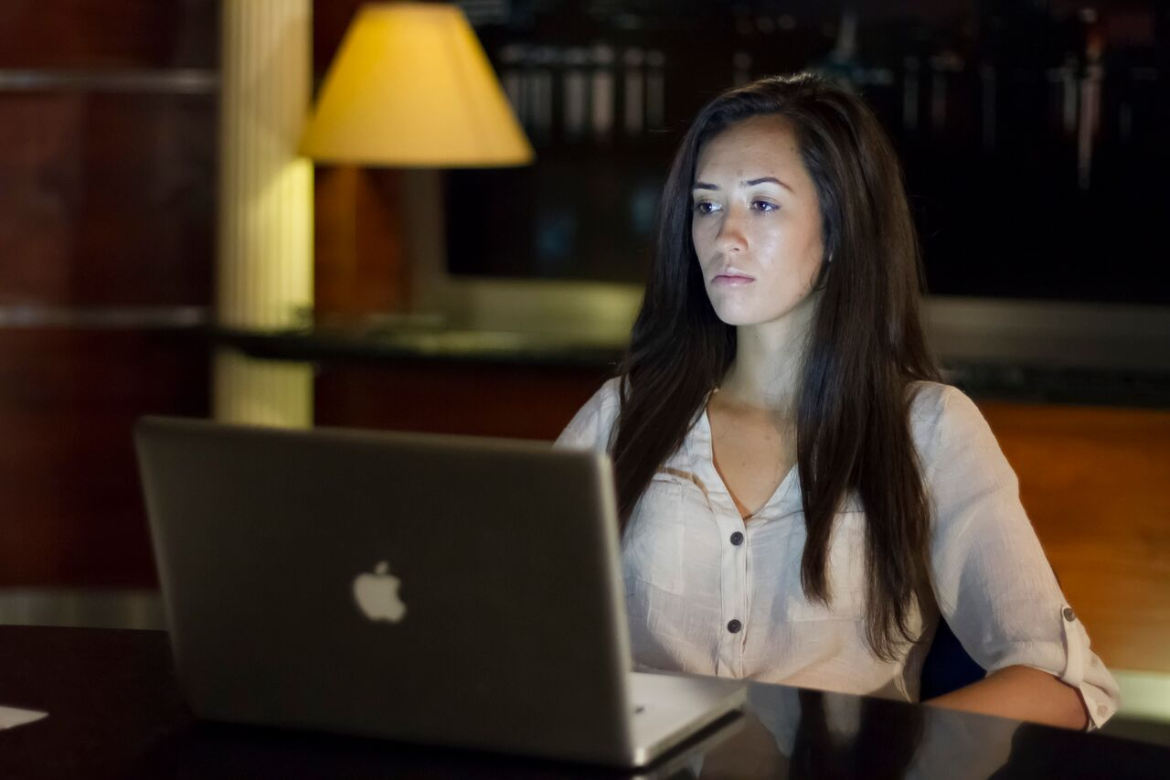

Slide 11
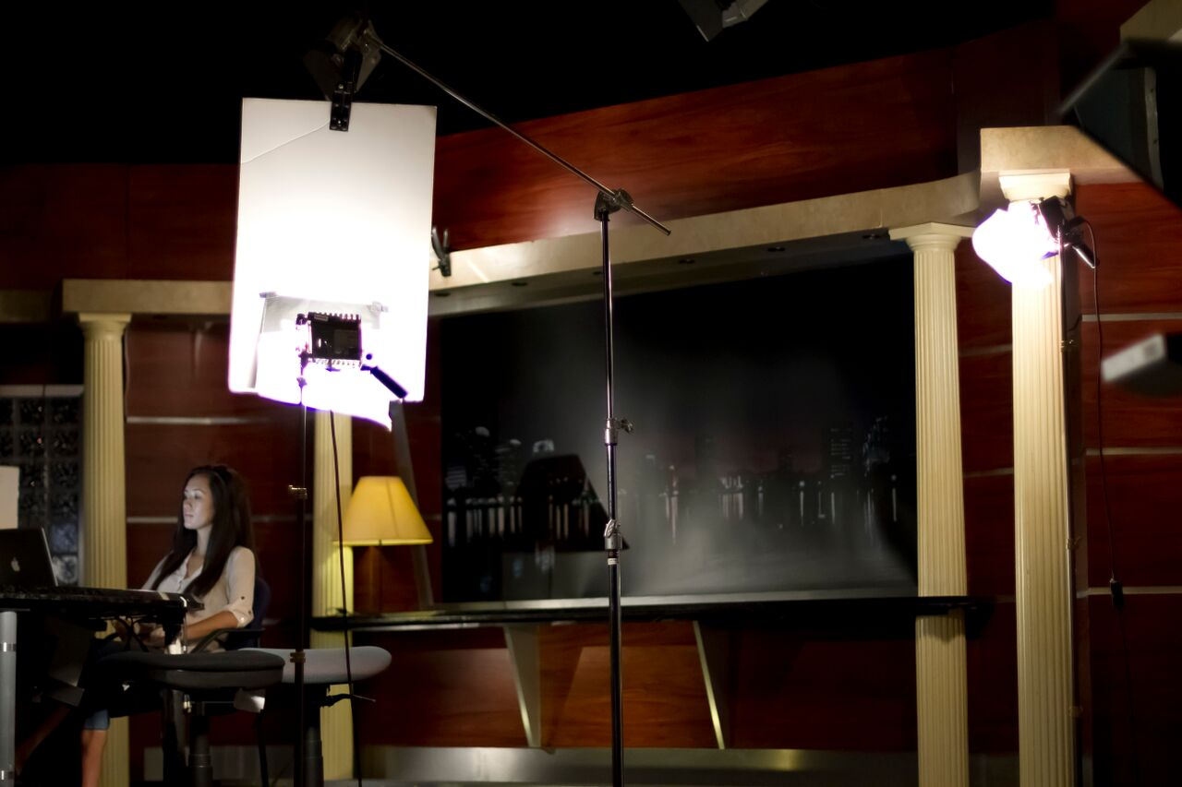

Slide 12
Light/Photography
History

Slide 13
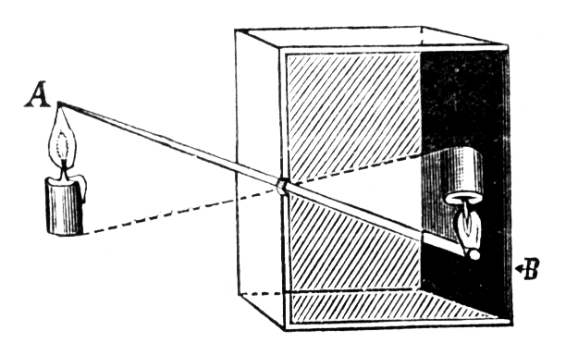
Leonardo da Vinci - 1519 manuscript
Camera
Obscura

Slide 14
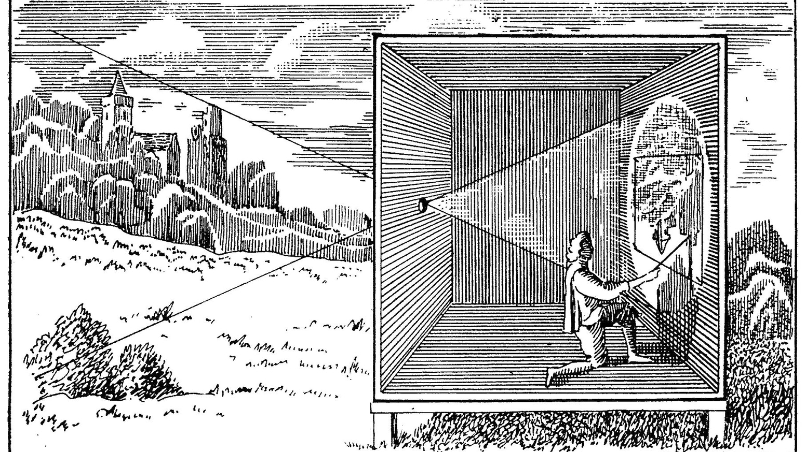

Slide 15
focal
plane

Slide 16
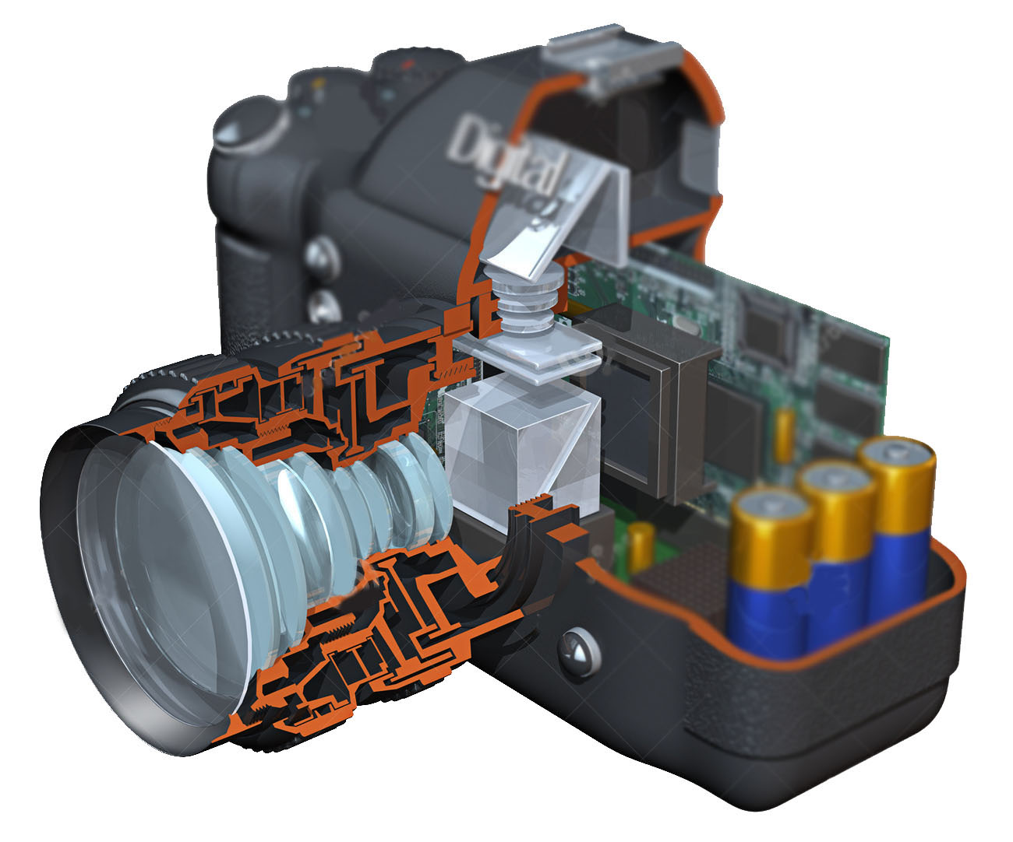
Image
Sensor

Slide 17
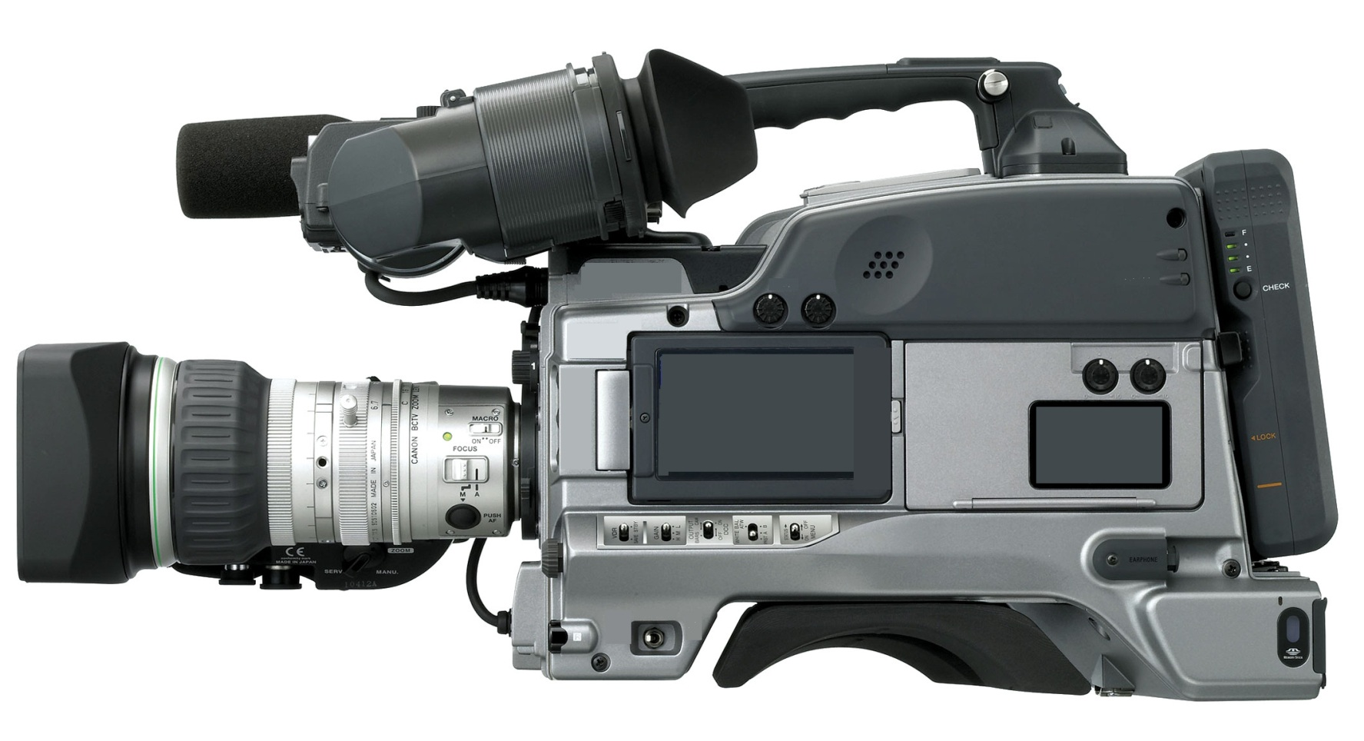

Slide 18
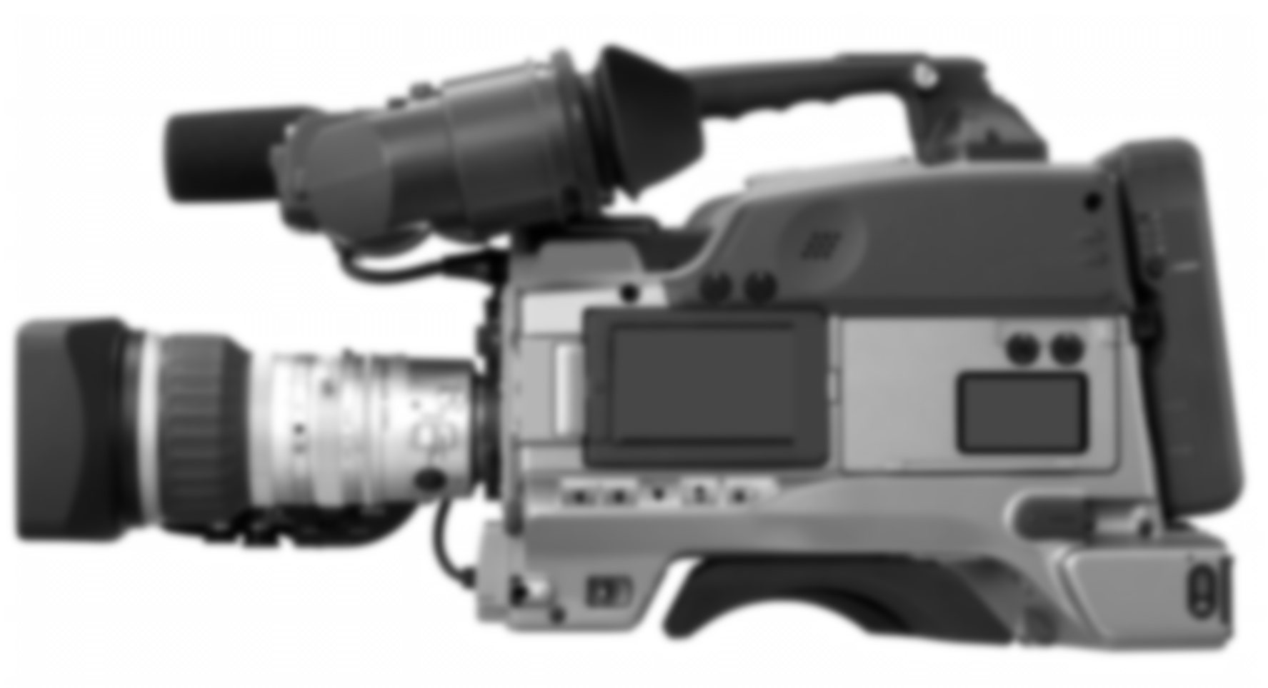

Slide 19
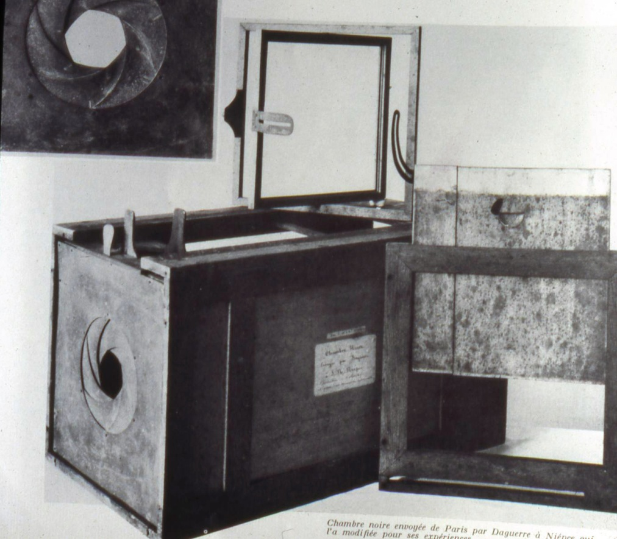

Slide 20
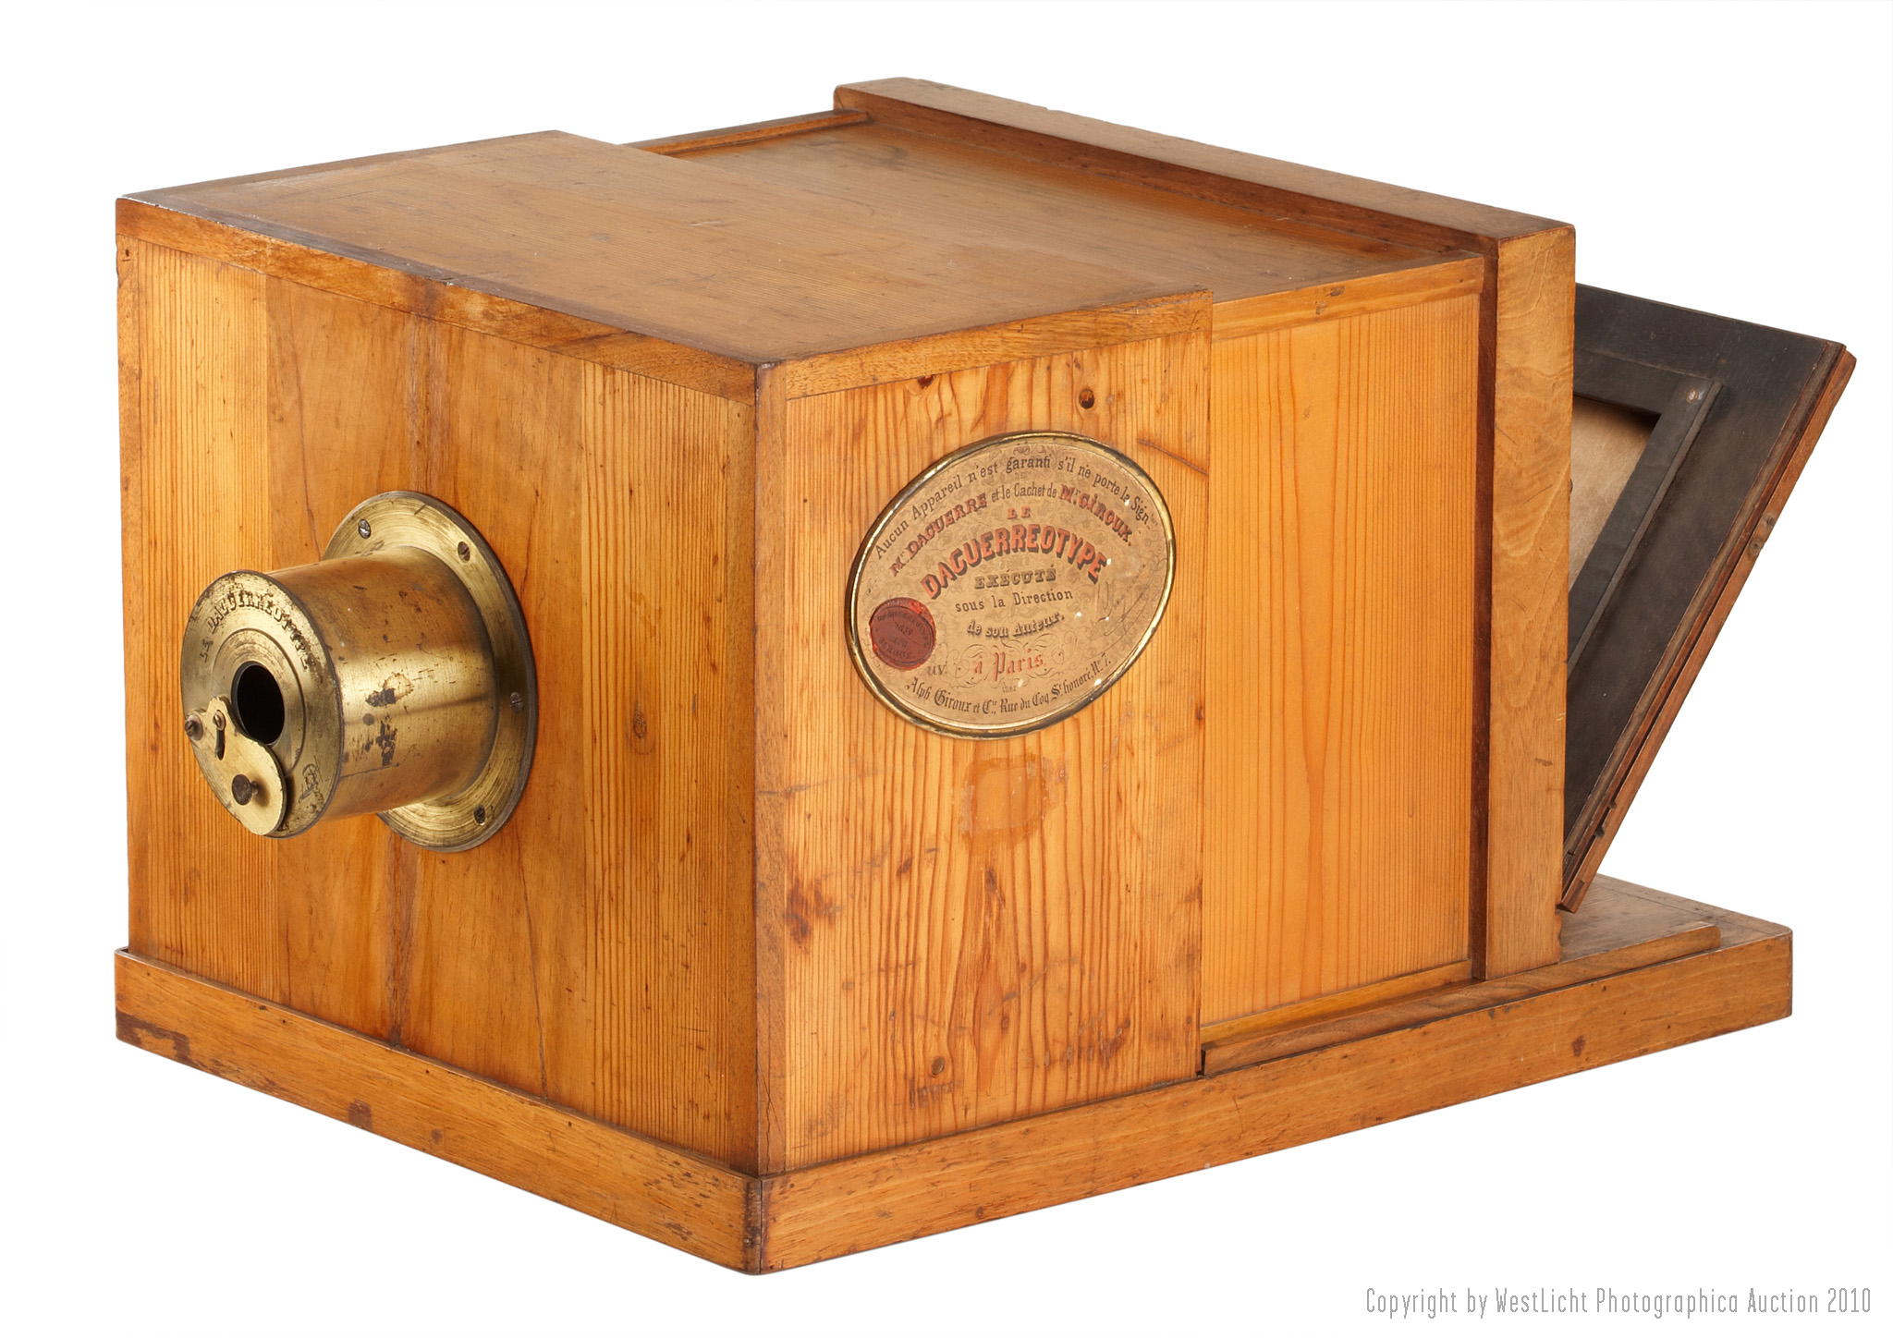

Slide 21
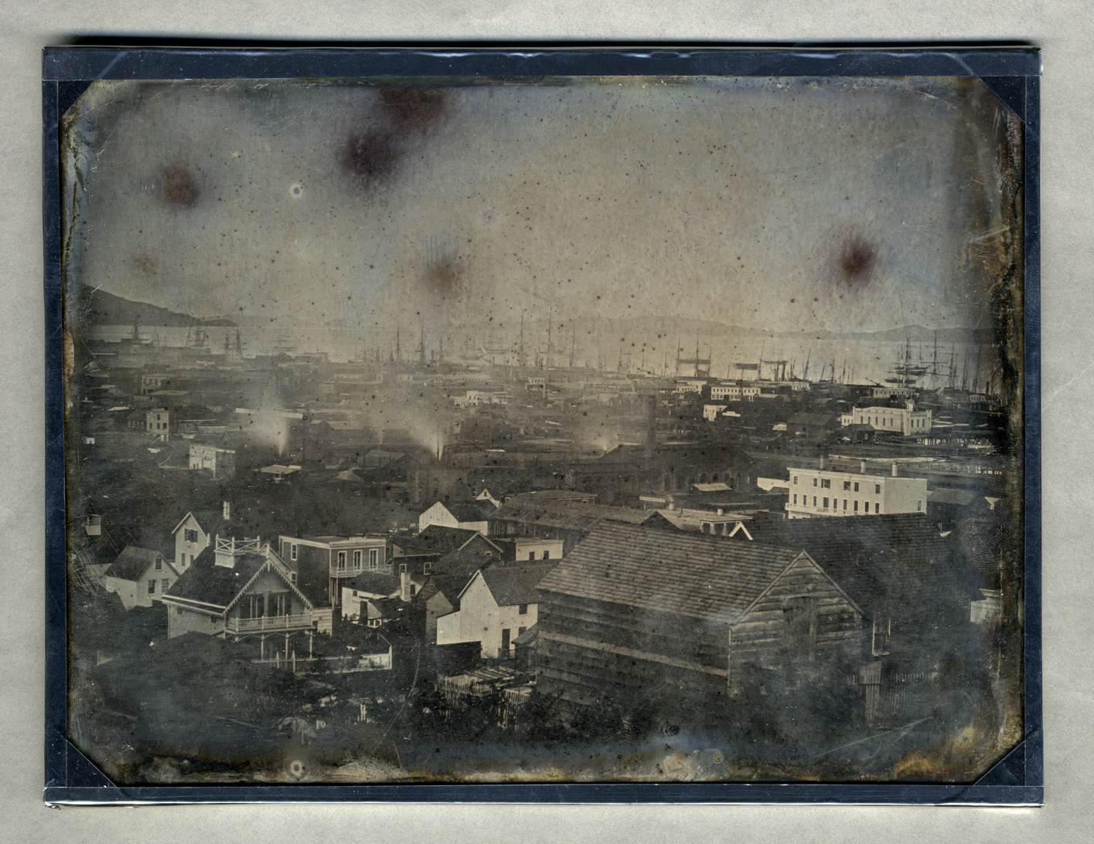

Slide 22
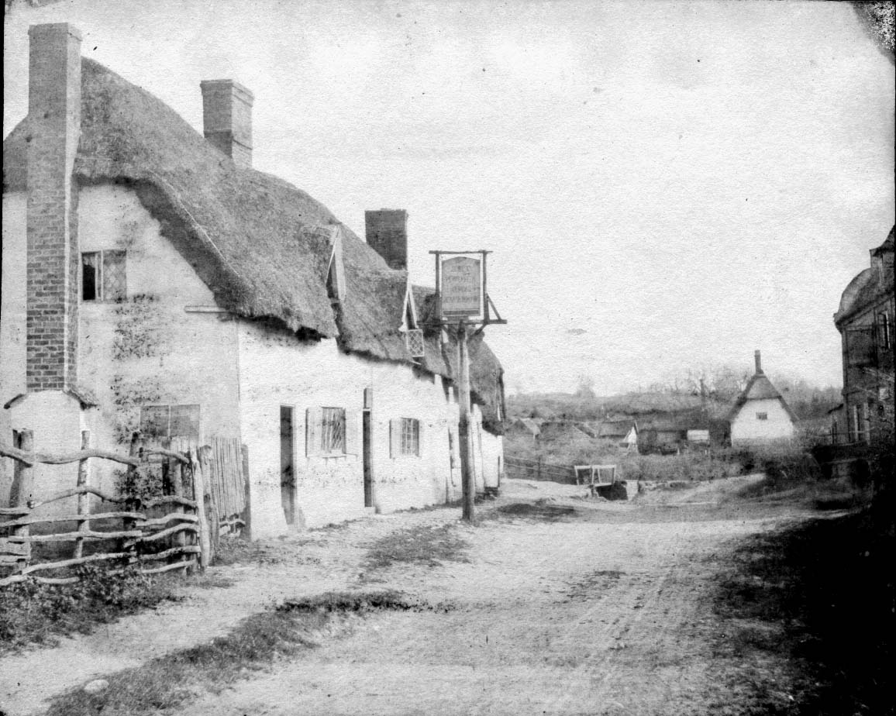

Slide 23
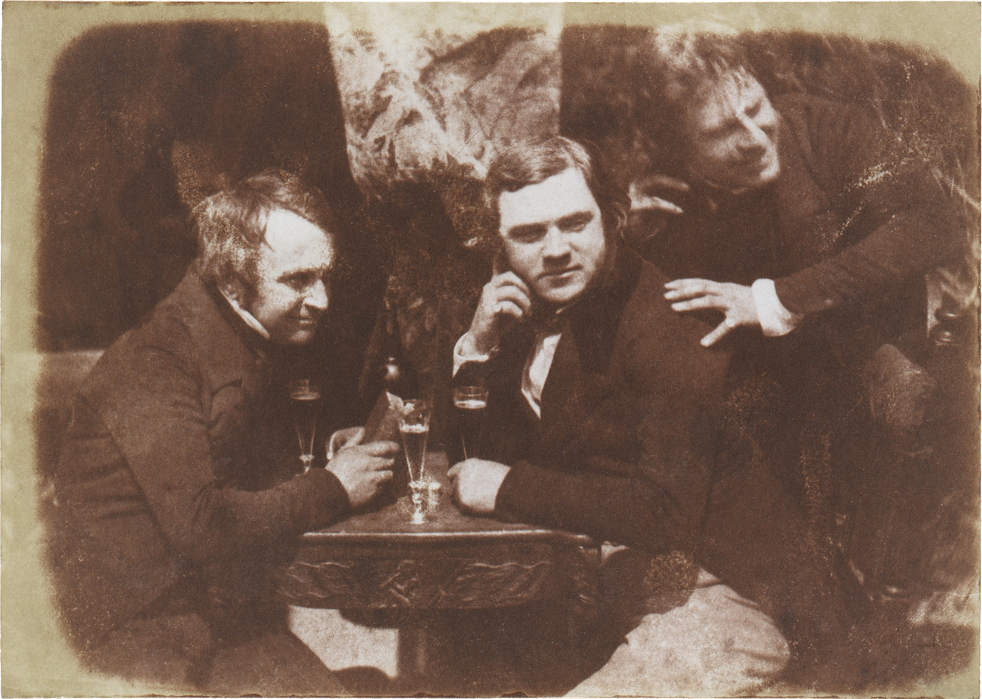

Slide 24
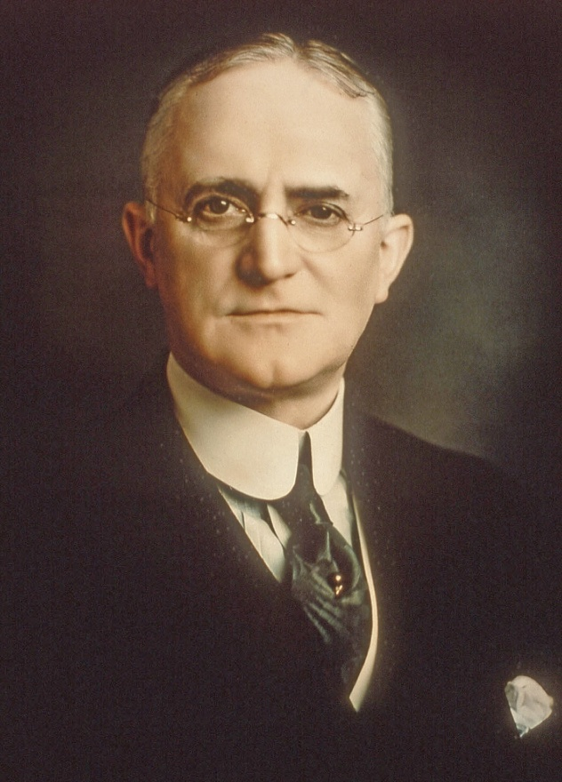
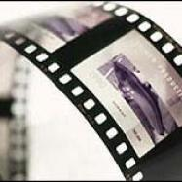
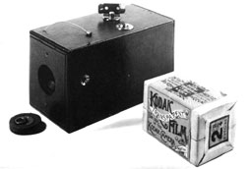
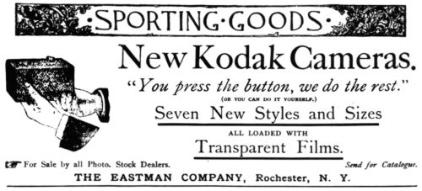
George
Eastman
(late 1800’s)
(1888)

Slide 25
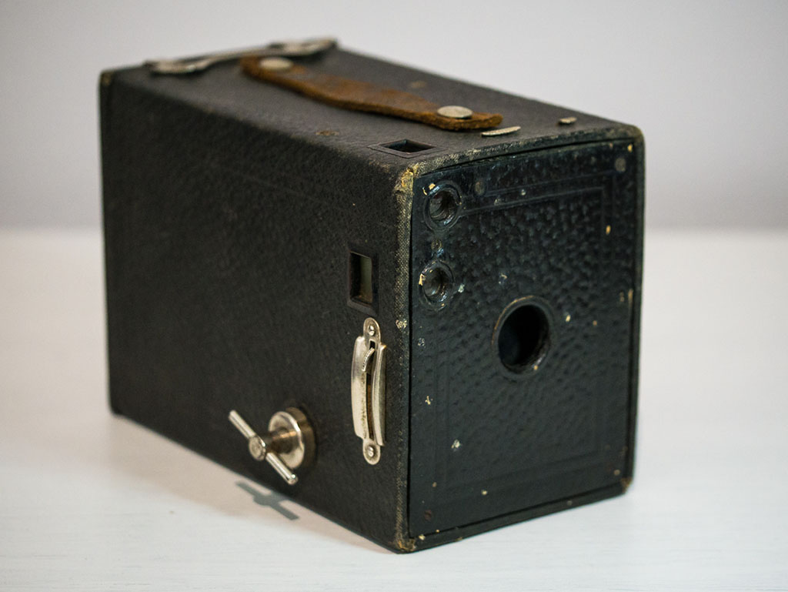
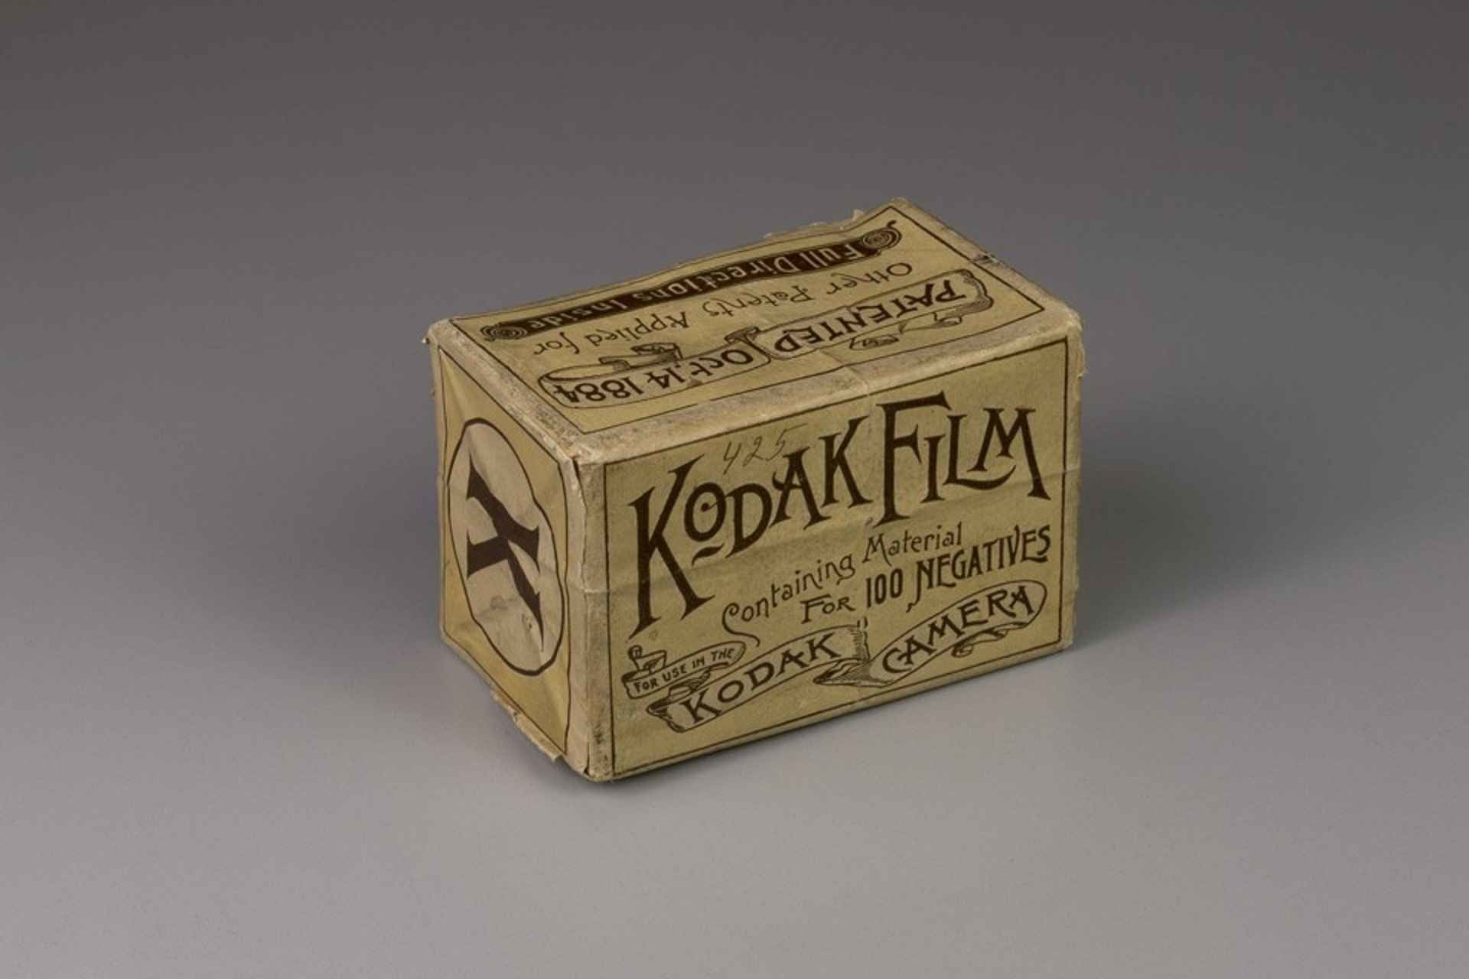

Slide 26
Why do we Light?
Technical
create a picture
-Lighting for Light-
2. Aesthetic
convey meaning
-Lighting for Shadow-

Slide 27
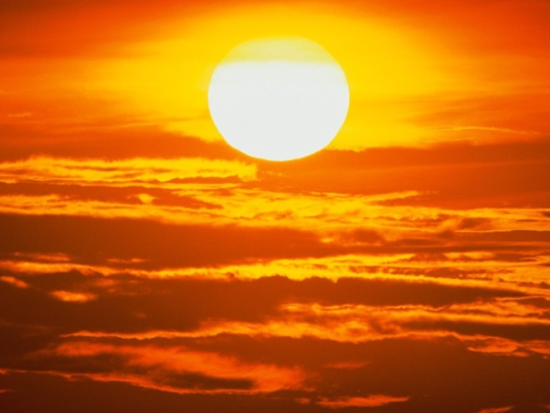
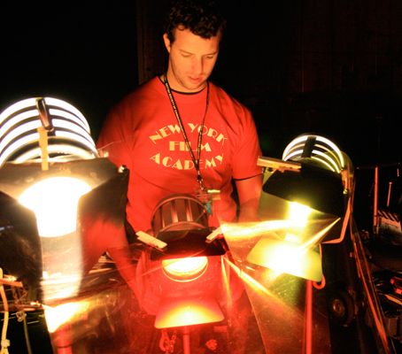
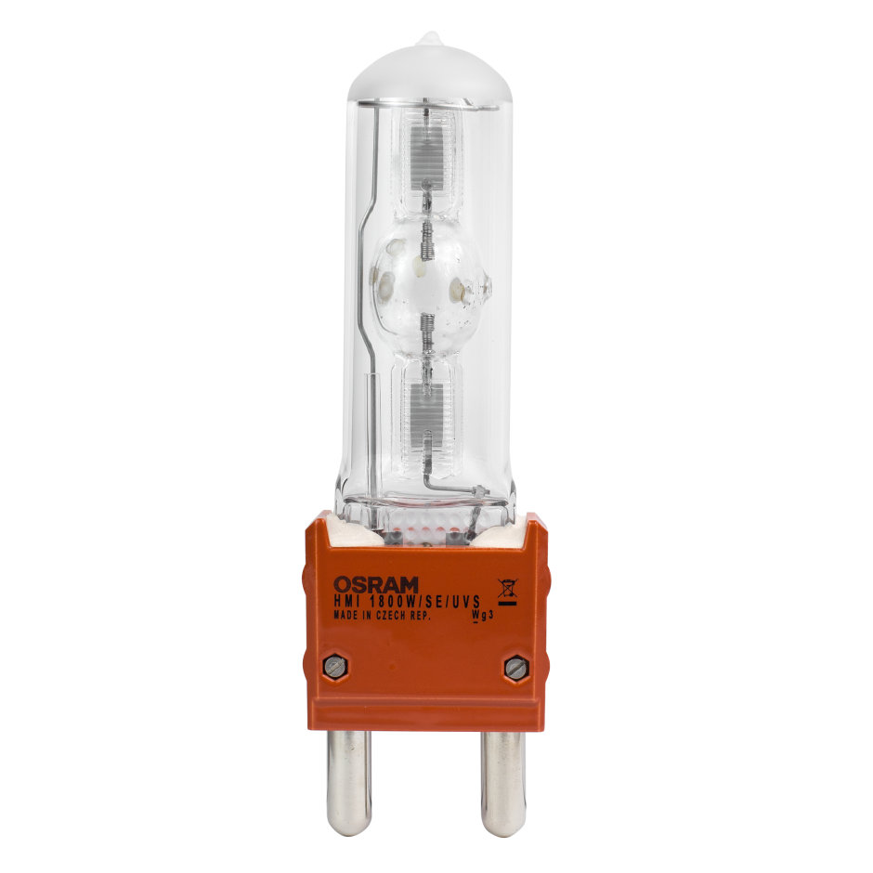
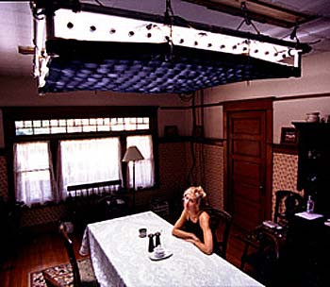
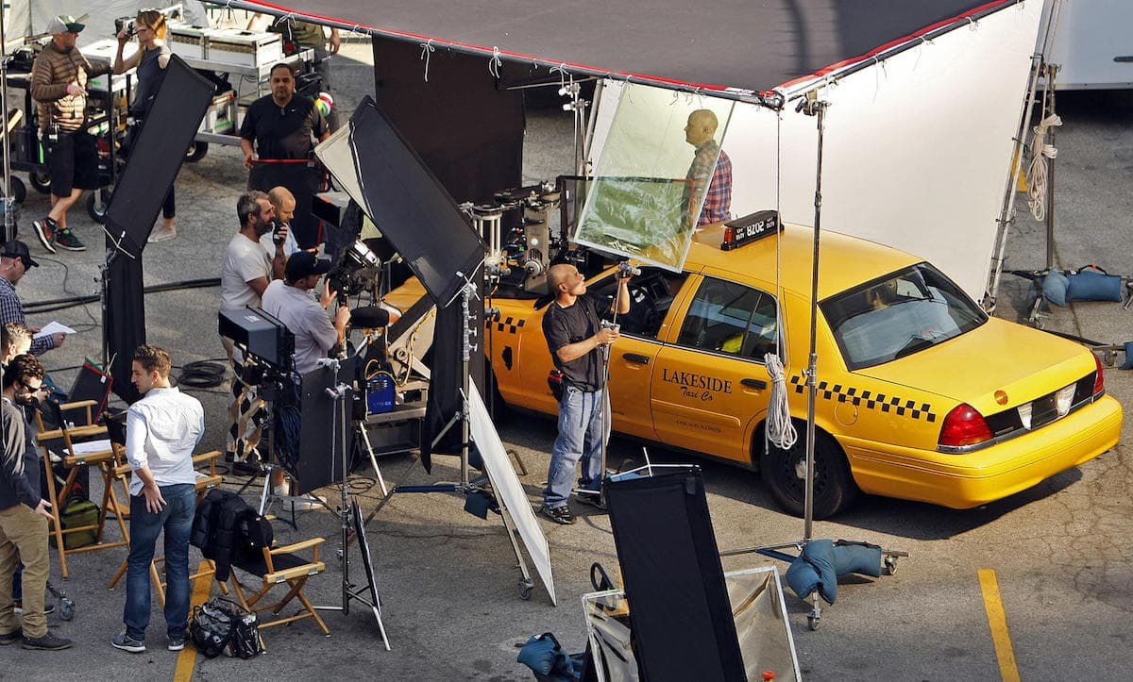
Light Sources
Natural
Artificial
- Tungsten -

Slide 28
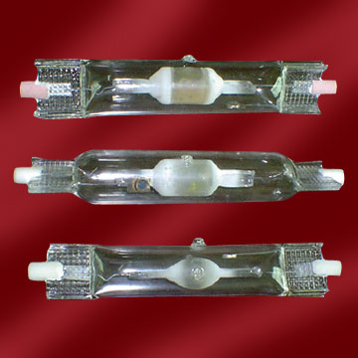
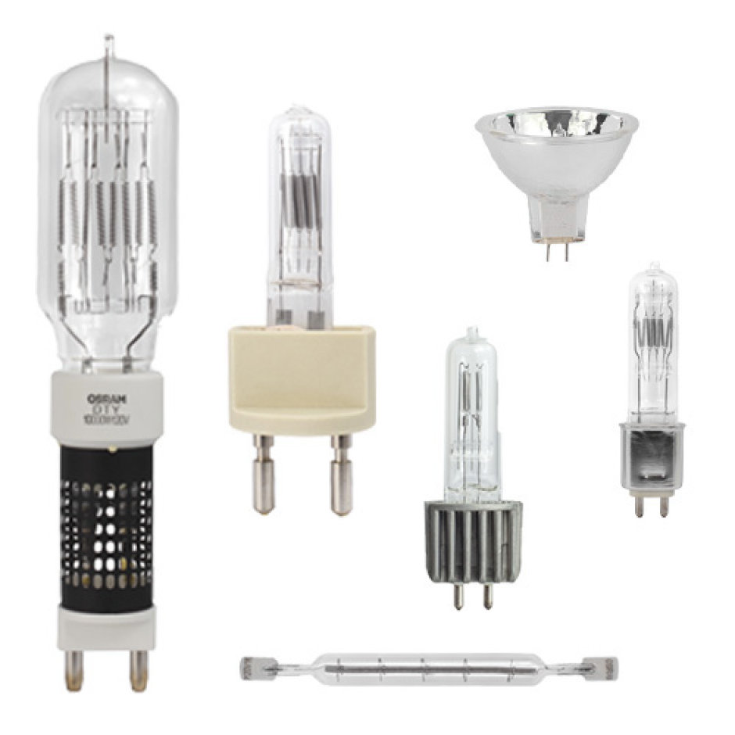
Lamp Wattages
25 watts
1,000 watts

Slide 29
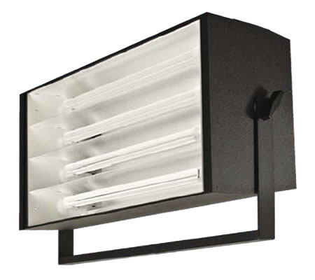
Tungsten Alternatives
Production Fluorescent

Slide 30
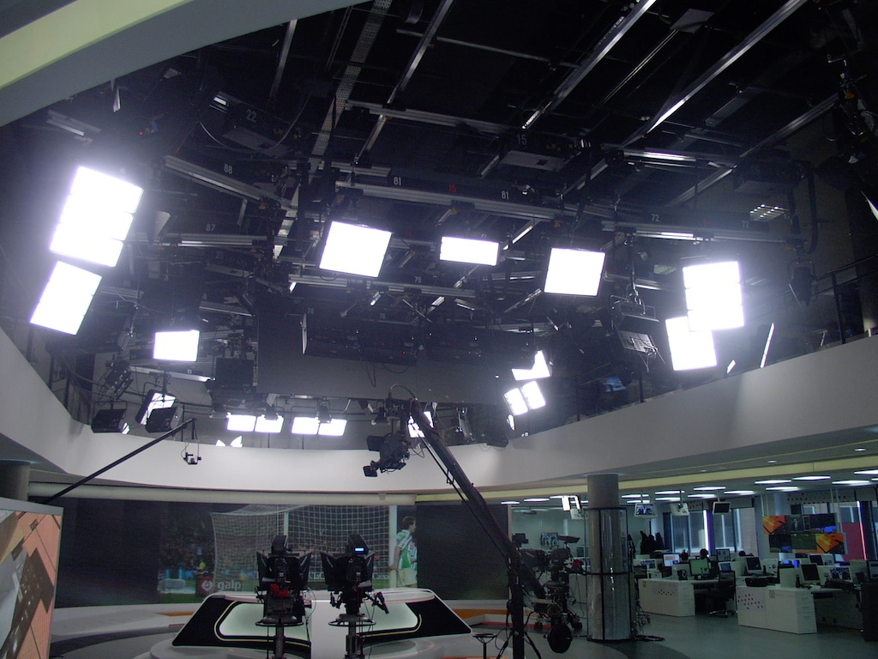
Tungsten Alternatives

Slide 31
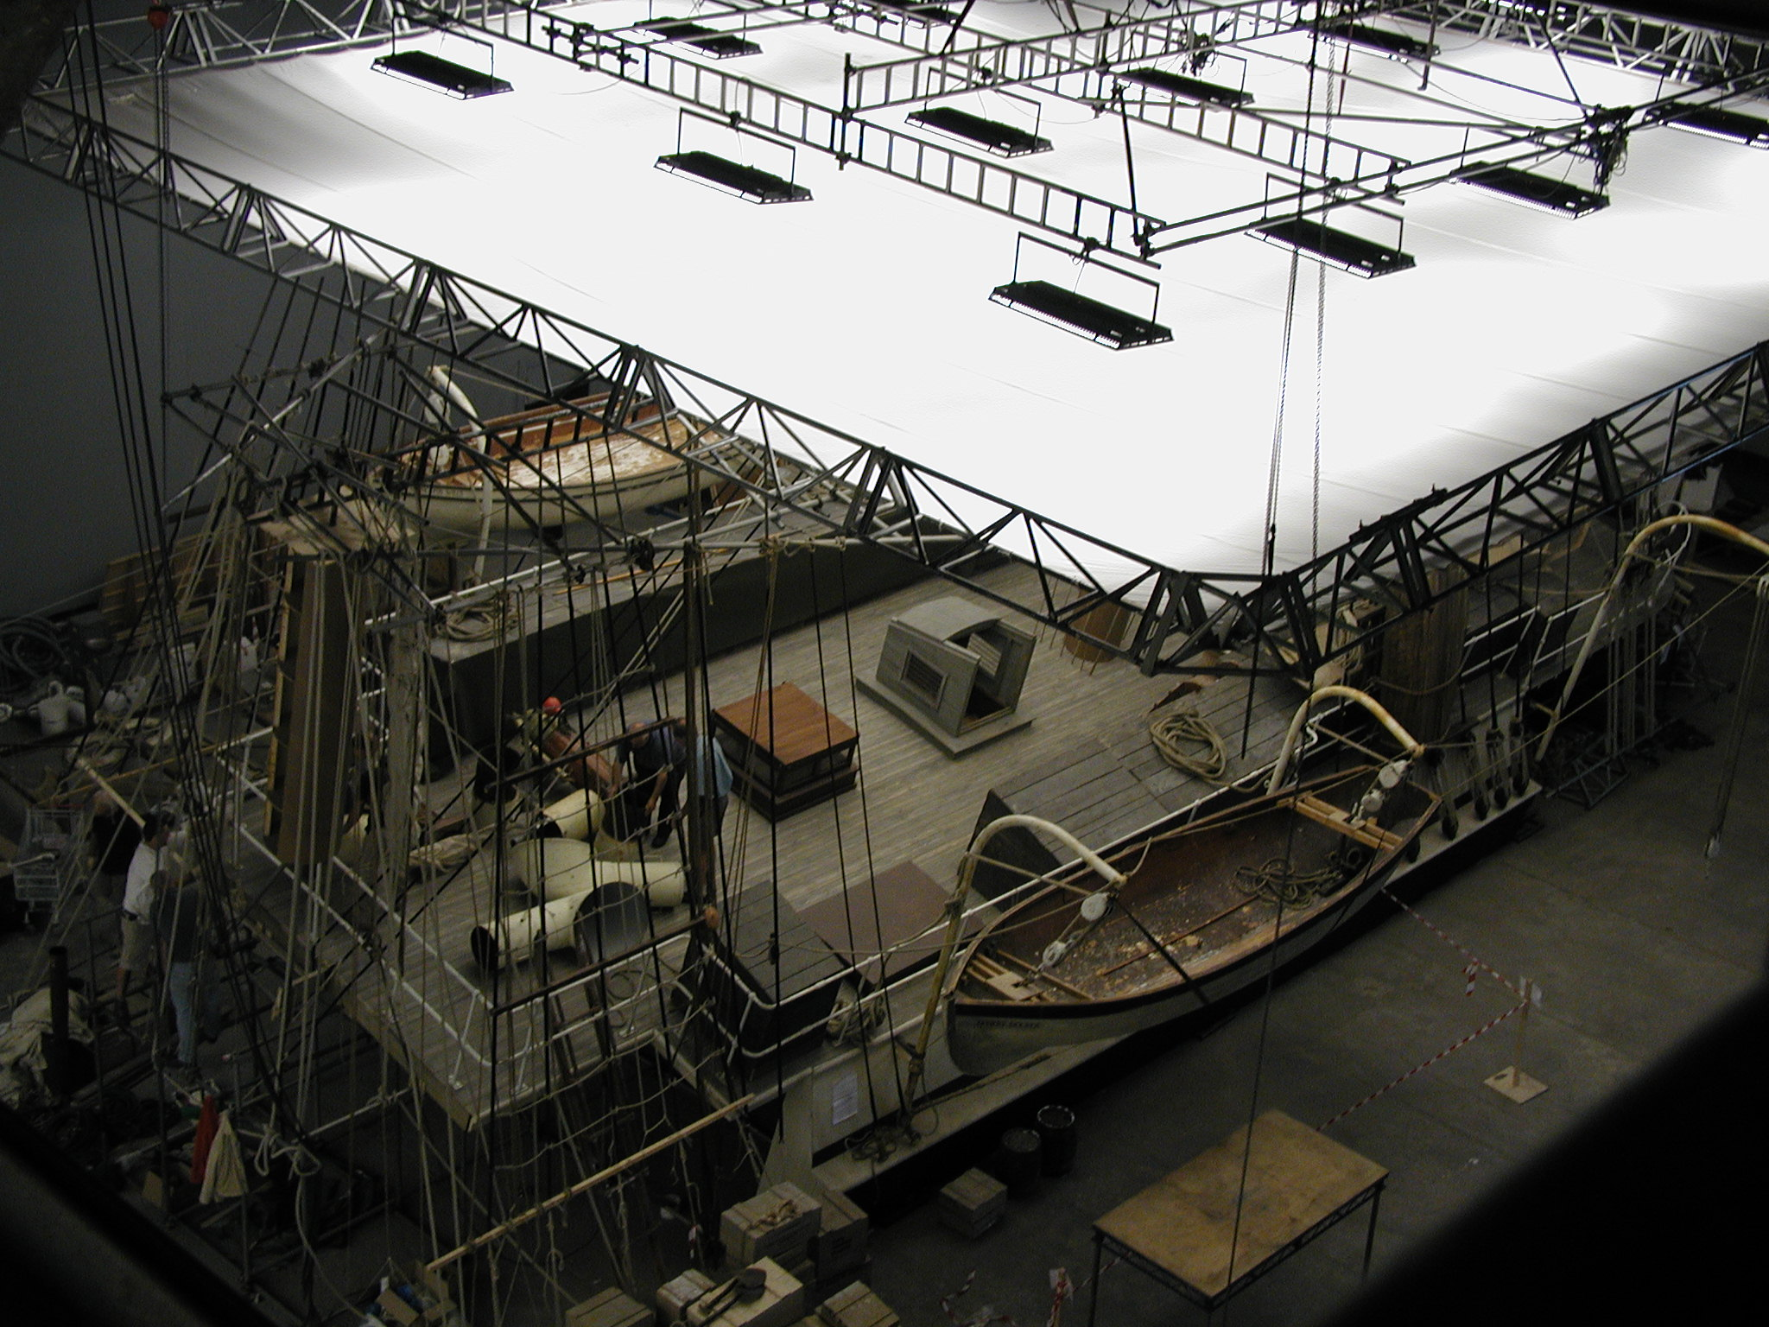

Slide 32
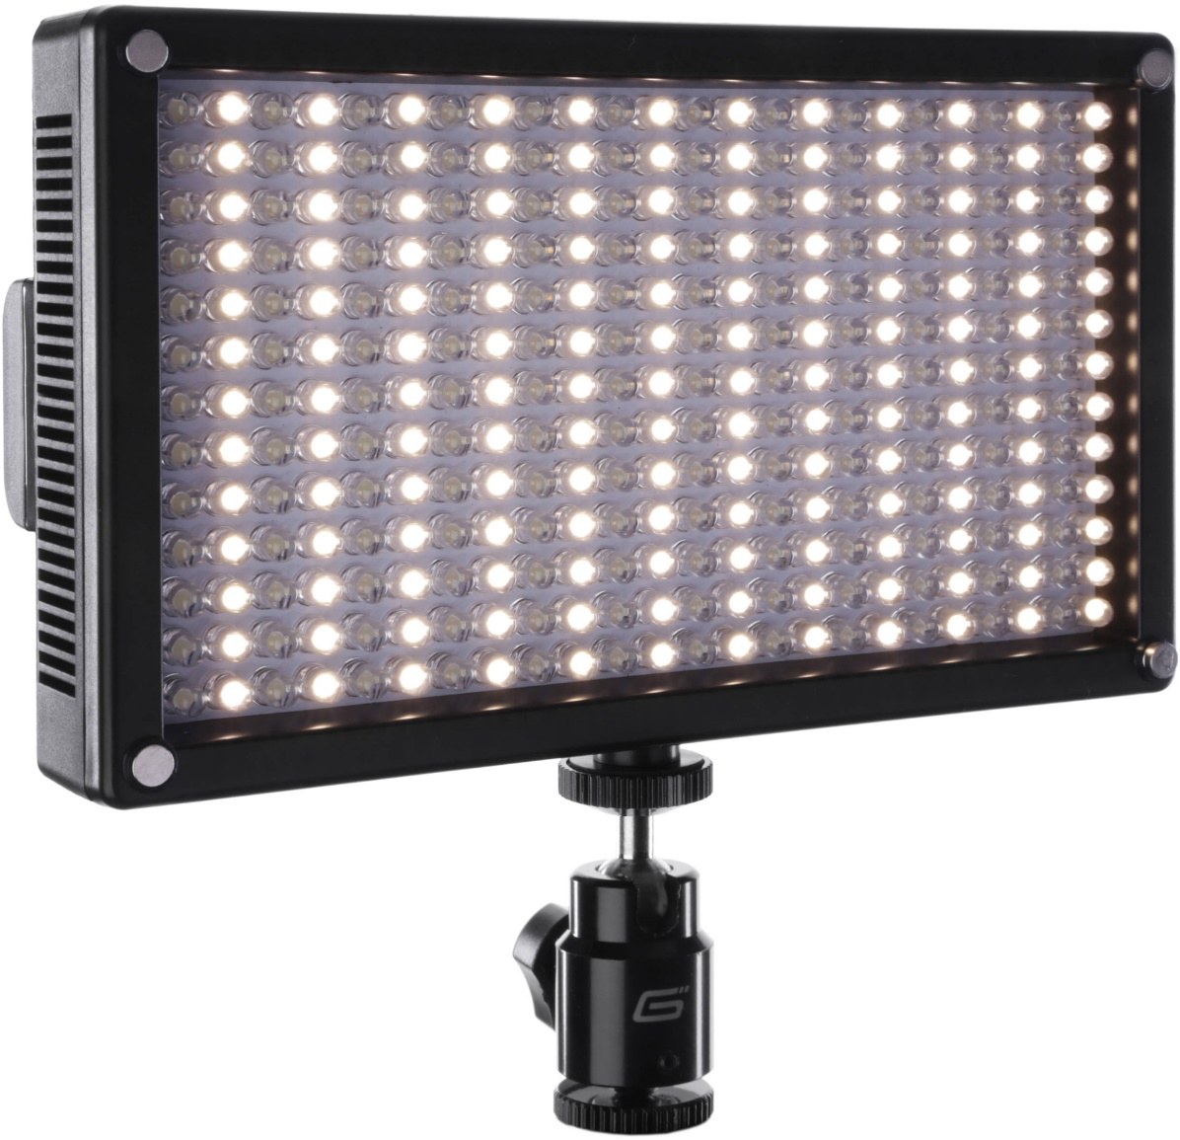
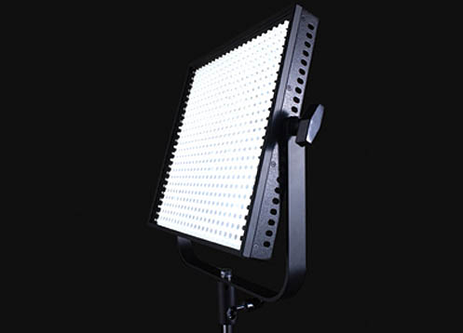
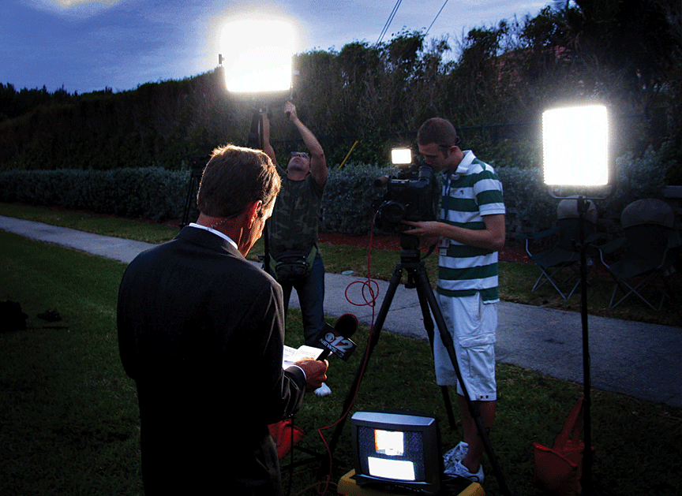
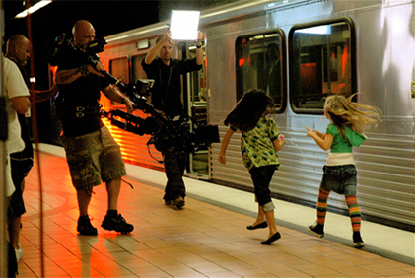
Tungsten Alternatives
LED

Slide 33
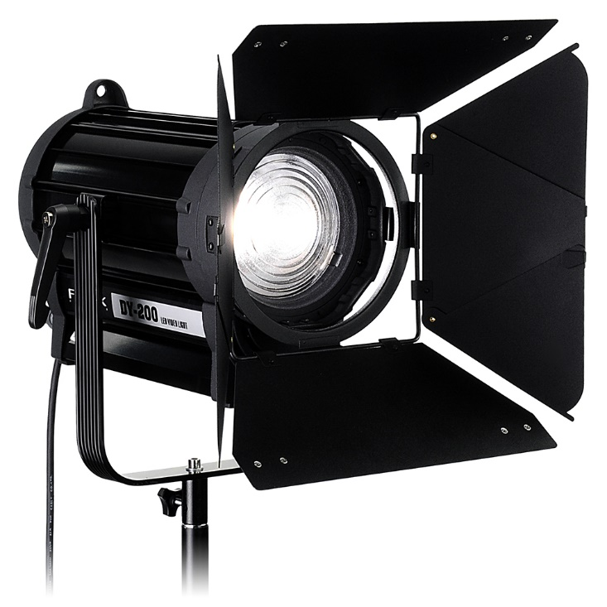

Slide 34
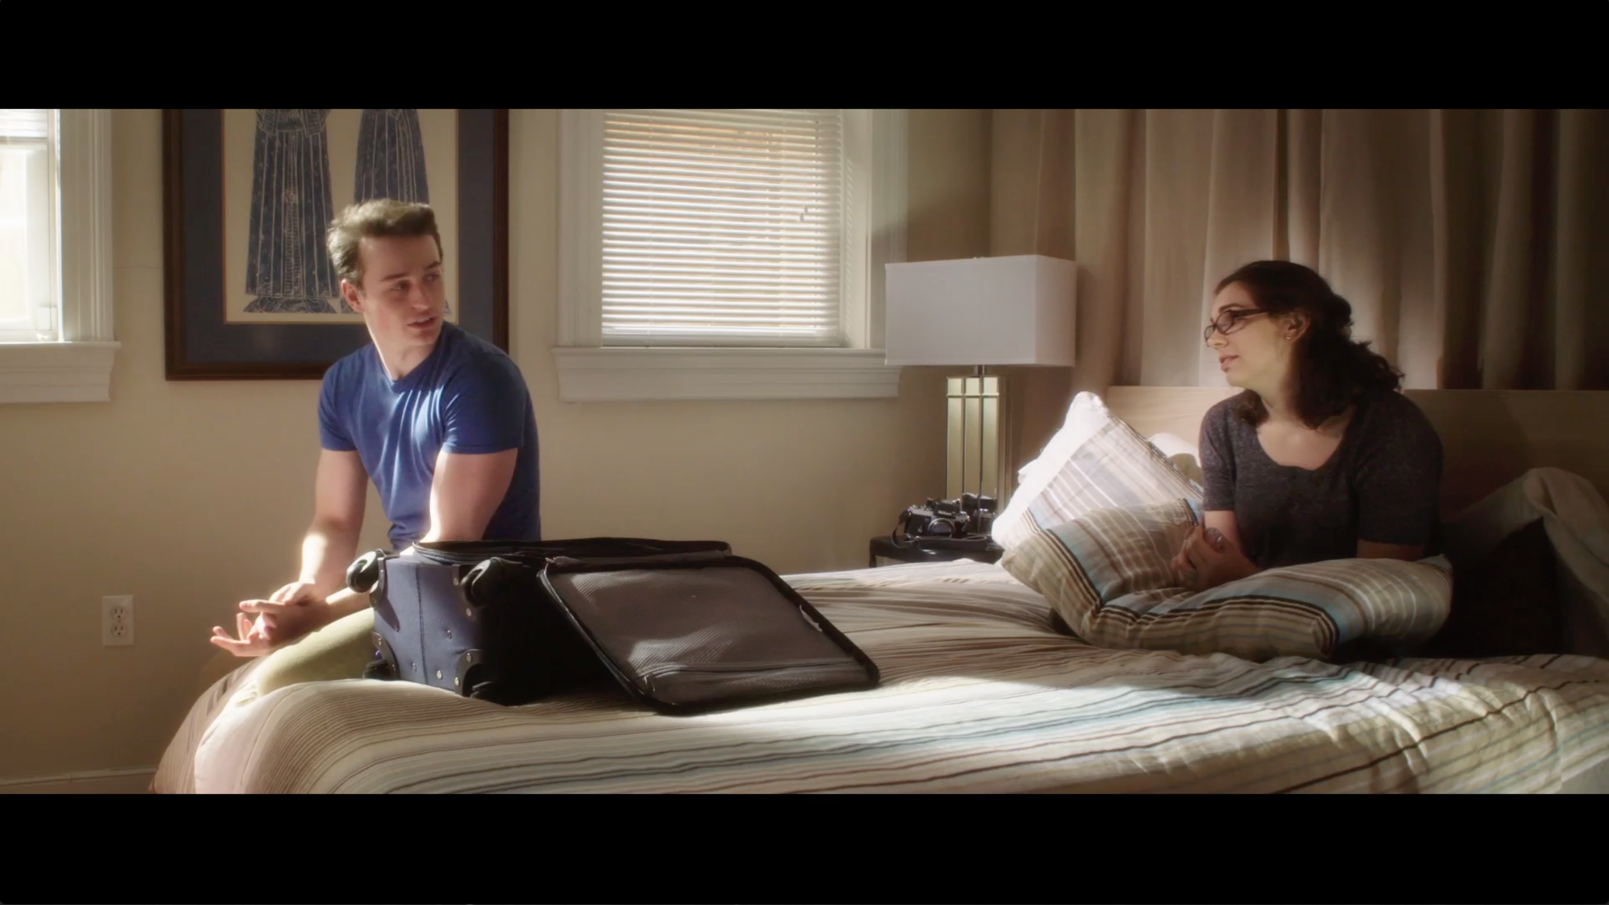

Slide 35
Light Properties
Baselight
Ambient Light Level
(overall illumination)

Slide 36
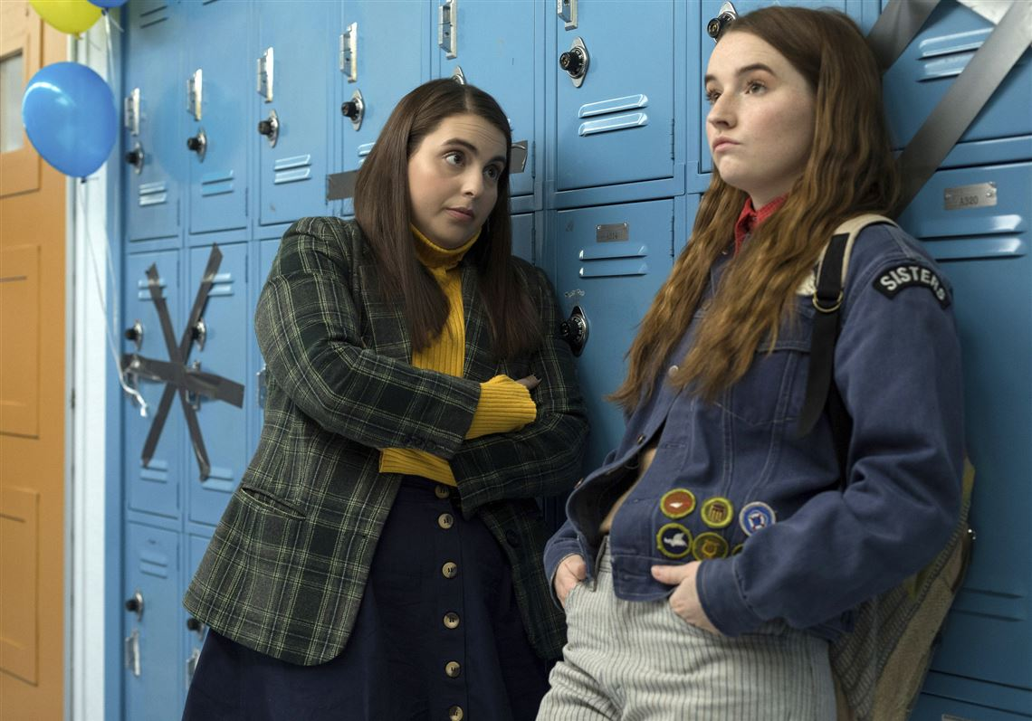
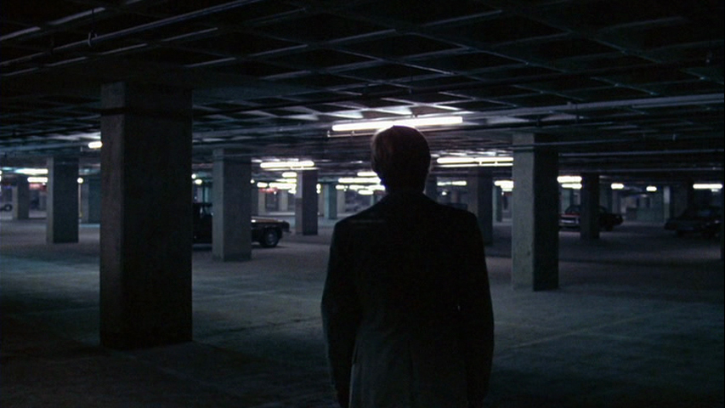
Baselight
High
Low

Slide 37
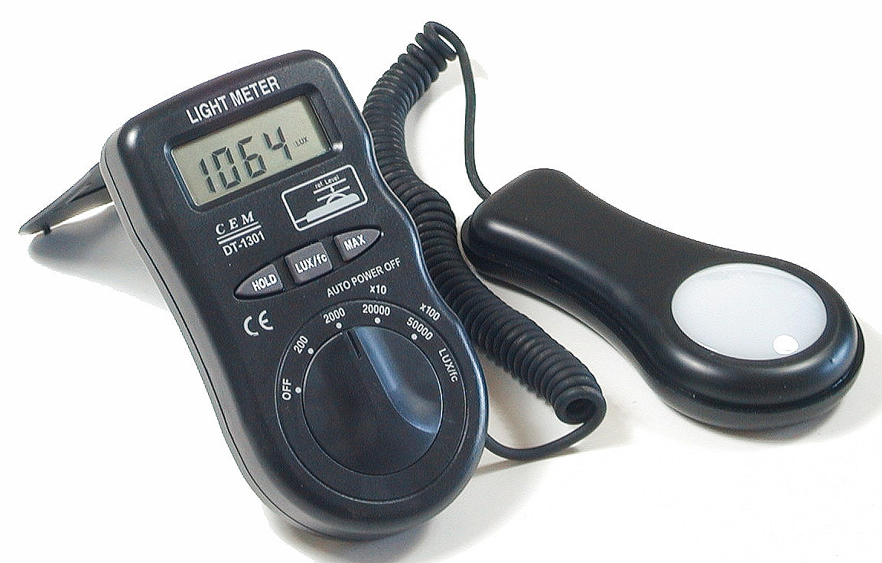
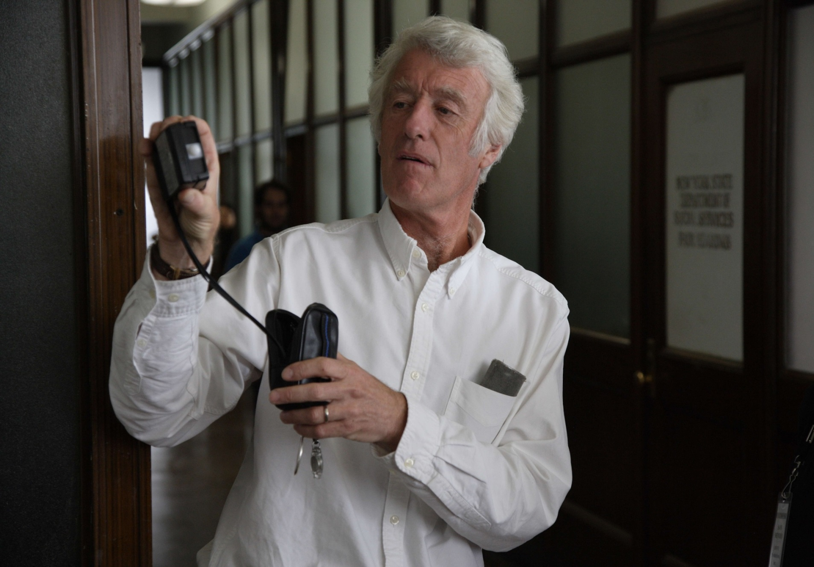
Measuring Illumination

Slide 38
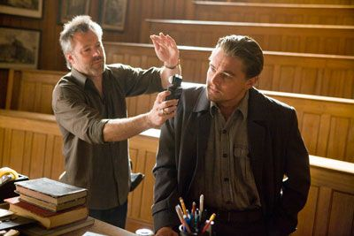
Illumination (Intensity)
European: lux
American: foot candles (fc)
(1 fc = 10 lux)

Slide 39
Foot Candle
1 X 1 foot
1 ft.

Slide 40
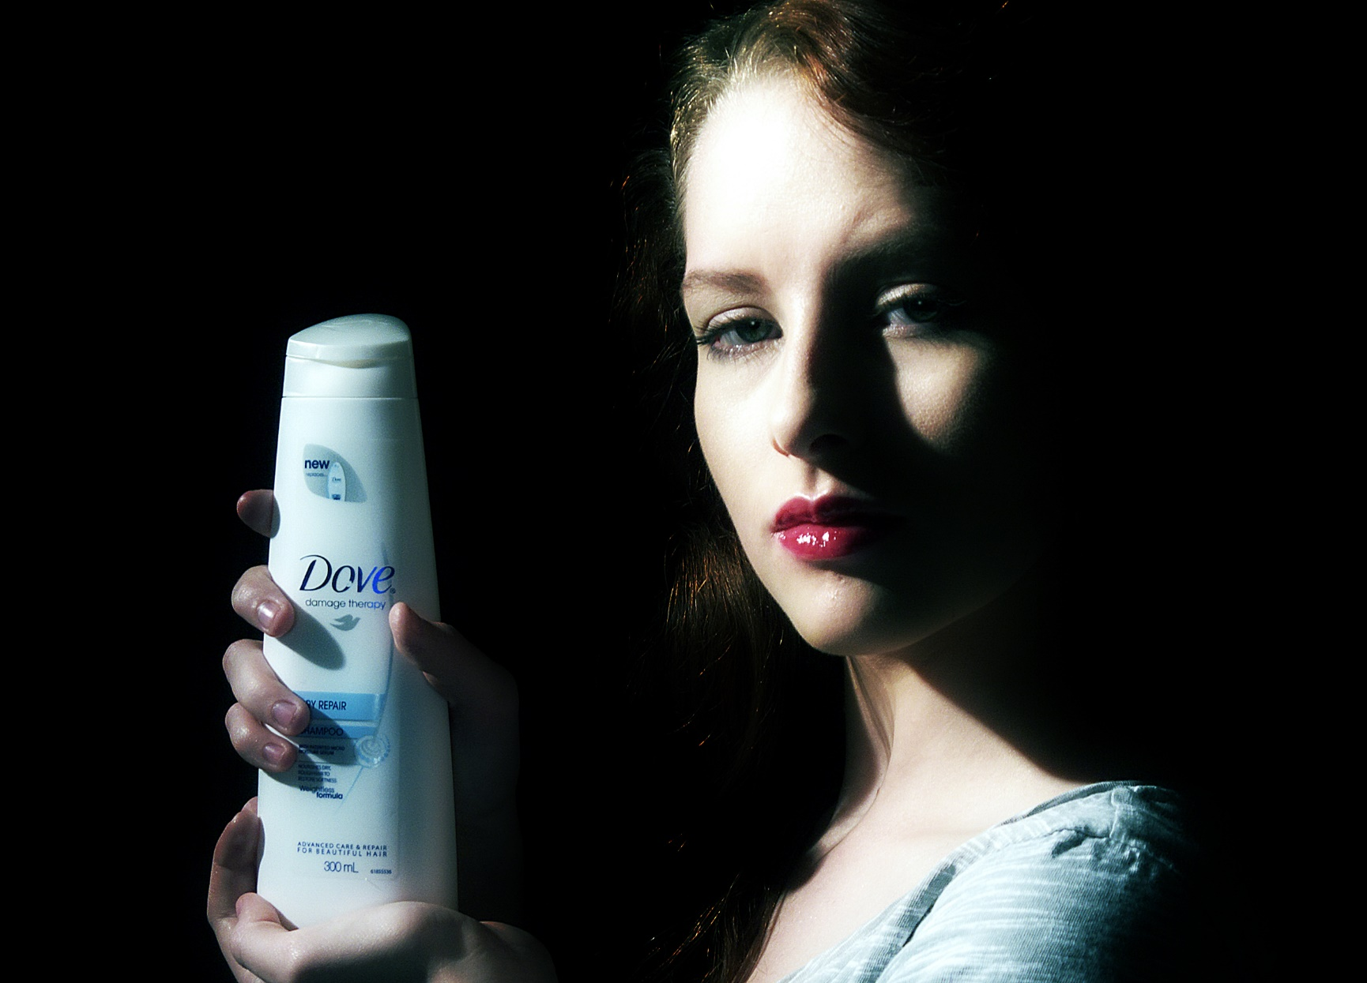
Light Illumination
Intensity

Slide 41
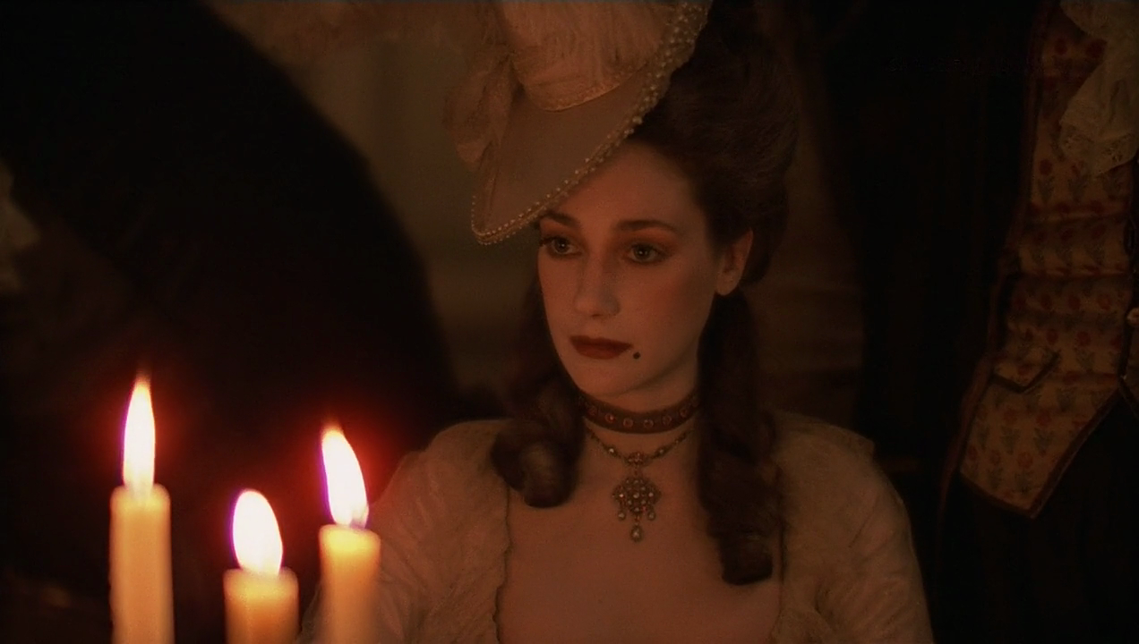
Light Illumination
Intensity

Slide 42
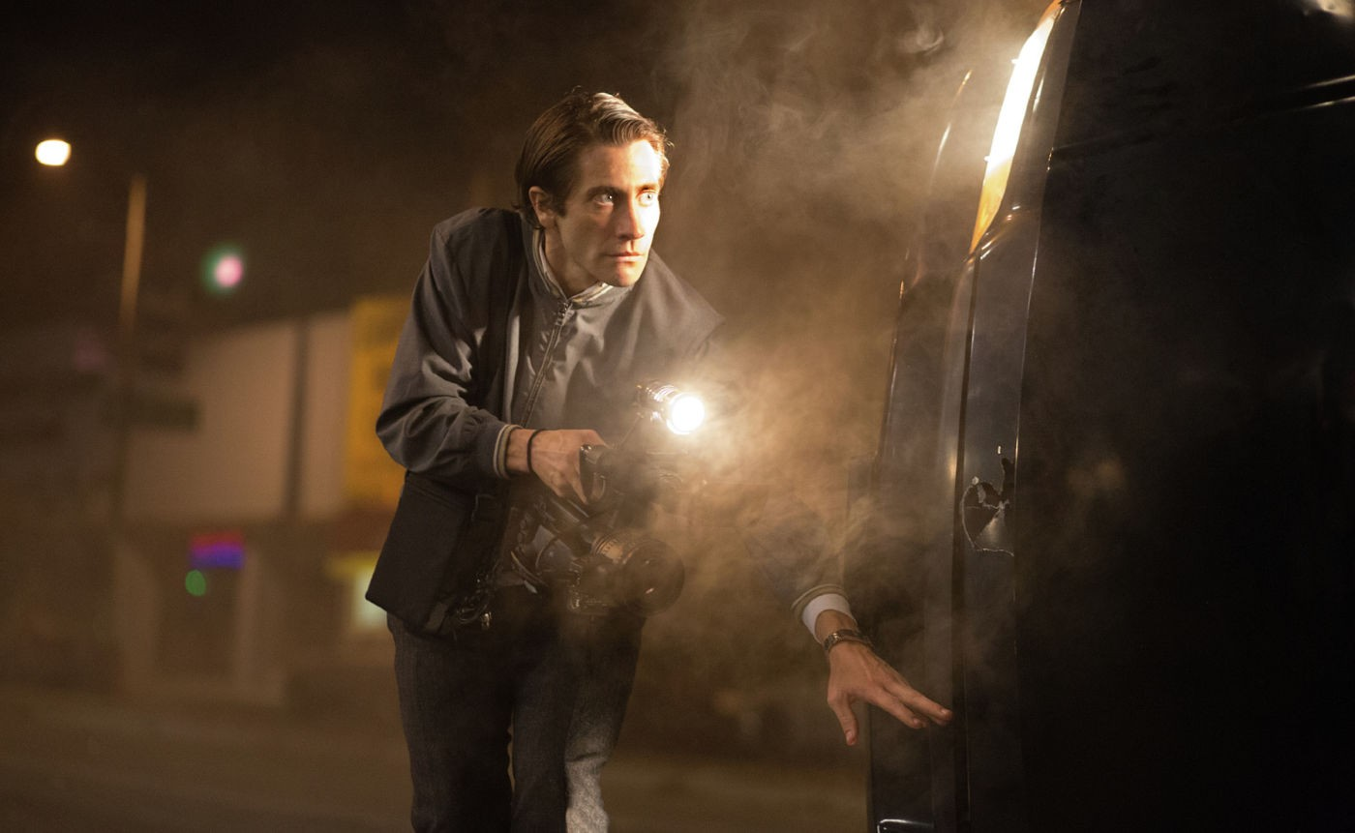
Light Illumination
Intensity

Slide 43
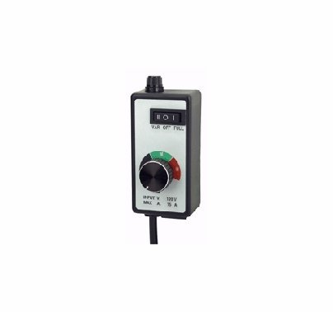
Dimmer

Slide 44
Light Properties
Color
Kelvin
degrees
Industrial
Fluorescent
Tungsten
Daylight
(White Balance)
3200⁰
4700⁰
5600⁰

Slide 45
LED Color Temperature

Slide 46
Aesthetic
(conveying meaning)
Lighting
for
Shadow

Slide 51
Aesthetic Lighting
- What Do We Light? -
subject
Environment
- defines space
- dimensionality

Slide 57
Notes:
57

Slide 58
Notes:
58

Slide 59
Notes:
59

Slide 61
Aesthetic Lighting Reveals
form

Slide 67
Aesthetic Lighting Reveals
form
drama
High Key
vs.
Low Key
(falloff)

Slide 68
High Key

Slide 71
Low Key

Slide 75
Silhouette

Slide 77
Aesthetic Lighting Reveals
form
drama
character (inner states)
setting
Notes:
77

Slide 78
Notes:
78

Slide 79
Notes:
79

Slide 80
Notes:
80

Slide 81
Aesthetic Lighting Reveals
form
drama
character (inner states)
setting
depth/dimensionality
Notes:
81

Slide 82
Incident Light
Reflected Light

Slide 83
Incident Light

Slide 84
Reflected Light

Slide 85
Controlling Light
Color
Intensity
Shape

Slide 86
Controlling Light
Color:
gels

Slide 90
Controlling Light
Color:
Intensity:
illumination

Slide 94
Controlling Light
Color:
Intensity:
illumination
2 patterns:
directional
diffused

Slide 95
Directional Light

Slide 99
Diffused Light

Slide 103
Incident Light
Reflected Light
Directional/Diffused
Diffused

Slide 104
Silk

Slide 107
Butterfly

Slide 109
Bounce Board

Slide 113
Reflector

Slide 116
Controlling Light
Color:
gels
Intensity:
level of illumination
Shape:
lighting accessories

Slide 117
Barn Doors

Slide 119
Snoots

Slide 121
C-Stand

Slide 127
Flags

Slide 130
Studio/Sound Stage Lighting
Controlled Conditions

Slide 132
Lighting
Grid

Slide 133
Battens

Slide 134
Lighting/Dimmer Board

Slide 135
Field Lighting
Uncontrolled Conditions

Slide 139
Outdoor
Lighting
HMI

Slide 142
Notes:
142

Slide 143
Outdoor
Diffusion

Slide 145
Scrim

Slide 148
With
Without

Slide 151
Notes:
151

Slide 153
Photographer
well prepared
understands visual composition
is disciplined
understands camera apparatus
understands the nature of light

Slide 154
Calotype
Negative
Print

