Slide 1
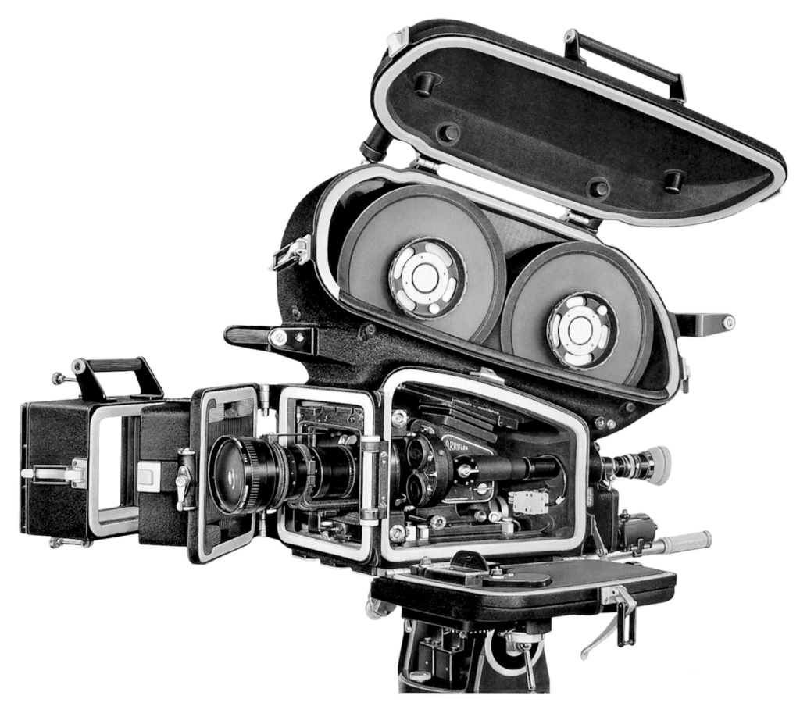
Notes:
1

Slide 2
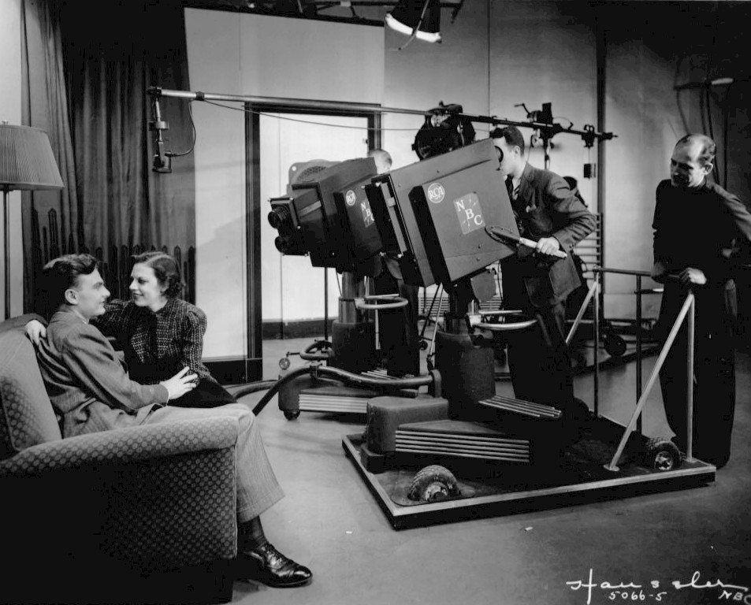
Notes:
2

Slide 3
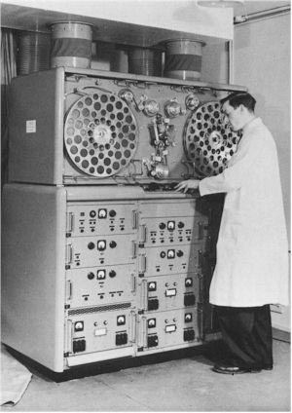

Slide 4
Kinescope
Notes:
4

Slide 5
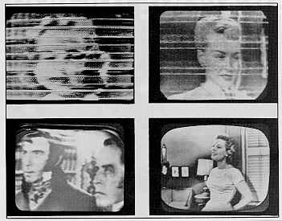

Slide 6
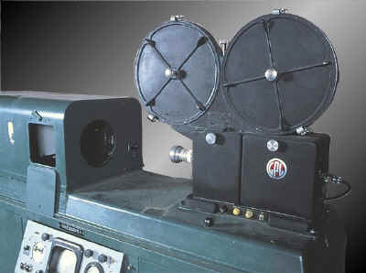
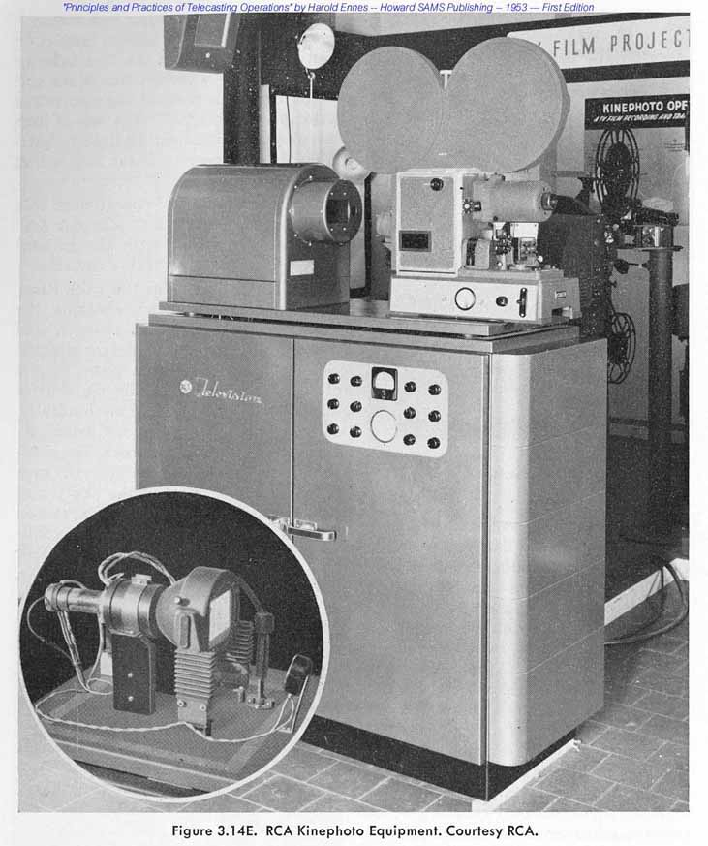
Film Chain

Slide 7
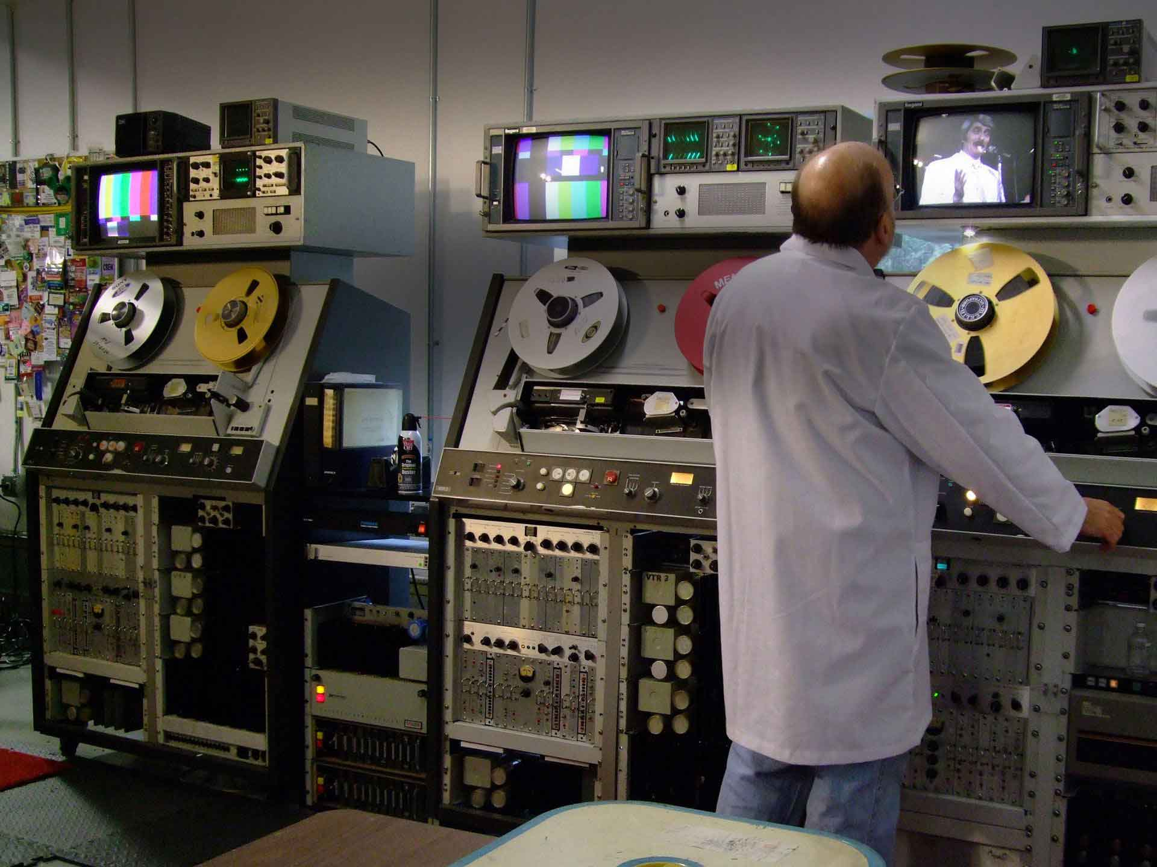
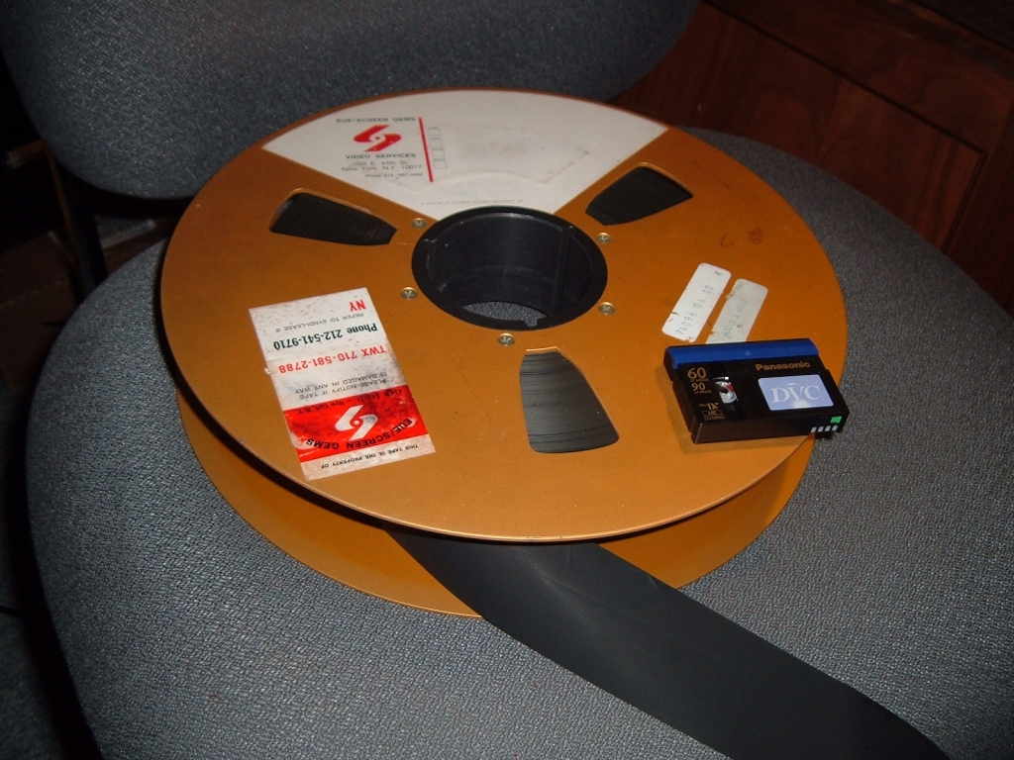
Videotape
(1956)
Quadruplex
-2 inches-

Slide 8
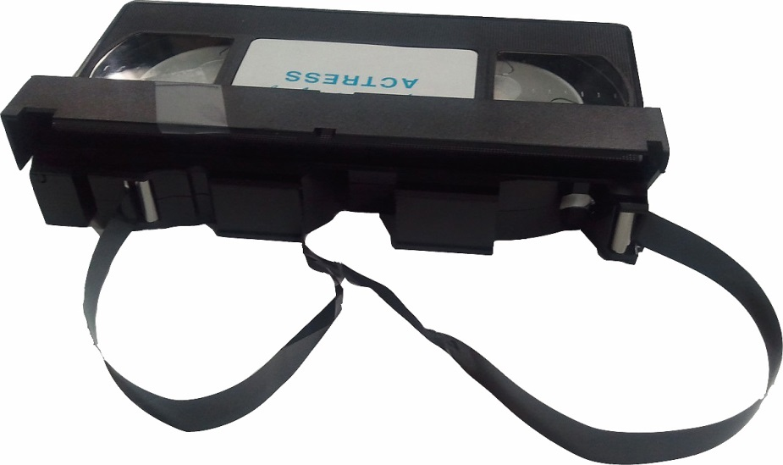
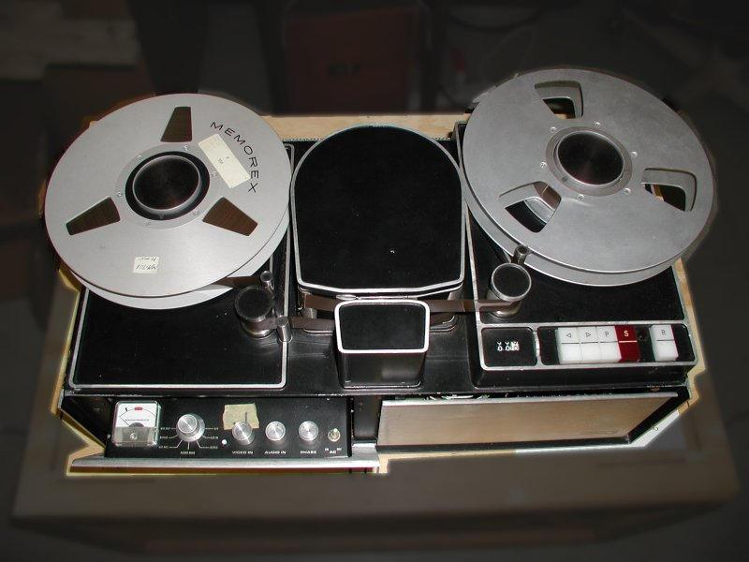
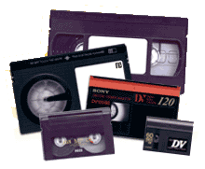
Videotape

Slide 9
Videotape Composition
Mylar
Ferrous Oxide Particles

Slide 10
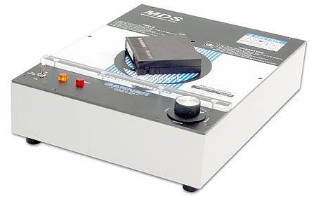
Degausser/Bulk Eraser

Slide 11
Videotape Tracks
Video
A₁
Audio
A₂
0:00/0:01/0:02/0:03/0:04/0:05/0:06/0:07/0:-8/0:09/0:10

Slide 12
Videotape Tracks
Time Code
Track
0:00/0:01/0:02/0:03/0:04/0:05/0:06/0:07/0:-8/0:09/0:10

Slide 13
Time Code
( h m s f )
04:10:23:18

Slide 14
Frame-Accurate
Editing

Slide 15
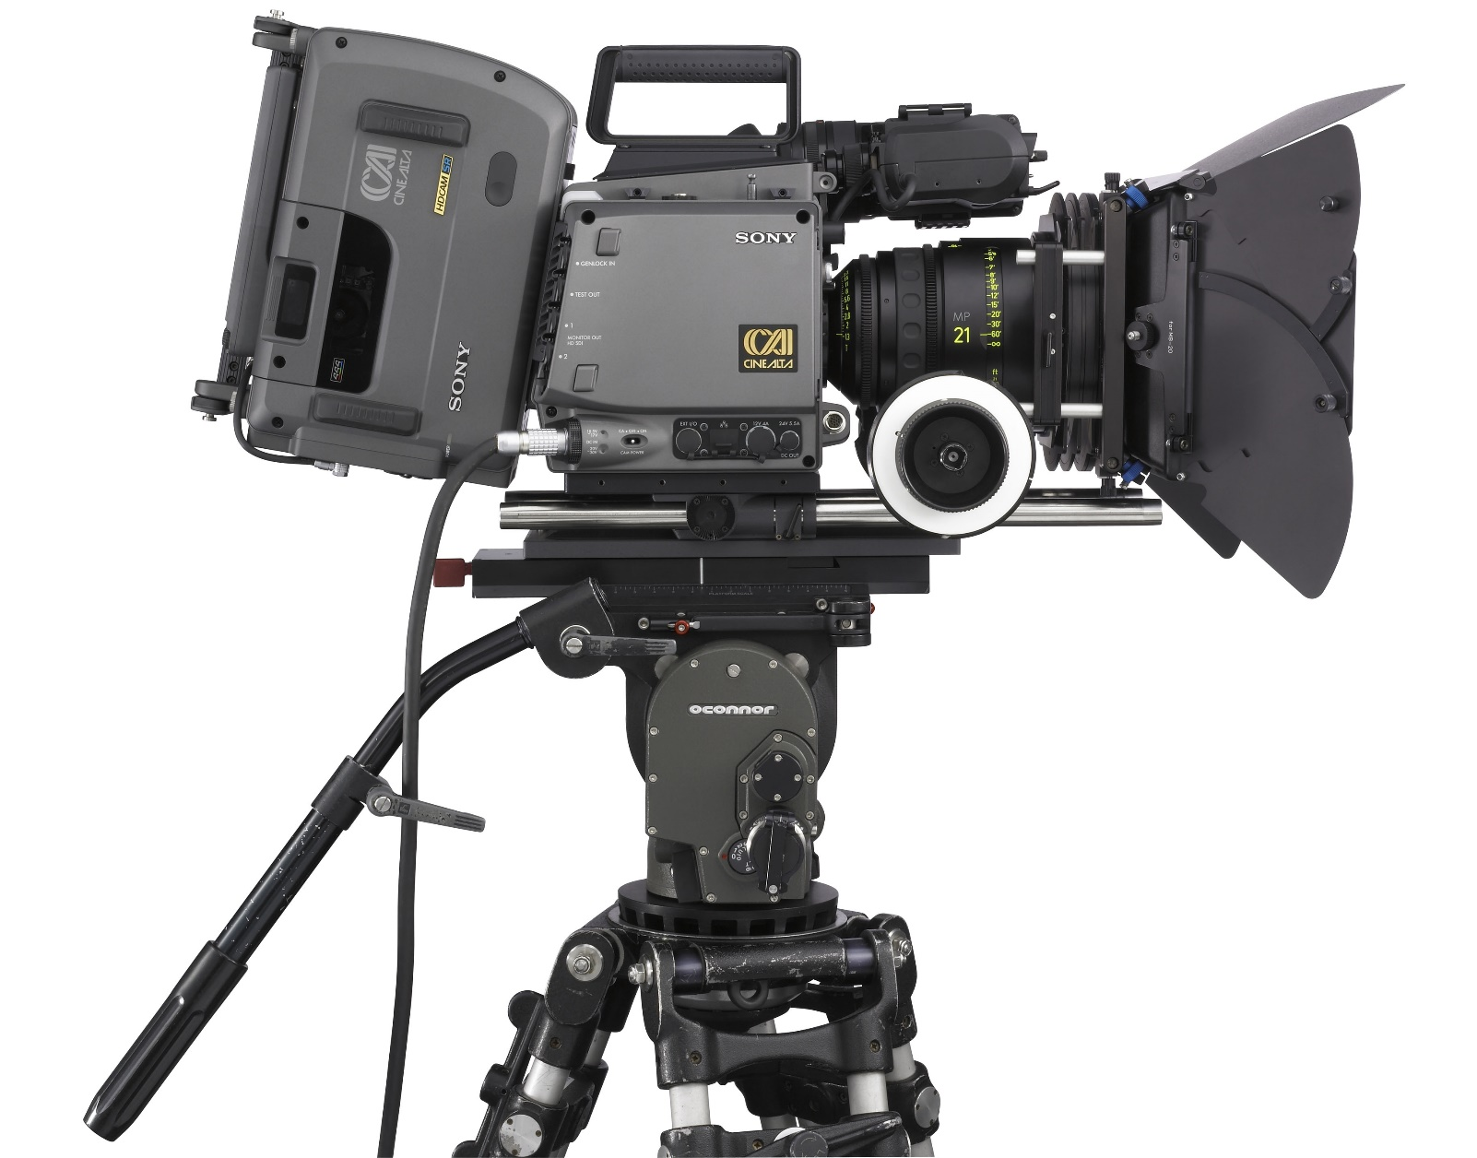
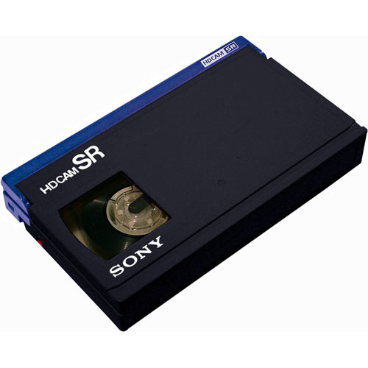
Dockable Tape Drives

Slide 16
Tape
Alternatives

Slide 17
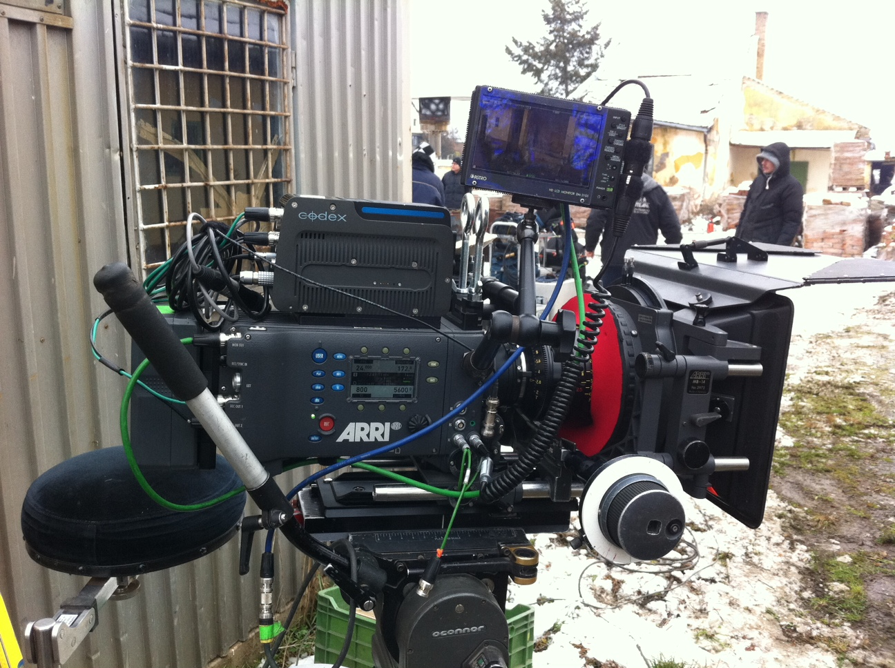
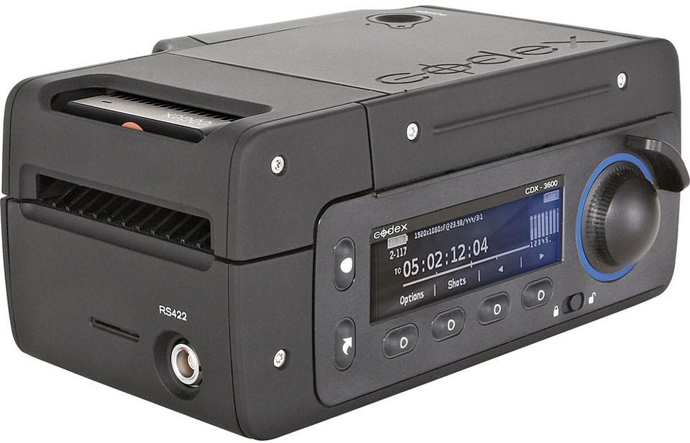
Onboard Hard Drives

Slide 18
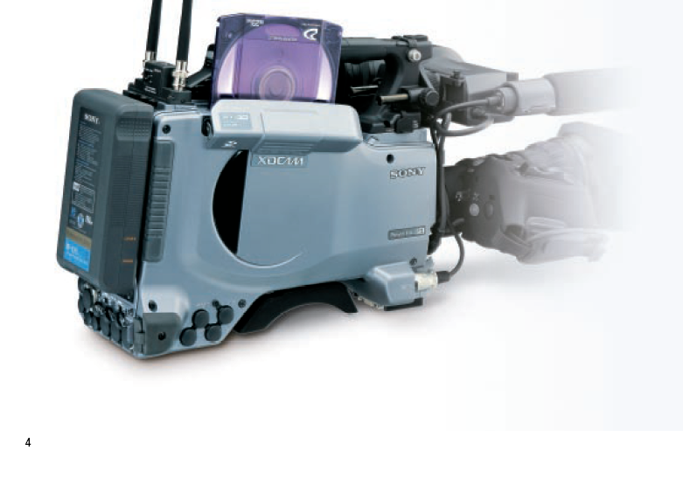
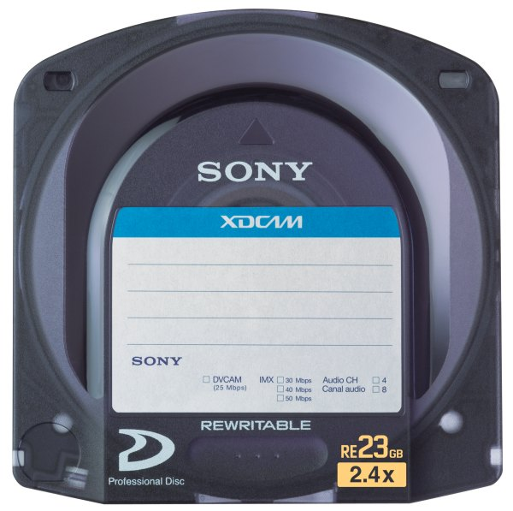
Optical
Disk
Drives
(Sony XDCAM)

Slide 19
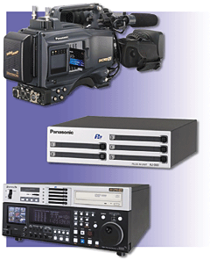
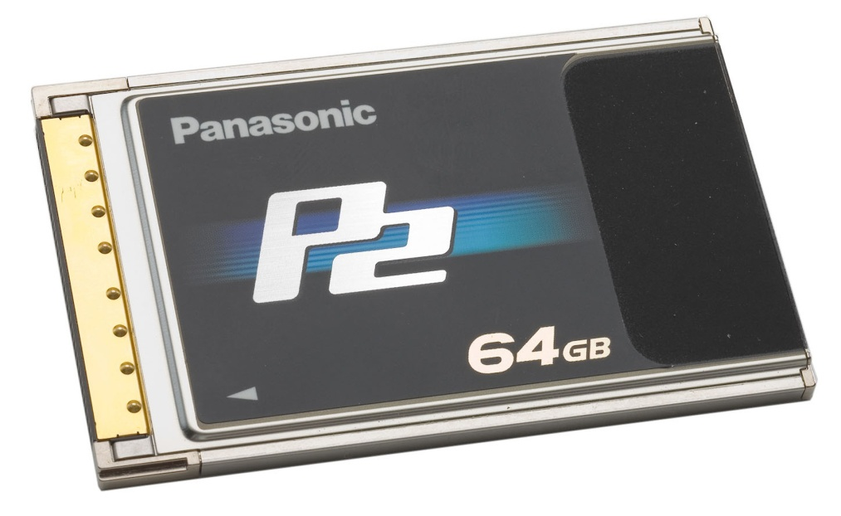
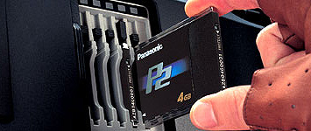
Memory Card Drives
Panasonic
P2
System

Slide 20
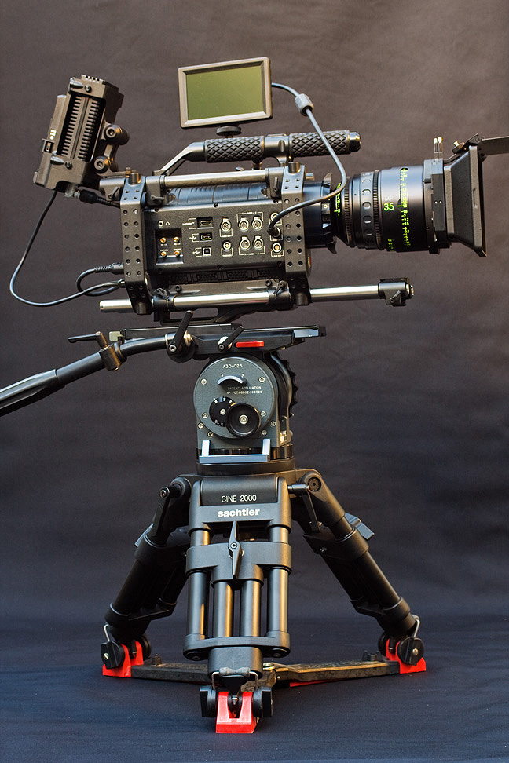
RED CAMERA SYSTEM

Slide 21
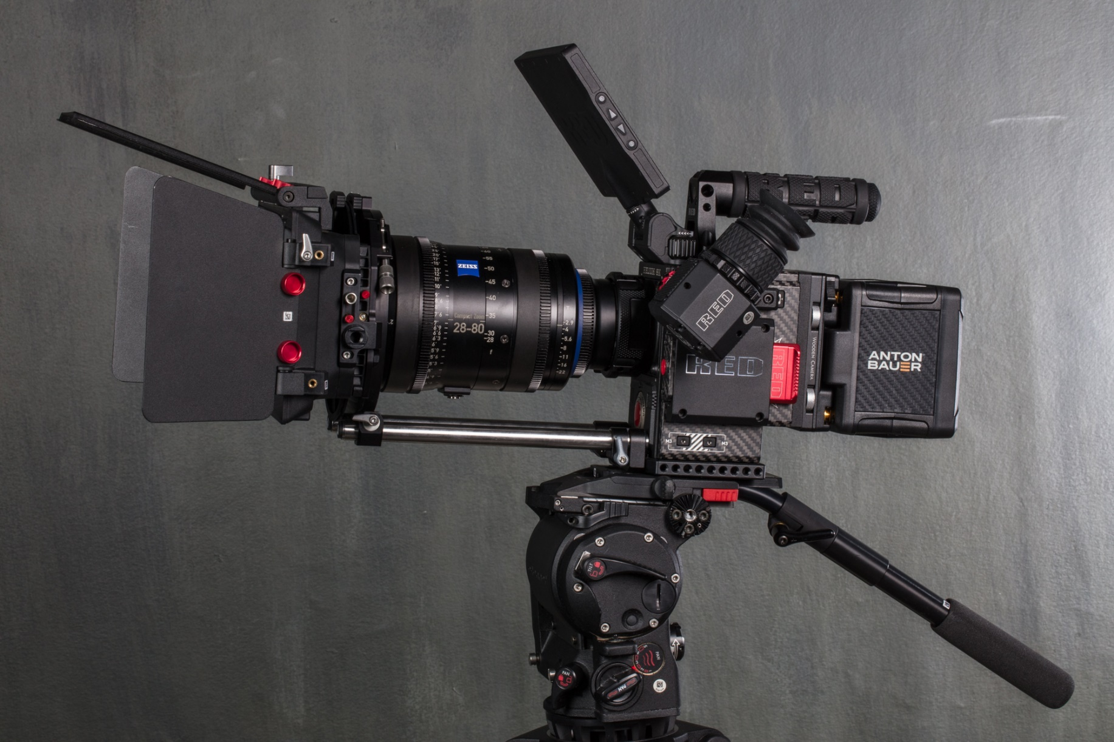
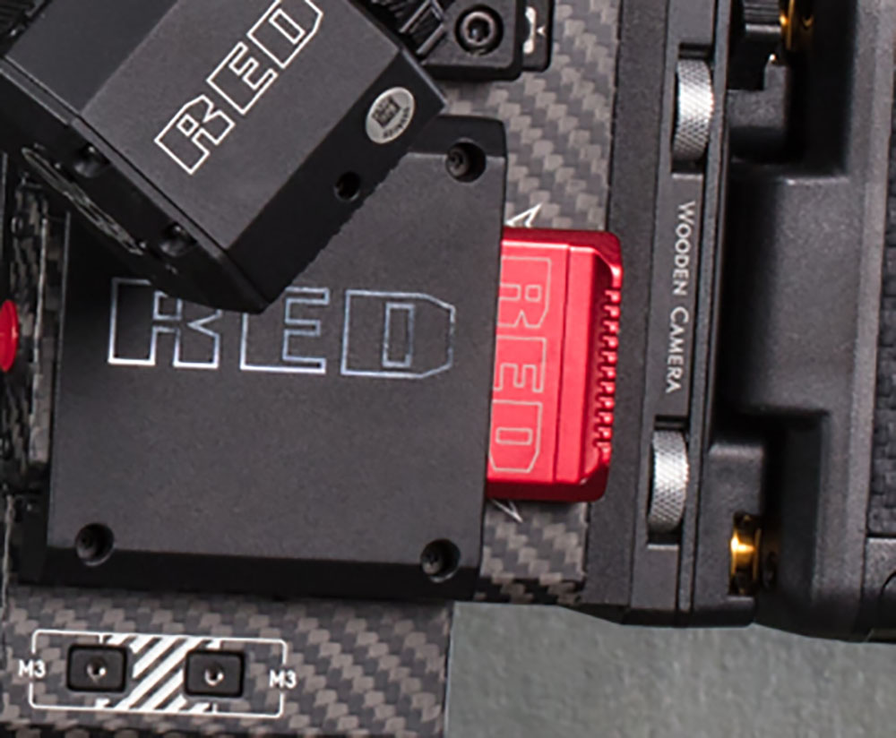
RED CAMERA SYSTEM

Slide 22
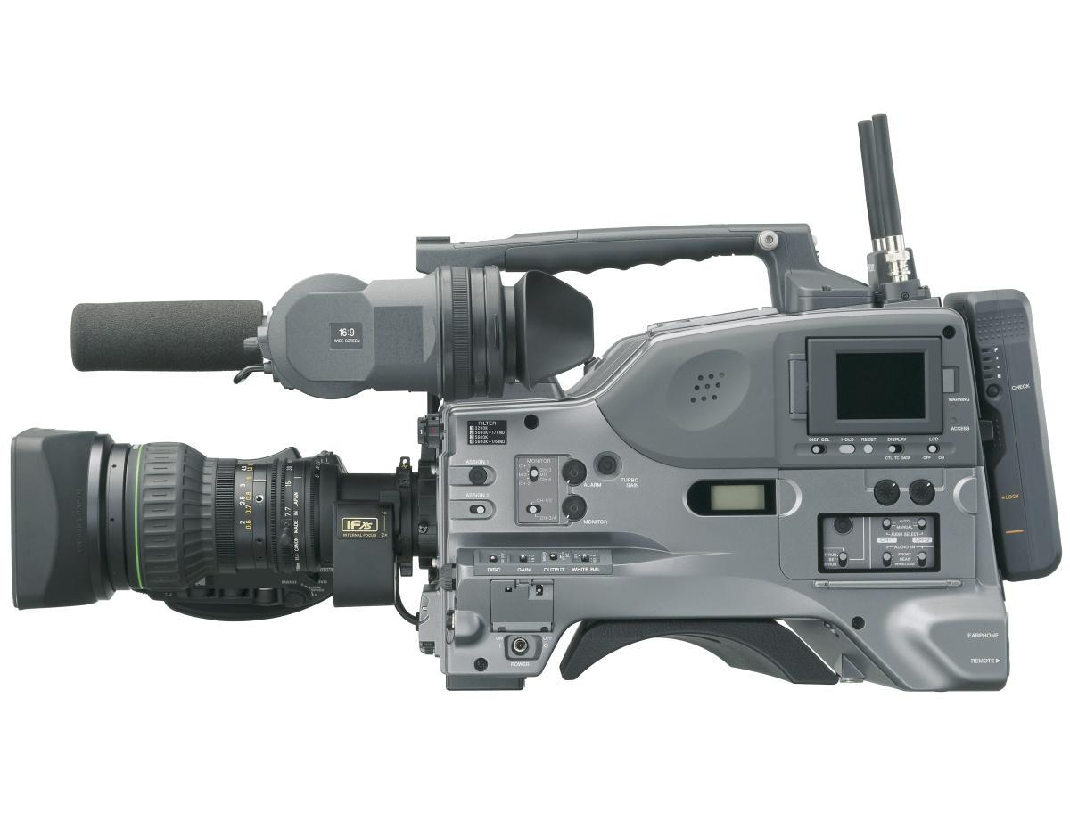
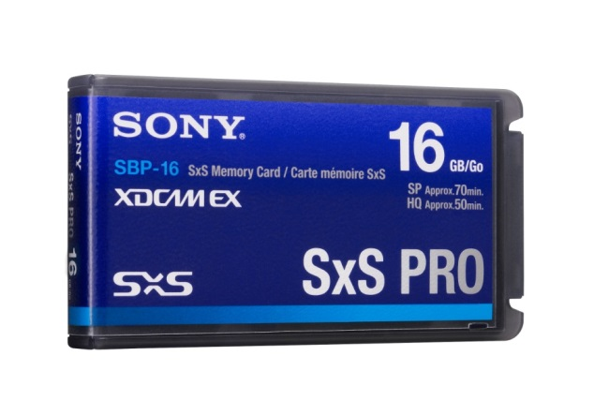
Sony XDCAM
(memory cards)

Slide 23
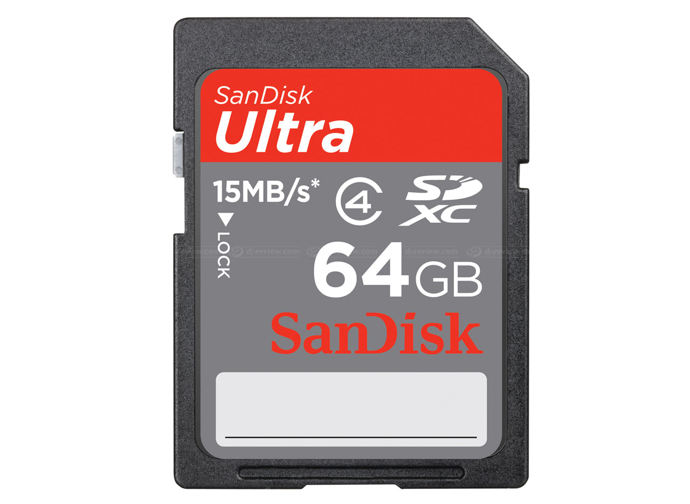
SD Cards

Slide 24
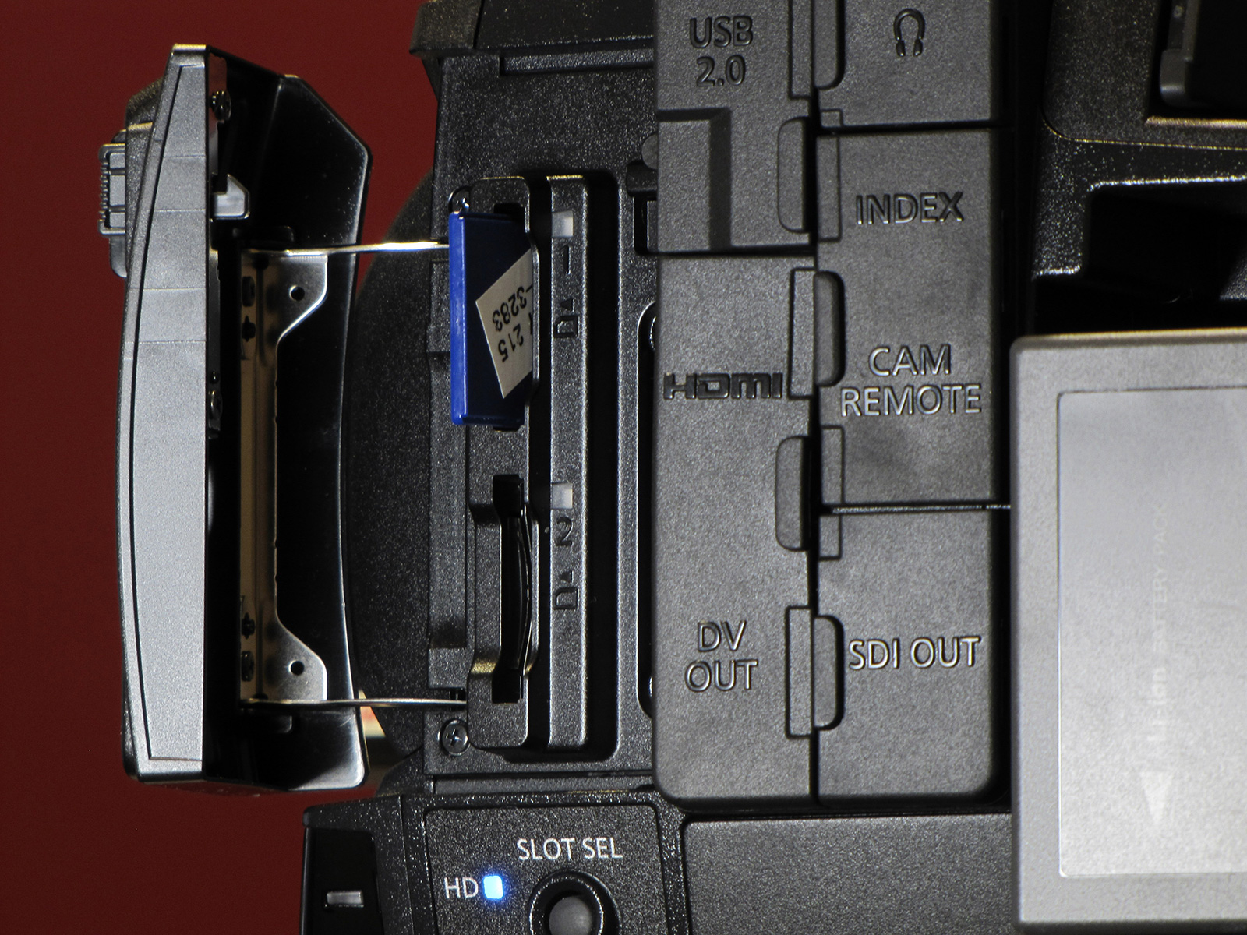

Slide 26
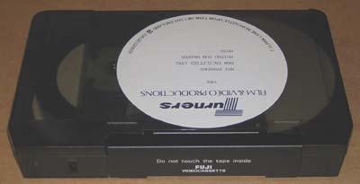
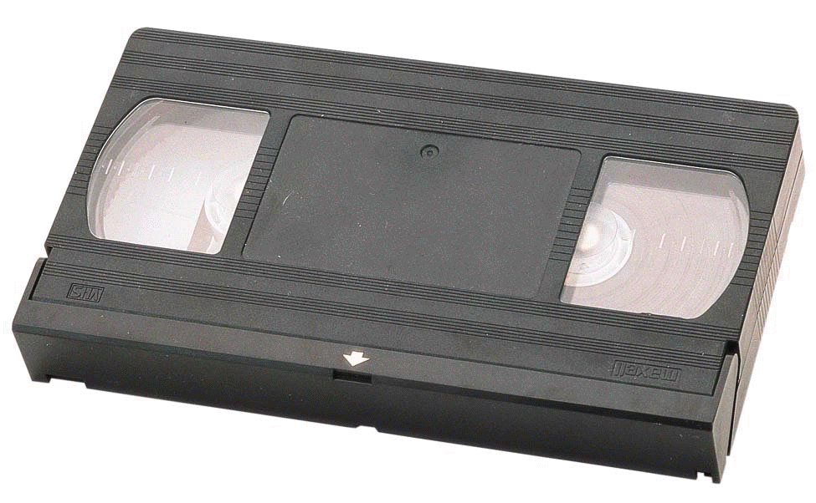
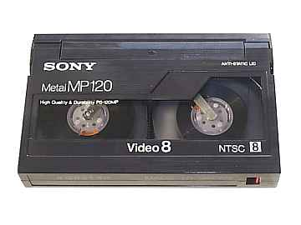
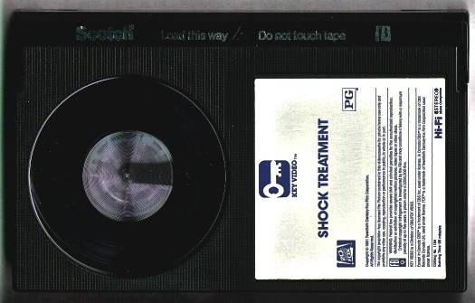
Videotape Cassettes
U-matic – ¾ inch (late 1970’s)
Consumer formats
½ inch (early 1980’s)
BETAMAX/VHS
8mm

Slide 27
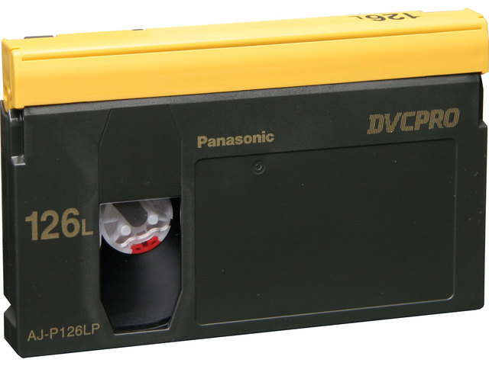
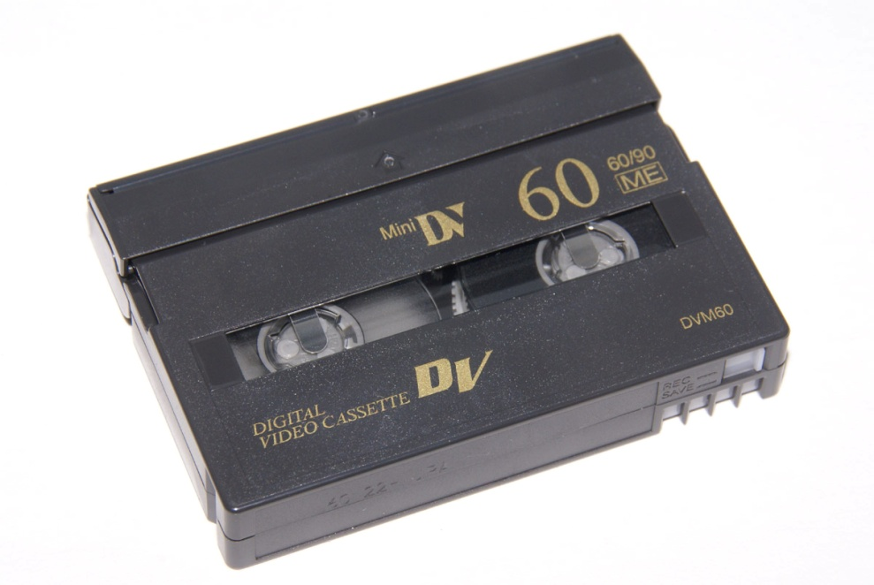
Digital Videotape

Slide 29
RED CAMERA SYSTEM
true cinematic orientation
high resolution
“affordable” cost (?)

Slide 30
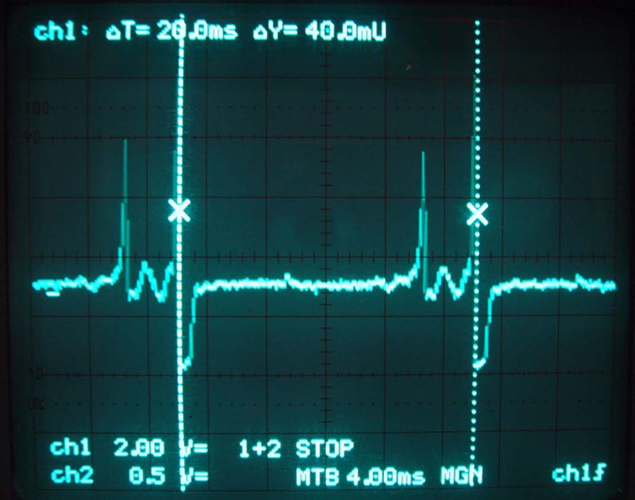

Slide 31
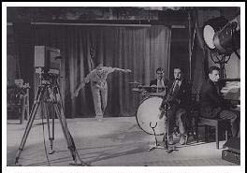
Kinescope

Slide 32
Time Code
0:00:00:01
0:00:00:02
0:00:00:03
0:00:00:04
0:00:00:05
0:00:00:06
0:00:00:07
0:00:00:08
0:00:00:09

Slide 33
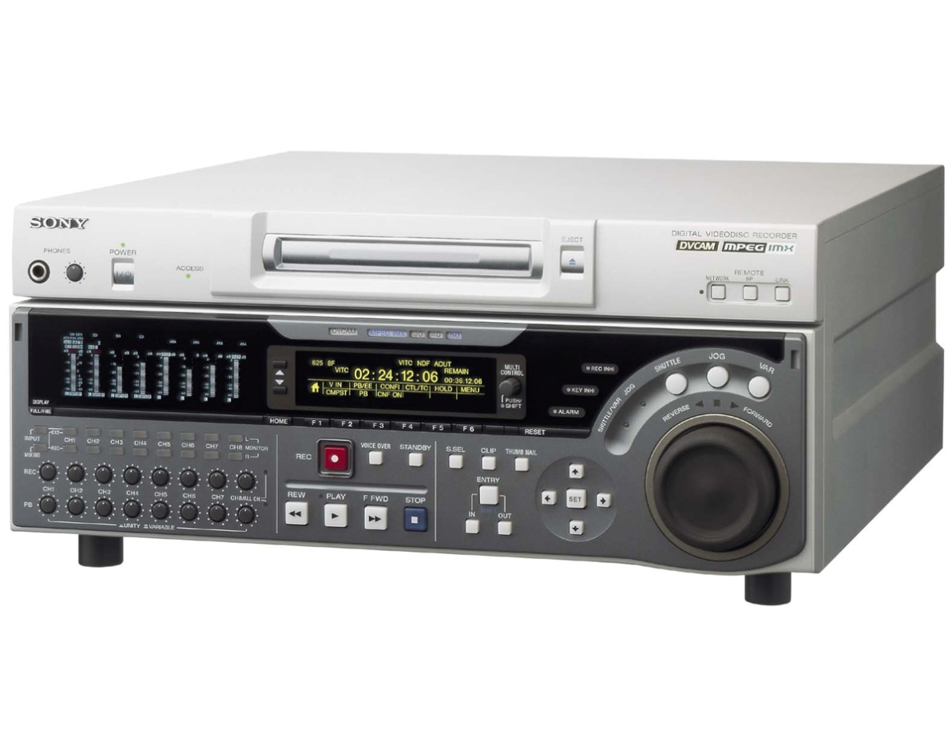
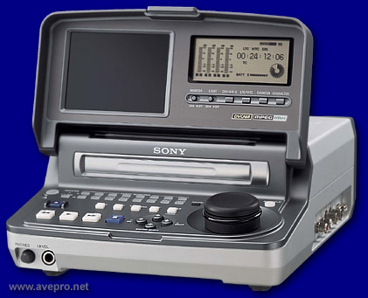

Slide 34
Transverse Scan
vertical frames
only for quadruplex tape
tape needs to be very wide
Helical Scan
diagonal frames
all tape formats after quadruplex
tapes could become narrower
AKA slant-track

Slide 35
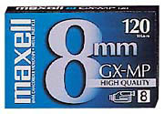
Compact Videotape

Slide 36
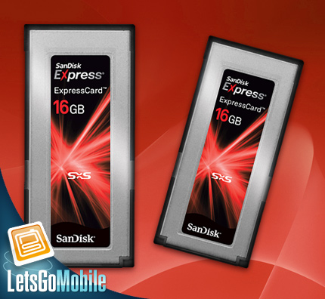
Memory
Cards/Sticks

Slide 37
Videotape Size
bandwidth
scanning method
analog to digital

Slide 38
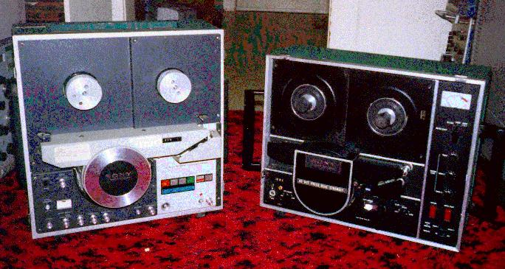
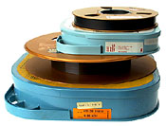
Videotape Size
-1 inch-
(1975)

Slide 39
Transverse Scanning

Slide 40
Helical Scanning

Slide 41
Helical Scanning

Slide 42
Consumer Recording
Formats
SD – DV (Digital Video)
HD – AVCHD
(Advanced Video Codec High Definition)
(Sony/Panasonic consumer/prosumer)
HDV – (High Definition Video)
(videotape)

Slide 43
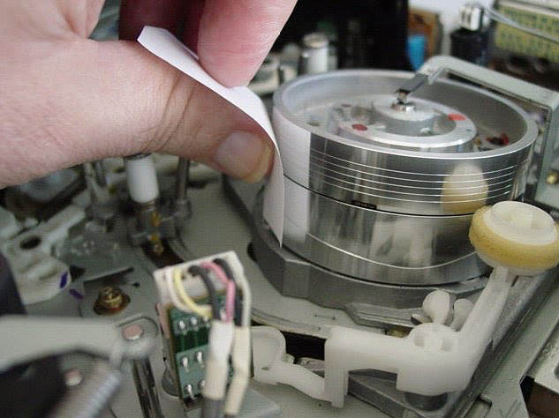
Head Assembly
drum
video/audio heads

