Slide 1
Chapters 5, 6, & 7
Television CAMERAs, Lenses, Camera operation and picture composition

Slide 2
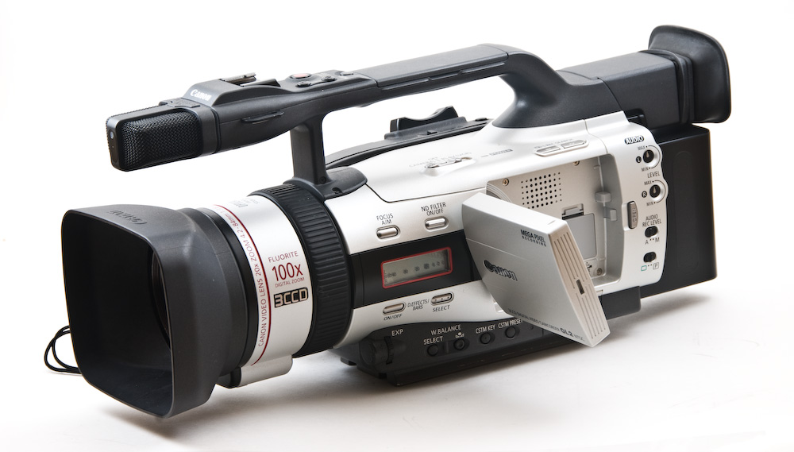
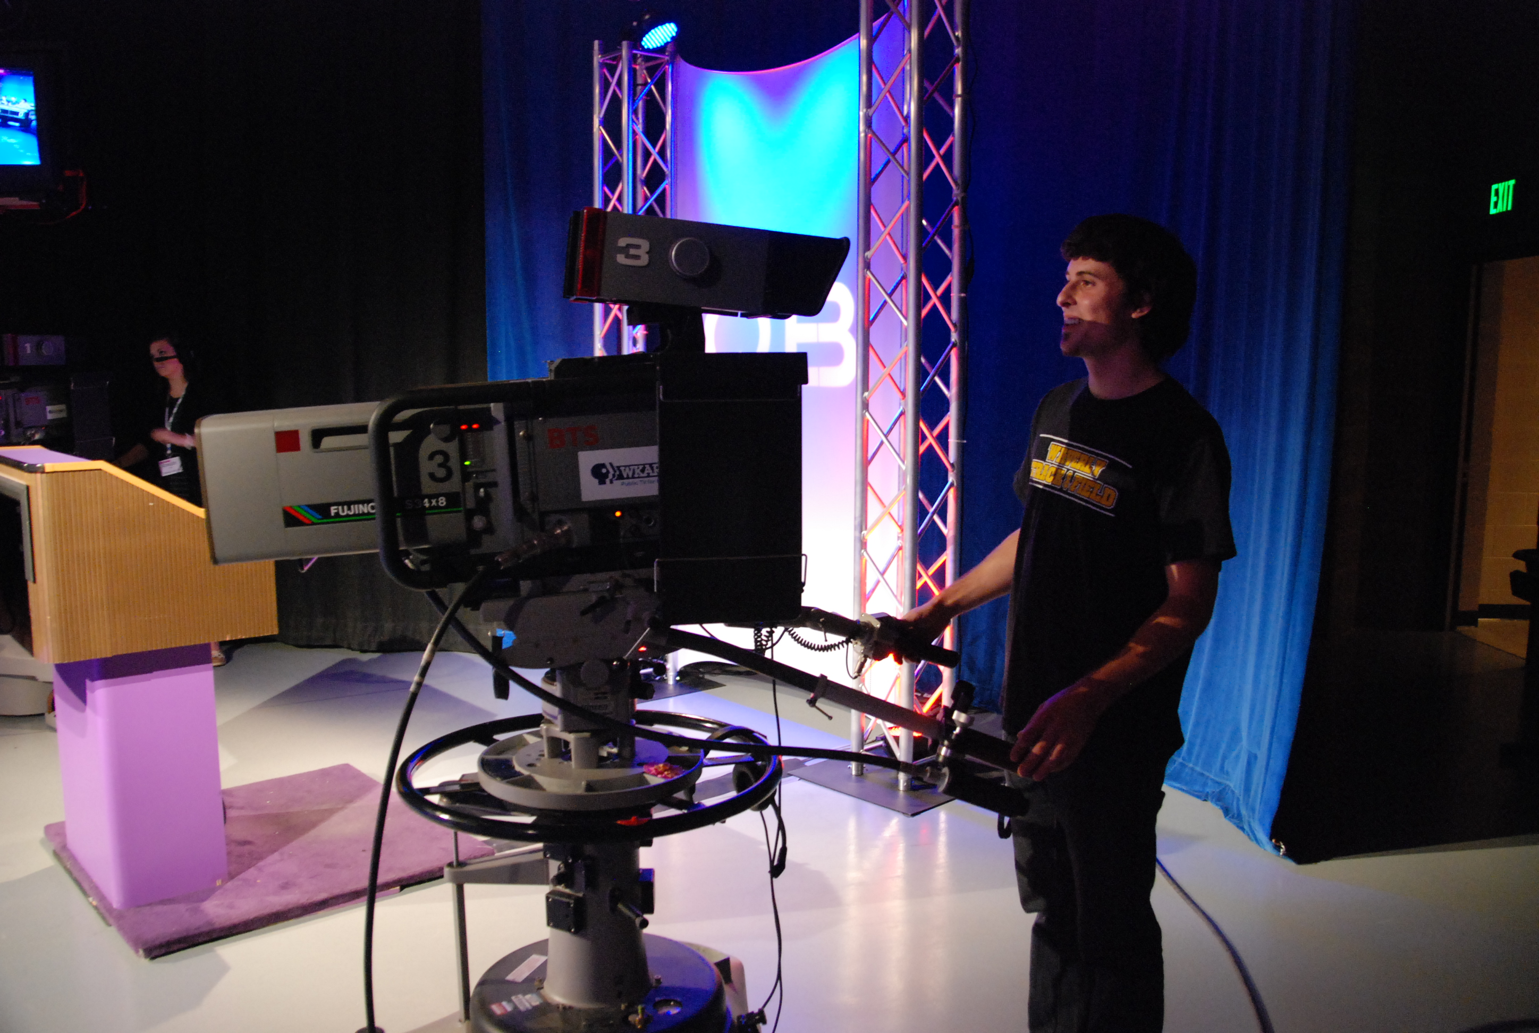
Television cameras
Camera Parts
Cam Body – includes imaging device or CCD (how we get the picture)
Viewfinder – how we see what the camera sees
Lens – the zoom lens for most video cams
Camera mount – tripod, steadicam, studio pedestal, jib, crane

Slide 3
Digital vs analog cams
SD, Standard Definition vs HD, High Definition
SD was analog and 525 horizontal scan lines to the picture
HD is digital and 1080 horizontal scan lines to the picture
More than double the resolution in HD and you can see the difference.
SD is a 3:4 Aspect Ration and HD is 16:9 Aspect Ration (much wider than SD)
Currently professionals all use HD cameras and gear
Some professionals (and our facility too) are beginning to use 4K camera technology (4K refers to a horizontal screen display resolution in the order of 4,000 pixels. Specifically, 3840 × 2160, these become very large files when editing requiring much storage capacity)

Slide 4
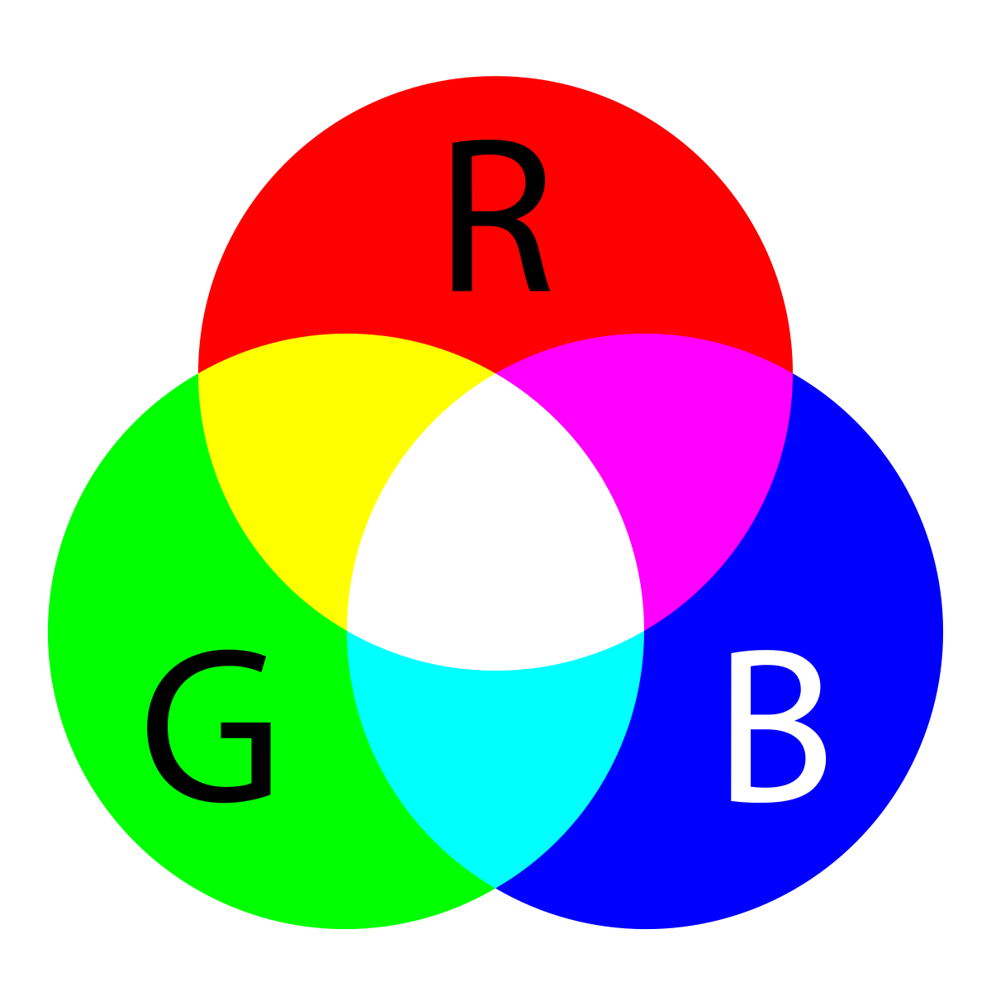
Professional Studio and Field cameras have these features
Imaging Device – Usually CCD’s (Charged Coupled Device) but they vary in size and cost
Gain switch – A signal boost that makes your image appear brighter even in low light situations but will add video noise
White Balance switch – It balances the cameras colors (and white) for the light that you are shooting in
Electronic Shutter – The faster an object or subject moves the shutter speed needs to be higher to avoid a blurred image.
Filter Wheel – Located between the lens and the imaging device, internal filters that usually have 4 settings, one for outdoor, one for indoor, and a couple of Neutral Density filters (sunglasses on the lens on very sunny days)

Slide 5
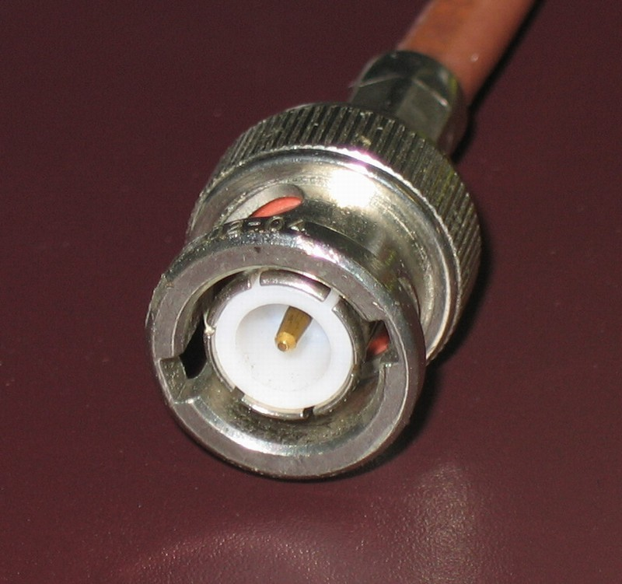
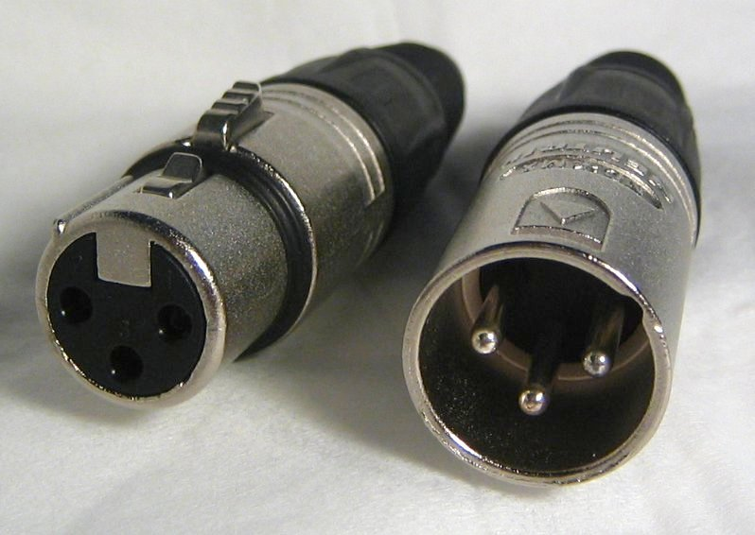
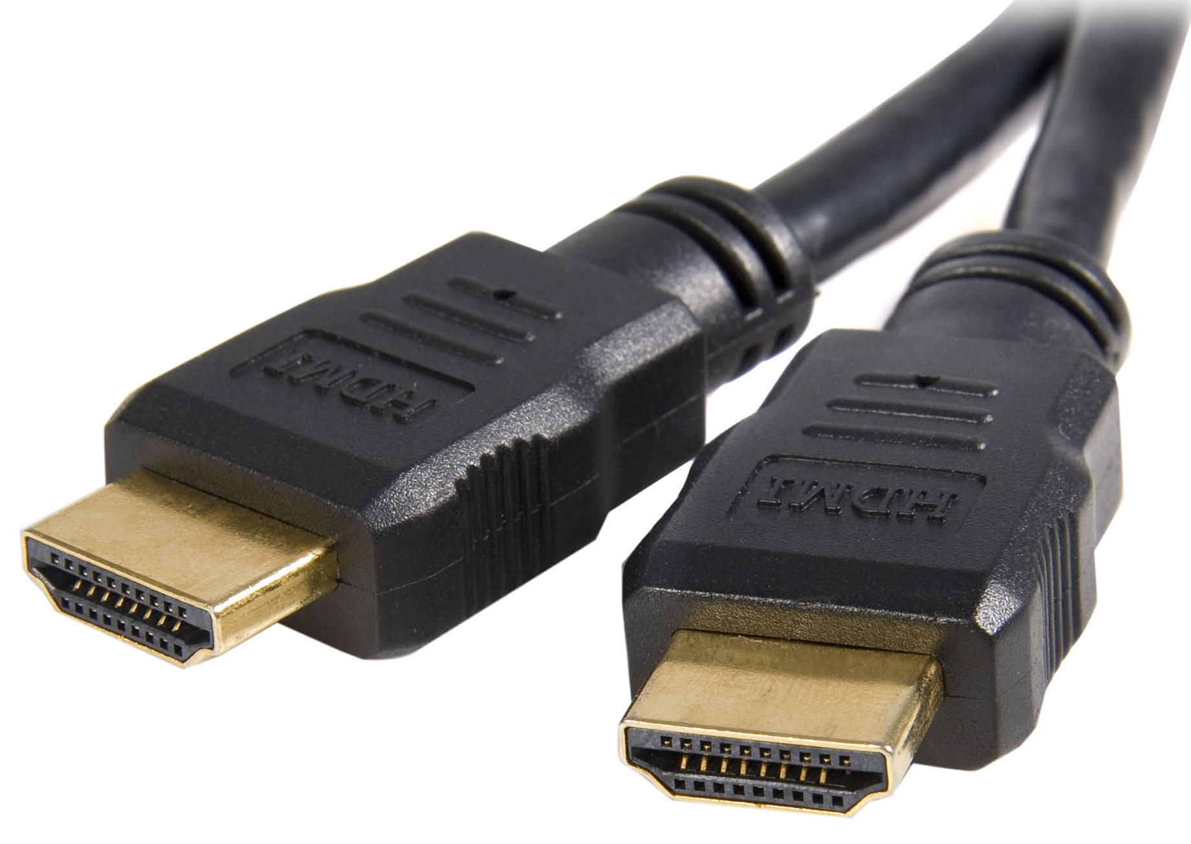
Other camera features
Power supplies – AC adaptor and/or batteries
Cables and connectors
Tally light
Viewfinder and/or fold out monitor (usually on field cams)
Contrast Ratio of 50:1 (this means the brightest part of the picture can only be 50 times brighter than the darkest part of the picture, tricky if you are shooting in high contrast areas or even with someone who has a black shirt on and white pants … to get detail in the black shirt the pants would appear too bright or to get detail in the pants then the shirt would go too dark)

Slide 6
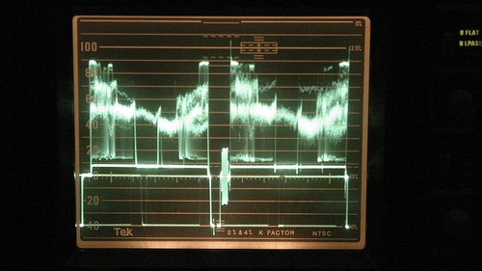
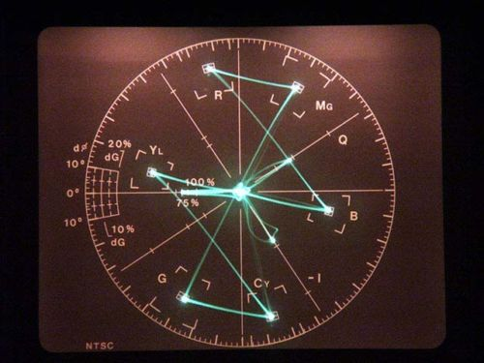
waveform monitors & vectorscopes
Waveform monitor measures brightness for a video image – needs to be at 100 IRE for broadcast
Vectorscope measures color balance of video image – see image below Red is at 11 o’clock, blue at 4 o’clock and green at 7 when balanced correctly.

Slide 7
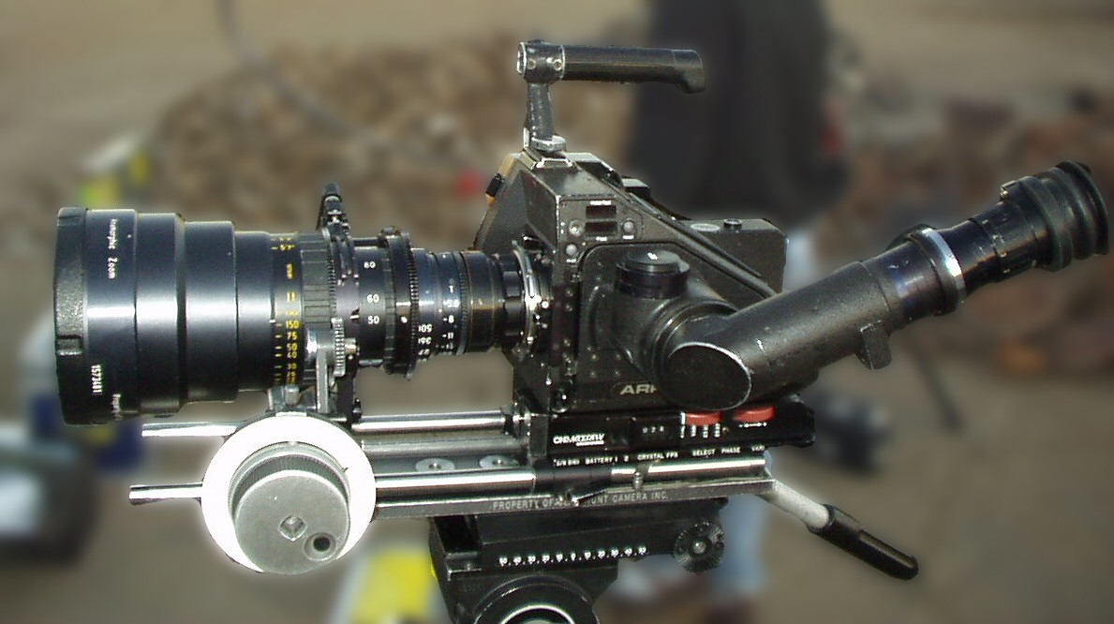
Lenses
Zoom lenses is what more videographers use because we can get wide (long) shots or extreme close ups with the same lens (they are also called variable focal length lenses).
Zoom lenses are expressed in range, or ratio such as the standard 16 to 1 (or 16:1 is how it is expressed) zoom lens means it can have 16 times the magnification.
The larger the number the greater the range/magnification (a 55:1 zoom lens can give you the range of an entire football field or give you a close up of the quarterback’s face).
Digital zooming is a “digital effect” where the electronics of the camera selects the center portion of the long shot and enlarges the cropped area to full-screen size. The problem with digital zooming is that the enlarged picture noticeably reduces the image resolution creating a pixilated look. Professional cameras do not have digital zoom as a option (this is a more consumer camera feature).

Slide 8
More on LENSEs
All professional zoom lenses have three (3) rings. From front to back they are:
Focus ring, zoom ring, iris ring
Focus allows us to bring subject or object into focus, zoom allows us to assume various focal distances (close up to long shot), and the iris is the mechanism within the lens that controls the amount of light sent to the imaging device.
Note about professional cameras and lenses: No professional cams have an auto focus on them … Why? Because we need to get pics in focus fast and sometimes auto focus takes awhile so it is not even an option on a pro cam.
There is an auto iris feature that pros use and it is helpful. It senses the light that you are shooting in and will open or close the iris the appropriate amount for optimum exposure.

Slide 9
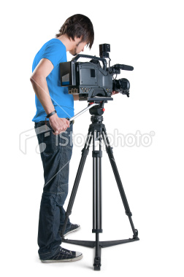
CAMERA OPERATION AND PICTURE COMPOSITION
Camera movements:
Pan means to move the camera horizontally left to right from tripod (pan right, pan left)
Tilt means to move the camera vertically up or down (tilt up, tilt down)
Truck means to move the camera AND tripod to the right or left (truck right, truck left)
Dolly means to move the camera AND tripod close or away from subject (dolly in, dolly out)
Pedestal means to elevate or lower the camera from a studio pedestal (pedestal up, pedestal down)
Crane means to move the whole camera up or down on a camera crane or jib arm (crane up or down)
Cant means tilting the shoulder mounted or handheld camera sideways creating a slanted horizon line (director will say “give me a canted shot” and cam op will tilt to either side)

Slide 10
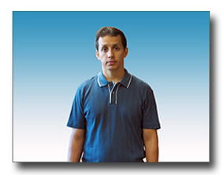
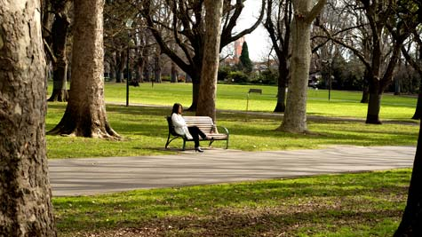
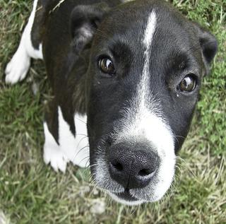
Can you name Picture’s “field of view”?

