Slide 1
Sound Terms
Signal
Gain
Modulation

Slide 2
Primary Sound
Objective
optimum sound quality

Slide 3
Acquisition
Sound Objective
Post-production
Sound Objective

Slide 4
Acquisition
Sound Objective
acquire best quality sound

Slide 5
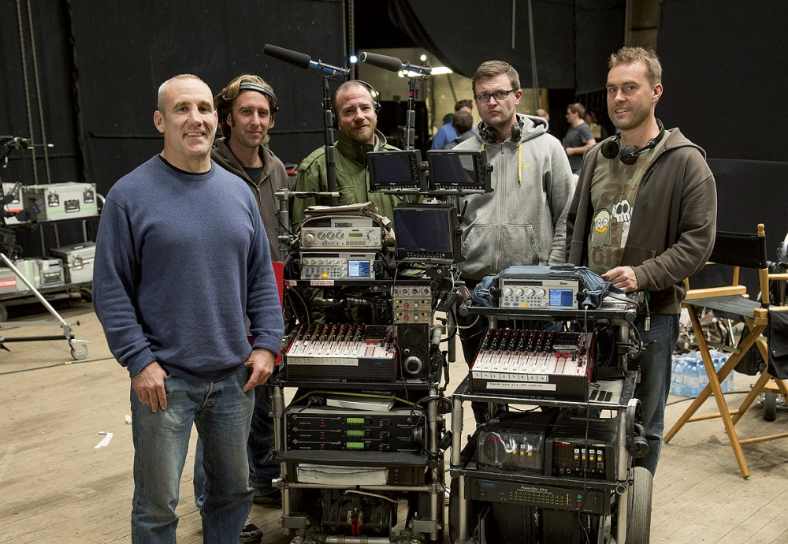

Slide 6
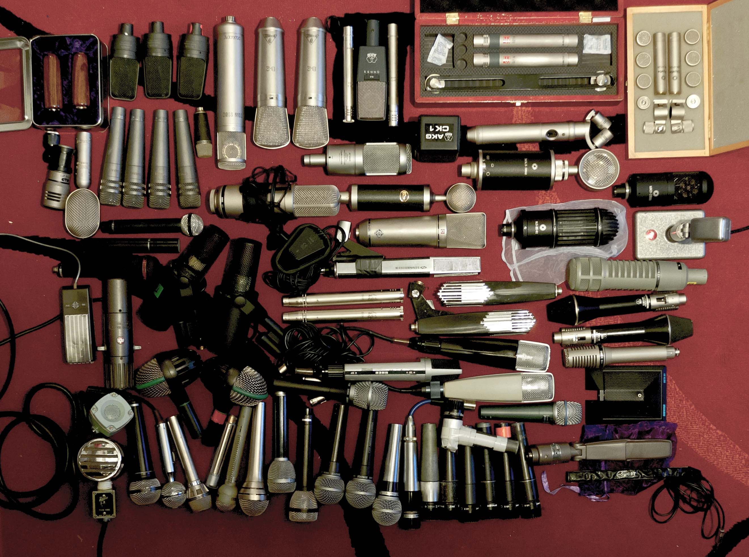

Slide 7
Post-Production
Sound Objective
create proper sound environment

Slide 8
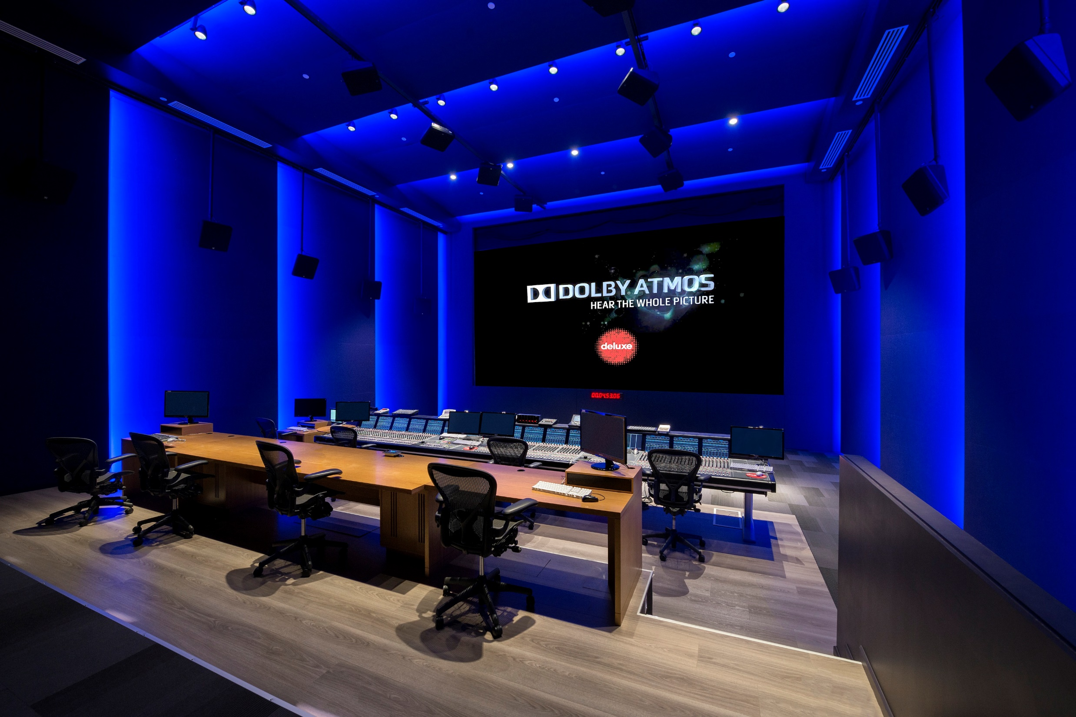

Slide 9
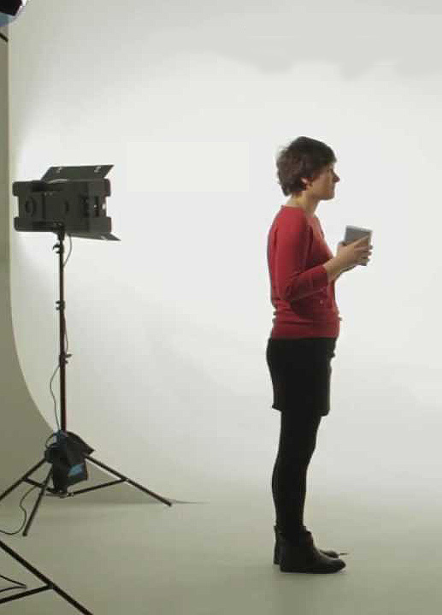
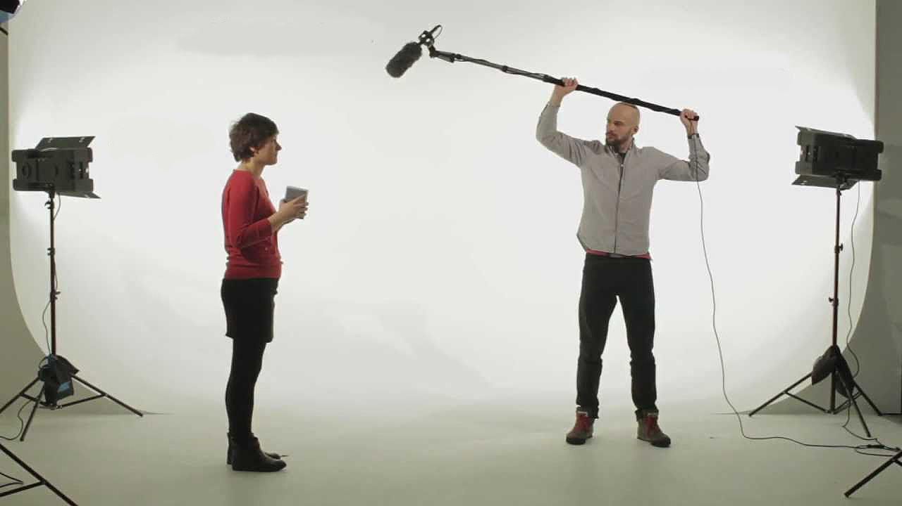
Production
Sound System
Sound Source
Transduction

Slide 10
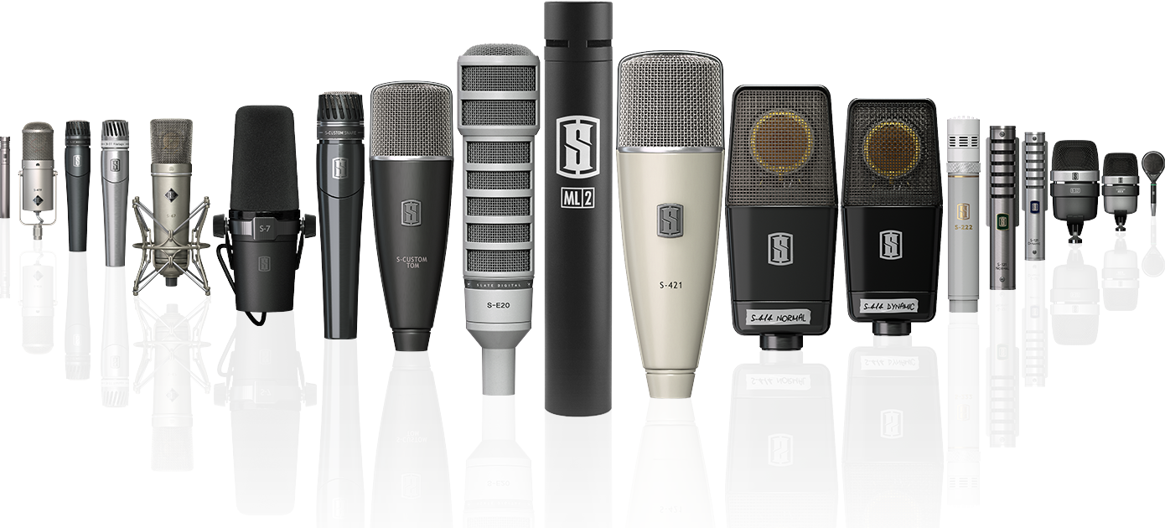
Microphones

Slide 11
Production
Sound System
Sound Source
Transduction
Signal Transport

Slide 12
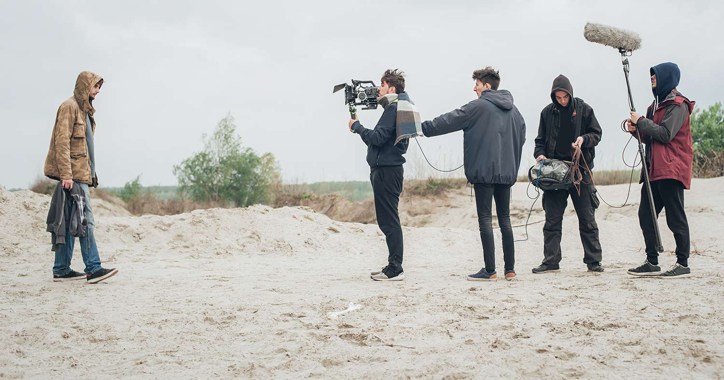
Field

Slide 13
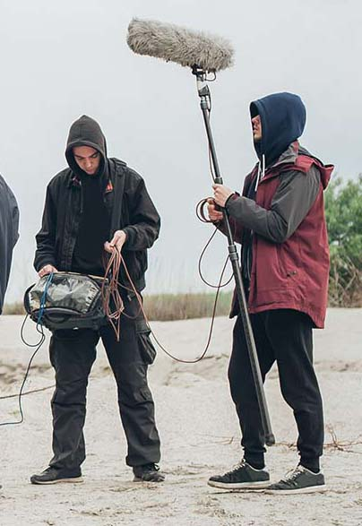
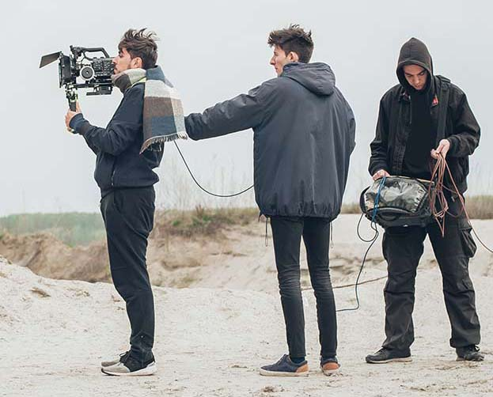
Field

Slide 14
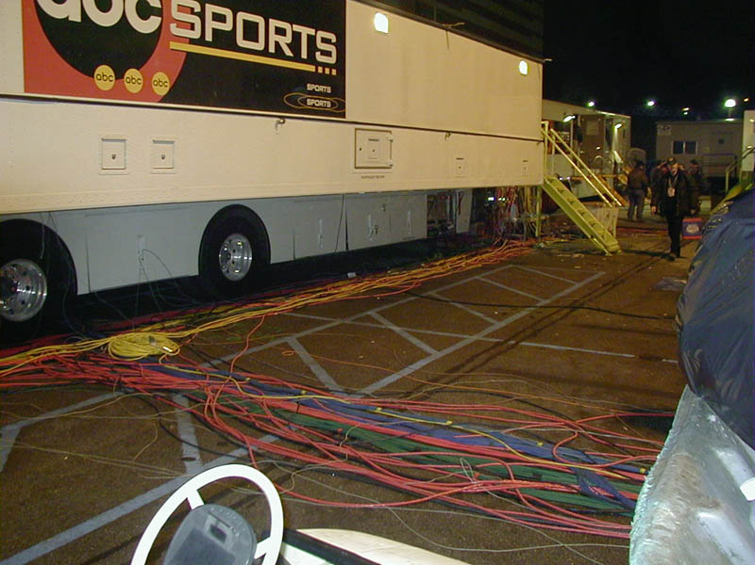
Field

Slide 15
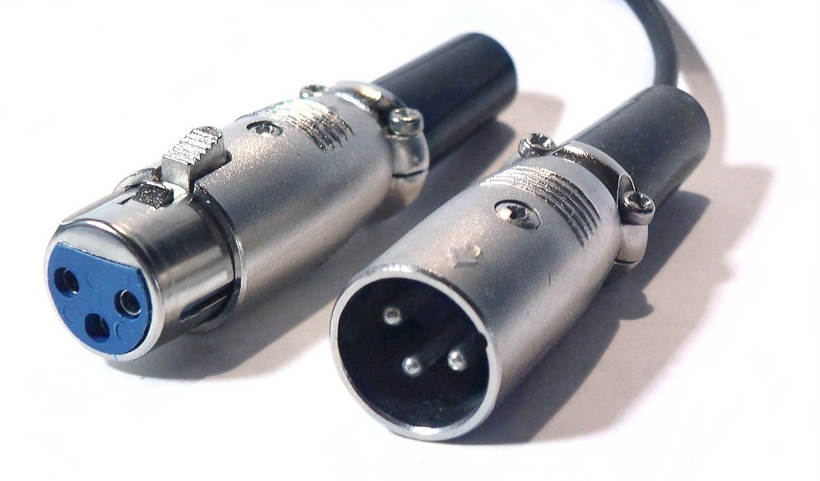
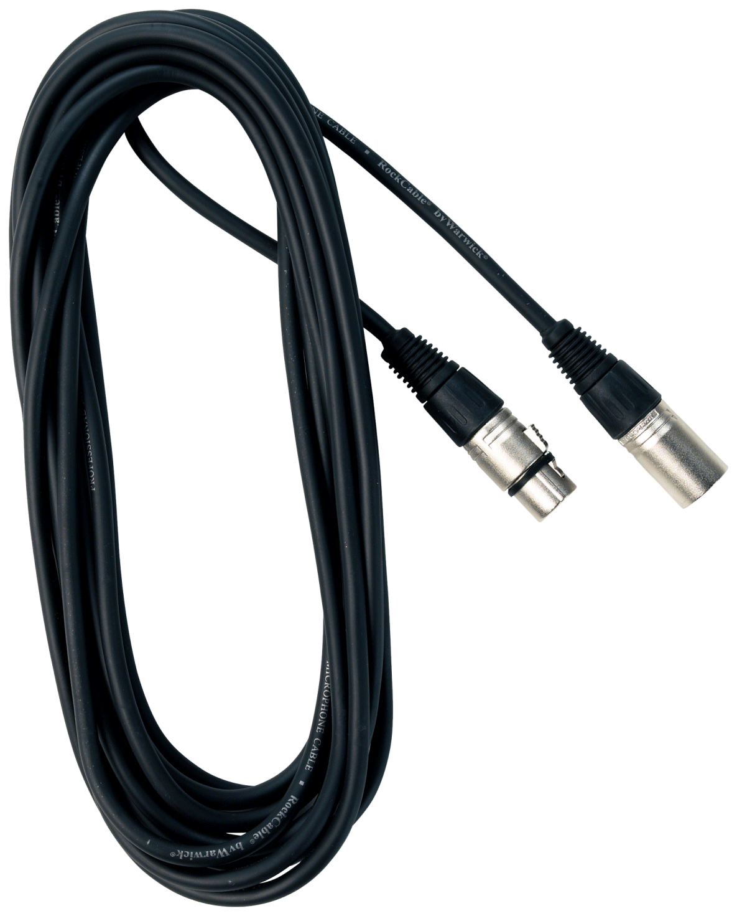
Audio Cables
XLR

Slide 16
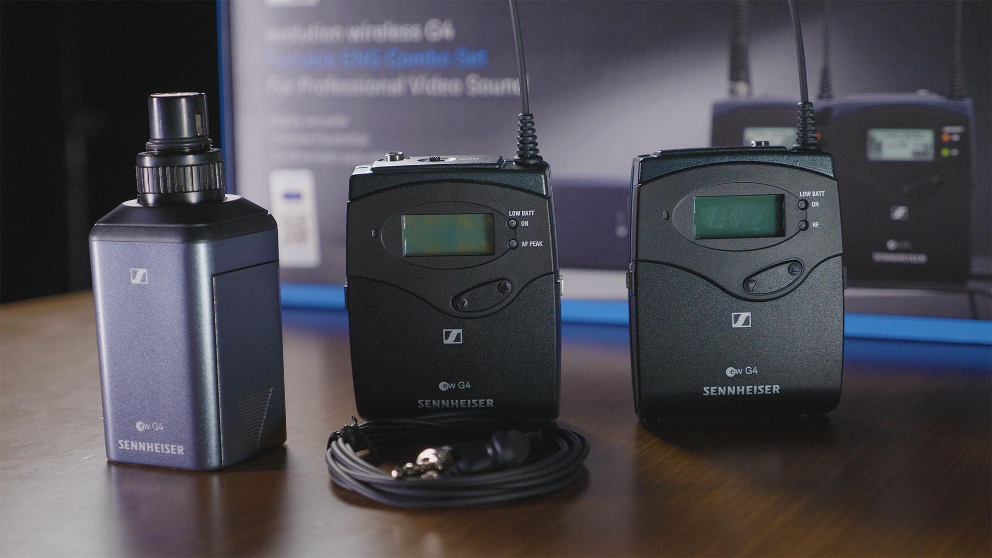
Wireless

Slide 17
Wireless

Slide 18
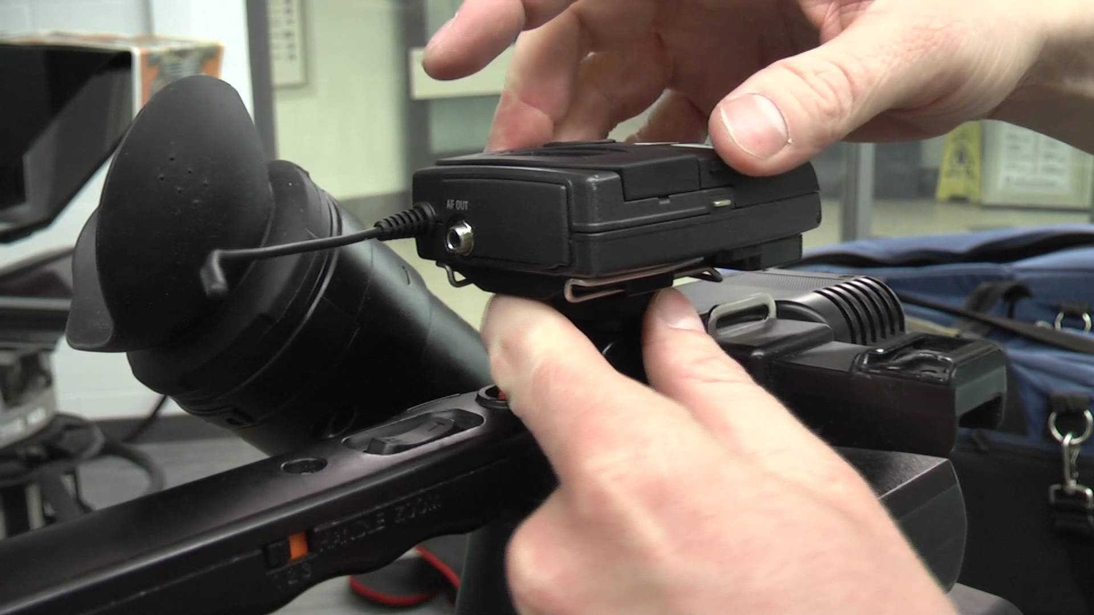
Wireless

Slide 19
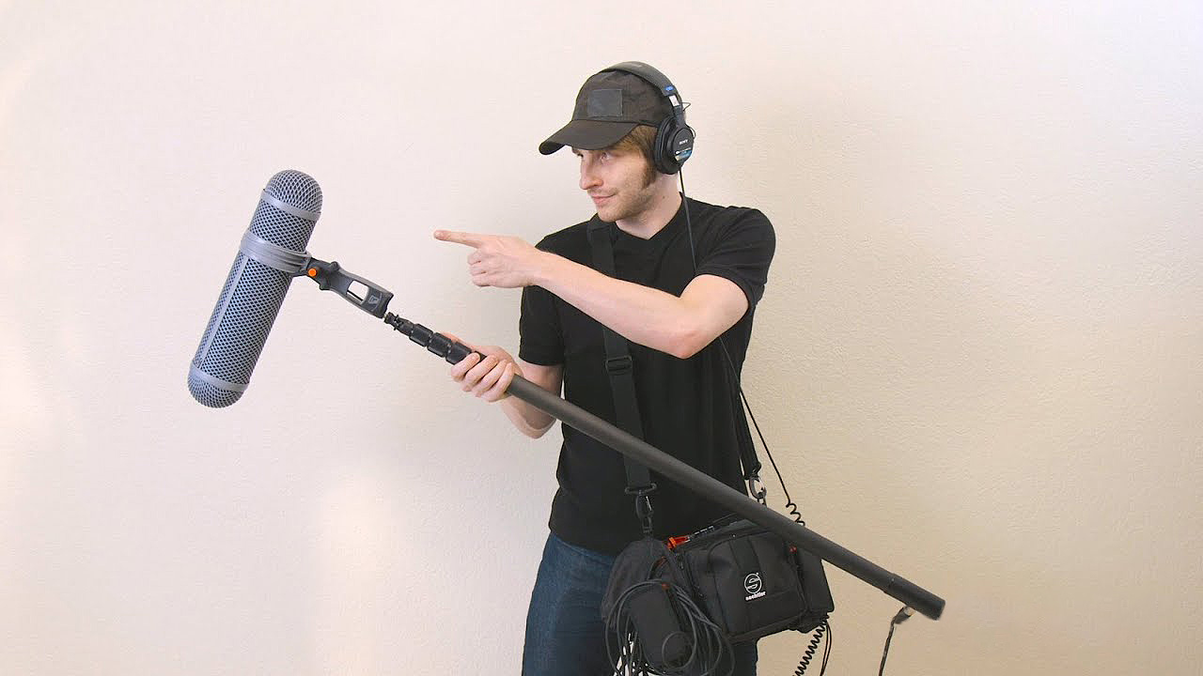
Wireless

Slide 20
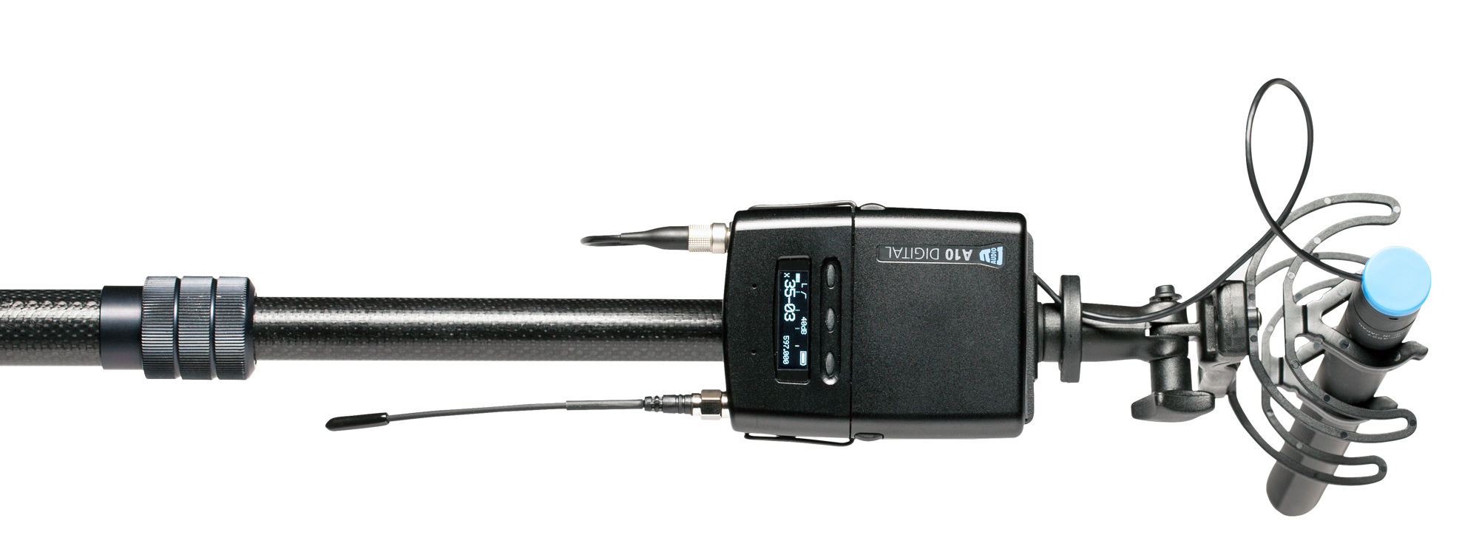
Wireless

Slide 21
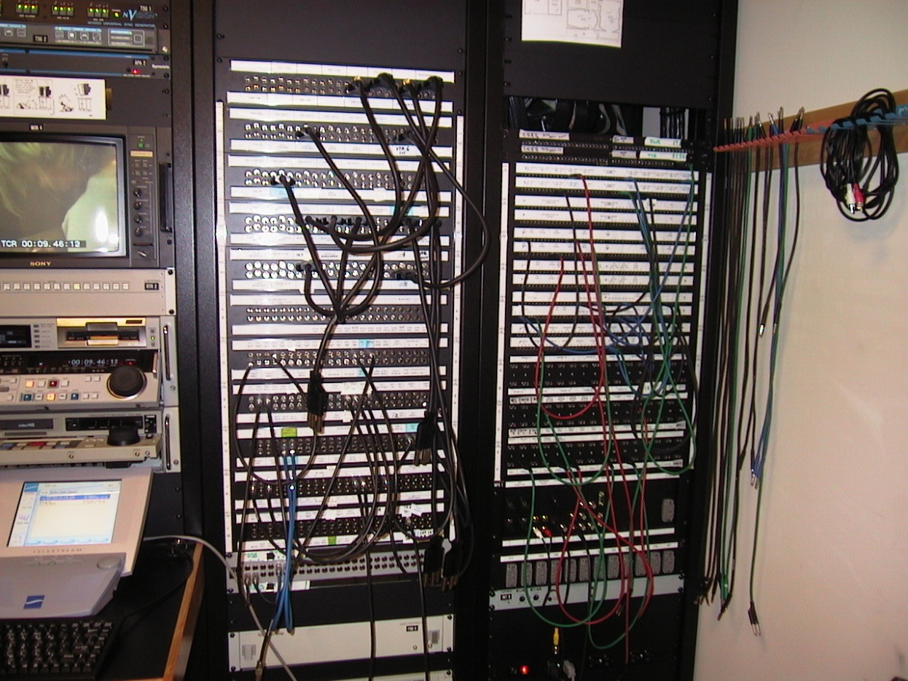
Studio/Broadcast
(Patch Panel)

Slide 22
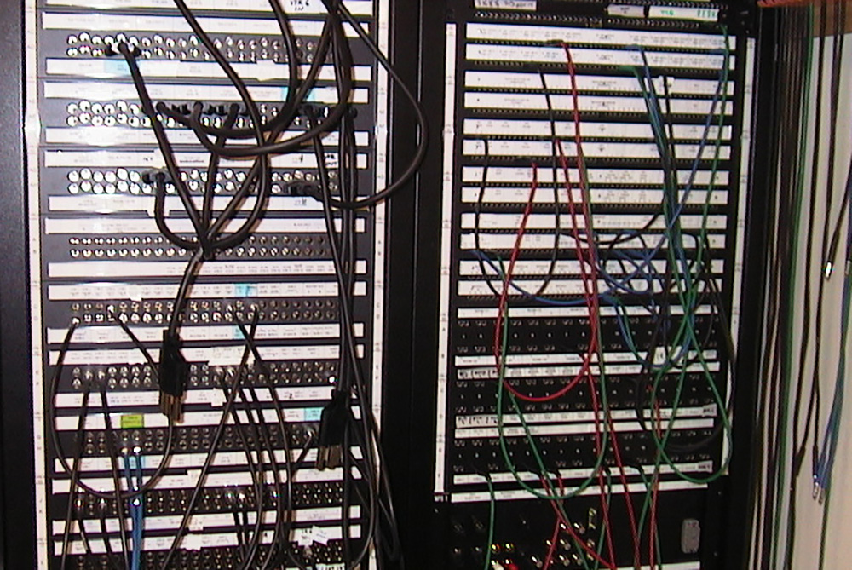

Slide 23
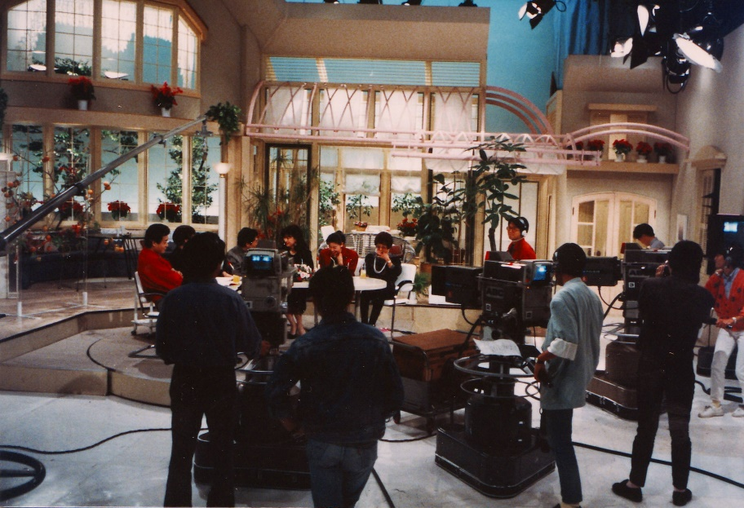
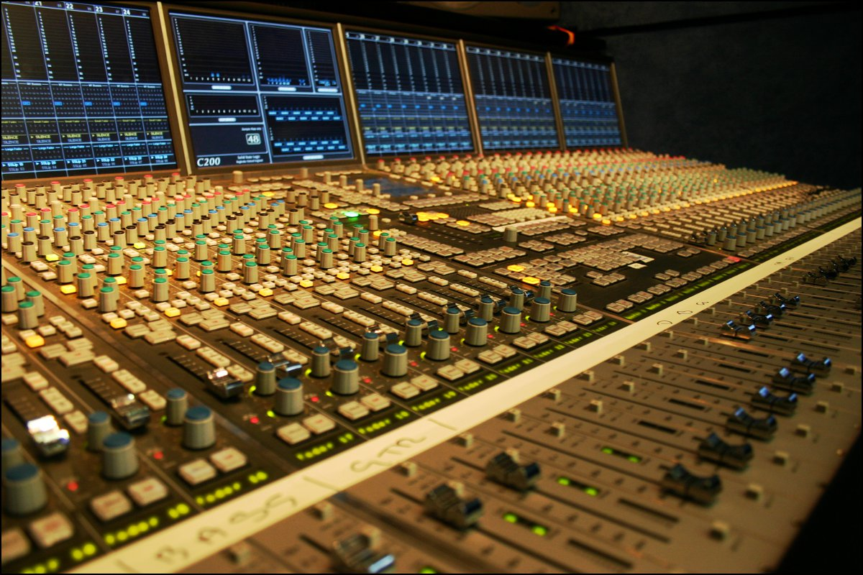
In
Out

Slide 24
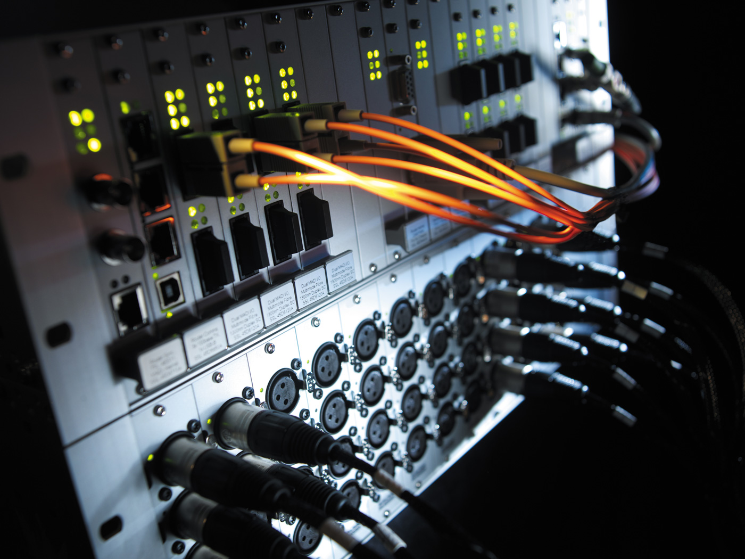
(Router)

Slide 25
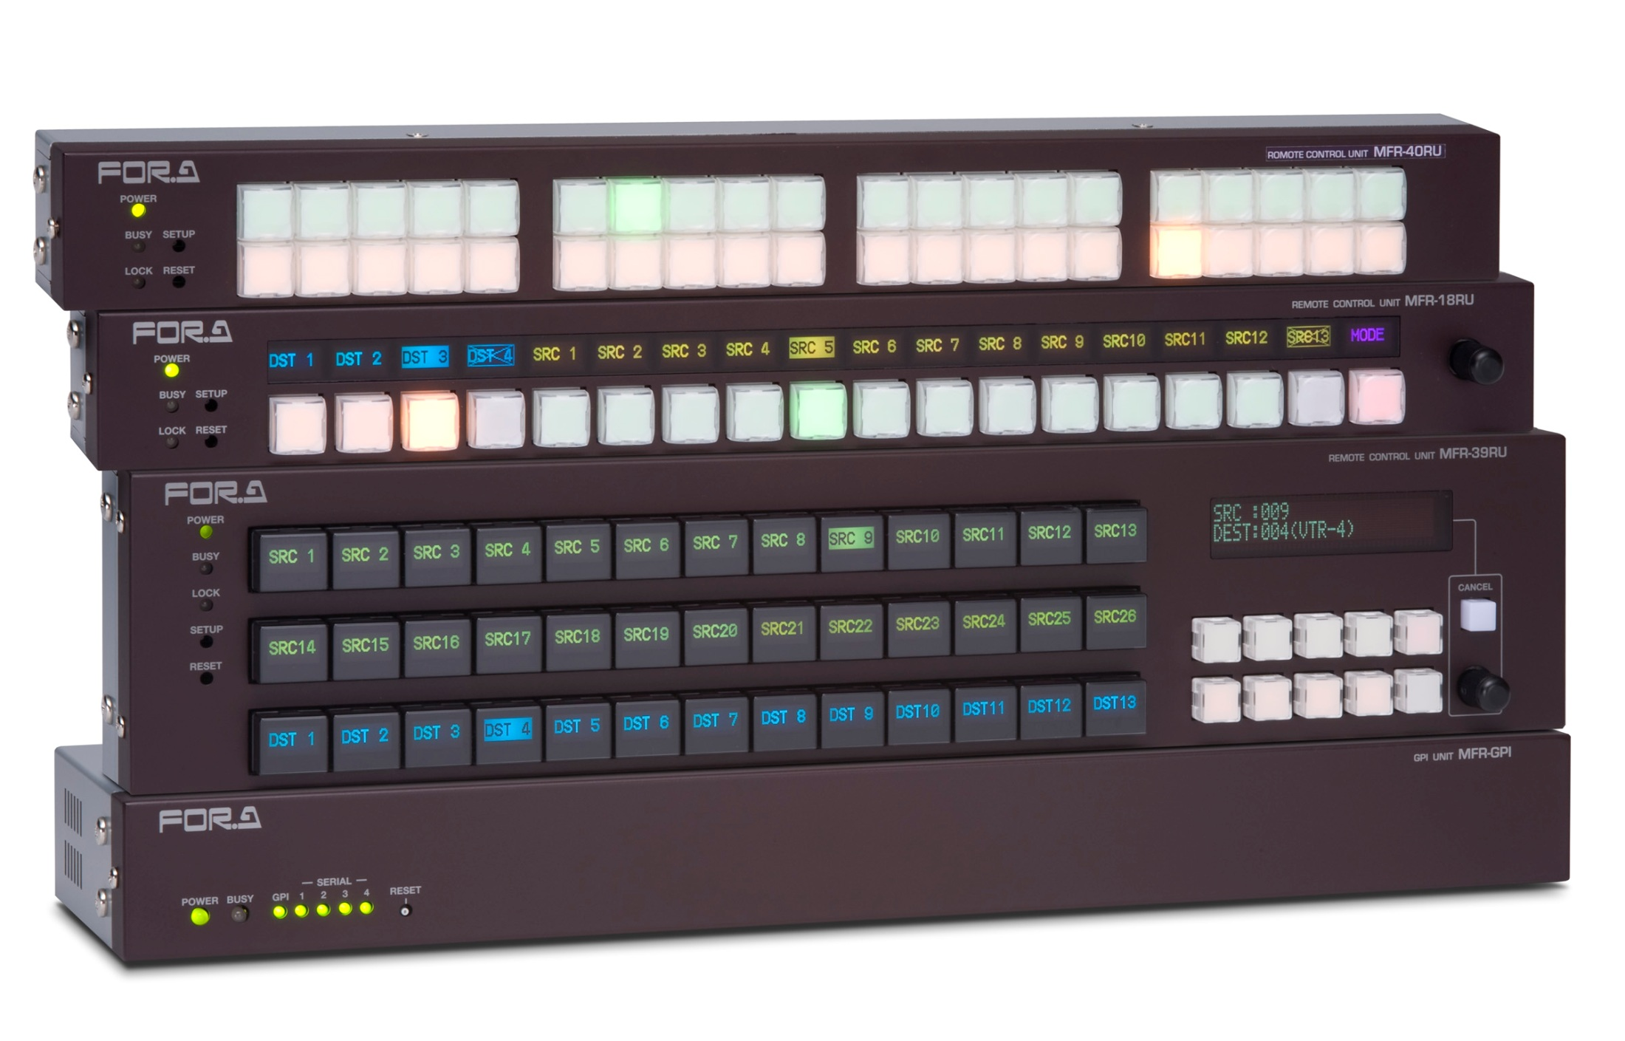
Router Switcher

Slide 26
Production
Sound System
Sound Source
Transduction
Signal Transport
Signal Recording
studio
field

Slide 27
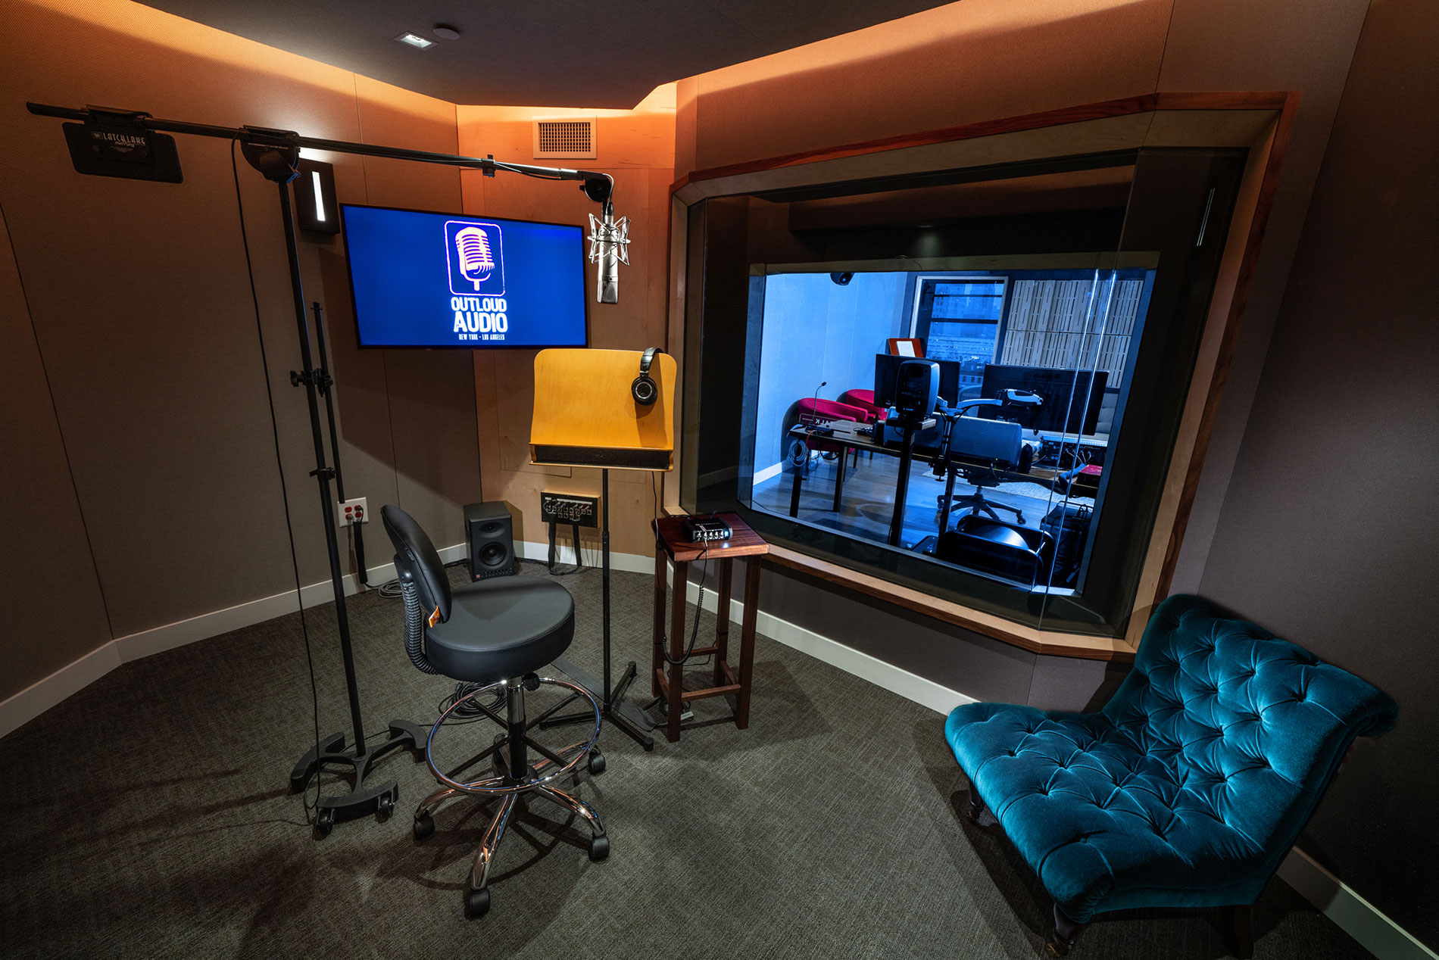
Studio

Slide 28
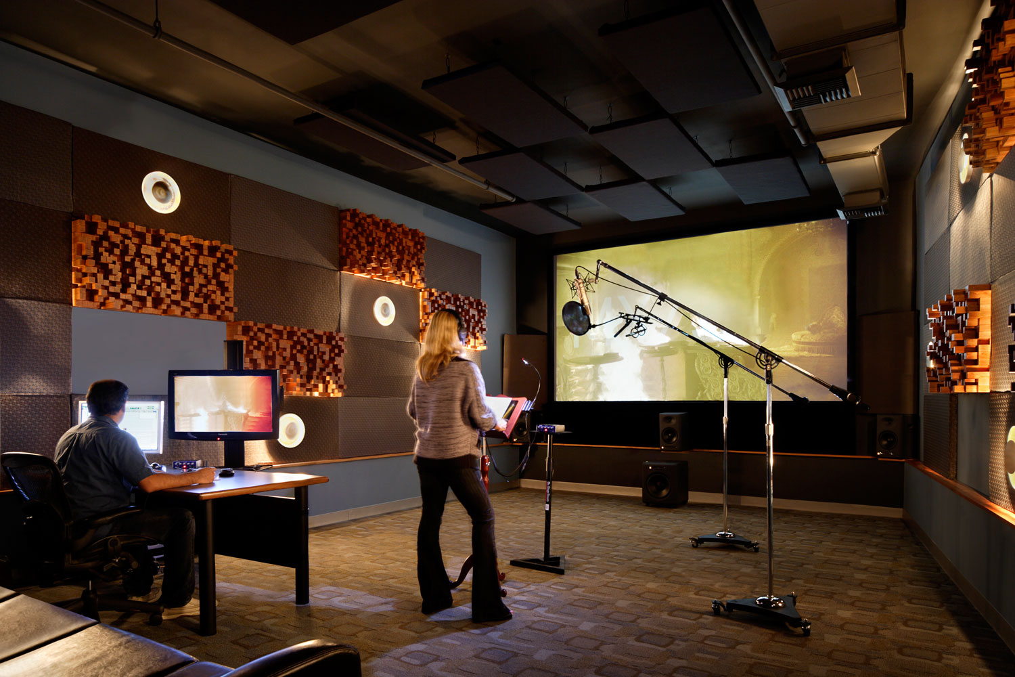

Slide 29
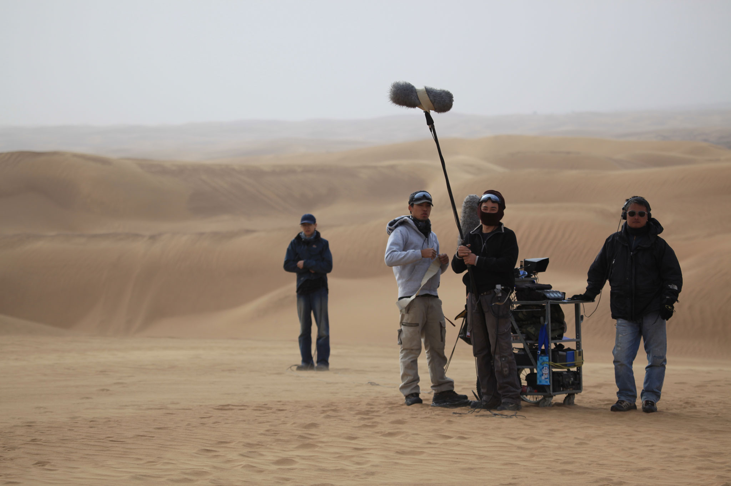
Field

Slide 30
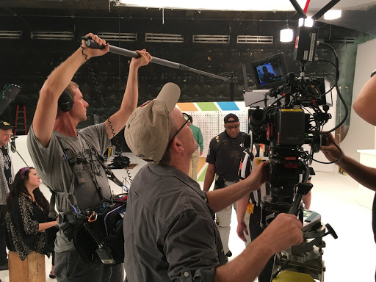

Slide 31
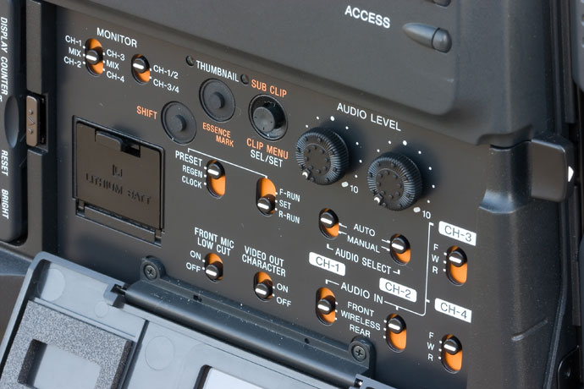
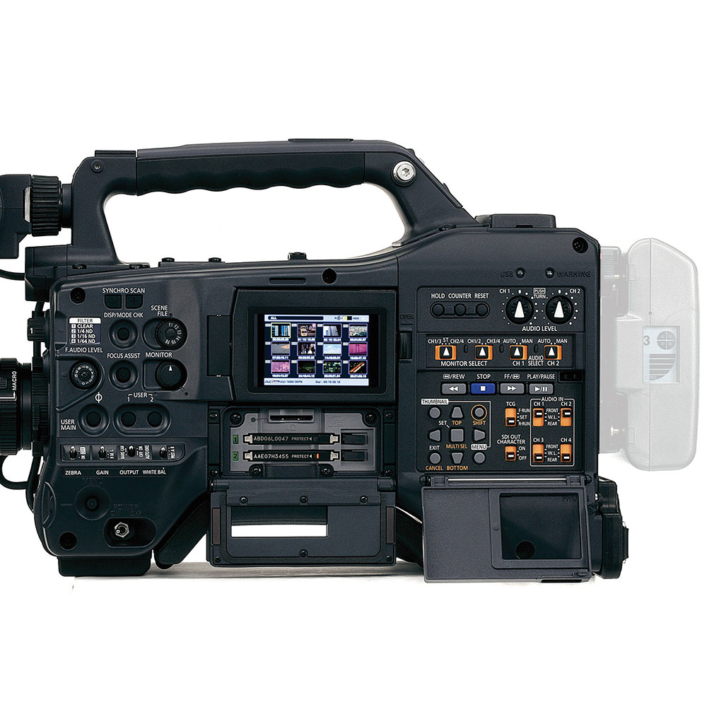

Slide 32
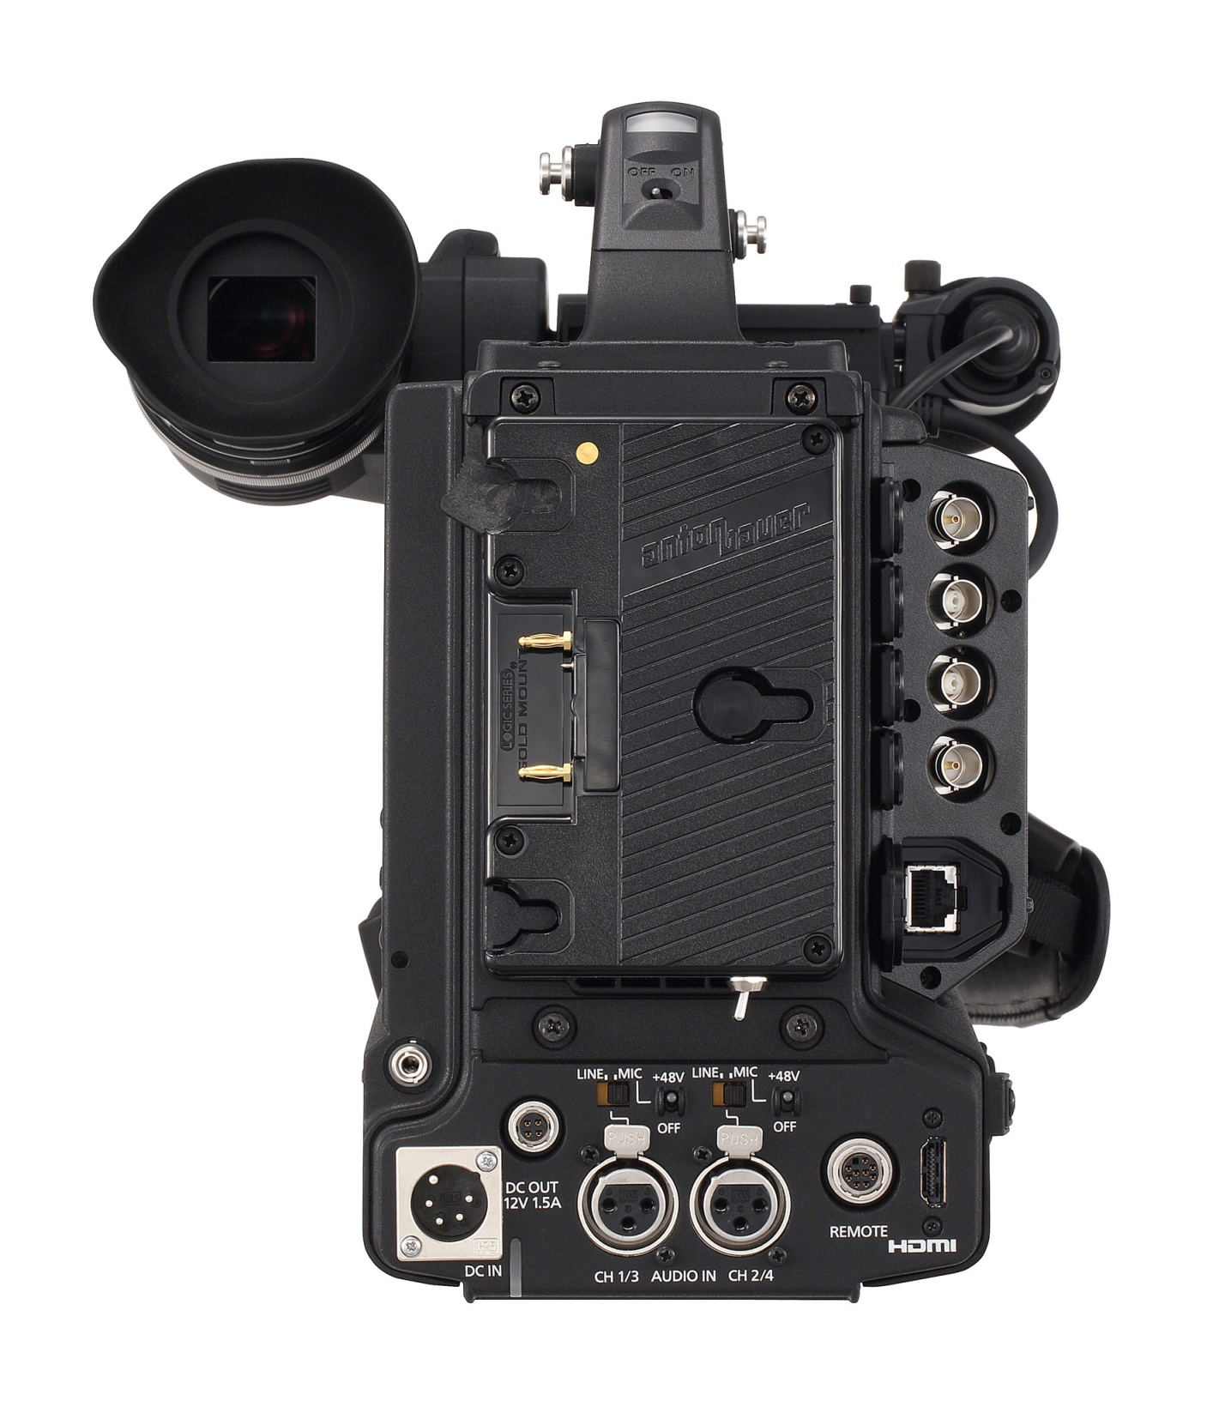
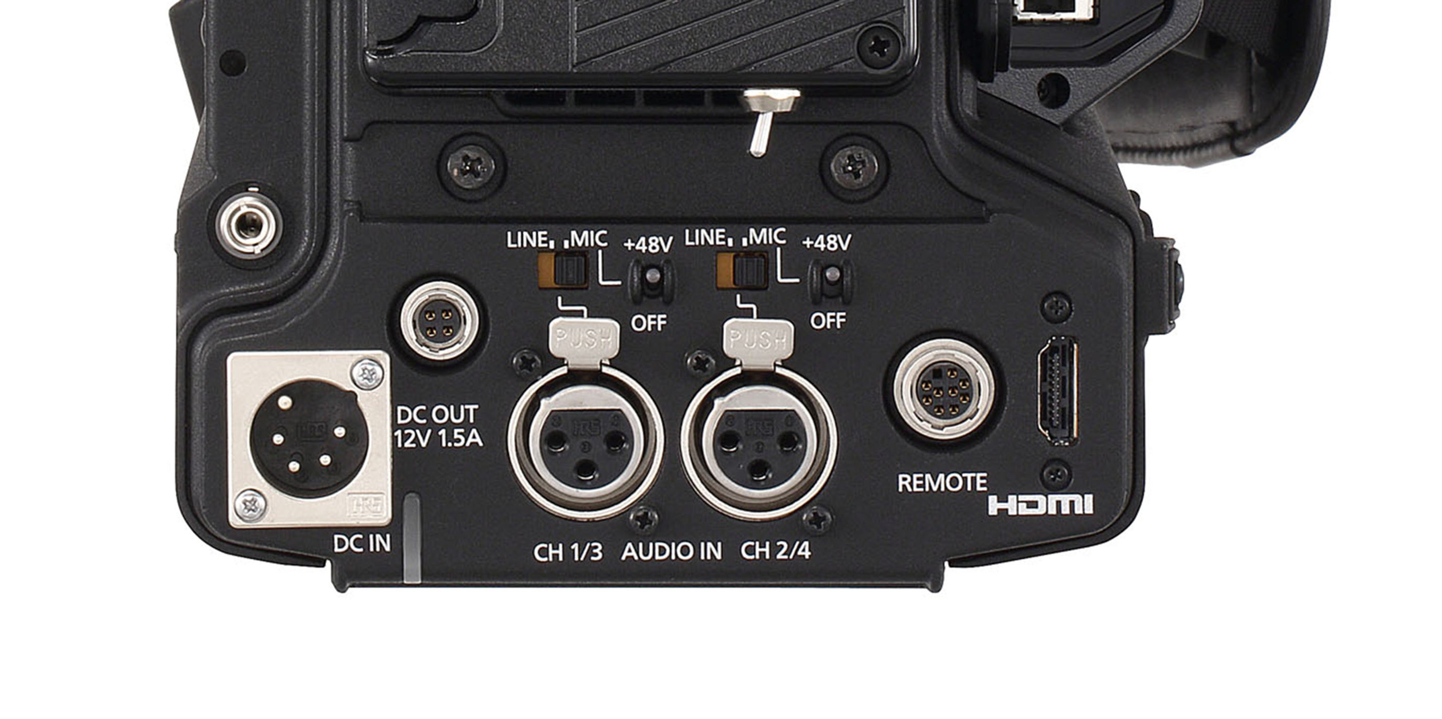

Slide 33
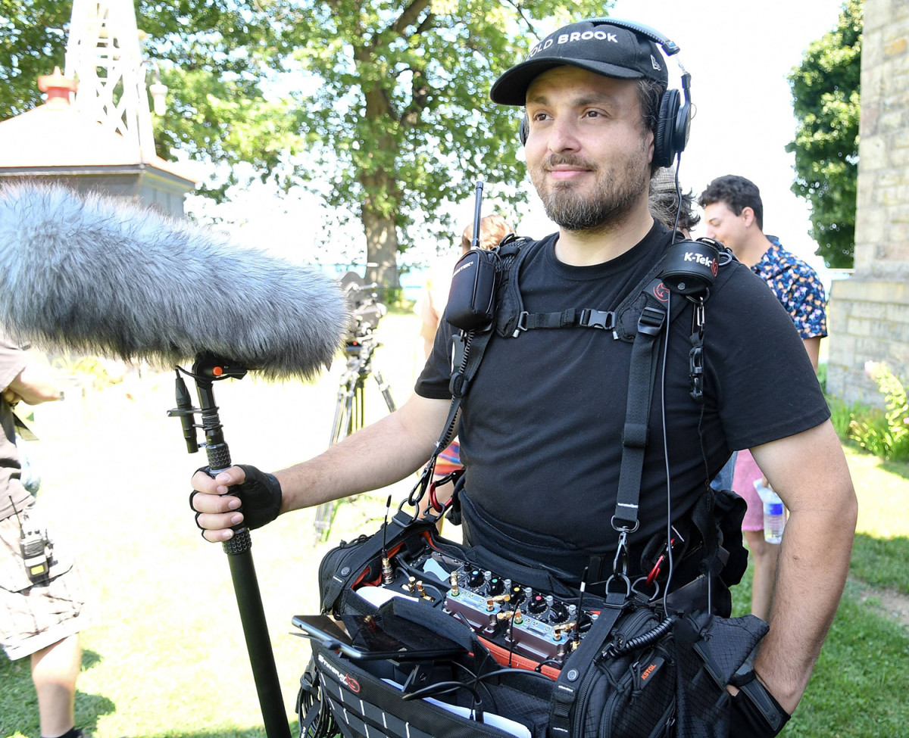

Slide 34
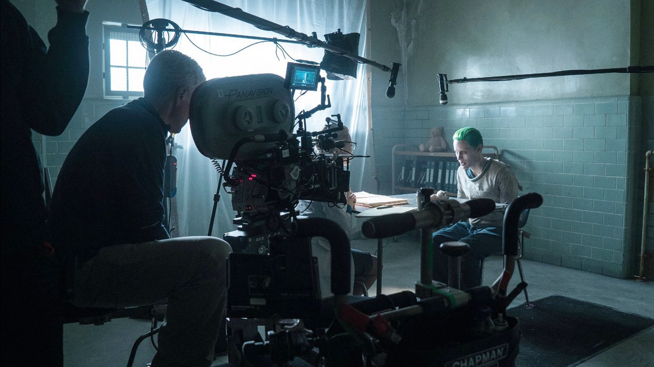

Slide 35
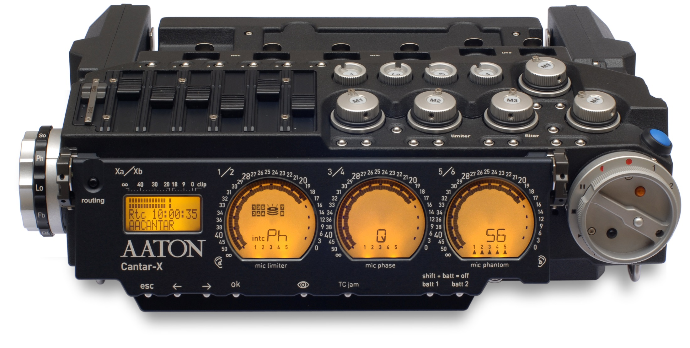

Slide 36
Production
Sound System
Sound Source
Transduction
Signal Transport
Signal Recording
Signal Processing

Slide 37
Mix Boards - Mixers
Single Signal
gain
tone
Line Out

Slide 38
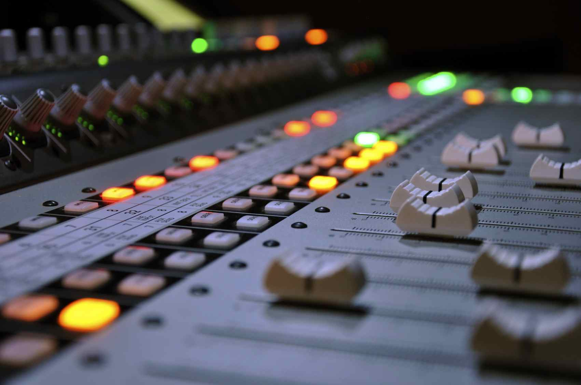
Gain Control
Potentiometer
(Slide Fader)

Slide 39
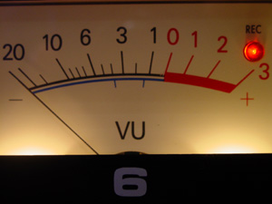
Measuring Gain
VU Meter
(decibels)

Slide 40
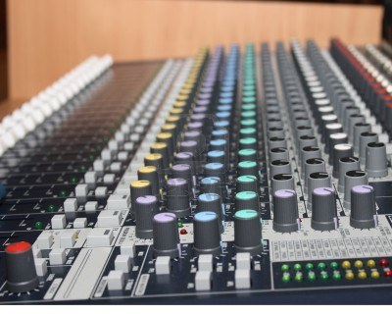
Tonal Control

Slide 41
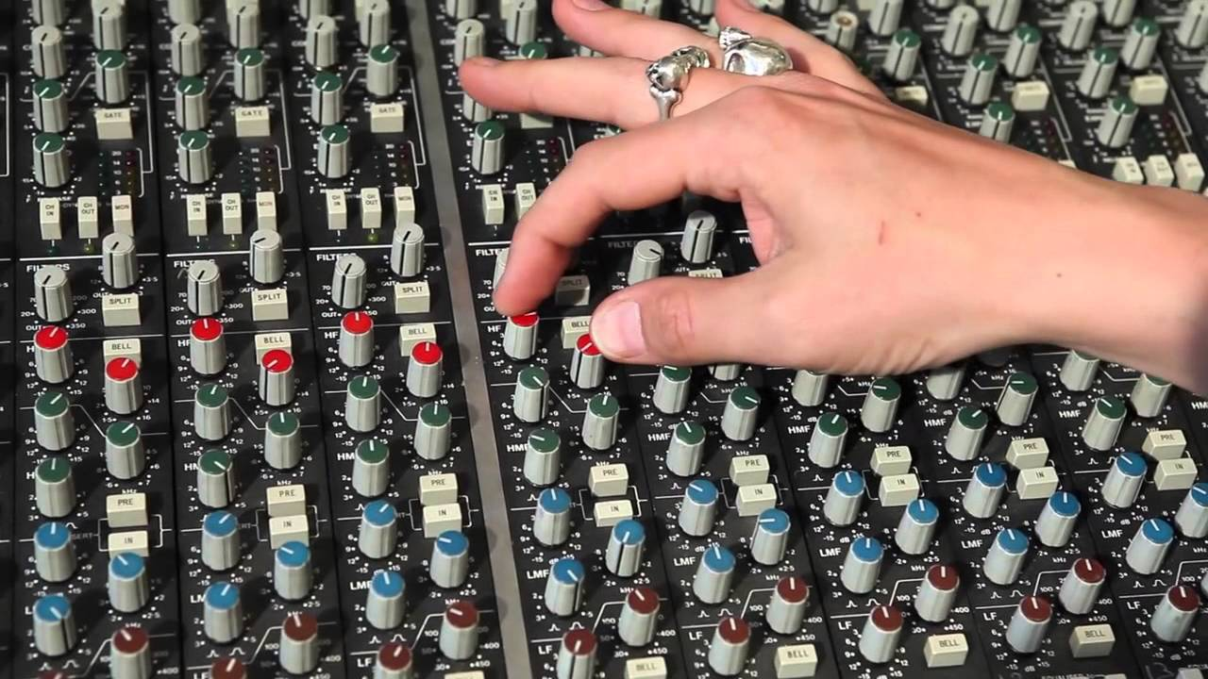
Equalization (sweetening)

Slide 42
Mix Boards - Mixers
Multiple Signals
combine
Single Signal

Slide 43
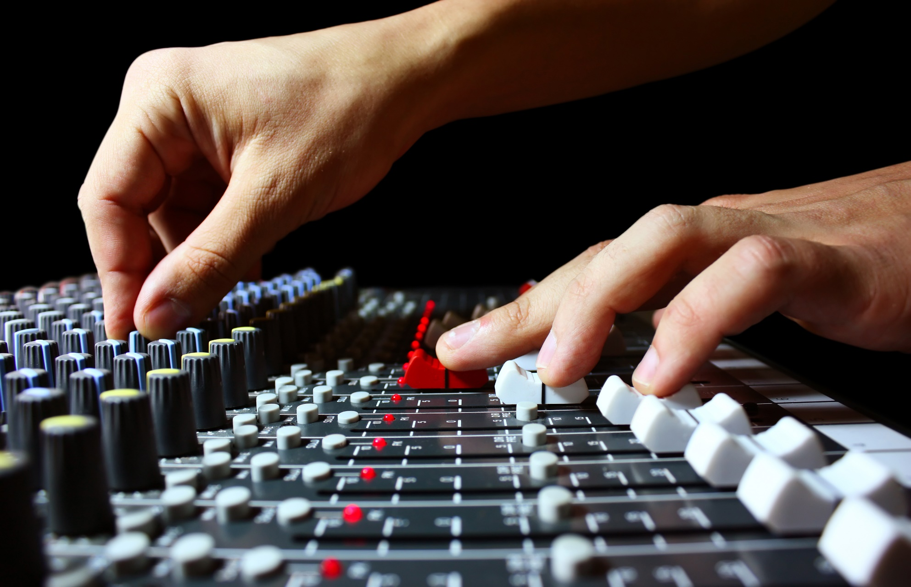
Combining = Mixing

Slide 44
Production
Sound System
Sound Source
Transduction
Signal Transport
Sound Recorder
Signal Processing
Sound Post Production

Slide 45
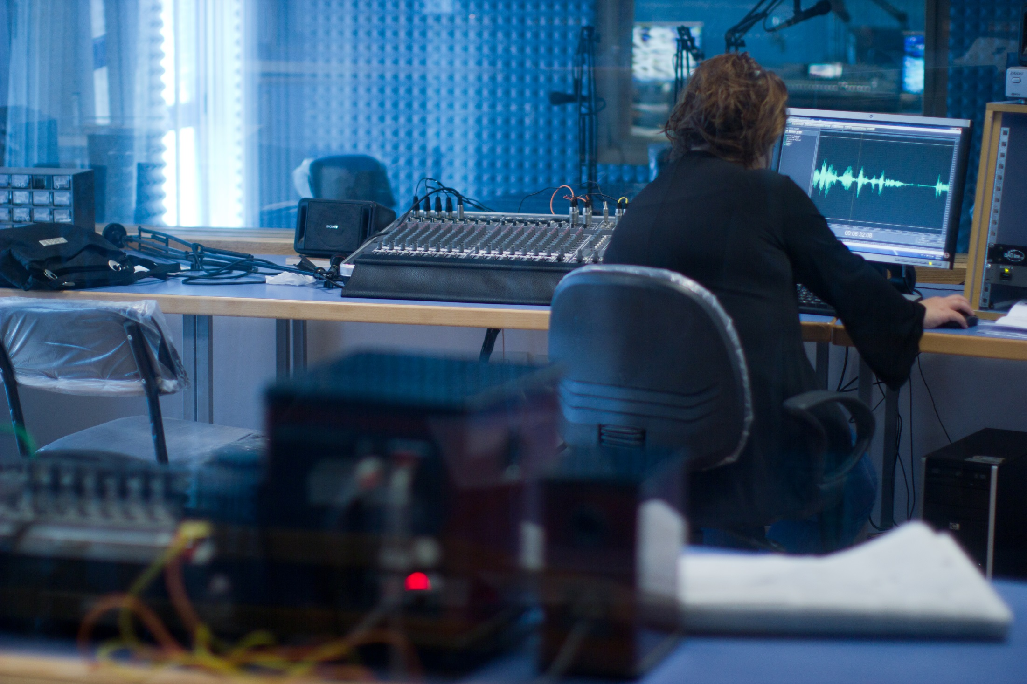

Slide 46
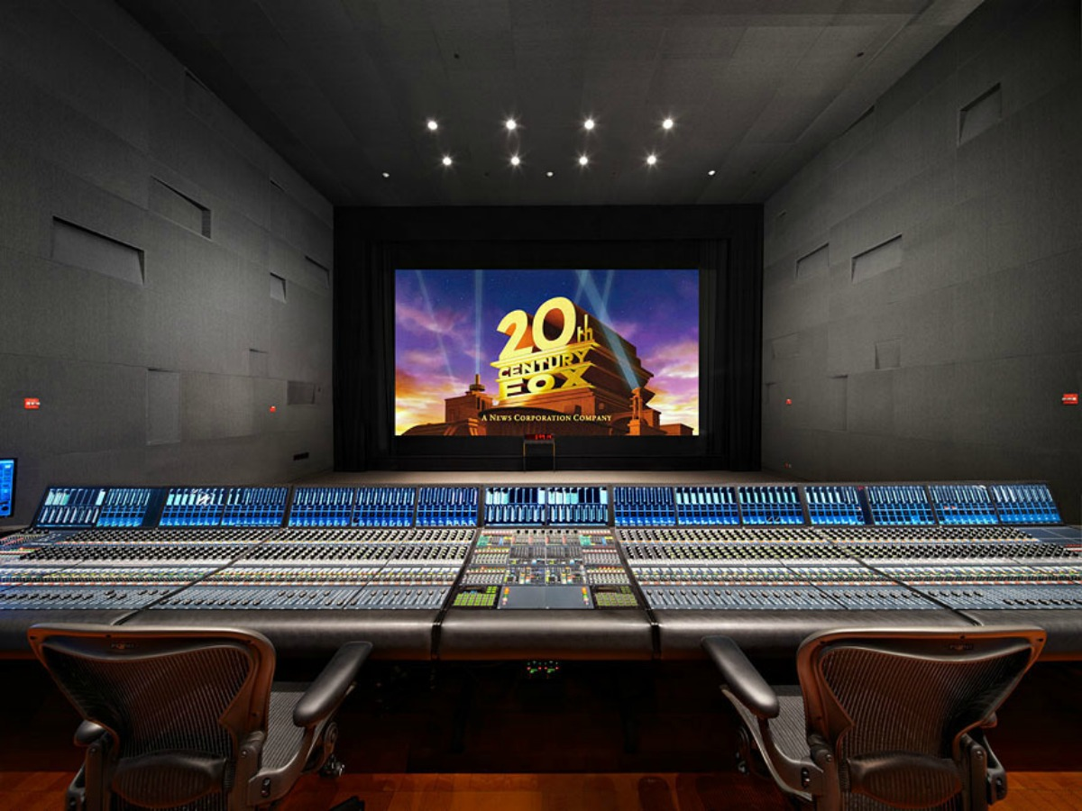

Slide 47
Technical Objectives
Aesthetic Objectives

Slide 48
Sound Technical
Objective
Optimum Sound Quality

Slide 49
Optimum Sound Quality
Proper Mic Placement
- Proximity -
(plosives)

Slide 50
Optimum Sound Quality
Proper Mic Placement
Choosing the Right Mic
signal generating element
pick-up pattern

Slide 51
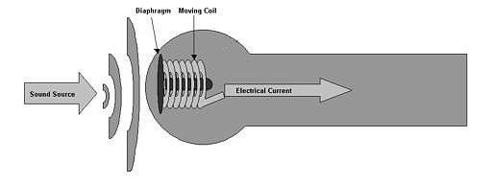
Signal Generation
Dynamic
- frequency response

Slide 52
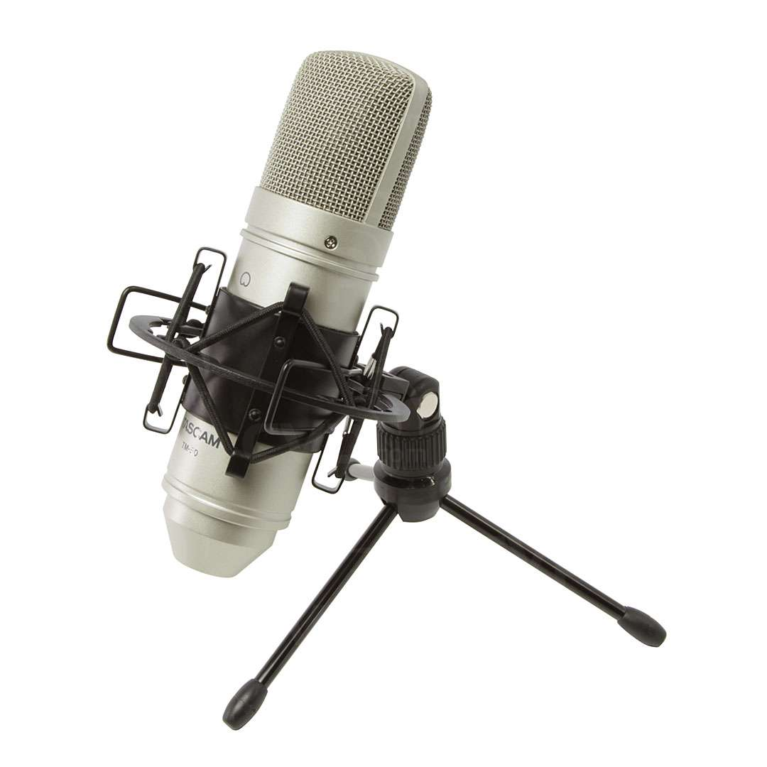
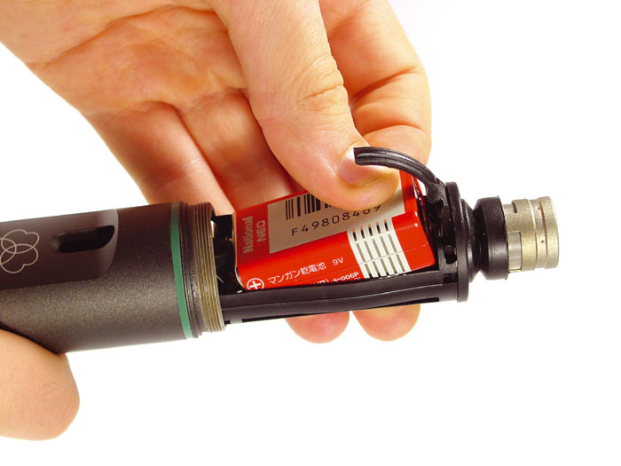
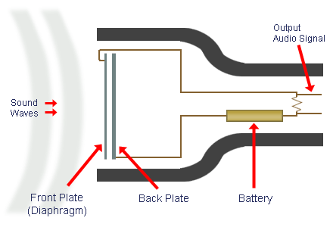
Signal Generation
Dynamic
Condenser
- frequency response

Slide 53
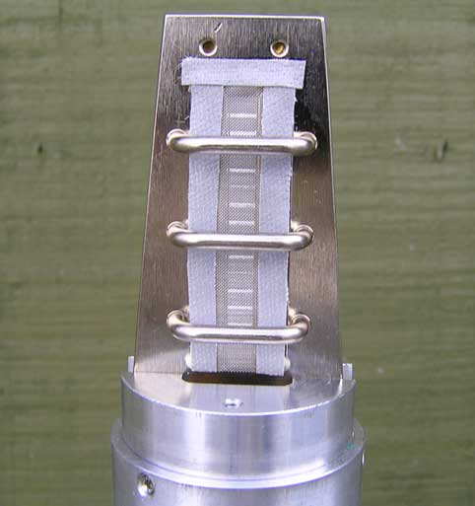
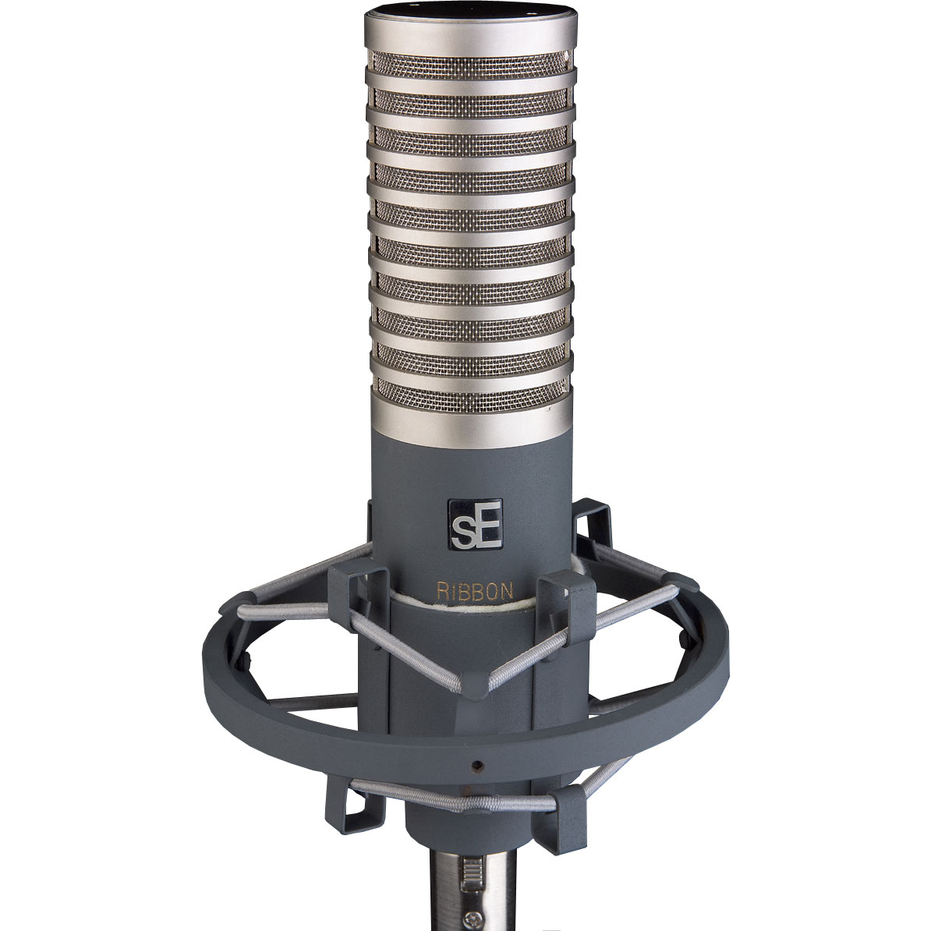
Signal Generation
Dynamic
Condenser
Ribbon
- frequency response

Slide 54
Pickup
Pattern

Slide 55
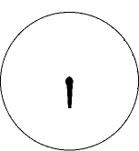
Pick-up Patterns
omnidirectional

Slide 56
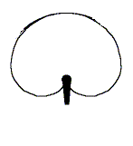
Pick-up Patterns
cardioid

Slide 57
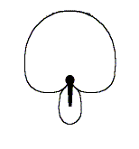
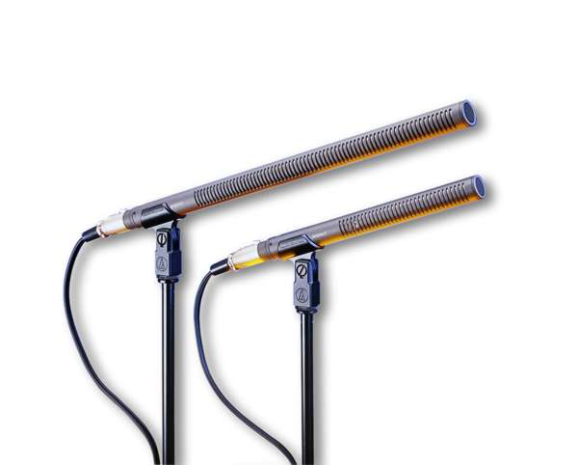
Pick-up Patterns
hypercardioid

Slide 58
Pick-up Patterns
hypercardioid

Slide 59
Other
Mic
Classifications

Slide 60
Handheld
(“stick mic”)

Slide 61
Lavaliere
(“lapel mic”)

Slide 62
Shotgun Mic

Slide 63
Pressure Zone Mic

Slide 64
Parabolic Mic

Slide 65
Parabolic Mic

Slide 66
Mic
Support
Gear

Slide 67
Windscreens/Pop Filters

Slide 68
Windscreens/Pop Filters

Slide 70
Zeppelin

Slide 74
Shock
Mount

Slide 77
Mic Booms
(field)

Slide 78
Mic Booms (studio)
Desk Boom

Slide 79
Mic Booms (studio)
perambulator
boom

Slide 80
Mic Booms (studio)
giraffe
boom

Slide 82
Mic Stands

Slide 83
Loudness Distinctions
MIC LEVEL
LINE LEVEL

Slide 84
LINE LEVEL
MIC LEVEL

Slide 86
The Sound Environment
Diegetic Sound
(sound in the scene)
synchronous sound
dialogue
asynchronous sound
Foley, Buzz/Ambient, ADR

Slide 88
The Sound Environment
Diegetic Sound
2. Non-Diegetic Sound
(sound not part of the scene)
music beds
VO
music soundtrack

Slide 89
Sound Aesthetics
Sound Perspective
Sound Continuity
Figure/Ground
FG/BG sound
3. Parallel/Contrapuntal Sound
4. Silence

