Slide 1
Chapter 1 Introduction to Chemistry
Gang Chen, Department of Chemistry, UCF

Slide 2
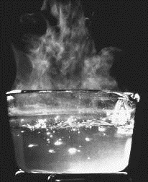
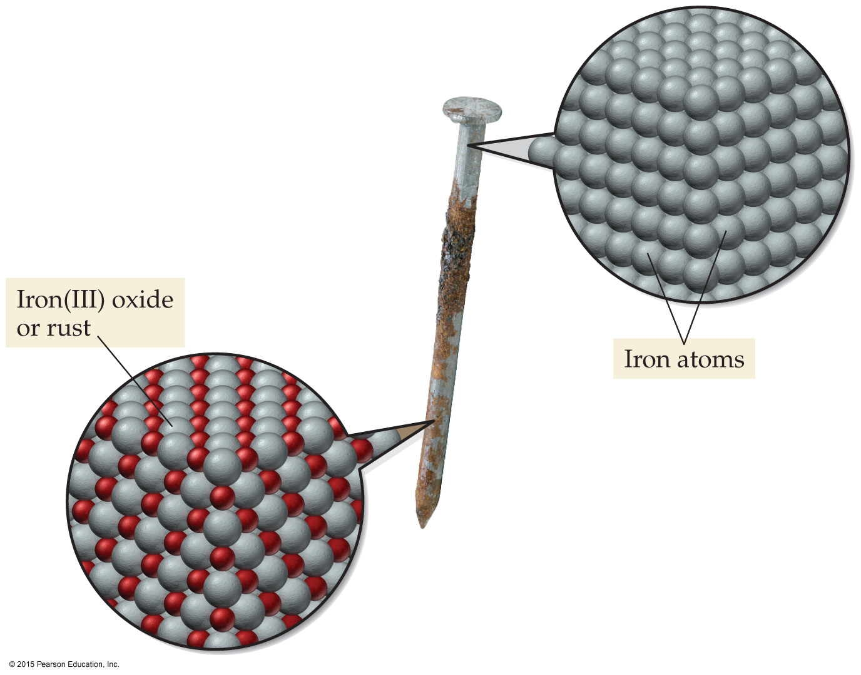
The Macroscopic Perspective
Matter is anything that has mass and can be observed.
Matter is observed through two types of changes.
i) Physical changes
ii) Chemical changes
melting & freezing
boiling & condensing
dissolving
iron
rust

Slide 3
Example Problem
Which of the following represent(s) a chemical change?
1. rusting of an iron bridge.
2. melting of ice.
3. burning of a wooden stick.
4. digestion of a baked potato.
5. dissolving of sugar in water.
C
P
C
C
P

Slide 4
The Macroscopic Perspective
Physical properties are variables of matter that we can measure without changing the identity of the substance being observed.
Color | Luster | Solubility
Size | Hardness | Conductivity
Odor | Condensing | Boiling point
Density | Melting point
More physical properties can be found online https://en.wikipedia.org/wiki/Physical_property

Slide 5
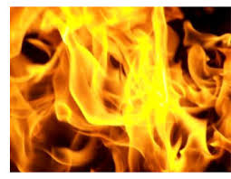
The Macroscopic Perspective
Chemical properties are determined only by observing how a substance changes its identity in chemical reactions.
flammability
oxidizing-reducing
(corrosion)
explosiveness

Slide 6
Example Problem
Which of the following properties of a metal are chemical properties?
It is hard
It rusts in air
Its density is 5.5 g/cm³
It reacts with a base
It is a good electrical conductor
P
C
P
C
P

Slide 7
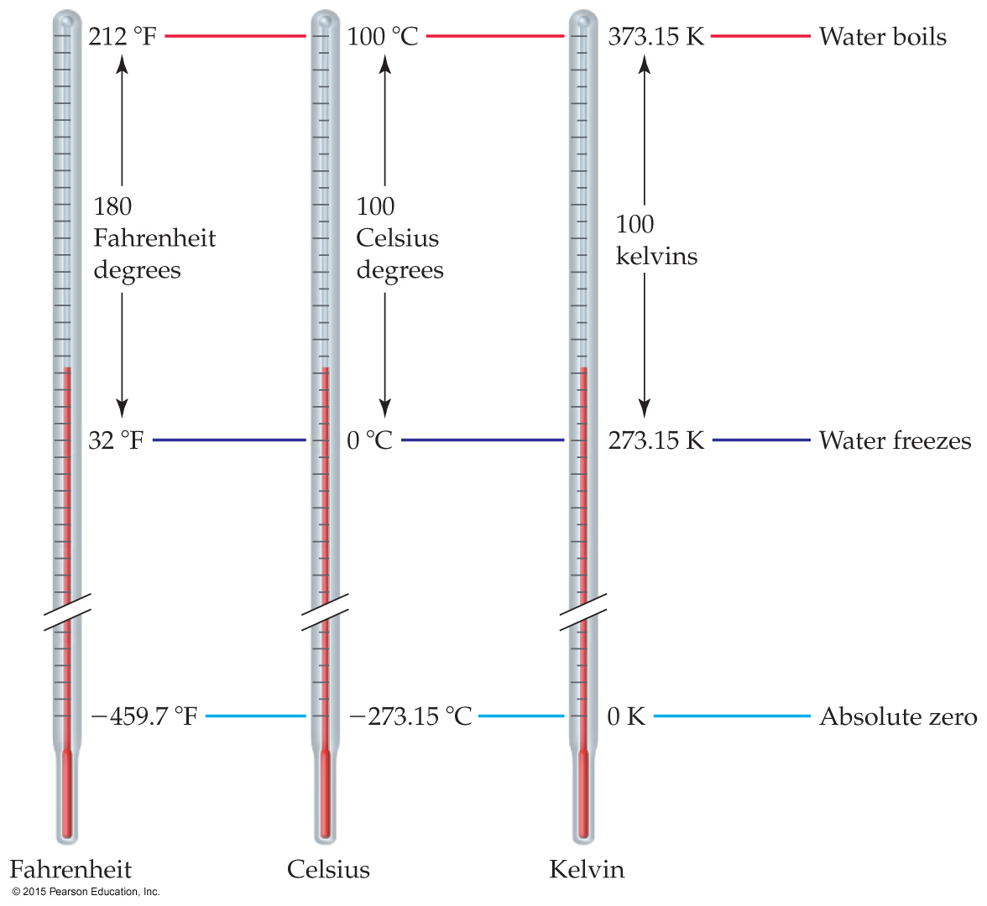
Temperature
Temperature is measured using the Fahrenheit, Celsius, and Kelvin (absolute) temperature scales.

Slide 8
Temperature Scale Conversions
Q: Nitrogen boils at −320.4 ºF. What is this temperature in Kelvin?
ºC = (-320.4 - 32) / 1.8
= (-352.4) / 1.8
= -195.8
K = -195.8 + 273.15 = 77.4

Slide 9
Chapter 2 Atoms and Molecules
Gang Chen, Department of Chemistry, UCF

Slide 10
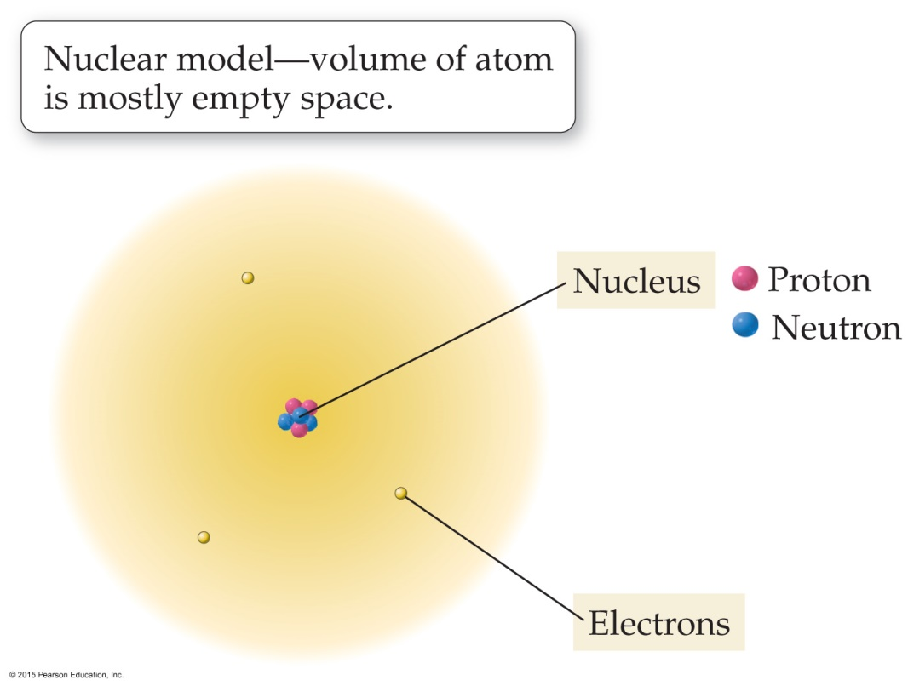
Atomic Structure and Mass
Atoms have a nucleus which contains protons and neutrons. The nucleus is surrounded by a cloud of electrons.
Most of the atom’s mass (proton; neutron) & its positive charge (proton) are in the nucleus.
The number of negatively charged electrons = number of positively charged protons.
Therefore, the atom is electrically neutral.

Slide 11
Atomic Number and Mass Number
Atomic Number, Z, is the number of protons in a nucleus.
identifies the element
Mass Number, A, is the sum of the number of protons and number of neutrons in a nucleus.
A = proton + neutron

Slide 12
Example Problem
Q. How many protons, neutrons, and electrons are in the ²⁵Mg atom?
Z = 12, A = 25, A – Z = 13
a) 25 protons, 0 neutrons, 25 electrons
b) 12 protons, 13 neutrons, 13 electrons
c) 12 protons, 13 neutrons, 12 electrons
d) 13 protons, 12 neutrons, 13 electrons
e) 12 protons, 25 neutrons, 12 electrons

Slide 13
Inorganic and Organic Chemistry
Organic chemistry is the study of the compounds of the element carbon, usually with oxygen, nitrogen, and hydrogen.
More than 18 million organic compounds exist.
Includes biological molecules and nearly all synthetic polymers.
Isomers: Different organic molecules that have the same formula but are connected differently.
Inorganic chemistry is the study of all other elements and their compounds.
C₂H₆O
CH₃CH₂OH
CH₃OCH₃

Slide 14
Functional Groups
Functional groups are arrangements of atoms that tend to display similar chemical properties.
Chemical formulas are often written to emphasize functional groups.
Methanol, an alcohol, is often written CH₃OH instead of CH₄O.
Hydrocarbons contain only H and C atoms.
Addition of functional groups to hydrocarbons results in more complex compounds.

Slide 15
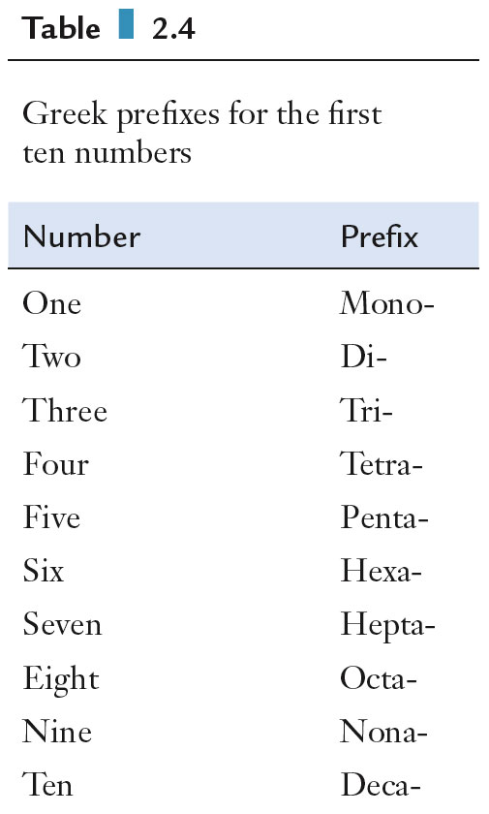
Naming Covalent Compounds
The first element in the formula retains is full name.
The second element is named by replacing the ending from its name with the suffix -ide.
Both elements are preceded by a number-designating prefix except when there is only one atom of the first element, which will not use the prefix mono-.

Slide 16
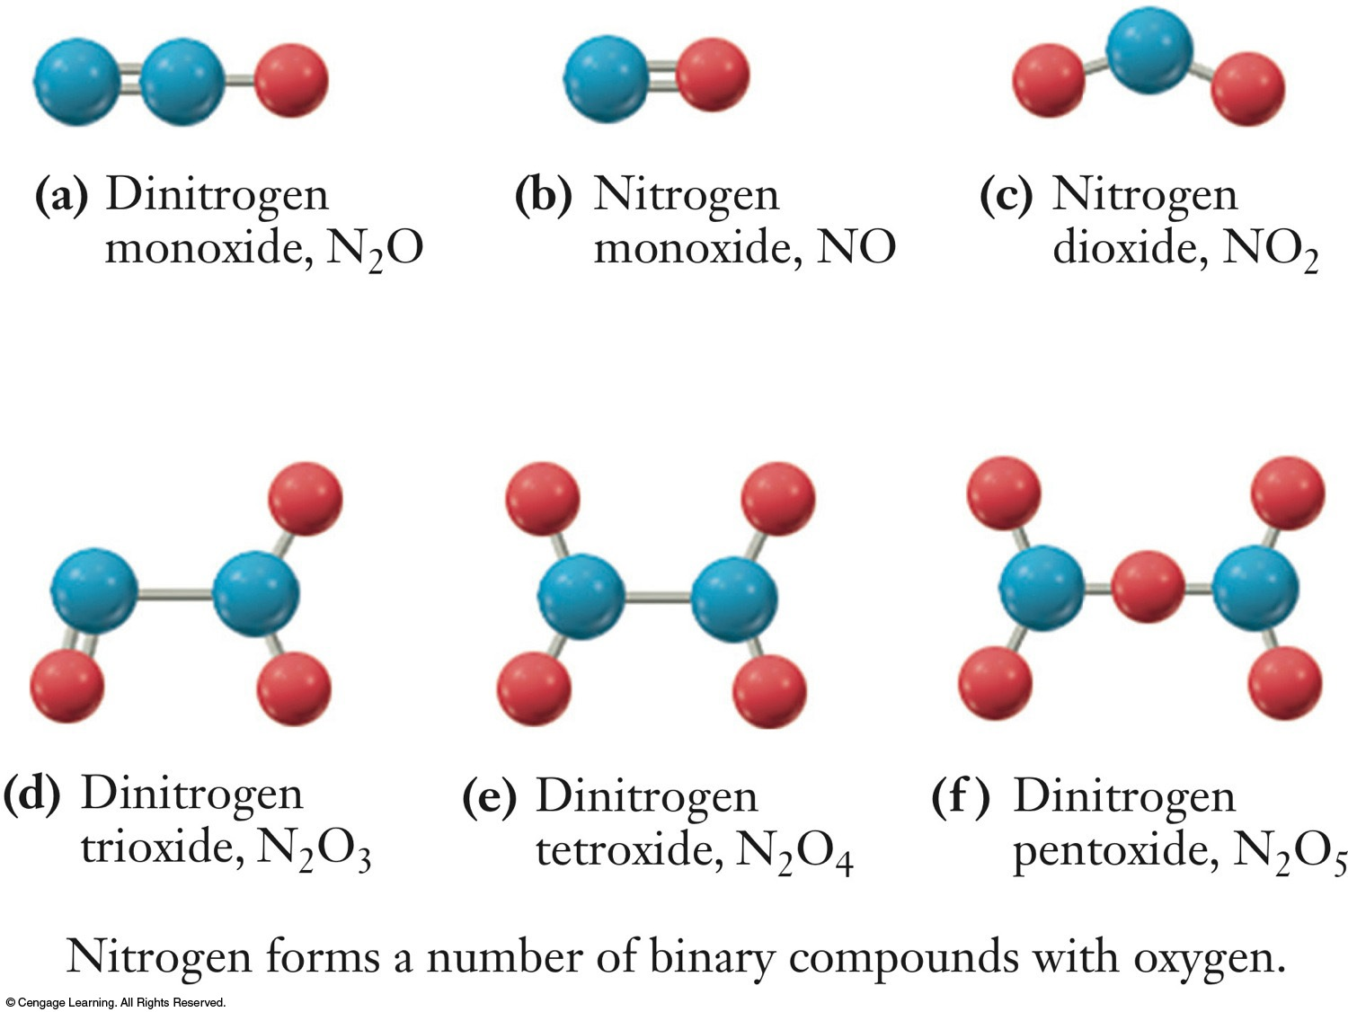
Naming Covalent Compounds

Slide 17
Naming Ionic Compounds
Ionic compounds are electrically neutral and are named in order of “cation anion”, as in sodium chloride.
The cation retains its full name.
Monoatomic cation charge can often be found by position in the periodic table.
Cations with more than one charge (e.g., transition metals) are named using Roman numerals indicating the charge, e.g., iron(II)
Monatomic anions are named by replacing the ending of the element name with the suffix -ide, e.g., bromide
A polyatomic cation or anion is named using its common name.
Potassium phosphate K₃PO₄

Slide 18
Chapter 3 Molecules, Moles, and Chemical Equations
Gang Chen, Department of Chemistry, UCF

Slide 19
Balancing Chemical Equations
The law of conservation of matter: matter is neither created nor destroyed.
Chemical reactions must obey the law of conservation of matter.
The same number of atoms for each element must occur on both sides of the chemical equation.
A chemical reaction simply rearranges the atoms into new compounds.

Slide 20
Balancing Chemical Equations
Chemical equations may be balanced via inspection, which really means by trial and error.
Numbers used to balance chemical equations are called stoichiometric coefficients.
The stoichiometric coefficient multiplies the number of atoms of each element in the formula unit of the compound that it precedes.
Stoichiometry is the various quantitative relationships between reactants and products.

Slide 21
Example
Q. Write a balanced chemical equation describing the reaction between butane (C₄H₁₀) and oxygen (O₂) to form carbon dioxide and water.
C₄H_{10(g)} + O_{2 (g)} → CO_{2 (g)} + H₂O _{(g)}
balance C
C₄H_{10(g)} + O_{2 (g)} → 4CO_{2 (g)} + H₂O _{(g)}
balance H
C₄H_{10(g)} + O_{2 (g)} → 4CO_{2 (g)} + 5H₂O _{(g)}
balance O
C₄H_{10(g)} + 6.5O_{2 (g)} → 4CO_{2 (g)} + 5H₂O _{(g)}
2C₄H_{10(g)} + 13O_{2 (g)} → 8CO_{2 (g)} + 10H₂O _{(g)}

Slide 22
Chemical Equations for Aqueous Reactions
Molecular equation
Total ionic equation
Net ionic equation
AgNO₃(aq) + NaCl(aq) AgCl(s) + NaNO3(aq)
Ag⁺(aq) + NO₃⁻(aq) + Na⁺(aq) + Cl⁻(aq) AgCl(s) + NO₃⁻(aq) + Na⁺(aq)
Ag⁺(aq) + Cl⁻(aq) AgCl(s)
Spectator ions: NO₃⁻ and Na⁺
Spectator ions are ions uninvolved in the chemical reaction.

Slide 23
Acid-Base Reactions
Mixing an acid and a base leads to a reaction known as neutralization, in which the resulting solution is neither acidic nor basic.
Net ionic equation for neutralization of strong acid and strong base.
salt
2HNO_{3(aq)} + Ba(OH)_{2(aq)} → Ba(NO₃)_{2(aq)} + 2H₂O(l)
2H⁺_{(aq)} + 2NO₃⁻_{(aq)} + Ba²⁺_{(aq)} + 2OH⁻_{(aq)} →
Ba²⁺_{(aq)} + 2NO₃⁻_{(aq)}+ 2H₂O(l)
H⁺_{(aq)} + OH⁻_{(aq)} → H₂O(l)
the net ionic equation for strong acid-strong base rxn.

Slide 24
Dilution
Dilution is the process in which solvent is added to a solution to decrease the concentration of the solution.
The number of moles of solute is the same before and after dilution.
Since the number of moles of solute equals the product of molarity and volume (M × V), we can write the following equation, where the subscripts denote initial and final values.

Slide 25
Example Problem
Determine the initial volume needed to generate 2.50 L of 1.50 M H₂SO₄ from 3.75 M H₂SO₄ by dilution.
a) 2.50 L b) 1.00 L c) 1.50 M d) 1.50 L e) 92.6 mL
Use M_{i} × V_{i} = M_{f} × V_{f}
M_{f} = 1.50 M; V_{f} = 2.50 L
M_{i} = 3.75 M; V_{i} = ?
= 1.00 L

Slide 26
Chapter 4 Stoichiometry
Gang Chen, Department of Chemistry, UCF

Slide 27
Ratios from a Balanced Chemical Equation
Mole ratios are obtained from the coefficients in the balanced chemical reaction.
1 CH₄ : 2 O₂ : 1 CO₂ : 2 H₂O
1 mol CH₄ : 2 mol O₂ : 1 mol CO₂ : 2 mol H₂O
These ratios can be used in solving problems:

Slide 28
Example Question
The combustion of methane (CH₄) produces carbon dioxide (CO₂) and steam (H₂O).
All of the following statements concerning this reaction are correct EXCEPT
a) one molecule of carbon dioxide is formed per one molecule of methane consumed.
b) two molecules of oxygen are consumed per one molecule of methane consumed.
c) two moles of steam are formed per two moles of oxygen consumed.
d) the combined mass of reactants consumed equals the mass of products formed.
e) 1 gram of carbon dioxide are formed per two grams of oxygen consumed.

Slide 29
Ratios from a Balanced Chemical Equation
This flow diagram illustrates the various steps involved in solving a typical reaction stoichiometry problem.
No different than unit conversion
Usually more than one conversion is necessary
Write all quantities with their complete units

Slide 30
Example Question
How many grams of water can be produced if sufficient hydrogen reacts with 26.0 g of oxygen?

Slide 31
Limiting Reactants
In many chemical reactions, one reactant is often exhausted before the other reactants. This reactant is the limiting reactant.
Limiting reactant is determined using stoichiometry.
The limiting reactant limits the quantity of product produced.

Slide 32
Q. If 43.0 kg NH₃ react with 35.4 kg of O₂, what mass of NO forms?
4 NH₃ + 5 O₂ ⎯→ 4 NO + 6 H₂O
43.0 kg 35.4 kg ?? kg
43.0×10³ g NH₃
in excess
75.8 kg NO
$$× \frac{1 mol O_{2}}{32.00g O_{2} }$$
35.4×10³ g O₂
limiting
26.6 kg NO
smaller amt produced; O₂ is limiting reactant!!

Slide 33
Theoretical Yield
The maximum mass of a product that can be obtained in a reaction is determined by the limiting reactant.
Determine which reactant is the limiting reactant.
Calculate the mass of product that can be made from the limiting reactant. This mass is the theoretical yield.
In stoichiometric mixtures, however, both reactants are consumed completely, so either could be considered the limiting reactant.

Slide 34
Theoretical and Percentage Yields
Reaction efficiency is measured with percentage yield.
The mass of product obtained is the actual yield.
The ideal mass of product obtained from calculation is the theoretical yield.

Slide 35
Example Question
Q. If 10.0 g NO react with 14.0 g of NO₂ and 8.52 g of N₂O₃ are produced. What is the percentage yield?
NO + NO₂ ⎯→ N₂O₃
36.9 %
10.0 g NO
in excess
25.3 g N₂O₃
14.0 g NO₂
limiting
23.1 g N₂O₃

Slide 36
Solution Stoichiometry
For reactions occurring in solution, the concentration and volume of reactants and products are often used instead of mass to solve solution stoichiometry problems.
Moles can be solved from concentration (molarity) and volume (Liters)
previously:

Slide 37
Solution Stoichiometry

Slide 38
Example Question
What is the molarity of a solution of nitric acid if 0.216 g of barium hydroxide is required to neutralize a 20.00-mL sample of nitric acid?
acid base salt
2 HNO₃(aq) + Ba(OH)₂(aq) ⎯→ Ba(NO₃)₂(aq) + 2 H₂O(l)
1.26 × 10⁻³ mol Ba(OH)₂
2.52 × 10⁻³ mol HNO₃
Molarity =
2.52 × 10⁻³ mol HNO₃
0.126 M HNO₃

Slide 39
Chapter 5 Gases
Gang Chen, Department of Chemistry, UCF

Slide 40
Ideal Gas Law
The ideal gas law is the quantitative relationship between pressure (P), volume (V), moles gas present (n), and the absolute temperature (T).
R is the universal gas constant.
R = 0.08206 L atm mol⁻¹ K⁻¹: used in most gas equations (universal gas constant)

Slide 41
History and Application of the Gas Law
Charles’s Law: T ∝ V
Boyle’s Law: P ∝ 1 / V
Avogadro’s Law: n ∝ V
The empirical gas laws led to the ideal gas law.

Slide 42
Example Questions
Which of the following relationships are true for gases?
i) The number of moles of a gas is inversely proportional to its volume (at constant pressure and temperature).
ii) The pressure of a gas is directly proportional to its temperature in kelvins (at constant volume).
iii) The volume of a gas is inversely proportional to its pressure (at constant temperature).
Wrong
True
True

Slide 43
Example Questions
At constant temperature, 14.0 L of O₂ at 2.70 atm is compressed to 5.35 L. What is the final pressure of O₂?
P₁ = 2.70 atm
V₁ = 14.0 L
V₂ = 5.35 L
7.06 atm

Slide 44
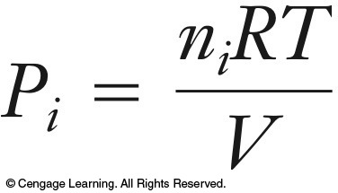
Partial Pressure
Dalton’s law of partial pressures: The total pressure (P) of a mixture of gases is the sum of the partial pressures of the component gases (P_{i}).
Daltons Law can be expressed in terms of mole fraction.
Mole fraction (X_{i}) for a gas in a gas mixture is the moles of the gas (n_{i}) divided by the total moles of the gases present.
The partial pressure of each gas is related to its mole fraction.

Slide 45
Example Questions
A mixture of He and O₂ is placed in a 4.00 L flask at 32 °C. The partial pressure of the He is 3.4 atm and the partial pressure of the O₂ is 2.6 atm. What is the mole fraction of O₂?
$$=PO2+PHe=3.4 atm+2.6 atm=6.0 atm$$

Slide 46
Stoichiometry of Reactions Involving Gases
For reactions involving gases, the ideal gas law is used to determine moles of gas involved in the reaction.
Use mole ratios (stoichiometry)
Connect number of moles of a gas to its temperature, pressure, or volume with ideal gas law

Slide 47
Example Questions
What volume of O₂, measured at 91.2 °C and 743 mm Hg, will be produced by the decomposition of 4.88 g KClO₃? (R = 0.08206 L·atm/mol·K)
2 KClO₃(s) → 2 KCl(s) + 3 O₂(g)
T = 91.2 + 273.15 = 364.4 K
P $=743 mm × \frac{1 atm}{760 mm}$
$$=0.978 atm$$
1.83 L

Slide 48
Chapter 6 The Periodic Table and Atomic Structure
Gang Chen, Department of Chemistry, UCF

Slide 49
Quantum numbers
n
l
m_{l}
m_{s}
Principle quantum number - shell
Secondary quantum number - subshell
Magnetic quantum number – subshell direction
Spin quantum number – spin direction
principal quantum number (n)
secondary quantum number (l)
n = 1, 2, 3, ….
l = 0, 1, 2, n-1
m_{l} = -l, …0, … l
m_{s} = ± 1/2
1s
indicates the principal shell of the orbital.
indicates the
subshell of the orbital.

Slide 50
Example Questions
Which of the following represents invalid set of quantum numbers?
a) n = 3, l = 3, m_{l} = 3, b) n = 2, l = 1, m_{l} = 0, c) n = 3, l = 0, m_{l} = 0,
d) n = 4, l = 3, m_{l} = 3, e) n =5, l = 1, m_{l} = -1
n = 1, 2, 3, ….
l = 0, 1, 2, n-1
m_{l} = -l, …0, … l
m_{s} = ± 1/2

Slide 51
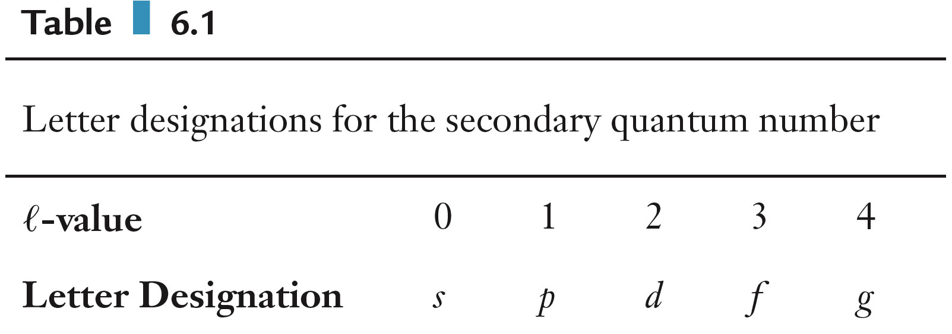
Quantum Numbers
n = 1 is the first shell, n = 2 is the second shell, etc.

Slide 52
Example Questions
A particular orbital has n = 4 and l = 2. What must this orbital be?
a) 3p b) 4s c) 4p d) 4d e) 5s
principal quantum number (n)
secondary quantum number (l)
1s

Slide 53
Electron Configuration
Pauli Exclusion Principle: no more than two electrons can occupy any orbital
Hund’s rule: Fill a set orbitals of same energy with electrons singly, with parallel spins, before pairing starts.
Aufbau Principle: Lower-energy orbitals fill before higher-energy orbitals.

Slide 54
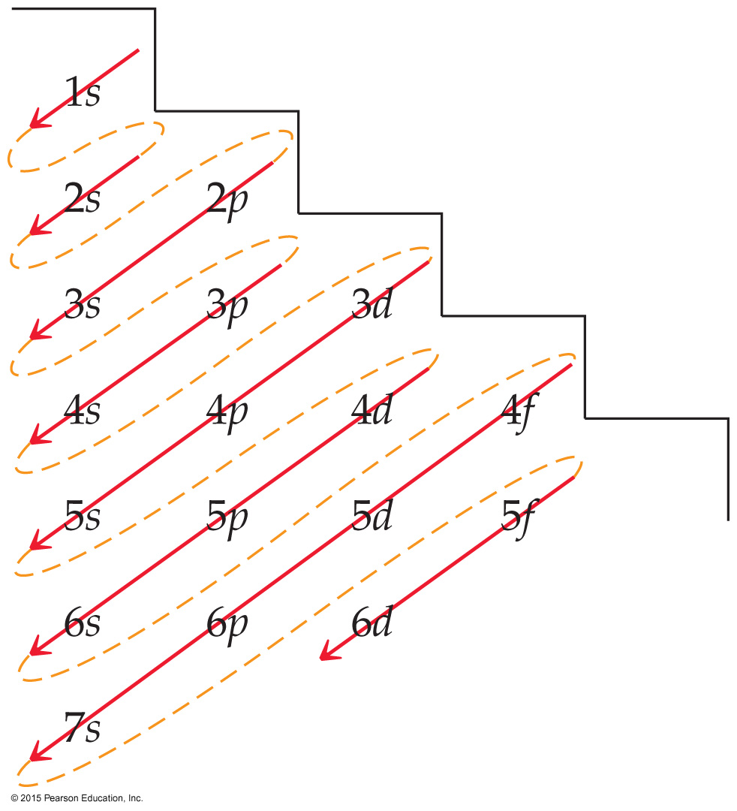
Aufbau Principle: order of electron filling 1s 2s 2p 3s 3p 4s 3d 4p 5s 4d 5p 6s 4f 5d 6p 7s 5f 6d 7p
Electron Configurations
Pauli Exclusion Principle:
Each orbital can hold 2 electrons
s subshell: 1 orbital
p subshell: 3 orbitals
d subshell: 5 orbitals
f subshell: 7 orbitals

Slide 55
Example Questions
Write the ground state electron configuration for manganese.
a) [Ar] 4s²4p⁵ b) [Ar] 4s²3d⁵ c) [Ar] 3d⁷
d) [Ar] 3d⁵4p² e) [Kr] 4s²3d⁵
₂₅Mn
Orbitals Fill in the Following Order: 1s 2s 2p 3s 3p 4s 3d 4p 5s 4d 5p 6s 4f 5d 6p 7s 5f 6d 7p
₂₅Mn: 1s²2s²2p⁶3s²3p⁶4s²3d⁵
[Ar] 4s²3d⁵

