Slide 1

Chapter 7
Chemical Bonding and Molecular Structure
Gang Chen, Department of Chemistry, UCF

Slide 2
Lattice Energy
The potential energy, V, for the ion pair can be calculated.
  k = 1.389 x 10⁵ kJ pm/mol
The lattice energy is the overall result of the potential energy between the ions in a crystal.
  Small ions with large charges form ionic compounds with large lattice energies.
  Large ions with small charges form ionic compounds with small lattice energies.

Slide 3
Example Problem
Choose the compound below that should has the largest lattice energy.
a) KF b) KCl c) KBr d) KI e) KAt
r=r_{cation} + r_{anion}
r_{F}- < r_{Cl}- < r_{Br}- < r_{I}- < r_{At}-
r_{KF} < r_{KCl} < r_{KBr} < r_{KI} < r_{KAt}
V_{KF} > V_{KCl} > V_{KBr} > V_{KI} > V_{KAt}
  Small ions with large charges form ionic compounds with large lattice energies.
  Large ions with small charges form ionic compounds with small lattice energies.

Slide 4
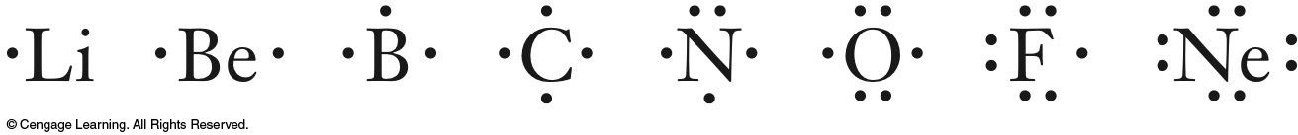
Chemical Bonds and the Structure of Molecules
Octet rule - an atom will form covalent bonds to achieve a complement of eight valence electrons.
  The valence shell electronic configuration is ns²np⁶ for a total of eight electrons.
Lewis dot symbols keep track of valence electrons, especially for main group elements, allowing prediction of bonding in molecules.
  To draw a Lewis dot symbol, the valence electrons are represented by dots and are placed around the element symbol.
  The first four dots are placed singly.
  Starting with the fifth dot, they are paired.

Slide 5
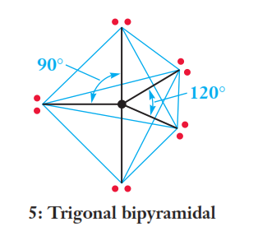
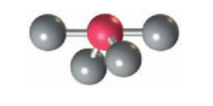
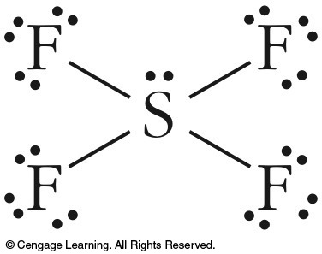
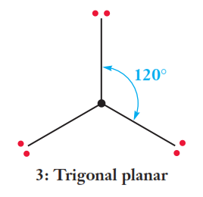
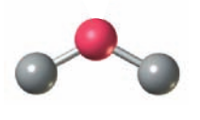
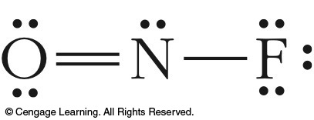
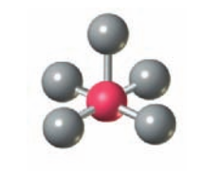
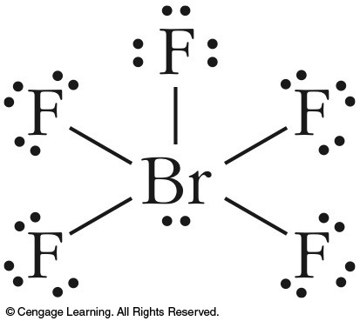
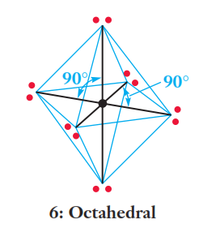
Example Problem
Determine the shape of the following molecules using VSEPR theory:
  SF₄
  NOF
  BrF₅
Base structure
Real structure
Seesaw
bent
Square pyramidal

Slide 6
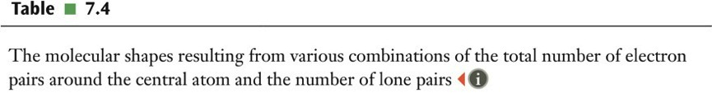
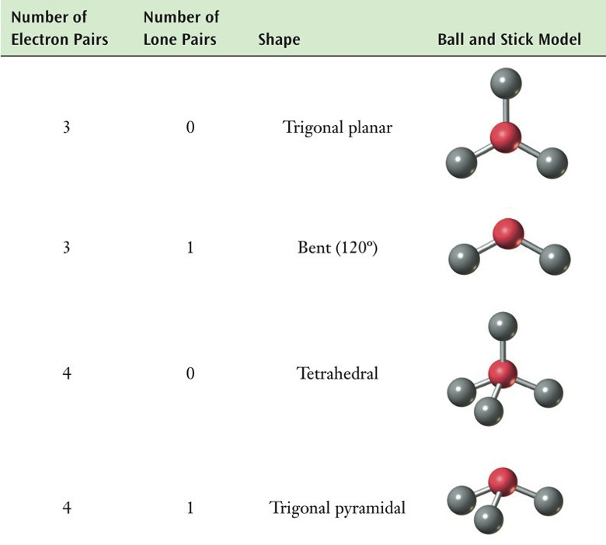

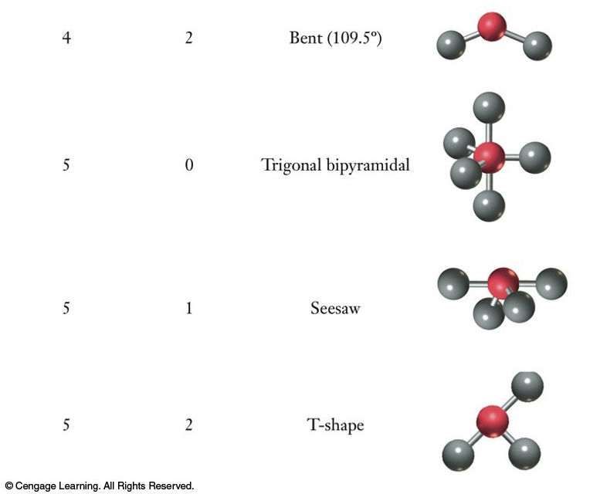
Shapes of Molecules
BF₃
H₂O
SO₂
PCl₅
SiH₄
SF₄
NH₃
BrF₃
Molecular shapes for various combinations of bonding and nonbonding electron pairs.

Slide 7
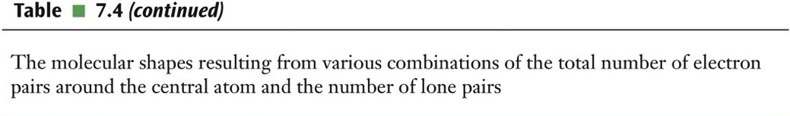
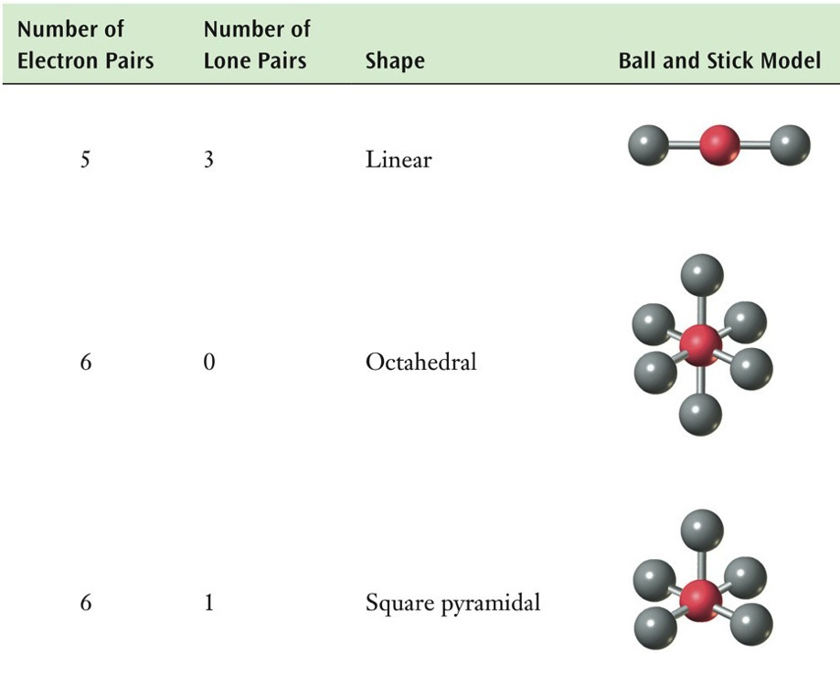
Shapes of Molecules
I₃⁻
SF₆
BrF₅

Slide 8
Chapter 8
Molecules and Materials
Gang Chen, Department of Chemistry, UCF

Slide 9
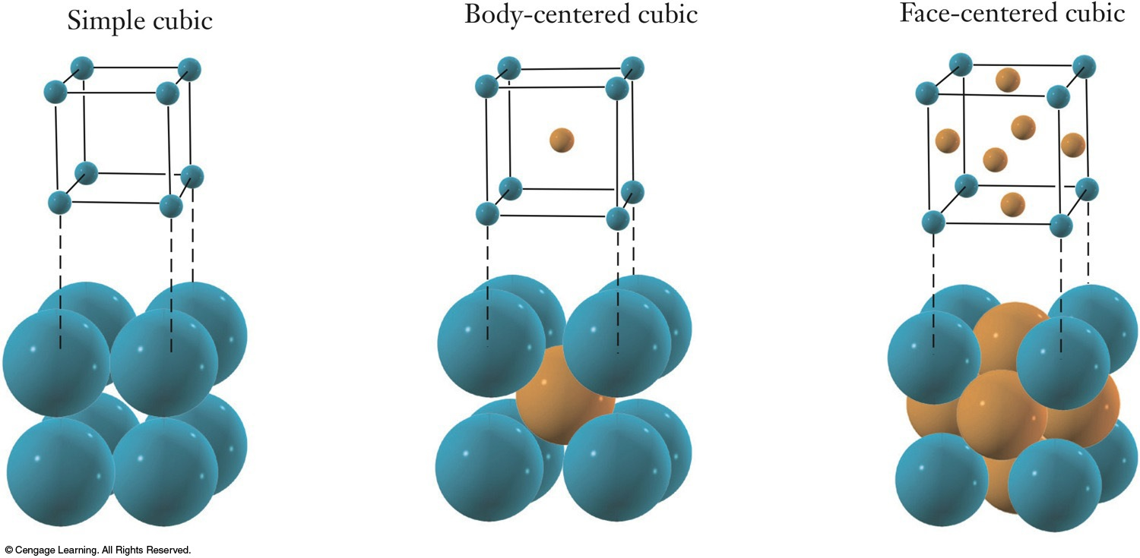
Condensed Phases - Solids
A unit cell is the smallest collection of atoms that displays all the features of the crystal structure.
  Three types of cubic unit cells:
  simple cubic (sc) containing 1/8 each of 8 corner atoms,
  body-centered cubic (bcc) containing one additional atom within, face-centered cubic (fcc) with an additional 1/2 each of 6 atoms along the faces.

Slide 10
Calculation of Packing Efficiency
To calculate packing efficiency:
To find the volume of the unit cell in terms of radius r:
To find the total volume occupied by atoms:

Slide 11
Calculation of Packing Efficiency
To determine the number of complete atoms per unit cell:
6
8
1
8
8

Slide 12
Calculation of Packing Efficiency
52 %
68 %
74 %

Slide 13
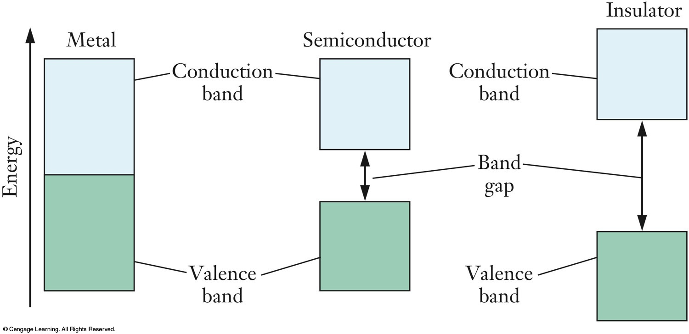
Band Theory and Conductivity
  The wave functions of the valence electrons interact with each other.
  Bonding molecular orbitals result from constructive interference.
  Antibonding molecular orbitals result from destructive interference.

Slide 14
Semiconductors
Electrical conductivity of semiconductors can be modified via doping.
  Doping - adding trace amounts of an element to a substance to modify its properties.
    n-type: prepared by doping with a valence electron rich element; “negative”
    p-type: prepared by doping with a valence electron deficient element; “positive”
  Doping Si with P introduces an extra valence electron.
  Doping Si with Al means the dopant has fewer than 4 valence electrons (holes).

Slide 15
Intermolecular Forces
Intermolecular forces - the attractive and repulsive forces between molecules. (H₂O^{δ-}⋅⋅⋅⋅⋅⋅ ^{δ+}H₂O)
Dispersion forces are common to all molecules.
  Also referred to as instantaneous dipole-induced dipole forces.
Dipole-dipole forces are the attractive and repulsive forces for molecules with a permanent dipole.
Hydrogen bonds are a special case of dipole-dipole forces.
  Hydrogen bonds occur only in compounds containing hydrogen covalently bonded to the highly electronegative elements F, O, or N.

Slide 16
Example Problem
Which type(s) of intermolecular forces need to be overcome to convert each of the following liquids to gases?
  CH₄
  CH₃F
  CH₃OH
liquid ⎯→ gas
dispersion
dispersion
dipole-dipole
dispersion
dipole-dipole
H-bonding

Slide 17
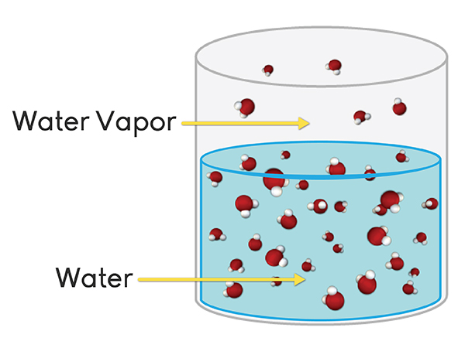
Vapor Pressure
Vapor pressure - the gas phase pressure of a substance in dynamic equilibrium with the pure liquid in a pure substance.
  Vapor pressure is a characteristic property of a particular substance at a particular temperature.
    Liquids with strong intermolecular forces have lower vapor pressures (cooking oil; motor oil).
    Liquids with weak intermolecular forces have higher vapor pressures & are described as volatile (formaldehyde).

Slide 18
Example Problem
Q. Predict the order of increasing vapor pressure for the following compounds.
Weakest IMFs
highest VP
Strongest IMFs
lowest VP
  a) FCH₂CH₂F
  b) HOCH₂CH₂OH
  c) FCH₂CH₂OH
dispersion
dipole-dipole
dispersion
dipole-dipole
H-bonding
dispersion
dipole-dipole
H-bonding (less)
order of increasing vp: b < c < a

Slide 19
Chapter 9
Energy and Chemistry
Gang Chen, Department of Chemistry, UCF

Slide 20
Heat Capacity
Different systems will absorb different amounts of energy based on three main factors.
  The amount of material, m or n.
    m is mass and n is number of moles
  The type of material, as measured by c or C_{p}.
    c is the specific heat capacity, or specific heat, and C_{p} is the molar heat capacity.
  The temperature change, ΔT.

Slide 21
Example Problem
Copper wires used to transport electrical current heat up because of the resistance in the wire. If a 140 g wire gains 280 J of heat, what is the change in temperature of the wire? Specific heat of Cu = 0.384 J/gºC

Slide 22
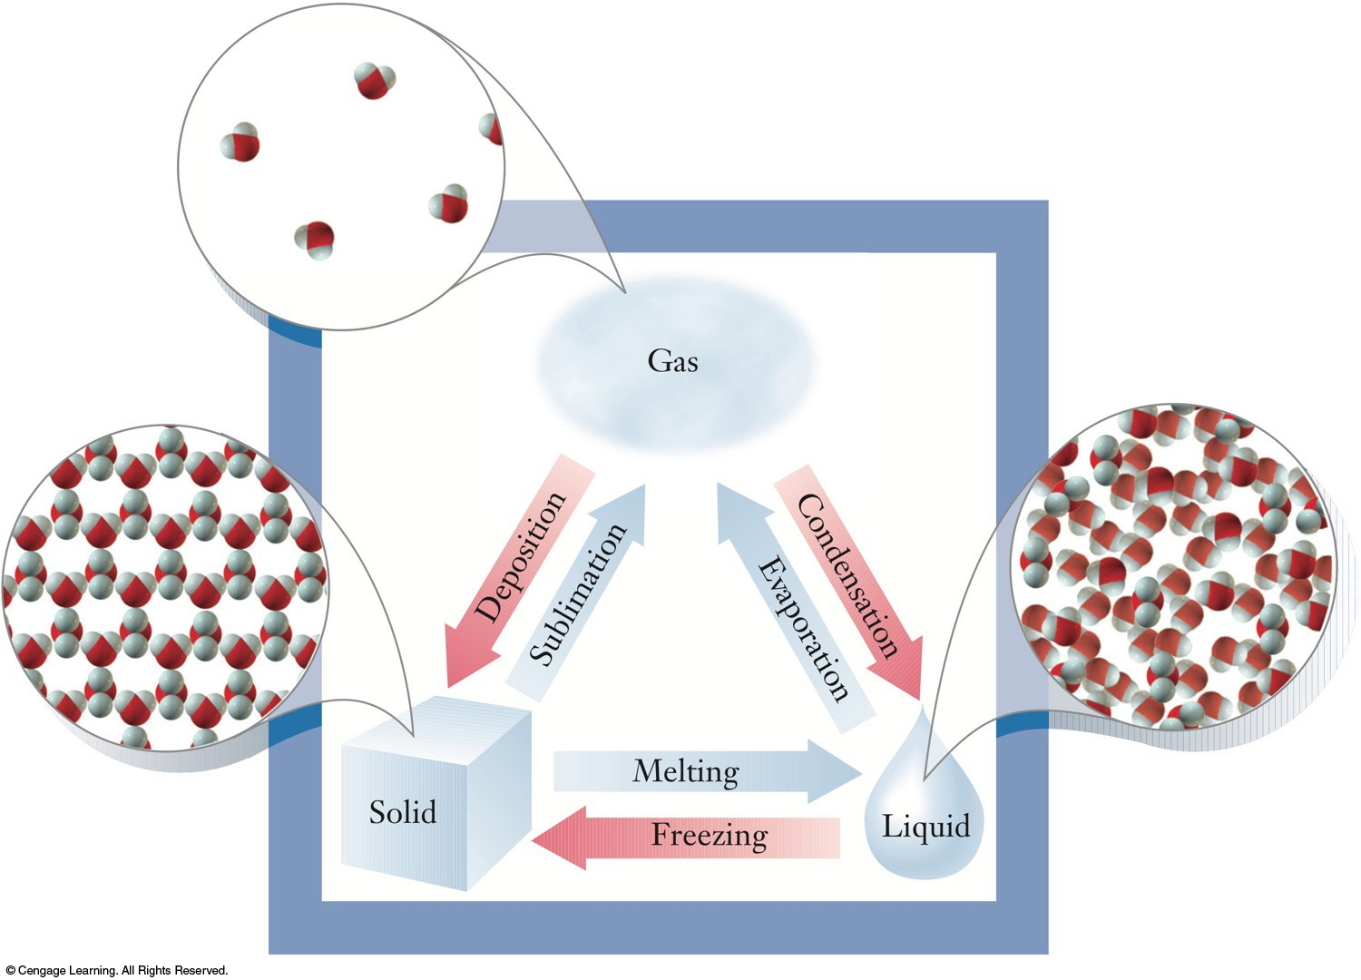
ΔH of Phase Changes
Phase changes occur under constant pressure conditions.
  The heat flow during a phase change is an enthalpy change.
  During a phase change, temperature does not change with heat flow due to formation or breaking of intermolecular attractive forces.
Practice 9.45

Slide 23
ΔH of Phase Changes
The value of ΔH for a phase change is compound specific and has units of kJ/mol.
  The heat flow can be calculated using the number of moles of substance, n, and the value of the enthalpy change.
H₂O: ΔH_{vap} = + 40.7 kJ/mol
(CH₃)₂CO: ΔH_{vap} = + 29.1 kJ/mol

Slide 24
Example Problem
The heat of fusion of pure silicon is 43.4 kJ/mol. How much energy is needed to melt a 5.24 g-sample of silicon at its melting point of 1693 K?
Practice 9.46, 9.47, 9.49

Slide 25
Heats of Formation
A formation reaction is the chemical reaction by which one mole of a compound is formed from its elements in their standard states.
Fractional coefficients are allowed for formation reactions because only one mole of product can be formed.
The standard state is the most stable form of an element at room temperature, 25°C, and pressure, 1 atm, indicated with a superscript °.
ΔH_{f}° = 0 for an element in its standard state.
8C_{(s; graphite)} + 9H_{2(g)} ⎯→ C₈H_{18(liq)}
H_{2(g)} + Cl_{2(g)} ⎯→ 2 HCl_{(g)}
½ H_{2(g)} + ½ Cl_{2(g)} ⎯→ HCl_{(g)}
Practice 9.52, 9.53

Slide 26
Hess’s Law and Heats of Reaction
Direct calorimetric determinations of some reactions may be too difficult or dangerous to perform.
  An indirect method is needed to obtain heats of reaction.
Hess’s law: the enthalpy change for any process is independent of the particular way the process is carried out.
  Enthalpy is a state function.
  A state function is a variable whose value depends only on the state of the system and not its history.
Practice 9.54

Slide 27
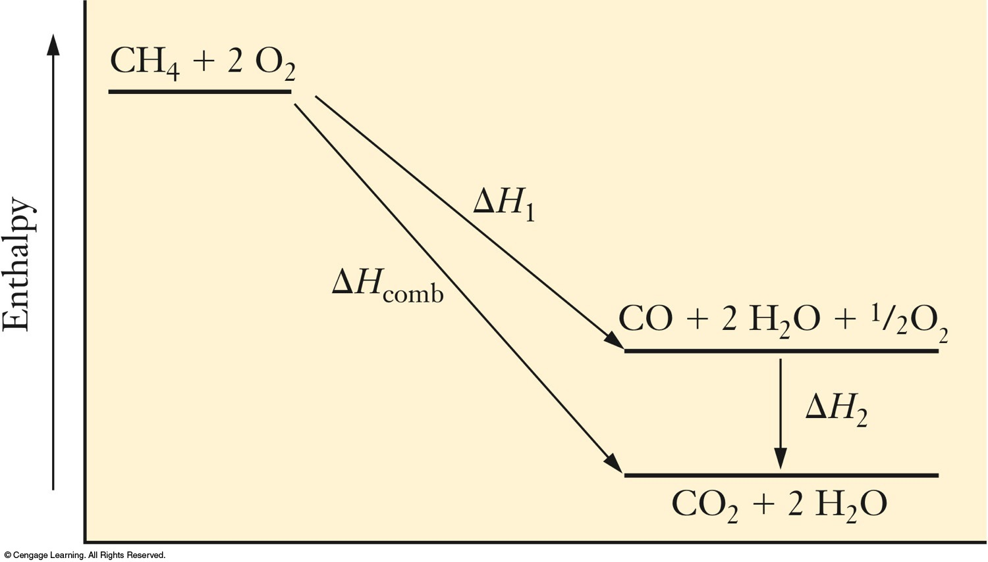
Hess’s Law
ΔH_{comb} = ΔH₁ + ΔH₂
Enthalpy diagram for the combustion of methane. The CH₄ is converted to CO, then the CO is converted to CO₂. The ΔH for each step is used to calculate the ΔH for the overall reaction. The ΔH will be the same for both paths.

Slide 28
Example Problem
One origin of SO₃ is the combustion of sulfur, which is present in small quantities in coal, according to the following equation.
Given the thermochemical information below, determine the heat of reaction for this reaction.

Slide 29
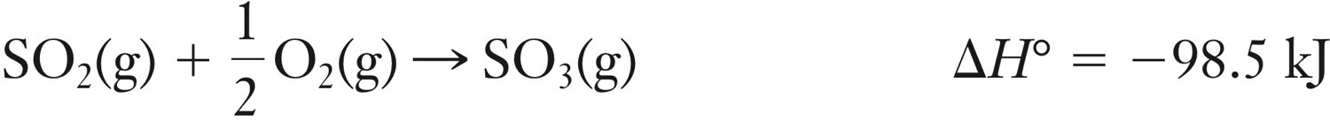
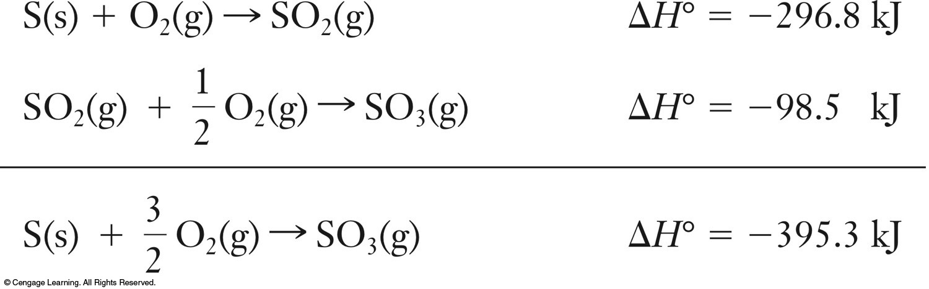
Example Problem
÷ 2
+
Practice 9.55, 57

Slide 30
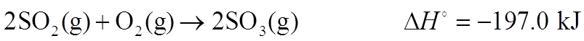
Energy and Stoichiometry
A thermochemical equation allows for the stoichiometric treatment of energy.
The thermochemical equation is used to convert between the number of moles of a reactant or product and the amount of energy released or absorbed.
  The stated value of ΔH for a thermochemical equation corresponds to the reaction taken place exactly as written, with the indicated numbers of moles of each substance reacting.
2 moles
- 197.0 kJ
1 moles
- 98.5 kJ

Slide 31
Example Problem
An engine generates 15.7 g of nitric oxide gas during a laboratory test. How much heat was absorbed in producing this NO?
Ratio to use: 2 mole NO need 180.5 kJ
Practice 9.63, 9.65, 9.67

Slide 32
Chapter 10
Entropy and the Second Law of Thermodynamics
Gang Chen, Department of Chemistry, UCF

Slide 33
Judging Entropy Changes in Processes
Entropy can be tentatively defined as a measurement of the randomness, or disorder, of a system.
Certain types of changes will result in increased entropy.
  Certain phase changes.
  An increase in the number of particles present.
  An increase in the temperature of a substance.
melting
boiling
solid ⎯⎯→ liquid ⎯⎯→ gas
entropy increases→
C₃H₈(g) + 5 O₂(g) ⎯→ 3 CO₂(g) + 4 H₂O(g)
entropy increases
CO(g) + 2 H₂(g) ⎯→ CH₃OH(l)
entropy decreases
Practice 10.23, 10.26, 10.27

Slide 34
Exam Questions
Without doing a calculation, predict the entropy change of these process?
2 HNO₃(l) + NO(g) ⎯→ 3 NO₂(g) + H₂O(l)
CO₂(s) ⎯→ CO₂(g) at 25 ºC
CO(g) +2 H₂(g) ⎯→ CH₃OH(l)
2H₂O(g) ⎯→ 2H₂(g) + O₂(g)
2H₂(g) + O₂(g) ⎯→ 2H₂O(l)
increase
increase
decrease
increase
decrease
  Certain phase changes.
  An increase in the number of particles present.

Slide 35
Exam Questions
If a 5.0 L flask holds 0.125 moles of nitrogen at STP, what happens to the entropy of the system upon cooling the gas to -75 °C?
The entropy decreases
  C) An increase in the temperature of a substance.

Slide 36
The Second Law of Thermodynamics
The second law of thermodynamics: in any spontaneous process, the total entropy change of the universe is positive (ΔS_{u} > 0); entropy increase.
    ΔS_{u} = entropy of the universe
    ΔS_{sys} = entropy of the system
    ΔS_{surr} = entropy of the surroundings
> 0

Slide 37
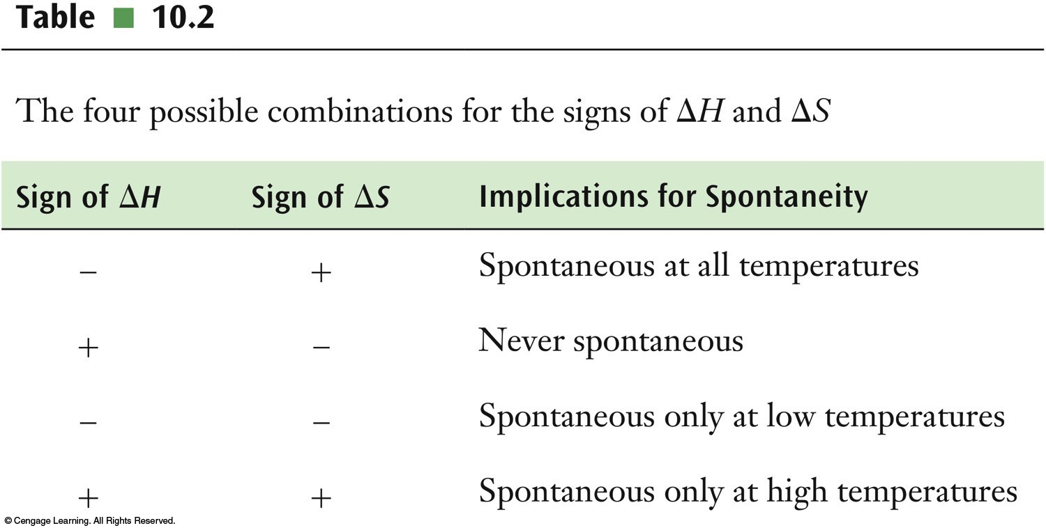
Gibbs Free Energy
The Gibbs free energy function, G, is defined as:
Changes in this function can predict whether or not a process is spontaneous under conditions of constant pressure and temperature.
ΔG < 0
spontaneous

Slide 38
Exam Questions
The sign of ΔH_{rxn} and ΔS_{rxn} for several reactions are given. Determine the spontaneity of these processes.
ΔH_{rxn} < 0; ΔS_{rxn} < 0
ΔH_{rxn} < 0; ΔS_{rxn} > 0
ΔH_{rxn} > 0; ΔS_{rxn} < 0
ΔH_{rxn} > 0; ΔS_{rxn} > 0
ΔH_{rxn} = ΔS_{rxn}
Spontaneous at low T
Always spontaneous
Always nonspontaneous
Spontaneous at high T

Slide 39
Chapter 11
Chemical Kinetics
Gang Chen, Department of Chemistry, UCF

Slide 40
Rates of Reaction
The reaction rate is the ratio of the change in concentration to the elapsed time.
  Concentration is measured in M, or mol L⁻¹, and designated with square brackets, [ ].
  Time in measured in s.
  The unit for rate is mol L⁻¹ s⁻¹.

Slide 41
Stoichiometry and Rate
The change in the concentrations of the product and reactant are not necessarily equal.
  To ensure that the same reaction rate is obtained when using either the reactants or the products, the stoichiometric coefficient, v, is included in the denominator of the rate expression.
a A + b B ⎯→ c C + d D
Practice 11.16, 11.17

Slide 42
Example Problem
  Q. Based on the reaction below
2HBr(g) ⎯→ H₂(g) + Br₂(g)
a) Express the rate of the reaction in terms of the change in concentration of each of the reactant and products
b) In the first 25 s, [HBr] decreased from 0.60 M to 0.51 M. What is the rate of the reaction during the first 25 s?
= 1.8×10⁻³ M/s

Slide 43
Determination of the Rate Law
For a reaction with two reactants, A and B, the rate of the reaction is rate = k[A]^{m}[B]^{n}.
To separate the influence of one reactant concentration from the other, one reactant concentration is held constant while changing the other to determine its effect on the rate.
To determine the order with respect to A and B, at least three experiments must be carried out.

Slide 44
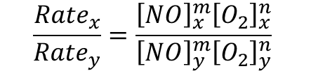
Example Problem
Q. Consider the following data for the reaction shown. Determine the rate law and rate constant for this reaction at the temperature of these experiments.
NO + O₂ → NO₂ + O
Expt | [NO] (mol L⁻¹) | [O₂] (mol L⁻¹) | Rate (mol L⁻¹ s⁻¹)
1 | 0.002 | 0.005 | 8.0×10⁻¹⁷
2 | 0.002 | 0.010 | 1.6×10⁻¹⁶
3 | 0.006 | 0.005 | 2.4×10⁻¹⁶
$$\frac{{Rate}_{x}}{{Rate}_{y}}=\frac{{\left[NO\right]}_{x}^{m}{\left[O_{2}\right]}_{x}^{n}}{{\left[NO\right]}_{y}^{m}{\left[O_{2}\right]}_{y}^{n}}$$
Practice 11.29, 11.33, 11.35

Slide 45
Example Problem
Use expts 1 and 2 to determine the value of n
2^{n} = 2
n = 1
Use expts 1 and 3 to determine the value of m
3^{m} = 3
m = 1

Slide 46
Example Problem
Use expt 1 information to solve for k
k = 8.0×10⁻¹² L mol⁻¹ s⁻¹
k = 8.0×10⁻¹² M⁻¹ s⁻¹

Slide 47
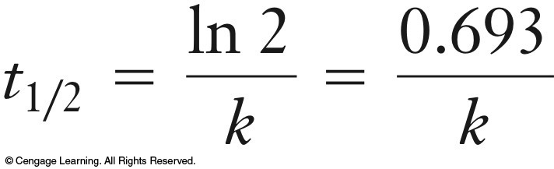
Half-Life
The half-life, t_{1/2}, of a reactant is the time it takes for its concentration to fall to one-half its original value.
  When a reaction has proceeded for one half-life, the concentration of the reactant must be [A]_{t} = 0.5[A]₀.
Substituting [A]_{t} = 0.5[A]₀ into the first-order integrated rate expression, t_{1/2} can be evaluated.
Other half-life equations can be constructed for zero-order and second-order reactions using the same method.
Practice 11.43, 11.45

Slide 48
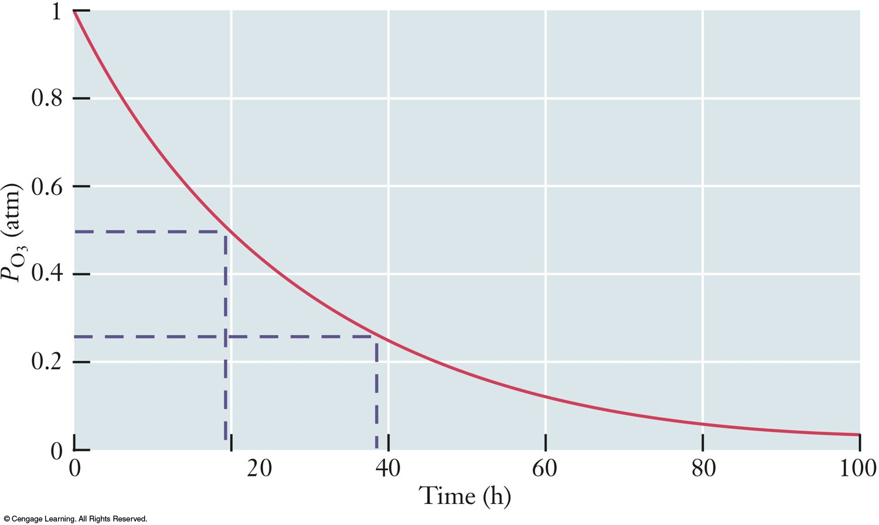
Half-Life
A₀
½ A₀
¼ A₀
1/8 A₀
1/16 A₀
t_{1/2}
2 t_{1/2}
3 t_{1/2}
4 t_{1/2}
Ozone pressure as a function of time in an experiment designed to model the destruction of ozone in the stratosphere.
  The ozone pressure falls by a factor of 0.5 every 19 hours.
  Thus, t_{1/2} is 19 hours.

Slide 49
Exam Questions
If the initial concentration of the reactant A in a first-order reaction, A → B + C, is 0.96 mol/L and the half-life is 30.0 s, what’s the concentration of A after reacting for a certain time?
30.0 s
60.0 s
90.0 s
120.0 s
150.0 s
0.48 mol/L
0.24 mol/L
0.12 mol/L
0.060 mol/L
0.030 mol/L

Slide 50
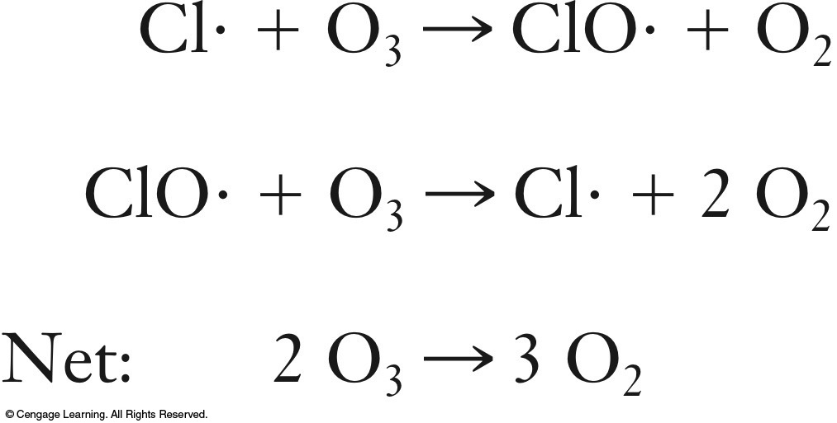
Reaction Mechanisms
A reaction mechanism is a collection of one or more molecular steps that account for the way reactants become products.
  A reaction mechanism is composed of a series of individual steps called elementary steps.

Slide 51
Elementary Steps and Reaction Mechanisms
Only three types of elementary steps may occur.
  Unimolecular steps have one reactant.
  Bimolecular steps have two reactants.
  Termolecular steps have three reactants.
    Reactions involving the collision of three reactants are uncommon.

Slide 52
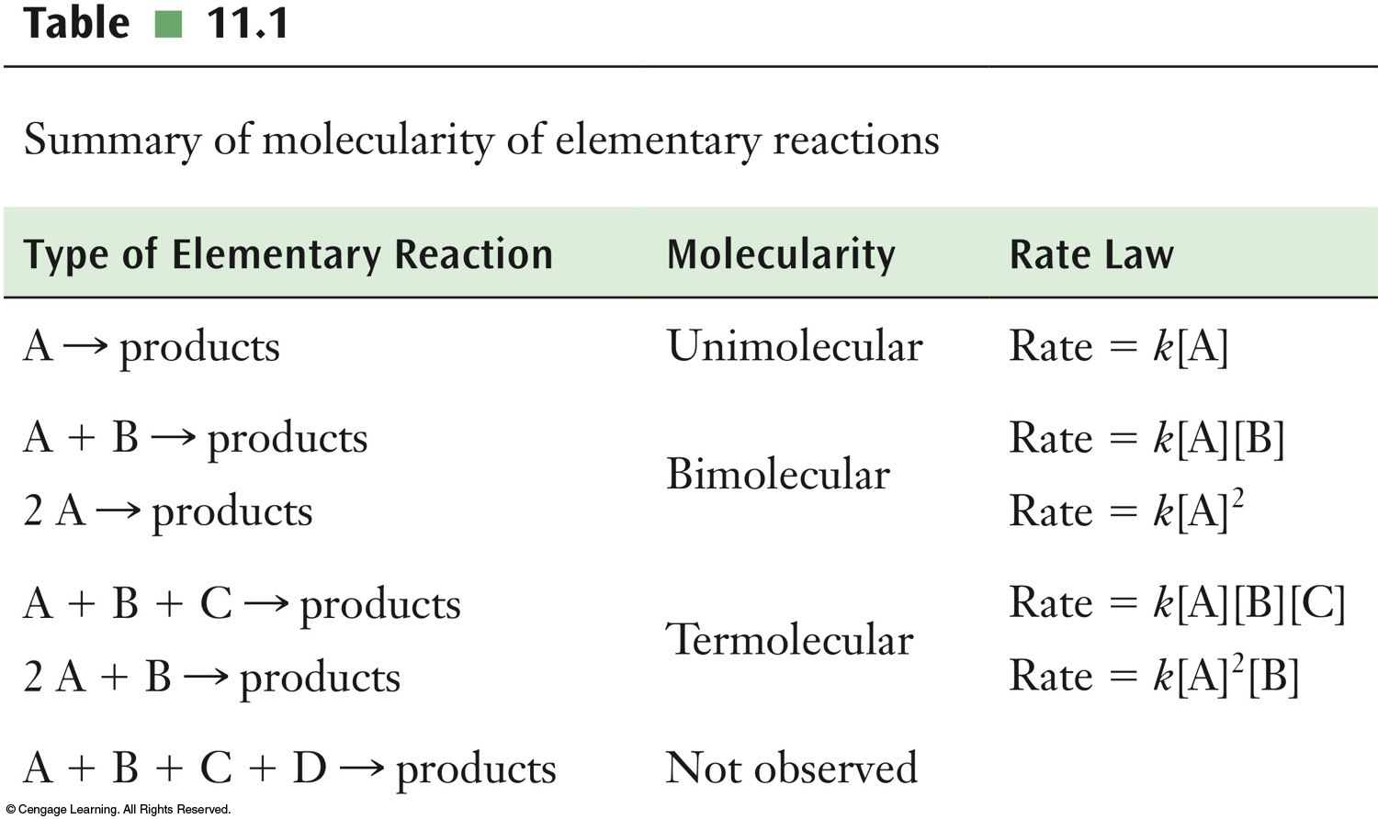
Elementary Steps and Reaction Mechanisms

Slide 53
Final Exam Review

