Slide 1
Developing Your Research Proposal

Slide 2
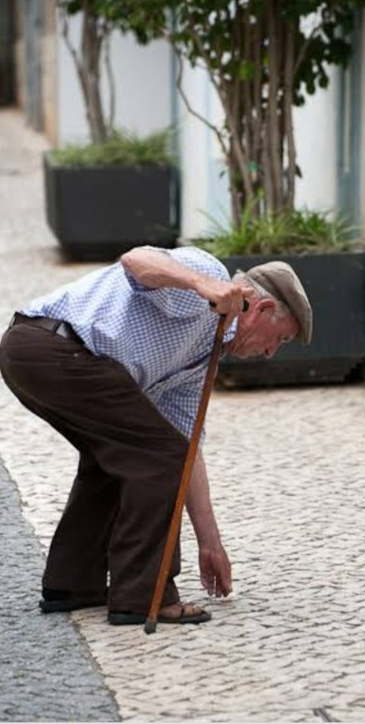
A strong proposal provides enough detail that the study could be replicated by other research teams…

Slide 3
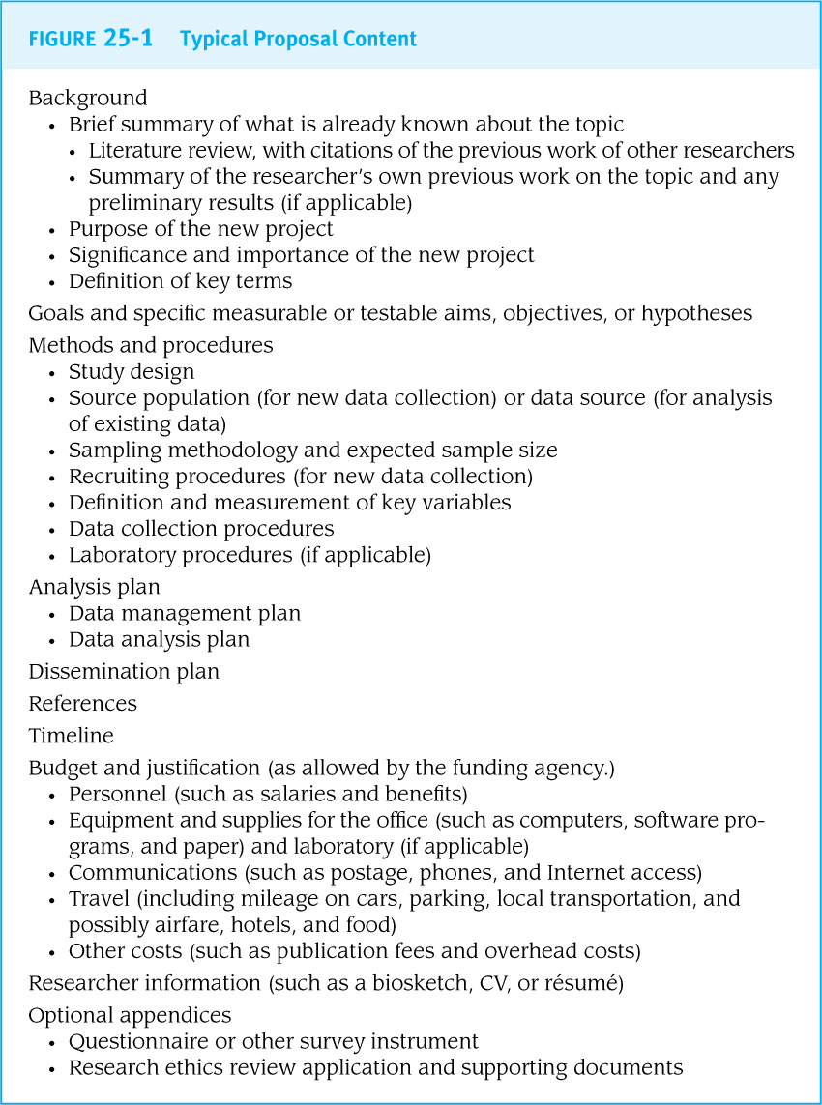
General Overview
A research proposal should describe the exact procedures that will be used for every step of the research process.
In the research world, research proposals are a time-intensive and multi-investigator project

Slide 4
Questions to Consider
Research Topic/Question?
Why do ‘we’ care?
What is the significance of your research?
What do we already know?
How does your research fill a ‘gap’ in the literature?
Limitations of other studies?
What makes your research question ‘original’?
Choice of study design?
Is it appropriate to answer your question?

Slide 5
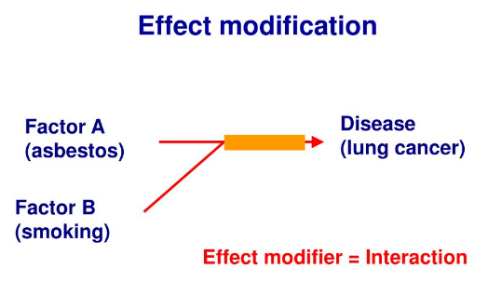
Questions to Consider (continued)
Sample Population?
Be specific!
Age, race/ethnicity, diseased/non-diseased?
Main ‘variables’ of interest?
What is your main exposure (predictor), disease (outcome)
Effect modifiers?
independent variable
= predictor/exposure;
and dependent variable
= outcome/disease
Does smoking influence the relationship between asbestos and lung cancer?

Slide 6
Questions to Consider (continued)
Hypothesis?
What do you think or expect to find?
Any secondary hypotheses?
How will you measure each variable?
Surveys, devices, clinical measures?
How many measurement timepoints?
If you choose an experimental design?
The treatment or intervention needs detail…What? When? How? How many? How long? Who by?

Slide 7
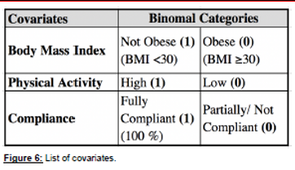
Questions to Consider (continued)
Data handling procedures
What outcome are you reporting?
(e.g., Minutes of activity or sleep?)
(e.g., Blood pressure (mm/Hg) change?)
(e.g., Depression score on a survey scale?)
Are you going to split your outcome or predictor variables ?
Participants who show ‘High’ or ‘Low’ outcomes?
In this example, this group proposed that they would split BMI into ‘Obese’ vs. ‘Not Obese’, ‘Physical Activity’ into ‘High’ vs. ‘Low’, and intervention compliance into ‘Fully Compliant’ and ‘Partially/Not Compliant’
Now they can explore Vitamin D supplementation and it’s impact on blood pressure by these other ‘covariates’

Slide 8
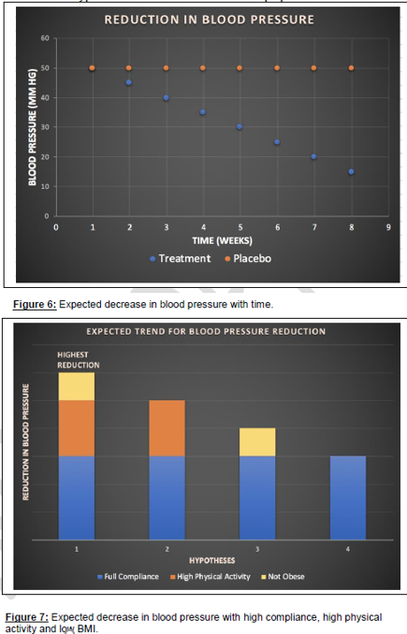
Questions to Consider (continued)
What do you expect to find?
This is your hypothesis
Will you illustrate this in a chart or graph?
Study Limitations
What are some of the weaknesses of your study?
Implications
What is the take away message from this study that we could use to inform public health?
Future Directions
What would be the next step after this study was completed?
Future research should explore…?

Slide 9
Guidelines
A 4-page research proposal
Single-spaced
0.5-inch Margins
11-point Arial font (everything)
3 main components of proposal
‘Front matter’
‘Main document’
‘Back matter’
‘Proposal Guide’
on Webcourses

Slide 10
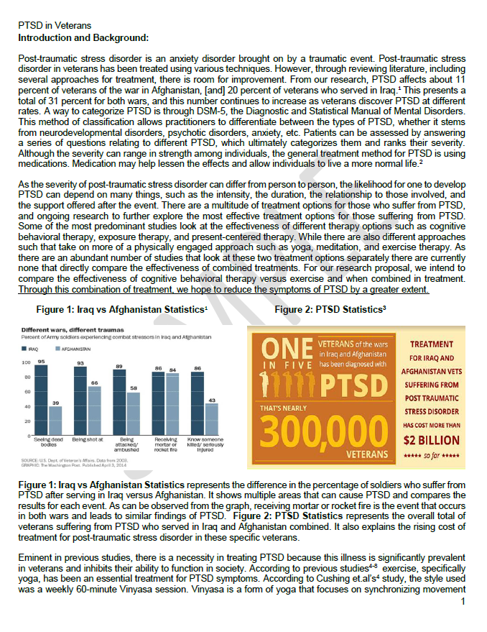
Review proposal examples of webcourses

Slide 11
Front matter
Title page
Running Header
Title
First/Last Name of group members
Class Section
Class Semester
Group Number
Abstract/Project Narrative page
250 words (max), Structured
Introduction/Background
Purpose statement
Methods
Hypothesis/Hypotheses
Future Implications
5 key words immediately below your abstract
TEMPLATE ON WEBCOURSES

Slide 12
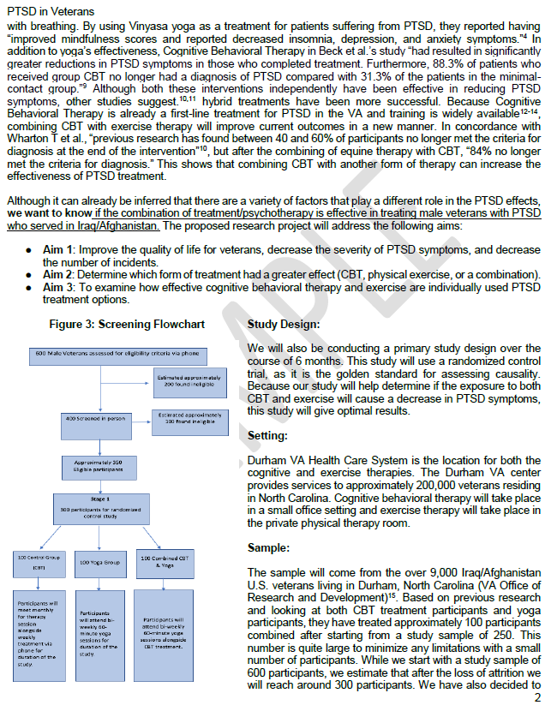
Main document
Proposal Outline:
Background/Literature Review
~1 to 1.5 pages
Methods
~2 to 2.5 pages
Expected Results, Study Limitations, Ethical Principles, and Future Implications
~0.5 to 1 page

Slide 13
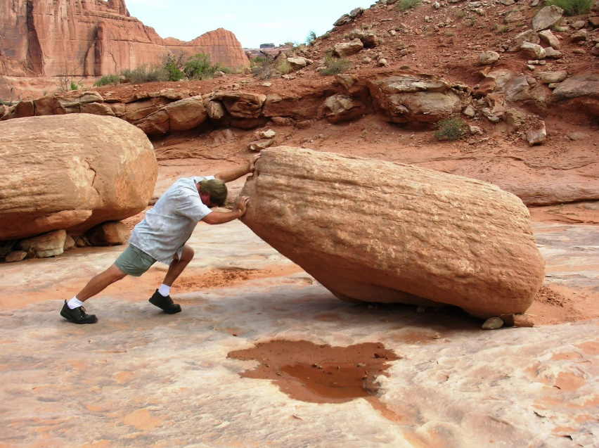
Writing a quality background supported by the literature
Start ‘big picture’ and narrow focus to end with your research question(s)
In between…
Why do ‘we’ care?
What do we know about this topic?
What is missing (limitations of other studies)?
What will your study add?
Use figures, data tables
Use boxes, bold important points, underline

Slide 14
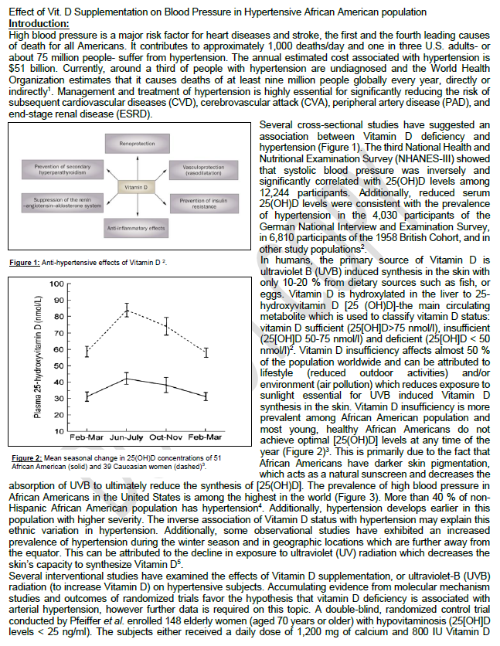
Make it visually appealing “grantsmanship”

Slide 15
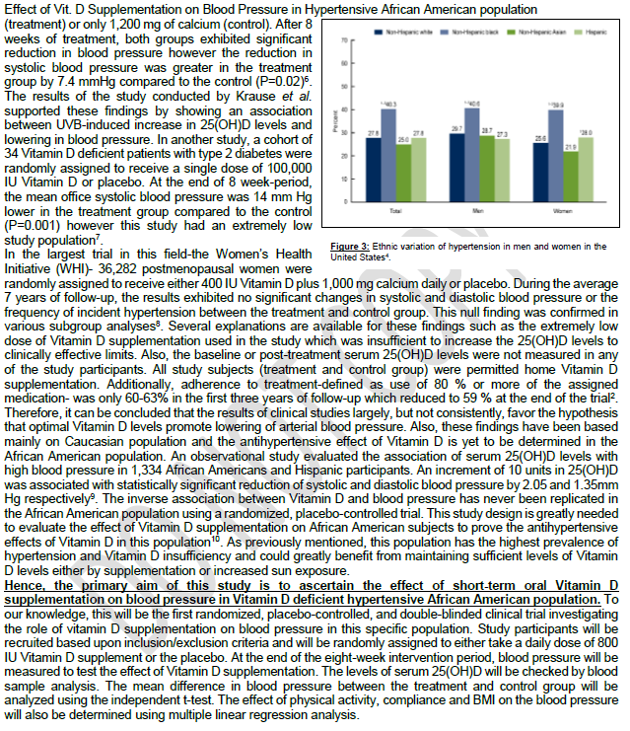
Incorporate figures and charts Bold and underline key words, phrases and sentences

Slide 16
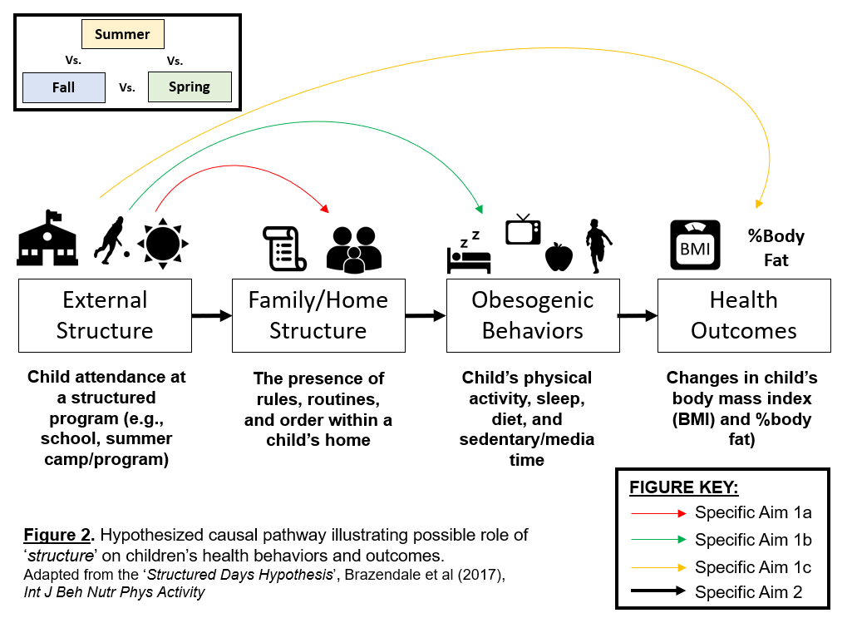
Conceptual or Theoretical models?
Children’s Physical Activity
Children’s Weight Status
Season:
Summer vs School Months

Slide 17
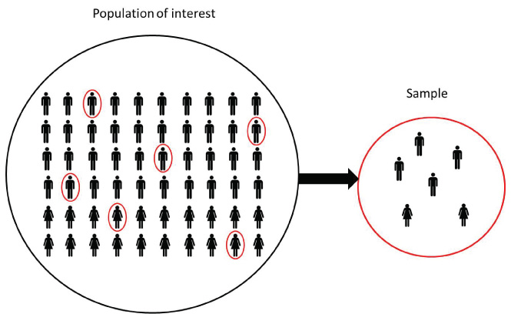
Methods
State study design chosen
Setting description (Will your study take place on campus, at a clinic, home, school?)
State sample population of study
Justification (why?)
Inclusion/Exclusion Criteria
Protocol to collect data (walk us through it!)
Experiment/intervention/RCT?
Define ‘conditions’ or ‘groups’
Use diagrams/timelines of when measurements will be taken

Slide 18
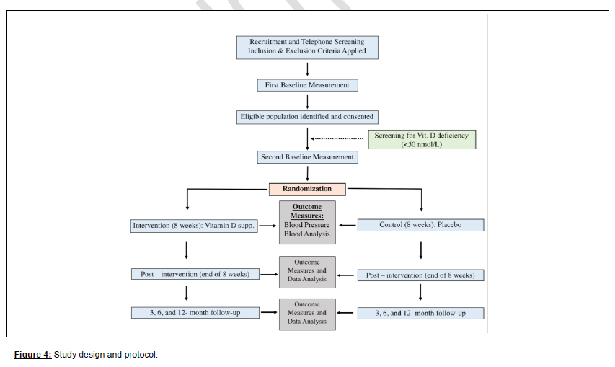

Slide 19
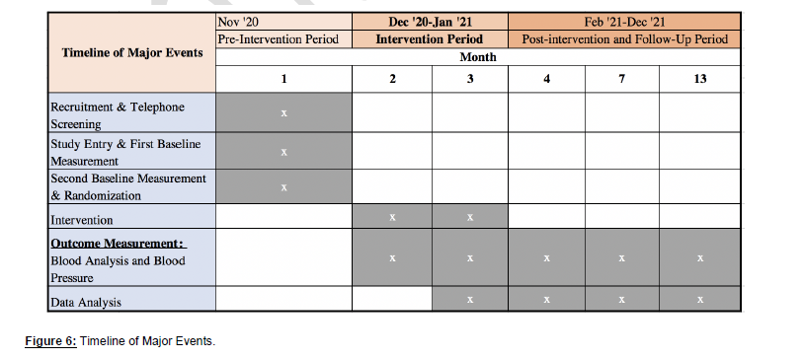

Slide 20
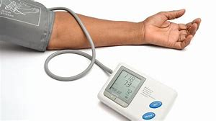
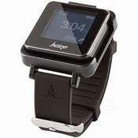
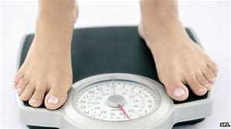
Measures (instruments)
Describe the ‘measures’ you will use to conduct the study
Objective measures
Subjective measures
Include all measures
Individual, environmental, demographic data etc.
When is this being collected? How often?
Why did you choose this ‘measure’?
Previous research?
Is it ‘valid’ and ‘reliable’ measure?

Slide 21
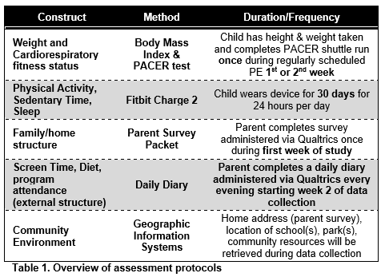

Slide 22
Data handling and analyses
How do you plan to ‘handle’ and ‘clean’ your data?
Main outcome of interest
What does that look like?
Variables
Dependent, independent, covariates/confounders?
Cleaning data
Reporting of descriptive statistics
Means, Standard Deviation (SD), range (min and max values)
Separate main results by covariates (Sex, Race, Age?)

Slide 23
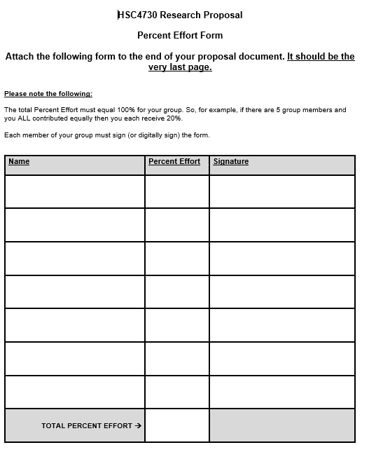
Back matter
Back matter should be presented in the following order:
References
Appendices (if any)
‘%Effort’
An Appendix (Appendices) is where you put any additional figures or graphs, surveys, pamphlets, educational handouts, etc. you want to share
Appendix (Appendices) OPTIONAL!
A 1-page ‘% effort’ sheet signed by each group member will be the LAST PAGE of your document.
Use 1-page template posted on Webcourses

Slide 24
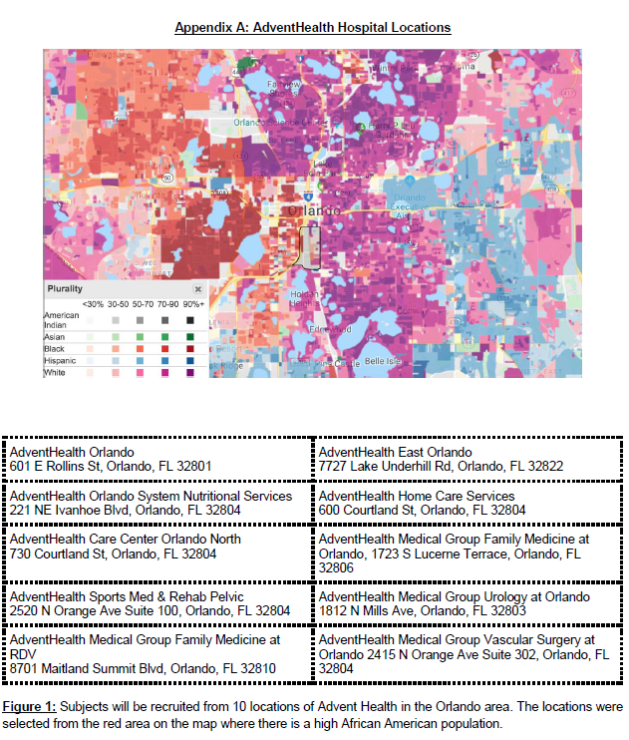

Slide 25
Use Webcourses…

