Slide 1




Data Analysis – Part 2
Notes:
Chapter 26 to 29

Slide 2
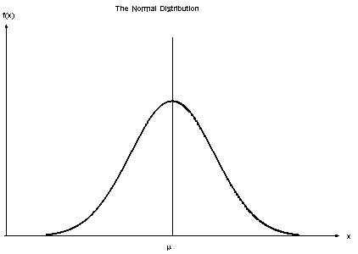
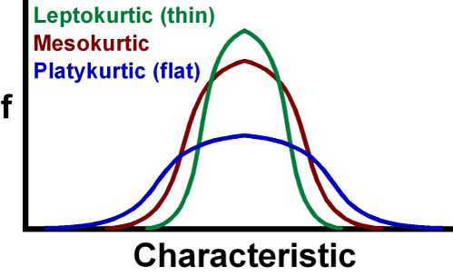
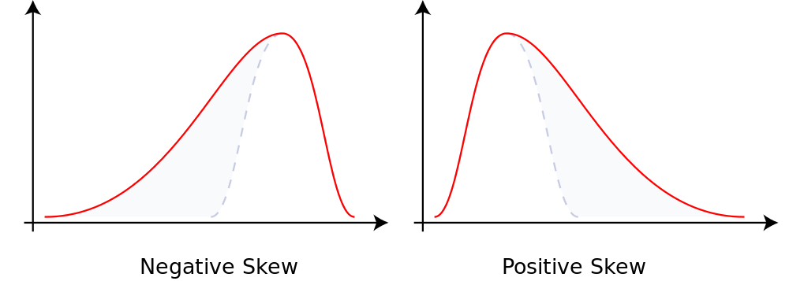
Normal Curves, Variance, and Standard Deviation
A histogram showing a normal distribution (or Gaussian distribution) or an approximately normal distribution of responses will have a bell-shaped curve with one peak in the middle.
Kurtosis describes how peaked or flat a distribution is.
Skewness occurs when responses extend farther from the peak on either the left (left-skewed/positive) or the right (right-skewed/negative) side of the histogram.
Kurtosis

Slide 3
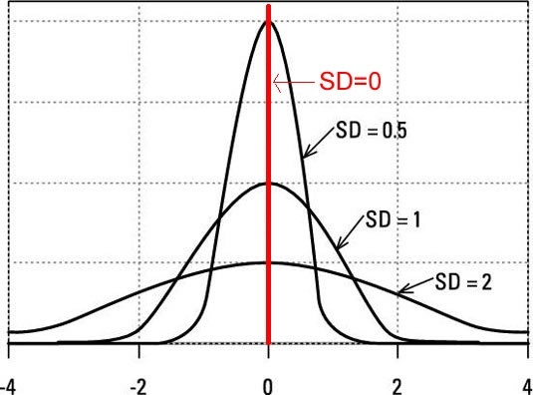
Understanding the Distribution
For variables with a relatively normal distribution—a reasonably bell-shaped curve—there are three different ways to quantify the narrowness or wideness of the distribution of the responses:
  Variance
  Standard deviation
  Standard error
A z-score indicates how many standard deviations away (+ or - ) from the sample mean the response is for an individual from within that population.

Slide 4
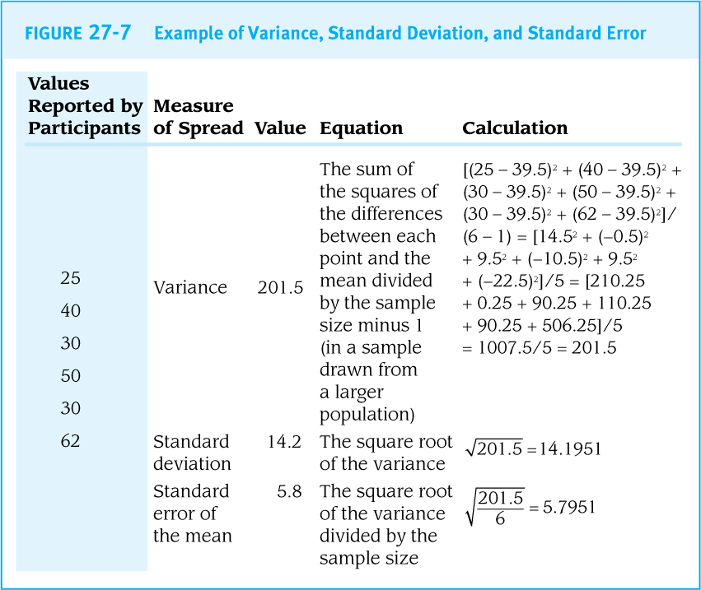
  Variance, Standard deviation & Standard error
Smaller values indicate a narrower distribution around the mean

Slide 5
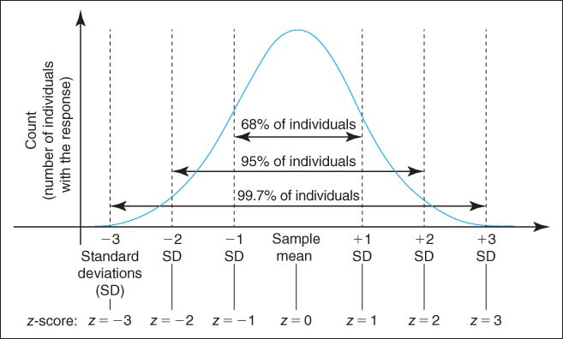
z-score example

Slide 6

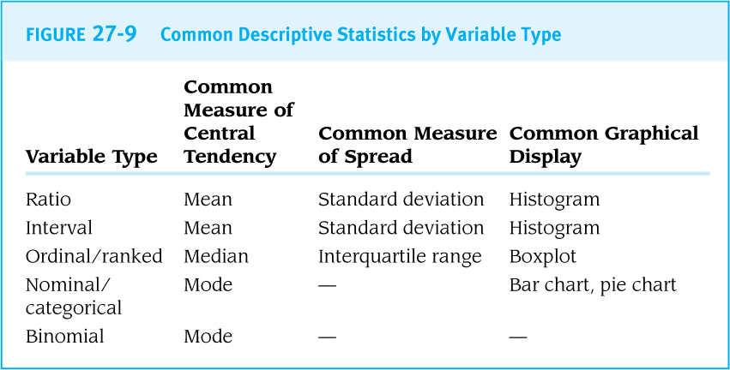
Reporting Descriptive Statistics
For ratio and interval variables with a normal distribution, both the mean and the standard deviation are typically reported.
For ordinal variables (and for ratio and interval variables with a non-normal distribution), the median and interquartile range are often reported.
For categorical variables, the proportions of participants who provided particular responses are usually used to describe the population.

Slide 7
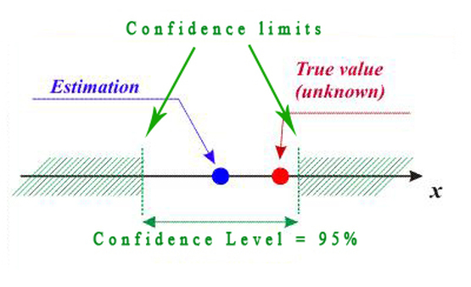
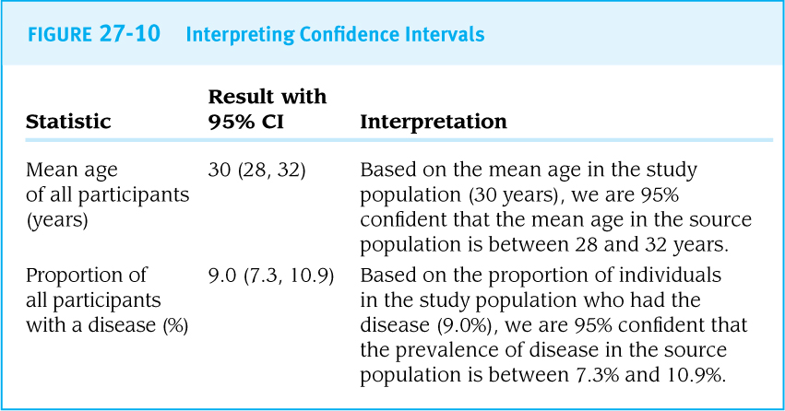
Understanding Confidence Intervals
If the 95% confidence interval for the mean age in a study population extends from 26 to 34, a researcher can be 95% confident that the mean age of all employees (not just the ones randomly sampled for the study) is between 26 and 34 years
Remember, a larger sample size will yield a narrower confidence interval.

Slide 8
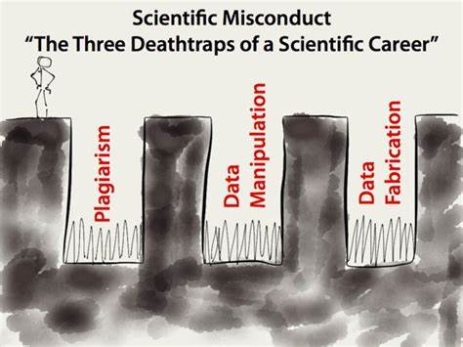
Statistical Honesty
Three of the most serious forms of research misconduct are:
Fabrication: the creation of fake data
Falsification: the misrepresentation of results
Plagiarism: the use of other people’s ideas, words, or images without proper attribution

Slide 9




Statistical Honesty
Statistical honesty requires adherence to accepted statistical practices.
Examples of unacceptable practices:
  It is not acceptable to run a dozen different types of statistical tests on a data set, hoping that one of them will happen to yield a statistically significant result to feature in a report.
  It is not appropriate to recode ratio variables into categorical variables by preferentially selecting the cutoff values that yield statistically significant results for tests of the new categorical variable.
p-value

Slide 10
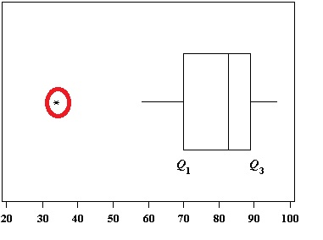
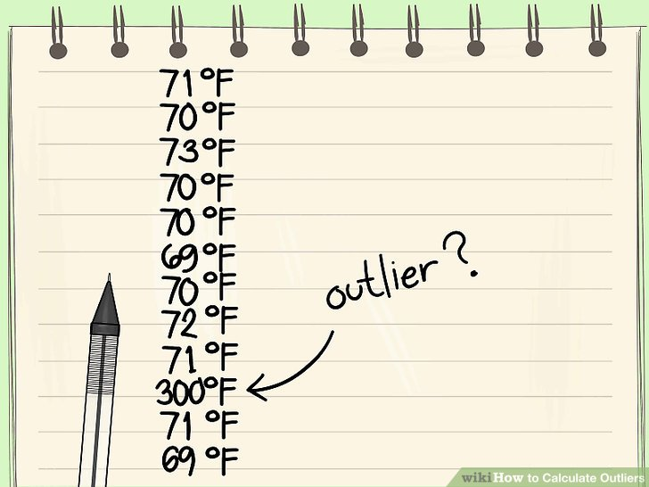

Statistical Honesty
  Examples of unacceptable practices (cont’d):
  It is not permissible to ignore outliers—unusual responses to a question—where there is not a valid and widely accepted reason for doing so.
Statistical analysis is about discovering the true story in a data set, not about creatively manipulating data toward a preferred result.
implausible

Slide 11


Comparative Statistics
Analytical Plan
Hypotheses for Statistical Tests
Interpreting p-values
Measures of Association
Interpreting confidence intervals
Comparative options
“Compare groups of participants by sex or age, by exposure or disease status, or by other characteristics”

Slide 12
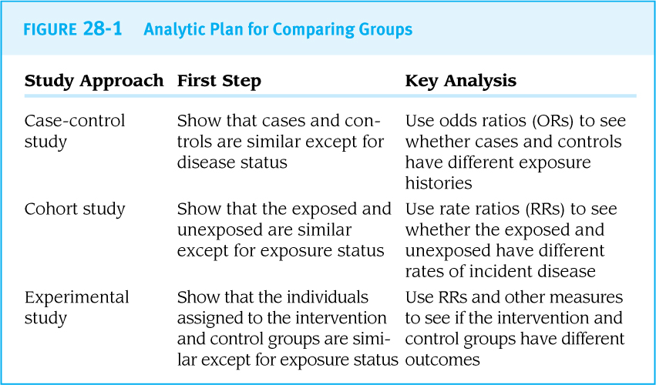

Comparative Analysis by Study Approach
Comparative statistics categorize study participants into two or more groups and then use tests to compare the characteristics of those groups.

Slide 13
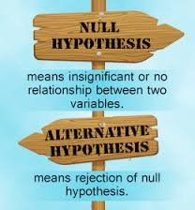
Hypotheses for Statistical Tests
Comparative statistical tests are designed to test for difference rather than for sameness; the outcome is either “different” or “not different.”
The null hypothesis (H₀) describes the expected result of a statistical test if there is no difference between the two or more values being compared.
A null result means that there was no statistically significant difference.
The alternative hypothesis (H_{a}) describes the expected result if there is a difference between the two or more populations being compared.

Slide 14
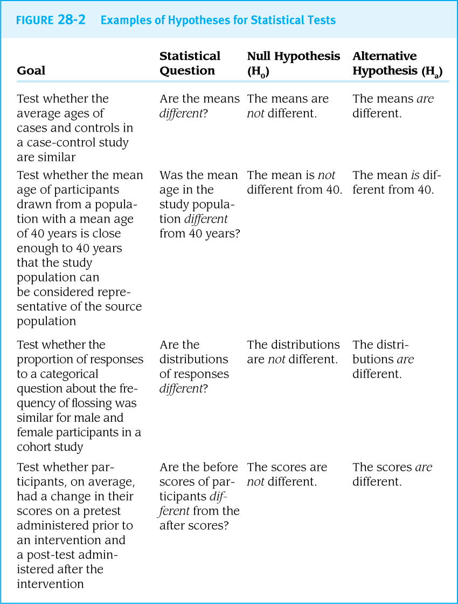

Slide 15

Rejecting the Null Hypothesis
Rejecting the null hypothesis means concluding that the values are different by ‘rejecting the claim that the values are not different’.
Failing to reject the null hypothesis means concluding that there is no evidence that the values are different.
Comparative statistics like these are called inferential statistics because the researcher does not study an entire population but instead makes inferences—that is, evidence-based assumptions—about the full population based on a sample of members of that population.
Generalizing

Slide 16
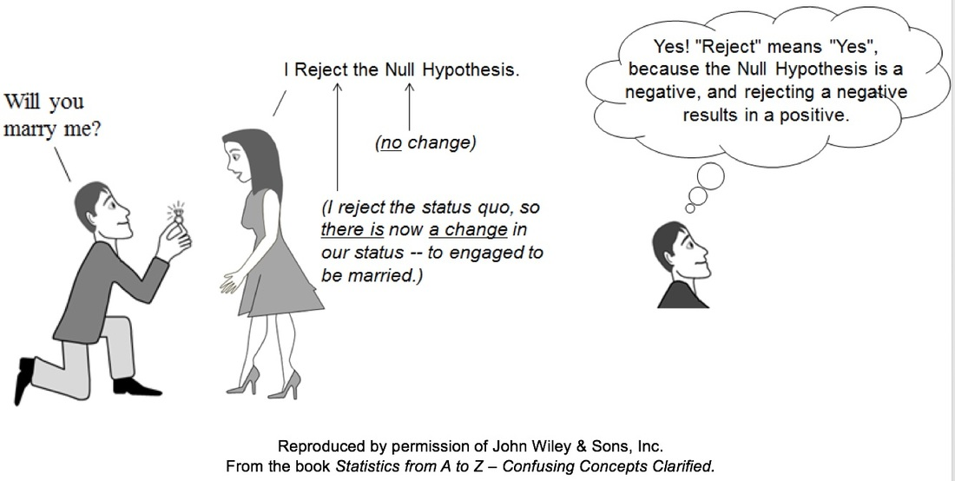
Rejecting the Null Hypothesis

Slide 17
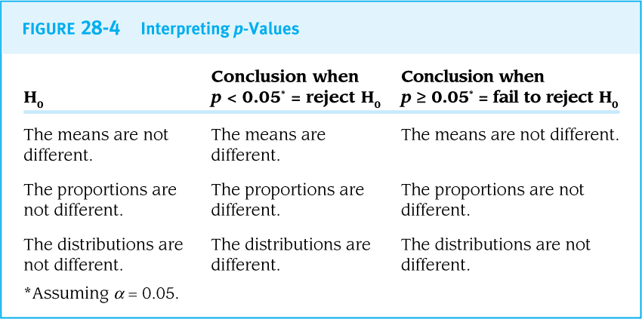
p-values
A p-value, or probability value, for a statistical test is used to decide whether the results observed are likely to reflect real differences between groups.
“p-value of 0.05 means that there is a 5% chance that the results of the study occurred by chance alone”

Slide 18
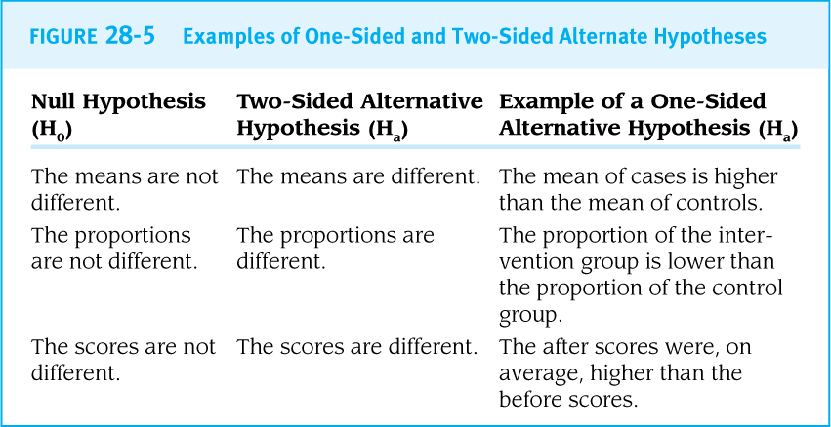
One Direction vs. Two Directions

Slide 19
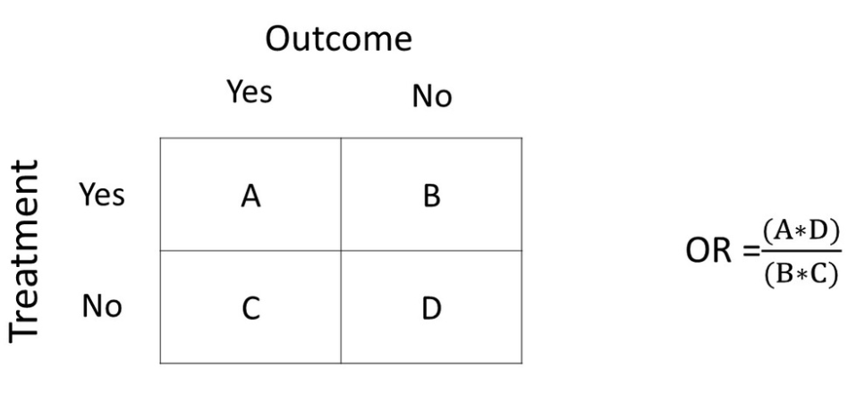
Measures of Association
Some of the most common types of comparative statistics are the odds ratio (OR) used for case-control studies and the rate ratio (RR) used for cohort studies.
These are presented with 95% confidence intervals.

Slide 20
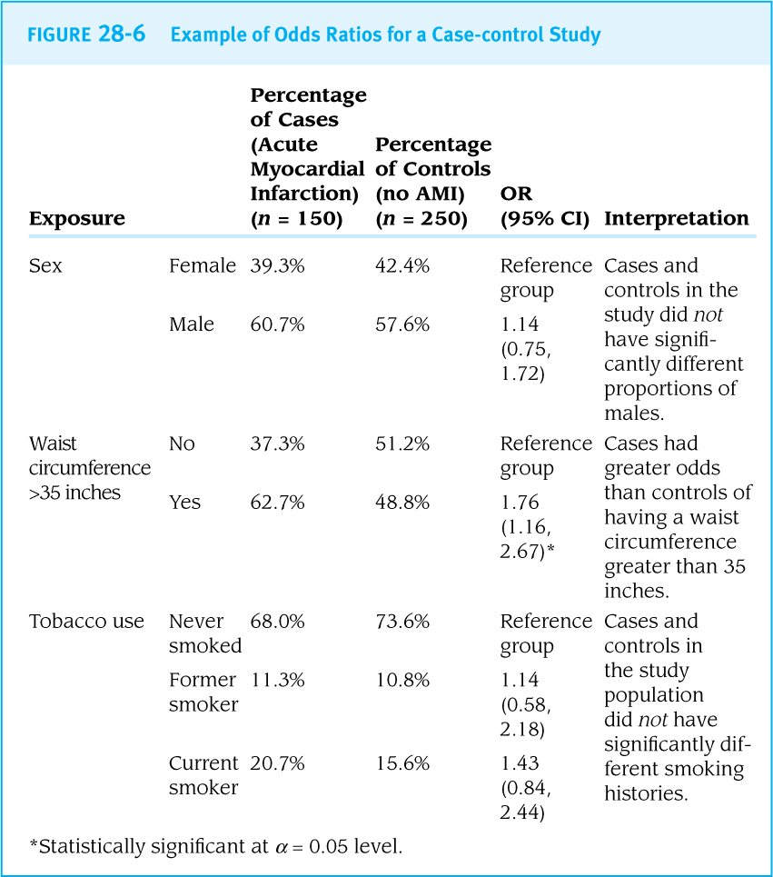

Slide 21
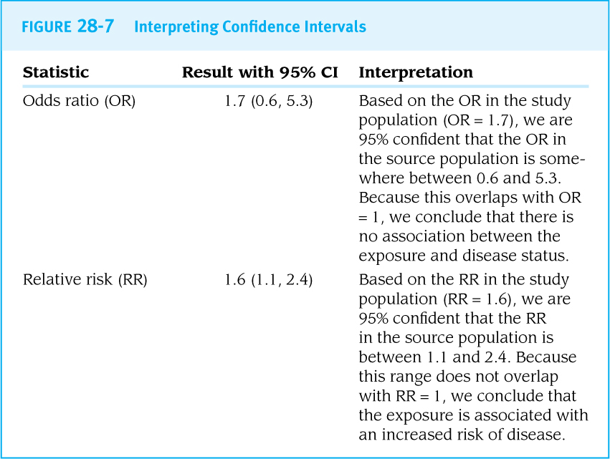
Interpreting Confidence Intervals
A 95% confidence interval (95% CI) corresponds to a significance level of α = 0.05.
For odds ratios and rate ratios, a 95% confidence interval that does not overlap 1 is equivalent to having a p-value of p < 0.05 (i.e., it is statistically significant)

Slide 22
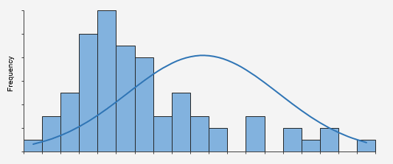
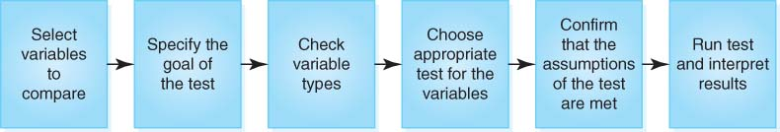
Selecting an Appropriate Test
Analysts must select a test that is appropriate for the goal of the analysis and the types of variables being analyzed.
Parametric tests assume that the variables being examined have particular distributions, often requiring the variables to have normal or approximately normal distributions.
Nonparametric tests do not make assumptions about the distributions of responses.
Non-normal
Normal

Slide 23
- END -

