Slide 1




Ethics in Research
Notes:
Chapters 23 and 24

Slide 2
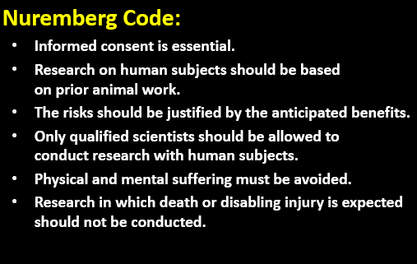
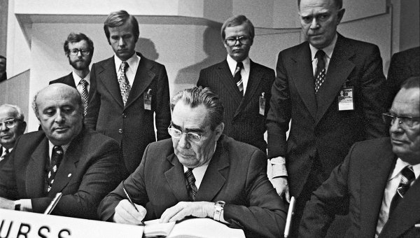
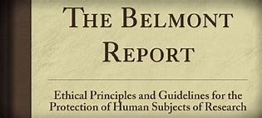
Key Milestones…
Nuremburg Code (1947): mandated voluntary consent for experimental studies of humans
Declaration of Helsinki (1964): written by the World Medical Association to provide guidelines for physicians conducting clinical trials
Belmont Report (1979): published by the U.S. National Commission for the Protection of Human Subjects of Biomedical and Behavioral Research to define key research principles and is a foundational document for the current U.S. federal policy for protecting human research participants (the ‘Common Rule’)

Slide 3

Ethics from the past…
The Public Health Service Syphilis Study (1932-1972) – Tuskegee
Purpose – safe and effective
means of treating syphilis
Control subjects denied treatments
28 deaths, 100 cases of disability

Slide 4
Key terms…
Respect for persons is a broad concept that emphasizes voluntariness and autonomy.
Beneficence means that the study should do good; nonmaleficence means that the study should do no harm.
Distributive justice seeks to ensure that the benefits and burdens of research are equitable.

Slide 5
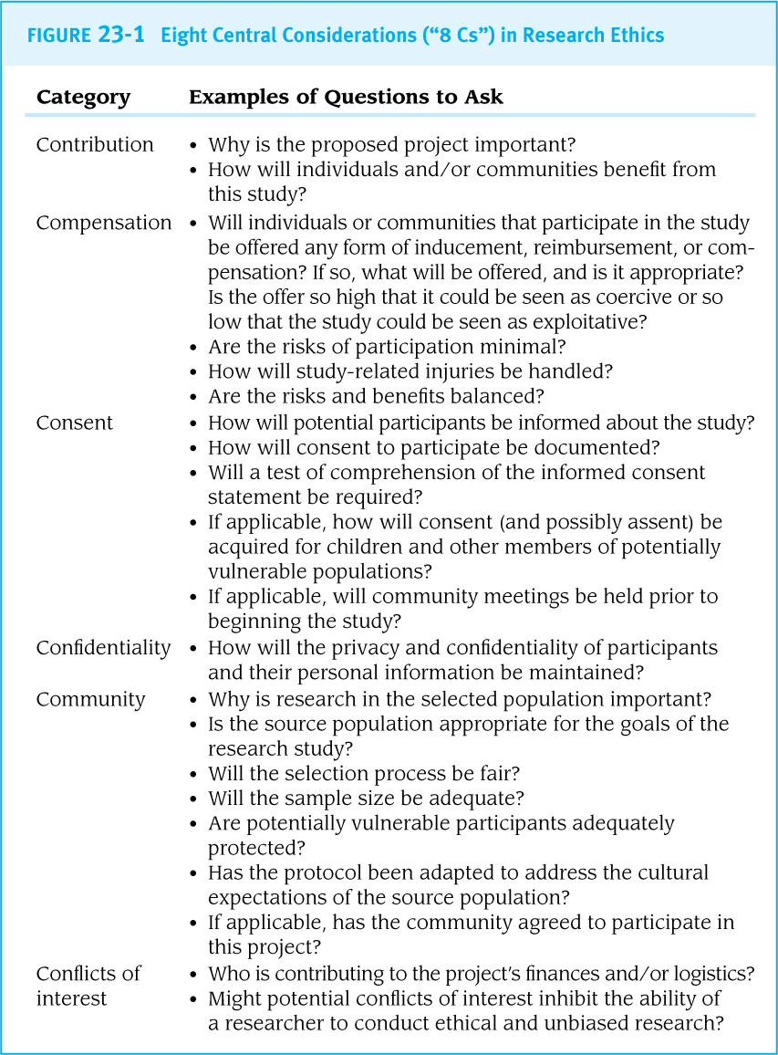



Research Ethics: considerations

Slide 6
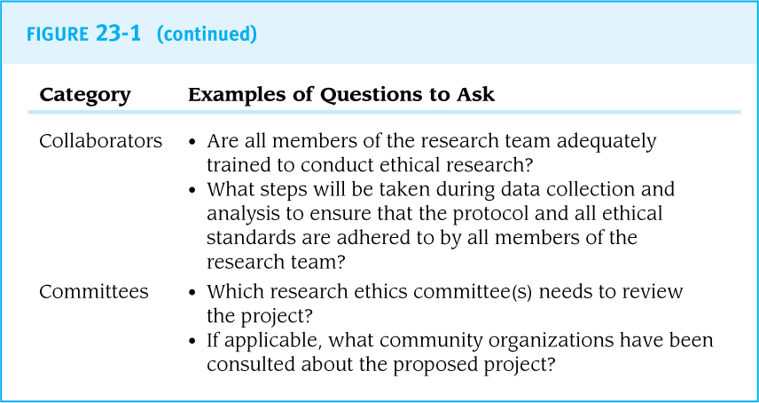

Research Ethics: considerations (cont’d)

Slide 7

Research Ethics: considerations (cont’d)
Incentives & Coercion
The desire to thank participants must be balanced with the need for participation and researchers have to be very transparent about what participants will gain from participation in a research study and what they will not gain.
Coercion in Research Example
“an investigator might tell a prospective subject that he or she will lose access to needed health services if he or she does not participate in the research.”

Slide 8
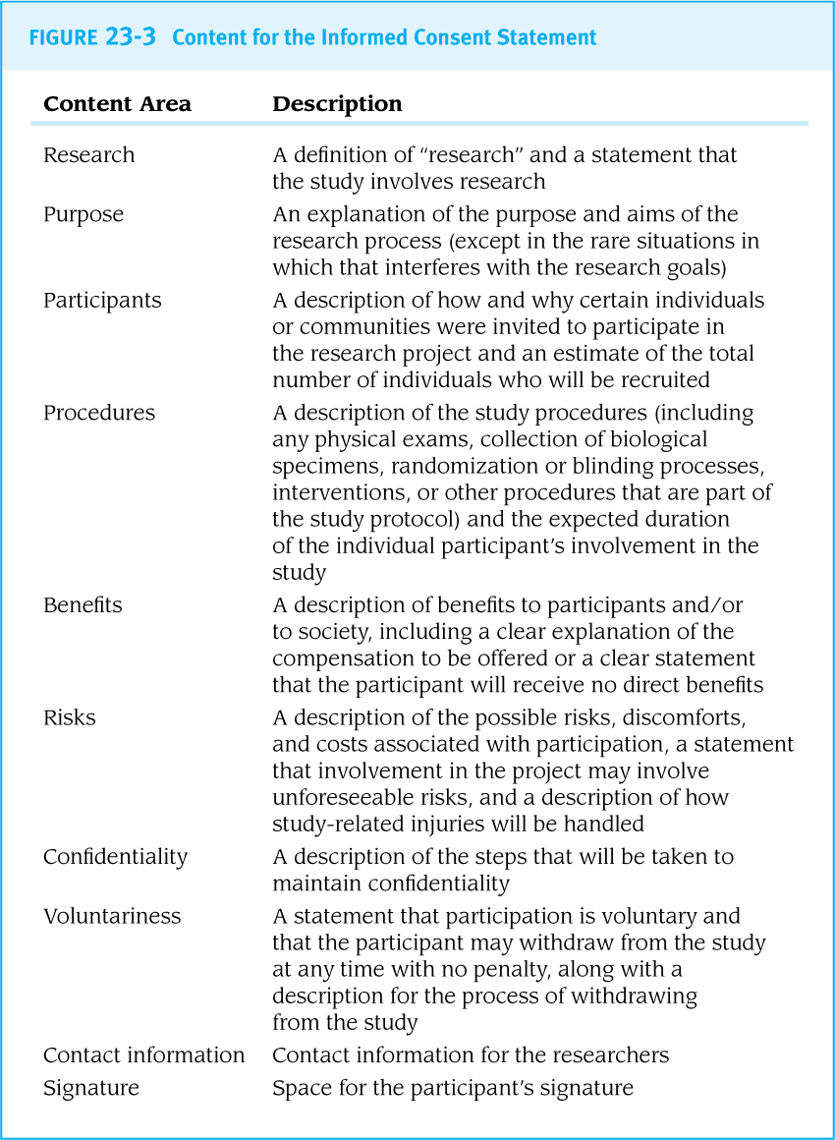
Obtaining Consent:
What’s involved?
“Informed Consent”
Informed consent statements provide essential information about research projects to potential research participants so that they can make a thoughtful decision about whether to enroll in a study.
The statement must use clear, simple language that the reader understands.
The lines of communication between researchers and participants must remain open during and even after the data collection process.

Slide 9

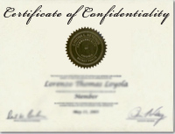
Privacy, Confidentially & Sensitive Issues
Privacy is the assurance that individuals get to choose what information they reveal about themselves.
Confidentiality is the protection of personal information provided to researchers.
Researchers asking questions about sensitive issues must decide ahead of time how to handle disclosures (such as disclosures of participation in illegal activities).
The research team can apply for a certificate of confidentiality that protects the identity of participants from being subject to court orders and other legal demands for information.

Slide 10

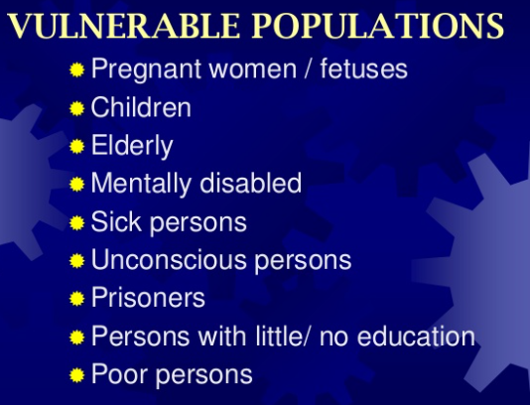

Cultural Considerations
Vulnerable Populations
A research protocol must be appropriate to the culture or cultures of the expected study participants.
It may be helpful to have a local advisory board facilitate communication between the community and the research team.
Children and some adults with cognitive impairments may not be considered competent to make an informed decision.
Whenever possible, in addition to having the legal representative’s consent, potential participants should assent to their own participation.
“culture” refers to everything that defines and distinguishes a person including ethnicity, gender, age, sexual orientation, language, values, goals, and life experiences.

Slide 11


Ethic Training and Certification
Research ‘ethics committees’ usually require everyone who will be in direct contact with research participants and/or their personal data to complete formal research ethics training
CITI Program – Collaborative Institutional Training Initiative
“online training program designed to educate faculty and students about issues involving human subject research”

Slide 12


Ethics Committees
The three primary goals of research ethics committees often called Institutional Review Boards (IRBs), are to:
protect the “human subjects” who will participate in research
protect researchers by preventing them from engaging in activities that could cause harm
legally protect the researcher’s institution from the liability that could occur as a result of research activities.
Day-to-day tasks of IRBs…
1) Review new and revised research protocols
2) Approve or disapprove protocols
3) Ensure informed consent is documented
4) Conduct continuing review of long-term research projects.

Slide 13
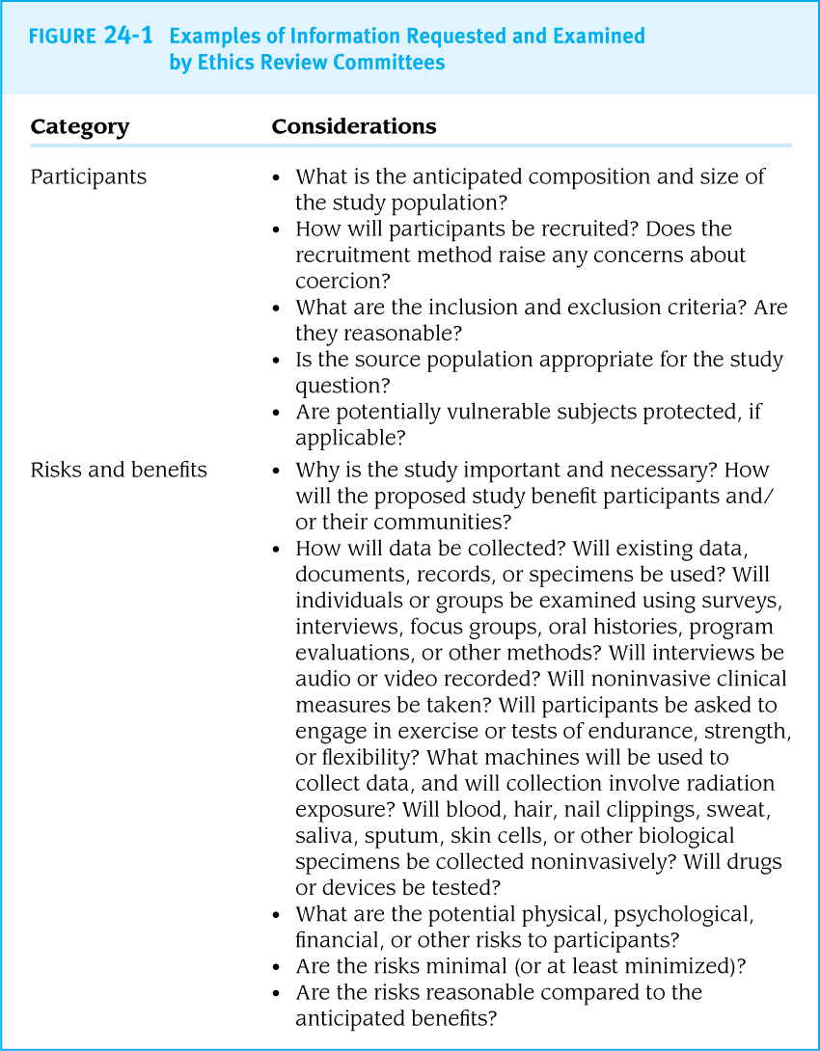
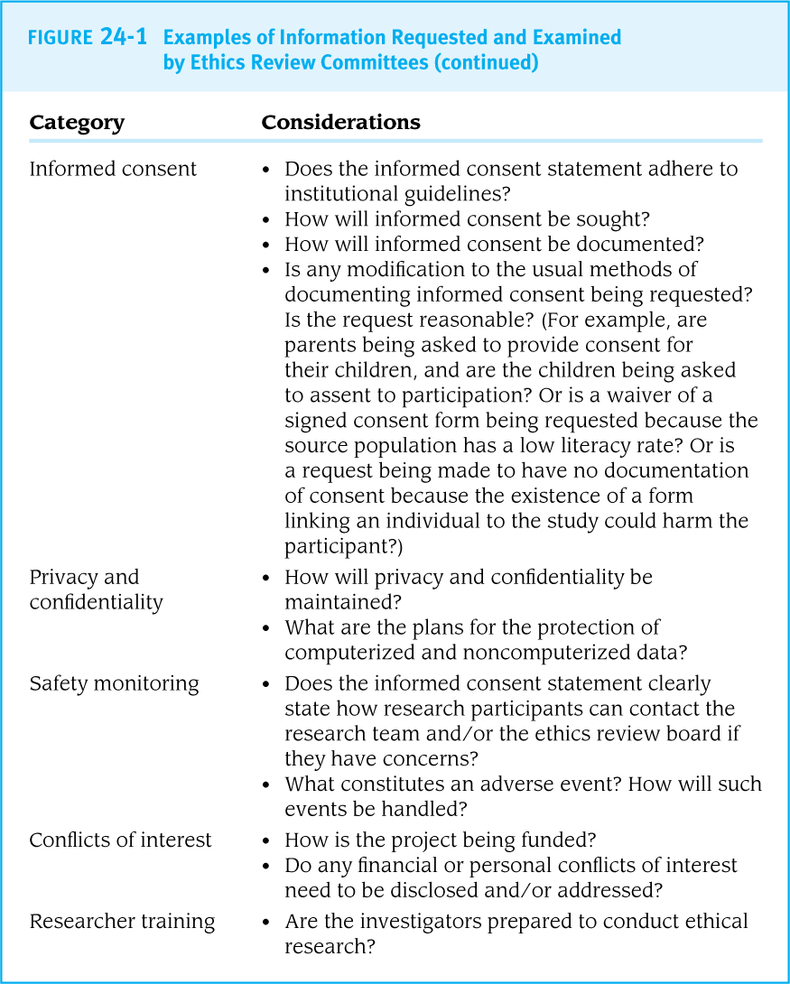
IRBs may request…

Slide 14
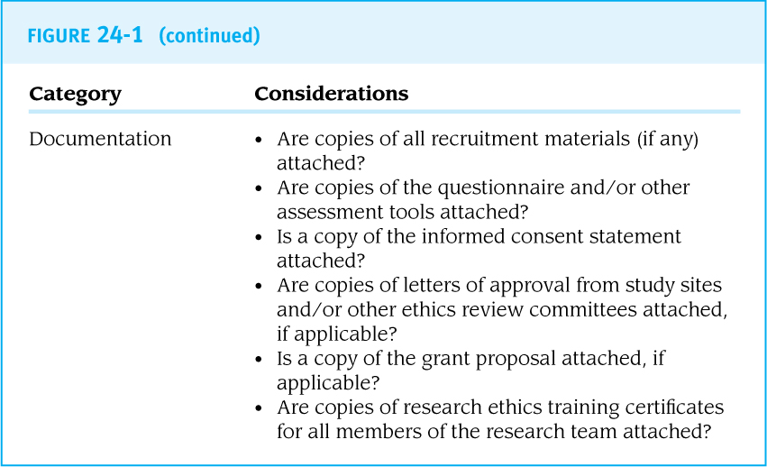
IRBs may request…

Slide 15
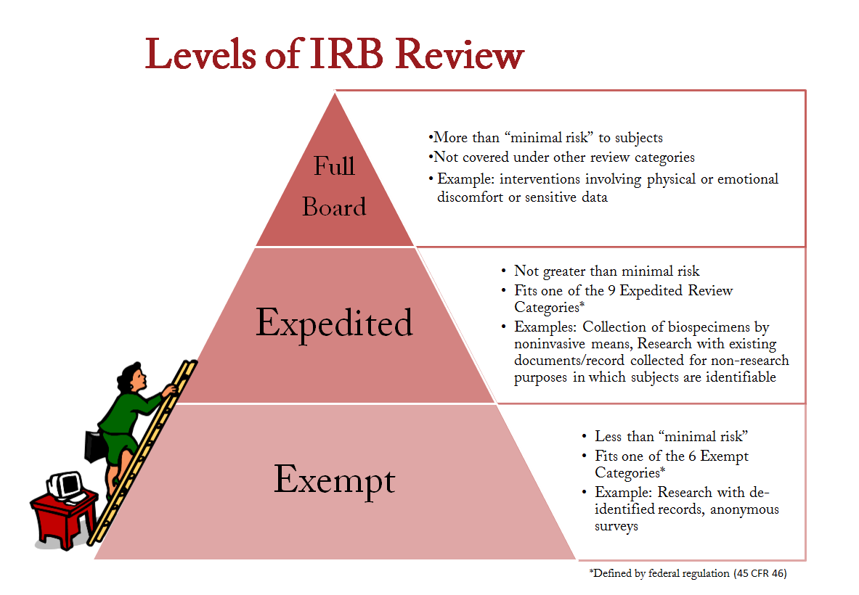
Review Process
Once all application materials have been submitted to a research ethics committee, there are three possible next steps
  Exempt, Expedited or Full Review

Slide 16
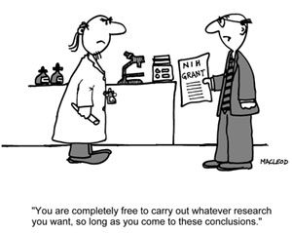
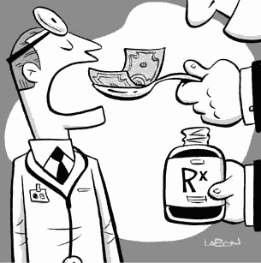
Conflicts of Interest
When a financial or other relationship (personal relationships, board membership, or others) could bias the design, conduct, or reporting of the study, the potential conflict of interest (COI) must be disclosed.
The disclosure of a potential COI is not an admission of bias, but it is an important assurance of transparency.

Slide 17

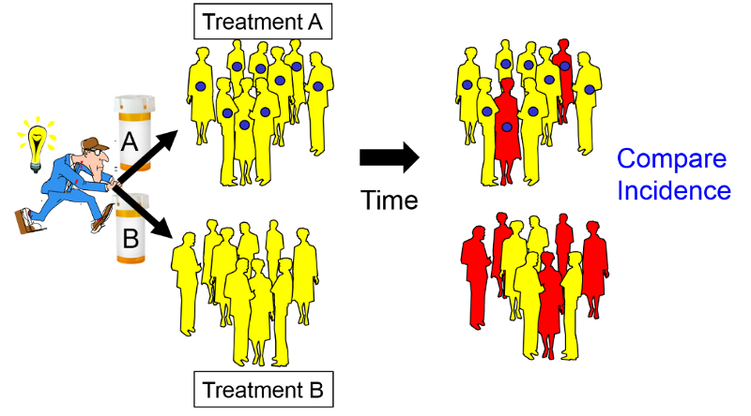
Ethical Considerations: Experimental/ Intervention studies
Intervention studies raise special ethical concerns because the researcher is assigning participants to exposures.
Equipoise: An experiment should only be conducted when there is genuine uncertainty about the outcome.
“provides the ethical basis for medical research that involves assigning patients to different treatment arms of a clinical trial”.
Standard Care
or
Treatment

Slide 18
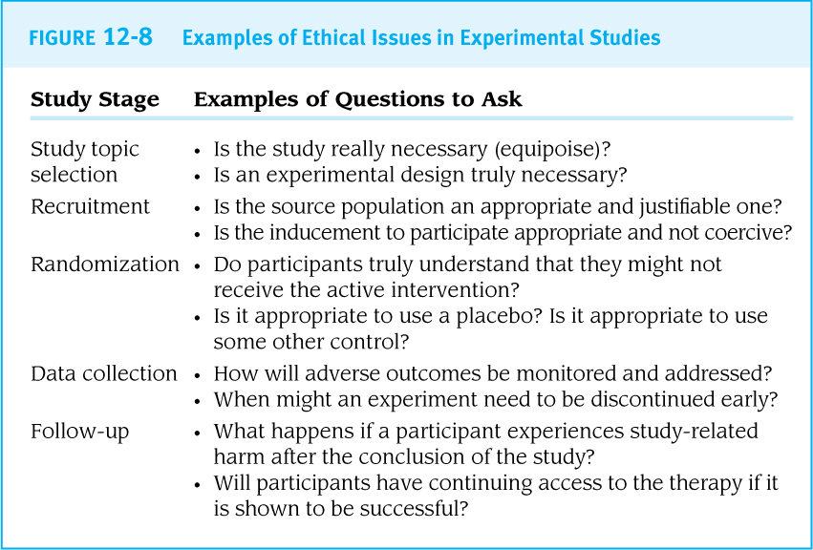
Example

Slide 19
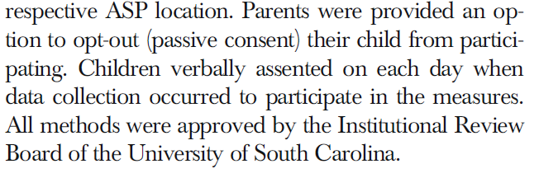
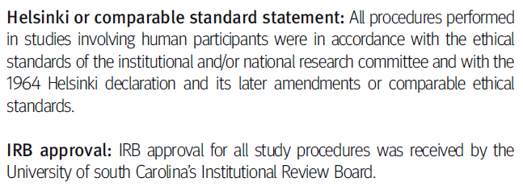
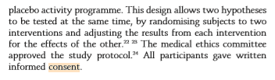
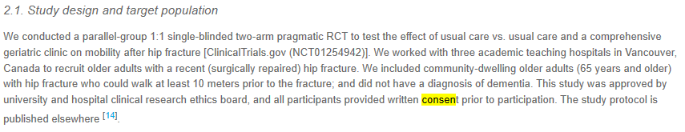
Ethics in action…

