Slide 1
Data Analysis – Part 3
Notes:
Chapter 26 to 29

Slide 2
Comparing Independent Populations
Independent populations are populations in which each individual can be a member of only one of the population groups being compared.
A variety of statistical tests can be used to compare independent populations, including independent-samples t-tests and Chi-square tests.

Slide 3
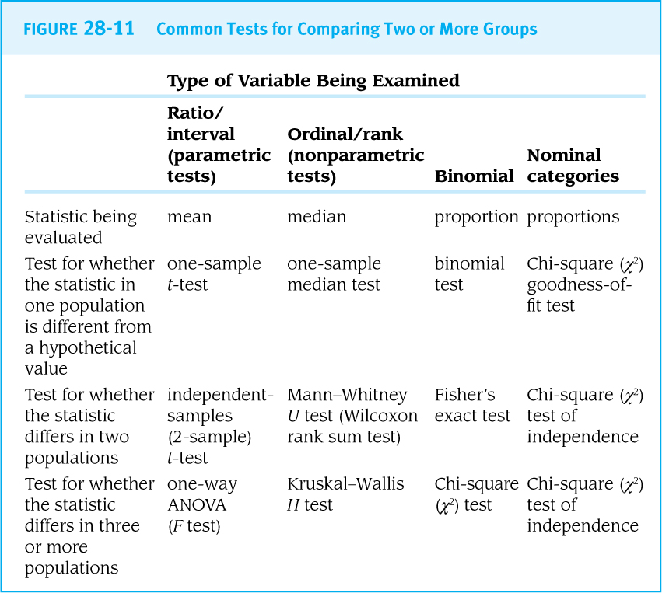
Choosing a test

Slide 4
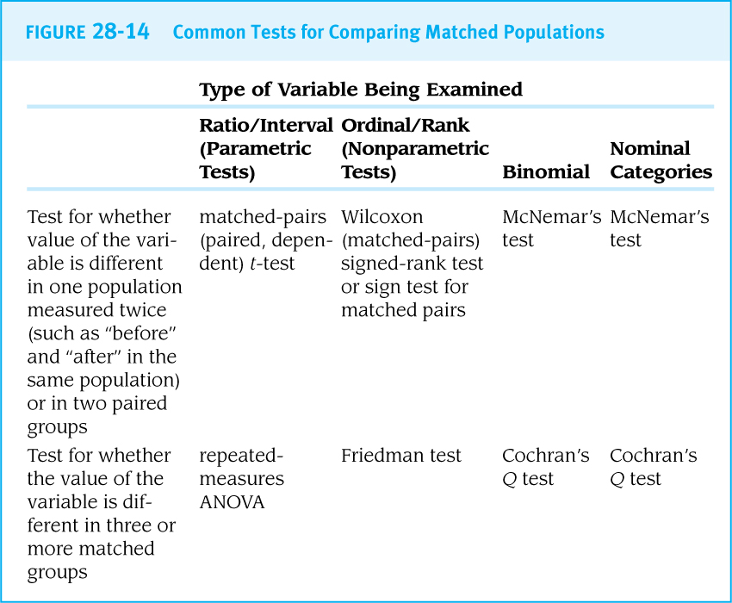
Comparing Paired Data
A different set of tests (like matched-pairs t-tests) is used when the goal is to compare before-and-after results in the same individuals.

Slide 5
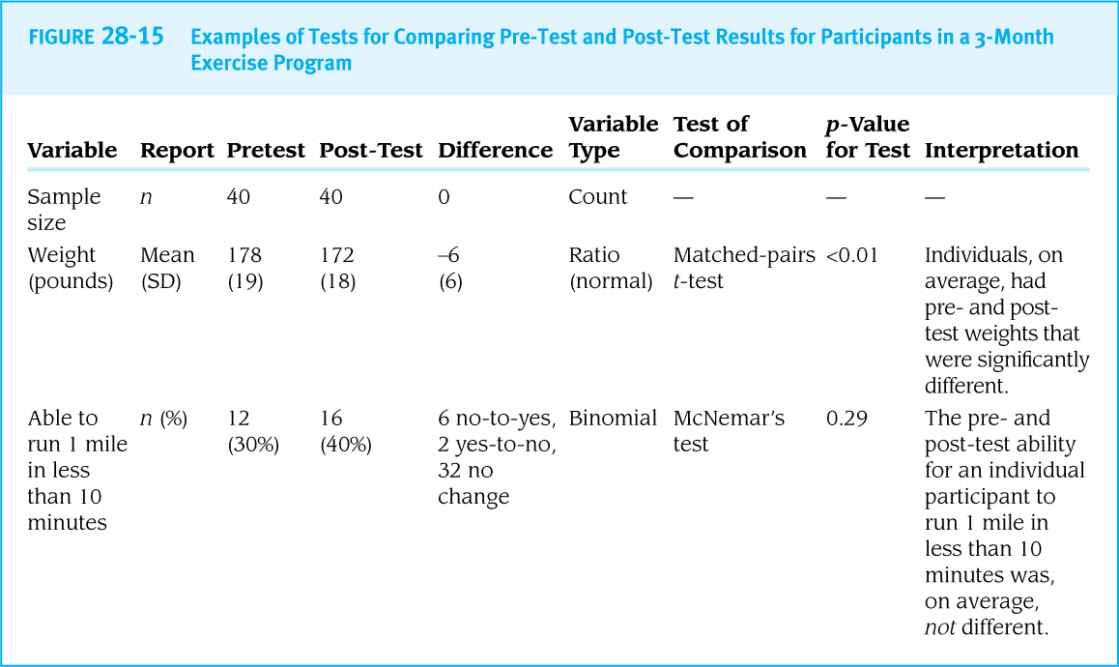

Slide 6
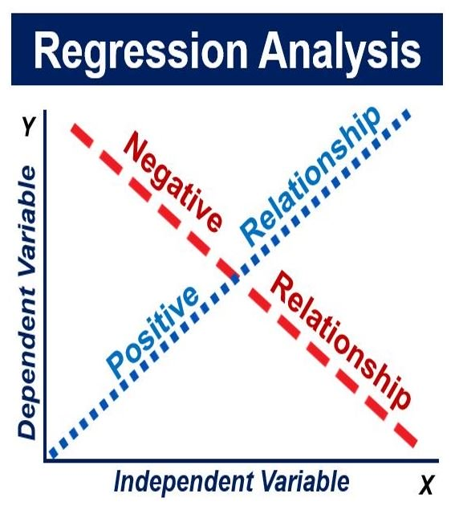
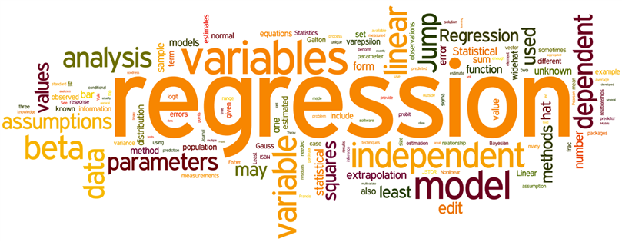
Regression Analysis
Simple Linear Regression
Simple Logistic Regression
Confounding and Effect Modifiers
Multivariable Comparisons
‘Dummy’ Variables
Multiple Regression
Causal Analysis
“seeks to understand the relationship between one or more independent variables (or predictor variable) and one dependent variable (or outcome variable).”

Slide 7
independent variables
aka
predictor variable
dependent variable aka
outcome variable

Slide 8
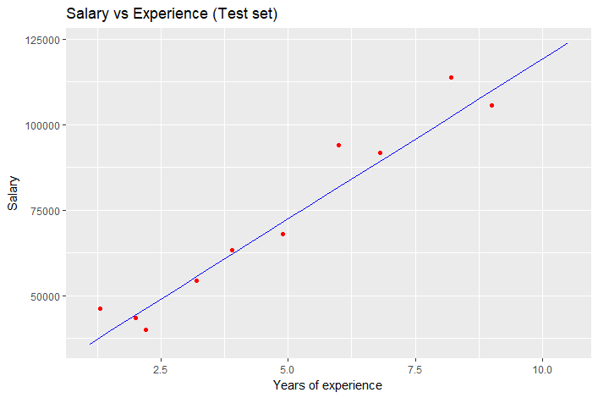
Simple Linear Regression
A linear regression model is used when the outcome variable (DV) is a ratio or interval variable.
Simple linear regression models examine whether there is a linear relationship between one predictor variable and the outcome variable.

Slide 9
Understanding Statistical Output: Linear Regression

Slide 10
Understanding Statistical Output: Is there a linear relationship between years of work experience (IV) and salary(DV)?

Slide 11
Simple Logistic Regression
Logistic regression models (sometimes called logit regression models) are used when the outcome variable is a dichotomous variable (binary, 1 or 0).
Logistic regression models predict the probabilities of the outcome occurring.
Logistic regression is commonly used in case-control studies, for which the outcome variable is usually case status (1) vs. non-case (0).
Predictor variables for a logistic regression model can be categorical (when the categories are coded with numbers) or continuous.

Slide 12
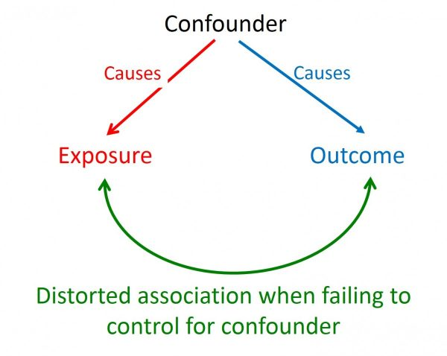
Confounding and Effect Modification
A confounder may make the association between an exposure variable (IV) and an outcome variable (DV) appear more or less significant than it truly is.
An effect modifier is a third variable (IV) that often defines groups of individuals who might experience different biological responses to various exposures.
To be a confounder or effect modifier, the third variable must be independently associated (p<0.05) with both an exposure (IV) variable and an outcome variable (DV).
Work experience
Salary

Slide 13
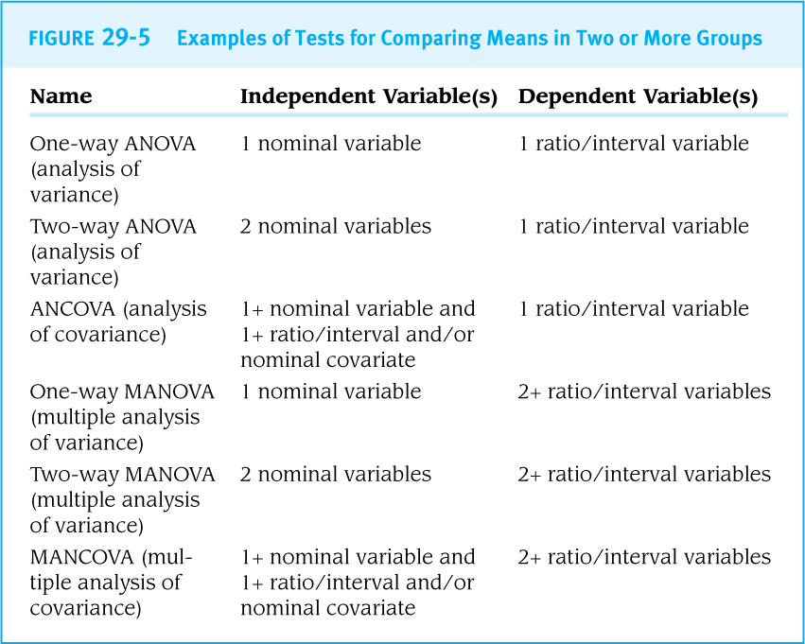
Multivariable Comparisons of Means
One-way ANOVA (analysis of variance) is used to compare the mean values of a continuous variable among independent groups of people.
Two-way ANOVA compares the mean values of a continuous variable across two factors (2 IVs).
Analysis of Covariance (ANCOVA) can be used to control for confounding variables when comparing the means of two or more groups.

Slide 14
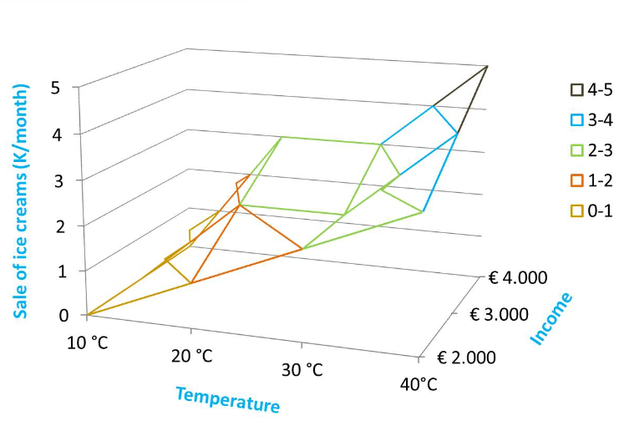
Multiple Regression (more complex analyses)
A variety of analytic approaches can be used to test relationships among three or more variables while adjusting for possible confounders, including both linear and logistic regression models.
Multiple linear regression models examine the effects of several predictor variables on the value of one continuous outcome variable.
Multiple logistic regression models examine the effects of several predictor variables on the value of one dichotomous outcome variable.

Slide 15
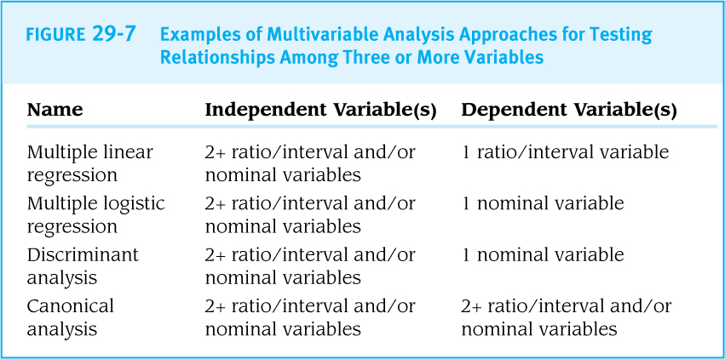
Multiple Regression Models

Slide 16
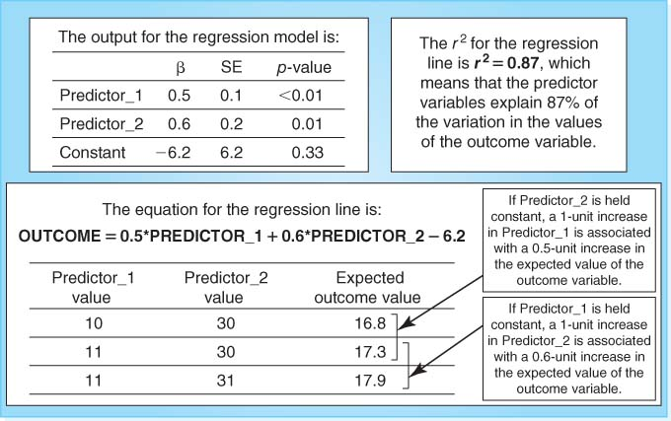
Example of a Multiple Linear Regression Model with Two Continuous Variables
Salary
Work experience
Hours per week

Slide 17
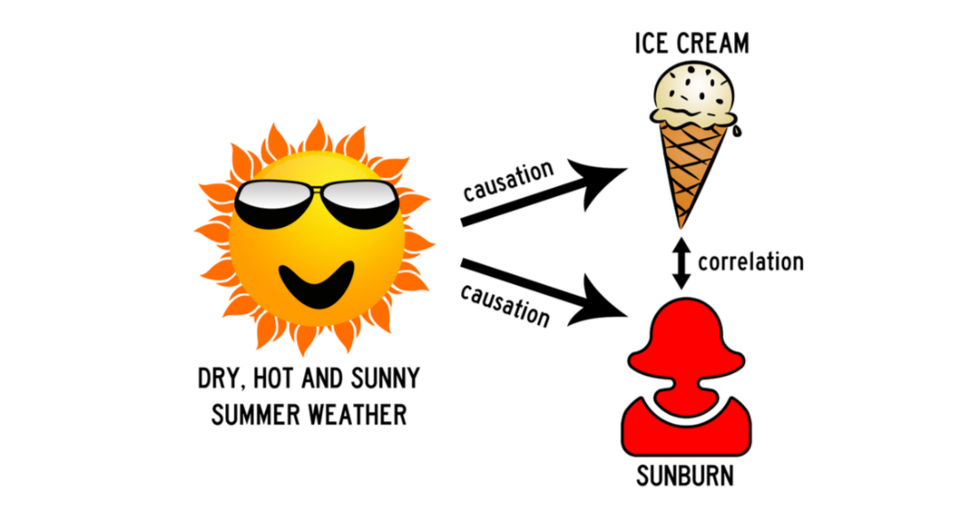
Causal Analysis
Although multiple regression models cannot prove that an exposure caused an outcome, they can provide insights into ‘causality’.
“
“the relationship between cause and effect”

Slide 18
- END -

