Slide 1

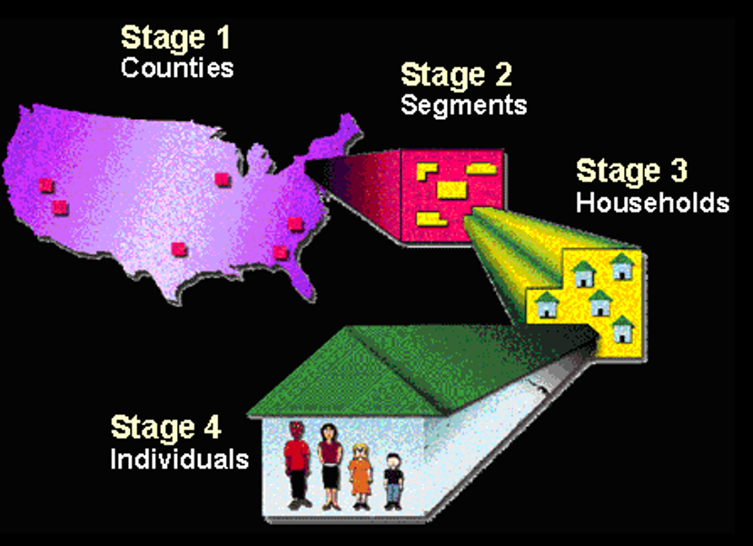

Sampling
Notes:
Chapter 16 and 17

Slide 2

Why Sample?
Seek to establish the broadest possible generalizations, applicable to an infinitely large class of events/objects
  Impossible to observe all relevant events/objects
Basic Idea:
  We seek knowledge/information about a whole class of similar objects/events (population)
  We observe some of these (sample)
  We extend our findings to the entire class

Slide 3
Number of Breakdowns Planned
National Health and Nutrition
Examination Survey
7176 individuals
(Troiano et al., 2008)

Slide 4
Number of Breakdowns Planned
National Health and Nutrition
Examination Survey
597 children
20,570,805 5-9 year old children in the U.S.*
(Troiano et al., 2008)
*Estimated from 2010 US Census Data

Slide 5
Number of Breakdowns Planned
National Health and Nutrition
Examination Survey
364 children
15,183,787 – Non-Hispanic white children in the U.S.*
(Troiano et al., 2008)
*Estimated from 2010 US Census Data

Slide 6
Number of Breakdowns Planned
National Health and Nutrition
Examination Survey
90
children
2,591,089 – Non-Hispanic black children in the U.S.*
*Estimated from 2010 US Census Data

Slide 7
Number of Breakdowns Planned
National Health and Nutrition
Examination Survey
88
children
2,230,186 – Mexican American children in the U.S.*
(Troiano et al., 2008)
*Estimated from 2010 US Census Data

Slide 8
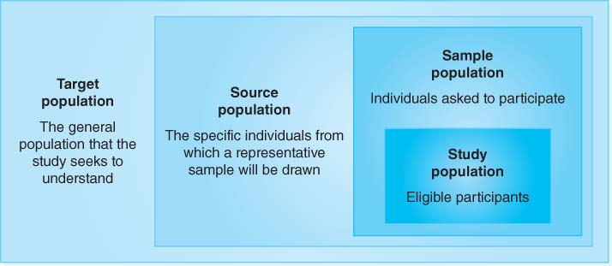

Slide 9
Defining your study population
Target population: the population to which the results of the study are intended to apply
Source population (“sampling frame”): a list of particular people from whom a sample population can be drawn
Sample population: the members of the source population who are invited to participate in the study
Probability-based sampling is used to ensure that the sample population is representative of the source population.
Probability Sampling
  “removes bias – every case has equal probability of inclusion”

Slide 10
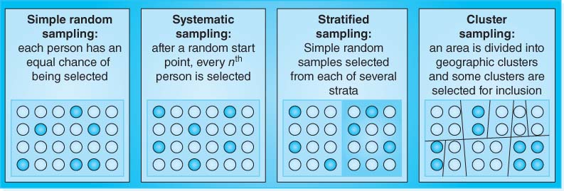
Cluster Sampling
  Sample is divided into groups of cases (naturally occurring clusters)
    States, counties, cities, blocks

Slide 11



Study population:
The people who actually participate in a study
Few studies achieve a 100% participation rate among those who are invited to participate, but researchers should aim for a high participation rate
  Consent forms returned…
  Complete all measures…
  Final sample for data analysis…

Slide 12
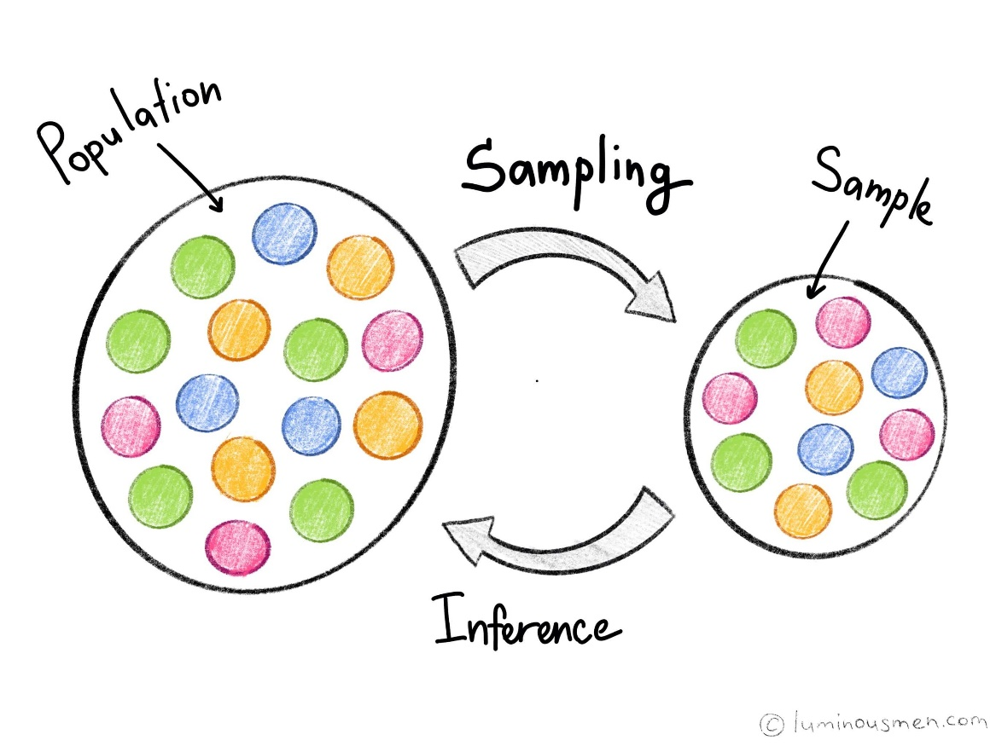
Examples

Slide 13
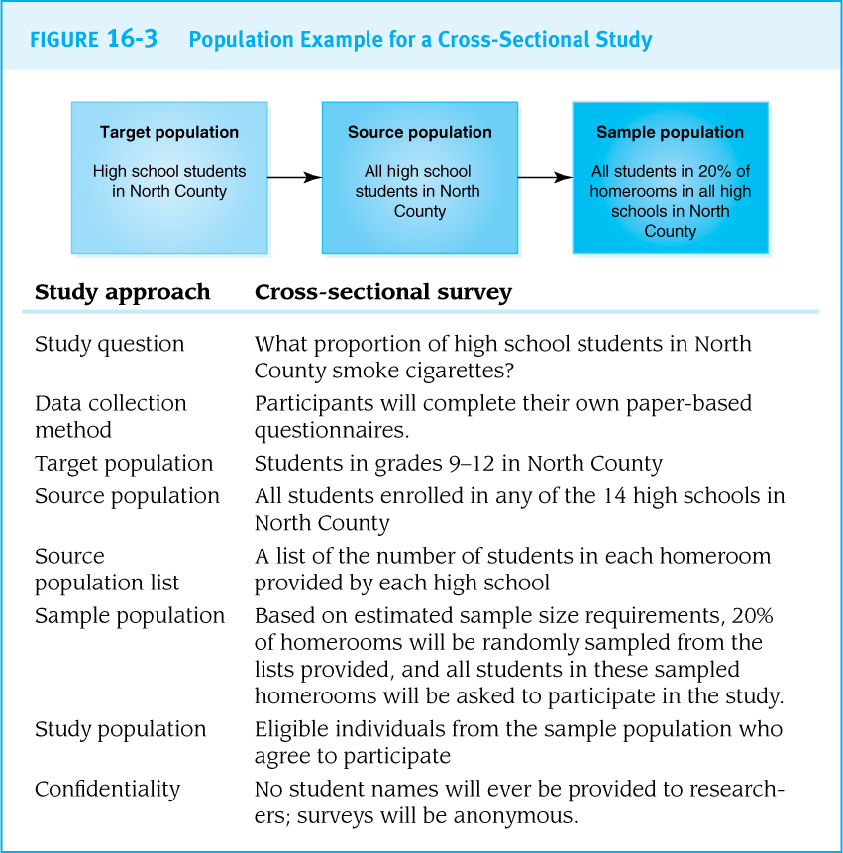
Cross-Sectional Surveys
Avoid convenience samples that are not representative of the target population.

Slide 14
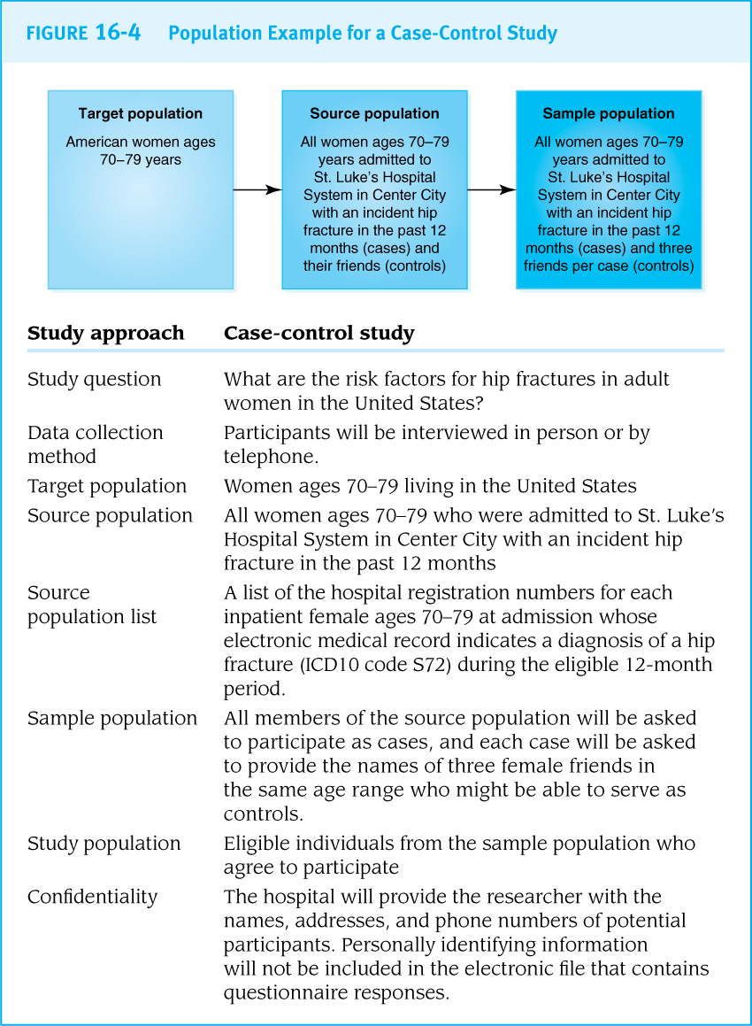
Populations for Case-Control Studies
Find the cases first, and then identify an appropriate source of controls.

Slide 15
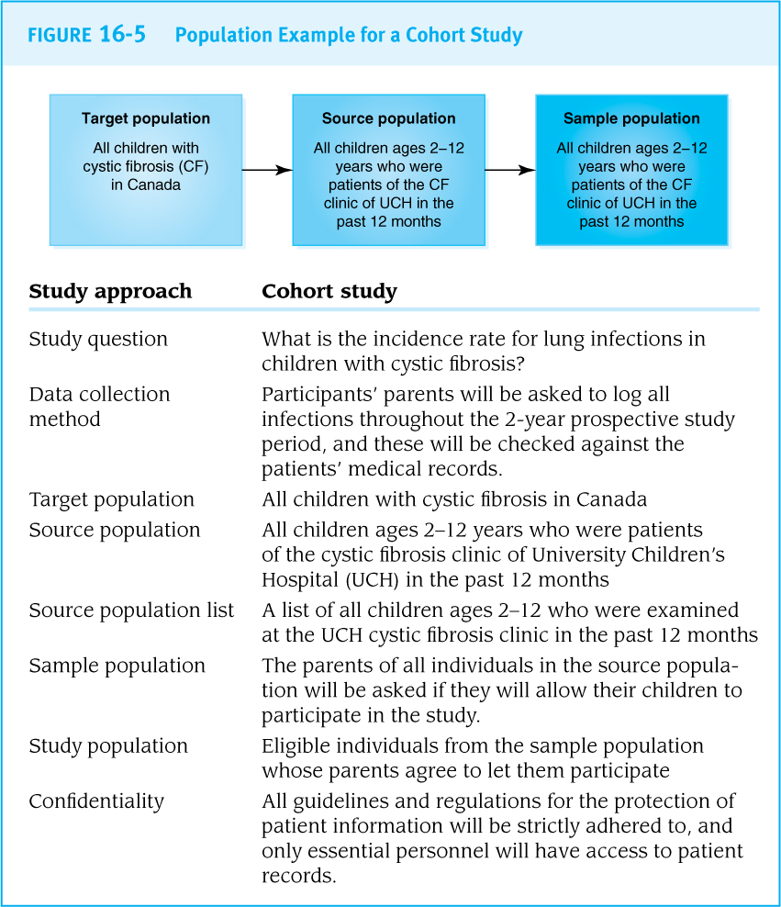
Populations for Cohort Studies
A longitudinal cohort study needs a representative population
  like a cross-sectional study
Prospective and retrospective cohort studies start by identifying an appropriate exposed population
  like case-control studies start by identifying a source of cases

Slide 16
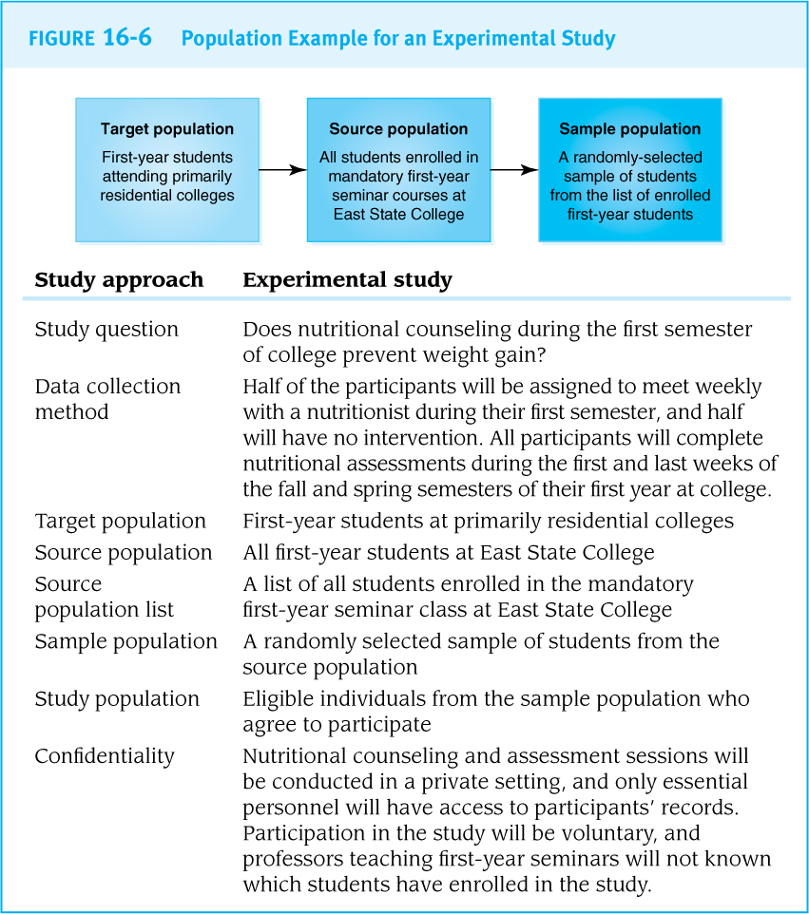
Populations for Experimental Studies
Be aware of special ethical requirements associated with interventional studies.
Safety must be the #1 priority.

Slide 17


Other considerations
Vulnerable Populations
Young children, people in prison, and some other groups of people may have limited ability to make an informed autonomous decision about participation.
Pay close attention to the ethics of research with vulnerable groups.

Slide 18

Community Involvement
Community-based participatory research (CBPR) is based on partnerships in which community members identify research priorities and are involved in every stage of the research process.
  Key stakeholders
  YMCA ‘HEPA Standards’ example
  Statewide Rollout

Slide 19
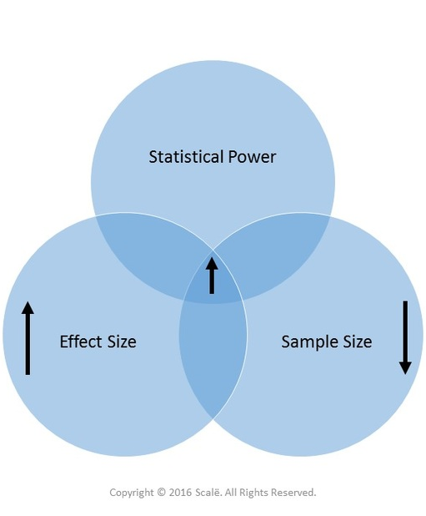
Sample Size, Effect Size, and Power

Slide 20



Importance of Sample Sizes
Recruiting too many participants wastes resources.
Recruiting too few participants makes the study invalid.

Slide 21

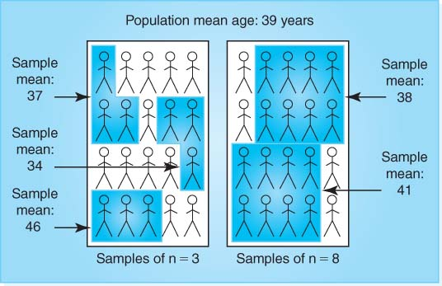

Sample Size and Certainty Levels
Larger sample sizes produce narrower confidence intervals for statistical measures.
Larger sample sizes yield more statistically significant results.

Slide 22
Sample Size Estimation
Sample size calculators estimate the number of participants necessary for a study based on guesses about the likely results of the study.
When the level of certainty about inputs is low, it is better to aim for a larger sample size.
Sample size calculator examples:
  Gpower, Optimal Design Software, Glimmpse
What you need for a sample size calculation:
  Alpha (usually 0.05)
  Beta or ‘Power’ (usually 0.8)
  Effect Size
  Effect Size (Cohen’s d)
0.20 small
0.50 medium
0.80 large

Slide 23
Effect Size Estimation
Large enough sample to detect the “smallest” meaningful effect or difference
  How large of a difference is meaningful/important?
  What is a typical difference?
Where can Effect Size estimates come from?
  Published literature
  Pilot studies
  Meta-analyses
  Best guesses
Bigger effects need smaller samples
Smaller effects need larger samples

Slide 24
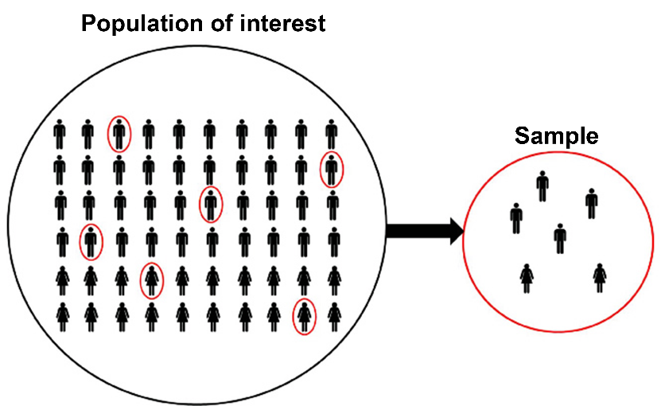

Power Estimation
Power is the ability of a statistical test to detect significant differences between subgroups of a population when differences really do exist.
  “Is the study adequately powered?”
  …basically, are there enough participants to uncover a statistically significant difference (should one exist)
Power analysis is normally conducted before data collection.
Helps researcher determine the smallest sample size that is suitable to detect the effect of a given test
  This is the minimum amount of individuals needed in your study

Slide 25
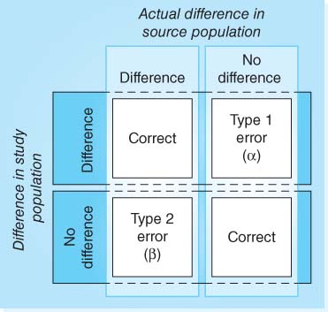
Error rates
  Type I Error
    Difference found in sample/ no difference in population
    “Rate of false alarms”
  Type II Error
    No difference found in sample/ difference in population
    “Rate of failed alarms”
Notes:
Alpha is the probability of a type I error, also identified as the statistical significance value (p<0.05). If the alpha is 5% (0.05) that means there is a 1 in 20 statistical tests will result in a difference found in sample/ no difference in population (TYPE I error).
Beta is the probability of a type II error. Usually set at around 80% (0.8), you have a 1 in 5 chance of not finding a difference in sample/ difference in population (Type II error).

Slide 26
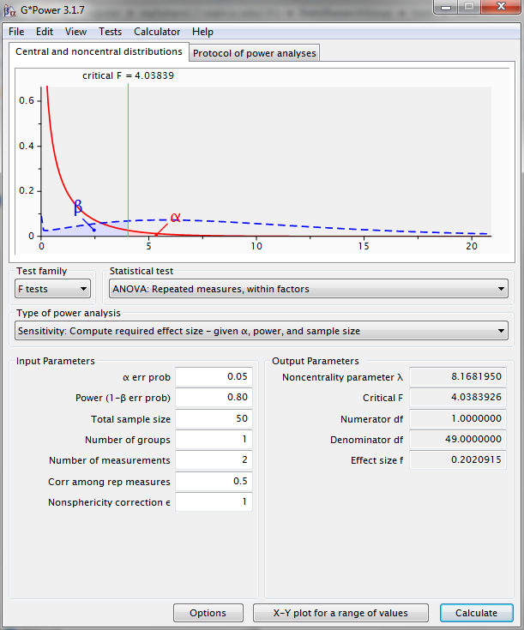
EXAMPLE***
Statistical Power and Effect Sizes
G*Power 3.1.7
Repeated-measures ANOVA (within-factor)
Sample size of 50
2 measurements (school & summer)
Β (Beta) = 0.80
α (Alpha) = 0.05
Effect size 0.20 or a 15% change (increase/decrease) comparing school vs. summer obesogenic behaviors
School vs. Summer and WE vs. WD studies
Obesogenic Behavior (outcome) | % Change Across Studies
Physical Activity (mins/day) | ~15 to 31%
Sedentary/Screen Time (hours/day) | ~16 to 39%
Sleep (hours/night) | ~7 to 12%
Diet (meal frequency/day) | ~10 to 32%

Slide 27
- END -

