Slide 1
Psychological Health
Chapter 3
Copyright 2022 © McGraw Hill LLC. All rights reserved. No reproduction or distribution without the prior written consent of McGraw Hill LLC.

Slide 2
Defining Psychological Health
Psychological health is a broad concept that can be defined negatively, as the absence of sickness; or positively, as the presence of wellness.
It contributes to every dimension of wellness.

Slide 3
Positive Psychology 1
Abraham Maslow’s Toward a Psychology of Being (1968) adopted a perspective he called “positive psychology.”
Maslow’s hierarchy of needs:
Physiological needs—the most important.
Safety and security.
Love and belongingness.
Self-esteem.
Self-actualization.

Slide 4
Positive Psychology 2
Self-actualization is a state met by people who have fulfilled a good measure of their human potential.
Realism.
Acceptance.
Positive self-concept and healthy self-esteem.
Autonomy: physical, social, emotional, and intellectual independence.
Authenticity.
Capacity for intimacy.
Creativity.

Slide 5
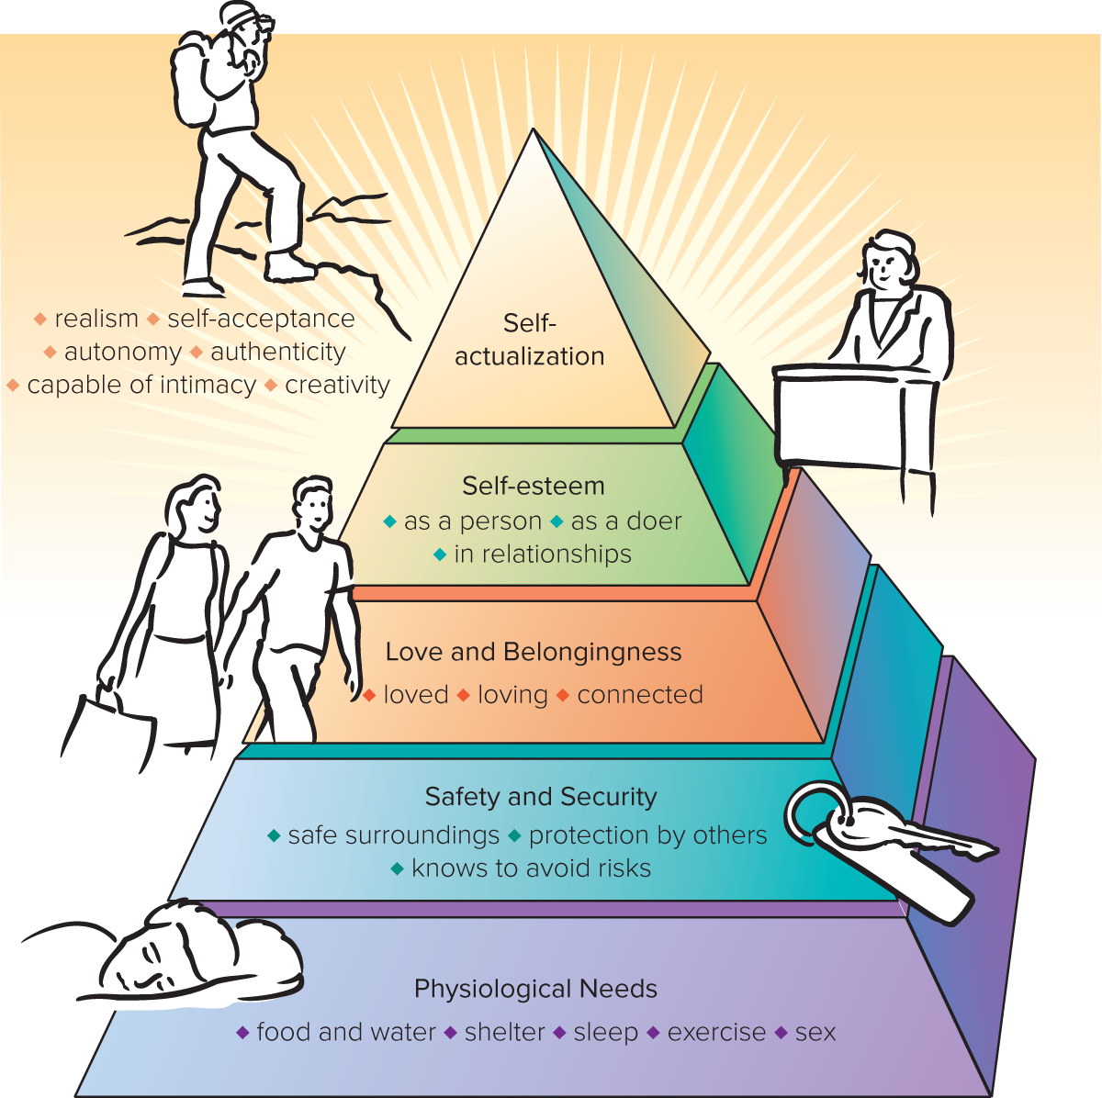
Figure 3.1 Maslow’s hierarchy of needs.
Access the text alternative for slide images.
SOURCE: Maslow, A. 1970. Motivation and Personality, 2nd ed. New York: Harper & Row.

Slide 6
Positive Psychology 3
Positive psychology is focused on defining goals and on ways to achieve them.
Martin Seligman: Happiness can come to us through three equally valid dimensions.
Pleasant life—maximizing positive emotions.
Engaged life—cultivating positive personality traits.
Emotional intelligence: the capacity to identify and manage your own emotions and the emotions of others.
Meaningful life—working with others toward meaningful objectives.

Slide 7
What Psychological Health Is Not
Psychological health is not the same as being “normal.”
Seeking help does not prove someone is psychologically unhealthy or mentally ill.
People cannot be “mentally ill” or “mentally healthy” solely on the basis of symptoms.
Psychological health can’t be judged on outward appearance.

Slide 8
Meeting Life’s Challenges with a Positive Self-Concept
Growing up psychologically means developing coping mechanisms for meeting life’s challenges.
Erik Erikson: Personality and identity develop through a series of eight stages that extend throughout life.
Developing a unified sense of self—an adult identity.
Developing values and purpose in your life.
Values: criteria for judging what is good and bad and that underlie our moral decisions and behavior.

Slide 9
Achieving Healthy Self-Esteem
Developing a positive self-concept:
Sense of being loved and being able to give love and accomplish goals.
Integration of your self-concept.
Stability—freedom from contradictions in your self-concept.
Meeting challenges to self-esteem:
Acknowledge when something has gone wrong.
Notice your thinking and avoid focusing on the negative.
Cognitive distortions: patterns of negative thinking that make events seem worse than they are.
Develop realistic self-talk—statements you make to yourself.

Slide 10
Psychological Defense Mechanisms—Healthy and Unhealthy
Defense mechanisms allow people to rearrange thoughts and feelings to resolve conflicts.
Can be healthy and adaptive—such as humor and altruism.
Can also be maladaptive, obscuring solutions.

Slide 11
Table 3.1 Defense and Coping Mechanisms
MECHANISM | DESCRIPTION
Projection | Reacting to unacceptable impulses by denying their existence in yourself and attributing them to others
Repression | Keeping an unpleasant feeling, idea, or memory out of awareness
Denial | Refusing to acknowledge to yourself what you really know to be true
Displacement | Shifting your feelings about a person to another person
Dissociation | Detaching from a current experience to avoid emotional distress
Rationalization | Giving a false, acceptable reason when the real reason is unacceptable
Reaction formation | Concealing emotions or impulses by exaggerating the opposite ones
Substitution | Replacing an unacceptable or unobtainable goal with an acceptable one
Acting out | Engaging in an action that makes an unacceptable feeling go away
Humor | Finding something funny in unpleasant situations
Altruism | Serving others without expecting anything in return
Table divided into two columns summarizes defense and coping mechanisms. The column headers are marked from left to right as: Mechanism and description.

Slide 12
Optimism and Honesty
Being optimistic:
Pessimism: a focus on the negative and the unfavorable.
Optimism: a tendency to emphasize the hopeful and expect a favorable outcome.
Optimism can be learned.
Maintaining honest communication:
Assertiveness: expression that is forceful but not hostile; being able to say no or yes depending on the situation.

Slide 13
Social Media and Loneliness
Finding a social media balance:
Consider whether social media is helping you feel connected or leading to a feeling of being left out.
Is it keeping you from things?
Dealing with loneliness:
Discover how to enjoy being by yourself.

Slide 14
Anger
Dealing with anger:
At one extreme are people who have great trouble expressing any anger.
At the other are people who express anger explosively and inappropriately.
Can signal a condition called intermittent explosive disorder (IED).
To manage anger:
Try to reframe what you’re thinking at that moment.
Try to distract yourself.
Dealing with anger in others:
Respond “asymmetrically”—not with anger but with calm.

Slide 15
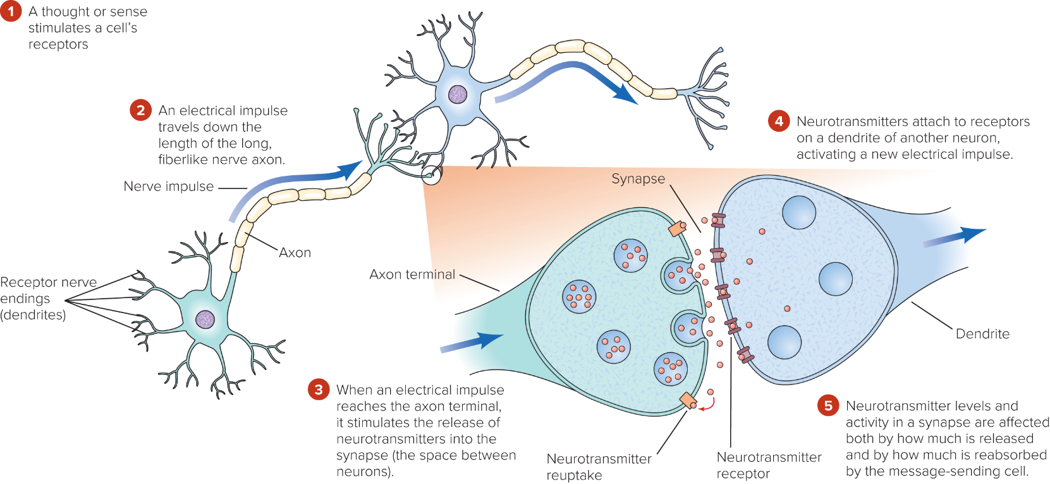
Figure 3.2 Nerve cell communication.
Nerve cells (neurons) communicate through a combination of electrical impulses and chemical messages. Neurotransmitters such as serotonin and norepinephrine alter the overall responsiveness of the brain and are responsible for mood, levels of attentiveness, and other psychological states. Many psychological issues are related to problems with neurotransmitters and their receptors, and drug treatments frequently target them. For example, some antidepressant drugs increase levels of serotonin by slowing the resorption (reuptake) of serotonin.
Access the text alternative for slide images.

Slide 16
Anxiety Disorders 1
Anxiety: fear that is not in response to any definite threat.
Specific phobia: fear of something definite.
Social anxiety disorder, or social phobia: fear of humiliation or embarrassment while being observed by others.
Panic disorder: sudden unexpected surges in anxiety.
Agoraphobia: fear of being alone away from help.
Panic attacks: brief surges of overwhelming anxiety.

Slide 17
Anxiety Disorders 2
Generalized anxiety disorder (GAD): excessive, uncontrollable worry about multiple issues.
Obsessive-compulsive disorder (OCD): uncontrollable, recurring thoughts and the performing of senseless rituals.
Obsessions: recurrent, unwanted thoughts or impulses.
Compulsions: repetitive, difficult-to-resist actions.

Slide 18
Anxiety Disorders 3
Posttraumatic stress disorder (PTSD): reliving traumatic events through dreams, flashbacks, and hallucinations.
If symptoms resolve in less than a month, considered acute stress disorder.
Treating anxiety disorders:
Medication.
Psychological interventions.

Slide 19
Attention-Deficit/Hyperactivity Disorder
Attention-deficit/hyperactivity disorder (ADHD):
Inattention.
Hyperactivity.
Impulsivity.
Diagnosis:
Persistent pattern of behavior.
Behaviors interfering in functioning or development.
Symptoms before age 12 (even if an adult at first diagnosis).

Slide 20
Mood Disorders 1
Mood disorder: emotional disturbance that is intense and persistent enough to affect normal function.
Two main types of mood disorder, together the most common in the United States:
Major depressive disorder.
Bipolar disorder (formerly manic-depression).

Slide 21
Mood Disorders 2
Depression: characterized by loss of interest, sadness, hopelessness, loss of appetite, disturbed sleep, and other physical symptoms.
Strikes nearly 6.7% of Americans annually.
Treatment depends on severity.
Best initial treatment is likely a combination of drug therapy and psychotherapy.
Only about 35% of people with depression seek treatment.
Electroconvulsive therapy (ECT): effective for severe depression when other approaches have failed.
For seasonal affective disorder (SAD), a type of depression, light therapy is used.

Slide 22
Mood Disorders 3
Bipolar disorder: a mental illness characterized by alternating periods of depression and mania.
Mania: excessive elation, irritability, talkativeness, inflated self-esteem, and expansiveness.
Antimanic drugs may be prescribed as a lifelong treatment.

Slide 23
Schizophrenia
Schizophrenia: a devastating mental disorder that affects thinking and perceptions of reality.
General characteristics:
Disorganized thoughts.
Disorganized or abnormal motor behavior.
Delusions, or firmly held false beliefs.
Auditory hallucinations.
Deteriorating social and work functioning.
Because of the risk of suicide, professional help and medications are necessary.

Slide 24
Table 3.2 Prevalence of Selected Psychological Disorders among Americans
DISORDER | LIFETIME PREVALENCE IN MEN | LIFETIME PREVALENCE IN WOMEN
Anxiety disorder: specific phobia | 9.9% | 17.5%
Anxiety disorder: social anxiety disorder | 11.8 | 14.2
Anxiety disorder: panic disorder | 3.3 | 7.0
Anxiety disorder: generalized anxiety disorder | 4.6 | 7.7
Anxiety disorder: obsessive-compulsive disorder | 1.8 | 3.6
Anxiety disorder: posttraumatic stress disorder | 4.0 | 11.7
Mood disorder: major depressive episode | 14.7 | 26.1
Mood disorder: bipolar disorder | 2.5 | 2.5
Mood disorder: manic episode | 1.0 | 1.0
Schizophrenia | 3.7 | 3.4
Table divided into three columns summarizes prevalence of selected psychological disorders. The column headers are marked from left to right as: Disorder, men (lifetime prevalence in percent), and women (lifetime prevalence in percent).
Note: Disorders listed as anxiety disorders are from the National Comorbidity Survey Replication, based on DSM-IV-TR/CIDI. OCD and PTSD are no longer categorized as anxiety disorders in the DSM-5.
SOURCES: Hasin, D. S., et al. 2018. Epidemiology of adult DSM-5 major depressive disorder and its specifiers in the United States. JAMA Psychiatry 75(4): 336–346; Kessler, R. C., et al. 2012. Twelve-month and lifetime prevalence and lifetime morbid risk of anxiety and mood disorders in the United States. International Journal of Methods in Psychiatric Research 21(3): 169–184; Lee, J., et al. 2017. Bipolar I disorder. Johns Hopkins Psychiatry Guide (https://www.hopkinsguides.com/hopkins/view/Johns_Hopkins_Psychiatry_Guide/787045/all/Bipolar_I_Disorder); McGrath, J., et al. 2008. Schizophrenia: A concise overview of incidence, prevalence, and mortality. Epidemiologic Reviews 30: 67–76.

Slide 25
Suicide 1
In the United States, suicide is the second leading cause of death for young people aged 10 to 34.
Suicide rate is higher among men than women.
Signs that a person may be suicidal:
Any mention of dying, disappearing, or self-harm.
Changes in personality.
Sudden, unexplained brightening of mood.
Sudden move to give away important possessions.
Increase in reckless behaviors.

Slide 26
Suicide 2
Key risk factors for suicide:
History of previous attempts.
Sense of hopelessness, helplessness, guilt, or worthlessness.
Alcohol or other substance use disorders.
Serious medical problems.
Mental disorders, especially mood disorders.
Availability of a weapon.
Family history of suicide.
Social isolation.
History of abuse or neglect.
Current or past experience of being bullied.

Slide 27
Suicide 3
Key protective factors:
Strong religious faith or cultural prohibition on suicide.
Connection to other people.
Engagement in treatment.
Connection with your children or pets.
Lack of access to lethal means.
Firearms are used in more suicides than homicides.
Encouraging the person to talk can be helpful, but further help from a mental health professional is essential.

Slide 28
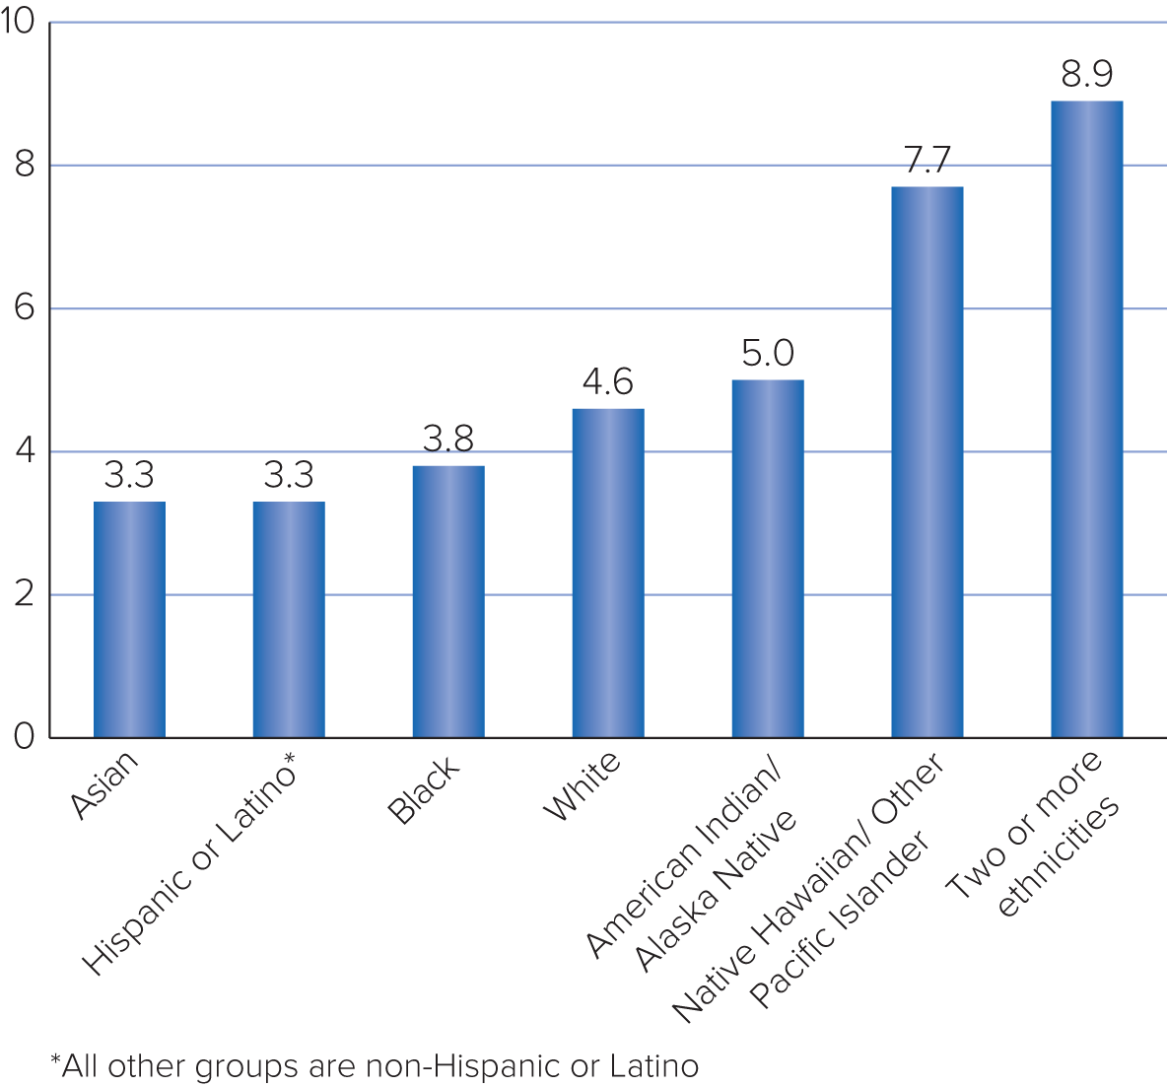
Figure 3.3 Percentages of American adults having suicidal thoughts in the past year, by ethnicity.
SOURCE: National Institute of Mental Health, 2019.

Slide 29
Table 3.3 Myths about Suicide: Don’t Be Misled
MYTH | FACT
People who really intend to kill themselves do not let anyone know about it. | This belief can be an excuse for doing nothing when someone says he or she might attempt suicide. In fact, most people who eventually follow through with suicide have talked about doing it.
People who made a suicide attempt but survived did not really intend to die. | This belief may be true for certain people, but people who seriously want to end their lives may fail because they misjudge what it takes. Even a pharmacist may misjudge the lethal dose of a drug.
People who succeed in suicide really wanted to die. | We cannot be sure of that either. Some people are only trying to make a dramatic gesture or plea for help but miscalculate.
People who really want to kill themselves will do it regardless of any attempts to prevent them. | Few people are single-minded about suicide even at the moment of attempting it. People who are quite determined to take their lives today may completely change their minds tomorrow.
Suicide is proof of mental illness. | Many suicides are carried out by people who do not meet ordinary criteria for mental illness, although people with depression, schizophrenia, and other psychological disorders (including substance use disorders) have a much higher than average suicide rate.
People inherit suicidal tendencies. | Certain kinds of depression that lead to suicide do have a genetic component. But many examples of suicide running in a family can be explained by factors such as psychologically identifying with a family member who kill themselves, often a parent.
All suicides are irrational. | By some standards, all suicides may seem “irrational.” But many people find it at least understandable that someone might want to attempt suicide—for example, when approaching the end of a terminal illness or when facing a long prison term.
Table divided into two columns summarizes myths about suicide. The column headers are: Myth and fact.

Slide 30
Models of Human Nature and Therapeutic Change 1
Biological model emphasizes that the mind’s activity depends entirely on an organic structure, the brain.
Pharmacological therapy:
Antidepressants.
Mood stabilizers.
Antipsychotics.
Anxiolytics (antianxiety agents) and hypnotics (sleeping pills).
Stimulants.
Issues in drug therapy:
For mild cases of depression, psychotherapy may be more effective.
For moderate to severe depression, combined therapy appears to be significantly more effective than either type of treatment alone.

Slide 31
Models of Human Nature and Therapeutic Change 2
Behavioral model focuses on what people do.
Behaviorists analyze behavior in terms of stimulus, response, and reinforcement.
Fearful people are taught to practice exposure.
Cognitive model emphasizes the effect of ideas on behavior and feelings.
Attempts to expose and identify harmful false ideas.
Psychodynamic model also emphasizes thoughts.
Symptoms are a result of a complex set of wishes and emotions hidden by active defenses.

Slide 32
Models of Human Nature and Therapeutic Change 3
Evaluating the models:
Most clinicians do not subscribe to a single model but understand mental illness through a biopsychosocial model.
Therapists have recently developed pragmatic cognitive-behavioral therapies (CBTs) that combine effective elements of both models.
Treating social anxiety: combination of exposure and changing problematic patterns of thinking.
Drug therapies and CBTs are also sometimes combined.
Psychodynamic therapies have been attacked as ineffective and endless.

Slide 33
Other Psychotherapies
Dialectical behavior therapy (DBT).
Encourages distress tolerance and acceptance of painful feelings through mindfulness.

Slide 34
Getting Help 1
Self help:
Learn more about what you can do on your own.
Writing a journal can help with coping.
Religious belief and practice is constructive for some.
Peer counseling and support groups:
Allow you to share your concerns with others.
Online help and apps.

Slide 35
Getting Help 2
Professional help is indicated when:
Depression, anxiety, or other emotional problems seriously interfere with school, work, or relationships.
Suicide is attempted or seriously considered.
Hallucinations, delusions, memory loss, or incoherent speech occurs.
Alcohol or drugs impair normal functioning, or reducing the amount leads to psychological withdrawal symptoms.
Overcoming the stigma of seeking help is the first step.
For students, the student help center is a great start.

Slide 36
Review
Describe what it means to be psychologically healthy.
Discuss psychological approaches you can use to face life’s challenges with a positive self-concept.
Describe common psychological disorders.
Recognize the warning signs, risk factors, and protective factors related to suicide.
Summarize the models of human nature on which therapies are based.
Describe the types of help available for psychological problems.

Slide 37
End of Main Content
Copyright 2022 © McGraw Hill LLC. All rights reserved. No reproduction or distribution without the prior written consent of McGraw Hill LLC.

Slide 38
Accessibility Content: Text Alternatives for Images
38

Slide 39
Figure 3.1 Maslow’s hierarchy of needs – Text Alternative
Return to parent-slide containing image
Physiological needs, the base of the pyramid: food and water; shelter; sleep; exercise; sex.
Next, safety and security needs: safe surroundings; protection by others; knowing to avoid risks.
Love and belongingness needs: being loved; loving others; being connected to others.
Self-esteem needs: self-esteem as a person; as a doer; and in relationships.
Self-actualization, the peak of the pyramid: realism; self-acceptance; autonomy; authenticity; capability for intimacy; creativity.
Return to parent-slide containing image

Slide 40
Figure 3.2 Nerve cell communication – Text Alternative
Return to parent-slide containing image
(1) A thought or sense stimulates a cell’s neurotransmitter receptors on receptor nerve endings, or dendrites.
(2) An electrical impulse travels down the length of the long, fiberlike nerve axon.
(3) When an electrical impulse reaches the axon terminal, it stimulates the release of neurotransmitters into synapse (the space between neurons).
(4) Neurotransmitters attach to receptors on a dendrite of another neuron, activating a new electrical impulse.
(5) Neurotransmitter levels and activity in a synapse are affected both by how much is released and by how much is reabsorbed by the message-sending cell (via neurotransmitter reuptakes).
Return to parent-slide containing image

