Slide 1
Effective Leadership and Management in Nursing Ninth Edition
Chapter 11
Delegating Successfully

Slide 2
Learning Outcomes
Explain delegation and distinguish between responsibility, accountability, and authority.
Describe how effective delegation benefits the delegator, the delegate, the unit, and the organization.
Explain how following the five rights of delegation can reduce nurses’ fears about delegation.
continued on next slide

Slide 3
Learning Outcomes
Evaluate the delegation process, including the steps in delegation, key behaviors for successful delegation, and the implications of accepting delegation.
Assess the factors that contribute to ineffective delegation.

Slide 4
Key Terms
accountability
assignment
authority
delegation
overdelegation
continued on next slide

Slide 5
Key Terms
responsibility
reverse delegation
underdelegation

Slide 6
Learning Outcome One
Explain delegation and distinguish between responsibility, accountability, and authority.

Slide 7
Delegation
Process by which responsibility and authority for performing a task is transferred to another individual who accepts that authority and responsibility
Delegator remains accountable for the task.
Delegation skills can be learned.
continued on next slide

Slide 8
Delegation
Principles for Delegation
The nursing profession determines the scope and standards of nursing practice.
The RN takes responsibility and accountability for the provision of nursing practice.
The RN directs care and determines the appropriate utilization of resources when providing care.
The RN may delegate tasks or elements of care but does not delegate the nursing process itself.
continued on next slide

Slide 9
Delegation
Principles for Delegation
The RN considers facility/agency policies and procedures and the knowledge and skills, training, diversity awareness, and experience of any individual to whom the RN may delegate elements of care.
The decision to delegate is based upon the RN’s judgment concerning the care complexity of the patient, the availability and competence of the individual accepting the delegation, and the type and intensity of supervision required.
The RN acknowledges that delegation involves the relational concept of mutual respect.
continued on next slide

Slide 10
Delegation
Principles for Delegation
Nurse leaders are accountable for establishing systems to assess, monitor, verify, and communicate ongoing competence requirements in areas related to delegation.
The organization/agency is accountable to provide sufficient resources to enable appropriate delegation. The organization/agency is accountable for ensuring that the RN has access to documented competency information for staff to whom the RN is delegating tasks.
Organizational/agency policies on delegation are developed with the active participation of registered nurses.
continued on next slide

Slide 11
Delegation
Responsibility
Denotes an obligation to accomplish a task
Accountability
Accepting ownership for the results or lack thereof
Responsibility can be transferred.
Accountability is shared.
You can delegate only those tasks for which you are responsible.
continued on next slide

Slide 12
Delegation
Authority
The right to act
By transferring authority, the delegator is empowering the delegate to accomplish the task.
continued on next slide

Slide 13
Delegation
Assignment
Bureaucratic function and reflect job descriptions
No transfer of authority occurs
Effective delegation benefits the delegator, the delegate, and the organization.

Slide 14
Learning Outcome Two
Describe how effective delegation benefits the delegator, the delegate, the unit, and the organization.

Slide 15
Benefits of Delegation
Benefits to the Nurse
Patient care is enhanced.
Nurse's job satisfaction increases.
Retention is improved.
continued on next slide

Slide 16
Benefits of Delegation
Benefits to the Delegate
Delegate gains new skills and abilities.
Delegate gains trust and support, resulting in greater self-esteem and confidence.
Job satisfaction and motivation are enhanced.
continued on next slide

Slide 17
Benefits of Delegation
Benefits to the Delegate
Individuals feel stimulated by new challenges.
Morale improves, and a sense of pride and belonging develops.
There is greater awareness of responsibility.
continued on next slide

Slide 18
Benefits of Delegation
Benefits to the Manager
Manager will have a better functioning unit.
Manager will have more time to devote to management tasks.
Manager will have time to develop new skills and abilities, enhancing the opportunity for career advancement.
continued on next slide

Slide 19
Benefits of Delegation
Benefits to the Organization
Organization achieves goals more efficiently.
Overtime and absences decrease, productivity increases.
Financial position may improve.
Quality of care improves.
Patient satisfaction increases.

Slide 20
Learning Outcome Three
Explain how following the five rights of delegation can reduce nurses’ fears about delegation.

Slide 21
The Five Rights of Delegation
Fear of liability often keeps nurses from delegating.
Each state board of nursing has its own rules regarding delegation.
continued on next slide

Slide 22
The Five Rights of Delegation
Right task
Specifies what can be safely delegated to a specific patient.
Right circumstances
Appropriate setting and available resources
Right person
Refers to both the delegator and the delegate
continued on next slide

Slide 23
The Five Rights of Delegation
Right direction and communication
Require the delegator to give clear, concise description of the task
Right supervision
Includes monitoring the delegate, evaluating the person’s performance, giving feedback as required, and intervening if necessary

Slide 24
Learning Outcome Four
Evaluate the delegation process, including the steps in delegation, key behaviors for successful delegation, and the implications of accepting delegation.

Slide 25
The Delegation Process
Steps in the Delegation Process
Define the task
Delegate only an aspect of your own work for which you have responsibility and authority.
Routine tasks
Tasks for which you do not have time
Tasks that have moved down in priority
Define the complexity of the task and its components.
Subdivide the task into component parts and delegate the components congruent with the available delegate's capabilities.
continued on next slide

Slide 26
The Delegation Process
Steps in the Delegation Process
Certain tasks should never be delegated.
Discipline
Highly technical tasks
Situations that involve confidentiality or controversy
continued on next slide

Slide 27
The Delegation Process
Steps in the Delegation Process
Decide on the delegate.
Match the task to the individual.
Delegate to the lowest person in the hierarchy who has the requisite capabilities and who is allowed to do the task legally.
Determine availability.
Delegation is an agreement that is entered into voluntarily.
continued on next slide

Slide 28
The Delegation Process
Steps in the Delegation Process
Determine the task
Clearly define your expectations for the delegate.
Plan when to meet.
Key behaviors in delegating tasks:
Describe the task using 'I' statements.
The delegate needs to know what is expected and when, where, and how the task is to be completed.
If written reports are required, indicate whether tables, charts, or other graphics are necessary.
Be specific about reporting times; identify critical events or milestones.
continued on next slide

Slide 29
The Delegation Process
Steps in the Delegation Process
Determine the task
Key behaviors in delegating tasks:
Describe the importance to the organization, you, the patient, and the delegate.
Clearly describe the expected outcome and the timeline for completion.
Identify any constraints on completing the task or any conditions that could change.
Validate understanding of the task and your expectations.
continued on next slide

Slide 30
The Delegation Process
Steps in the Delegation Process
Reach agreement.
Be sure that the delegate agrees to accept responsibility and authority for the task.
Monitor performance and provide feedback.
Monitoring performance provides a mechanism for feedback.
Be sure to give praise and recognition due.

Slide 31
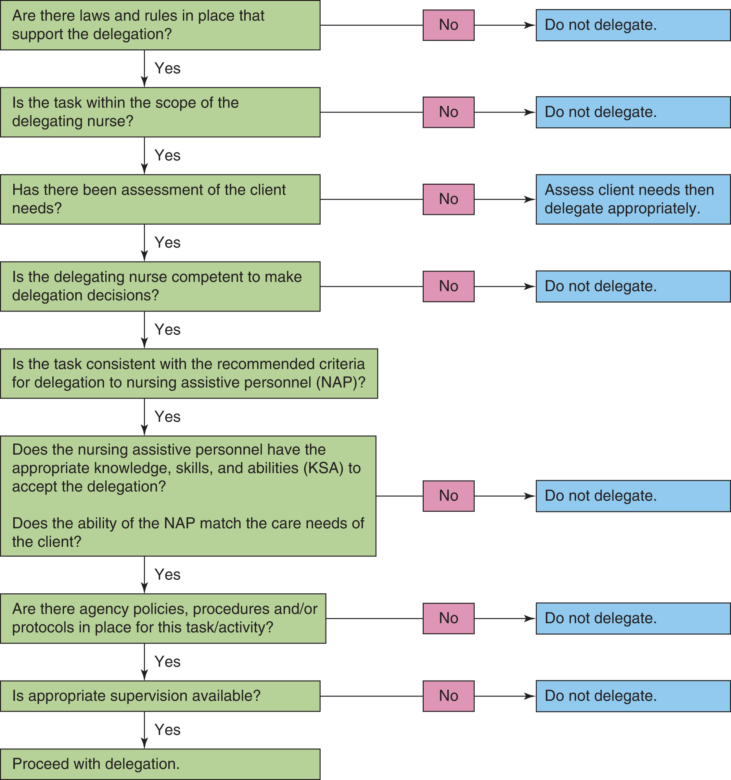
Figure 11-1 Decision tree for delegation to nursing assistive personnel Source: Adapted from National Council of State Boards of Nursing. (2006). Joint statement on delegation. Retrieved December 2007 from www.ncsbn.org/Joint_statement.pdf
continued on next slide

Slide 32
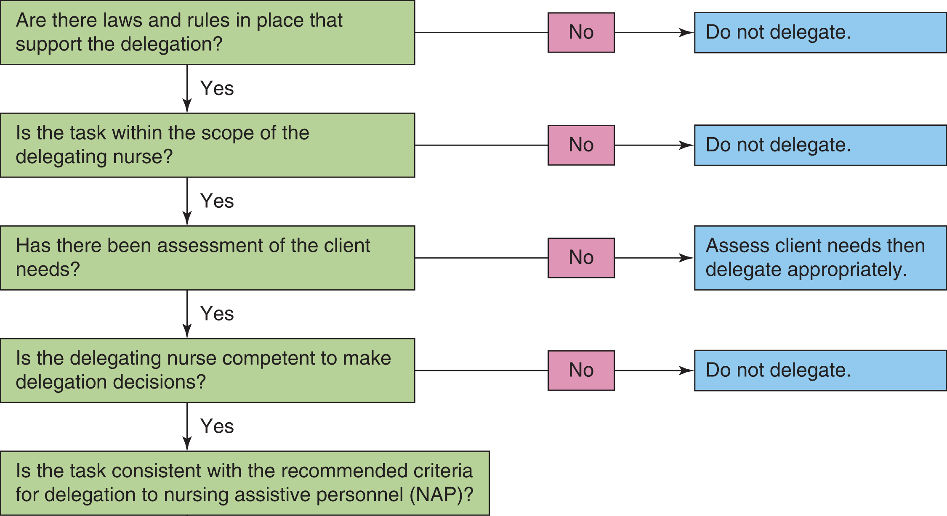
Figure 11-1 (detail) Decision tree for delegation to nursing assistive personnel Source: Adapted from National Council of State Boards of Nursing. (2006). Joint statement on delegation. Retrieved December 2007 from www.ncsbn.org/Joint_statement.pdf
continued on next slide

Slide 33
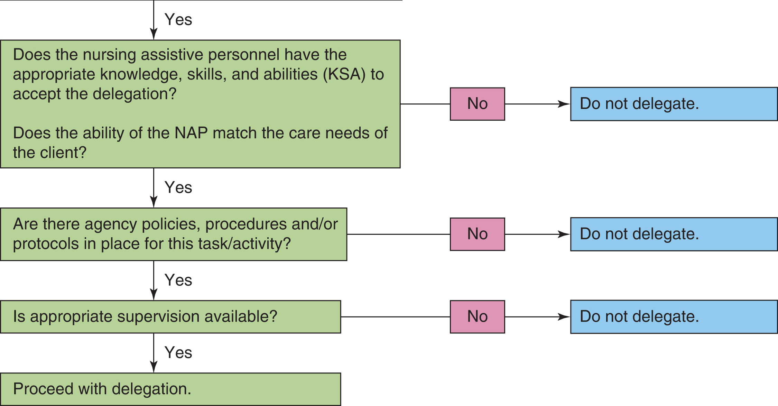
Figure 11-1 (detail continued) Decision tree for delegation to nursing assistive personnel Source: Adapted from National Council of State Boards of Nursing. (2006). Joint statement on delegation. Retrieved December 2007 from www.ncsbn.org/Joint_statement.pdf

Slide 34
The Delegation Process
Accepting Delegation
Means accepting full responsibility for the outcome and its benefits or liabilities
When you accept delegation, you must understand what is being asked of you.
Realistically examine whether you have the skills and abilities for the task and the time to do it.
Make sure you are clear on the time frame, feedback mechanisms, and other expectations.
Throughout the project, keep the delegator informed.

Slide 35
Learning Outcome Five
Assess the factors that contribute to ineffective delegation.

Slide 36
Ineffective Delegation
Poor communication and interpersonal relationships between nurses and UAPs have been found to result in ineffective delegation.
The RN/UAP unit is a microsystem in healthcare.
When that unit is dysfunctional or functioning at less than optimal performance, the quality of care suffers.
continued on next slide

Slide 37
Ineffective Delegation
Organizational Culture
Culture within the organization may restrict delegation.
Rigid chains of command and autocratic leadership styles do not facilitate delegation.
Atmosphere of distrust
Poorly defined job descriptions or chains of com- mand also impede successful delegation.
continued on next slide

Slide 38
Ineffective Delegation
Lack of Resources
Lack of possible delegates
Financial constraints
Limited educational resources
Time limits
continued on next slide

Slide 39
Ineffective Delegation
An Insecure Delegator
Fear of competition or criticism
Fear of liability
Fear of loss of control
Fear of overburdening others
Fear of decreased personal job satisfaction
continued on next slide

Slide 40
Ineffective Delegation
An Unwilling Delegate
Inexperience and fear of failure can motivate a potential delegate to refuse to accept a delegated task.
If proper selection criteria are used and steps of delegation followed, the delegate should not fail.
Another barrier is the individual who avoids responsibility or is overly dependent on others.
continued on next slide

Slide 41
Ineffective Delegation
Underdelegation
Failure to transfer full authority to the delegate.
Taking back responsibility for aspects of the task.
Failure to equip and direct the delegate.

Slide 42
Ineffective Delegation
Reverse delegation
Someone with a lower rank delegates to someone with more authority.
Overdelegation
The delegator loses control over a situation by providing the delegate with too much authority or too much responsibility.
This places the delegator in a risky position, increasing the potential for liability.

