Slide 1
Select Psychological Theories

Slide 2
Major Principles of Psychological Theories
The individual is the primary unit of analysis
Personality is the major motivational element because it is the seat of drives and source of motives
Crime results from abnormal, dysfunctional, or inappropriate mental processes within the personality
Criminal behavior may be purposeful for the individual insofar as it addresses certain felt needs.

Slide 3
Major Principles(cont.)
Normality is generally defined by social consensus
Defective, or abnormal, mental processes may have a variety of causes, including a diseased mind, inappropriate or improper conditioning, the emulation of inappropriate role models, and poor adjustment to inner conflicts

Slide 4
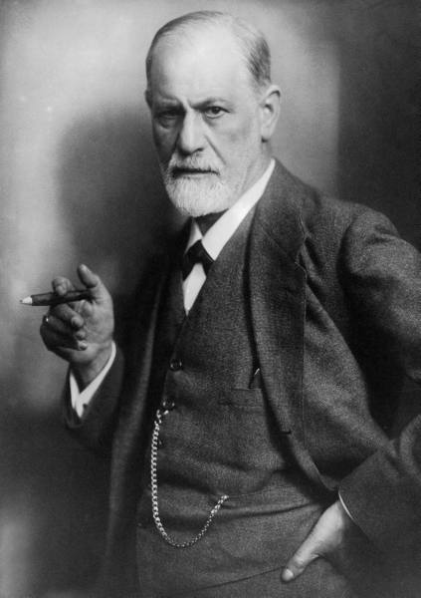
The Psychoanalytic Perspective
Sigmund Freud and psychoanalysis
Id, Ego, and Superego
Superego-
Based on the Ethical Principle
Ego- Based on the Reality Principle
Id- Based on the Pleasure Principle

Slide 5
Freud’s Other Theories
Sublimation- psychological process whereby one aspect of consciousness comes to be symbolically substituted for another
Oedipus Complex
Thanatos- fundamental desire to die, death wish
Neurosis and Psychosis
Freud not well supported in modern day

Slide 6
The Psychotic Offender
Neurosis- minor emotional disorder, such as anxiety or a phobia
Psychosis- mental illness where one is out of touch with reality
Schizophrenia- psychosis with disjointed thinking

Slide 7
Self-Control Theory
Self-control is defined as “a person’s ability to alter his or her own mental and emotional states and behavioral responses.”
Most people can exercise this well enough so as to not get in trouble with the law.
Impulse control
Control over the contents of the mind
Control over emotions and moods
Controlling performance

Slide 8
The Four Types of Self-Control
Impulse Control: resisting temptations and refraining from impulses seen as socially or personally undesirable.

Slide 9
Four Types continued…
Control Over Contents of the Mind: suppressing unwanted thoughts.
Being able to focus and concentrate
Being able to reason and analyze information

Slide 10
Four Types Continued…
Self Control Over Emotions and Moods: self explanatory.
The ability to push aside unwanted moods.

Slide 11
Four Types Continued…
Controlling Performance: perseverance in the face of adversity or physical challenges.

Slide 12
Attachment Theory
A social-psychological perspective on delinquent and criminal behavior that holds that the successful development of secure attachment between the child and his or her primary caregiver provides the basic foundation for all future psychological development.
Most problematic individuals will be those abandoned earlier, experience multiple placements, deal with earlier absence of parents, and faced traumatic conditions in early childhood

Slide 13
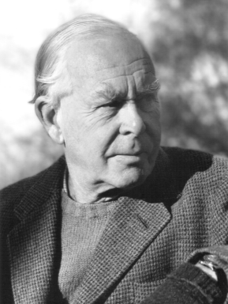
John Bowlby
English child psychiatrist who first proposed the attachment theory.
Observed children during his tenure at the London Child Guidance Clinic after WWII.
Maladjusted behavior of children who lacked a solid relationship with a mother figure.
Called delinquents “affectionless”-they
did not from intimate attachments as
children and therefore cannot form
them later in life.
Believed that attachment behaviors are
instinctive.

Slide 14
The Three Forms of Attachment
Secure attachment: only healthy form; develops early in life when a child is confident that the mother figure will be responsible and available when needed.
According to attachment theory, delinquent behavior arises when non-secure attachments are created.

Slide 15
Three Forms Continued…
Anxious-avoidant attachment: develops when children feel rejection and lack confidence concerning parental support and care.
Anxious-resistant attachment: develops from similar experiences and results in feelings of uncertainty, causing the child (and later, the adult), to feel anxious, to be fearful of his or her environment, and to cling to potential caregivers or partners

Slide 16
Is it acceptable today?
Tests seem to confirm that difficulties in childhood produce criminality later in life.
Studies have shown that children who were raised in insecure environments are likely to engage in violent behavior as adults.

Slide 17
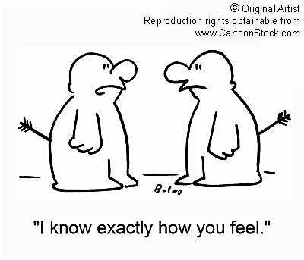
What other theorists believe
Childhood insecurity leads to a relative lack of empathy.
The development of empathy is the single most important factor leading to conformity.
When children do not receive
empathy from those around them,
they appear to also be unable to
see others as deserving of
empathy and become more likely
to inflict injury on others.

