Slide 1
Final Review

Slide 2
Notes
Available Remotely from Thursday, April 29th through Tuesday, May 4th
Official Exam Blocks:
Section 1: Thursday, April 29th, 7:00am – 9:50am
Section 2: Tuesday, May 4th, 4:00pm – 6:50pm
2 hour time limit
Open Notes
Please restrict to notes on the webcourse or those you have created
Calculator Encouraged

Slide 3
Previous Material
Combinational Logic
Truth Tables
Logic Gates
Canonical Forms
Karnaugh Maps
Sequential Logic
Shift Register
Data Register
Register File
Binary Conversions
Arithmetic Logic Unit

Slide 4
MIPS Assembly
Operations
Arithmetic
Logical
Load/Store
Branches
Instruction Formats
R-Type
I-Type
J-Type
Software Conventions
Registers
Procedures
Stacks

Slide 5
Sample Question
Write a sequence of MIPS instructions to implement the following segment of C code:
int count_positive(int * a, int n) {
int i = 0; int v = 0;
while (n > 0) {
if(a[i] > 0)
v++;
i++;
n--;
}
return v;
}
Use the following register allocation in your code:
$a0 base address of a $a1 n
$v0 v

Slide 6
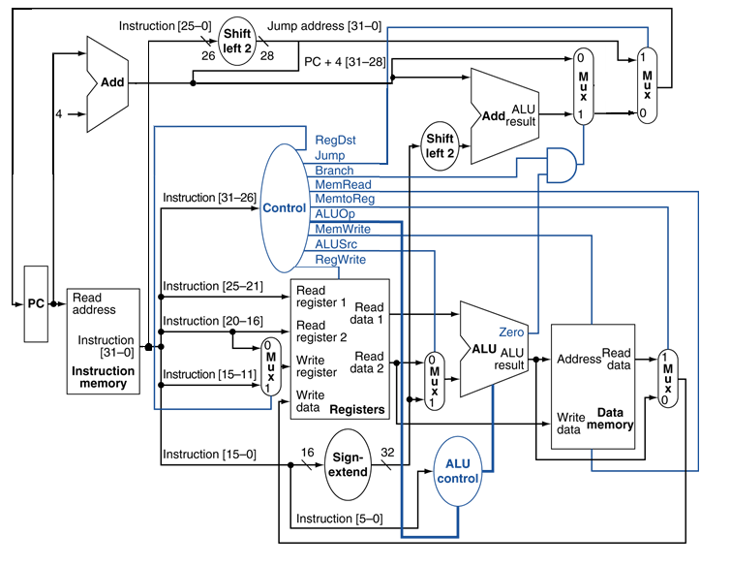
MIPS Single Cycle Datapath
Decoding instructions
Processing instructions
Control Signals
Addressing modes

Slide 7
Sample Question
How would the control signals be set for the addi instruction?

Slide 8
Sample Question
If the current PC is 4000, what would be the PC of the next instruction if instructionmemory[PC] = j 20?

Slide 9
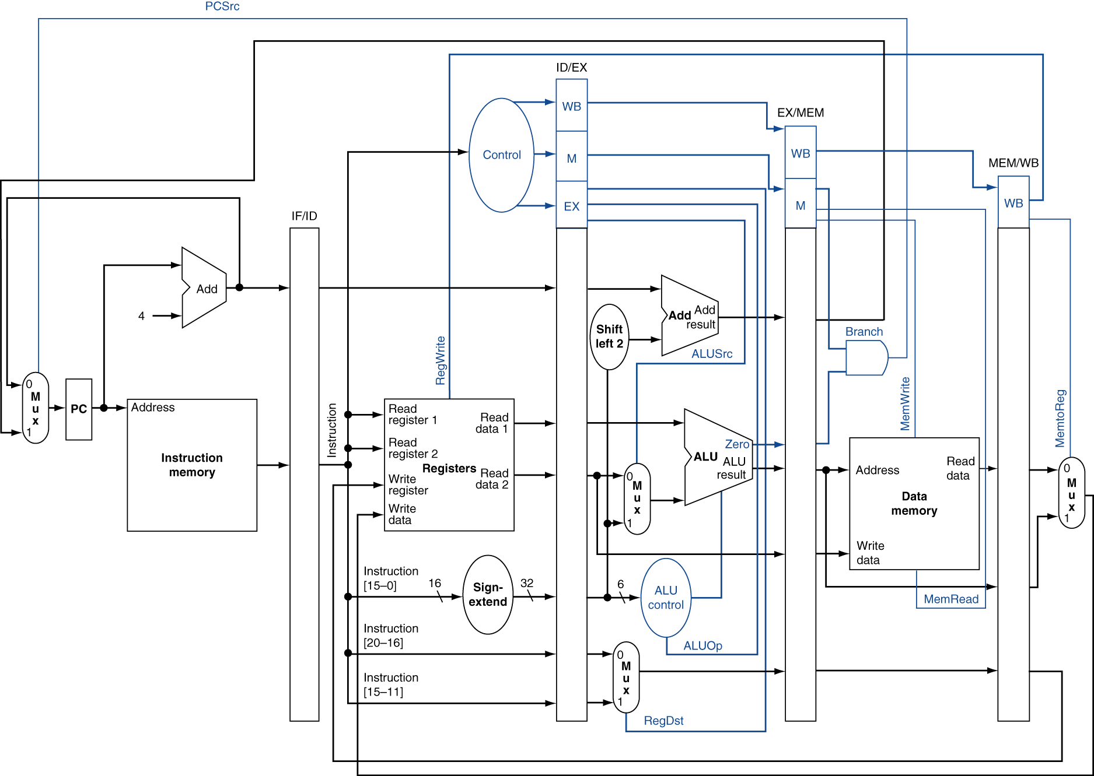
Pipelined Datapath
Pipelining
Throughput vs. Response Time
MIPS 5-Stage Pipeline
IF, ID, EX, MEM, WB
Hazards
Structure, Data, Control
Forwarding/Bypassing
Stalls

Slide 10
Sample Question
I0: sll $s2, $s1, 4
I1: beq $s1, $zero, top
I2: addi $s3, $s2, 6
I3: sub $t2, $s3, $s1
I4: addi $s4, $s2, 8
I5: sw $t2, 0($s4)
Consider a pipeline without any hazard handling. The pipeline is the typical 5-stage IF, ID, EX, MEM, WB MIPS design. For the above code, complete the pipeline for the code. Insert the characters IF, ID, EX, MEM, WB for each instruction in the boxes.
Label all stalls in the pipeline by drawing an X in the box. Assume the branch, when calculated by the datapath, is not taken. Assume also that the second half of the decode stage performs a read of source registers, and that the first half of the write-back stage writes to the register file. What is the final execution time (in cycles) of the code?
 | T0 | T1 | T2 | T3 | T4 | T5 | T6 | T7 | T8 | T9 | T10 | T11 | T12 | T13 | T14 | T15
I0
I1
I2
I3
I4
I5

Slide 11
Performance
CPU Performance
CPU Time = Instruction Count x CPI x Clock Cycle
Clock Cycle = Clock Cycle time = 1 / Clock Frequency

Slide 12
Sample Question
Computer A has an overall CPI of 1.3 and can be run at a clock rate of 600MHz. Computer B has a CPI of 2.5 and can be run at a clock rate of 750 Mhz.
Suppose we have a particular program we wish to run. When compiled for computer A, this program has exactly 100,000 instructions. How many instructions would the program need to have when compiled for Computer B, in order for the two computers to have exactly the same execution time for this program?

Slide 13
Memory Hierarchy
Locality
Caches
Associativity
Replacement policies
Write policies

Slide 14
Sample Question
Suppose we have a 32 block cache. Each block of the cache is one word wide. When a given program is executed, the processor reads data from the decimal addresses show in the table below. Show the contents of the cache at the end of the read operations if the cache is 4-way set associative. Assume LRU is the replacement policy.
Set Index | Block 1 | Block 2 | Block 3 | Block 4
000
001
010
011
100
101
110
111
Address | Hit/Miss | Justification
5
16
37
21
13
24
21
45
26

