Slide 1
Computer Organization CDA 3103
Sarah Angell
sarah.angell@cs.ucf.edu

Slide 2
Course Details
Website: webcourses, check regularly
Instructor Contact: webcourse messages or sarah.angell@ucf.edu
Instructor Office Hours: Mondays, 10:30 am – 11:45 am Tuesdays, 10:30 am – 11:45 am Wednesdays, 2:00 pm – 3:15 pm Thursdays, 2:00 pm – 3:15 pm
Prereqs: COP 3223

Slide 3
Course Details
Recommended Course Textbook:
Computer Organization and Design MIPS Edition by David Patterson
Content Delivery
Synchronous classroom meetings via zoom
Section 1, TR 9:00 – 10:15 am
Section 2, TR 6:00 – 7:15 pm
Asynchronous recorded lectures

Slide 4
Course Details
Grading:
Assignments/Quizzes 35%
Project 15%
Midterm 25%
Final Exam 25%

Slide 5
Course Details: Quizzes
There are seven pairs of quizzes planned for this semester. Each pair focuses on a single module in the course.
The quizzes are not identical but will have similar questions.
Questions will also be similar to provided Study Sets
Results for “Quiz 1” can be reviewed prior to taking “Quiz 2” of the pair.

Slide 6
Course Details: Exams
There are two exams: the Midterm Exam and the Final Exam.
Respondus LockDown Browser will be required.
But not Respondus Monitor (no webcam needed).
A testing window period of three days is allotted for the Midterm exam: March 11-13 (Thur-Sat)
Final Exams will be available (at a minimum) the day of the regularly scheduled final exam for your section. The final exam is cumulative.
Section 1: April 29th
Section 2: May 4th

Slide 7
Course Details: Project
Final Project: Write an emulator in C for a scaled down MIPS ISA processor
The emulator must compile and run in an UNIX environment
Eustis accounts will be provided after the add/drop period
You may also use your own environment as preferred
Projects may be done individually or in teams of two or three.
Details will be provided after our section on pipelining

Slide 8
Feedback
Your opinion is vital to the pace of the course
Let me know your opinions on:
Pacing (too fast/too slow)
Level (too easy/too difficult)
Class and Recitation Examples (too few/too many)
Homework
Exams

Slide 9
Course Goals
Introduce fundamentals of the organization and design of computers from both the computer programmer’s perspective and computer architect’s perspective
Cover the components of a computer, the functions of each component, and how the components interact with each other and with software
Make each of you a better computer scientist

Slide 10
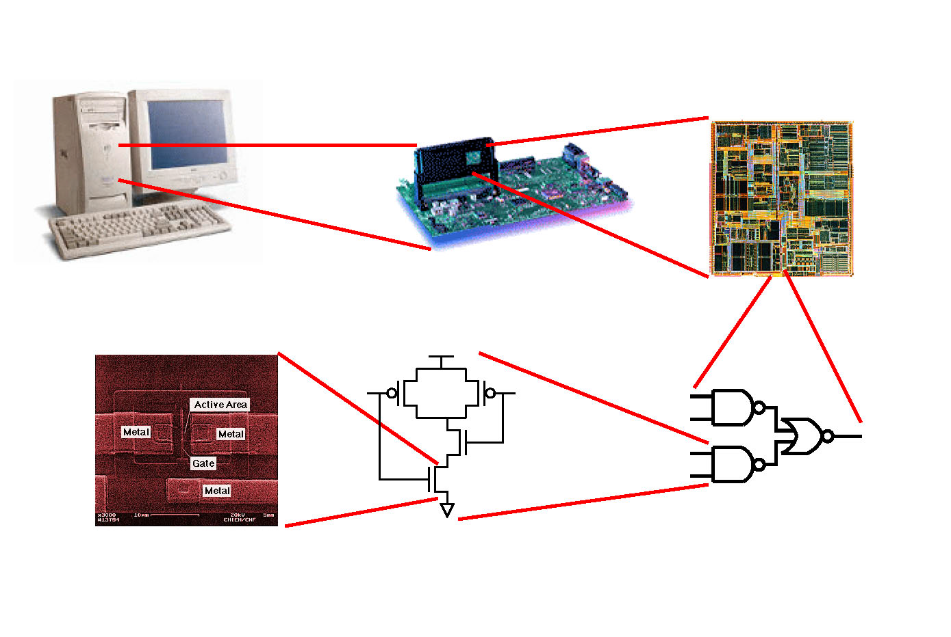
Computer Systems
Computer System
System Architecture
Processor Design
Device Fabrication
Circuit Design
Logic Design

Slide 11
Computer Systems
addi $s1, $zero, 0
addi $s2, $zero, 0
chk: slt $t3, $s1, $s0
beq $t3, $0, done
sll $t1, $s1, 2
add $t1, $t1, $s3
lw $t0, 0($t1)
add $s2, $s2, $t0
addi $s1, $s1, 1
j chk
done:
0x20110000
0x20120000
0x0233582A
0x100B0018
0x00114880
0x01334820
0x8D280000
0x01129020
0x22310001
0x08000008
0x00000000
i = 0, sum =0;
while (i < n) {
sum += A[i];
i++;
}

Slide 12
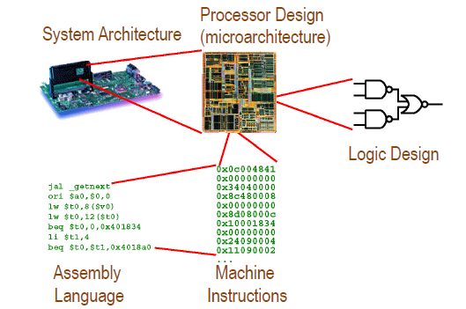
CDA 3103 focuses on:

Slide 13
Why should you know this?
These components are important to a number of fields:
Operating Systems
Compiler design and optimization
Mobile and low-power architectures
Parallelism
Parallel programming
Parallel processing
Parallel architectures
It’s important to know how different parts of the system contribute to the system, interact, and affect each other

Slide 14
Course Topics
Data Representation
Boolean Logic Design
Instruction Set Architecture (ISA)
MIPS Assembly Language Programming
Computer Arithmetic (Integer and IEEE 754 Floating Point)
Performance and Power Metrics
Datapath Design and Control Logic Design
Pipelining Basics
Memory Hierarchy, Caches, and Virtual Memory

