Slide 1
UCF College of Nursing Nursing Licensure Information
Mary Lou Sole, PhD, RN, CCNS, CNL, FAAN, FCCM
Dean Professor
Orlando Health and Endowed Chair
Spring 2021

Slide 2
It’s that time to think about RN licensure!
This Photo by Unknown Author is licensed under CC BY-NC

Slide 3
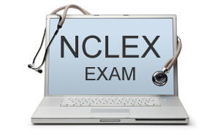
UCF has had great NCLEX results!
This Photo by Unknown Author is licensed under CC BY-NC-ND

Slide 4
2020 NCLEX High pass rates on licensure examination; exceed national averages Highest number of newly licensed RNs among SUS schools
 | Take | Pass | % Pass
State University System
Florida Gulf Coast | 81 | 79 | 97.50%
Florida Atlantic University | 122 | 117 | 95.90%
University of West Florida | 124 | 119 | 95.90%
UCF | 262 | 251 | 95.80%
University of Florida | 192 | 184 | 95.80%
Florida International University | 166 | 159 | 95.70%
Unversity of South Florida | 200 | 191 | 95.50%
University of North Florida | 140 | 133 | 95.00%
Florida State | 105 | 95 | 94.40%
Florida A & M | 78 | 52 | 66.60%
State Colleges
Seminole State College | 203 | 197 | 97.00%
Lake Sumter State | 64 | 61 | 95.30%
Daytona State College | 240 | 213 | 93.00%
Valencia College | 323 | 295 | 91.30%
Eastern Florida (Melbourne) | 139 | 111 | 79.80%

Slide 5
Types of license
Single state vs. multi-state compact (MSCL)
Residents of states that offer MSCL default to that option
34 states offer MSCL
nlcmemberstates.pdf (ncsbn.org)
NLC-Fast-Facts_11 (ncsbn.org) Infographic
Must be a resident of a compact state to secure a MSCL
Florida residents can apply for Florida MSCL and practice in the 34 states
If resident of other MSCL, you have to apply to that state (e.g., GA, NC)
No CE requirements for initial licensure
https://www.ncsbn.org/nurse-licensure-compact.htm

Slide 6
Compact Licensure States

Slide 7
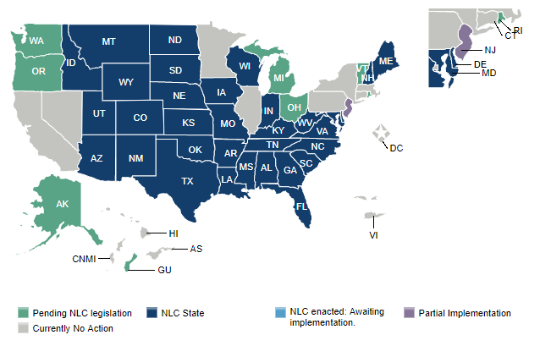
Initial Licensure Other than Compact
Get materials and directions; processes vary.
If need transcript, ask that FINAL transcript showing conferral of degree sent.
Can meet with Dean if needed.
Experience:
DC
IL
HI
NY
PA
WA

Slide 8
Examination Process

Slide 9
Resources
Florida Board of Nursing » Licensed Practical Nurse & Registered Nurse by Examination - Licensing, Renewals & Information (floridasnursing.gov)
https://home.pearsonvue.com/

Slide 10
Summary of Processes
Apply to Florida Board of Nursing $ 110
Obtain LiveScan Fingerprints $ Varies
Apply to Pearson VUE—NO REFUNDS $ 200
Receive acknowledgement of registration
Receive Authorization to test (ATT) following graduation and certification of degree

Slide 11
UCF NCLEX Code
University of Central Florida (US70506700)
Not College of Central Florida

Slide 12
FAQs
Do I need to send transcripts to FBON?
No
We will send list to FBON upon certification of degrees
What about other states?
Yes
Request FINAL transcript showing conferral of degree
Can request transcript ahead of time
When will I get my ATT?
After degrees conferred (approx. 2 weeks after graduation)
After your application is processed by board of nursing (allow up to 30 days after degree conferral)

Slide 13
Board of Nursing Hints
Use name EXACTLY as ID for ALL applications.
Complete applications online.
Need to list employer address; if none, list the CON address: CON, 12201 Research Parkway, Orlando, FL 32826
Keep copies of everything.
Special test accommodations available with documentation.
Take exam within 90 days of the ATT being issued or re-register with Pearson VUE and notify Board of Nursing (pay fees again)

Slide 14
Start the process NOW!
Apply to state board of nursing within 30 days of graduation
Allow extra time if applying to other state
Allow extra time if positive background check
Get fingerprints done
Apply to PearsonVue

Slide 15
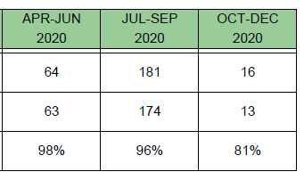
After get ATT, schedule NCLEX
Schedule as soon as you can when you are READY!
This Photo by Unknown Author is licensed under CC BY-SA

Slide 16
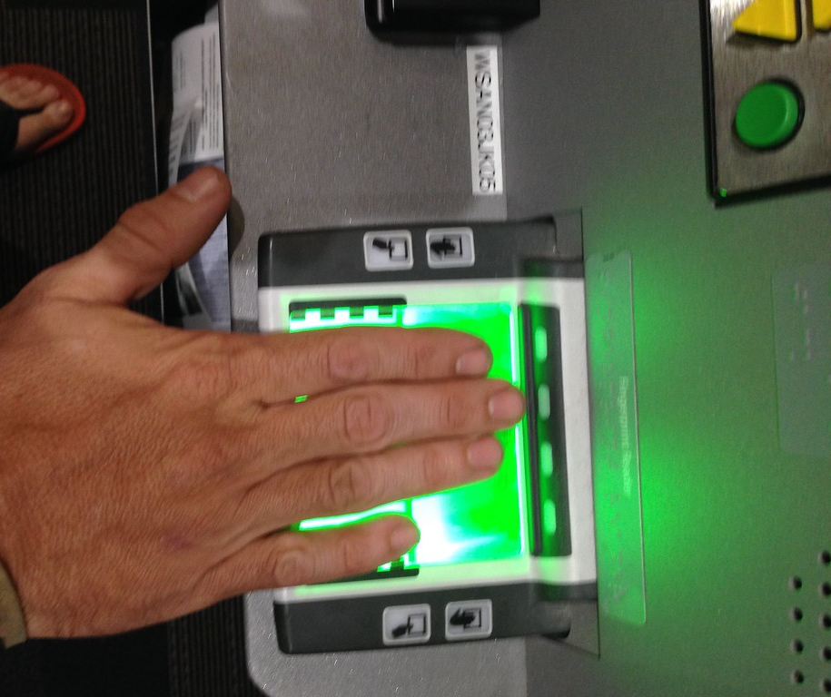
Livescan and Other Fingerprint Services
Form and link in Board of Nursing packet.
To find the Board of Nursing ORI#, go to http://www.flhealthsource.gov/bgs-providers
Registered Nurse FLORIDA ORI: EDOH4420Z
Will differ if other states
UPS Fingerprinting | UPS Live Scan Services | Printscan
Requirements and services vary by state
Provide social security number and 2 forms of ID – Photo and signature
Note: your name must be consistent on all paperwork. Be mindful if getting married, if you have multiple last names, etc.
Also, cannot be expired

Slide 17
Positive Background Check
Full disclosure is required for any offense other than a minor traffic offense.
Must list each offense and submit documentation of arrest record or certification of unavailability of documentation.

Slide 18
Positive Background Check
MUST meet with the Dean in person/via Zoom to discuss case.
Contact Dean’s office via email to debra.urban@ucf.edu to schedule.
Allow 30-60 minutes.
Send all arrest records & disposition documents to mary.sole@ucf.edu prior to meeting day.
Draft a letter to BON explaining case and disposition, and your leadership/accomplishments since the case (Ms. Urban will send sample upon making appointment Send ahead of time to Dr. Sole.
Additional application materials will be uploaded as part of FBON application:
Letter to BON explaining case and outcomes
Letter of recommendation from the College of Nursing Dean
3 letters of recommendation from faculty, employers, counselors, or others that can attest to character/leadership; secure now
Keep copies in personal file
N/A if records have been expunged

Slide 19
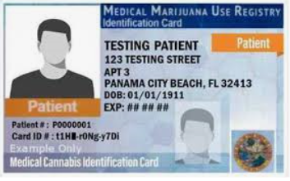
Good Choices
Negative drug screens
Negative background checks

Slide 20
Job Searches and Next Steps

Slide 21
Apply and Interview
Job fairs
Evaluate options
Be willing to be flexible
Update resume
Practice interviewing

Slide 22
GN Status
Many facilities now offering GN status; allows expanded practice beyond tech
Many residency programs will offer you GN position before you pass the NCLEX; however, you cannot begin the program until you have passed.
If you do not pass NCLEX, you lose GN status and are no longer eligible for employment as a GN.

Slide 23
Prepare for NCLEX
Practice, practice, practice
Options
F2F classes
Online resources
Self-study
Practice, practice, more practice
DON’T WAIT for a test date
Start your preparation plan NOW!

Slide 24
Online Status Check
Applicants can view deficiencies, email their processor, and check their exam score.
Certification Office will update application as deficiencies are cleared up.
Applicant will receive a message when application for license has been approved.

Slide 25
Summary
Complete application to Board of Nursing
Positive background check—meet with Dean
Complete LiveScan process
Complete application to Pearson VUE
UCF-BS program code US70506700
Once eligible to take NCLEX exam, you will receive ATT
Schedule test when ready
Must test within 90 days

Slide 26
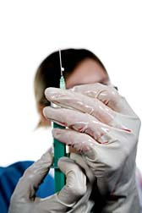
After Licensure
Maintain CE
Florida https://www.cebroker.com/

