Slide 1
Effective Leadership and Management in Nursing Ninth Edition
Chapter 5
Initiating and Managing Change

Slide 2
Learning Outcomes
Explain why nurses have the opportunity to be change agents.
Describe how different theorists explain change.
Delineate steps in the change process.
Differentiate among change strategies.
Evaluate ways to handle resistance to change.
Describe the nurse’s role in planned and unplanned change.

Slide 3
Key Terms
Change inevitable : adaptation : continuous process
change agent – bedside nurse : time, energy , effort
driving forces – push participants in the right way:
too much turnover
administration mandates the change
budgetary considerations
key people must be interested and committed
Restraining forces – resistant staff
nurse manager lacks skills
fear of retaliation
continued on next slide

Slide 4
Introduction
Organizational change is essential for adaptation.
Creative change is mandatory for growth.
Those who initiate and manage change often encounter resistance.
Change can be threatening and a source of conflict.
Institute of Medicine (IOM) proposes radical change for the nursing profession.
continued on next slide

Slide 5
Introduction
Key Messages from The Future of Nursing: Leading Change, Advancing Health from the IOM
Nurses should practice to the full extent of their education and training.
Nurses should achieve higher levels of education and training through an improved education system that promotes seamless academic progression.
Nurses should be full partners with physicians and other healthcare professionals in redesigning healthcare in the United States.
Effective workforce planning and policymaking require better data collection and an improved information infrastructure.
continued on next slide

Slide 6
Introduction
Key Messages from The Future of Nursing: Leading Change, Advancing Health
IOM makes further recommendations:
Remove scope-of-practice barriers.
Expand opportunities for nurses to lead and diffuse collaborative improvement efforts.
Implement nurse residency programs.
Increase the proportion of nurses with baccalaureate degrees to 80% by 2020.
Ensure nurses engage in lifelong learning.
Prepare and enable nurses to lead change to advance health.
Build an infrastructure for the collection and analysis of interprofessional healthcare workforce data.

Slide 7
Learning Outcome One
Explain why nurses have the opportunity to be change agents.

Slide 8
The Nurse as Change Agent
Change agent
One who works to bring about a change
Change requires time, effort, and energy, all of which are in short supply.
Changes will continue at a rapid pace with or without nursing’s expert guidance.
Opportunities exist now for nurses, especially those in management positions, to change the system about which they so often complain.

Slide 9
Learning Outcome Two
Describe how different theorists explain change.

Slide 10
Change Theories
Lewin
Driving forces
Facilitate change because they push participants in the desired direction
Restraining forces
Impede change because they push participants in the opposite direction.
Three-step process
Unfreezing
Moving
Refreezing
Change occurs by:
Adding a new force.
Changing the direction of a force.
Changing the magnitude of any one force.
continued on next slide

Slide 11
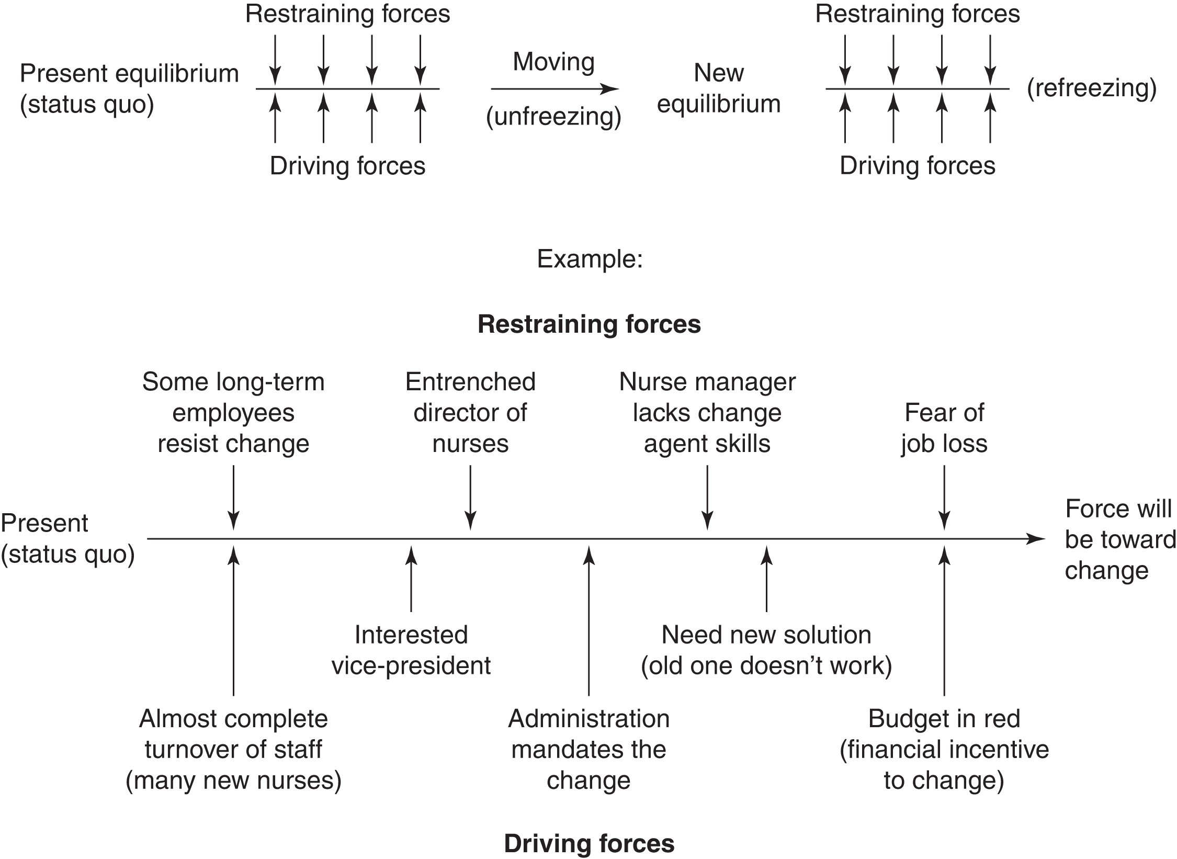
Figure 5-1 Lewin’s force-field model of change. Adapted from Resolving Social Conflicts and Field Theory in Social Science by K. Lewin. Copyright © 1997, by the American Psychological Association. Adapted with permission.

Slide 12
Change Theories
Lippitt
Expanded Lewin's theory to a seven-step process:
Diagnose problem.
Assess motivation.
Assess change agent’s motivations and resources.
Select progressive change objects.
Choose change agent role.
Maintain change.
Terminate helping relationships.
Focuses on what change agent must do
Emphasizes importance of participation of key members for success
continued on next slide

Slide 13
Change Theories
Havelock
Modified Lewin's theory to six-step process
Building a relationship
Diagnosing the problem
Acquiring resources
Choosing the solution
Gaining acceptance
Stabilization and self-renewal
Describes active change agent
Emphasizes participative approach
continued on next slide

Slide 14
Change Theories
Rogers
Describes five-step innovation–decision process
Knowledge
Persuasion
Decision
Implementation
Confirmation
Emphasizes the reversible nature of change
continued on next slide

Slide 15
Change Theories
Rogers
If the change agent is unsuccessful in achieving full implementation of a proposal, it should not be assumed the issue is dead.
The issue can be resurrected, perhaps in an altered form or at a more opportune time.
Stresses importance of key people and policy makers to successful change
Key people and policy makers must be interested in the innovation and committed to making it happen.
continued on next slide

Slide 16
Change Theories
Kotter
Successful organizations:
Created a sense of urgency for the change
Formed a powerful coalition to guide the change
Created a vision of the desired change
Communicated that vision to all
Empowered employees to act on the vision
Planned for and created short-term wins
Consolidated improvements
Institutionalized the new approach

Slide 17
Learning Outcome Three
Delineate steps in the change process.

Slide 18
The Change Process
Steps in the Change Process Important
Identify the problem or opportunity.
Collect necessary data and information.
Select and analyze data.
Develop a plan for change, including time frame and resources.
Identify supporters and opposers.
Implement interventions to achieve desired change.
Evaluate effectiveness of the change and, if successful, stabilize the change.
continued on next slide

Slide 19
The Change Process
Step 1: Identify the Problem or Opportunity
Ask the right questions:
Where are we now?
What is unique about us?
What can we do that is different?
What is the driving stimulus in our organization?
What prevents us from moving?
What kind of change is required?
continued on next slide

Slide 20
The Change Process
Step 2: Collect Necessary Data and Information
Collect all data external and internal to the system.
Identify all driving and restraining forces.
Assess political climate.
Assess costs and benefits.
continued on next slide

Slide 21
The Change Process
Step 3: Select and Analyze Data
Change agent should focus more energy on analyzing and summarizing the data than on just collecting it.
Flush out resistance.
Identify potential solutions and strategies
Begin to identify areas of consensus.
Build a case for whichever option is selected.
continued on next slide

Slide 22
The Change Process
Step 4: Develop a Plan for Change, Including Time Frame and Resource
Determine who, how, and when of the change.
Include organization/system members
Plan resources required to make the change.
Establish feedback mechanisms to evaluate progress.
continued on next slide

Slide 23
The Change Process
Step 5: Identify Supporters and Opposers
Who will gain from this change?
Who will lose?
Who has more power and why?
Selecting and placing personnel or terminating key people often is used to alter the forces for or against change.
continued on next slide

Slide 24
The Change Process
Step 6: Implement Interventions to Achieve Desired Change
Plans are put into action.
Lewin's moving stage
Change agent:
Creates a supportive climate.
Acts as an energizer.
Obtains and provides feedback.
Overcomes resistance.
continued on next slide

Slide 25
The Change Process
Step 7: Evaluate Effectiveness of the Change and, if Successful, Stabilize the Change
Change agent determines whether presumed benefits were achieved from a financial as well as a qualitative perspective.
Terminates the relationship by delegating responsibilities to target system members.
Energizer role is still needed to reinforce new behaviors through positive feedback.

Slide 26
Learning Outcome Four
Differentiate among change strategies.

Slide 27
Change Strategies
Power-Coercive Strategies
Based on the application of power by legitimate authority, economic sanctions, or political clout
Changes are made through law, policy, or financial appropriations.
Patient Protection and Affordable Care Act (PPACA)
Useful when a consensus is unlikely despite efforts to stimulate participation
continued on next slide

Slide 28
Change Strategies
Empirical–Rational Model Strategies
Power ingredient is knowledge.
Assumption is people are rational and will follow their rational self-interest if that self-interest is made clear to them.
Often effective when little resistance to the proposed change is expected and the change is perceived as reasonable
continued on next slide

Slide 29
Change Strategies
Normative–Reeducative Strategies
Rest on the assumption that people act in accordance with social norms and values
People’s roles and relationships, perceptual orientations, attitudes, and feelings will influence their acceptance of change.
Power ingredient is skill in interpersonal relationships.
Change agent uses collaboration, not coercion or nonreciprocal influence.
Well suited to the creative problem solving needed in nursing and healthcare today
Effective in reducing resistance and stimulating creativity

Slide 30
Learning Outcome Five
Evaluate ways to handle resistance to change.

Slide 31
Resistance to Change
Resistance to change is to be expected
Lack of trust
Vested interest in status quo
Fear of failure
Loss of stature or income
Misunderstanding
Belief that change is unnecessary or that it will not improve the situation
continued on next slide

Slide 32
Resistance to Change
If resistance does not surface, change may not be significant enough
Resistance prevents the unexpected.
Forces changes agent to:
Clarify information.
Keep interest high.
Establish reason for change.
Resistance is a stimulant as much as it is a force to be overcome.
continued on next slide

Slide 33
Resistance to Change
To manage resistance, use the following guidelines:
Talk to those who oppose the change.
Clarify information, and provide accurate feedback.
Be open to revisions.
Present negative consequences of resistance.
Emphasize positive consequences.
Keep resisters involved.
Maintain climate of trust, support, confidence.
Divert attention.
continued on next slide

Slide 34
Learning Outcome Six
Describe the nurse’s role in planned and unplanned change.

Slide 35
The Nurse’s Role
Initiating Change
Successful change agents demonstrate certain characteristics that can be cultivated and mastered with practice.
Ability to combine ideas from unconnected sources
Ability to energize others by keeping the interest level up and demonstrating a high personal energy level
continued on next slide

Slide 36
The Nurse’s Role
Initiating Change
Successful change agents demonstrate certain characteristics that can be cultivated and mastered with practice.
Skill in human relations
Well-developed interpersonal communication, group management, and problem-solving skills
Integrative thinking
Ability to retain a big picture focus while dealing with each part of the system
continued on next slide

Slide 37
The Nurse’s Role
Initiating Change
Successful change agents demonstrate certain characteristics that can be cultivated and mastered with practice.
Sufficient flexibility to modify ideas when modifications will improve the change
Enough persistence to resist nonproductive tampering with the planned change
Confidence and the tendency not to be easily discouraged
Realistic thinking
continued on next slide

Slide 38
The Nurse’s Role
Initiating Change
Successful change agents demonstrate certain characteristics that can be cultivated and mastered with practice.
Trustworthiness
Track record of integrity and success with other changes
Ability to articulate a vision through insights and versatile thinking
Ability to handle resistance
continued on next slide

Slide 39
The Nurse’s Role
Initiating Change
Energy is needed to change a system.
Power is the main source of that energy.
To access optimum power, use the following strategies:
Analyze the organizational chart.
Identify key persons who will be affected by the change.
Find out as much as possible about these key people.
Begin to build a coalition of support before you start the change process.
Follow the organizational chain of command.
continued on next slide

Slide 40
The Nurse’s Role
Implementing Change
In addition to initiating change, nurses and nurse managers are called on to assist with change in other ways.
Transitions
Periods of time between the current situation and when change is implemented
Accepting loss and honoring the past with respect is essential.
continued on next slide

Slide 41
The Nurse’s Role
Unplanned Change
Occurs without warning
Challenges the organization to respond
Nurse’s role in leading unplanned change is to ensure:
The team is well-prepared for emergencies.
Coordination and collaboration are assured.
Focus is on patients and their families.
continued on next slide

Slide 42
The Nurse’s Role
Handling Constant Change
Change has always occurred.
What is different today is both the pace of change and an initial change causes a chain reaction.
Change has become the norm.
Nurses find themselves constantly dealing with change.

