Slide 1
Effective Leadership and Management in Nursing Ninth Edition
Chapter 9
Thinking Critically, Making Decisions, Solving Problems

Slide 2
Learning Outcomes
Summarize ways to use the critical-thinking process.
Compare and contrast individual and collective decision-making processes in various situations.
Develop a plan to improve your problem-solving skills.
Evaluate stumbling blocks to making decisions and solving problems.
Foster innovation in your work and in the work of others.

Slide 3
Key Terms
adaptive decisions
artificial intelligence
brainstorming
creativity
critical thinking
continued on next slide

Slide 4
Key Terms
decision making
descriptive rationality model
experimentation
expert systems
groupthink
continued on next slide

Slide 5
Key Terms
innovation
innovative decisions
objective probability
political decision-making model
probability
continued on next slide

Slide 6
Key Terms
probability analysis
problem solving
rational decision-making model
routine decisions
satisficing
continued on next slide

Slide 7
Key Terms
subjective probability
trial-and-error method

Slide 8
Learning Outcome One
Summarize ways to use the critical-thinking process.

Slide 9
Critical Thinking
Process of:
Examining underlying assumptions
Interpreting and evaluating arguments
Imagining and exploring alternatives
Developing a reflective criticism for the purpose of reaching a conclusion that can be justified
continued on next slide

Slide 10
Critical Thinking
Critical-thinking skills can be used to resolve problems rationally.
Critical thinking
An essential component of decision making
A higher level cognitive process that includes creativity, problem solving, and decision making

Slide 11
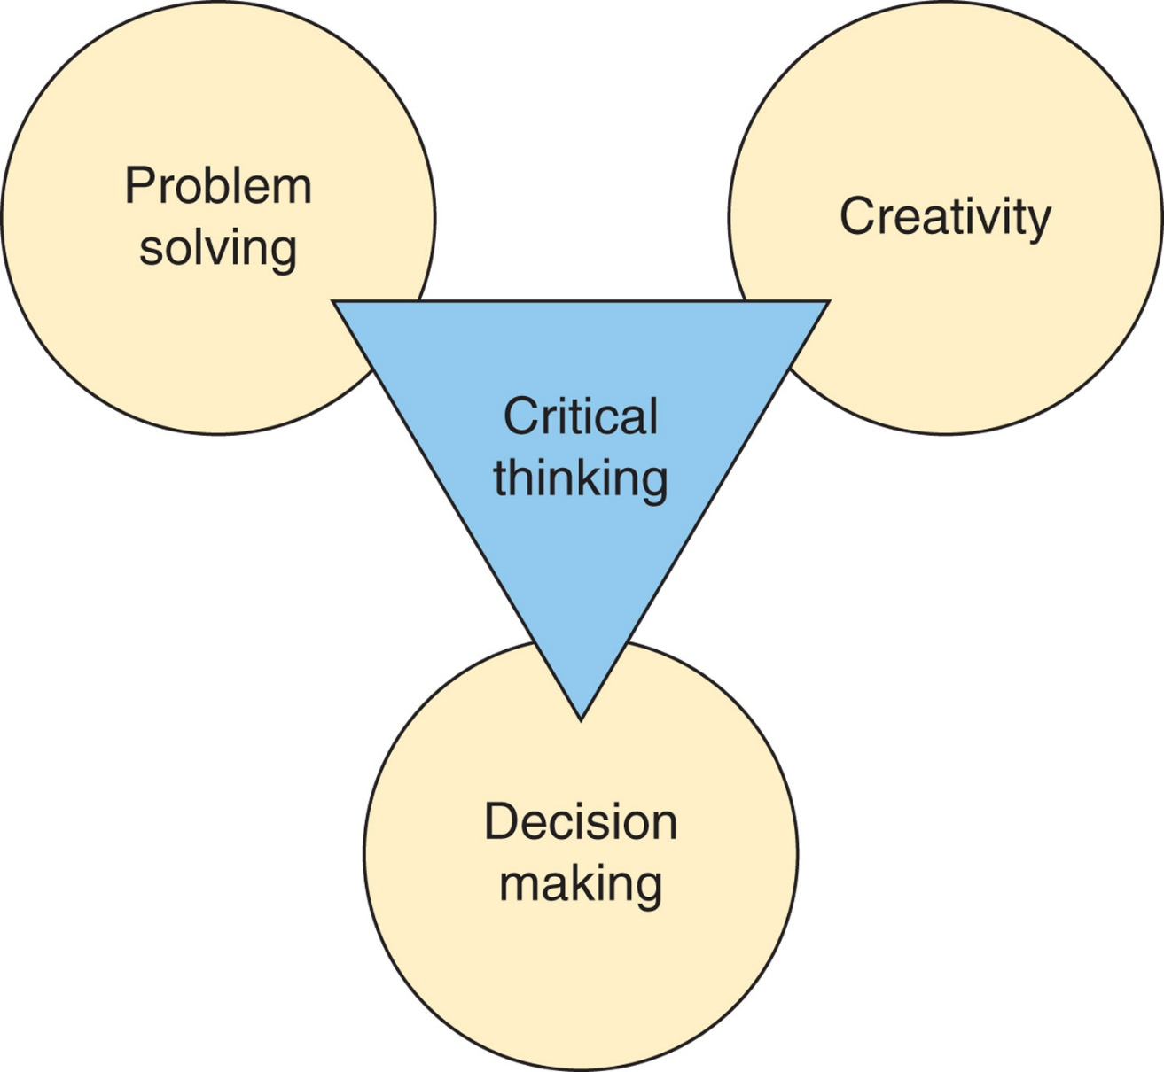
Figure 9-1 Critical-thinking model.

Slide 12
Critical Thinking
Critical Thinking in Nursing
Nurses supervised by managers with higher critical-thinking skills perceived their work environment to be more positive.
Critical-thinking classes for new nurses improve patient safety, job satisfaction, and retention.
continued on next slide

Slide 13
Critical Thinking
Using Critical Thinking
What are the underlying assumptions?
Underlying assumptions are unquestioned beliefs that influence an individual’s reasoning.
How is evidence interpreted?
How are the arguments to be evaluated?
What are possible alternate perspectives?
Using different basic assumptions and paradigms can help the critical thinker develop several different views of an issue.
continued on next slide

Slide 14
Critical Thinking
Creativity
Essential to the critical thinking process
The ability to develop and implement new and better solutions
Produces new and better solutions to challenges
One way to keep organizations alive
Must be encouraged and made a priority

Slide 15
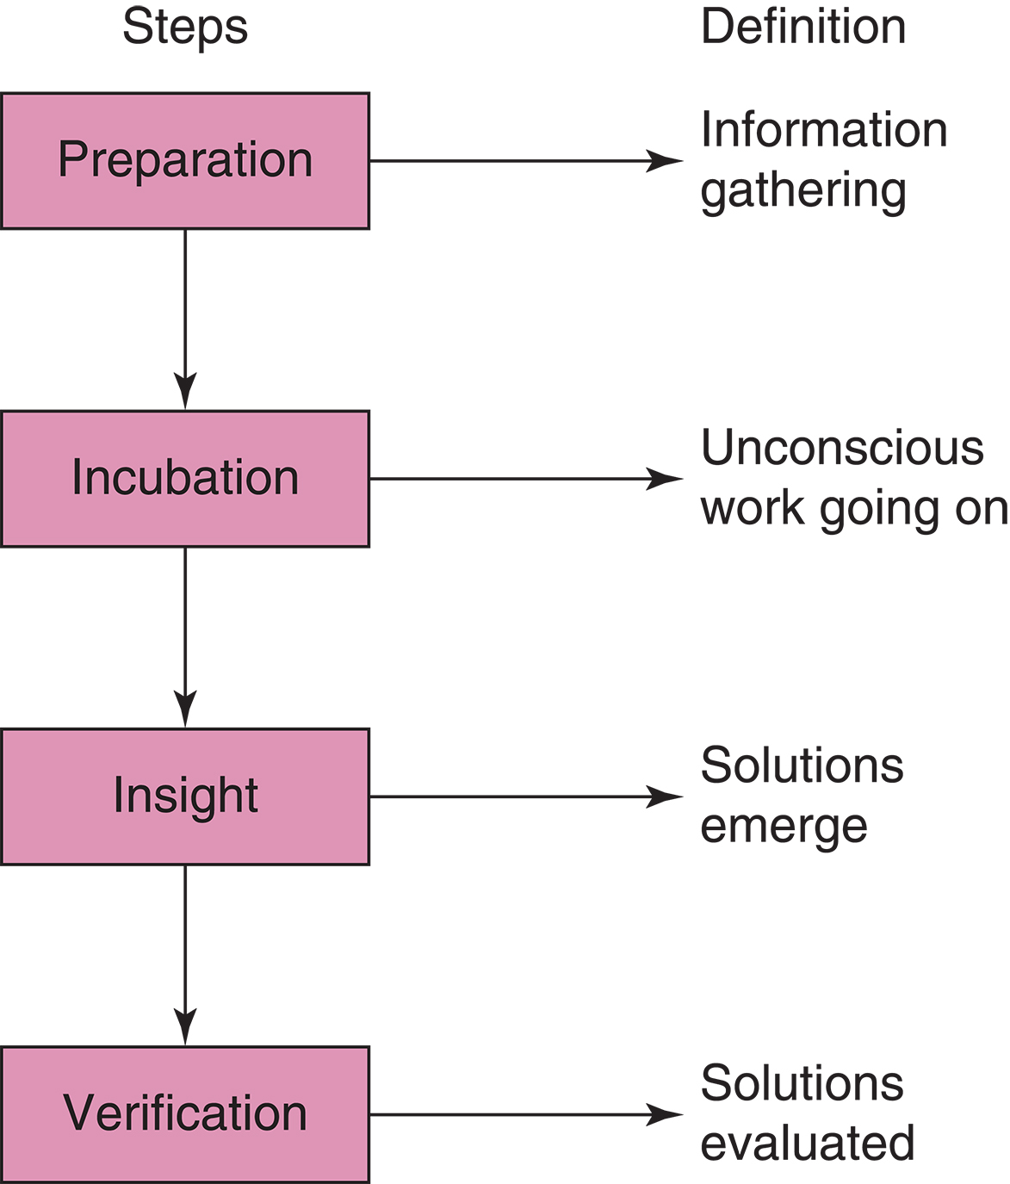
Figure 9-2 The creative process.

Slide 16
Critical Thinking
Four Stages of Creativity
Preparation
Pick a specific task
Gather relevant facts
Challenge every detail
Develop preferred solutions
Implement improvements
continued on next slide

Slide 17
Critical Thinking
Four Stages of Creativity
Incubation
Allow as much time as possible to elapse before deciding on solutions
Insight
Solutions often emerge after a period of reflection,
Verification
Once a solution has been implemented, evaluate it for effectiveness.

Slide 18
Learning Outcome Two
Compare and contrast individual and collective decision-making processes in various situations.

Slide 19
Decision Making
Decision making
May or may not involve a problem
Always involves making a choice
Problem solving
Involves diagnosing a problem and solving it
May or may not require making a decision
continued on next slide

Slide 20
Decision Making
Types of Decisions
Routine
Relatively well-defined, common problems
Often using established rules, policies, and procedures
Adaptive
Necessary when both problems and alternative solutions are somewhat unusual and only partially understood
Innovative
When problems are unusual and unclear
When creative, novel solutions are necessary
continued on next slide

Slide 21
Decision Making
Decision-making Conditions
Under certainty
When alternatives and the conditions surrounding each alternative are known, a state of certainty is said to exist.
Uncertainty and risk
Individual or group making the decision does not know all the alternatives, attendant risks, or possible consequences of each option.
Probability
Likelihood, expressed as a percentage, that an event will or will not occur
continued on next slide

Slide 22
Decision Making
Key element in decision making under conditions of risk is to determine the probabilities of each alternative as accurately as possible.
Probability analysis
Expected risk is calculated or estimated.
continued on next slide

Slide 23
Decision Making
Objective probability
Likelihood that an event will or will not occur based on facts and reliable information
Subjective probability
Likelihood that an event will or will not occur based on manager's personal judgment and beliefs
continued on next slide

Slide 24
Decision Making
The Decision-making Process
Rational decision-making model
Descriptive rationality model
Satisficing
Political decision-making model
continued on next slide

Slide 25
Decision Making
The Decision-making Process
Rational decision-making model
Identify all possible outcomes.
Examine the probability of each alternative.
Take the action that yields the highest probability of achieving the most desirable outcome.
continued on next slide

Slide 26
Decision Making
The Decision-making Process
Descriptive rationality model
Emphasizes limitations of decision maker and situation
Three ways decision makers depart from the decision-making model:
Limits of time, energy, or money
Lack of adequate information and control of conditions
Use of satisficing strategies
continued on next slide

Slide 27
Decision Making
The Decision-making Process
Satisficing
The individual chooses an alternative that is not ideal but either is good enough under existing circumstances to meet minimum standards of acceptance or is the first acceptable alternative.
continued on next slide

Slide 28
Decision Making
The Decision-making Process
Political decision-making model
Power is the ability to influence or control how problems and objectives are defined, what alternative solutions are considered and selected, what information flows, and what decisions are made.
continued on next slide

Slide 29
Decision Making
Steps in Decision Making
Identify the purpose
Set the criteria
Weigh the criteria
Seek alternatives
Test alternative.
Troubleshoot
Evaluate the action
continued on next slide

Slide 30
Decision Making
Decision-making Techniques
Vary with the nature of the problem, the decision maker, the situation, and the decision-making method
Routine decisions can be made quickly with established policies and procedures.
Adaptive decisions can be made using several techniques.
Cause-and-effect diagrams can predict outcomes.
Each technique requires data collection and analysis.
continued on next slide

Slide 31
Decision Making
Group Decision Making
Professionals function best in organizations with shared governance
Group problem solving of substantial issues casts the manager in the role of facilitator and consultant.
Groups tend to:
Provide more input.
Often produce better decisions.
Generate more commitment.
continued on next slide

Slide 32
Decision Making
Group Decision Making
Brainstorming
Group members meet together and generate many diverse ideas about the nature, cause, definition, or solution to a problem without consideration of their relative value.
Premium is placed on generating lots of ideas as quickly as possible and on coming up with unusual ideas.

Slide 33
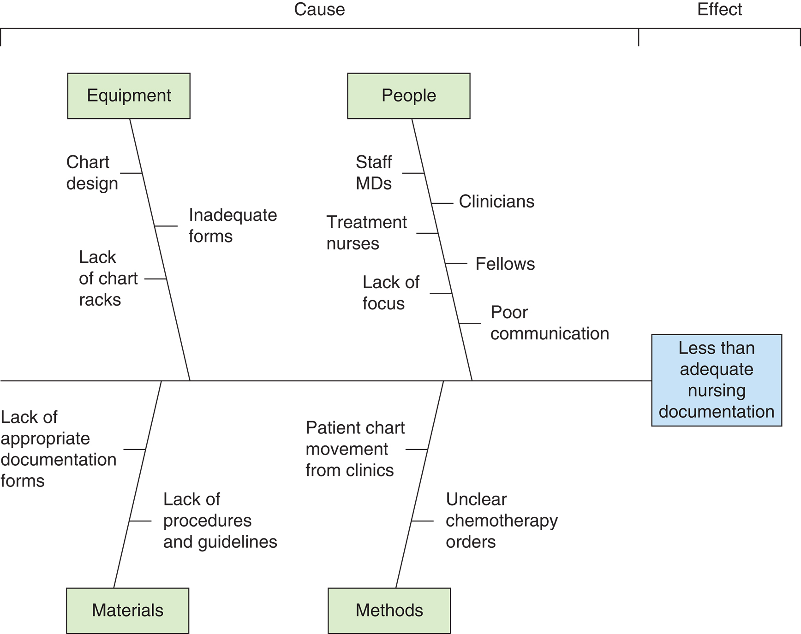
Figure 9-3 Brainstorming session of a nursing quality focus team.

Slide 34
Learning Outcome Three
Develop a plan to improve your problem-solving skills.

Slide 35
Problem Solving
Problem-Solving Methods
Trial-and-error method
Applying one solution after another until the problem is solved or appears to be improving
Experimentation
More rigorous than trial and error
Involves testing a theory or hunch
A project or study is carried out in either a controlled or uncontrolled setting.
Data are collected and analyzed and results interpreted to determine whether the solution tried has been effective.
continued on next slide

Slide 36
Problem Solving
Problem-Solving Methods
Past experience and intuition
An individual's experience can determine how much risk tomtake in present circumstances.
Intuition
Relies heavily on past experience and trial and error
Some problems are self-solving.
If permitted to run a natural course, problems are solved by those personally involved.
continued on next slide

Slide 37
Problem Solving
Steps in Problem Solving
Define the problem
Gather information
Analyze the information
Develop solutions
Make a decision
Implement the decision
Evaluate the solution
continued on next slide

Slide 38
Problem Solving
Group Problem Solving
Today, consensus-based problem solving, inherent in shared governance, is the norm.
Advantages
Groups can deal with more complex problems than a single individual.
Groups are more likely than individuals to try several approaches.
Groups may generate more complete, accurate, and less biased information than individuals.
When groups solve problems, the likelihood of cooperation in implementation increases.
continued on next slide

Slide 39
Problem Solving
Group Problem Solving
Disadvantages
Time consuming
Conflict
Benign tyranny
Resistance by managers
continued on next slide

Slide 40
Problem Solving
Group Problem Solving
Disadvantages
Groupthink
Group members come to think alike and have similar prejudices and blind spots.
Seriously impairs critical thinking; can result in erroneous and damaging decisions.
Risky decisions

Slide 41
Learning Outcome Four
Evaluate stumbling blocks to making decisions and solving problems.

Slide 42
Stumbling Blocks
Personality
Managers are often selected because of their expert clinical, not managerial, skills.
Optimism, humor, and a positive approach are crucial to energizing staff and promoting creativity.
Rigidity
An inflexible management style
Tunnel vision
Tendency to look at new things in old ways and from established frames of reference
continued on next slide

Slide 43
Stumbling Blocks
Preconceived Ideas
One proposed course of action is right and all others are wrong.
Only one opinion can be voiced and others will be silent.

Slide 44
Learning Outcome Five
Foster innovation in your work and in the work of others.

Slide 45
Innovation
Strategy to bridge the gap between an existing state and a desired state
"Raise the Voice"
Techniques for stimulating innovation include:
Simulations
Case studies
Problem-based learning
Debate

