Slide 1
Effective Leadership and Management in Nursing Ninth Edition
Chapter 13
Handling Conflict

Slide 2
Learning Outcomes
Explain how the various types of conflict can be positive or negative.
Describe the conflict process.
Describe approaches that can be used to manage conflict.

Slide 3
Key Terms
accommodating
avoiding
collaboration
competing
compromise
continued on next slide

Slide 4
Key Terms
conflict
confrontation
consensus
felt conflict
forcing
continued on next slide

Slide 5
Key Terms
mediation
negotiation
perceived conflict
resistance
resolution
continued on next slide

Slide 6
Key Terms
smoothing
suppression
withdrawal

Slide 7
Learning Outcome One
Explain how the various types of conflict can be positive or negative.

Slide 8
Conflict
Conflict is the consequence of real or perceived differences in mutually exclusive goals, values, ideas, attitudes, beliefs, feelings, or actions.
Intrapersonal conflict
Within one individual
Interpersonal conflict
Between two or more individuals
continued on next slide

Slide 9
Conflict
Conflict is the consequence of real or perceived differences in mutually exclusive goals, values, ideas, attitudes, beliefs, feelings, or actions.
Intragroup conflict
Within one group
Intergroup conflict
Between two or more groups
continued on next slide

Slide 10
Conflict
Conflict is a dynamic process, rather than a state.
Can be positive or negative
Can be healthy or dysfunctional
A certain amount of conflict is beneficial to an organization.
Heighten sensitivity to an issue
Stimulus for developing new ideas
Helps people recognize legitimate differences within the organization or profession
continued on next slide

Slide 11
Conflict
Interprofessional Conflict
Nurses often have conflicts with other healthcare professionals, administrators, or coworkers.
Conflicts between physicians and nurses dominate the problems reported by both professions.
DESC script
D: Describe the specific situation or behavior; provide concrete data.
E: Express how the situation makes you feel, and what your concerns are.
S: Suggest other alternatives and seek agreement.
C: Consequences should be stated in terms of impact on established goals; strive for consensus.

Slide 12
Learning Outcome Two
Describe the conflict process.

Slide 13
Conflict Process Model
Conflict and resolution develop according to a process that may be characterized as a life span.
Begins with certain preexisting conditions (antecedent conditions)
Conflict is either resolved or suppressed.
Outcome results in new or reinforced attitudes and feelings among the parties.

Slide 14
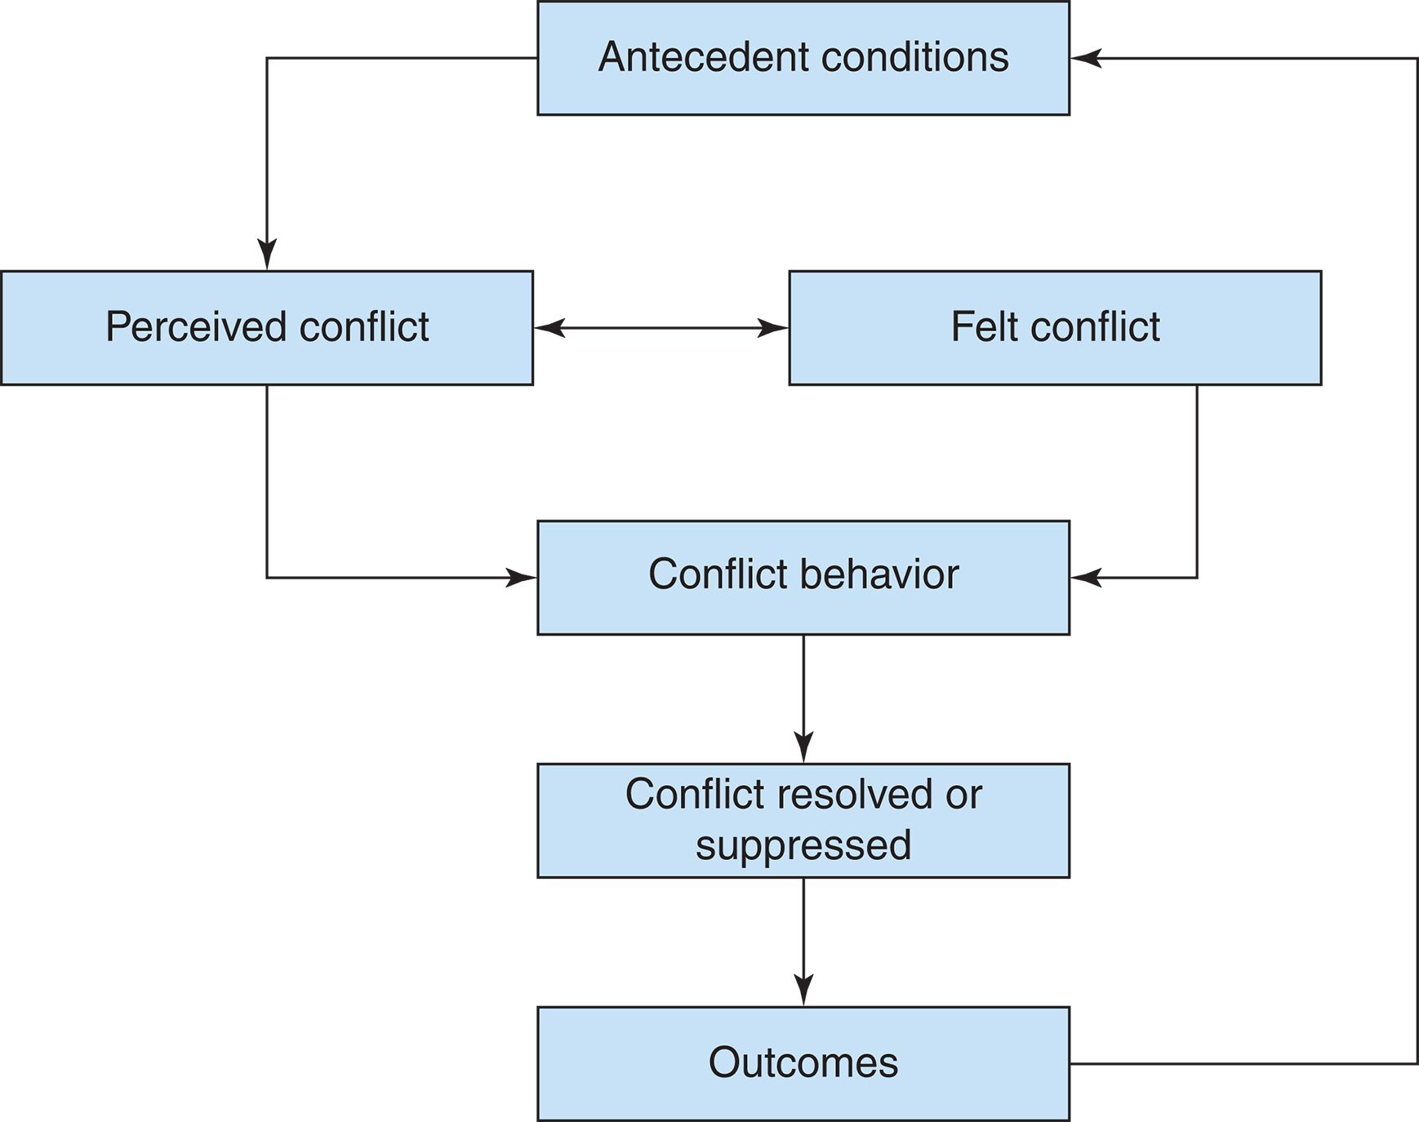
Figure 13-1 The conflict process.

Slide 15
Conflict Process Model
Antecedent Conditions
Propel a situation toward conflict
In nursing, antecedent conditions include:
Incompatible goals
Differences in values and beliefs
Task interdependencies
Unclear or ambiguous roles
Competition for scarce resources
Differentiation or distancing mechanisms
Unifying mechanisms.
continued on next slide

Slide 16
Conflict Process Model
Antecedent Conditions
Incompatible goals
Most important antecedent condition to conflict
Goals are important because they become the basis for allocating resources.
Individuals themselves have multiple goals, and those goals may also conflict.
Role conflicts
Roles are defined as other people's expectations regarding behavior and attitudes.
Task interdependence is another potential source of conflict.
continued on next slide

Slide 17
Conflict Process Model
Antecedent Conditions
Structural conflict
Structural relationships (superior to subordinate, peer to peer) provoke conflict because of poor communication.
Competition for resources, opposing interests, or lack of shared perceptions or attitudes
Competition for resources
Can be internal or external
continued on next slide

Slide 18
Conflict Process Model
Antecedent Conditions
Values and beliefs
Result from an individual's socialization experience
Distancing mechanisms or differentiation serve to divide a group's members into small, distinct groups, thus increasing the chance for conflict.
Unifying mechanisms occur when greater intimacy develops.
continued on next slide

Slide 19
Conflict Process Model
Perceived and Felt Conflict
Parties involved view situations or issues from differing perspectives.
Perceived conflict
Each party's perception of the other's position
Felt conflict
Negative feelings between two or more parties
Often characterized by mistrust, hostility, and/or fear
continued on next slide

Slide 20
Conflict Process Model
Conflict Behaviors
Result from the parties' perceived or felt conflict
Behaviors may be overt or covert.
Overt
Aggression, competition, debate, or problem solving
Covert
Indirect tactics such as scapegoating, avoidance, and apathy
continued on next slide

Slide 21
Conflict Process Model
Conflict Resolved or Suppressed
Resolution
A mutually agreed-upon solution to which both parties commit
Suppression
One person or group defeats the other.
Outcomes
Optimal solution
Both parties see themselves as winners and the problem is solved.

Slide 22
Learning Outcome Three
Describe approaches that can be used to manage conflict.

Slide 23
Managing Conflict
Managers may be participants in the conflict as individuals, administrators, or representatives of a unit.
Conflict management begins with a decision regarding whether and when to intervene.
Increased intensity can motivate participants to seek resolution.
Sometimes best to postpone intervention to allow the conflict to escalate
When the conflict might result in considerable harm, however, the nurse manager must intervene.
continued on next slide

Slide 24
Managing Conflict
Apply mediation techniques, deciding when, where, and how the intervention should take place.
Location for an intervention should have no distractions and be available for an adequate length of time.
Be prepared to allow sufficient time for all parties to explain their points of view and arrive at a mutually agreeable solution.
Constructive responses to conflict include perspective taking, creating solutions, expressing emotions, reaching out, thinking reflectively, delaying response, and adapting.
continued on next slide

Slide 25
Managing Conflict
Conflict Responses
Confronting
Considered the most effective means for solving conflicts
Problem-oriented technique in which the conflict is brought out into the open
Attempts are made to resolve it through knowledge and reason.
Goal is to achieve win-win solutions.
Most effective when delivered in private as soon as possible
continued on next slide

Slide 26
Managing Conflict
Conflict Responses
Negotiating
Involves give-and-take on various issues among the parties
Seeks to achieve agreement even though consensus will never be reached
Collaborating
Mutual attention to the problem, in which the talents of all parties are used
Useful in situations in which the goals of both parties are too important to be compromised
continued on next slide

Slide 27
Managing Conflict
Conflict Responses
Compromising
Used to divide the rewards between both parties
Neither gets what he or she wants
Expedient when a solution is needed rapidly
Competing
All-out effort to win, regardless of the cost
continued on next slide

Slide 28
Managing Conflict
Conflict Responses
Accommodating
Unassertive, cooperative tactic used when individuals neglect their own concerns in favor of others' concerns
Suppression
In situations where conflict is discouraged
Could include elimination of one of the conflicting parties through transfer or termination
Avoiding
Participants never acknowledge that a conflict exists.
continued on next slide

Slide 29
Managing Conflict
Conflict Responses
Withdrawing
One party removes itself, thereby making it impossible to resolve the situation.
Smoothing
Complimenting opponent
Downplaying differences
Focusing on areas of agreement
continued on next slide

Slide 30
Managing Conflict
Conflict Responses
Forcing
Method that yields an immediate end to the conflict but leaves the cause of the conflict unresolved
Resistance
Can be positive or negative
continued on next slide

Slide 31
Managing Conflict
Alternative Dispute Strategies
Mediation
Protect each party's self-respect.
Do not put blame or responsibility for the problem on the participants.
Allow open and complete discussion of the problem from each participant.
Maintain equity in the frequency and duration of each party's presentation.
Encourage full expression of positive and negative feelings in an accepting atmosphere.
continued on next slide

Slide 32
Managing Conflict
Alternative Dispute Strategies
Mediation
Make sure both parties listen actively to each other's words.
Identify key themes in the discussion.
Encourage the parties to provide frequent feedback.
Help the participants develop alternative solutions.
At an agreed-upon interval, follow up on the progress of the plan.
Give positive feedback to participants.

