Slide 1
Effective Leadership and Management in Nursing Ninth Edition
Chapter 12
Building and Managing Teams

Slide 2
Learning Outcomes
Describe how groups and teams function.
Explain the norms and roles in groups and teams.
Describe various methods of team building.
Discuss factors that influence team management.
Explain why the nurse manager’s leadership skills are essential to team performance.
Discuss how to lead groups, task forces, and patient care conferences.

Slide 3
Key Terms
additive task
adjourning
cohesiveness
committees
conjunctive task
continued on next slide

Slide 4
Key Terms
disjunctive task
divisible task
formal committees
formal groups
forming
continued on next slide

Slide 5
Key Terms
group
hidden agendas
informal committees
informal groups
norming
continued on next slide

Slide 6
Key Terms
norms
ordinary interacting groups
performing
pooled interdependence
productivity
continued on next slide

Slide 7
Key Terms
real (command) groups
reciprocal interdependence
re-forming
role
sequential interdependence
continued on next slide

Slide 8
Key Terms
status
status incongruence
storming
task forces
task group
continued on next slide

Slide 9
Key Terms
teams
team building

Slide 10
Introduction
Work groups that share common objectives function as teams.
Teamwork is essential in healthcare’s demanding environment.
Nurse managers must skillfully orchestrate the activity and interactions of interprofessional teams as well as conventional nursing work groups.
continued on next slide

Slide 11
Learning Outcome One
Describe how groups and teams function.

Slide 12
Groups and Teams
Group
An aggregate of individuals who interact and mutually influence each other
May be formal or informal
Formal groups
Members may include the following:
Individuals from a single work group
Individuals from different job levels
Individuals from different work groups and different job levels
May be permanent or temporary
continued on next slide

Slide 13
Groups and Teams
Group
Informal groups
Evolve naturally from social interactions
Not defined by an organizational structure
continued on next slide

Slide 14
Groups and Teams
Real (command) groups
Accomplish tasks in organizations
Recognized as legitimate organizational entity
Assignments are usually routine and designed to fulfill the specific mission of the agency or organization.
continued on next slide

Slide 15
Groups and Teams
Task groups
Composed of several persons who work together
May or may not have a designated leader
Charged with accomplishing specific time-limited assignments
Committees or task forces
Formed to deal with specific issues involving several service areas
continued on next slide

Slide 16
Groups and Teams
Teams
Real groups in which individuals must work cooperatively with each other in order to achieve some overarching goal
Have command or line authority to perform tasks
Membership is based on the skills needed to accomplish tasks.
May have a short life span or exist indefinitely
continued on next slide

Slide 17
Groups and Teams
Ordinary interacting groups
Usually have a designated leader
May be leaderless
Include most work teams, task groups, and committees
Normally, the final decision is made by consensus.
Enhance cohesiveness of group members
Participants are able to build strong social ties and will be committed to the solution decided on by the group.
continued on next slide

Slide 18
Groups and Teams
Group Interaction
Ordinary interacting groups may be dominated by one or a few members.
Decision-making ability may be affected by groupthink.
Functioning of ordinary groups is dependent on the leader’s skills.
Group Leadership

Slide 19
Learning Outcome Two
Explain the norms and roles in groups and teams.

Slide 20
Group Essentials
Homans’s social system conceptual scheme provides a framework for understanding group inputs, processes, and outcomes.
Dynamics
Processes
Elements of the required group system and processes influence each other and the emergent group system and social structure.

Slide 21
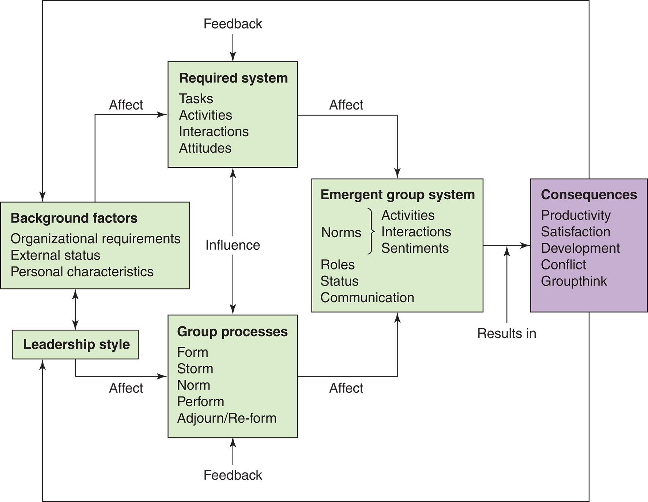
Figure 12-1 Conceptual scheme of a basic social system. Source: Adapted from Homans, G. (1950). The human group. New York: Harcourt Brace Jovanovich; and Homans, G. (1961). Social behavior: Its elementary forms. New York: Harcourt Brace. By permission of Transaction Publishers.

Slide 22
Group and Team Processes: Homans Framework
Three essential elements of a group system include:
Activities
Observable behaviors of group members
Interactions
Verbal or nonverbal exchanges of words or objects among two or more group members
Attitudes
Perceptions, feelings, and values held by individual group members
continued on next slide

Slide 23
Group and Team Processes: Homans Framework
Phases of Group Development
Forming
Individuals assemble into a well-defined cluster.
Group members are cautious in approaching one another.
Members often depend on a leader to define purpose, tasks, and roles.
continued on next slide

Slide 24
Group and Team Processes: Homans Framework
Phases of Group Development
Storming
Conflict, dissatisfaction, and conflict arise.
Members often compete for power and status.
Informal leadership emerges.
Leader helps the group acknowledge the conflict and resolve it in a win-win manner
continued on next slide

Slide 25
Group and Team Processes: Homans Framework
Phases of Group Development
Norming
Group defines goals and rules of behavior.
Group structure, roles, and relationships become clearer.
Cohesiveness develops.
continued on next slide

Slide 26
Group and Team Processes: Homans Framework
Phases of Group Development
Performing
Members agree on purposes and activities and carry out work.
Cooperation improves, and emotional issues subside.
The leader provides feedback.
Adjourning
The group dissolves after achieving its objectives.
Re-forming
A major change requires the group to refocus its activities and recycle through the four stages.
continued on next slide

Slide 27
Group and Team Processes: Homans Framework
Norms
Informal rules of behavior are shared and enforced by group members.
Groups develop norms that members believe must be adhered to for fruitful, stable group functioning.
Norms are likely to be enforced if they serve to facilitate group survival.
continued on next slide

Slide 28
Group and Team Processes: Homans Framework
Norms
Groups go through several stages in enforcing norms with deviant members.
First, members use rational argument or present reasons to the deviant individual for adhering to the norms.
Second, if rational argument is not effective, members may use persuasive or manipulative techniques, reminding the deviant of the value of the group.
The third stage is attack.
Attacks may be verbal or even physical and sometimes include sabotaging the deviant’s work.
Final stage is ignoring the deviant.
continued on next slide

Slide 29
Group and Team Processes: Homans Framework
Roles
Sets of expected behaviors that fit together into a unified whole
Are characteristic of persons in a given context
Task roles attempt to keep the group focused on its goals.
continued on next slide

Slide 30
Group and Team Processes: Homans Framework
Task roles include the following:
Initiator-contributor
Information seeker
Information giver
Opinion seeker
Opinion giver
Elaborator
continued on next slide

Slide 31
Group and Team Processes: Homans Framework
Task roles include the following:
Coordinator
Orienter
Evaluator critic
Energizer
Procedural technician
Recorder
continued on next slide

Slide 32
Group and Team Processes: Homans Framework
Nurturing roles facilitate the growth and maintenance of the group.
Nurturing roles include the following:
Encourager
Harmonizer
Compromiser
Gatekeeper
Group observer
Follower
continued on next slide

Slide 33
Group and Team Processes: Homans Framework
Status
Social ranking of individuals relative to others in a group based on the position they occupy
Higher-status members often exercise more influence than others in group decisions.
Status incongruence
Occurs when factors associated with group status are not congruent

Slide 34
Learning Outcome Three
Describe various methods of team building.

Slide 35
Building Teams
Team building focuses on both task and relationship aspects of a group’s functioning and is intended to increase efficiency and productivity.
Assessment
Questions must be asked about:
The group's context
Characteristics of the group's work
How effective is the group’s leadership?
The team, its problem-solving style, interpersonal relationships, and relations with other groups
Only after diagnosing the problems of the team can the leader take actions to improve team functioning.
continued on next slide

Slide 36
Building Teams
Team-building Activities
Training sessions
TeamSTEPPS
Involves three steps:
Assessing the need
Training onsite
Implementing and sustaining training
Simulation-based training

Slide 37
Learning Outcome Four
Discuss factors that influence team management.

Slide 38
Managing Teams
Task
Additive task
Group performance depends on the sum of individual performances.
Disjunctive task
Group succeeds if one member succeeds.
Divisible task
Task can be broken down into subtasks with division of labor.
Conjunctive task
Group succeeds only if all members succeed.
continued on next slide

Slide 39
Managing Teams
Pooled interdependence
Each individual contributes, but no one contribution is dependent on any other.
Sequential interdependence
Group members coordinate activities with others in some designated order.
Reciprocal interdependence
Members coordinate activities with every other individual in the group.
continued on next slide

Slide 40
Managing Teams
Group Size and Composition
Groups with five to ten members tend to be optimal for most complex organizational tasks.
Groups tend to perform better with competent individuals as members.
Homogeneous groups tend to function more harmoniously.
Heterogeneous groups may experience considerable conflict.
continued on next slide

Slide 41
Managing Teams
Productivity and Cohesiveness
Productivity
Represents how well the work group or team uses available resources to achieve its goals and produce its services
Cohesiveness
Degree to which the members are attracted to the group and how much they are willing to contribute
continued on next slide

Slide 42
Managing Teams
Productivity and Cohesiveness
Groups are more likely to become cohesive when members are characterized by the following:
Share similar values and beliefs
Are motivated by the same goals and tasks
Interact to achieve their goals and tasks
Work in proximity to each other (e.g., on the same unit and on the same shift)
Have specific needs that can be satisfied by involvement in the group
continued on next slide

Slide 43
Managing Teams
Productivity and Cohesiveness
Group cohesiveness is also influenced by the formal reward system.
Cohesiveness can produce intense social pressure.
Groups with high levels of cohesiveness exhibit lower turnover and absenteeism than groups with low levels of cohesiveness.
continued on next slide

Slide 44
Managing Teams
Development and Growth
Group cohesiveness and effectiveness improve as staff members take responsibility for teaching each other and jointly seeking new information or techniques.
Shared Governance
Shared decision making is a hallmark of shared governance.
Managers perceive staff to have more power in making decisions than staff perceive that they do.

Slide 45
Learning Outcome Five
Explain why the nurse manager’s leadership skills are essential to team performance.

Slide 46
The Nurse Manager as Team Leader
Communication
The manager can increase the perceived value of the group.
The manager's communication style affects group cohesiveness.
The manager controls what information is received and who receives it (gatekeeping).
Team evaluation is based on patient outcomes and team functioning.
continued on next slide

Slide 47
The Nurse Manager as Team Leader
Evaluating Team Performance
Group functioning can be assessed by the level of:
Work-group cohesion.
Involvement in the job.
Willingness to help each other.
Stability of members is an additional measure of group functioning.

Slide 48
Learning Outcome Six
Discuss how to lead groups, task forces, and patient care conferences.

Slide 49
Leading Committees and Task Forces
Committees
Generally permanent
Deal with recurring problems
Formal committees
Part of the organization
Have authority as well as a specific role
continued on next slide

Slide 50
Leading Committees and Task Forces
Informal committees
Primarily for discussion and have no delegated authority
Task forces
Ad hoc committees appointed for a specific purpose and a limited time
continued on next slide

Slide 51
Leading Committees and Task Forces
Guidelines for Conducting Meetings
Preparation
Includes clearly defining the purpose of the meeting
The leader should prepare an agenda.
Participation
Meeting should include the fewest number of stakeholders who can actively and effectively participate in decision making.
continued on next slide

Slide 52
Leading Committees and Task Forces
Guidelines for Conducting Meetings
Place and time
Meetings should be held in places where interruptions can be controlled and at a time when there is a natural time limit to the meeting.
Meetings should be limited to 50 to 90 minutes.
Meetings should start and finish on time.
continued on next slide

Slide 53
Leading Committees and Task Forces
Guidelines for Conducting Meetings
Member behaviors
Group members should:
Be prepared for the meeting.
Ask for clarification as needed.
Offer suggestions and ideas as appropriate.
Encourage others to contribute ideas and opinions.
Offer constructive criticism as appropriate.
Help the discussion stay on track.
Assist with implementation as agreed.
continued on next slide

Slide 54
Leading Committees and Task Forces
Managing Task Forces
Members of a task force have less time to build relationships.
Preparing for the first meeting
Leader must clarify the objectives of the task force.
Task force members should be selected on the basis of their:
Knowledge.
Skills.
Personal concern for the task.
Time availability.
Organizational credibility.
continued on next slide

Slide 55
Leading Committees and Task Forces
Managing Task Forces
Conducting the first meeting
Goal is to come to a common understanding of the group's task and to define the group's working procedures and relationships.
A standard of total participation should be well established.
Managing subsequent meetings and subgroups
Keep all members informed of the group's progress.
A work plan should be developed.
The leader must be sensitive to the conflicting loyalties.
continued on next slide

Slide 56
Leading Committees and Task Forces
Managing Task Forces
Completing the task force's report
Prepare a written report for the commissioning administrators.
Leader should consider involving a few task force members in the administrative presentation.
continued on next slide

Slide 57
Leading Committees and Task Forces
Patient Care Conferences
Held to address the needs of individual patients or patient populations
Meetings are usually interprofessional and used for case management to discuss specific patient care problems.
Team leader needs to have excellent leadership skills.
Task varies according to the task and the skill level of the team members.

